Slide 1


Database Using SQL Server & Raw Data available over my GitHub Profile
SQL CTAS With 12 Most Used Queries
AnshLibrary

Slide 2
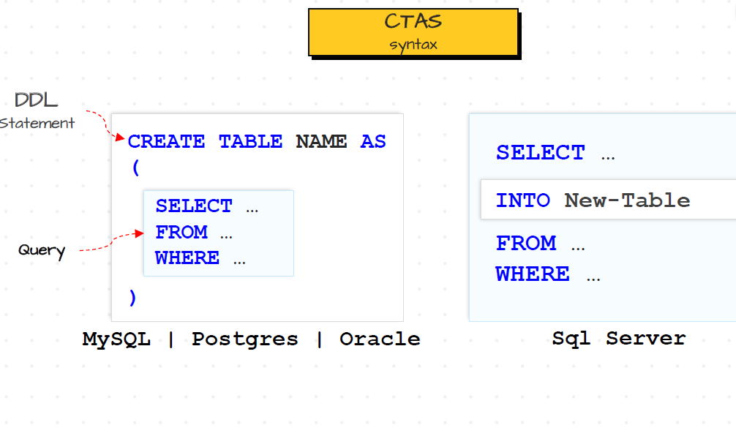
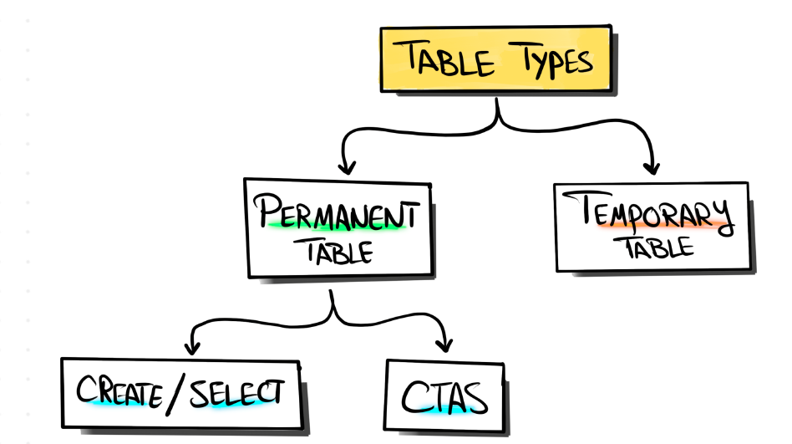
What is a CTAS
The CREATE TABLE AS SELECT (CTAS) statement is one of the most important T-SQL features available. CTAS is a parallel operation that creates a new table based on the output of a SELECT statement.
Syntax :

Slide 3
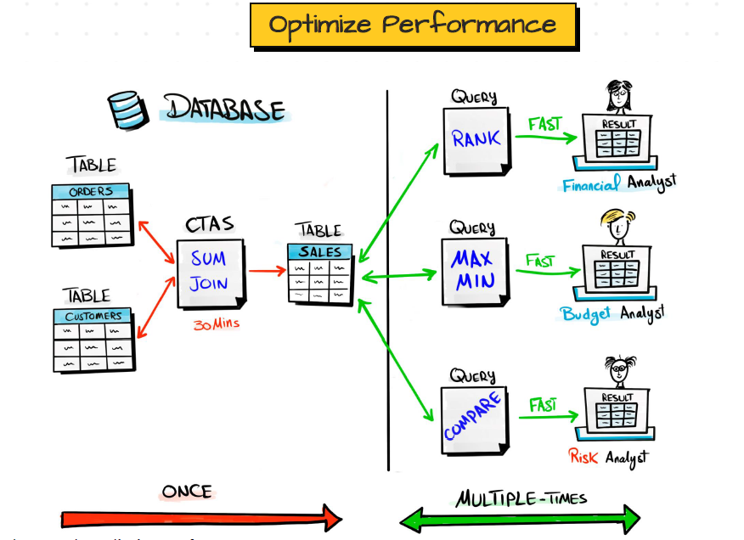
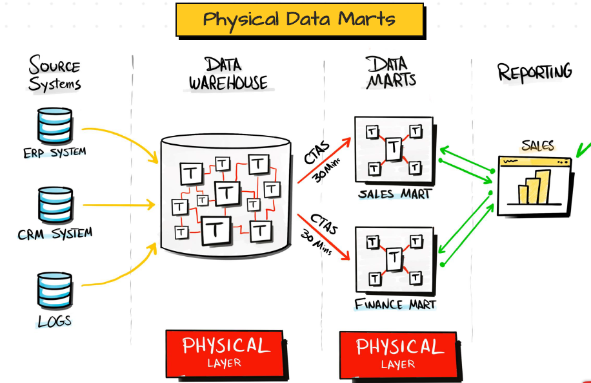
Why We Using :
Persisting the Data Marts of a DWH improves the speed
of data retrieval compared to using views

Slide 4

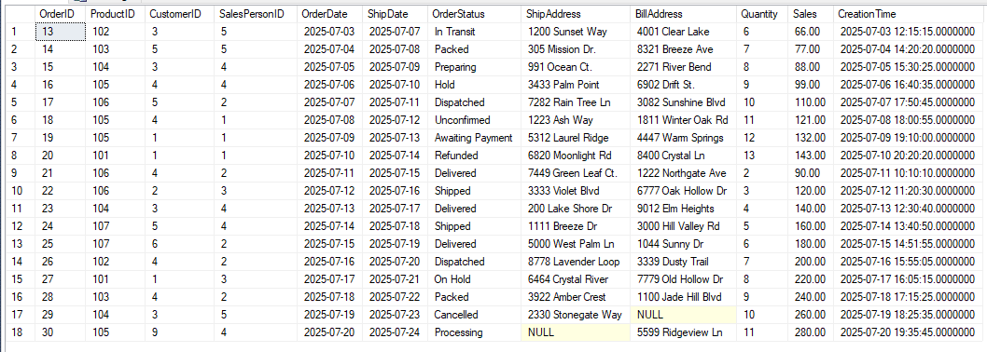
ETL / Staging Use Cases
Stage Orders for Last 7 Days (ETL staging)
--Created Like This
SELECT *
INTO stage_Orders_Last7Days
FROM orders
WHERE OrderDate >= DATEADD(DAY, -7, GETDATE());
--USED BY This Select Query
SELECT * FROM stage_Orders_Last7Days
Use by: Use for transforming only recent orders in ETL pipelines.
AnshLibrary

Slide 5

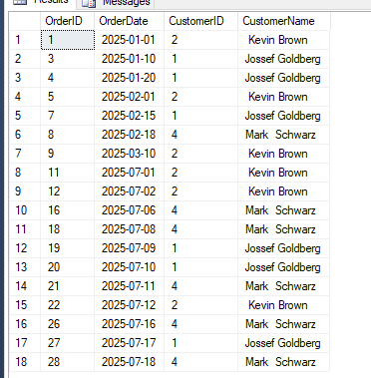
Join Orders with Customers (Data Enrichment)
sql
Join Orders with Customers (Data Enrichment)
SELECT
o.OrderID,
o.OrderDate,
o.CustomerID,
CONCAT(c.First_Name, ' ', c.Last_Name) AS CustomerName
INTO enriched_OrdersWithCustomers
FROM Orders o
JOIN Customers c ON o.CustomerID = c.Customer_id;
-------------------------------------------------------------------------------------------
SELECT * FROM enriched_OrdersWithCustomers
WHERE CustomerID IN (1,2,4)
Use by: Prepares enriched records for reporting/BI
AnshLibrary

Slide 6

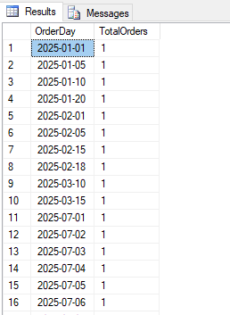
Reporting & Analytics Use Cases
Daily Order Summary
SELECT
CAST(OrderDate AS DATE) AS OrderDay,
COUNT(*) AS TotalOrders
INTO rpt_DailyOrderSummary
FROM Orders
GROUP BY CAST(OrderDate AS DATE);
-------------------------------------------------------------
SELECT * FROM rpt_DailyOrderSummary
Use by: Daily operational dashboard or Power BI source.
.
AnshLibrary

Slide 7

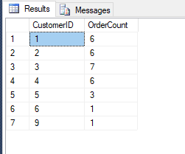
Customer Order Frequency
SELECT
CustomerID,
COUNT(*) AS OrderCount
INTO rpt_CustomerOrderFrequency
FROM Orders
GROUP BY CustomerID;
--------------------------------------------------------------------
SELECT * FROM rpt_CustomerOrderFrequency
Use by: For loyalty scoring, churn analysis, or CRM integration
AnshLibrary

Slide 8

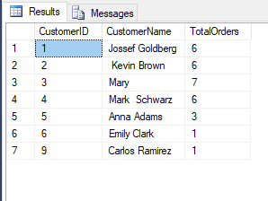
Customer-wise Total Orders
SELECT
o.CustomerID,
CONCAT(c.First_Name, ' ', c.Last_Name) AS CustomerName,
COUNT(o.OrderID) AS TotalOrders
INTO rpt_EmployeeOrderStats
FROM Orders o
JOIN Customers c ON o.CustomerID = c.Customer_id
GROUP BY o.CustomerID, c.First_Name, c.Last_Name;
--------------------------------------------------------------------------------------------
SELECT * FROM rpt_EmployeeOrderStats
Used For :HR dashboard or performance tracking.
AnshLibrary

Slide 9

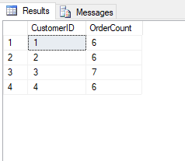
High-Value Customers (based on order count)
SELECT
CustomerID,
COUNT(OrderID) AS OrderCount
INTO rpt_HighValueCustomers
FROM Orders
GROUP BY CustomerID
--------------------------------------------------------------
SELECT * FROM rpt_HighValueCustomers
Where OrderCount >4
Use by: For marketing or upsell targeting.
AnshLibrary

Slide 10

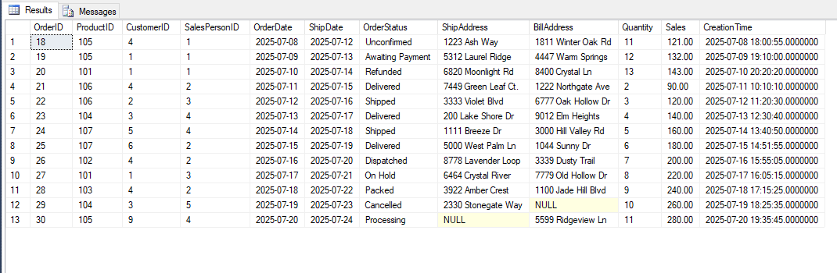
Archival & Backup Use Cases
Copy of Orders Before Deleting From Live Table
SELECT *
INTO backup_Orders_ToDelete
FROM Orders
WHERE OrderID NOT IN (SELECT OrderID FROM OrdersArchive);
------------------------------------------------------------------------
SELECT * FROM backup_Orders_ToDelete
Use by: Used before purging data.
.
AnshLibrary

Slide 11

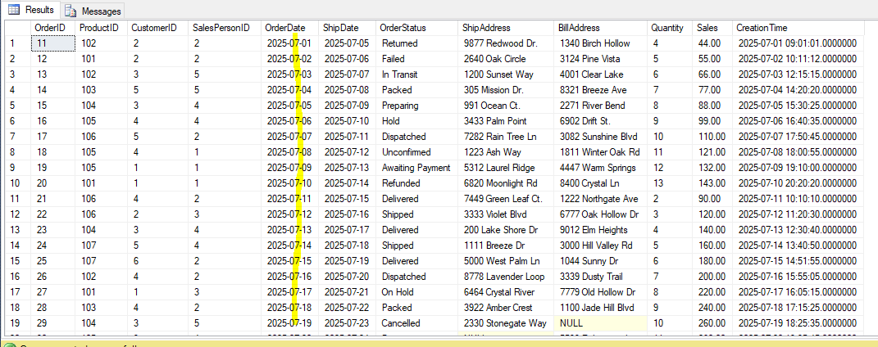
Copy Current Month Orders to Archive Table Format
SELECT *
INTO OrdersArchive_July
FROM Orders
WHERE MONTH(OrderDate) = 7 AND YEAR(OrderDate) = YEAR(GETDATE());
------------------------------------------------------------------------------
SELECT * FROM OrdersArchive_July
Using: Use in a monthly ETL job or scheduled archival process.
AnshLibrary

Slide 12

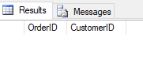
Auditing & Quality Checks
Identify Orphan Orders (No Matching Customer)
SELECT
o.OrderID,
o.CustomerID
INTO audit_OrdersOrphanCustomers
FROM Orders o
LEFT JOIN Customers c ON o.CustomerID = c.Customer_id
WHERE c.Customer_id IS NULL;
-----------------------------------------------------------------
Select * from audit_OrdersOrphanCustomers
No Records
Use by: Data integrity validation.
AnshLibrary

Slide 13

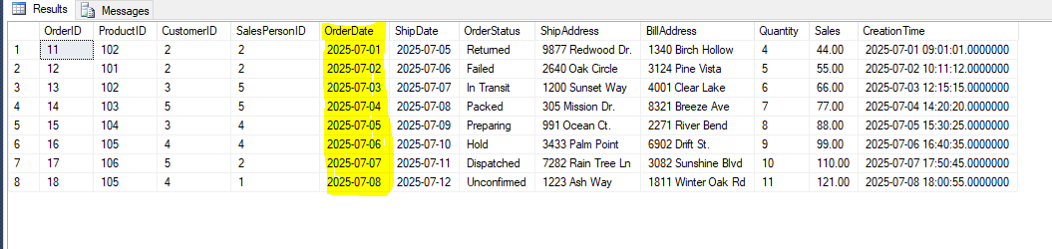
Utility & Development
Snapshot Orders for Dev/Testing
SELECT *
INTO dev_SnapshotOrders
FROM Orders
WHERE OrderDate >= '2025-07-01' AND OrderDate <= '2025-07-08’;
------------------------------------------------------------------
SELECT * FROM dev_SnapshotOrders
Use by: Sample data for non-prod testing.
AnshLibrary

Slide 14
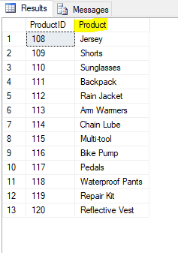
11
Products Without Orders (Zero Sales)
SELECT
p.ProductID,
p.Product
INTO rpt_UnsoldProducts
FROM Products p
LEFT JOIN OrdersArchive oi
ON p.ProductID = oi.ProductID
WHERE oi.ProductID IS NULL;
--------------------------------------------------------------------
select * from rpt_UnsoldProducts
Use Case: Detect inventory that hasn’t moved..
AnshLibrary

Slide 15
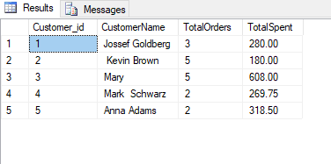
12
Generate Customer Order Summary
SELECT
c.Customer_id,
CONCAT(c.First_Name, ' ', c.Last_Name) AS CustomerName,
COUNT(DISTINCT o.OrderID) AS TotalOrders,
SUM(oi.Quantity * oi.Sales) AS TotalSpent
INTO rpt_CustomerOrderSummary
FROM customers c
JOIN orders o ON c.Customer_id = o.CustomerID
JOIN OrdersArchive oi ON o.OrderID = oi.OrderID
GROUP BY c.Customer_id, c.First_Name, c.Last_Name;
---------------------------------------------------------------------------------------------
select * from rpt_CustomerOrderSummary
Use Case: Combines total orders and value per customer.
AnshLibrary

