Slide 1


Database Using SQL Server & Raw Data available over my GitHub Profile
JOINS With 12 Most Used Queries
AnshLibrary

Slide 2
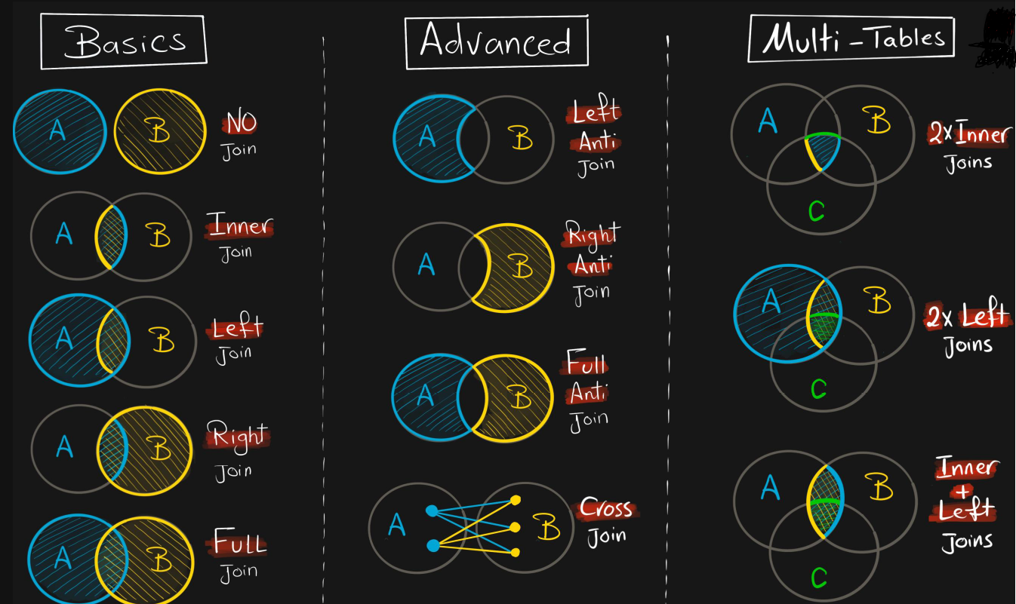
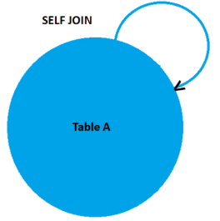
What is JOIN
In SQL Server, a join is a way to combine data from two or more tables based on a related column between them. The join operation allows you to retrieve data from multiple tables at once and create a new virtual table that contains information from all the tables involved in the join.
Syntax of VIEW:
Types Of Joins:
SELECT column_list FROM table1 JOIN table2
ON table1.column = table2.column;

Slide 3
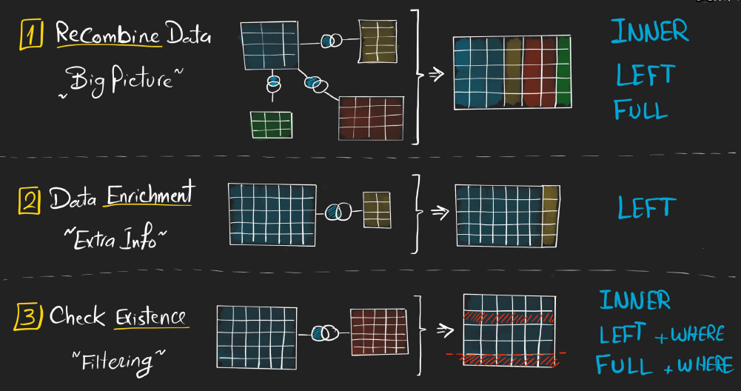
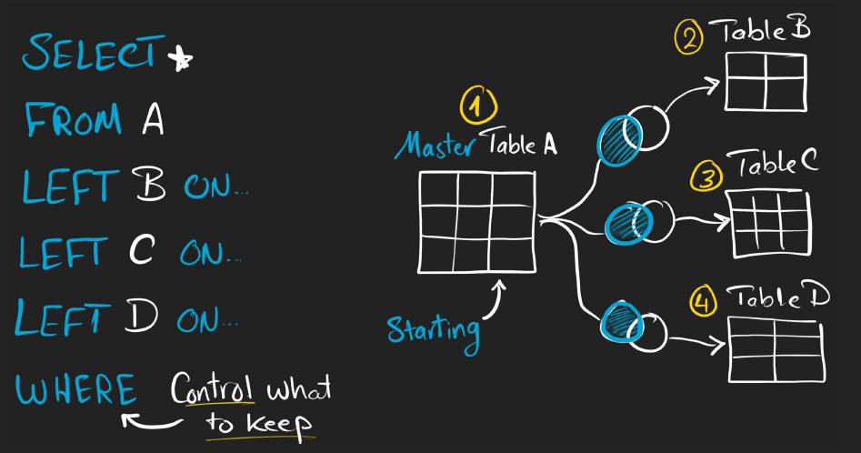
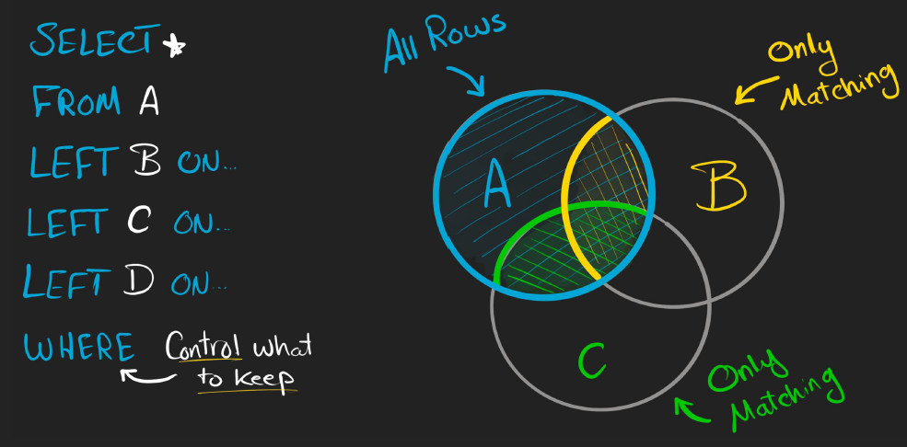
Purpose to Use Joins:
How I Join Multiple Tables

Slide 4

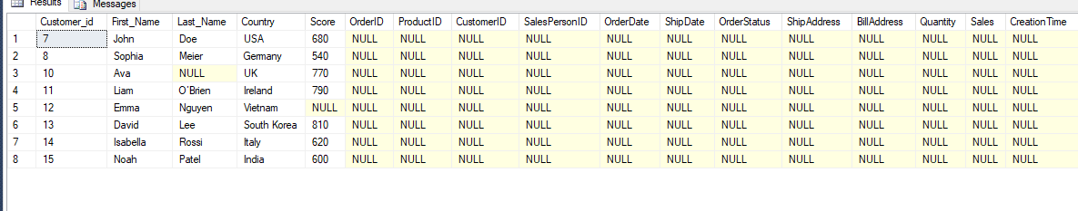
Get all customers who haven’t place any orders
SELECT *
FROM
Customers AS c
LEFT JOIN orders AS o
ON c.id = o.customer_id
WHERE o.customer_id IS NULL
AnshLibrary

Slide 5

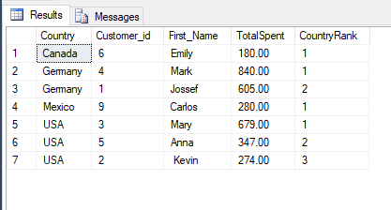
Customer Purchase Rank in Country
SELECT
c.Country,
c.Customer_id,
c.First_Name,
SUM(o.Sales) AS TotalSpent,
RANK() OVER(PARTITION BY c.Country ORDER BY SUM(o.Sales) DESC) AS CountryRank
FROM Orders o
JOIN Customers c ON o.CustomerID = c.Customer_id
GROUP BY c.Country, c.Customer_id, c.First_Name;
Use by: Rank customers within their country based on total sales.
AnshLibrary

Slide 6

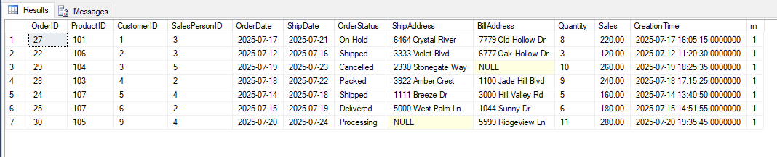
Latest Order Per Customer Using CTE + Window
WITH RankedOrders AS (
SELECT *,
ROW_NUMBER() OVER(PARTITION BY CustomerID ORDER BY OrderDate DESC) AS rn
FROM Orders
)
SELECT *
FROM RankedOrders
WHERE rn = 1;
Use by: Identify the most recent order placed by each customer.
AnshLibrary

Slide 7

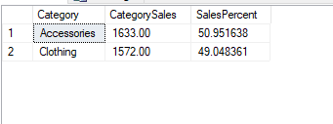
Category-Wise Sales Contribution
SELECT
p.Category,
SUM(o.Sales) AS CategorySales,
SUM(o.Sales) * 100.0 / SUM(SUM(o.Sales)) OVER() AS SalesPercent
FROM Orders o
JOIN Products p ON o.ProductID = p.ProductID
GROUP BY p.Category;
Use by: Break down product category sales and show percentage contribution.
AnshLibrary

Slide 8

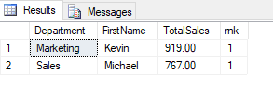
Top Salesperson in Each Department
WITH DeptSales AS (
SELECT
e.Department,
e.FirstName,
SUM(o.Sales) AS TotalSales,
RANK() OVER(PARTITION BY e.Department ORDER BY SUM(o.Sales) DESC) AS rnk
FROM Employees e
JOIN Orders o ON e.Employee_id = o.SalesPersonID
GROUP BY e.Department, e.FirstName
)
SELECT * FROM DeptSales WHERE rnk = 1;
Use by: Use CTE + Rank to find top seller per department.
AnshLibrary

Slide 9

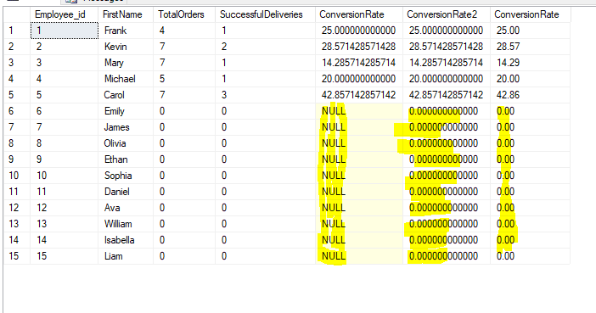
Sales Conversion Rate by Employee
SELECT
e.Employee_id,
e.FirstName,
COUNT(o.OrderID) AS TotalOrders,
COUNT(CASE WHEN o.OrderStatus = 'Delivered' THEN 1 END) AS SuccessfulDeliveries,
--NULLIF(COUNT(o.OrderID), 0) returns NULL instead of 0.
--Division by NULL is safe — it just results in NULL, avoiding the runtime error.
100.0 * COUNT(CASE WHEN o.OrderStatus = 'Delivered' THEN 1 END)
/ NULLIF(COUNT(o.OrderID), 0) AS ConversionRate,
COALESCE(100.0 * COUNT(CASE WHEN o.OrderStatus = 'Delivered' THEN 1 END)
/ NULLIF(COUNT(o.OrderID), 0), 0) AS ConversionRate2,
--Cast(…As DECIMAL (5,2)) directly controls decimal precision (2 digits after the decimal)
CAST( COALESCE(100.0 * COUNT(CASE WHEN o.OrderStatus = 'Delivered' THEN 1 END)
/ NULLIF(COUNT(o.OrderID), 0),0) AS DECIMAL(5,2)) AS ConversionRate
FROM Employees e
LEFT JOIN Orders o ON e.Employee_id = o.SalesPersonID
GROUP BY e.Employee_id, e.FirstName;
--If you prefer to show 0% instead of NULL, you can wrap it with ISNULL() or COALESCE():
Use by: Total orders handled vs. completed deliveries.
AnshLibrary

Slide 10

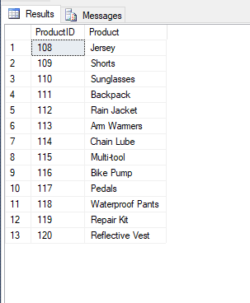
Products Never Ordered (LEFT JOIN Anti-Join)
SELECT
p.ProductID,
p.Product
FROM Products p
LEFT JOIN Orders o ON p.ProductID = o.ProductID
WHERE o.ProductID IS NULL;
AnshLibrary

Slide 11

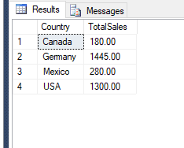
Total Revenue by Region (Derived Table Join)
SELECT
c.Country,
SUM(o.Sales) AS TotalSales
FROM Orders o
JOIN Customers c
ON o.CustomerID = c.Customer_id
GROUP BY c.Country;
AnshLibrary

Slide 12

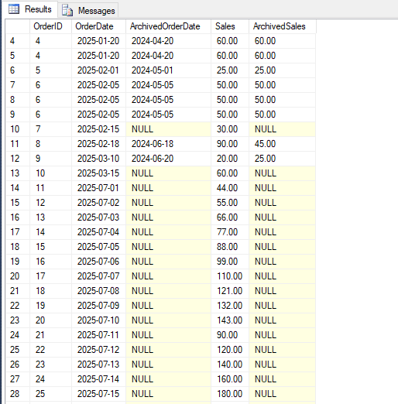
Order History Audit from Both Tables
SELECT
o.OrderID,
o.OrderDate,
oa.OrderDate AS ArchivedOrderDate,
o.Sales,
oa.Sales AS ArchivedSales
FROM Orders o
LEFT JOIN OrdersArchive oa
ON o.OrderID = oa.OrderID
AND o.CustomerID = oa.CustomerID;
Use by: Match and compare current and archived records.
AnshLibrary

Slide 13

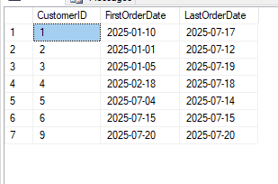
Customers with multiple orders & compare first vs last
WITH RankedOrders AS (
SELECT *,
ROW_NUMBER() OVER(PARTITION BY CustomerID ORDER BY OrderDate ASC) AS FirstOrder,
ROW_NUMBER() OVER(PARTITION BY CustomerID ORDER BY OrderDate DESC) AS LastOrder
FROM Orders
)
SELECT
First.CustomerID,
First.OrderDate AS FirstOrderDate,
Last.OrderDate AS LastOrderDate
FROM RankedOrders First
JOIN RankedOrders Last
ON First.CustomerID = Last.CustomerID
WHERE First.FirstOrder = 1 AND Last.LastOrder = 1;
Use by: SELF JOIN + Window Function
AnshLibrary

Slide 14
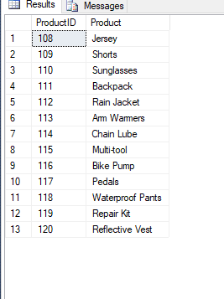
11
Products never ordered
SELECT
p.ProductID,
p.Product
FROM Products p
WHERE NOT EXISTS (
SELECT 1 FROM Orders o WHERE
o.ProductID = p.ProductID
);
Use by: ANTI JOIN (NOT EXISTS)
AnshLibrary

Slide 15
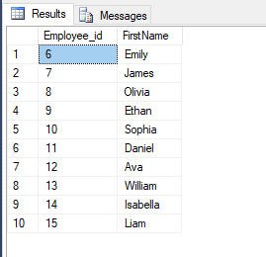
12
Orders With Missing Billing or Shipping Info View
SELECT
e.Employee_id,
e.FirstName
FROM Employees e
WHERE NOT EXISTS (
SELECT 1 FROM Orders o
WHERE o.SalesPersonID = e.Employee_id
AND YEAR(o.OrderDate) = 2025
);
Use by: ANTI JOIN
AnshLibrary

