Slide 1


Database Using SQL Server & Raw Data available over my GitHub Profile
SET Operators With 12 Most Used Queries
AnshLibrary

Slide 2
What is a JOINs
Set operators allow you to combine the results of two or more SELECT statements into a single result set — similar to how sets work in mathematics.
Types Of Set Operators:
Operator | Description
UNION | Combines results and removes duplicates
UNION ALL | Combines results including duplicates
INTERSECT | Returns rows common to both queries
EXCEPT | Returns rows from first query not in second

Slide 3
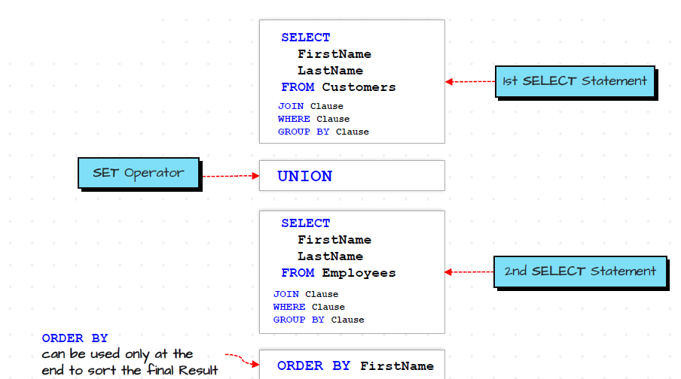
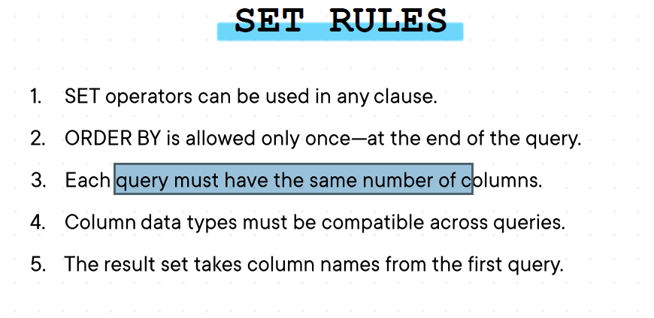
Syntax :

Slide 4

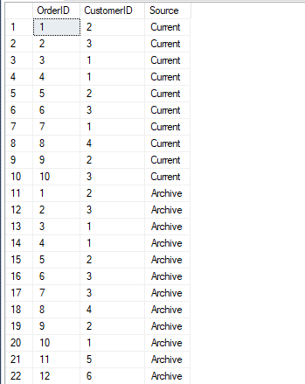
UNION for Customer Order Tracking (with source tag)
SELECT TOP 10 OrderID, CustomerID, 'Current' AS Source
FROM Orders
UNION
SELECT OrderID, CustomerID, 'Archive' AS Source
FROM OrdersArchive;
AnshLibrary

Slide 5

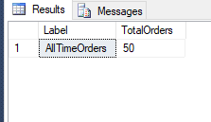
Total number of orders across all time
SELECT
'AllTimeOrders' AS Label,
COUNT(*) AS TotalOrders
FROM (
SELECT OrderID FROM Orders
UNION ALL
SELECT OrderID FROM OrdersArchive
) AllOrders;
Use by: UNION ALL + Aggregation
AnshLibrary

Slide 6

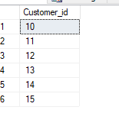
Customers who never placed archived orders
SELECT Customer_id FROM Customers
EXCEPT
SELECT DISTINCT CustomerID FROM OrdersArchive;
AnshLibrary

Slide 7

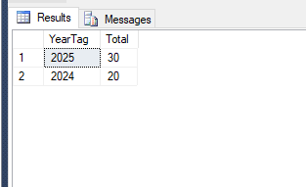
Compare recent vs old order volume
SELECT
'2025' AS YearTag,
COUNT(*) AS Total
FROM Orders
WHERE YEAR(OrderDate) = 2025
UNION ALL
SELECT
'2024' AS YearTag,
COUNT(*)
FROM OrdersArchive
WHERE YEAR(OrderDate) = 2024;
Use by: UNION ALL with Filtering
.
AnshLibrary

Slide 8

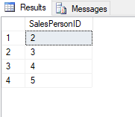
INTERSECT on Employees involved in both current and archived sales
SELECT SalesPersonID
FROM Orders
INTERSECT
SELECT SalesPersonID
FROM OrdersArchive;
AnshLibrary

Slide 9

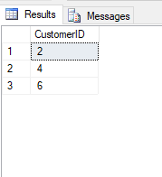
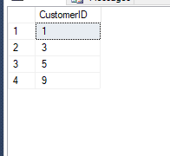
High-spending customers only in current data
SELECT CustomerID FROM (
SELECT CustomerID, SUM(Sales) AS TotalSpent
FROM Orders
GROUP BY CustomerID
HAVING SUM(Sales) > 100
) curr
EXCEPT
SELECT CustomerID FROM OrdersArchive
Where CustomerID NOT IN (2,4,6);
SELECT CustomerID FROM (
SELECT CustomerID, SUM(Sales) AS TotalSpent
FROM Orders
GROUP BY CustomerID
HAVING SUM(Sales) > 100
) curr
EXCEPT
SELECT CustomerID FROM OrdersArchive
Where CustomerID IN (2,4,6);
Use by: EXCEPT with Aggregation and IN , NOT IN Operators
.
AnshLibrary

Slide 10

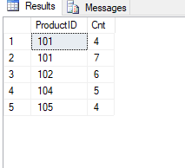
Top 3 ordered products from each dataset
WITH TopCurr AS (
SELECT TOP 3 ProductID, COUNT(*) AS Cnt
FROM Orders
GROUP BY ProductID
ORDER BY COUNT(*) DESC
),
TopArch AS (
SELECT TOP 3 ProductID, COUNT(*) AS Cnt
FROM OrdersArchive
GROUP BY ProductID
ORDER BY COUNT(*) DESC
)
SELECT * FROM TopCurr
UNION
SELECT * FROM TopArch;
Use by: UNION with Multiple CTE
.
AnshLibrary

Slide 11

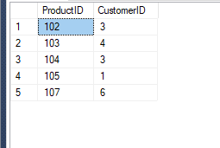
Common product-customer pairs with sales over threshold
SELECT ProductID, CustomerID
FROM (
SELECT ProductID, CustomerID, SUM(Sales) AS Total
FROM Orders
GROUP BY ProductID, CustomerID
HAVING SUM(Sales) > 50
) a
INTERSECT
SELECT ProductID, CustomerID
FROM (
SELECT ProductID, CustomerID, SUM(Sales) AS Total
FROM OrdersArchive
GROUP BY ProductID, CustomerID
HAVING SUM(Sales) > 50
) b;
Using: INTERSECT with Window
AnshLibrary

Slide 12

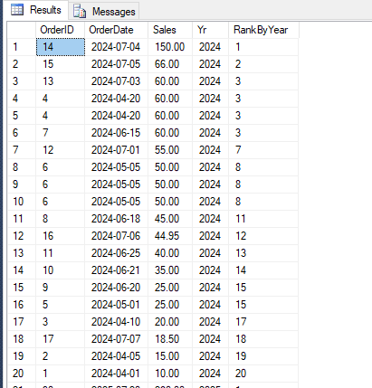
Rank order volumes by year
SELECT
OrderID,
OrderDate,
Sales,
YEAR(OrderDate) AS Yr,
RANK() OVER(PARTITION BY YEAR(OrderDate) ORDER BY Sales DESC) AS RankByYear
FROM (
SELECT OrderID, OrderDate, Sales FROM Orders
UNION ALL
SELECT OrderID, OrderDate, Sales FROM OrdersArchive
) all_data;
Use by: UNION ALL with Partitioned Window
AnshLibrary

Slide 13

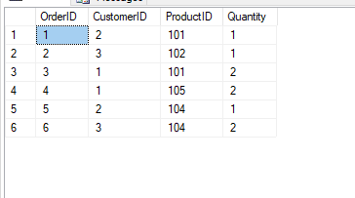
Validate backup data using multiple fields
SELECT
OrderID,
CustomerID,
ProductID,
Quantity
FROM Orders
INTERSECT
SELECT
OrderID,
CustomerID,
ProductID,
Quantity
FROM OrdersArchive;
Use by: INTERSECT on Composite Keys
AnshLibrary

Slide 14
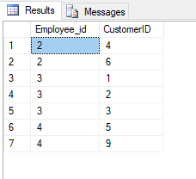
11
Employees who were managers and also submitted orders to same customers
SELECT e.Employee_id, o.CustomerID
FROM Employees e
JOIN Orders o
ON e.Employee_id = o.SalesPersonID
WHERE EXISTS (
SELECT 1 FROM Employees e2
WHERE e2.ManagerID = e.Employee_id
)
INTERSECT
SELECT e.Employee_id, oa.CustomerID
FROM Employees e
JOIN OrdersArchive oa
ON e.Employee_id = oa.SalesPersonID;
Use Case: Mixed-role activity analysis in legacy migration.
AnshLibrary

Slide 15
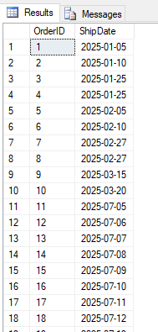
12
Orders with mismatched ShipDate due to timezone conversion issue
SELECT
OrderID,
FORMAT(ShipDate, 'yyyy-MM-dd') AS ShipDate
FROM Orders
EXCEPT
SELECT
OrderID,
FORMAT(ShipDate, 'yyyy-MM-dd') AS ShipDate
FROM OrdersArchive;
Use Case: Catch data loss during date/time format conversions in ETL.
AnshLibrary

