Slide 1


Database Using SQL Server & Raw Data available over my GitHub Profile
VIEW With 12 Most Used Queries
AnshLibrary

Slide 2
What is a VIEW
A View is a virtual table based on the result of a SQL query. It doesn't store data physically but fetches it dynamically from underlying tables.
Think of it as a stored SELECT query that can simplify complex joins or business logic.
Syntax of VIEW:
CREATE VIEW view_name AS
SELECT columns
FROM tables
WHERE condition;
Select from a view
SELECT * FROM view_name;
Join a view with a table
SELECT e.FirstName, v.*
FROM Employees e
JOIN vw_TotalSalesPerEmployee v ON e.Employee_id = v.SalesPersonID;

Slide 3

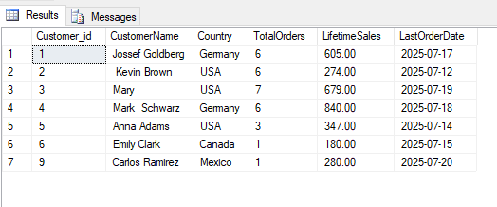
Customer Lifetime Sales View
CREATE VIEW vw_CustomerLifetimeSales AS
SELECT
c.Customer_id,
CONCAT(c.First_Name, ' ', c.Last_Name) AS CustomerName,
c.Country,
COUNT(o.OrderID) AS TotalOrders,
SUM(o.Sales) AS LifetimeSales,
MAX(o.OrderDate) AS LastOrderDate
FROM Customers c
JOIN Orders o ON c.Customer_id = o.CustomerID
GROUP BY c.Customer_id, c.First_Name, c.Last_Name, c.Country;
We can fetch this VIEW with this query :
Select * from vw_CustomerLifetimeSales
Use by: CRM & Loyalty Systems
AnshLibrary

Slide 4

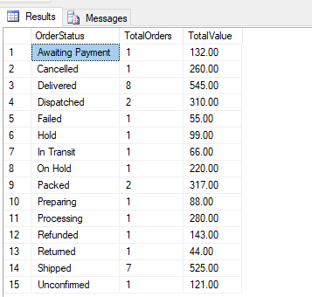
Sales Funnel Monitoring View
CREATE VIEW vw_SalesFunnel AS
SELECT
OrderStatus,
COUNT(OrderID) AS TotalOrders,
SUM(Sales) AS TotalValue
FROM Orders
GROUP BY OrderStatus;
========================================
Select * from vw_SalesFunnel
Use by: Sales & Marketing Teams
AnshLibrary

Slide 5

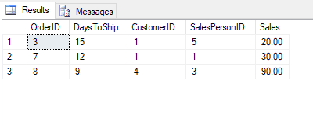
Delayed Shipments View
CREATE VIEW vw_DelayedShipments AS
SELECT
OrderID,
DATEDIFF(DAY, OrderDate, ShipDate) AS DaysToShip,
CustomerID, SalesPersonID, Sales
FROM Orders
WHERE DATEDIFF(DAY, OrderDate, ShipDate) > 7; =============================================
Select * from vw_DelayedShipments
Use by: Logistics or Delivery Ops
AnshLibrary

Slide 6

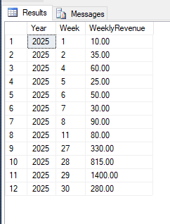
Weekly Sales Trend View
CREATE VIEW vw_WeeklySalesTrend AS
SELECT
DATEPART(YEAR, OrderDate) AS Year,
DATEPART(WEEK, OrderDate) AS Week,
SUM(Sales) AS WeeklyRevenue
FROM Orders
GROUP BY
DATEPART(YEAR, OrderDate), DATEPART(WEEK, OrderDate);
====================================================
Select * from vw_WeeklySalesTrend
Use by: Finance & BI Teams
AnshLibrary

Slide 7

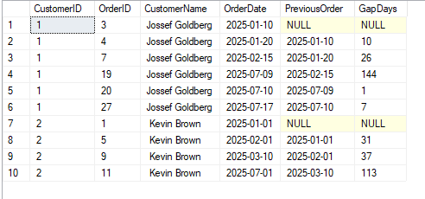
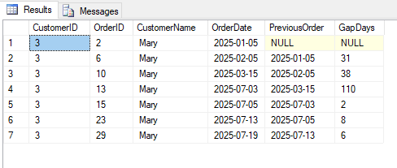
Customer Order Gaps View
CREATE VIEW vw_CustomerOrderGap AS
SELECT
o.CustomerID,
o.OrderID,
CONCAT(c.First_Name, ' ', c.Last_Name) AS CustomerName,
o.OrderDate,
LAG(o.OrderDate) OVER(PARTITION BY o.CustomerID ORDER BY o.OrderDate) AS PreviousOrder,
DATEDIFF(DAY, LAG(o.OrderDate) OVER(PARTITION BY o.CustomerID ORDER BY o.OrderDate), OrderDate) AS GapDays
FROM Orders o
JOIN Customers c
ON o.CustomerID = c.Customer_id
=======================================================================
Select TOP 10 * from vw_CustomerOrderGap
Select * from vw_CustomerOrderGap
Where CustomerName = 'Mary'
Use by: Churn Prediction Teams
AnshLibrary

Slide 8

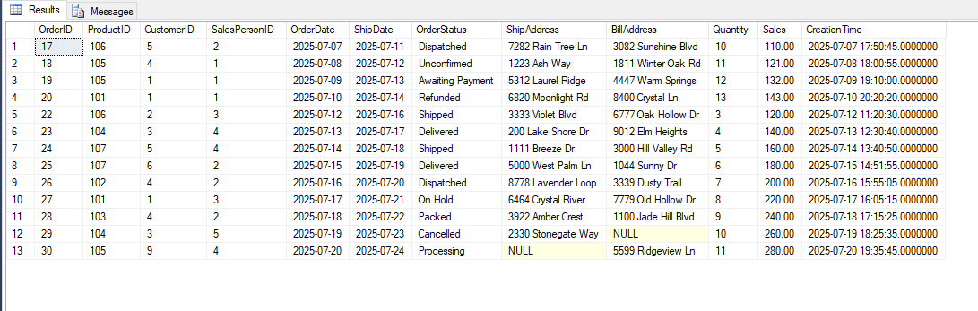
High-Value Orders View
CREATE VIEW vw_HighValueOrders AS
SELECT * FROM Orders
WHERE Sales >= 100;
=======================================
Select * from vw_HighValueOrders
Use by: Fraud Detection / Finance
AnshLibrary

Slide 9

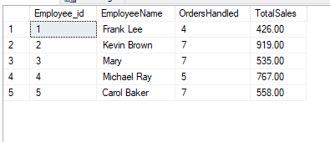
Employee Productivity View
CREATE VIEW vw_EmployeeProductivity AS
SELECT
e.Employee_id,
CONCAT(e.FirstName, ' ', e.LastName) AS EmployeeName,
COUNT(o.OrderID) AS OrdersHandled,
SUM(o.Sales) AS TotalSales
FROM Employees e
JOIN Orders o ON e.Employee_id = o.SalesPersonID
GROUP BY e.Employee_id, e.FirstName, e.LastName;
==================================================
Select * from vw_EmployeeProductivity
Use by: HR / Team Managers
AnshLibrary

Slide 10

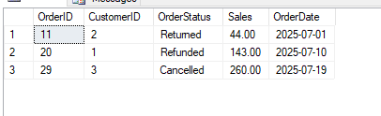
Refund , Return, and Cancelled Analysis View
CREATE VIEW vw_ReturnRefundStats AS
SELECT
OrderID,
CustomerID,
OrderStatus,
Sales,
OrderDate
FROM Orders
WHERE OrderStatus IN ('Refunded', 'Returned’, Cancelled);
=================================================
Select * from vw_ReturnRefundStats
Use by: Customer Support / Audit
AnshLibrary

Slide 11

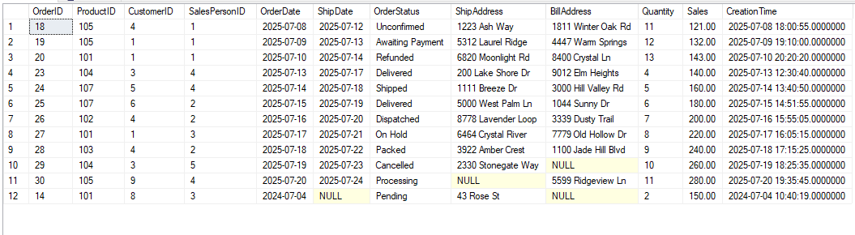
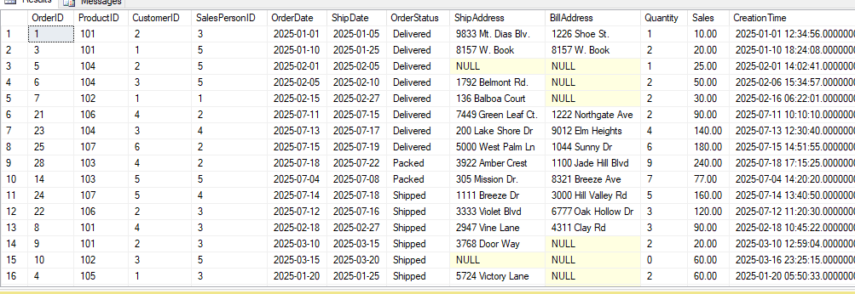
Archived Order History View
CREATE VIEW vw_CombinedOrders AS
SELECT * FROM Orders
UNION ALL
SELECT * FROM OrdersArchive;
==============================================
Select * from vw_CombinedOrders
WHERE Sales > 120
Select * from Orders
WHERE OrderStatus
IN ( 'Delivered', 'Shipped','Packed' )
Order By OrderStatus
Use by: Compliance / Audit / Legal
AnshLibrary

Slide 12

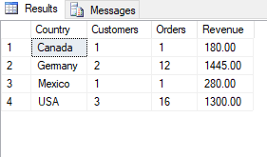
Country-Wise Customer Performance View
CREATE VIEW vw_CountryWiseCustomerSales AS
SELECT
c.Country,
COUNT(DISTINCT c.Customer_id) AS Customers,
COUNT(o.OrderID) AS Orders,
SUM(o.Sales) AS Revenue
FROM Customers c
JOIN Orders o ON c.Customer_id = o.CustomerID
GROUP BY c.Country;
=======================================================
Select * from vw_CountryWiseCustomerSales
Use by: Regional Sales Teams
AnshLibrary

Slide 13
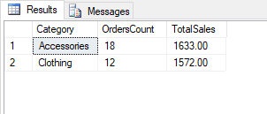
11
Product Category Sales Summary View
CREATE VIEW vw_CategorySalesSummary AS
SELECT
p.Category,
COUNT(o.OrderID) AS OrdersCount,
SUM(o.Sales) AS TotalSales
FROM Orders o
JOIN Products p ON o.ProductID = p.ProductID
GROUP BY p.Category;
=======================================================
Select * from vw_CategorySalesSummary
Use by: Category Managers / Inventory Planners
AnshLibrary

Slide 14
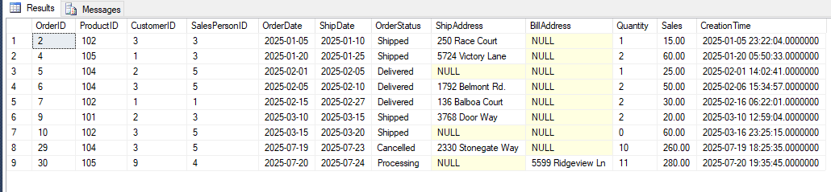
12
Orders With Missing Billing or Shipping Info View
CREATE VIEW vw_IncompleteOrders AS
SELECT * FROM Orders
WHERE ShipAddress IS NULL OR BillAddress IS NULL;
================================================
Select * from vw_IncompleteOrders
Use by: Data Quality / Ops
AnshLibrary

