Slide 1
DISASTER RELIEF COORDINATION PLATFORM
MERN STACK WEB APP BY ANSH S PATEL (230090116005)
Real-Time Collaboration | GIS Mapping | Resource Management | Multi-Language Support
Technology
Web Dev
Security
Cloud
Live: disasterhelper.dpdns.org

Slide 2
1. Domain & Technology Stack
Application Domain
Technologies Used
Web Development
Frontend
• React 18, TypeScript, Vite 5
Cyber Security
• Framer Motion, Recharts
• Leaflet GIS, Socket.io Client
• i18next (10 languages), PWA SW
Cloud / DevOps
Backend
• Node.js 20, Express 4
GIS / Data Science
• MongoDB, Mongoose, JWT
• Socket.io, Socket.io auth
• Joi validation, Multer, Passport
Libraries & Tools
• ESLint, Vitest, Playwright
• @axe-core (a11y), lint-staged
• bcrypt, Helmet, Compression
• Docker, GitHub Actions CI

Slide 3
2. Internship Objectives & Work Assigned
Internship Objectives
Work Assigned
• Understand full-stack MERN development lifecycle
• Full-stack application development (frontend + backend)
• Implement enterprise-grade security best practices
• Database modeling & MongoDB integration
• Build real-time features using WebSockets (Socket.io)
• Real-time event system & Socket.io chat
• Deploy application using Docker & Render/Vercel
• GIS mapping with Leaflet & geo-spatial queries
• Write comprehensive unit, integration & E2E tests
• Security hardening (11 security items implemented)
• Implement WCAG AA accessibility compliance
• Docker containerization & Render deployment
• Performance optimization (code splitting, lazy loading)
• Writing testing suites (Vitest + Playwright)

Slide 4
3. Problem Statement
EXISTING SYSTEM / PROBLEM
During disaster events, relief coordination is severely hampered by: • Fragmented communication between government agencies, NGOs and volunteers • No centralized view of resources, shelters, or affected populations • Delayed response due to manual phone calls & paper-based tracking • No real-time SOS alerts broadcast to field responders • Inability to track resource allocation across disaster zones dynamically • Language barriers limiting access for rural & Urdu-speaking communities
PROPOSED SOLUTION
The Disaster Relief Coordination Platform (DRCP) provides a unified MERN-based web application: • Centralized task board with status tracking for all relief requests • Real-time GIS map (Leaflet) with disaster overlays for zone monitoring • SOS emergency broadcast system with GPS coordinates to all responders • Resource & inventory management with smart allocation & matching • 10-language i18n support (including Urdu RTL) for inclusive access • Admin dashboard with escalation workflows, bulk CSV ops & analytics

Slide 5
4. System Architecture
CLIENT TIER
API TIER
DATA TIER
• React 18 SPA (port 5173)
• Express.js REST API (port 5001)
• MongoDB 7 (2dsphere indexes)
• 22 lazy-loaded pages
• 15 route modules (70+ endpoints)
• 9 Mongoose models
• 17 reusable UI components
→
→
• JWT Auth + Passport OAuth2
• GeoJSON Point locations
• 9 custom React hooks
• Socket.io real-time
• $geoWithin / $near queries
• Role-based routing
• Joi input validation
• 5x retry connection logic
• Dark/Light/Neon themes
• Rate limiting per endpoint
• Real-time sync via Socket.io

Slide 6
5. Project Description — Modules
Auth Module
GIS Map Module
Requests Module
JWT auth, OAuth2 (GitHub/Google), password reset via email, role-based access (volunteer / NGO / admin)
Leaflet maps with satellite/terrain overlays, flood/cyclone/earthquake layers, pulsing SOS markers
CRUD relief requests with status/priority, file attachments, comments, real-time chat
SOS System
Volunteer Mgmt
Real-time Chat
One-tap emergency alert with GPS broadcast to all responders, auto-notification
Profile, availability, skill tags, check-in/attendance, schedule calendar
Socket.io rooms per request, JWT-authenticated, live message updates
i18n Module
Security
Admin Dashboard
10 languages incl. Urdu (RTL), lazy-loaded locale files, automatic locale detection
Helmet CSP, CORS allowlist, rate limiting (SOS: 5/min), Joi validation, Helmet, SanitizeBody
User & request management, escalation workflows, charts, CSV upload

Slide 7
6. Work Performed — Week-wise Activities
Week 1
Week 2
Training & Requirement Analysis
Development
• Set up MERN development environment
• Built authentication (JWT + OAuth2)
• Analyzed 17+ page requirements & existing APIs
• Developed GIS mapping with Leaflet (satellite/terrain/flood overlays)
• Studied design system (17 CSS files, design tokens)
• Implemented real-time SOS broadcast system
• Explored 9 Mongoose models & 15 Express routes
• Built resource & inventory management (15 categories)
• Reviewed security checklist (11 items)
• Created admin dashboard with charts & escalation
• Learned Socket.io real-time event patterns
• Integrated Socket.io chat rooms per request
Week 3
Week 4
Testing & Integration
Deployment & Documentation
• Wrote 175+ unit tests (Vitest + @testing-library)
• Docker multi-stage builds (client + server)
• 13 Playwright E2E tests (theme toggle, login, lang)
• Docker Compose for local MongoDB
• Accessibility tests (axe-core, ARIA check)
• GitHub Actions CI/CD pipeline
• Integrated Socket.io with auth & reconnection
• Render backend + Vercel frontend deployment
• PWA: service worker v7, offline fallback
• Wrote DESIGN_SYSTEM.md, UI-UX-DESIGN.md
• Cross-browser & responsive testing
• Integrated monitoring & server keepalive

Slide 8
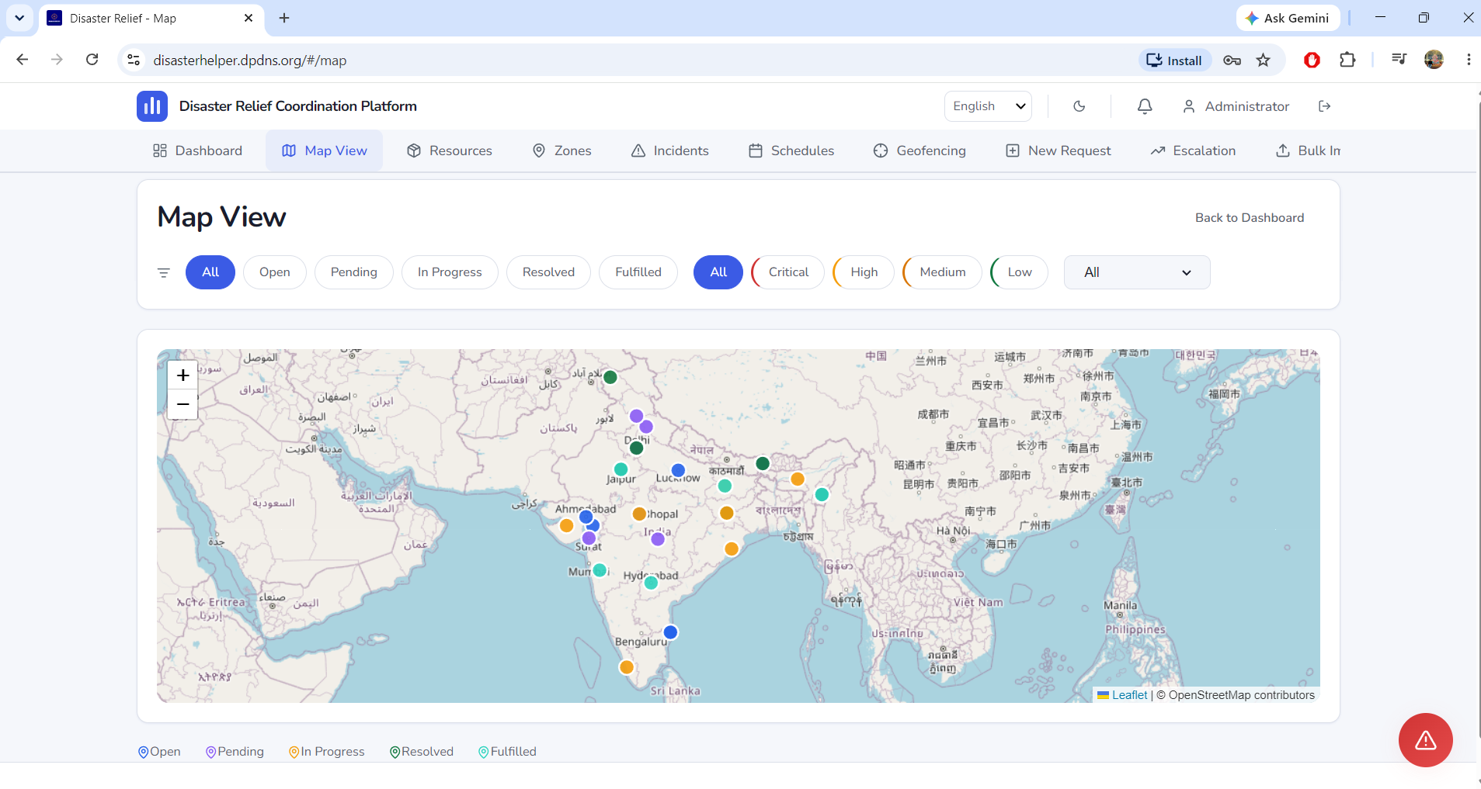
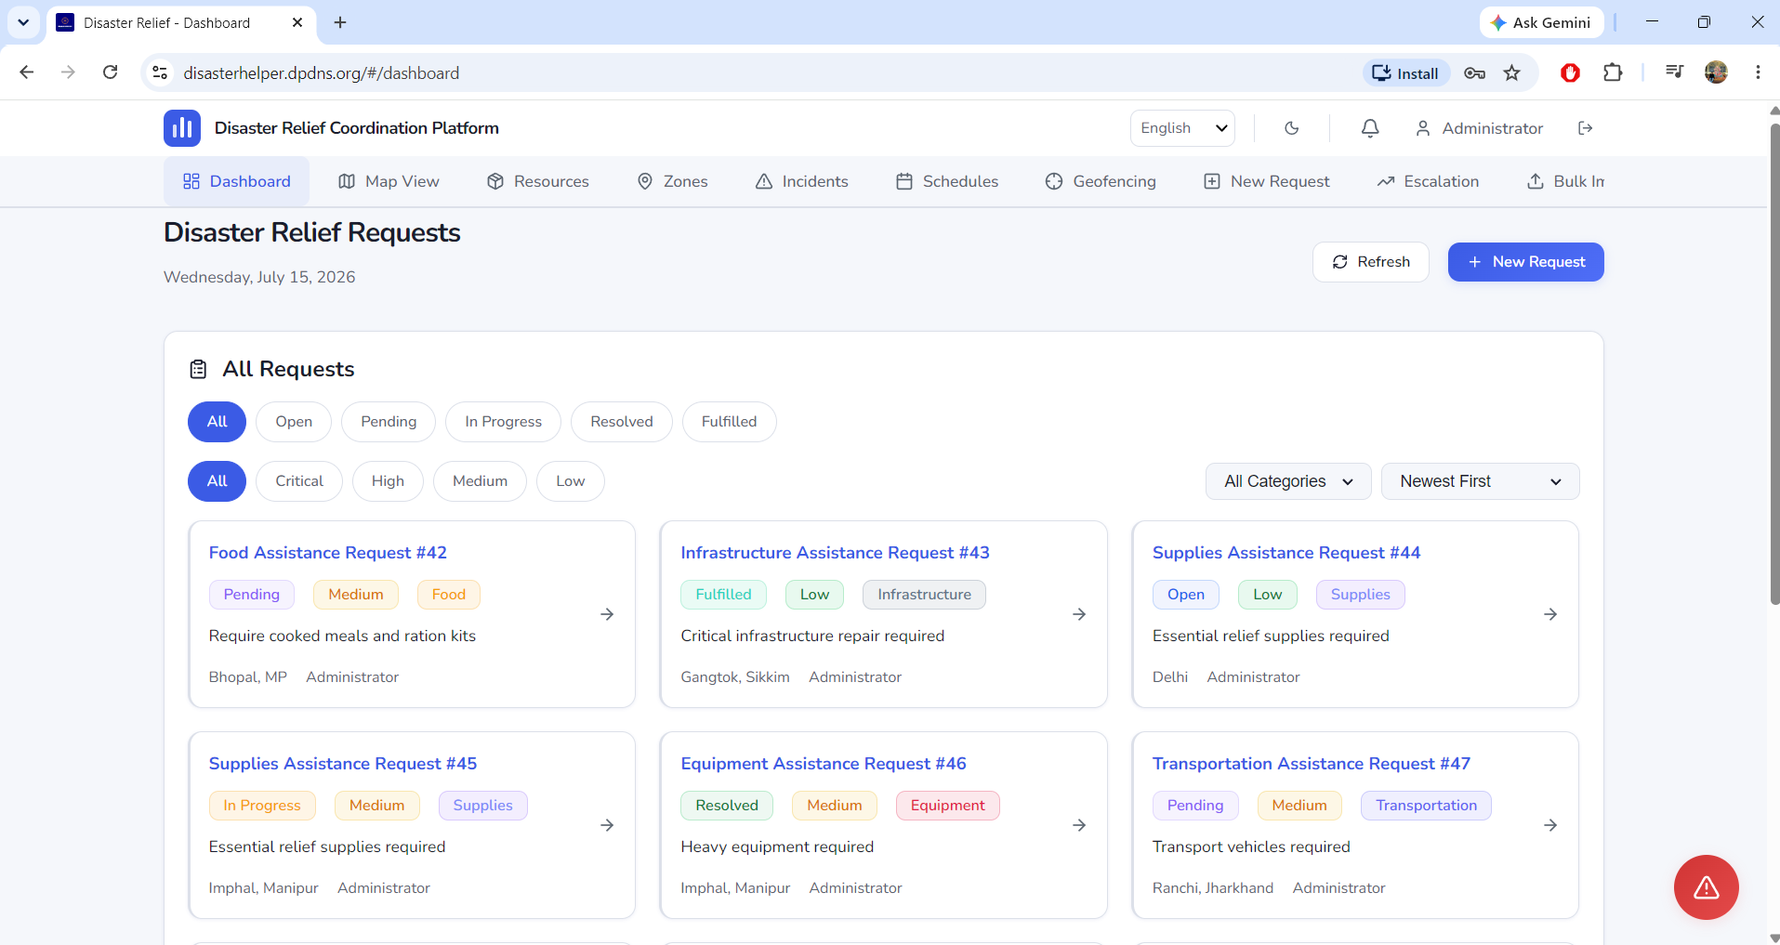
7. Implementation Details
SOURCE CODE HIGHLIGHTS (server/routes/sos.js)
UI PAGES / SCREENSHOTS
// SOS emergency broadcast via Socket.io io.to('sos').emit('new:sos', { location: SOSAlert.location, category, priority, requestedBy: user.name, timestamp: new Date(), }); // Geo-spatial query — find nearby resources const nearby = await Resource.find({ location: { $near: { $geometry: { type: 'Point', coordinates }, $maxDistance: 5000 } }, category, }).select('name category location amount'); // Joi validation — sanitize SOS input const schema = Joi.object({ category: Joi.string().required(), priority: Joi.string().valid(...).required(), description: Joi.string().max(500).allow(''), });
→ disasterhelper.dpdns.org
DATABASE (9 Models)
• User, Request, Resource • Zone, SosAlert, Incident • Schedule, ChatMessage, Feedback

Slide 9
8. Results & Achievements
Features Completed
17
70+
9
10
175+
• End-to-end MERN full-stack app with 17 pages & 70+ API endpoints
UI Pages
API Endpoints
DB Models
Languages
Unit Tests
• Real-time GIS mapping with 9 disaster zone overlays
• SOS emergency broadcast with Socket.io
• 10-language i18n including Urdu (RTL)
13
15
19
A+
AA+
• PWA with service worker & offline fallback
E2E Tests
Route Modules
CSS Files
Security Grade
Accessibility
• Docker multi-stage build + Render deployment
• 19 CSS files — glassmorphism design system, light/dark/neon themes
Testing Results
Deliverables
• 175+ unit tests passing — Vitest framework
✔ Production app: disasterhelper.dpdns.org
• 13 Playwright E2E tests (theme toggle, login, lang, password)
✔ GitHub repo with GitHub Actions CI/CD
• axe-core accessibility audit — WCAG AA+ compliant
✔ Docker Compose local setup
• Rate limiting tested per-endpoint
✔ Full documentation (DESIGN_SYSTEM.md, UI-UX-DESIGN.md)
• Lighthouse score: >95 (target met)
✔ Server keepalive via inner + UptimeRobot (5-min pings)
• 0 unhandled errors in production
✔ render.yaml + Dockerfile.server for Render deploy

Slide 10
Thank You
Disaster Relief Coordination Platform
disasterhelper.dpdns.org
Live · Feature-Complete · Production-Ready

