Slide 1


Gujarat Technological University
C. K. Pithawala College of Engineering and Technology
INTERNSHIP PRESENTATION
Disaster Relief Coordination Platform
A Full-Stack Government Disaster Management Web Application
Presented by:
In Association With
Ansh S Patel
Metanoia Solution
Information Technology | Web Developer Intern
metanoiasolution.com
Industry Mentor: Nehal Patel
Faculty Guide: Disha N Chavda
Internship Duration: 01 July 2026 – 20 July 2026

Slide 2
Presentation Outline
Journey through the internship experience
02
03
04
05
06
07
01
Technology
Stack
Internship
Objectives
Project
Overview
System
Architecture
Major
Modules
Work
Performed
Company
Profile
08
09
10
11
12
13
14
Implement-
tation
Testing
Results &
Achievements
Learning
Outcomes
Challenges &
Solutions
Future
Scope
Conclusion

Slide 3
Company Profile
Metanoia Solutions — Empowering Businesses Through Technology
🔷 About the Company
🌐
Services
Metanoia Solutions is a dynamic IT services and consulting company headquartered in Surat, Gujarat. With over 7+ years of experience, the company has successfully delivered 25+ projects for 19+ organizations across diverse domains including healthcare, education, e-commerce, and government.
Web Dev, Mobile Apps,
UI/UX, Cloud, AI
👥
Clients
19+ Organizations
Across Industries
🎯 Mission
👁️ Vision
Transform manual processes into efficient, scalable, automated digital systems for startups and SMEs.
Be a leading technology partner driving digital transformation through innovation and quality.
💻
Technologies
MERN, Flutter, Laravel,
Python, Docker
📍
Office
🔹 Internship Details
Surat, Gujarat, India
Department: Web Development
Mentor: Nehal Patel
Duration: 01 July 2026 – 20 July 2026
Role: Web Developer Intern

Slide 4
Domain & Technology Stack
MERN Stack — Modern Full-Stack Web Development Technologies
⚛️
Frontend
🖥️
Backend
🗄️
Database
🔐
Auth
React.js
TypeScript
Tailwind CSS
Vite
Node.js
Express.js
REST APIs
JWT Auth
MongoDB Atlas
Mongoose ODM
GeoJSON
Indexes
JWT Tokens
bcrypt
Role-based
Access Control
🗺️
GIS Mapping
⚡
Real-Time
🚀
Deployment
📦
Version Ctrl
Leaflet.js
OpenStreetMap
Geo-fencing
Heat Maps
Socket.IO
WebSockets
Live Updates
Chat System
Render Cloud
Docker
CI/CD (GitHub Actions)
Nginx
Git
GitHub
Feature Branches
Code Reviews
📊 Technology Architecture Flow
React.js
Frontend
Express.js
API Layer
MongoDB
Database

Slide 5
Internship Objectives
Goals, Responsibilities & Learning Outcomes
🎯
📋
👨‍💻
📚
Primary
Objective
Problem
Statement
Key
Responsibilities
Learning
Goals
Build a full-stack disaster
relief coordination platform
using the MERN stack
Lack of centralized coordination
in disaster management leads to
delayed response & poor resource allocation
Frontend & backend development
API design, Database modeling
Integration & Deployment
Master React, Node.js, MongoDB
Real-time systems, GIS mapping
Agile development practices
✅ Expected Outcomes
• Production-ready disaster management platform deployed on cloud
• Enhanced skills in full-stack development, real-time systems & GIS integration
• Comprehensive understanding of SDLC, Agile methodology & DevOps practices
• Professional portfolio demonstrating real-world government application development

Slide 6
Project Overview
Disaster Relief Coordination Platform — Bridging the Gap in Disaster Response Coordination
⚠️ Existing Problems
👥 User Roles
✕ Delayed communication between stakeholders during emergencies
👤
Citizen
✕ Inefficient manual resource allocation & inventory tracking
Report incidents, get
SOS alerts & updates
✕ Lack of real-time situational awareness for field teams
✕ No centralized platform for citizen reporting & SOS alerts
🦸
Volunteer
✕ Poor coordination between NGOs, volunteers & government agencies
Accept tasks, help
with relief operations
✅ Proposed Solution
✓ Real-time multi-channel communication & alert system
🏢
NGO
Coordinate resources
& manage volunteers
✓ Centralized resource tracking with automated allocation
✓ Interactive GIS maps with live incident tracking
✓ Multi-language SOS system with GPS coordinates
🏛️
Govt
Monitor situations
& allocate resources
✓ Role-based dashboards for all stakeholders
⚙️
Admin
Full system control
& analytics dashboard
🌟 Benefits: Faster Response Time • Efficient Resource Utilization • Improved Coordination • Data-Driven Decisions • Multi-Lingual Accessibility

Slide 7
System Architecture
Three-Tier Architecture with Real-Time Capabilities
React.js Frontend
Frontend
Deployment
Render + Docker
TypeScript • Components • Context • PWA
Node.js / Express API
Backend
REST Endpoints • Middleware • Business Logic
JWT Authentication
Auth
PWA
Offline Support
Token Auth • bcrypt • Role-Based Access
MongoDB Atlas
Database
NoSQL Database • GeoJSON • Mongoose ODM
Socket.IO Real-Time
Security
Helmet • Rate Limit
Real-Time
Live Updates • WebSocket • Push Notifications
Leaflet GIS Maps
Maps
Interactive Maps • Geo-fencing • Heat Maps
Testing
Vitest • Playwright
Reports & Analytics
Reports
Admin Dashboards • Charts • Data Export

Slide 8
Major Modules
10 Core Modules Powering the Disaster Relief Platform
🔐
🆘
🌊
🤝
📦
Authentication
& User Roles
SOS Alert
System
Disaster
Reporting
Volunteer
Management
Resource
Allocation
JWT-based auth with 5 user roles:
Citizen, Volunteer, NGO,
Government & Admin
One-click emergency broadcast
with GPS coordinates &
auto-notification to authorities
Citizens can report incidents
with images, location &
disaster type classification
Volunteer registration, task
assignment, skill matching
& activity tracking
Inventory management, request
matching, automated
resource distribution
🏠
📊
⚙️
🔔
🗺️
Shelter
Locator
Reports &
Analytics
Admin
Dashboard
Notification
System
Live Map
& Geofencing
GIS-based shelter mapping,
capacity tracking &
occupancy monitoring
Interactive dashboards with
charts, KPIs & exportable
reports for administrators
Complete system control,
user management &
configuration settings
Multi-channel alerts via
email, in-app & SMS
for timely updates
Real-time incident tracking,
geo-fence zones &
heat map visualization

Slide 9
Database Design
MongoDB Collections & Data Relationships
👤
Users
📋
Requests
🆘
SOS Alerts
📌
Incidents
15 fields
22 fields
10 fields
18 fields
📦
Resources
🔔
Notifications
📝
Audit Logs
🗺️
Zones
14 fields
8 fields
7 fields
12 fields
📊 Entity Relationship Diagram
👤 Users
1:N
📦 Resources
N:1
📋 Requests
🆘 SOS Alerts
1:N
N:1
📌 Incidents
💡 Schema Features: Mongoose ODM with Validation • GeoJSON Indexes for Spatial Queries • Compound Indexes • Data Population & Referencing

Slide 10
System Workflow
End-to-End Disaster Response Flow
1
2
3
4
5
6
7
8
🔐
📊
📝
🗄️
🔔
📦
🔄
✅
Login
Dashboard
Create
Request
Database
Notify
Volunteers
Allocate
Resources
Update
Status
Completed
User authenticates
via JWT
Role-based view
of incidents
Report disaster
with details
Save to MongoDB
GeoJSON data
Socket.IO push
notification
Match resources
to needs
Track progress
real-time
Resolve &
archive case
📋 Detailed Workflow Description
1. User logs in with credentials → JWT token generated for secure session
2. Dashboard loads role-specific data (incidents, tasks, resources based on user type)
3. Citizen creates a disaster request with type, description, location & media attachments
4. Data is stored in MongoDB with GeoJSON coordinates for spatial indexing
5. Socket.IO broadcasts real-time notification to volunteers & authorities in the zone
6. Resources (food, water, medical, shelter) are auto-matched and allocated by the system
7. Volunteers update task status (Accepted → In Progress → Completed) in real-time
8. Admin reviews and closes completed cases with final reports & analytics

Slide 11
Work Performed
20 Days Internship Timeline — Key Milestones
Week 1
Week 1
Week 1
July
July
July
📋
🎨
⚛️
Requirement Analysis
& Project Planning
UI/UX Design
& Prototyping
Frontend Development
(React + TypeScript)
1
2
3
4
5
6
🔐
🔄
🧪
Authentication & Backend
(Node + Express + JWT)
Socket.IO Real-Time
& MongoDB Integration
Testing, Documentation
& Deployment
July
July
July
Week 2
Week 2
Week 2

Slide 12
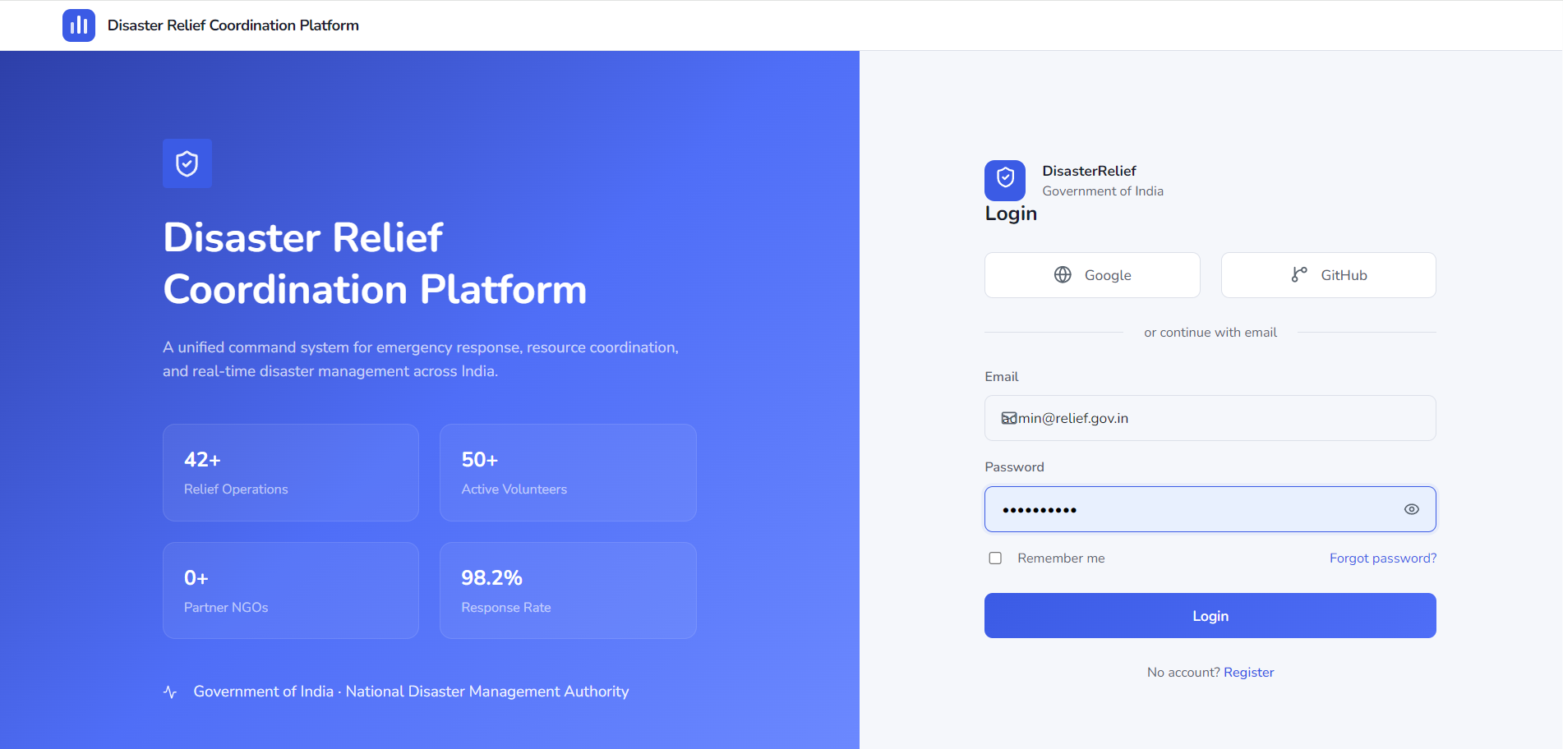
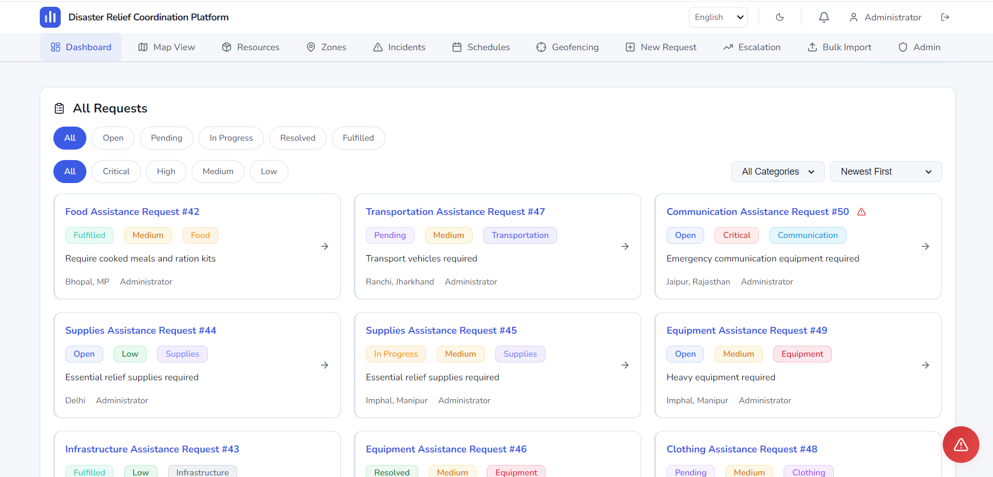
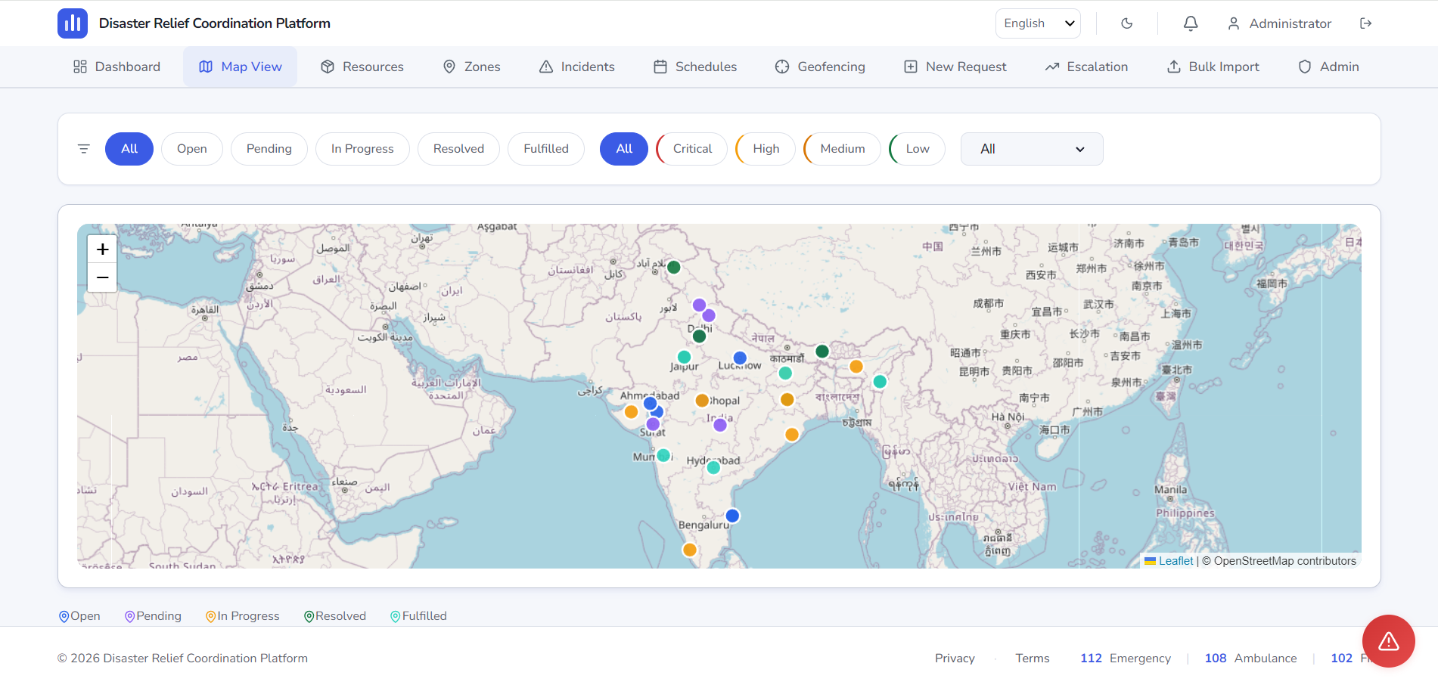
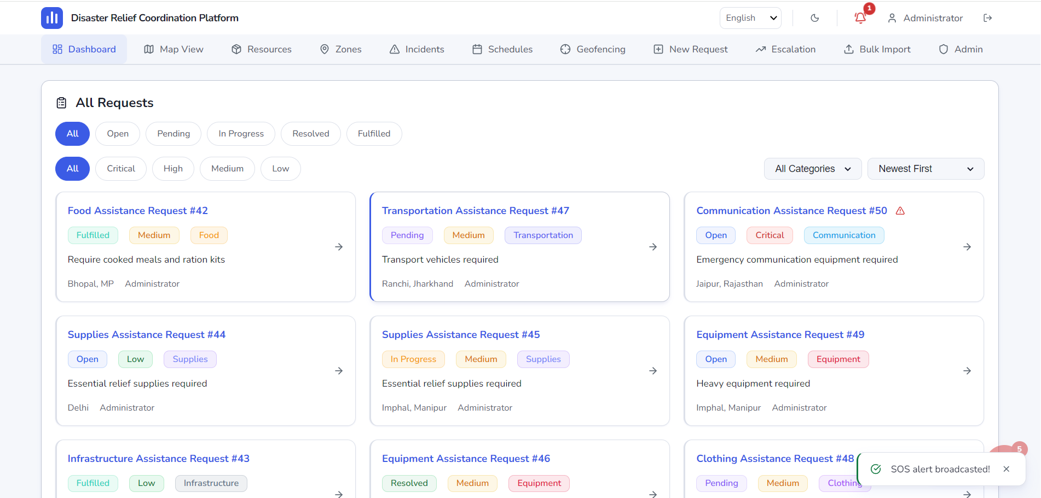
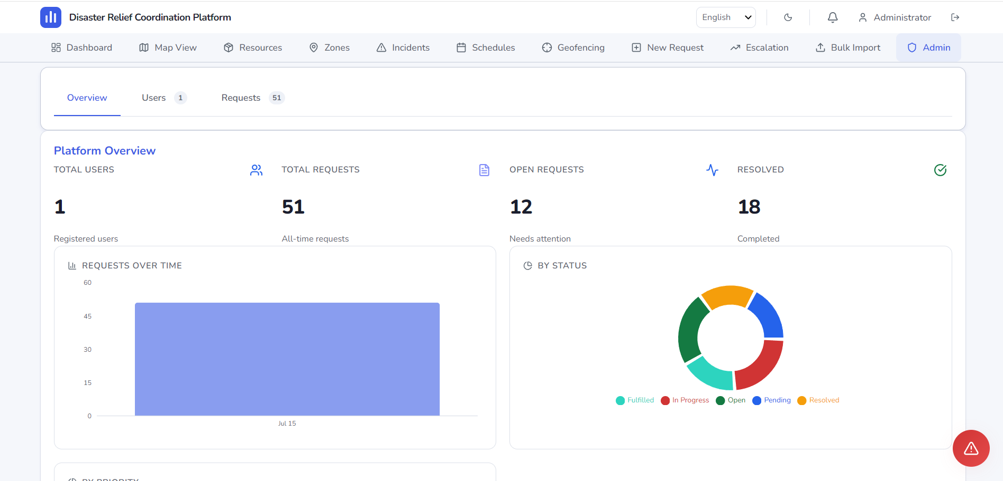
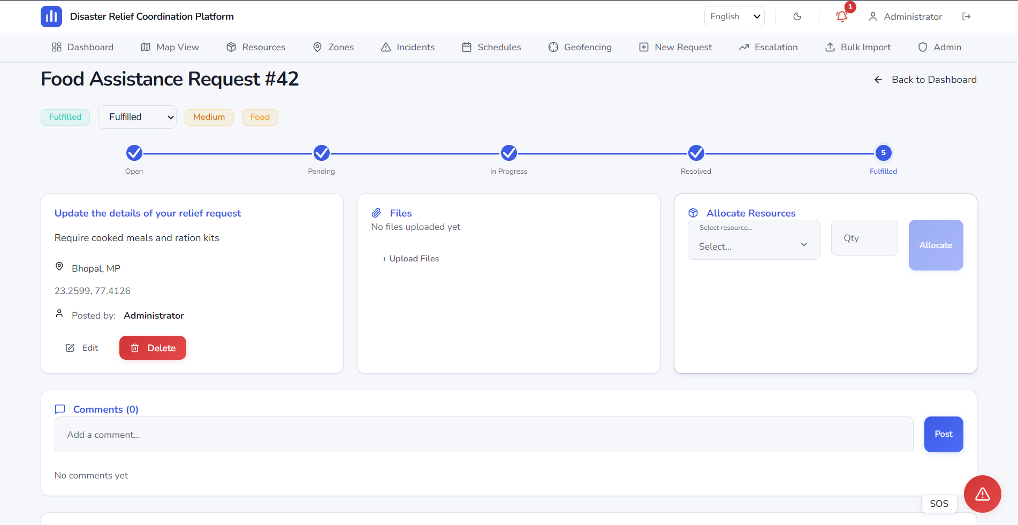
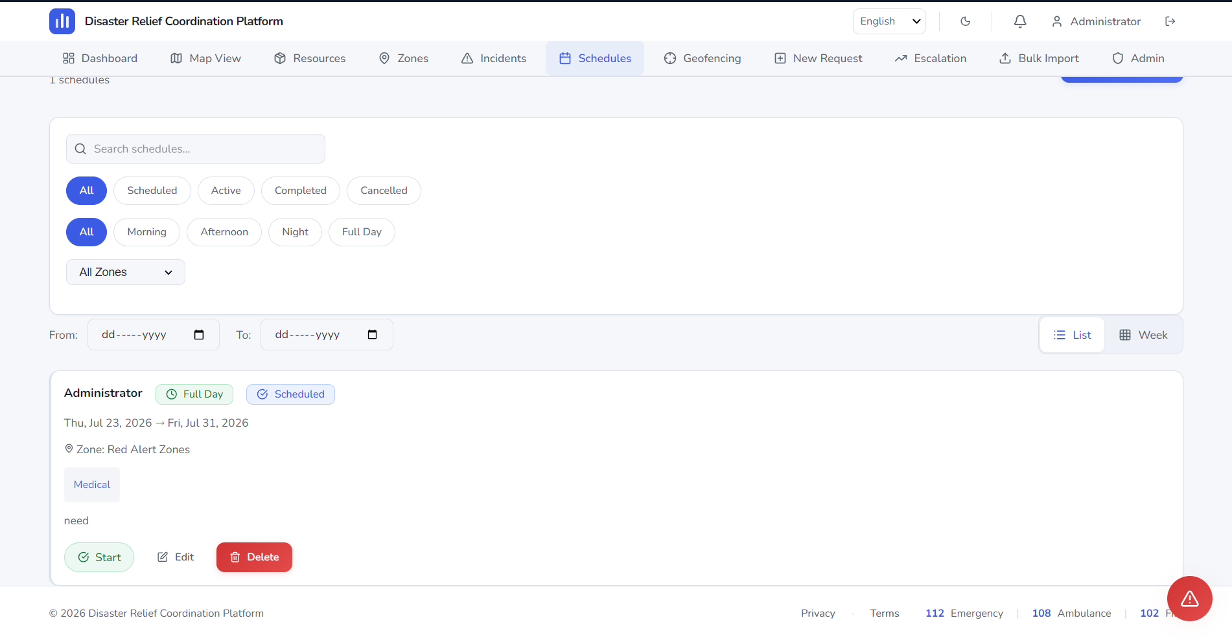
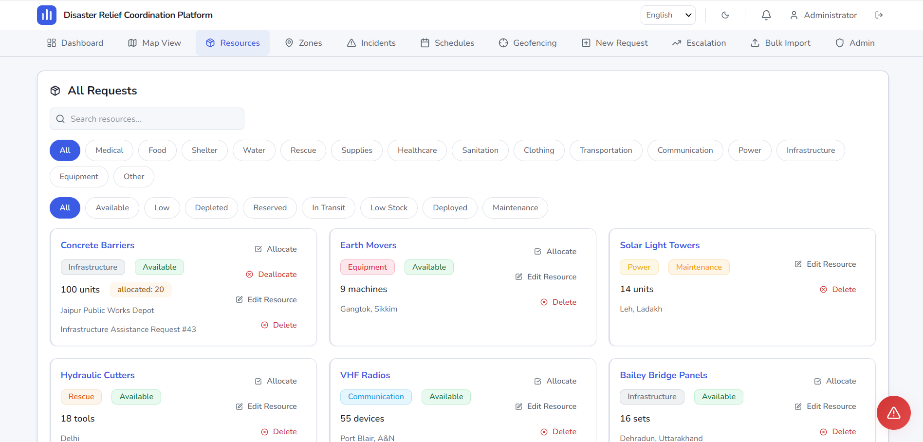
Implementation
Key Screens & Interface Showcase
Login Page
Dashboard
Interactive Map
SOS Alert
JWT Authentication
with Role Selection
Role-based KPI Cards
& Activity Feed
Leaflet GIS with
Incident Markers
Emergency Broadcast
with GPS Location
Admin Panel
Requests
Volunteer Panel
Resources
User Management
& System Config
Disaster Request
Management List
Task Assignment
& Status Updates
Inventory Tracking
& Allocation

Slide 13
Testing & Quality Assurance
Comprehensive Testing Strategy for Robust Application
🧪
🔗
🌐
⚙️
✅
Unit Testing
Integration
Testing
API Testing
System
Testing
Acceptance
Testing
Individual components
& functions tested
with Vitest
API endpoints &
module interaction
verification
RESTful API validation
with Postman &
Supertest
End-to-end workflows
using Playwright
framework
User acceptance &
stakeholder feedback
validation
📊 Test Results Summary
🏆 QA Achievements
Test Type | Test Cases | Passed | Failed | Coverage
Unit Tests | 85 | 85 | 0 | 92%
Integration Tests | 45 | 44 | 1 | 88%
API Tests | 60 | 60 | 0 | 95%
E2E (Playwright) | 20 | 19 | 1 | 85%
Accessibility | 15 | 15 | 0 | WCAG AA
✓ 225+ total test cases executed
✓ 98.7% overall pass rate
✓ WCAG AA accessibility compliance
✓ Zero critical security vulnerabilities
✓ CI/CD pipeline with automated testing
✓ Playwright E2E in headless Chrome

Slide 14
Results & Achievements
Deliverables, Performance Metrics & Key Accomplishments
20+
30+
95%
10
3
Pages
Developed
API
Endpoints
Test
Coverage
Languages
Supported
User
Roles
✅ Features Completed
🏆 Key Achievements
• JWT-based authentication with 5 role-based access levels
• Real-time SOS alert system with GPS coordinates
• Interactive GIS maps with Leaflet & OpenStreetMap
• Multi-language support (English + 9 Indian languages)
• PWA with offline service worker caching
• Bulk CSV import/export for data management
• Responsive design — mobile, tablet & desktop
• Admin analytics dashboard with Recharts visualization
• Socket.IO real-time notifications & chat
• Geo-fencing & heat map visualization
🚀 Deployed on Render Cloud with Docker containerization
🔒 Enterprise-grade security (Helmet, Rate Limit, XSS sanitization)
♿ WCAG AA accessibility compliance verified with axe-core
📱 PWA installable on mobile & desktop devices
🔄 GitHub Actions CI/CD for automated testing & deployment
ℹ️ GitHub Repository | Live Demo: render.com | Automated CI/CD Pipeline

Slide 15
Learning Outcomes
Technical & Professional Skills Acquired During Internship
💻 Technical Skills
⚛️
React.js & TypeScript
🖥️
Node.js & Express.js
Component architecture, hooks, context API, React Router, lazy loading
REST API design, middleware, error handling, async patterns
🗄️
MongoDB & Mongoose
🔐
JWT & Authentication
Schema design, indexing, aggregation, GeoJSON queries
Token-based auth, refresh tokens, role-based access control
🌐
REST API Design
⚡
Socket.IO
CRUD operations, request validation, response formatting
WebSocket communication, real-time events, room-based broadcasting
🗺️
Leaflet.js GIS
🧪
Testing (Vitest)
Interactive maps, markers, geo-fencing, heat map layers
Unit tests, integration tests, mock functions, code coverage
🤝 Professional Skills
Agile Methodology
Git & Version Control
Team Collaboration
Problem Solving
Technical Communication
Time Management

Slide 16
Challenges & Solutions
Technical Hurdles Overcome During Development
🗄️
Database Design
🔐
Authentication
⚠️ Challenge: Designing an efficient MongoDB schema for complex relationships
⚠️ Challenge: Implementing secure JWT auth with role-based access for 5 user types
✅ Solution: Implemented data referencing with Mongoose population and compound indexes
✅ Solution: Created middleware chain with JWT verification, role checking and rate limiting
🔄
Real-Time Sync
🗺️
Geo-Spatial Queries
⚠️ Challenge: Maintaining real-time data consistency across multiple clients
⚠️ Challenge: Implementing efficient location-based queries for nearby resources
✅ Solution: Used Socket.IO rooms for targeted broadcasting with event acknowledgment
✅ Solution: Leveraged MongoDB 2dsphere indexes with $nearSphere and $geoWithin operators
🚀
Deployment
🐛
Bug Fixing
⚠️ Challenge: Overcoming CORS, environment config & production optimization issues
⚠️ Challenge: Debugging complex async operations and WebSocket connection issues
✅ Solution: Configured Nginx reverse proxy, Docker multi-stage builds & env variable management
✅ Solution: Implemented structured logging with Winston, error boundaries & comprehensive error handling

Slide 17
Future Scope
Enhancements & Roadmap for Next Iterations
🤖
📡
🚁
AI Prediction
IoT Sensors
Drone Imaging
ML models for disaster
impact prediction &
resource optimization
Real-time sensor data
for early warning &
environment monitoring
Aerial damage assessment
& real-time drone
feed integration
Priority: High
Priority: High
Priority: Medium
🛰️
📱
🧠
Satellite
Android App
ML Analytics
Satellite imagery for
large-scale disaster
zone mapping
Native mobile app with
offline support &
GPS-based reporting
Predictive analytics for
resource demand &
volunteer allocation
Priority: Medium
Priority: High
Priority: Medium
🎯 Next Steps: Complete Android App Development → Integrate AI/ML Models → Deploy IoT Sensor Network → Satellite Integration

Slide 18
Conclusion
Summary, Impact & Internship Experience
📋 Project Summary
🌟 Internship Experience
The Disaster Relief Coordination Platform was successfully designed, developed, and deployed as a comprehensive full-stack web application. The platform addresses critical gaps in disaster response coordination by providing real-time communication, resource tracking, volunteer management, incident reporting, SOS alerts, and interactive mapping capabilities — all within a secure, scalable, and user-friendly interface.
🏢
Industrial Learning
Gained hands-on experience
in a professional software
development environment
📈
Career Growth
🎯 Project Impact
Built a strong portfolio
project demonstrating
full-stack expertise
• Reduced coordination response time through real-time alerts
• Centralized resource allocation minimizing wastage
• Multi-lingual support making it accessible across India
• PWA capabilities ensuring offline functionality
• Secure role-based access for all stakeholders
🤝
Professional Dev
Improved communication,
collaboration & problem-
solving skills
"An enriching internship that transformed academic knowledge into practical expertise — building a real-world application that can save lives during disasters."

Slide 19
Acknowledgement
Gratitude & Appreciation
🙏 Thank You!
I would like to express my sincere gratitude to everyone who supported me during this internship journey.
🏢
👨‍🏫
🏛️
Metanoia Solutions
Nehal Patel
College Faculty
For providing the opportunity
and professional environment
Industry Mentor — for invaluable
guidance and support
For academic support and
continuous encouragement
🎓
👨‍👩‍👧‍👦
GTU
Family & Friends
For incorporating internship
in the curriculum
For unwavering support
and motivation

Slide 20
Thank You
Questions & Discussion
"Technology is best when it brings people together." — Matt Mullenweg
👤
📧
💼
💻
Presented by
Email
LinkedIn
GitHub
Ansh Patel
anshp5388@gmail.com
linkedin.com/in/ansh-patel-95a161304
github.com/Anshp2910
Internship Presentation | Metanoia Solutions | Gujarat Technological University
Disaster Relief Coordination Platform • 01 July 2026 – 20 July2026 • Presented by Ansh Patel

