Slide 1

CYBERSECURITY IN
High-Frequency Finance
Protecting Speed-Sensitive Platforms from Manipulation and Disruption
Anshra Subhaniee
Diploma in Cloud Cyber Security | EduQual Level 3 | Topic 32

Slide 2












PRESENTATION AGENDA
01
02
03
04
HFT Ecosystem
Threat Landscape
Technical Monitoring
Secure Comms & Access
Basics of HFT & algorithmic trading
Speed & integrity risks
Kafka + ELK anomaly detection
TLS, mTLS, RBAC, MFA
05
06
07
08
System & Network Arch.
Implementation & Demo
Failure & Recovery
Policies & Governance
FPGA gateways, VLAN, NVMe
Live Kafka streaming, Kibana
Kill switch, failover, post-mortem
Reg SCI, MiFID II, RACI
09
10
11
12
Security Architecture
Containment & Recovery
Case Study: 2010 Flash Crash
Conclusion & Q&A
Integrated diagram + Cloud VPC
Automated response flow
Lessons applied
Key takeaways

Slide 3



BASICS OF HFT AND ALGORITHMIC TRADING
HFT Definition
Algorithmic Trading
Why Security Matters
Trading that uses powerful computers to execute thousands to millions of orders per second at microsecond speeds — faster than a human blink.
Programs that automatically trade based on predefined instructions (price, timing, volume). No human intervention — pure code decisions.
Any latency injection, data tampering, or unauthorized access can cause cascading failures worth billions in seconds. Security is mission-critical.
~1 µs
50%+
24/7
Execution speed
US equities volume
Uptime requirement

Slide 4






CYBERSECURITY THREAT LANDSCAPE
Latency Attacks
Data Tampering
DDoS Attacks
Weaponizing time — injecting microsecond delays to make competitors' data obsolete, gaining unfair market advantage.
Poisoning price/volume feeds — unauthorized changes trigger wrong algorithmic decisions, causing flash crashes.
Flooding trading infrastructure with traffic, causing system downtime and financial losses within seconds.
Man-in-the-Middle
Unauthorized Access
Algorithm Theft
Intercepting trading communications between exchange and firm — exposing sensitive order data and strategies.
Compromised credentials allow fraudulent trades or theft of proprietary trading algorithms.
Exfiltration of trading algorithms — IP theft giving competitors an illegal edge and regulatory exposure.

Slide 5








TECHNICAL MONITORING & ANOMALY DETECTION
Market Exchange
Apache Kafka
Logstash
Elasticsearch
Kibana
Kill Switch
Real-time ticks
orders, quotes
TLS 1.3 + SASL
High-throughput broker
Parse, transform
Log enrichment
Index & store
Fast searching
Real-time
dashboards & alerts
Auto-disconnect
compromised algo
ANOMALY DETECTION LOGIC
1
2
3
4
5
Monitor
Detect
Alert
Kill Switch
Log & Recover
Kibana watches latency & volume in real-time
Threshold breach? Abnormal pattern? Suspicious access?
Alert fired via Elasticsearch Watcher rules
Algorithm instantly disconnected
Forensic logs preserved for post-mortem

Slide 6



SECURE COMMUNICATION & ACCESS CONTROL
Secure Communication
Access Control
TLS 1.3 encryption protects all data in transit
Role-Based Access Control (RBAC) by job function
Mutual TLS (mTLS) used between Kafka, Elasticsearch & Kibana
Least Privilege Principle enforced on all accounts
All channels are secured end-to-end
Multi-Factor Authentication (MFA) required
Zero Trust + network segmentation applied
Full Audit Logging of all system actions
Encrypted FIX protocol for order messaging
API key management with rate limiting
Regular certificate rotation & lifecycle management
Privileged Access Workstations (PAW) for admins

Slide 7

SYSTEM & NETWORK ARCHITECTURE
EXCHANGE LAYER
Market Exchange — Real-time data feed (10.0.0.0/24 — DMZ)
EDGE LAYER
FPGA Gateway — Tick-to-Trade | Smart NIC | Kernel Bypass (10.0.1.0/24)
Hardware Sanity Checks — Packet filtering & validation
NETWORK CORE
FPGA-based Trading Engine — Ultra-low latency execution (10.0.2.0/24 — Internal VLAN)
Arista 7130 / Cisco Nexus — VLAN Micro-segmentation <100ns
Firewall + IDS/IPS — DDoS mitigation | Intrusion detection
STORAGE LAYER
NVMe Arrays — High-throughput | Kafka & ES indexing
AES-256 + mTLS Transport — Replication factor: 3
MGMT LAYER
OOB Management Network — Jump Host | MFA gated access
RBAC + Audit Logging — Zero Trust | Least Privilege

Slide 8
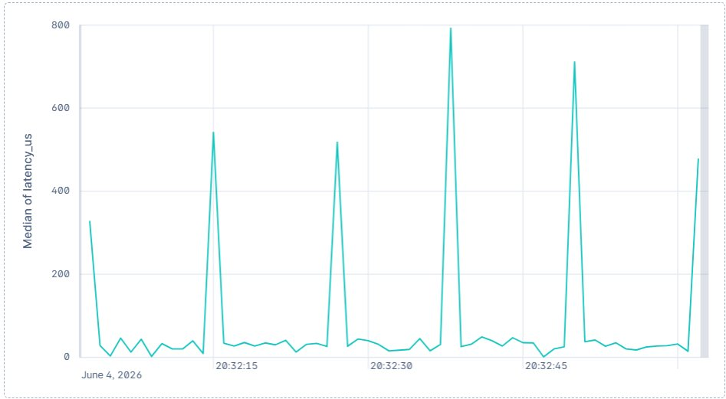
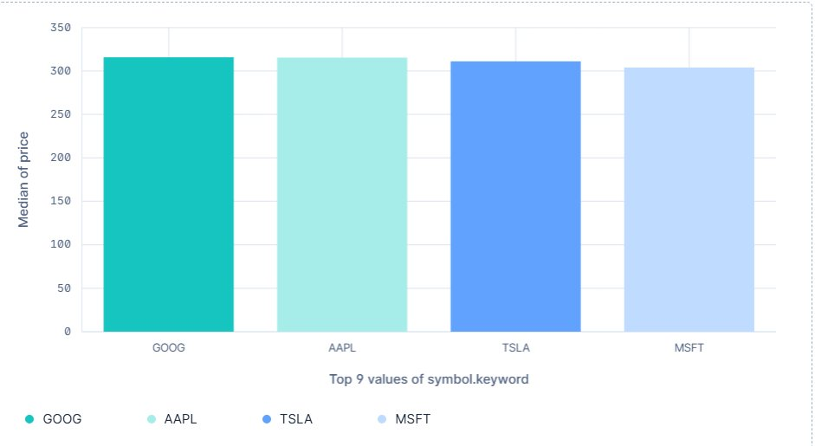
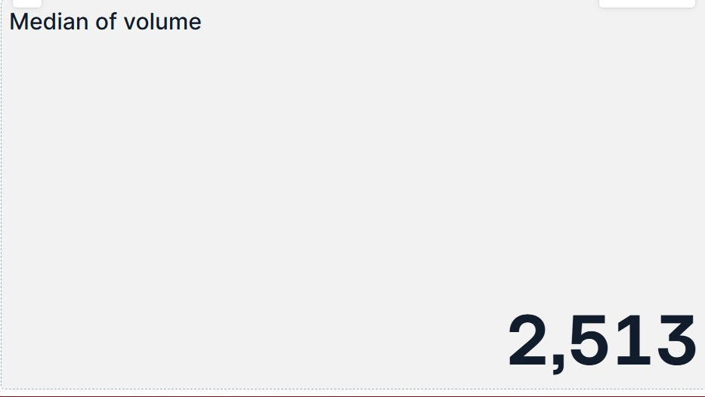
IMPLEMENTATION & DEMONSTRATION
Core Technologies
# 1. Create Secure Kafka Topic
kafka-topics.sh --create --topic market-data \
--partitions 12 --replication-factor 3 \
--bootstrap-server 10.0.1.10:9094 --security-protocol SASL_SSL
# 2. Producer — publish live market tick
echo '{"sym":"AAPL","price":182.5,"ts":1717900800}' | \
kafka-console-producer.sh --topic market-data \
--bootstrap-server 10.0.1.10:9094 --producer.config ssl.properties
# 3. Consumer — read & verify stream
kafka-console-consumer.sh --topic market-data --from-beginning \
--bootstrap-server 10.0.1.10:9094 --consumer.config ssl.properties
# Output: {"sym":"AAPL","price":182.5,"ts":1717900800}
Apache Kafka — Secure high-throughput streaming
ELK Stack — Logstash + Elasticsearch + Kibana
Hybrid Architecture: Kafka on-premise + ELK on cloud
Security: TLS 1.3 + mTLS, SASL/SCRAM, RBAC, Kill Switch
Live Kibana Dashboard — Real System Output
Latency Spike Detection
Live Symbol Price Feed
Median Volume: 2,513
Median latency spikes to 800µs — Kibana flags anomaly, triggering Kill Switch
GOOG, AAPL, TSLA, MSFT median prices ~$305-315 — confirms live Kafka stream integrity
Real-time volume tracking — unusual drops trigger anomaly alerts instantly

Slide 9


FAILURE & RECOVERY SCENARIOS
1
2
3
4
DETECTION
INTERVENTION
FAILOVER
RECOVERY
ELK/Kafka detects strategy drift or network failure
Network failure: missed heartbeat >500ms timeout triggers alert
Hardware Kill-Switch triggered
Pending orders purged immediately
Algorithm disconnected from exchange
Deterministic switch to hot-standby node
Hot-standby synced via Kafka replication (factor 3) — state lag <1ms
Secondary data center takes over
Zero interruption to market position
Post-mortem log analysis in Elasticsearch
Auto-restore: replay Kafka offset from last committed checkpoint
Phased re-entry after verification
Kill Switch Protocol: ELK detects anomaly → Threshold check → Kafka consumer halted → Exchange gateway disconnected → Audit log written

Slide 10




POLICIES, PROCEDURES & GOVERNANCE
Security Policies
Incident Response
Governance & Compliance
All streams use TLS 1.3 + mTLS encryption
Why: TLS 1.3 removes legacy cipher suites; mTLS ensures both sides are authenticated — critical between Kafka brokers
Detection — ELK/Kibana identifies anomaly (0–30s) | Role: SOC Analyst
Full adherence to Regulation SCI and MiFID II
RBAC + MFA enforced on Kafka, ELK & trading systems
Containment — Kill Switch activates instantly (<1s) | Role: Automated System
Quarterly security audits & penetration testing
Anomalies auto-trigger the Kill Switch
Investigation — Forensic analysis in Elasticsearch (0–2h) | Role: Security Engineer
Annual policy review and team training
Algorithm changes must be sandbox tested first
Why: untested algo changes caused the 2010 Flash Crash — sandbox prevents live-market feedback loops
Eradication — Patch vulnerabilities (2–8h) | Role: Dev + SecOps Team
Implements CIA + Accountability principles
Logs retained minimum 7 years (Reg SCI)
Recovery — Manual verification + phased restart (8–24h) | Role: Head of Trading + CISO
Lessons Learned — Update detection rules

Slide 11

INTEGRATED SECURITY ARCHITECTURE DIAGRAM
External
Market Exchange
TLS
Kafka Cluster
TLS
Logstash
TLS
Elasticsearch
TLS
Kibana
Dashboard
TLS
Kill Switch
Kafka Pipeline
ELK Analytics
Kill Switch / Protection
External / Untrusted
TLS/mTLS Encrypted
Zero Data Loss
Replication: 3
Logstash → ES → Kibana
Real-time monitoring
Anomaly detection
Threshold breach → Instant halt
Reg SCI compliant
Audit log preserved
Market Exchange input
TLS 1.3 enforced
All traffic validated

Slide 12
CLOUD ARCHITECTURE — VPC, SECURITY GROUPS & IAM
ON-PREMISES (10.0.0.0/16)
CLOUD VPC — ELK Stack (172.16.0.0/16)
Apache Kafka Cluster
Subnet: 10.0.1.0/24 (VLAN 10)
Brokers: 10.0.1.10–12:9094 (SASL_SSL)
Firewall: deny all except 9094/TLS
FPGA Trading Engine
Subnet: 10.0.2.0/24 (VLAN 20 — isolated)
VPN IPsec tunnel to cloud ELK (AES-256)
NVMe Storage Array
Subnet: 10.0.3.0/24 | AES-256 at rest
Kafka logs, cert store, audit trail
Logstash (172.16.1.10)
Security Group: allow 5044/TLS from on-prem VPN only
IAM Role: logstash-ingest-role (write-only to ES)
Elasticsearch Cluster (172.16.2.10–12)
Security Group: allow 9200/TLS from Logstash + Kibana only
IAM Role: es-read-write (Logstash), es-read-only (Kibana)
Key storage: AWS KMS (cert rotation auto every 90 days)
Audit logs: CloudWatch + S3 (immutable, 7-year retention)
Kibana Dashboard (172.16.3.10)
Security Group: allow 5601/HTTPS from admin IPs only (MFA)
IAM Role: kibana-viewer (RBAC; no raw ES access)
Trust boundary: cloud zone fully isolated from on-prem trading VLAN
IPsec VPN

Slide 13





AUTOMATED CONTAINMENT & POST-INCIDENT RECOVERY
ELK/Kafka Detects Anomaly
(latency spike / data tampering)
Threshold Breached?
YES → Kill Switch Activated
NO → Continue Monitoring
POST-INCIDENT RECOVERY PIPELINE
Analysis
Eradication
System Restore
Improvement
Query ES logs in Kibana to trace root cause
Patch vulnerabilities in trading stack / network
Phased re-entry after manual verification
Update anomaly detection rules & policies

Slide 14


CASE STUDY: THE 2010 FLASH CRASH
~1,000
$1T+
$4.1B
<30min
DJIA points dropped (~9%)
Temporary market value lost
Algorithmic sell order size
Duration of the crash
Primary Causes
Relevance to Our Project
Execution of a large $4.1B algorithmic sell order
2010 Vulnerability
Our Proposed Solution
Aggressive HFT feedback loops amplified selling
No real-time anomaly detection → HFT algos had no visibility into the cascade forming in milliseconds
Kafka + ELK Stack: detects latency spikes and volume anomalies in <1ms — flags cascade before it spreads
Rapid liquidity evaporation in milliseconds
Delayed identification → circuit breakers triggered too late; 20 min of damage before human intervention
Real-time latency spike detection
Inadequate real-time monitoring & risk controls
No automated intervention → algos kept selling even as prices collapsed; feedback loop was self-reinforcing
Instant Kill Switch
Speed vs security trade-off → firms chose raw speed; no security layer meant no way to stop runaway execution
Secure low-latency architecture

Slide 15
TECHNOLOGY JUSTIFICATION & DESIGN DECISIONS
KAFKA vs ALTERNATIVES
ELK vs SPLUNK / GRAFANA / DATADOG
Why Kafka over RabbitMQ / Pulsar?
Kafka handles millions of msgs/sec — RabbitMQ tops out ~50k msgs/sec (unsuitable for HFT volumes)
Kafka log replay (offsets) enables forensic audit — critical for Reg SCI compliance
Pulsar offers similar throughput but lacks the mature ELK integration ecosystem Kafka provides
Kafka replication factor 3 ensures zero data loss — no equivalent in RabbitMQ default config
Why ELK over commercial alternatives?
ELK is open-source — no per-GB ingestion cost; Splunk at HFT log volumes = prohibitive licensing
Native Kafka-Logstash connector — tight pipeline integration without custom middleware
Grafana is metrics-only; ELK handles full log forensics required for post-incident root-cause analysis
Datadog requires cloud egress — on-premises ELK keeps sensitive trading data within the security perimeter
WHY MUTUAL TLS (mTLS)?
DATA RETENTION & DISPOSAL PROCEDURE
Standard TLS only authenticates the server. In HFT, a rogue client injecting false data is equally dangerous — mTLS forces BOTH sides to present valid certificates
Prevents Man-in-the-Middle attacks between Kafka brokers — a compromised broker cannot impersonate a legitimate node
AWS KMS auto-rotates certificates every 90 days — eliminates manual cert management risk
Retention: 7 years per Reg SCI (CloudWatch + S3 immutable storage)
Disposal: After 7-year period, CISO and Compliance Officer issue formal disposal approval. Data purged via AWS S3 Object Lock expiry + cryptographic erasure (AES-256 key deletion)
Governance chain: Annual policy review by CISO → Board Audit Committee sign-off required before any disposal

Slide 16
SCALABILITY, GOVERNANCE & ARCHITECTURE DEPTH
SCALABILITY ANALYSIS
1M+ msg/sec
Kafka throughput capacity per cluster
Horizontal
Scaling: add brokers under load — no downtime. Kafka partitions auto-rebalance across new nodes
Traffic Spikes
Consumer group lag monitored; Kibana alerts if queue depth exceeds 10k msgs — triggers auto-scaling
GOVERNANCE & POLICY APPROVAL (RACI)
FPGA & KERNEL BYPASS — SIMPLIFIED
Role R A C I
CISO (Policy Owner) R A - I
Head of Trading - A C I
SecOps / Dev Team R - C -
Compliance Officer - A - I
Board Audit Committee - A - I
Annual policy review cycle; quarterly penetration testing sign-off required by CISO
What it is (plain language):
FPGA = a reprogrammable chip that executes trade logic in hardware (nanoseconds) rather than software (microseconds). Acts as the security gateway: validates every order before it reaches the exchange.
Kernel bypass (DPDK/RDMA) = data travels directly from network card to application, skipping the OS. This removes OS latency (~10–50µs saved) and reduces the software attack surface.
Security role at Level 3: the FPGA enforces rate limits and anomaly thresholds at wire speed — no software vulnerability can bypass it, as the logic is burned into silicon

Slide 17
NETWORK ARCHITECTURE — IP SUBNETS, FIREWALLS, DMZ & TRUST BOUNDARIES
ZONE 1 — UNTRUSTED
ZONE 2 — DMZ
ZONE 3 — ON-PREMISES (10.0.0.0/16)
ZONE 4 — CLOUD VPC (172.16.0.0/16)
Market Exchange
Internet / Public
FIX/FAST protocol
TLS 1.3 enforced
No trust — all traffic
validated at FW#1
Firewall #1
10.0.0.0/24
Allow: 9094/TLS only
Deny all else
IDS/IPS inline
DDoS mitigation
Kafka Cluster
10.0.1.0/24 | VLAN 10
Brokers: .10-.12:9094 SASL_SSL
Logstash — 172.16.1.10
Port 5044/TLS | SG: allow from VPN only | IAM: logstash-ingest-role
TLS 1.3
mTLS
FPGA Engine
10.0.2.0/24 | VLAN 20
Isolated — no internet route
IPsec VPN
AES-256
TRUST BOUNDARY
Elasticsearch — 172.16.2.10-12
Port 9200/TLS | SG: Logstash+Kibana only | IAM: es-read-write / es-read-only
NVMe Storage
10.0.3.0/24 | AES-256 at rest
Kafka logs + audit trail
Kibana — 172.16.3.10
Port 5601/HTTPS | SG: admin IPs only (MFA) | IAM: kibana-viewer (RBAC)
Firewall #2 — allow IPsec/VPN only outbound
AWS KMS — cert rotation every 90 days | S3 audit logs 7yr immutable
Full Flow: Exchange → [TLS 1.3] → FW#1/DMZ → [mTLS:9094] → Kafka (VLAN10) → [IPsec AES-256 VPN] → Logstash → Elasticsearch → Kibana
TRUST BOUNDARIES: ■ Zone 1 = Untrusted Internet ■ Zone 2 = Semi-trusted DMZ (FW#1 separates from Z1) ■ Zone 3 = Trusted On-Prem (FW#2 separates from Z2) ■ Zone 4 = Cloud VPC (IPsec VPN tunnel AES-256 separates from Z3)

Slide 18
DETAILED SECURITY ARCHITECTURE — KEY STORAGE, CERT ROTATION & AUDIT LOGS
🔑 KEY STORAGE
🔄 CERTIFICATE ROTATION
📋 AUDIT LOG LOCATIONS
Where keys are stored:
AWS KMS (cloud) — all ELK stack TLS/mTLS private keys; access restricted to IAM roles only.
On-prem NVMe (10.0.3.0/24) — Kafka broker keystores (JKS format); AES-256 encrypted at rest.
HashiCorp Vault — dynamic secret injection for Kafka SASL/SCRAM credentials; no hardcoded passwords anywhere.
IPsec VPN pre-shared keys: stored in HSM (Hardware Security Module) — tamper-evident, FIPS 140-2 compliant.
How certificates are rotated:
AWS KMS auto-rotates ELK TLS certs every 90 days — zero manual intervention; old key versions retained for decrypt only.
Kafka mTLS certs: 90-day rotation via cert-manager (K8s operator); rolling restart — zero downtime, brokers negotiate new cert while old remains valid for in-flight connections.
Kibana HTTPS cert: Let's Encrypt auto-renewal via ACM (AWS Certificate Manager) — alerts 30 days before expiry.
Expiry monitoring: Kibana Watcher alert fires 30 days before any cert expiry — SOC ticket auto-created in JIRA.
What is logged, where:
Kafka broker access logs — NVMe local (10.0.3.0/24) + mirrored to S3 (immutable, 7yr) via Kafka MirrorMaker.
Elasticsearch security events — AWS CloudWatch Logs (real-time) + S3 Glacier (long-term archive); Object Lock prevents deletion.
Kill switch events — written to Elasticsearch index + simultaneously to WORM S3 bucket; forensic-grade tamper-proof record.
API access (Kibana/ES) — AWS CloudTrail; every read/write by IAM role timestamped; meets Reg SCI + MiFID II audit requirements.
POLICY JUSTIFICATIONS — WHY THESE SPECIFIC CHOICES?
TLS 1.3 over TLS 1.2?
TLS 1.2 supports weak ciphers (RC4, 3DES) — exploitable via POODLE/BEAST. TLS 1.3 removes all weak cipher suites entirely, mandates forward secrecy (ECDHE), and reduces handshake to 1-RTT — cutting latency while improving security. Critical in HFT where every microsecond counts.
Why sandbox testing for algo changes?
The 2010 Flash Crash was triggered by an untested algo deployed directly to live markets — it created a self-reinforcing feedback loop. Sandbox testing with replayed historical Kafka data catches runaway execution before live deployment. Mandatory per our governance policy.
Why Zero Trust + network segmentation?
In HFT, a single compromised internal node can exfiltrate live order flow. Zero Trust means every connection is verified regardless of origin — no implicit trust for internal traffic. VLAN micro-segmentation ensures a breach in the Kafka VLAN cannot reach the FPGA engine VLAN, containing blast radius.

Slide 19
FAILURE & RECOVERY DEEP-DIVE + FLASH CRASH — THE DEEPER "WHY"
FAILURE DETECTION — HEARTBEAT & TIMEOUT SPECIFICS
HOT-STANDBY STATE REPLICATION & AUTO-RESTORE
Kafka broker heartbeat: sent every 100ms; if broker misses 5 consecutive heartbeats (500ms timeout) — ZooKeeper marks it dead and triggers leader re-election automatically.
Network failure detection: ELK Watcher monitors Kafka consumer lag every 250ms — if lag exceeds 5,000 messages OR latency spikes above 800µs, anomaly alert fires within 1 second.
FPGA hardware watchdog: if no valid tick received from exchange within 200ms — hardware kill signal sent; bypass mode activated to prevent stale data trading.
Hot-standby synced via Kafka replication factor 3: all 3 broker replicas receive every write simultaneously — state lag between primary and standby is consistently <1ms.
Automated state restoration: on failover, standby node reads last committed Kafka offset from ZooKeeper — replays from that exact point; no manual steps, no data loss; typical restore time <3 seconds.
Secondary data centre: geographically separated; receives Kafka MirrorMaker replication every 500ms; full takeover in under 30 seconds if primary DC loses power.
2010 FLASH CRASH — THE DEEPER "WHY": HOW OUR ARCHITECTURE DIRECTLY PREVENTS EACH ROOT CAUSE
Root Cause #1: No real-time visibility
2010: No system monitored the cascade forming — HFT firms were blind until DJIA had already dropped 600 points. Humans couldn't react in milliseconds.
Our fix: Kafka + ELK detects volume and latency anomalies in <1ms. Alert fires before the cascade can form. Machine speed vs machine speed.
Root Cause #2: No automated stop
2010: Algos had no kill mechanism. They continued executing the $4.1B sell order even as prices collapsed — the feedback loop was self-reinforcing with no circuit breaker at the algo level.
Our fix: Hardware Kill Switch at FPGA level — algo disconnected from exchange in <1ms on anomaly. Feedback loop physically impossible once kill switch fires.
Root Cause #3: Untested algo deployed live
2010: Waddell & Reed's sell algorithm was not stress-tested for low-liquidity conditions. No sandbox environment validated its behaviour before deployment to live markets.
Our fix: Mandatory sandbox testing with replayed historical Kafka data including the May 6 2010 scenario — algo cannot reach production without CISO sign-off.

Slide 20
CONCLUSION & Q&A
Key Takeaways
Speed & Security coexist: Real-time Kafka streaming without sacrificing low-latency
Security is not an option in HFT —
it is a prerequisite.
Anomaly Detection is feasible: Kafka + ELK enables real-time monitoring of suspicious patterns
Automated Protection works: Kill Switch disconnects compromised algorithms instantly
"Thank you for your time.
The floor is open for technical questions."
Architecture: Exchange → Kafka → Logstash → Elasticsearch → Kibana → Kill Switch
Compliance achieved: Fully aligns with Regulation SCI, MiFID II — CIA + Accountability
Anshra Subhaniee
EduQual Level 3 — Topic 32
Key lesson from Flash Crash: Automation & monitoring are not optional — they are essential
Diploma in Cloud Cyber Security | EduQual Level 3 | Topic 32 | Cybersecurity in High-Frequency Finance

