Slide 1
SQL-POWERED LENDING ANALYTICS
End-to-End Query Logic for KPI & Risk Segmentation

Slide 2



PROJECT OVERVIEW
Our approach offers a precise, data-driven solution for analyzing bank loan performance using SQL. By converting raw financial records into structured insights, the project enables comprehensive tracking of key metrics such as application volume, funding, repayments, and loan quality. It addresses critical challenges in portfolio assessment through modular queries, segment-level breakdowns, and repeatable logic. Designed with clarity and scalability in mind, this solution empowers stakeholders to make informed decisions, streamline reporting, and improve overall financial oversight.

Slide 3



🛠 TOOLS USED
MISCROSOFT EXCEL
MySQL
Tableau

Slide 4
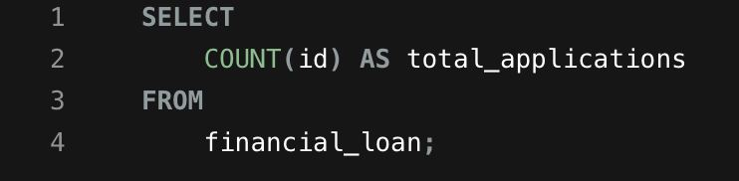
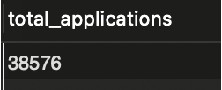

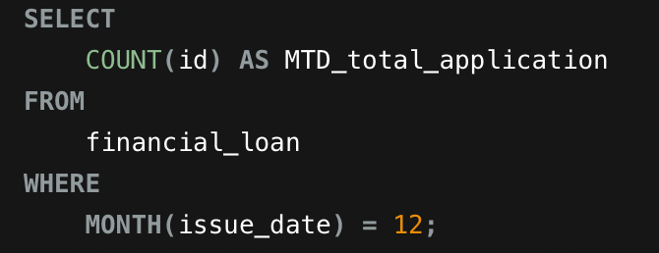
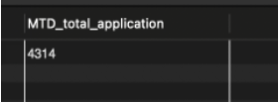
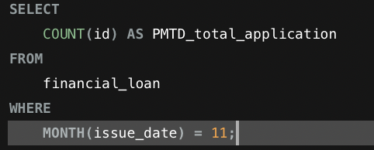
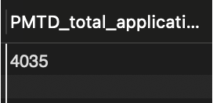
BANK LOAN REPORT | SUMMARY
TOTAL LOAN APPLICATIONS
MONTH-TO-DATE LOAN APPLICATIONS
MONTH-OVER-MONTH LOAN APPLICATIONS

Slide 5
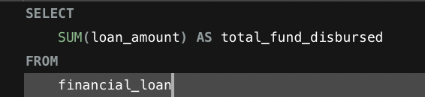
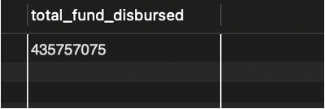
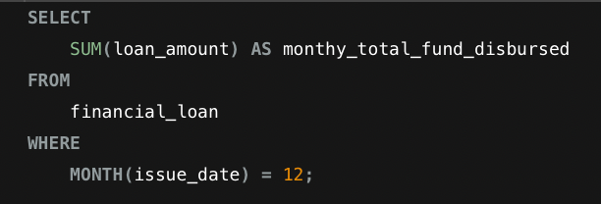

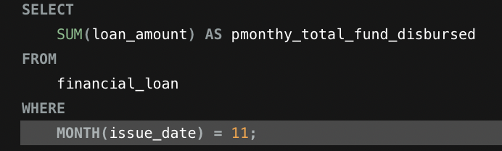

TOTAL FUNDED AMOUNT
MONTH-TO-DATE LOAN APPLICATIONS
MONTH-OVER-MONTH LOAN APPLICATIONS

Slide 6
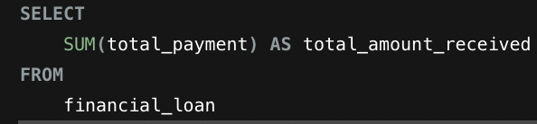
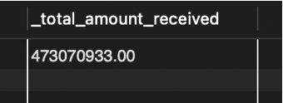
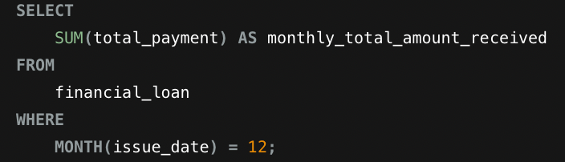
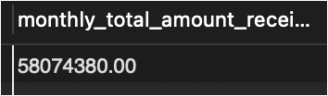
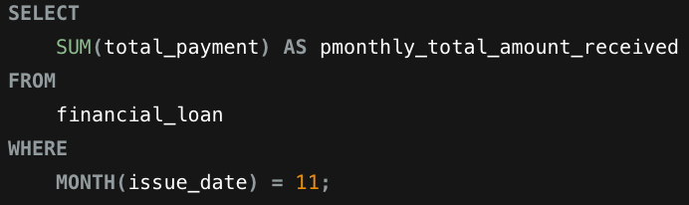
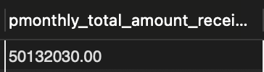
TOTAL AMOUNT RECEIVED
MONTH-TO-DATE LOAN APPLICATIONS
MONTH-OVER-MONTH LOAN APPLICATIONS

Slide 7
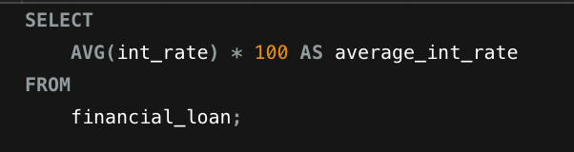
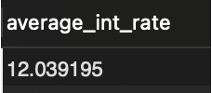
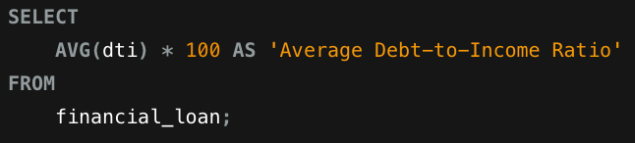

AVERAGE INTEREST RATE
AVERAGE DEBT-TO-INCOME RATIO

Slide 8
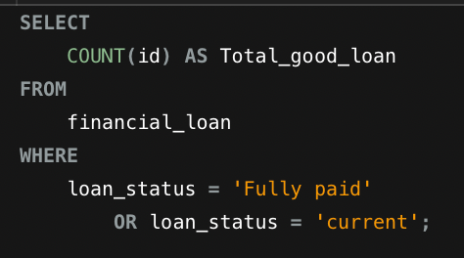
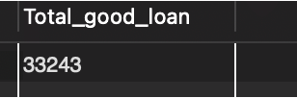
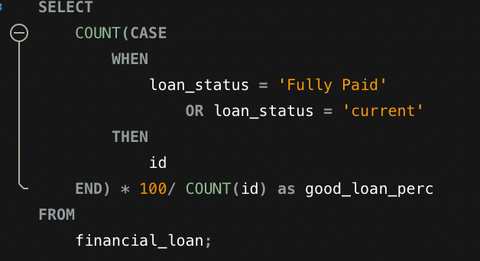
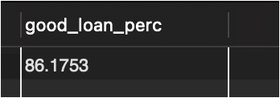
GOOD LOAN ISSUED
TOTAL GOOD LOAN
TOTAL GOOD LOAN PERCENTAGE

Slide 9
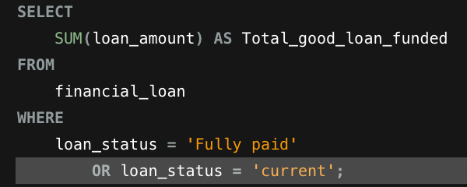
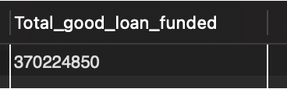
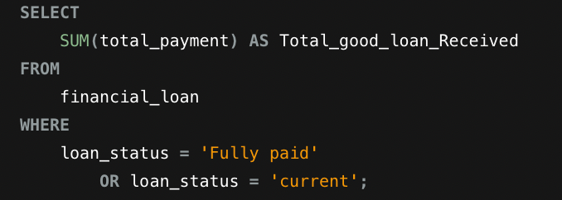
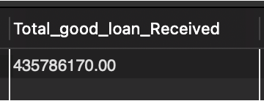
GOOD LOAN FUNDED AMOUNT
GOOD LOAN AMOUNT RECEIVED

Slide 10
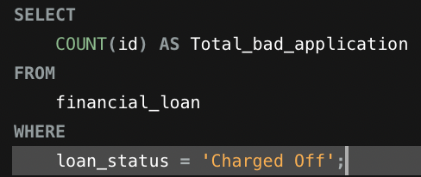
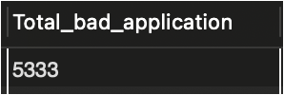
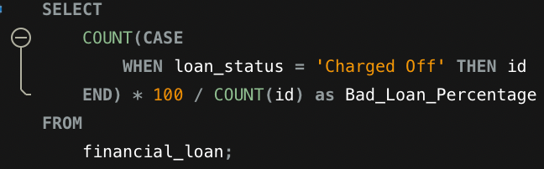

BAD LOAN ISSUED
BAD LOAN APPLICATIONS
BAD LOAN PERCENTAGE

Slide 11
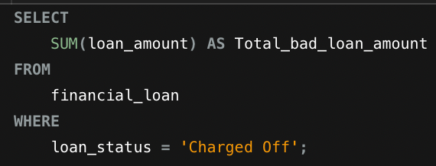
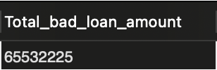
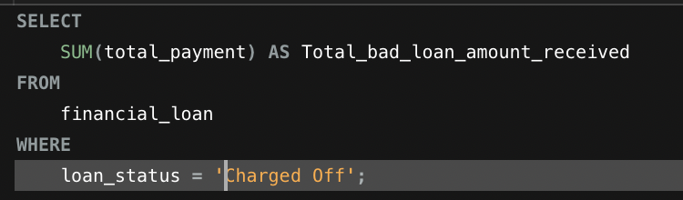
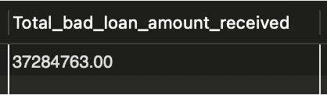
BAD LOAN FUNDED AMOUNT
BAD LOAN AMOUNT RECEIVED

Slide 12
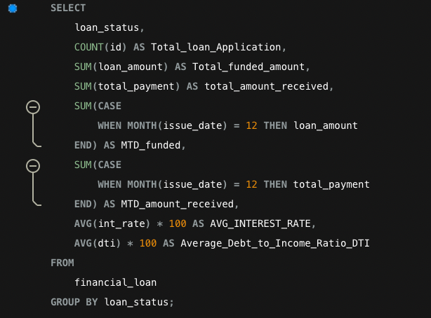
LOAN STATUS GRID VIEW

Slide 13
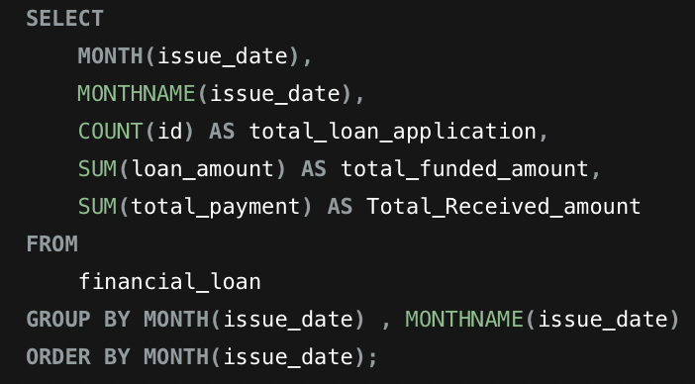
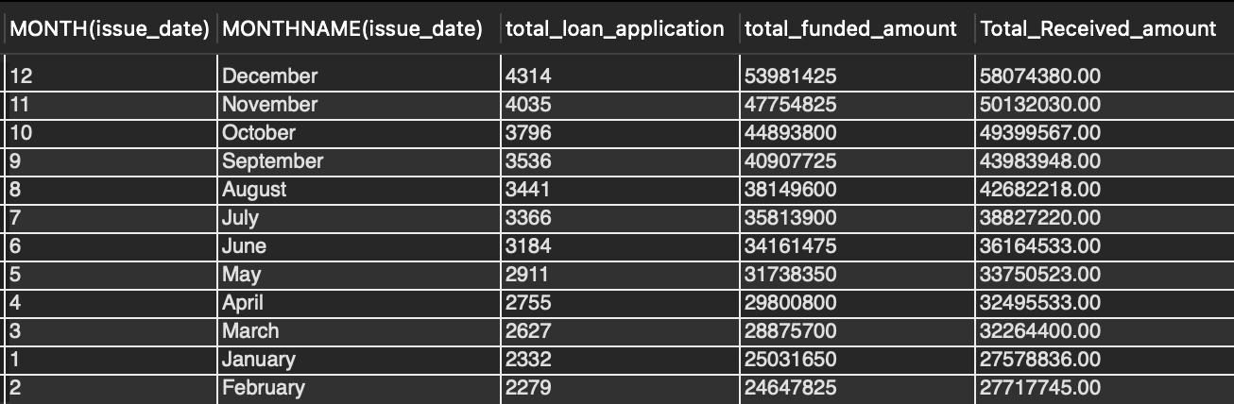
BANK LOAN REPORT | MONTHLY

Slide 14
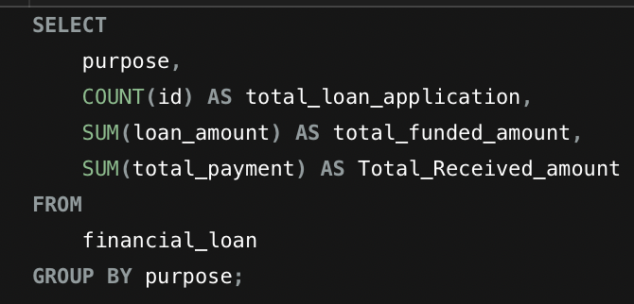
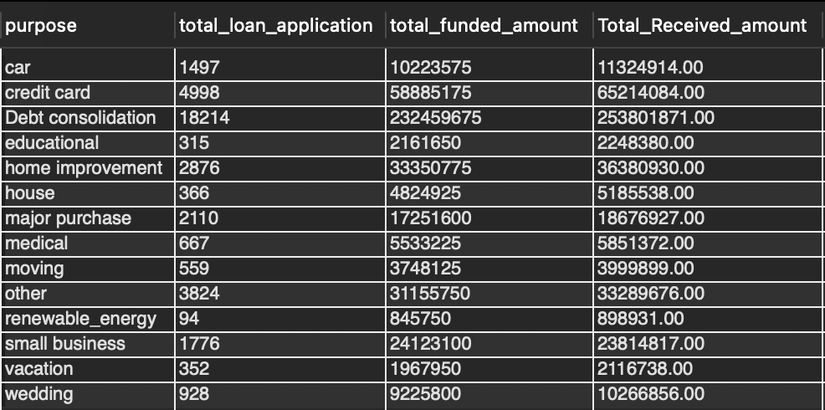
BANK LOAN REPORT |
PURPOSE

Slide 15
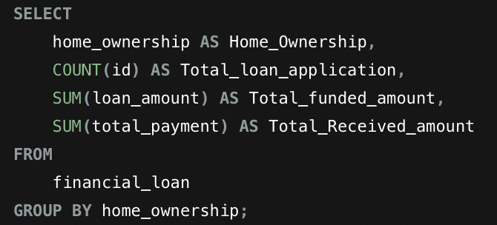
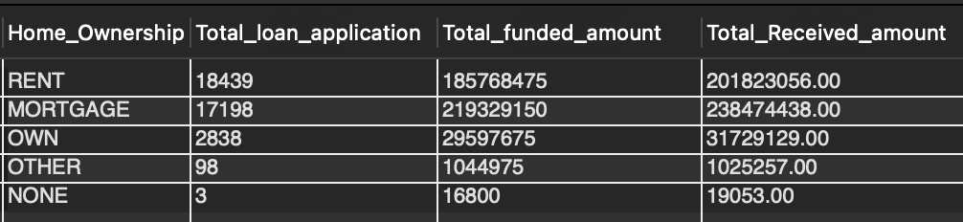
BANK LOAN REPORT |
HOME OWNERSHIP

Slide 16

CONCLUSION
Through systematic SQL queries, this report transforms raw lending data into actionable insights. It supports strategic decision-making by surfacing trends in loan applications, funding, repayments, and risk classification.
The modular design allows easy scaling and customization, enabling both granular views and high-level dashboards. This foundation empowers the organization to better manage risk, optimize lending practices, and strengthen portfolio performance.
Presented by: Ansh Sharma

