Slide 1
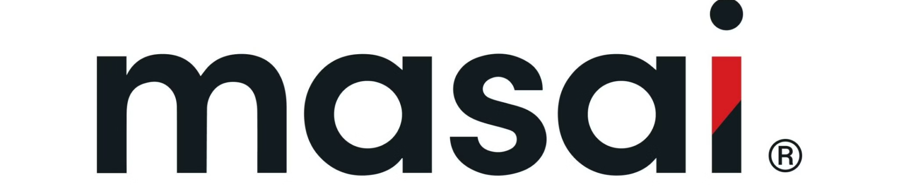

Introduction to Masai School
Masai School is a pioneering educational institution that is transforming the landscape of tech education in India. With a focus on practical, industry-relevant skills, Masai School equips students with the knowledge and tools they need to thrive in the dynamic world of technology.

Slide 2



Overview of the Masai School (Hire from Us) Clone Project
Project Goals
Key Features
The primary goal of this project is to create a comprehensive clone of Masai School's "Hire from Us" platform, replicating the functionality and user experience.
The clone will include features such as Interactive Elements, user profiles (log in and sign up), navigation menus, and flexible layouts aiming to mirror the original platform's capabilities.

Slide 3

Methodology
Planning
Development
Thorough planning and requirement gathering to ensure the clone aligns with the original platform's features and user workflows.
Implementing the clone's functionality using an agile development approach to ensure timely delivery and iterative improvement.
1
2
3
Design
Designing a user-friendly interface that matches the branding and visual identity of the Masai School platform.

Slide 4

Technology Stack
1
Frontend Development
2
Collaboration and Repository Hosting
HTML: Used to create the structure and content of web pages.
GitHub: Serves as the central platform for hosting the project's Git repositories.
CSS: Applied to style the web pages, ensuring they are visually appealing and responsive.
3
Extensions
4
Development Tools
Colorzilla
Visual Studio Code: Preferred code editor for writing, debugging, and maintaining the project's codebase.
Measure It
CSS Viewer
Font Finder

Slide 5



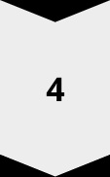
Functionalities
Functional Navbar
Log in/sign up.
Dashboard after log in.
Working links in Clickable Buttons

Slide 6

Design Decisions
1
Intuitive Navigation
2
Responsive Layout
The clone will prioritize a clean and intuitive user interface, with clear navigation paths.
The design will be optimized for various device sizes, ensuring a seamless experience across desktop, tablet, and mobile platforms.
3
Branding Integration
4
Accessibility
The clone will closely match the visual identity and branding of the original Masai School platform.
The clone will adhere to web accessibility standards.

Slide 7



Challenges and Solutions
Challenges
Initial Inconsistencies in Clone: The initial version of the website clone may not fully match the original in terms of design, functionality, and performance.
Limited Resources and Time Constraints: Designing the clone's architecture to handle increasing user traffic and data volumes as the platform grows in popularity.
User Experience: Achieving a seamless and high-quality user experience comparable to the original website can be challenging.
Solutions
Continuous Improvement: Regularly update the clone based on user feedback and testing results.
Iterative Development: Implement an iterative development process to refine and enhance the clone in stages.
Comparison Analysis: Conduct thorough comparisons between the clone and the original to identify and address discrepancies.
Phased Approach: Plan for multiple phases of development, allowing for gradual enhancement and addition of features.
User Testing: Conduct extensive user testing to gather feedback and identify areas for improvement.

Slide 8
Webpages
We have currently designed successfully functional clones of 8 pages of the masai website, which includes:
1
Hire from us
2
Courses
3
Events
4
Fees
5
Our Team
6
Mentors
7
Our Investors
8
Coach

Slide 9
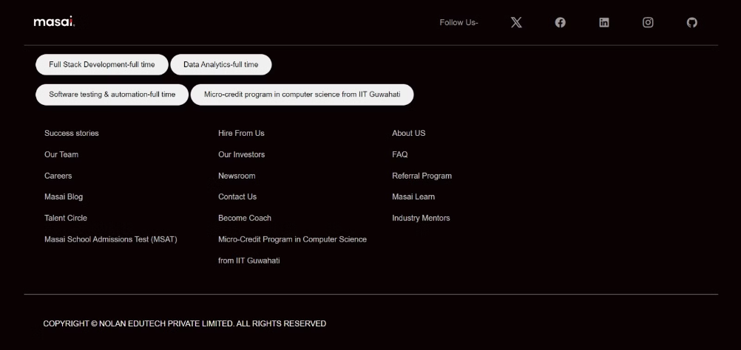
Some output of the clone
Header
Footer

Slide 10
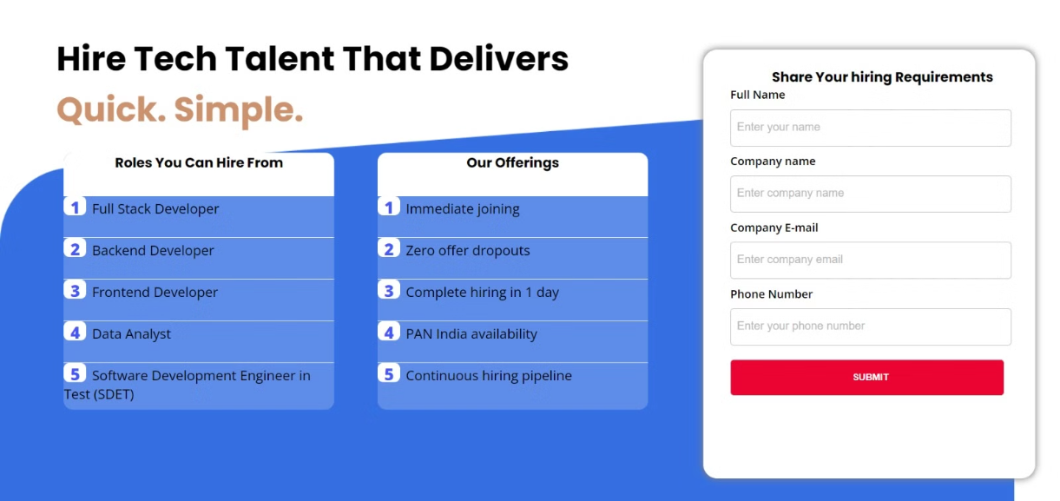
Masai hire from us

Slide 11
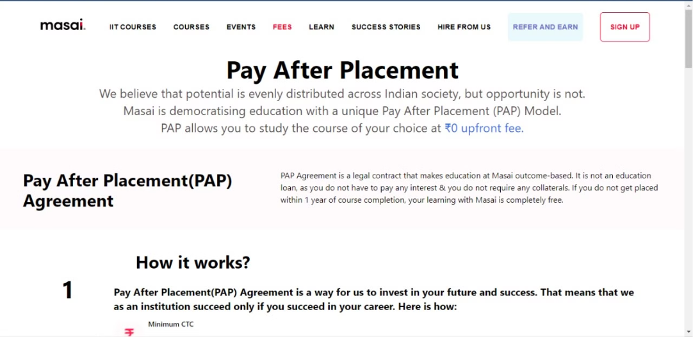
Fees

Slide 12

Conclusion and Future Work
Continuous Improvement
1
The clone will undergo regular updates and enhancements to keep pace with the evolving needs of the Masai School ecosystem.
Expanded Integrations
2
Exploring opportunities to integrate the clone with other Masai School services and platforms.
Innovative Features
3
Identifying and implementing new features that go beyond the original platform, further enhancing the value proposition for both employers and students.

Slide 13


Git Link
The source code for the Masai School (Hire from Us)
Clone project is available on GitHub.

