Slide 1
MOBILE PRICE PREDICTION
Anshu
Dated- 31-07-2024

Slide 2
OBJECTIVE –
TO PREDICT THE PRICE OF MOBILE BASED ON VARIOUS FEATURES USING
KNN MODEL

Slide 3
DATA DESCRIPTION
The data contains different attributes of mobile. The detailed dictionary of data is given below-
1. RAM
2. Processore
3. Battery capacity
4. Operating System
5. Camera

Slide 4

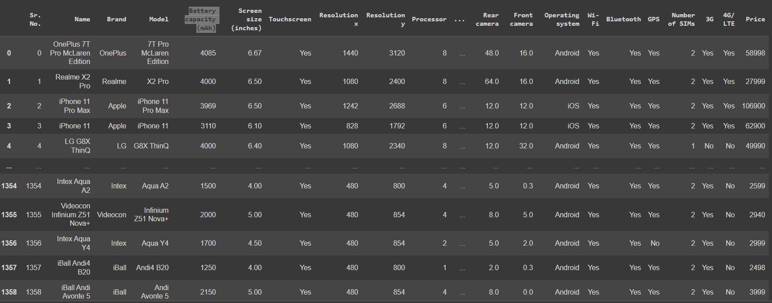
DATA SET

Slide 5

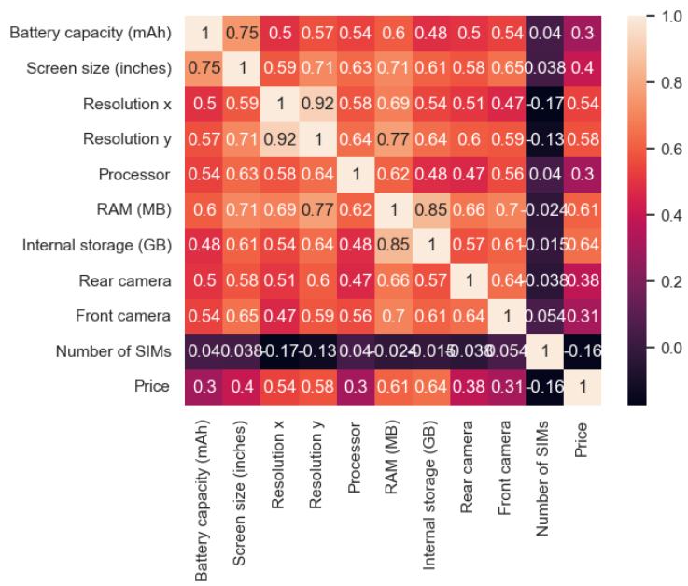
EXPLORATORY DATA ANALYSIS (EDA)
Given is the correlation matrix representing all the columns consisting of data
given in the data set used

Slide 6
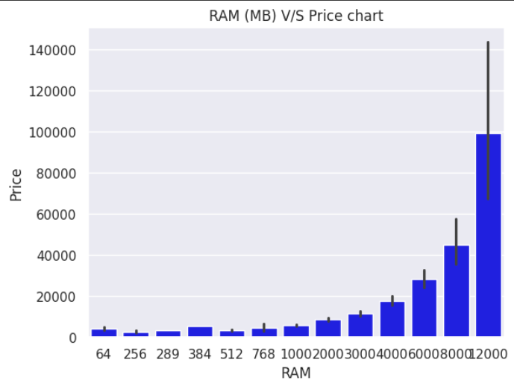
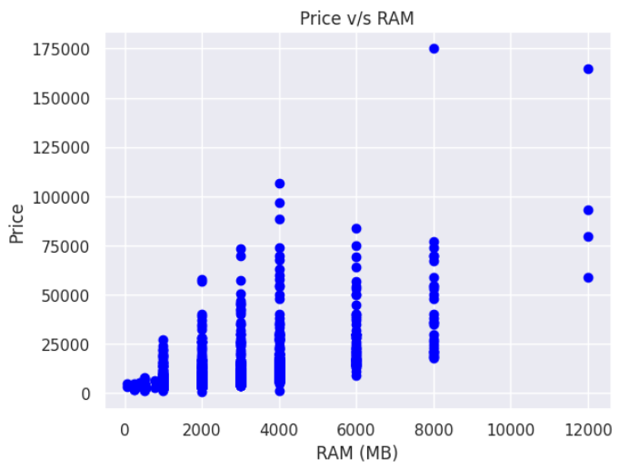
THESE CHARTS CLEARLY SHOW HOW THE PRICE OF MOBILE INCREASE PRICE WITH THE INCREASE IN RAM

Slide 7
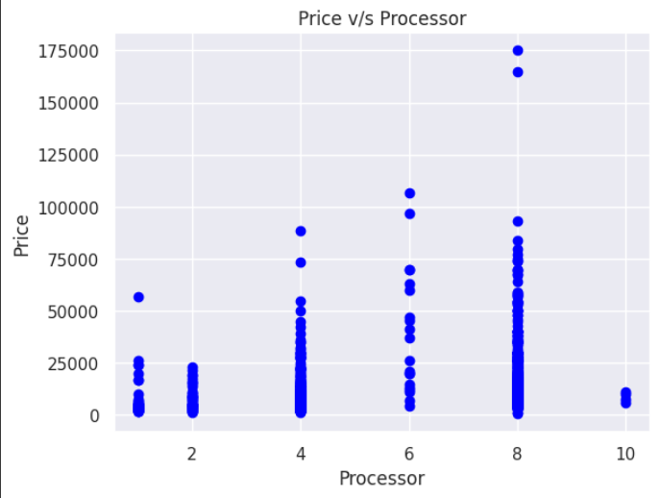
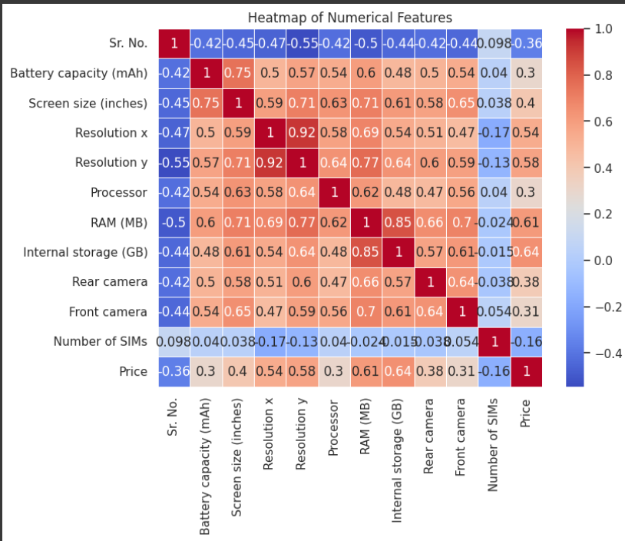
The correlation heatmap represents the relationship between various dataset subparts having integer values
This charts show the price ranges as per the Processor

Slide 8
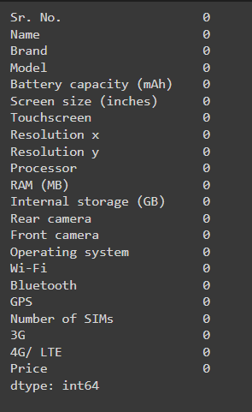

DATA PREPROCESSING
Here we are dealing with the
missing values(None in our case) :-
Number of Duplicate value are also Zero :-

Slide 9
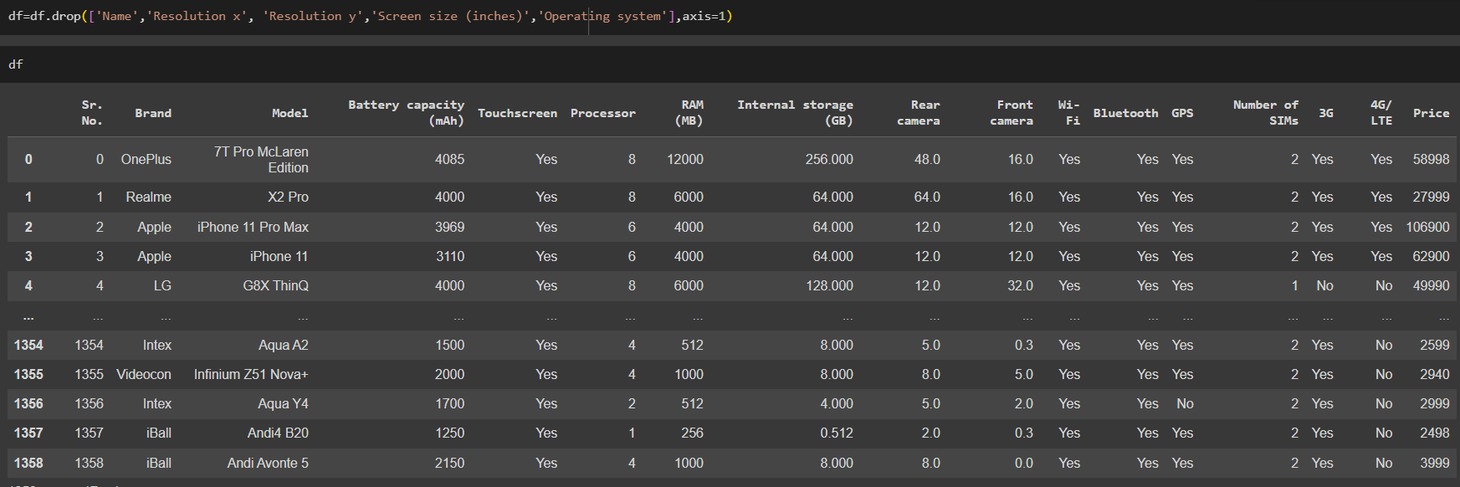
Normalizing - Here we are removing the unnecessary columns

Slide 10
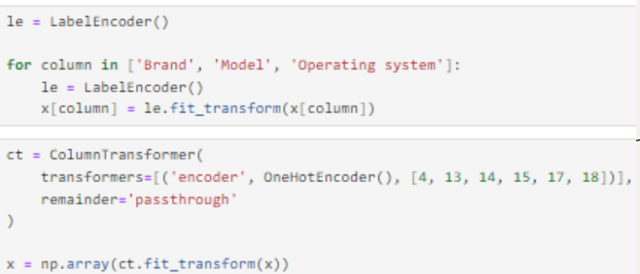
Data Encoding:-

Slide 11
MODELLING
The k-Nearest Neighbor (kNN) algorithm is chosen over linear regression as kNN has several
advantages, including:
Simple :-
kNN is easy to implement and understand, and is often one of the first classifiers that data scientists learn.
Adaptable :-
kNN can adjust its predictions to include new training samples that are added to its dataset.
Interpretable :-
kNN is interpretable and doesn't make assumptions about data distribution.
Effective :-
kNN can be effective at capturing complex interactions among variables without having to
define a separable statistical model.
Useful :-
kNN is most useful when labeled data is too expensive or impossible to obtain, and it can
achieve high accuracy in a wide variety of prediction-type problems.

Slide 12















regression
There are many different metrics that can be used to evaluate the performance of
models. Some of the most common metrics include:
This metric is the square root of the MSE. It is a more interpretable metric than the MSE, as it is
in the same units as the target variable.
Mean absolute error (MAE):
This metric measures the average absolute error between the predicted values and the actual
values. A lower MAE indicates a better fit.
R-squared:
This metric measures the proportion of the variance in the target variable that is explained by the
model. A higher R-squared indicates a better fit.

Slide 13

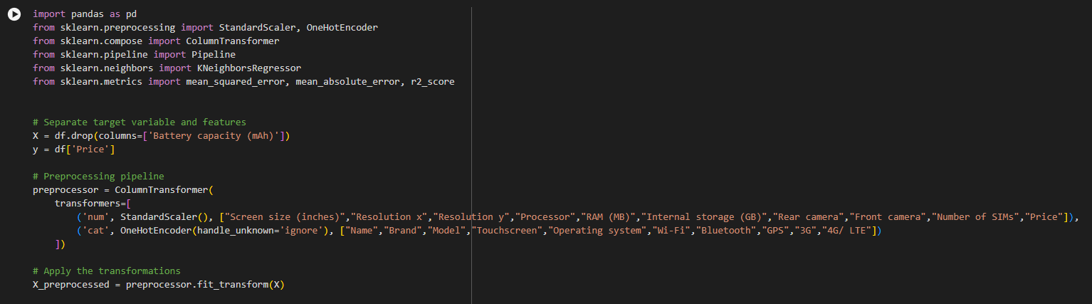
MODEL EVALUATION

Slide 14
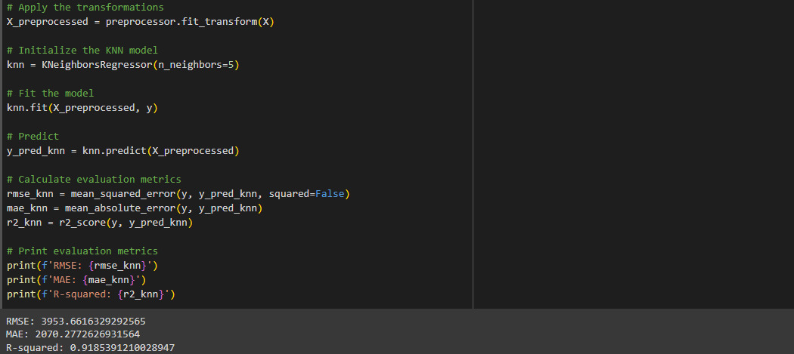

Slide 15
CONCLUSION
The chosen model successfully predicts the Mobile prices using KNN regressor.

Slide 16
FUTURE WORK
For more accurate analysis, we can use more complex algorithms, we can even gather more data.
If the performance is not satisfactory, more complex models can be explored subsequently.

