Slide 1




Introduction to Mobile Price Prediction
Mobile price prediction is crucial in today’s tech-driven market. With numerous brands and models, predicting prices helps consumers and retailers make informed decisions. It utilizes historical data and machine learning techniques to forecast prices accurately.
by anshu Kumari

Slide 2

Data Collection and Preprocessing
1
Data Sources
2
Cleaning Data
3
Normalization
Gather data from various online retailers and tech websites.
Remove inconsistencies and fill in missing values for accuracy.
Standardize features to ensure uniformity across datasets.

Slide 3
Feature Engineering and Selection
Creating Features
Feature Selection
Dimensionality Reduction
Extract relevant attributes like specifications, ratings, and reviews.
Identify the most impactful features using correlation matrices.
Apply techniques like PCA to reduce the feature set.

Slide 4


Model Selection and Training
1
Choosing the Model
Evaluate different algorithms such as linear regression and decision trees.
2
Training the Model
Feed the selected model with training data for learning.
3
Tuning Hyperparameters
Optimize parameters to enhance model performance effectively.

Slide 5

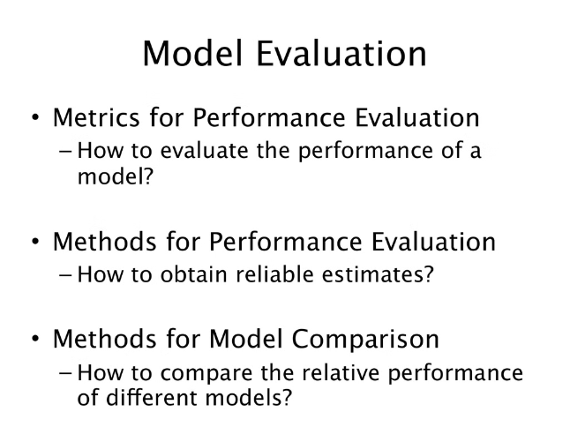
Model Evaluation and Performance Metrics
1
Accuracy Score
2
Mean Absolute Error
Measure the model's correctness in predictions.
Evaluate how far off predictions are from actual prices.
3
Comparison of Models
Assess different models to select the best performer.

Slide 6


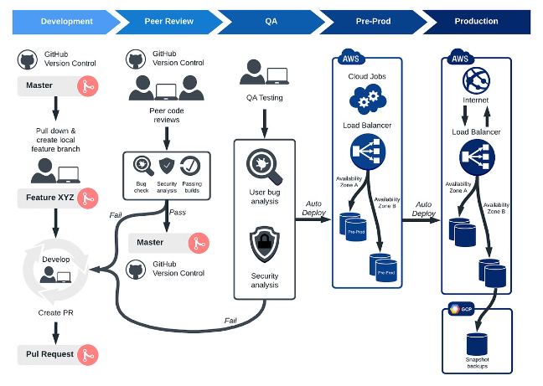


Deployment and Integration
Deployment Planning
Outline a strategy for seamlessly integrating the model.
Real-World Integration
Embed the model into applications for user accessibility.
Continuous Monitoring
Regularly check model performance and update as needed.

Slide 7

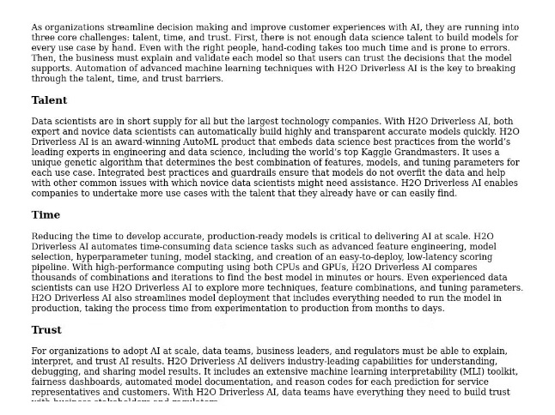
Limitations and Future Improvements
Data Limitations
Model Complexity
Quality and variety of data can affect predictions.
Complex models may require extensive computational resources.
Future Enhancements
Incorporate more features to improve prediction accuracy.

Slide 8


Conclusion and Key Takeaways
1
Importance of Predictions
2
Efficiency Techniques
Utilizing machine learning enhances predictive capabilities.
Accurate price prediction benefits consumers and retailers alike.
3
Ongoing Research
Continual advancements will lead to better models in the future.

