Slide 1



Water Quality Prediction
Anshu
Stu_ID:-STU68146f33c3ede1746169651

Slide 2

Learning Objectives
Understand the impact of water pollutants on human and environmental health
Perform data preprocessing techniques such as handling missing values and scaling
Understand the working of the Random Forest Regressor model
Build and train a machine learning model for water quality prediction
Evaluate model performance using accuracy, RMSE, and R² score
Interpret prediction results for real-world relevance
GOAL
Source :
www.freepik.com/

Slide 3
Tools and Technology used
Pandas, NumPy, Matplotlib — Data manipulation & visualization
Streamlit — Explored as a future option for model deployment and interactive visualization
Scikit-learn — Machine learning model building
Jupyter Notebook — Interactive coding environment
GitHub — Version control and project sharing
Python — Core programming language

Slide 4
Methodology
Step 1: Data Collection
Step 2: Data Preprocessing (handling missing values, encoding)
Step 3: Model Selection (e.g., Random Forest)
Step 4: Training and Testing
Step 5: Model Evaluation (RMSE, R², accuracy)
Step 6: Explored Streamlit for future deployment
Step 7: Deployment and Testing

Slide 5
Problem Statement:
Traditional testing methods are manual, expensive, and time-consuming.
This project proposes a machine learning-based system to predict water pollution
levels automatically using measurable parameters such as dissolved oxygen (O₂), nitrate (NO₃),
nitrite (NO₂), sulfate (SO₄), phosphate (PO₄), chloride (Cl), and others.
Contaminated water poses serious risks to both human health and the environment.
There’s a growing need for an intelligent system that can automatically predict
water quality using known input parameters.

Slide 6
Solution:
Developed a machine learning model using Random Forest Regressor
trained on water quality features such as dissolved oxygen (O₂), nitrate (NO₃),
nitrite (NO₂), sulfate (SO₄), phosphate (PO₄), chloride (Cl), and others.
Built a Streamlit web app to allow users to input pollutant concentrations and receive
real-time predictions.
Offers a fast, low-cost, and scalable alternative to manual chemical testing in labs.
Trained and tested the model to predict pollution levels, achieving strong results using
metrics like R² score, RMSE, and accuracy.

Slide 7
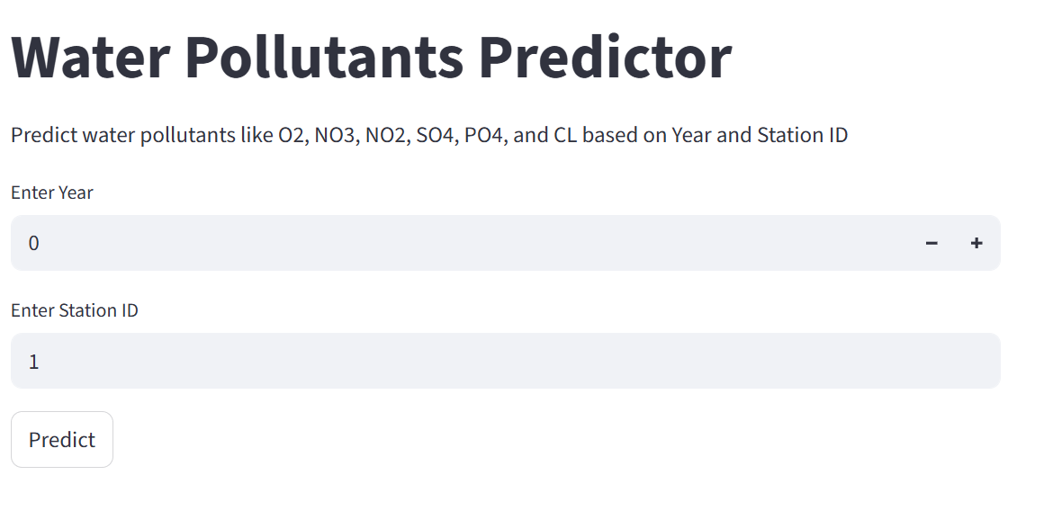
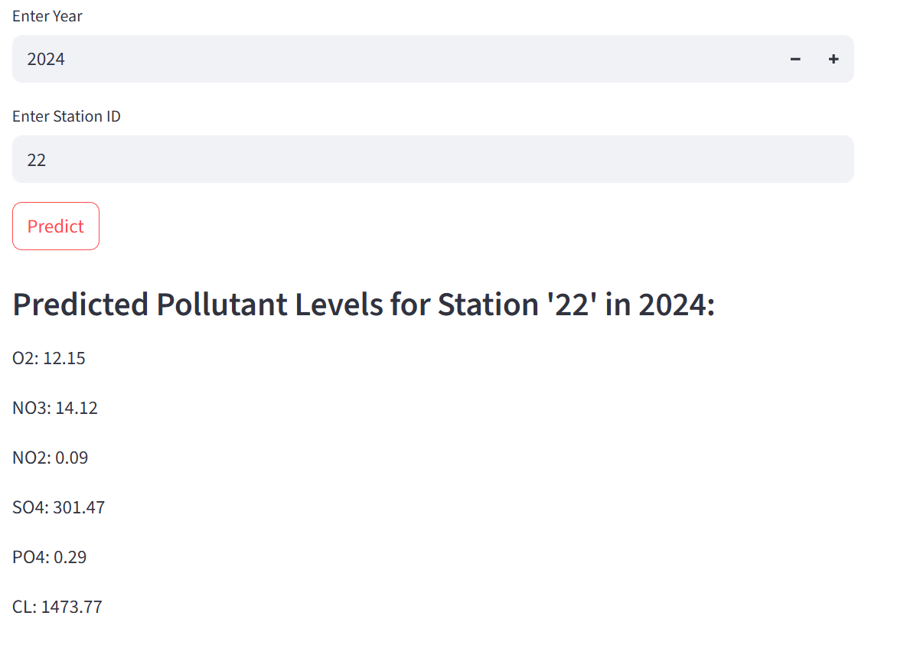
Screenshot of Output:
Prediction generated using Random Forest Regressor trained on historical water quality data.

Slide 8
Conclusion:
Successfully developed a machine learning model to
predict pollutant levels in water based on chemical indicators.
Used Random Forest Regressor to achieve results with strong accuracy and evaluation metrics(RMSE, R² score).
Explored the potential of deploying predictions via a Streamlit web interface
The system provides a cost-effective,fast,and accessible alternative to manual water quality testing.
Future scope includes integrating real-time sensor data,adding more pollutants types, and deploying the model for public use.
🔗 GitHub Link: https://github.com/Anshu-code-202/waterqualityprediction_AICTE

