Slide 1
Boardinfinity presentation on “Company Financial analyzing system”
Session 2021-2022
Submitted by:
Anshu Mishra

Slide 2
Problem
1. Which year has maximum Sales.
2. Which month has maximum number of Sales.
3.Segment wise sale.To predict higest sale sagment
4.Product sales with Discount brand.
5.Segment Sales in year with Profit.

Slide 3
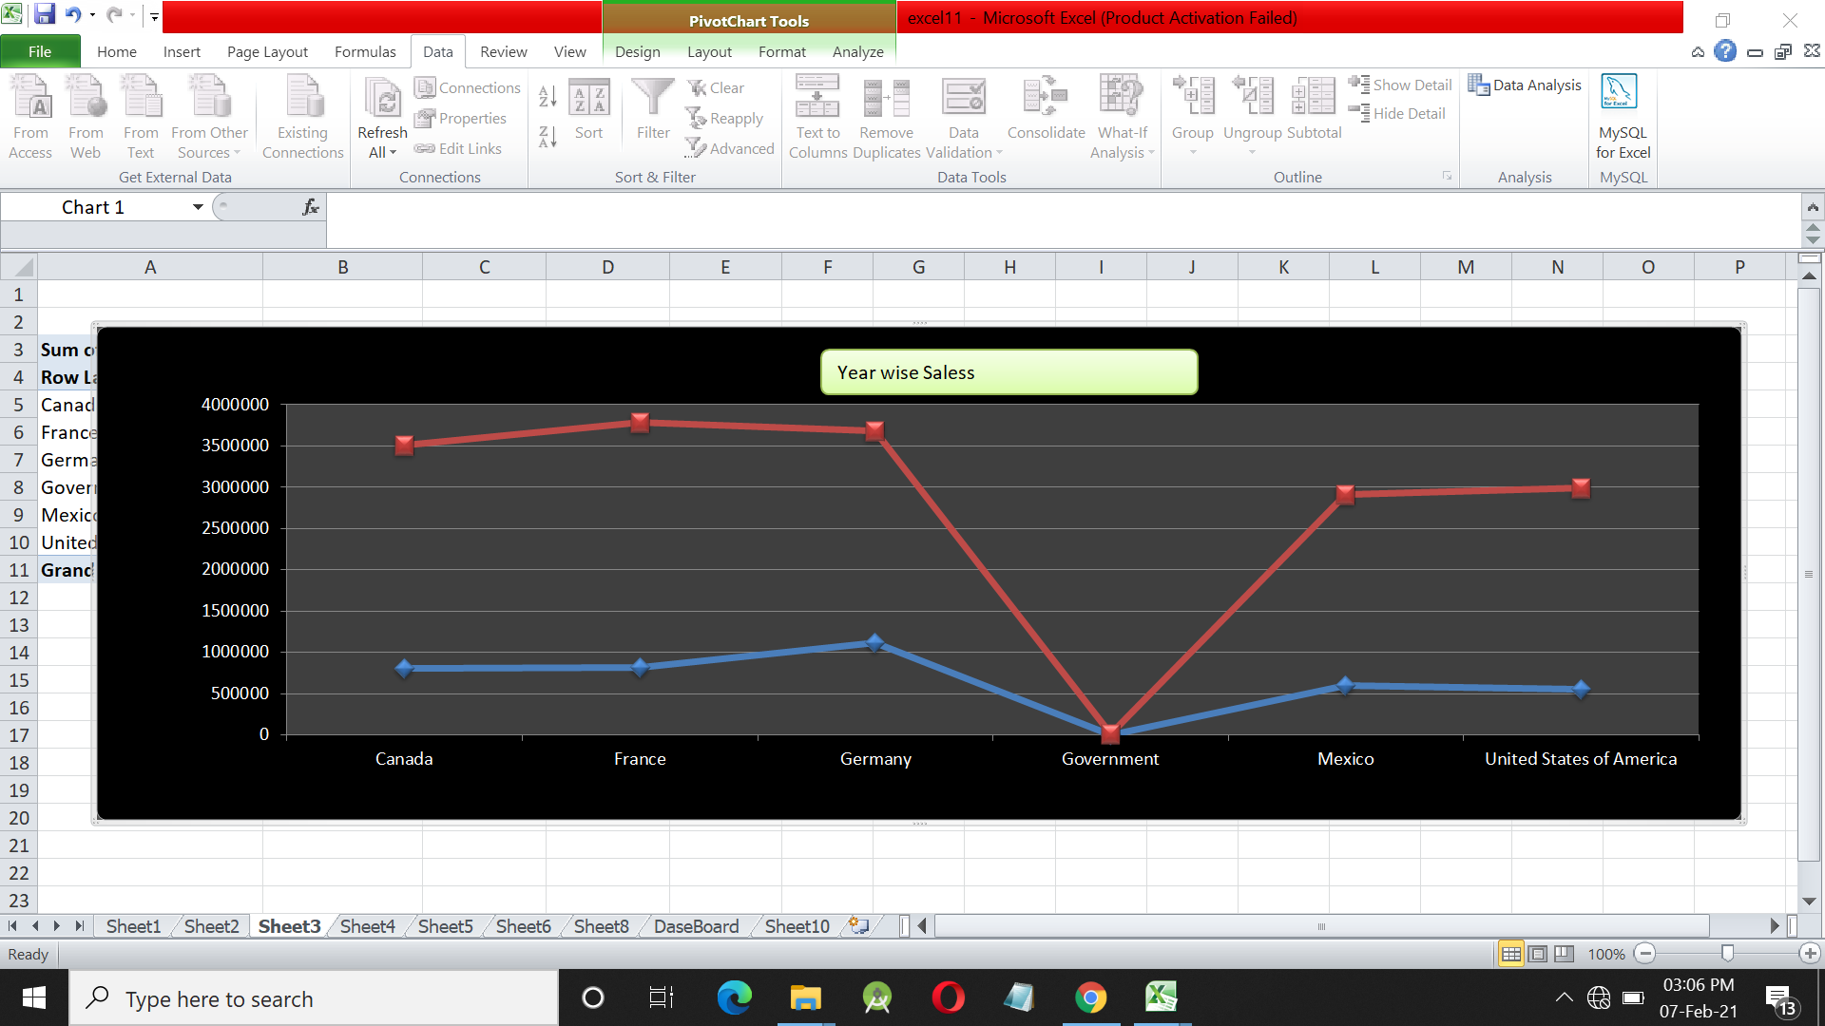
Which year has maximum Sales

Slide 4
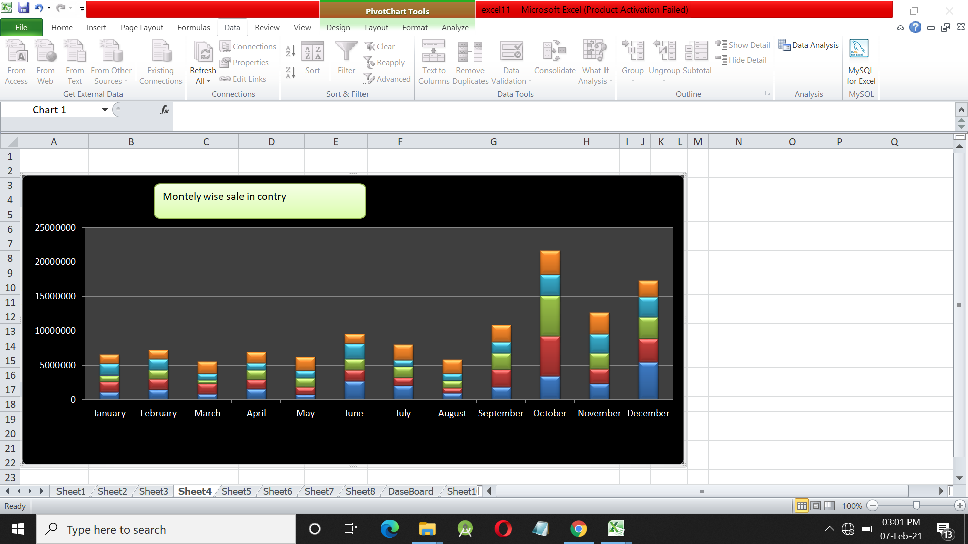
Which month has maximum number of Sales
Best product purchase city in supermarket
Which gender(female & male) purchase more goods
At what time sales rise more.
Which payments opestion is best for customer.

Slide 5
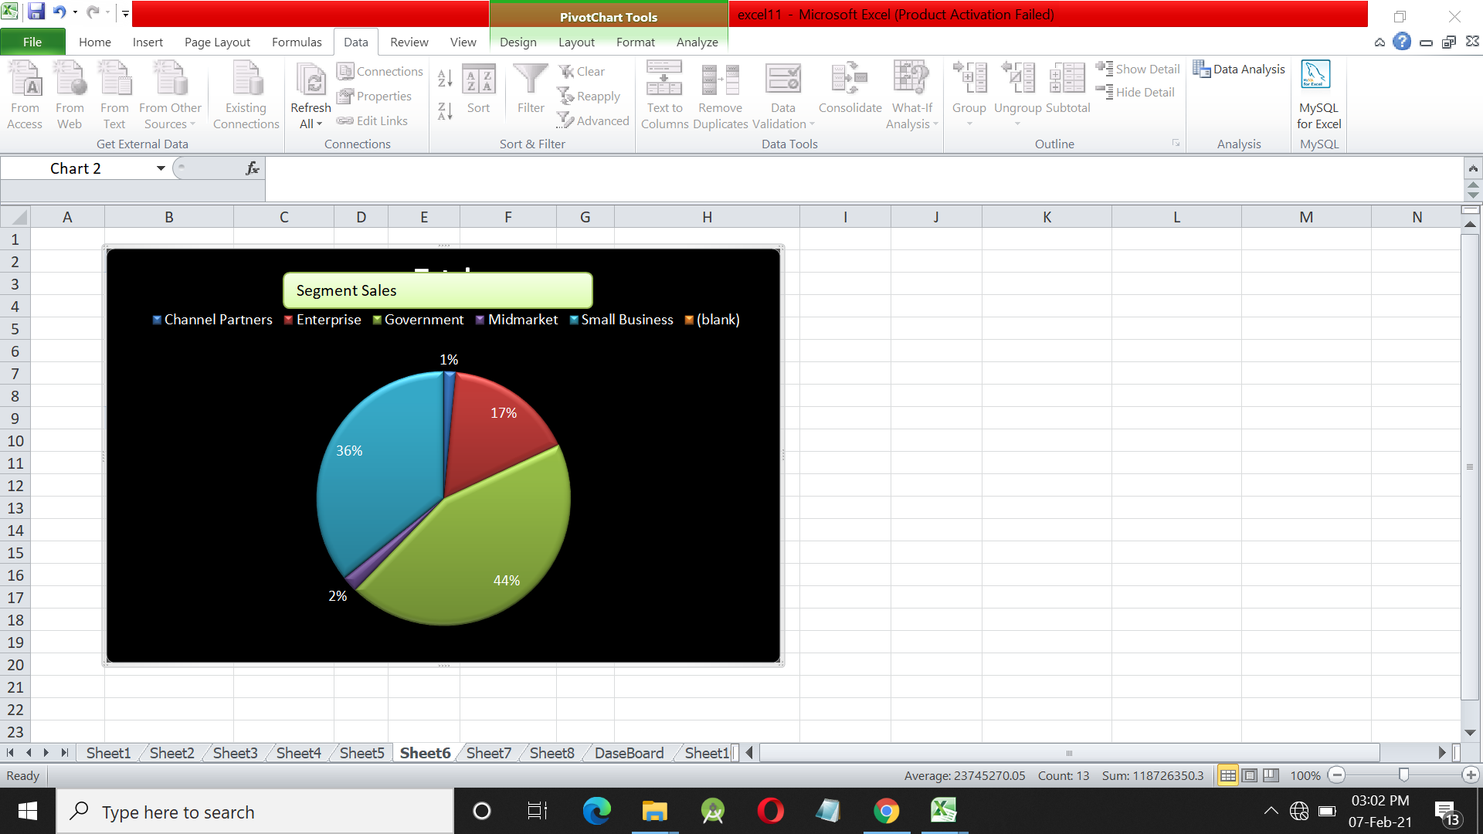
3.Segment wise sale.To predict higest sale sagmen
The supermarkets are generating a lot of data at each day. The data are producing at each day are billing system , gender , date , sale ,
This data are maintain proper in database. They also generate records.
Throw the Record-Analyze the people can know what are the condition
Of business and can know the overall profit or lose.

Slide 6
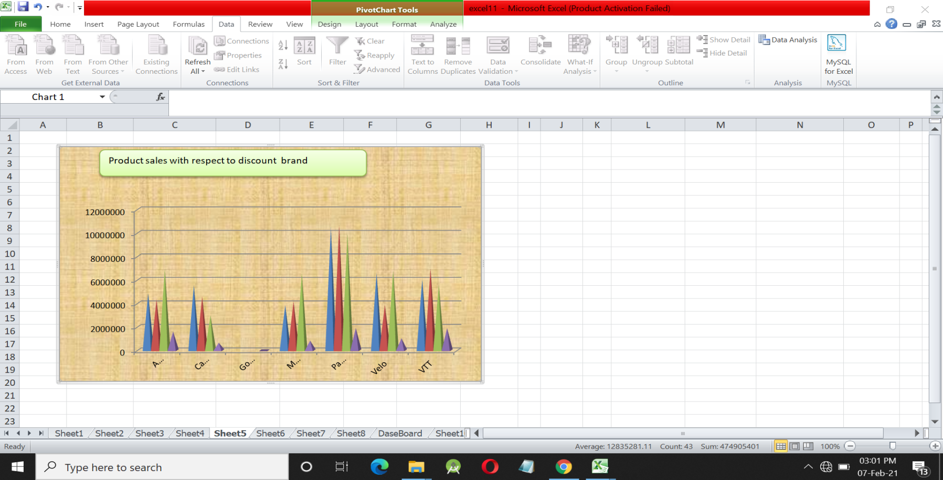
4.Product sales with Discount brand

Slide 7
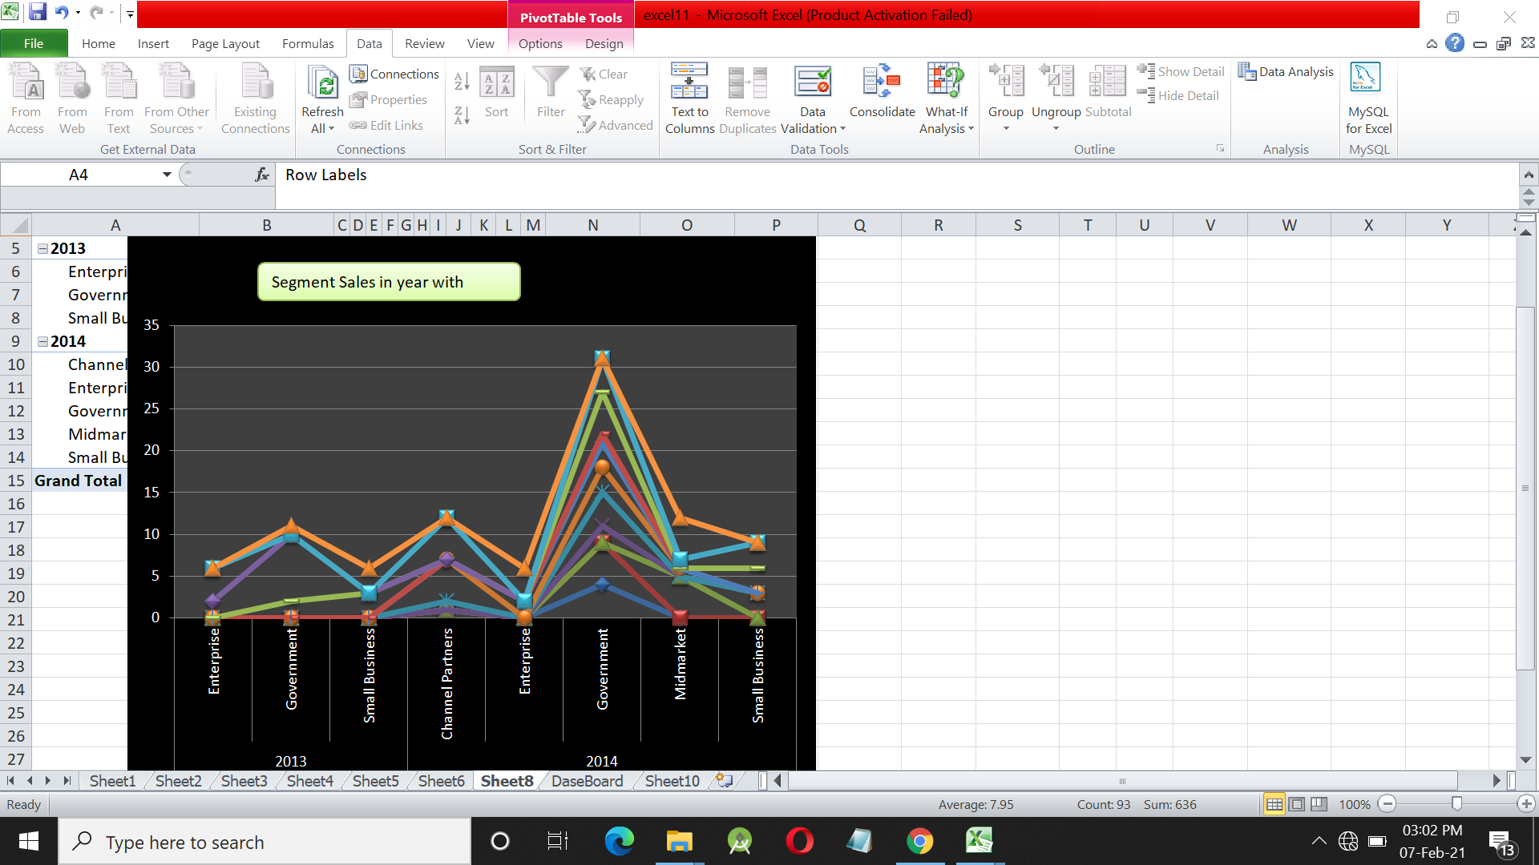
5.Segment Sales in year with Profit

Slide 8
Technology&tools
Excel
Windows 10

Slide 9
Modules:
Administration
Data scienceties
Row Data
Usefull Data

