Slide 1
Boardinfinity presentation on “Vehicles sales”
Session 2020-2021
Submitted by:
Anshu Mishra

Slide 2
content:
Introduction.
Description of project.
Technology & tools used.
Modules.
Benefit.
Conclusion of Project.

Slide 3
Introduction:
Vehicle store and sales management system manages a vehicle company that provide vehicle specification ,
Customer interaction and service.
Project scope is about to provide knowledge about company database ,increase sales.

Slide 4
View city-wise sales. Best performing city.
Weekly Information.
Country Information.
Production Information.

Slide 5
Description :
The main idea behind the project contain all information of vehicle sale information such as:-
Weekly sales
In this Owner can get all the information of week.

Slide 6
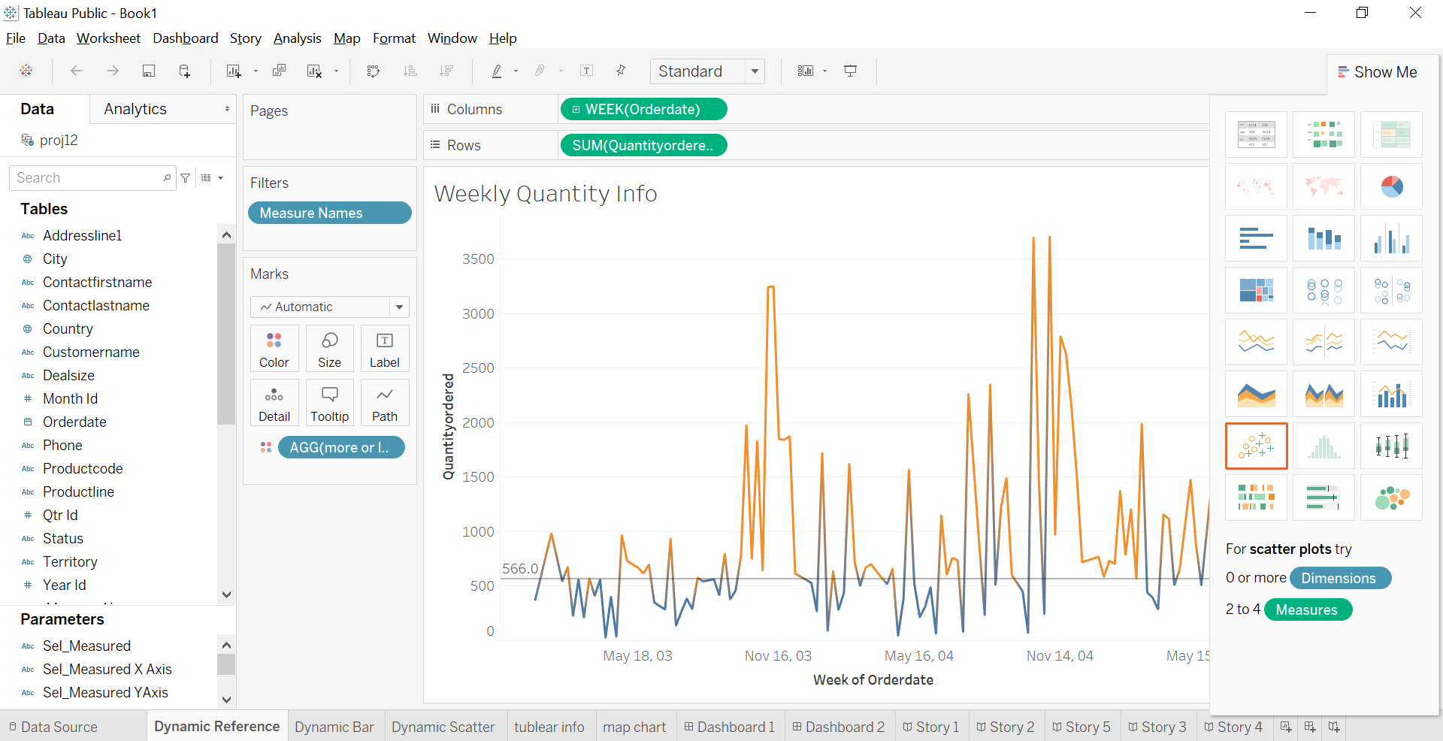

Slide 7
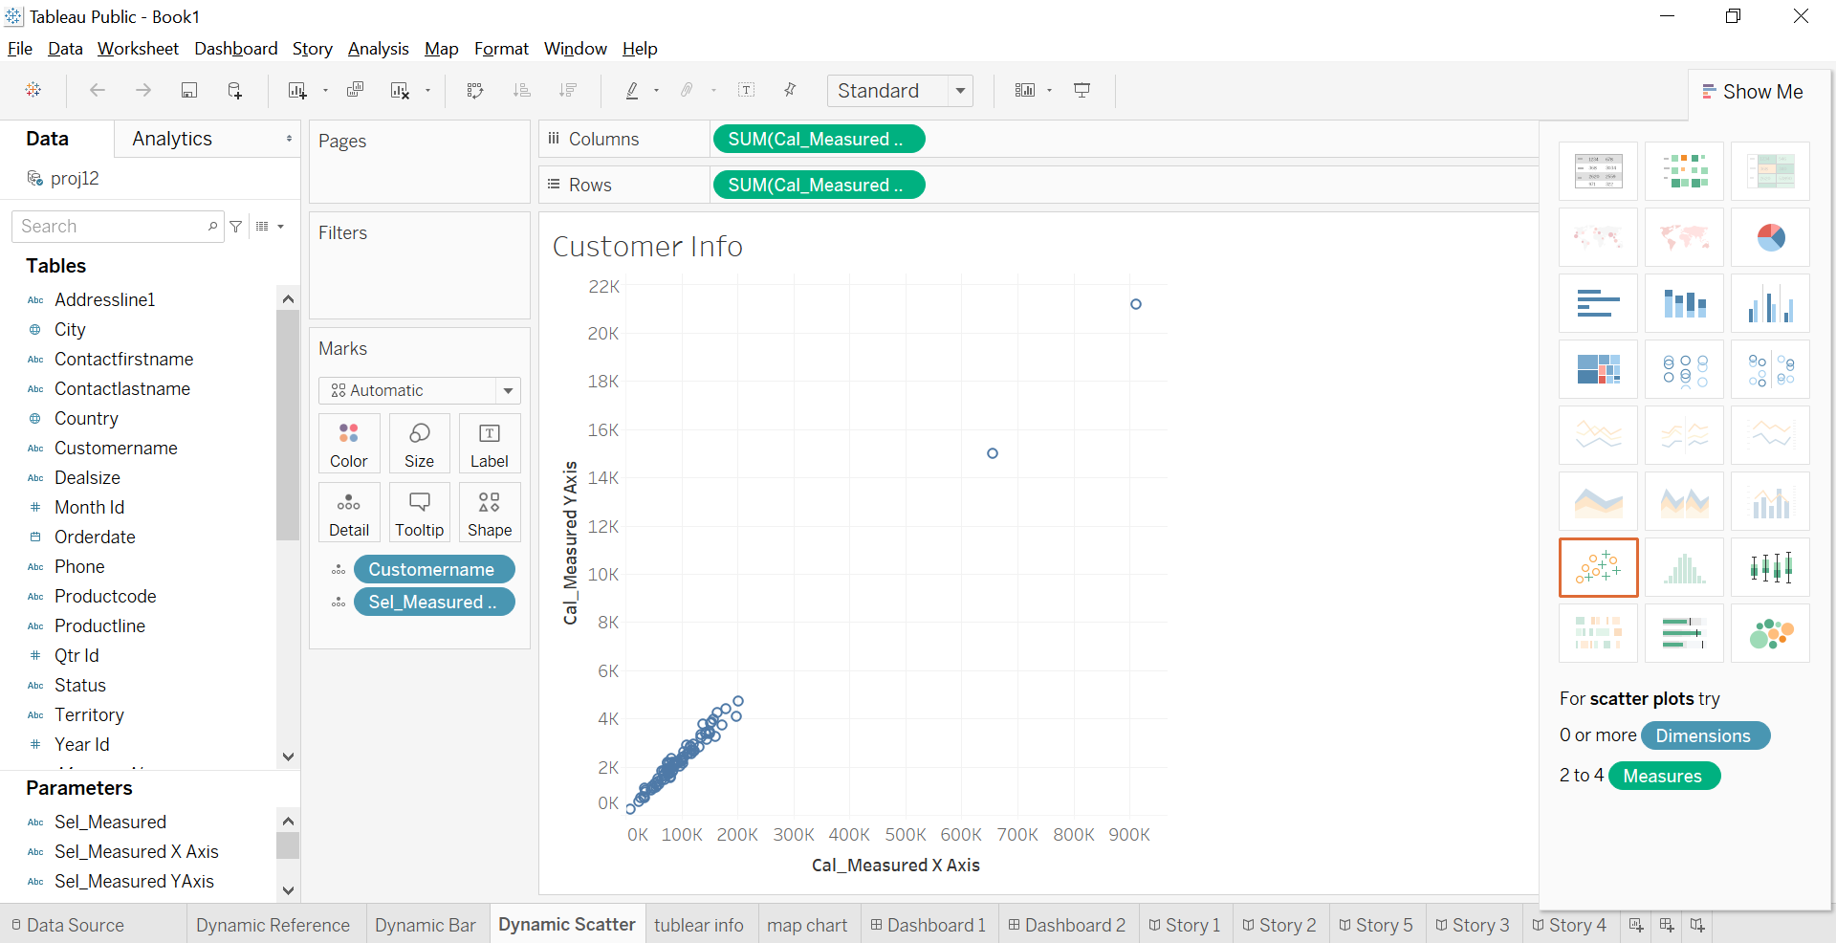
Customer information

Slide 8
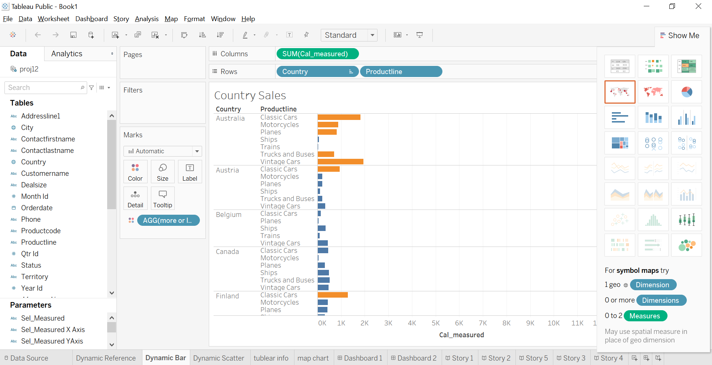
Country sales

Slide 9
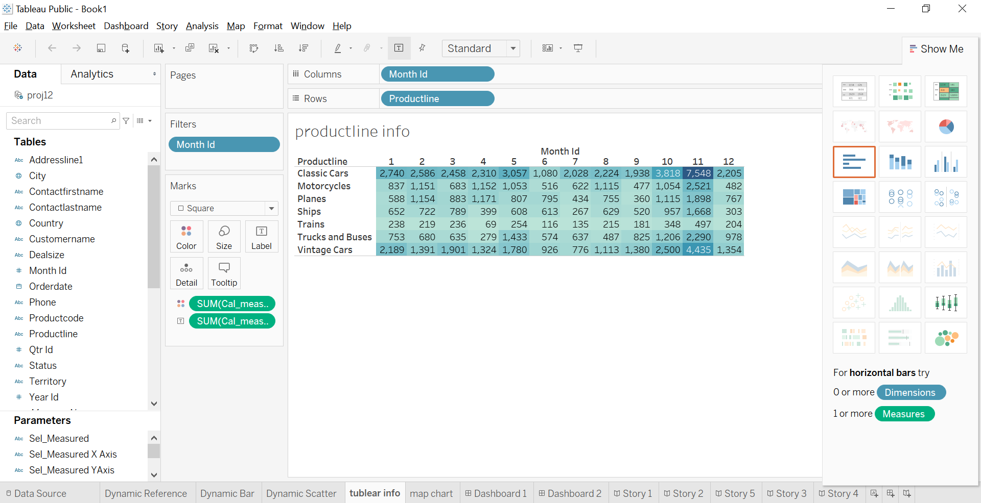
Top-n sales

Slide 10
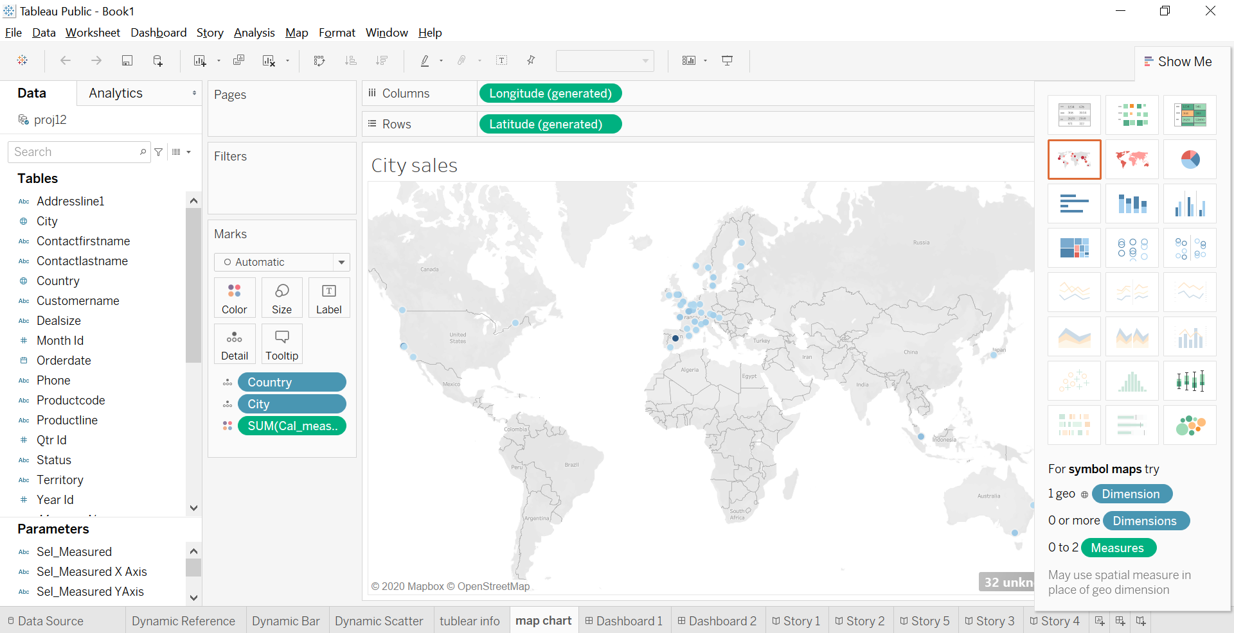
Map sale

Slide 11
Technology &tools
Tableau
Windows 10

Slide 12
Modules:
Administration
Data scienceties
Row Data
Usefull Data

Slide 13
benefits
Vehicles sales information.
Weekly sales information
Country wise sales
Know city wise sales.

Slide 14
Conclusion:
Our project is on vehicles sales system. I Successfully completed it.
We take this opportunity to express our sense and gratitude to all those people who helped us in completing this project.
This project and implementation has contributed a lot to our
Knowledge that has proved to be a value addition for us

