Slide 1
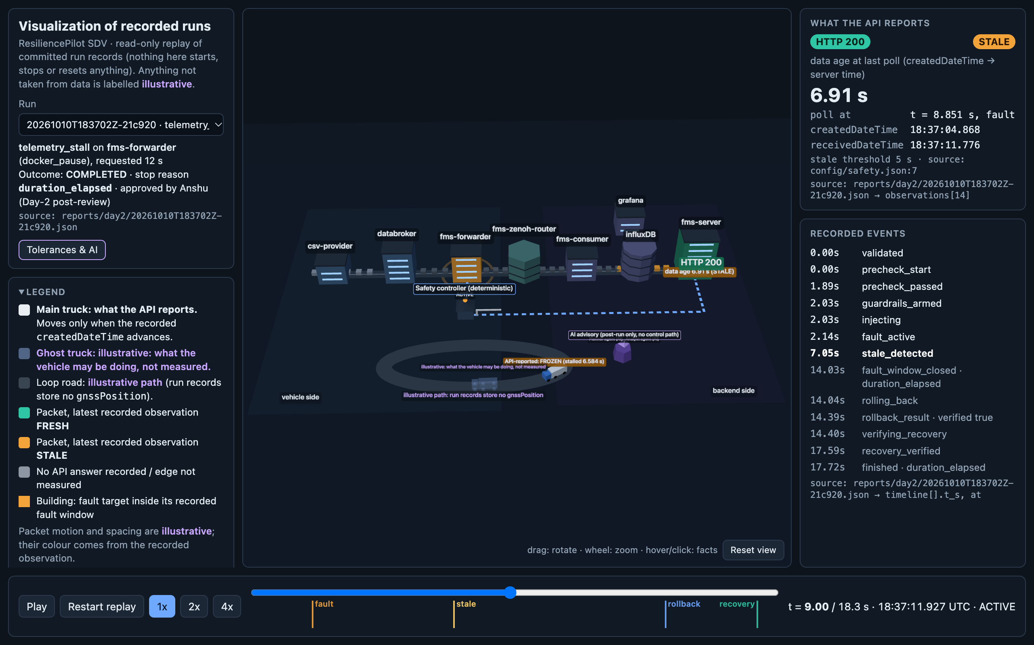
SECTION 1 · TEAM DETAILS
ResiliencePilot SDV
AI-Driven Chaos Engineering for Cloud-Native Fleet Resilience
HTTP 200 is not recovery. Fresh data is.
TEAM
Team ResiliencePilot - Team No: 26
Offline 3D digital twin of the blueprint, replaying a recorded run
VR
AR
NT
J
S
Vaibhav Raghav
Anshu Raj
Nishant Tripathi
Jahnavi
Samhithaa
Lead Architect & Safety Controller
Full-Stack Observability & 3D Twin
Chaos Engineering & Systems
Data Quality & AI Safety
Validation & Test Automation
INSTITUTE & BATCH Manipal Institute Of Technology, Bengaluru, Karnataka — Batch of 2027
ResiliencePilot SDV · AI-Driven Chaos Engineering for Cloud-Native Resilience
1 / 8
Notes:
Section 1 - Team details. Fill in the bracketed roll numbers and institute before submitting. Screenshot: the offline 3D digital twin (docs/scene/index.html).

Slide 2
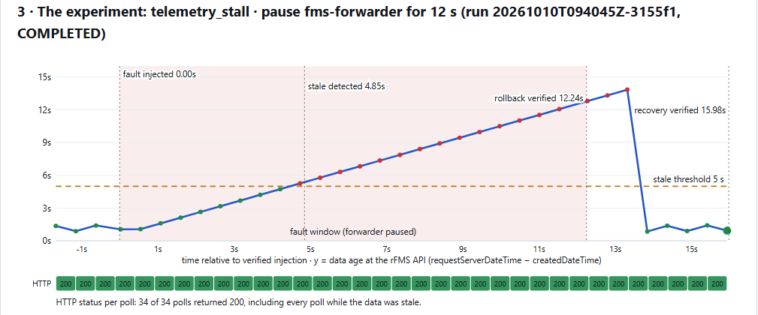
SECTION 2 · PROBLEM UNDERSTANDING & APPROACH
Problem Understanding & AI-Driven Approach
!
The problem
Fleet monitoring usually trusts container health and HTTP status codes.
The Eclipse SDV rFMS API keeps returning HTTP 200 while the vehicle's createdDateTime is frozen.
receivedDateTime (server clock) keeps ticking and masks the silent failure of createdDateTime (vehicle clock).
telemetry_stall run 3155f1: data age climbs past the 5 s threshold, every HTTP chip stays green
AI
The approach
34 / 34
4.85 s
A black-box observer polls the rFMS API and tests data freshness, not just status codes.
Three tiers: advisory AI (planner + analyst) → human approver → deterministic safety controller.
The AI reorders allowlisted experiments and proposes verify / mitigate / fix playbooks; a deterministic grounding check audits every claim.
polls returned HTTP 200, including every poll while the data was stale
until the observer flagged stale data; a status check never would
ResiliencePilot SDV · AI-Driven Chaos Engineering for Cloud-Native Resilience
2 / 8
Notes:
Sources: docs/PROJECT_A_TO_Z.md (two timestamps), docs/AI_LAYER.md (planner/analyst/grounding), reports/day1/explainer.html run 20261010T094045Z-3155f1 (34/34 polls HTTP 200, stale detected at 4.85 s).

Slide 3
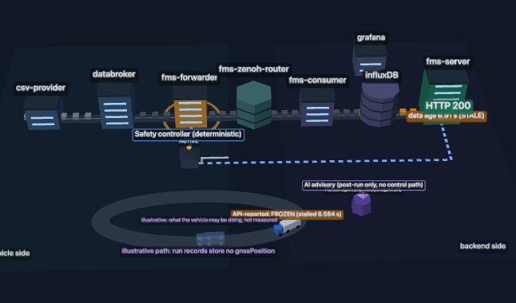
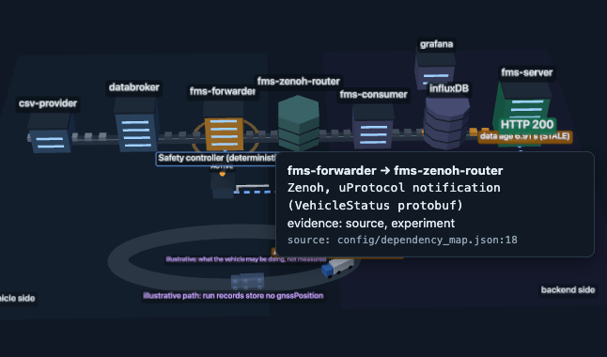
SECTION 3 · SAMPLE APPLICATION
Target Application — Eclipse SDV Fleet Management Blueprint
WHAT IT IS
REPO & LICENSE
DEPLOYMENT
Open-source reference blueprint by the Eclipse Software Defined Vehicle (SDV) working group.
github.com/eclipse-sdv-blueprints/fleet-management
Pinned at 3d514ac72a · Apache-2.0
8 containers in an isolated local Docker Compose sandbox. Reproducible, zero cloud cost.
KEY SERVICES & DATA FLOW
csv-provider
replays vehicle data
KUKSA.val databroker
VSS signals
fms-forwarder
stamps createdDateTime
fms-zenoh-router
Eclipse Zenoh / uProtocol
fms-consumer
writes telemetry
InfluxDB
time-series store
fms-server
rFMS REST API
STEPS TO RUN
git submodule update --init
./scripts/stack-up.sh
Then scripts/stack-status.sh to confirm all 8 containers are up.
3D twin: the fms-forwarder building
Data road: forwarder → Zenoh router
ResiliencePilot SDV · AI-Driven Chaos Engineering for Cloud-Native Resilience
3 / 8
Notes:
Sources: docs/DECISIONS.md D-001 (pinned 3d514ac72a, Zenoh transport), docs/PROJECT_A_TO_Z.md service table. The forwarder and InfluxDB are outlined in red: they are the fault targets.

Slide 4
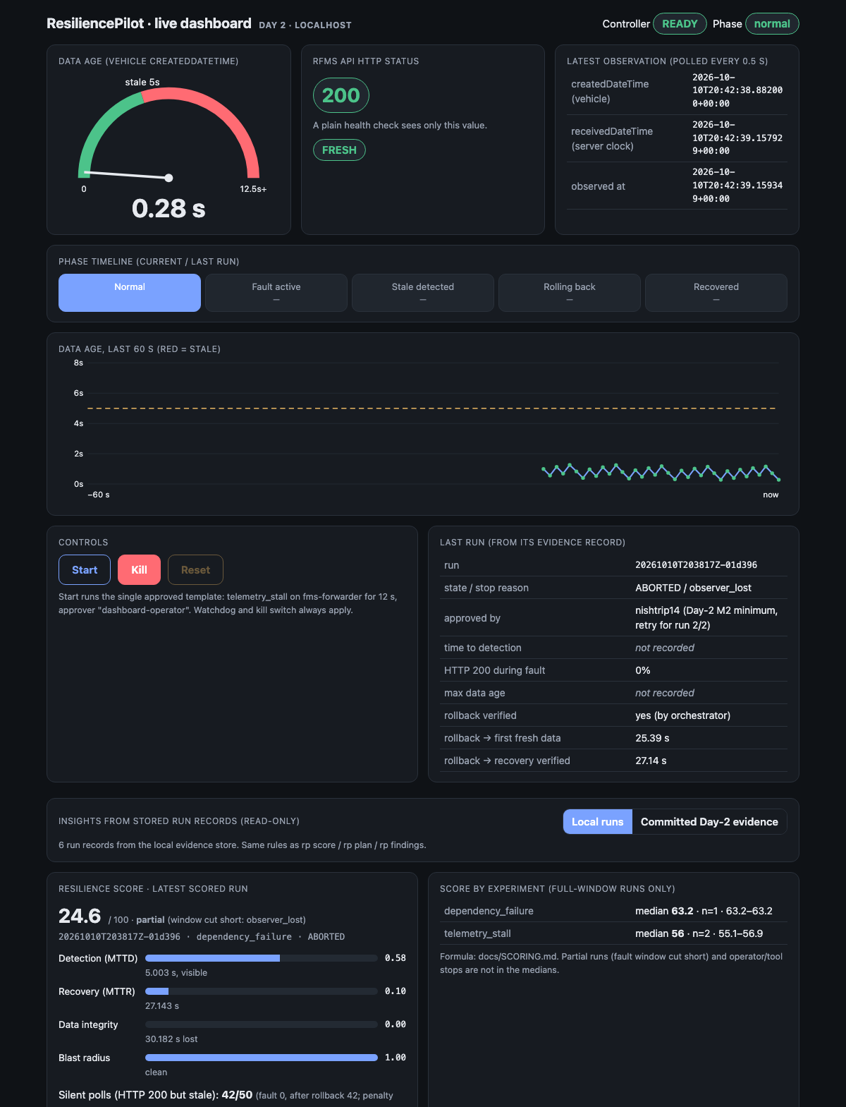
SECTION 4 · SOLUTION ARCHITECTURE
Solution Architecture & Safety Framework
Advisory AI
Human approver
Safety controller
Fault adapter
Recovery verifier
1
Observer
2
Automatic guardrails
Polls the rFMS API and computes true data age: server time − createdDateTime. Older than 5 s = stale.
Roll back on the first non-200, latency p95 above max(5× baseline p95, 250 ms), or any change outside the blast radius.
3
Deterministic safety controller
4
Verified recovery gate
Exact-name allowlist + Compose-project label, one run at a time (run.lock), watchdog thread with a 30 s cap.
Rollback checked by docker inspect, then 3 successive fresh (≤ 5 s) advances. HTTP 200 alone never counts.
5
LATCHED_UNSAFE
6
Independent kill switch
Unverified rollback or recovery blocks new runs until a logged human reset on fresh telemetry.
kill-switch.sh works even if the backend has crashed: unpauses or starts the allowlisted targets.
Local dashboard: data age, HTTP status, phases, score
ResiliencePilot SDV · AI-Driven Chaos Engineering for Cloud-Native Resilience
4 / 8
Notes:
Sources: CLAUDE.md safety rules 1-7, config/safety.json, backend/resiliencepilot/guardrails.py, scripts/kill-switch.sh. Watchdog is a thread in the backend with a 30 s total cap including grace; config may only lower it.

Slide 5
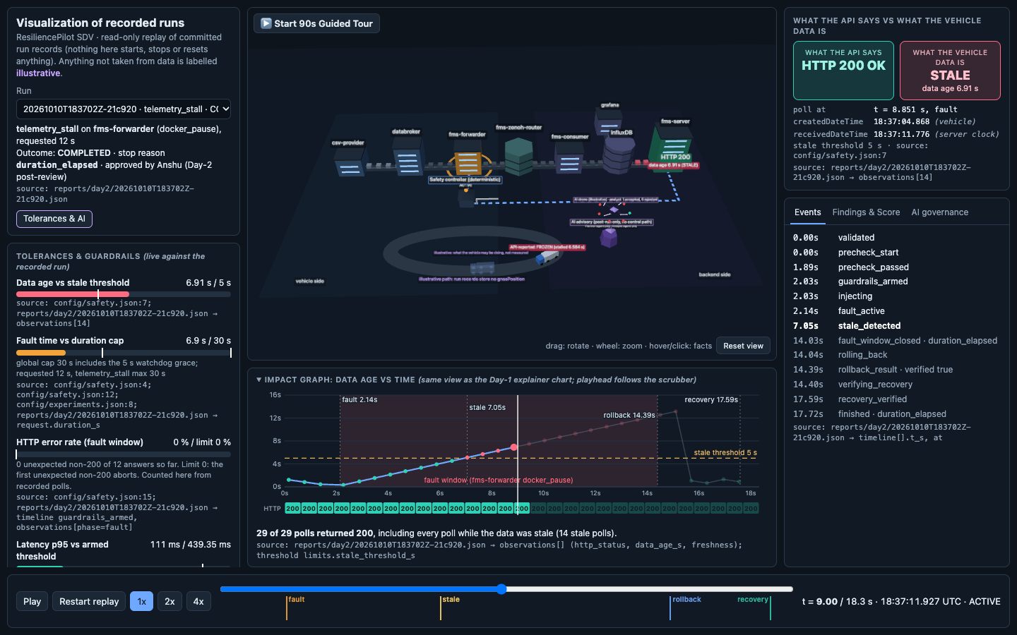
SECTION 5 · TOOLS & TECHNOLOGIES
Tools, Technologies & Platform Capabilities
</>
V
DB
AI
Languages & Backend
Automotive & Transport
Cloud & Storage
AI & Visualization
Python 3.13
FastAPI + Uvicorn
httpx · Pydantic
pytest (317 tests)
Eclipse KUKSA.val
COVESA VSS
Eclipse Zenoh
uProtocol
Docker + Docker Compose
InfluxDB (time series)
JSON run records (evidence store)
Ollama + qwen2.5:7b (local, advisory only)
Three.js r160 (offline 3D twin)
PLATFORM CAPABILITIES · CLI: RP <COMMAND>
One CLI and one local API share the same safety path. Runs offline on a laptop: no cloud account, no API keys.
observe
baseline
run
stop
reset
plan
advise
score
findings
discover
report
serve
3D twin HUD: impact graph and gauges
ResiliencePilot SDV · AI-Driven Chaos Engineering for Cloud-Native Resilience
5 / 8
Notes:
Sources: backend/pyproject.toml, docs/PROJECT_A_TO_Z.md tool table, config/ai.json (qwen2.5:7b via local Ollama), docs/scene/index.html (three.r160.min.js bundled, no network). Run records are JSON files committed under reports/.

Slide 6
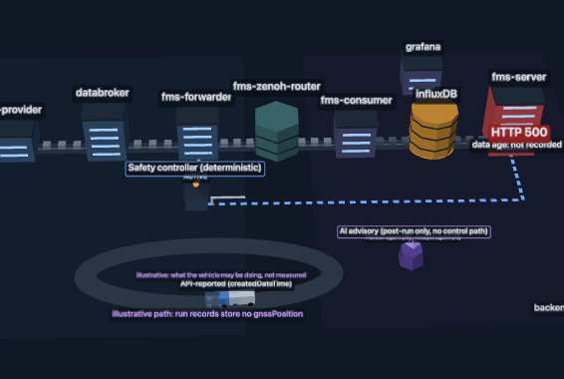
SECTION 6 · FAILURE SCENARIOS SELECTED
Selected Chaos Experiments & AI Ordering
1
telemetry_stall
2
service_crash
3
dependency_failure
docker pause fms-forwarder
docker stop fms-forwarder
docker stop influxDB
SIMULATES
SIMULATES
SIMULATES
Vehicle-edge publisher freeze, e.g. a cellular stall.
Publisher crash or unhandled exception.
Cloud database outage.
OBSERVED
OBSERVED
OBSERVED
HTTP 200 on 100 % of fault polls while data froze: the HTTP 200 illusion of health.
Same silent HTTP 200 failure; verified recovery in 2.5–3.7 s after restart.
Visible HTTP 500s. After the DB returned, name lookups kept failing for ~21–24 s and stale data came back as HTTP 200.
WHY THESE THREE
ORDERING LOGIC
Reversible, no host contamination, and they hit real failure modes on the verified data path instead of artificial CPU burn.
Rule-based priority = 0.6 × information + 0.4 × risk (untested hypotheses, dependents in the dependency map, latch rate). The AI may only reorder it; a human approves each run.
ResiliencePilot SDV · AI-Driven Chaos Engineering for Cloud-Native Resilience
6 / 8
Notes:
Sources: docs/PROJECT_A_TO_Z.md results table and top findings; backend/resiliencepilot/planner.py docstring. The name-lookup failures after the database returned are observed; DNS caching as the cause is a hypothesis, not verified.

Slide 7
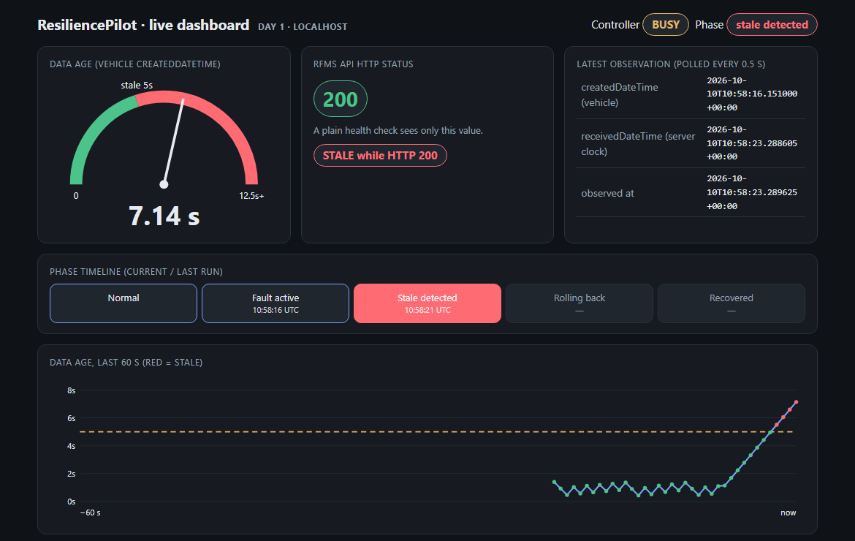
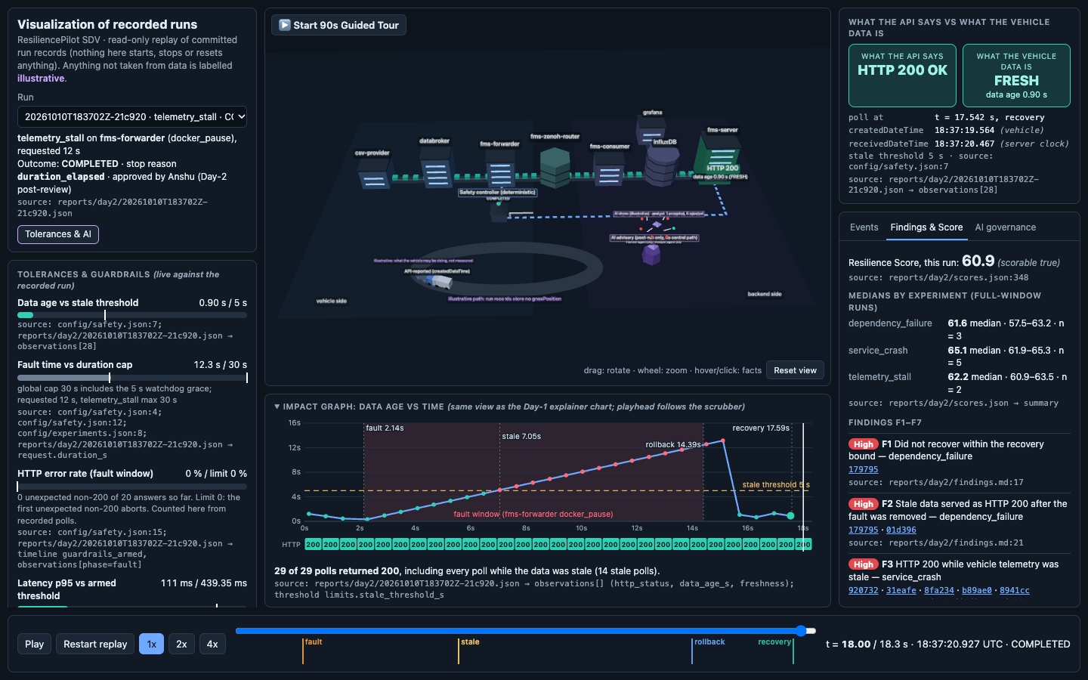
SECTION 7 · IMPLEMENTATION & DEMONSTRATION
Live Demonstration, Results & Resilience Score
37
MEDIAN RESILIENCE SCORE (0–100)
recorded runs, each kept as a JSON evidence record
317
automated tests passed (11 skipped; 320 with live tests)
3 / 3
RESILIENCE SCORE
Score = 100 × M × (1 − 0.5 × Psilent)
M = weighted mean of
0.25 D · 0.30 R · 0.20 G · 0.25 B
guardrails tripped live: error rate, latency, blast radius
1.88 s
D detection · R recovery · G data integrity · B blast radius. Psilent = share of polls that were HTTP 200 but stale. Unmeasured parts drop out; nothing is imputed.
into the fault, the latency guard tripped and rolled back
ResiliencePilot SDV · AI-Driven Chaos Engineering for Cloud-Native Resilience
7 / 8
Notes:
Sources: docs/coordination/CURRENT_STATUS.md (317 passed, 11 skipped; 320 with RP_LIVE=1), HANDOFF.md (37 runs), docs/REQUIREMENTS_TRACE.md and reports/guardrail-demo (guardrails tripped live with deliberately tight demo profiles; latency guard: 30 ms cap, tripped 1.88 s into the fault), docs/SCORING.md (formula), docs/PROJECT_A_TO_Z.md (medians: telemetry_stall 62.2 (60.9-63.5, Day 2), service_crash 65.1 (61.9-65.3), dependency_failure 61.6 (57.5-63.2)).

Slide 8
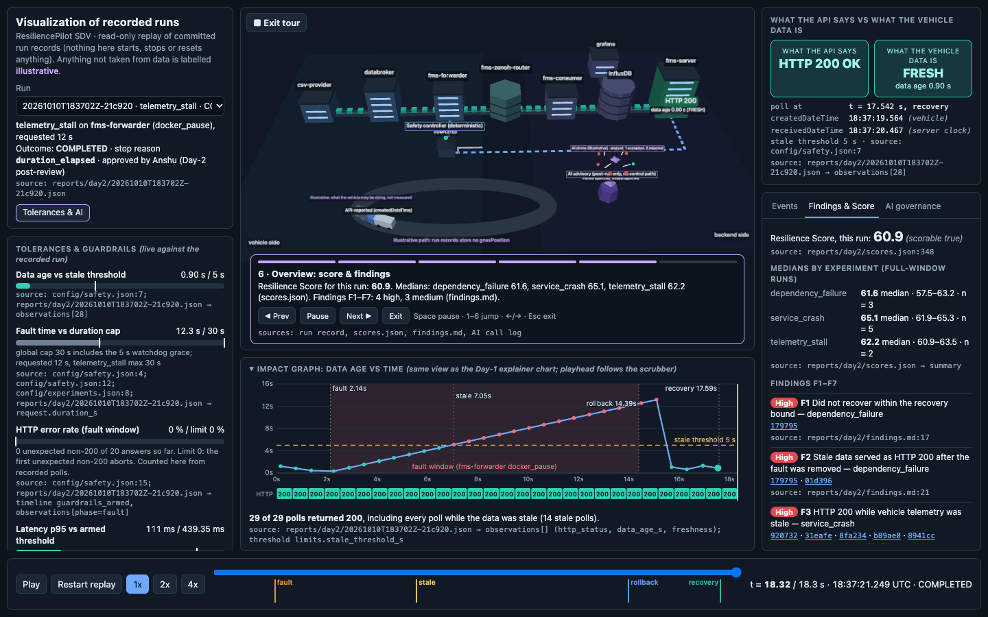
SECTION 8 · KEY LEARNINGS & FUTURE ENHANCEMENTS
Key Learnings, Limitations & Future Roadmap
CHALLENGES → SOLUTIONS
LIMITATIONS
FUTURE ENHANCEMENTS
1
HTTP 200 masked a frozen vehicle feed
→ Track both timestamps; judge freshness from the age of createdDateTime.
Single simulated vehicle in the current catalogue.
Container-level faults only (pause / stop); no packet-level proxy in the data path.
Multi-vehicle fleets across distributed edge nodes.
Network chaos (packet loss, corruption, jitter) via Toxiproxy.
2
AI root causes contradicted the evidence
→ Deterministic grounding check against the recorded run facts: 1 of 7 accepted, 6 rejected and replaced by the rules.
3
Windows CRLF line endings broke InfluxDB init
→ stack-up.sh normalizes the mounted blueprint files to LF before starting.
DEMO VIDEO
< 3 min
[VIDEO_LINK]
▶ 90 s guided tour
▶ Demo script
Key learning: verify recovery from the data, never from the status code.
Guided tour, step 6 (docs/scene/index.html)
ResiliencePilot SDV · AI-Driven Chaos Engineering for Cloud-Native Resilience
8 / 8
Notes:
Sources: docs/AI_LAYER.md (analyst 1/7 accepted, 6/7 rejected by the grounding check against recorded run facts), docs/DECISIONS.md D-005 (CRLF to LF in stack-up.sh). Replace [VIDEO_LINK] with the uploaded demo video URL.

