Slide 1
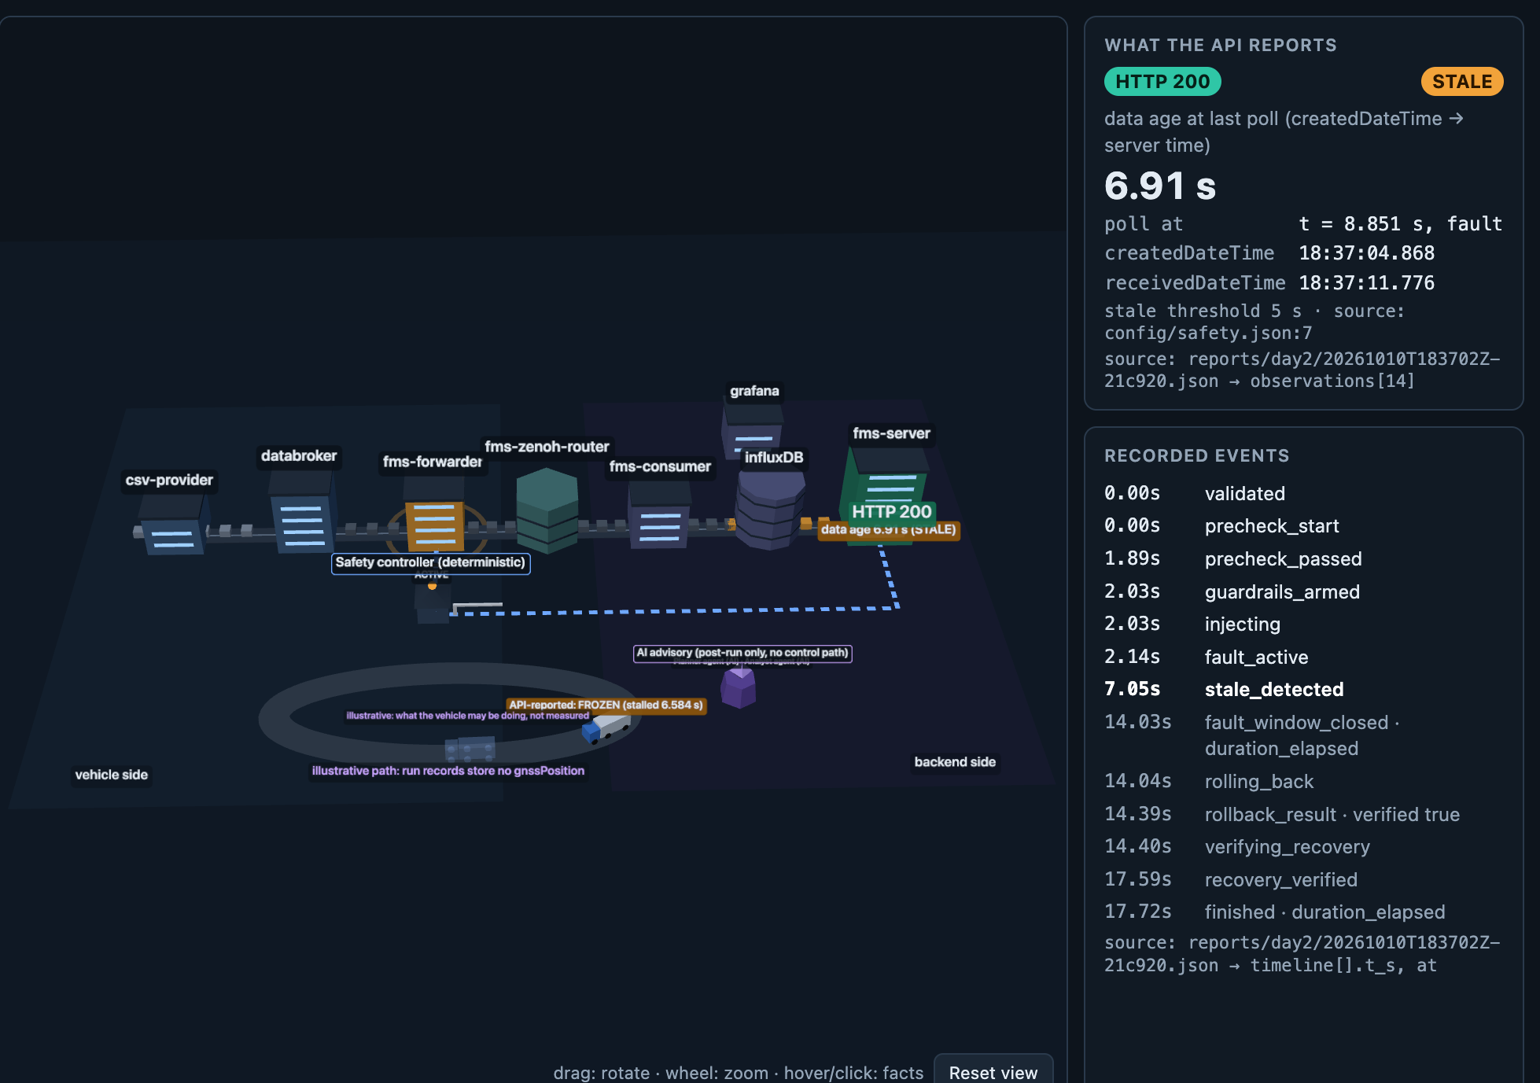
BOSCH HACKATHON 2026 · TEAM 26
ResiliencePilot SDV
AI-Driven Chaos Engineering for Cloud-Native Fleet Resilience
“HTTP 200 is not recovery. Fresh data is.”
A local resilience workbench and deterministic safety controller for the Eclipse SDV Fleet Management Blueprint: it injects bounded, reversible faults and proves recovery from advancing vehicle telemetry.
Team ResiliencePilot · Team No. 26
Manipal Institute of Technology, Bengaluru · Batch of 2027
VR
Vaibhav Raghav
Lead & Safety Architecture
AR
Anshu Raj
Full-Stack & Observability
Offline 3D digital twin replaying a recorded telemetry_stall run (docs/scene/index.html)
NT
Nishant Tripathi
Systems & Chaos Engineering
J
Jahnavi
Data Pipelines & Analytics
37
396
3
30 s
S
Samhithaa
Validation & Test Automation
recorded runs
tests passing
reversible fault types
hard cap per fault
ResiliencePilot SDV · Team ResiliencePilot (Team 26) · Bosch Hackathon 2026
1 / 8
Notes:
Hook: a fleet API that says 200 is not proof that the trucks' data is fresh. We built a workbench that proves the gap on the real Eclipse SDV blueprint and only ever declares recovery from fresh data.

Slide 2
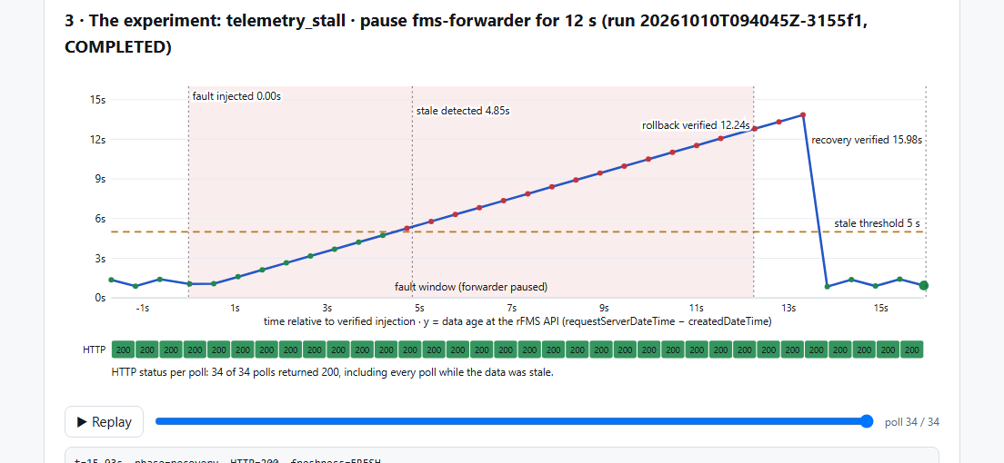
PROBLEM UNDERSTANDING & APPROACH
The “Illusion of Health”: HTTP 200 hides frozen vehicles
The flaw in standard monitoring
› Health checks look at docker ps = Up and HTTP 200 OK.
› We proved the Eclipse SDV rFMS API keeps answering HTTP 200 while vehicle telemetry is frozen.
› Root cause: receivedDateTime is the cloud server's clock; createdDateTime is stamped on the vehicle side.
Our approach: an independent black-box observer
Polls the API like a client every 0.5 s and computes true data age = server_time − createdDateTime. Older than 5 s → STALE, even under HTTP 200. Faults run only through a deterministic safety controller; recovery needs 3 fresh, advancing vehicle timestamps.
Run 3155f1: data age climbs past 5 s while every poll chip stays green (HTTP 200). docs/demo/explainer-chart.png
34 / 34
4.85 s
How AI is used (advisory only)
Plan: a local Qwen2.5 model may only reorder the rule-based, allowlisted experiment ranking.
Analyze: it drafts root causes and verify / mitigate / fix playbooks; a grounding check rejects anything the evidence does not support. It never executes anything.
polls returned HTTP 200 during the run, 17 of them while the data was stale
median time to detect the stall (6 full-length Day-1 runs)
ResiliencePilot SDV · Team ResiliencePilot (Team 26) · Bosch Hackathon 2026
2 / 8
Notes:
receivedDateTime always looks fresh because the server stamps it at request time. createdDateTime comes from the vehicle side; when it stops advancing the fleet is blind, yet the API still says 200.

Slide 3
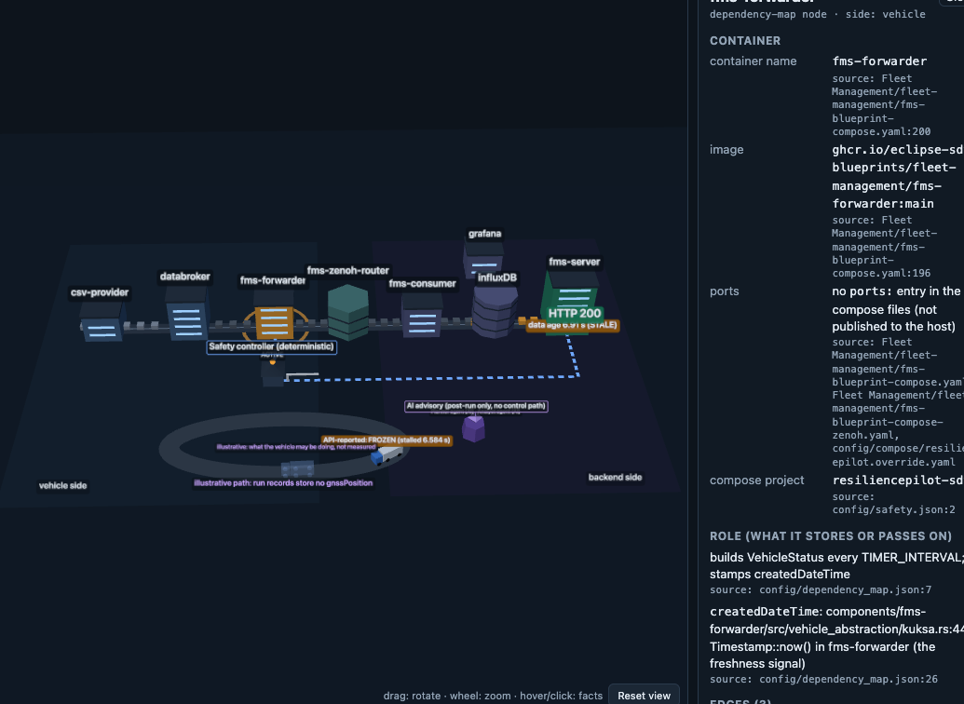
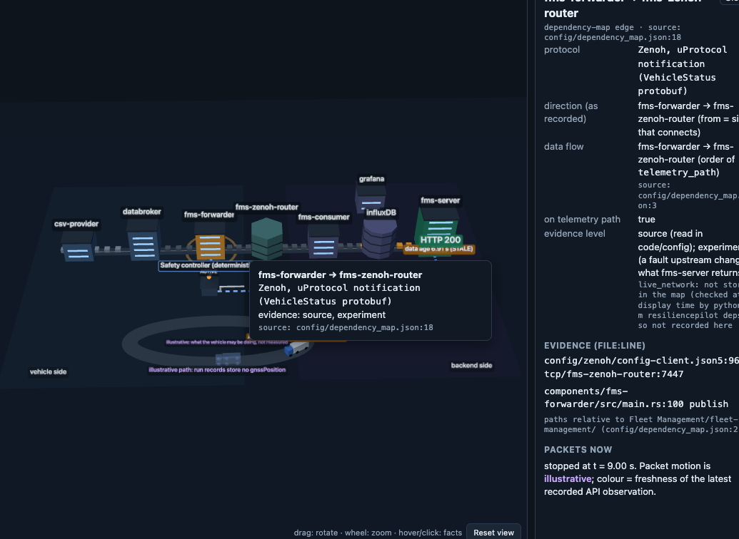
SAMPLE APPLICATION
Target: Eclipse SDV Fleet Management Blueprint
Vendored unchanged (submodule 3d514ac72a, Apache-2.0) · 8 containers in a local Docker Compose project · no cloud, fully reproducible
csv-provider
replays CAN-like signals
databroker
Eclipse KUKSA.val (VSS)
fms-forwarder
stamps createdDateTime
fms-zenoh-router
Eclipse Zenoh · uProtocol
fms-consumer
decodes, writes
InfluxDB
time-series store
fms-server
rFMS REST API
Vehicle edge → transport → cloud backend. Dark nodes: where ResiliencePilot reads (fms-server) or injects allowlisted faults (fms-forwarder, InfluxDB). Grafana is the 8th container.
Deployment
Docker Compose project resiliencepilot-sdv, local only; our changes live in a Compose override, never in the blueprint.
One-command start
./scripts/stack-up.sh (normalises Windows CRLF line endings for bind-mounted files), then stack-status.sh checks all 8 containers + HTTP 200.
Tested on
Windows 11 x86-64 and macOS Apple Silicon (amd64 images under emulation).
Repository
github.com/Anshu-raj-co/ResiliencePilot
fms-forwarder inspector: image, ports, role, edges with evidence
forwarder → Zenoh router road: protocol, direction, source line
ResiliencePilot SDV · Team ResiliencePilot (Team 26) · Bosch Hackathon 2026
3 / 8
Notes:
Seven-hop telemetry journey. The forwarder stamps createdDateTime; the server answers the rFMS API. We never edit the blueprint: everything is adapted through a Compose override.

Slide 4
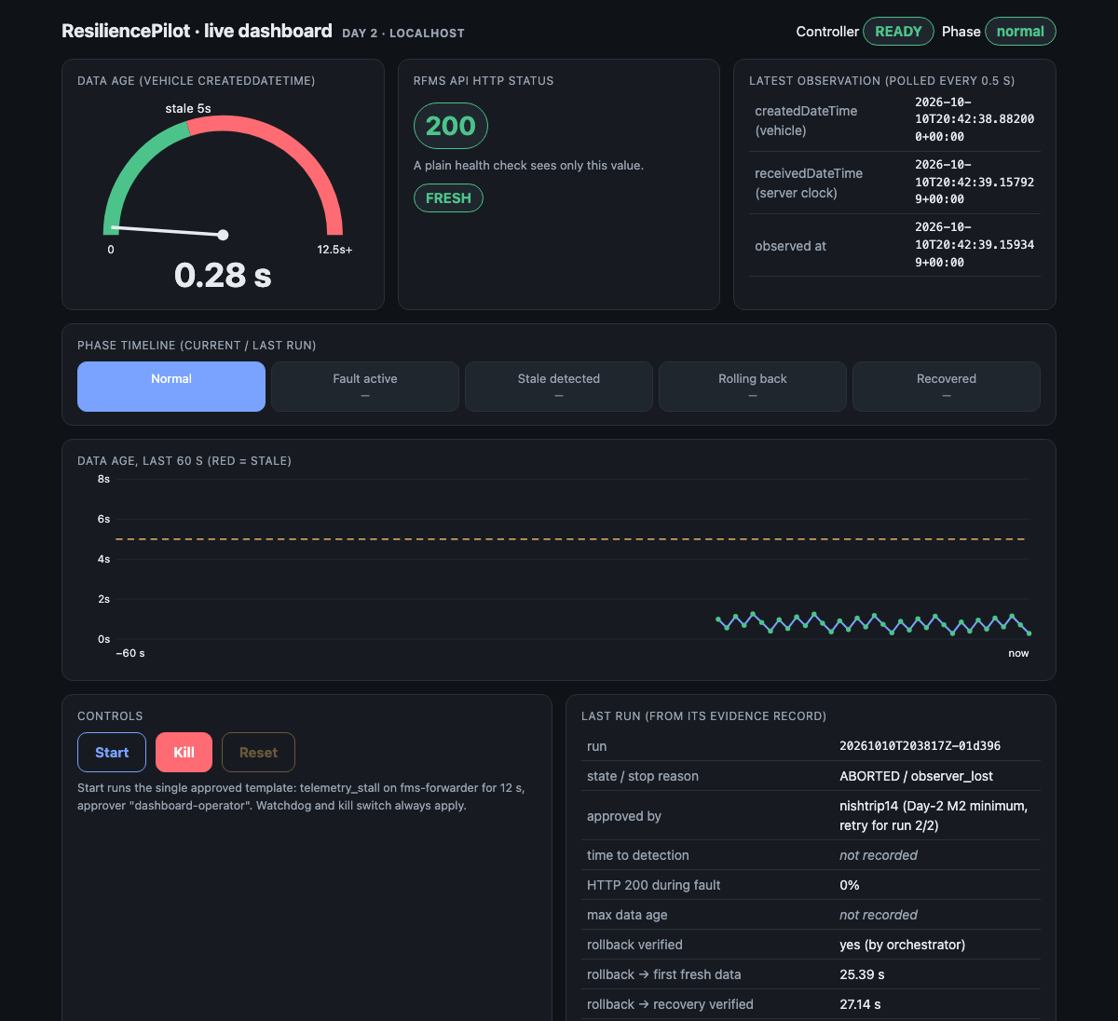
SOLUTION ARCHITECTURE & SAFETY CONTROLS
Advisory AI vs. deterministic safety controller
Advisory AI
reorders · explains
Human approver
types name, recorded
Safety controller
validates · locks · arms
Fault adapter
pause / stop, allowlisted
Recovery verifier
3 fresh timestamps
The AI can only suggest. Nothing reaches Docker without a named human and the deterministic controller.
1
Dual-timestamp observer
True data age from createdDateTime; > 5 s is STALE even under HTTP 200.
2
Automated guardrails
Live auto-abort + rollback on HTTP errors, latency p95 above the armed limit, or any change outside the blast radius.
3
Deterministic controller
Exact-name allowlist + Compose label, one run at a time (run.lock), independent watchdog thread: 30 s hard cap.
4
Verified recovery gate
3 consecutive fresh, advancing vehicle timestamps with HTTP 200. HTTP 200 alone never counts.
5
LATCHED_UNSAFE
Unverified rollback or recovery blocks all experiments until a logged human reset.
6
Independent kill switch
scripts/kill-switch.sh unpauses / starts every allowlisted target even if the backend is dead.
Live dashboard: data-age gauge, HTTP chip, phase timeline, controls
ResiliencePilot SDV · Team ResiliencePilot (Team 26) · Bosch Hackathon 2026
4 / 8
Notes:
Pipeline: the AI proposes, a human approves, and only the deterministic controller touches Docker. Six controls; every one has negative-path tests and live evidence in reports/.

Slide 5
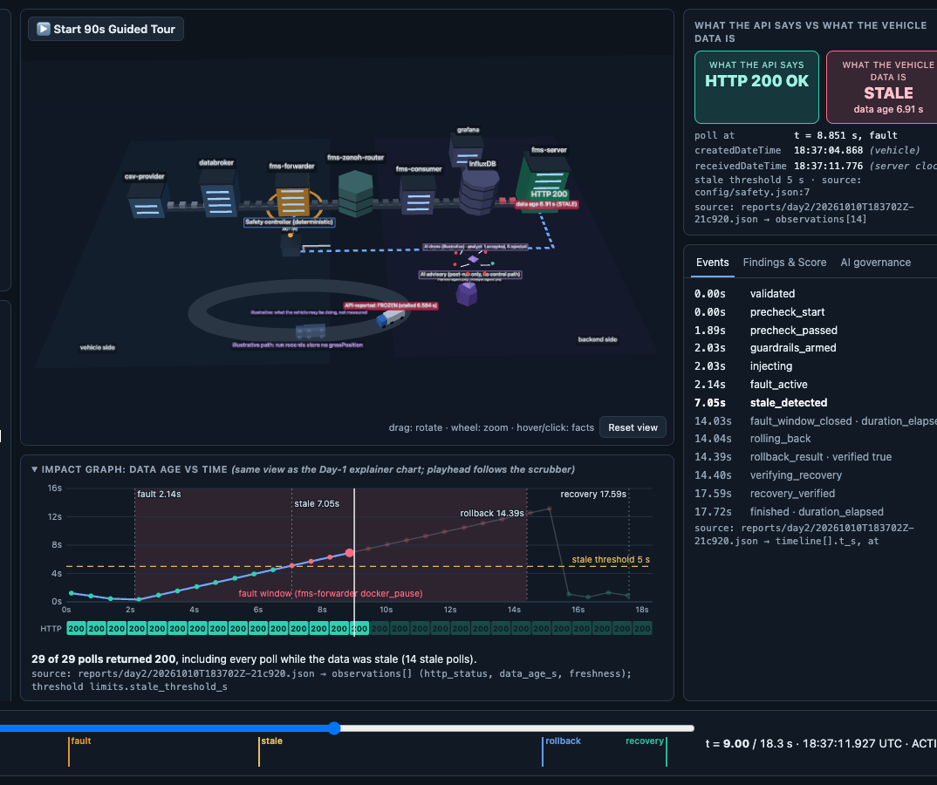
TOOLS & CAPABILITIES
Tools, technologies & platform capabilities
Languages & frameworks
Automotive & networking
• Python 3.13
• FastAPI
• Uvicorn
• Pydantic
• httpx
• pytest · 396 passing
• Eclipse KUKSA.val
• COVESA VSS
• Eclipse Zenoh
• uProtocol
• rFMS REST API
Infrastructure & storage
AI & observability
• Docker Compose
• InfluxDB
• SQLite (DQ quarantine / audit)
• JSON run evidence
• Ollama · Qwen2.5:7b (loopback, no shell / Docker)
• Three.js r160 (offline 3D twin)
• Live dashboard
3D twin HUD: impact graph, guardrail gauges, event timeline, sources per fact
Platform CLI (every command goes through the same safety controller)
rp observe
rp baseline
rp run
rp stop
rp reset
rp plan
rp advise
rp score
rp findings
rp serve
python -m resiliencepilot.dq
ResiliencePilot SDV · Team ResiliencePilot (Team 26) · Bosch Hackathon 2026
5 / 8
Notes:
Everything is open source and local. The AI model runs on the laptop over loopback and has no access to the shell, Docker or credentials.

Slide 6
FAILURE SCENARIOS SELECTED
Three reversible faults, two vulnerabilities found
1
telemetry_stall
docker pause fms-forwarder
2
service_crash
docker stop / start fms-forwarder
3
dependency_failure
docker stop / start influxDB
Models: Publisher freeze / lost cellular uplink
Models: Container crash and restart
Models: Database outage
› HTTP 200 on 100 % of fault polls while data froze
› Stale detected in 4.8–5.3 s; recovery verified 2.6–3.7 s after rollback
› Same silent symptom: HTTP 200 with stale data
› Forwarder ignores SIGTERM (always SIGKILL, exit 137); recovery 2.5–3.7 s
› Visible failure first (HTTP 500), which is good
› Then ~21–24 s of HTTP 200 with frozen data after InfluxDB was back; fms logs showed 'failed to resolve host name' (DNS caching: hypothesis, not verified); 4–31 s of stored data lost
8 completed runs · median score 62.2
5 completed runs · median score 65.1
3 completed runs · median score 61.6
V1: silent blackout
V1 confirmed
V2: stale after recovery
Why these three, in this order Each hits a real link of the telemetry chain (publisher, process, storage), is fully reversible (pause/unpause, stop/start), and leaves the host untouched; no CPU burning. The rule-based planner ranks the next run by information gain × risk (unresolved runs, latch rate, neighbours in the dependency map); a human approves each one.
ResiliencePilot SDV · Team ResiliencePilot (Team 26) · Bosch Hackathon 2026
6 / 8
Notes:
V1 = HTTP 200 while telemetry is frozen (stall, crash). V2 = stale HTTP 200 for 21–24 s after the database recovered. The DNS explanation is a hypothesis; the logs and timings are measured.

Slide 7
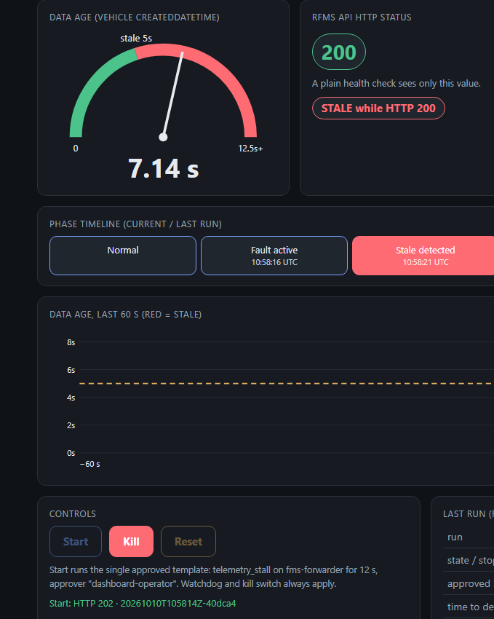
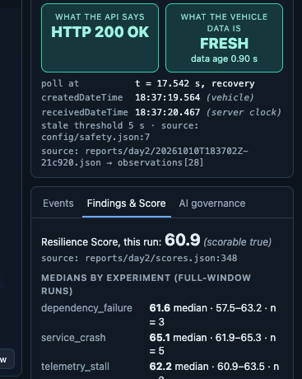
IMPLEMENTATION & RESULTS
The proof: tests, recorded runs, guardrails tripped live
396
37
3 / 3
unit tests passing
317 core + 79 data quality · 0 failed · 11 live-stack tests skipped
recorded runs, evidence committed
reports/day1 · day2 · guardrail-demo, every record replayable in the 3D twin
guardrails tripped live
Error rate (77b84c) · Latency p95 (8ad2b8) · Blast radius (4aa9f7)
Resilience Score (0–100)
Score = 100 × M × (1 − 0.5 × P_silent)
M = 0.25·D + 0.30·R + 0.20·G + 0.25·B (measured parts only)
D detection · R recovery · G data integrity · B blast radius
P_silent = share of polls that returned HTTP 200 with stale data; a run that is silent on every poll keeps at most half its score.
Medians, full-window Day-2 runs (overall 62.65, n = 10):
service_crash
65.1
telemetry_stall
62.2
dependency_failure
61.6
STALE while HTTP 200 (live)
Score + findings tab (3D twin)
ResiliencePilot SDV · Team ResiliencePilot (Team 26) · Bosch Hackathon 2026
7 / 8
Notes:
Live run in the demo video (2b1f95, approved by Nishant Tripathi): stale detected 4.99 s after injection, recovery verified 3.78 s after rollback, score 47.6. The latency guard was proven with a deliberately tight 30 ms cap (tripped at 1.88 s); it proves the abort path, not a real slowdown.

Slide 8
DATA QUALITY · LEARNINGS · DEMO VIDEO
Data quality, key learnings & the demo
DQ
Multi-region data-quality gate
i
Key learnings & what's next
2:40 live demo video
Universal format: EU DD/MM, US MM/DD, IN DD-MM, ISO, epoch → canonical UTC ISO-8601.
Never guess: ambiguous dates without a region and timestamps > 5 s in the future are quarantined.
AI hallucination guardrail
the 7B analyst proposed 7 root causes; our grounding check against recorded evidence accepted 1 and rejected 6. The deterministic layer carries the analysis.
Health ≠ freshness
status codes and container state missed every silent failure we injected.
Limitations
container pause/stop only (no proxy → no network faults); one vehicle, one host; in-process watchdog (kill switch covers a crash); no LICENSE file yet.
Next
network-delay faults via a proxy, a larger local model, more vehicles, CI on the live stack.
0:00 Team, architecture, our sandbox, healthy live dashboard
0:33 Live telemetry_stall: human approval, HTTP 200 while data freezes
1:01 Verified recovery (3 advancing timestamps), metrics, Resilience Score
1:22 Findings + 3D replay of the InfluxDB outage that latched
1:47 AI analysis: 1 of 7 answers accepted; safety controls, kill switch
2:20 Data-quality gate (2/100 committed vs 10/100 rolled back), results
2 / 100
≤ 5 % errors: commit 98 + quarantine 2 with reasons, one atomic transaction
10 / 100
> 5 % errors: atomic rollback, 0 saved, operator review flag
Video link
Google Drive link added at submission (make_ppt.py --video-url)
backend/resiliencepilot/dq/ · synthetic logistics feed · 79 tests
ResiliencePilot SDV · Team ResiliencePilot (Team 26) · Bosch Hackathon 2026
8 / 8
Notes:
Close: HTTP 200 is not recovery, fresh data is. Everything shown in the video is the real stack; the live run is 2b1f95. Repository: https://github.com/Anshu-raj-co/ResiliencePilot

