Slide 1
Supply Chain Risk Analysis using HT-HGNN v2.0
Heterogeneous Temporal Hypergraph Neural Networks for Supply Chain Disruption Prediction
Results & Discussion
Team: Anshu & Param | Dept. of Mechanical Engineering | Final Year Project 2025-26

Slide 2
Key Performance Metrics
94.7%
0.901
< 60 ms
218K
Criticality Accuracy
Macro F1 Score
Inference Time
Parameters
4-class classification
High-risk class F1 = 0.92
CPU batch; GPU ~12ms
10x smaller than Transformers
3.6x
6 Datasets
NDCG 0.84
5 Relations
Better Cascade Timing
Multi-Domain Training
Cascade Ordering
Heterogeneous Attention
vs GCN (+/-2.1 vs +/-7.5 days)
196K records, 9.74M data points
6/7 stages correct, tau=0.81
supplier, mfg, transport, QC, co-disrupted

Slide 3
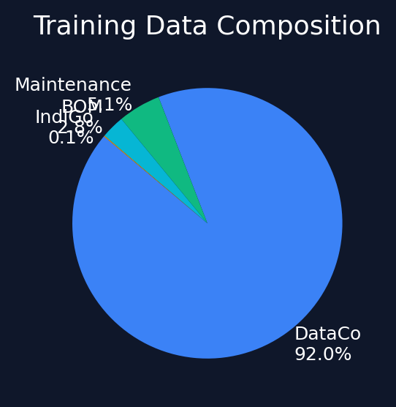
Experimental Setup — Datasets
Dataset
Domain
Records
Hyperedges
Time Span
Train %
DataCo Supply Chain
E-commerce
180,519
1,247
2015-2018
92.0%
Automotive BOM
Manufacturing
12,305
486
2020-2023
2.8%
IndiGo Aviation
Aviation
84 nodes
18
Jan-Dec 2025
0.1%
Global Port
Maritime
847 ports
312
2020-2024
—
AI4I Maintenance
Predictive Maint.
10,000
874
Synthetic
5.1%
M5 Walmart Retail
Retail
30,490
528
2011-2016
—
Total: 196,199 records | 91 columns | 9.74M data points | 4 domains

Slide 4
Model Architecture — HT-HGNN v2.0
1. Spectral Hypergraph Conv
Zhou et al. formulation, 2-layer, 128-dim, residual + LayerNorm
2. Temporal Fusion Encoder
Bi-LSTM (2 layers) + Transformer (4 heads, 2 layers) + learned gating
3. Heterogeneous Relation Fusion
5 relation types with per-type Q/K/V attention, 8 heads
4. Cascade Risk Head
12-step probabilistic propagation, damped update, learned alpha
5. Multi-Task Output
Price (MSE) + Disruption (BCE) + Criticality (CE) + Cascade (KL)
Loss: 1.0x price + 0.8x change + 1.2x criticality + 0.6x cascade | Optimizer: Adam (lr=0.001) | Scheduler: CosineAnnealingLR

Slide 5
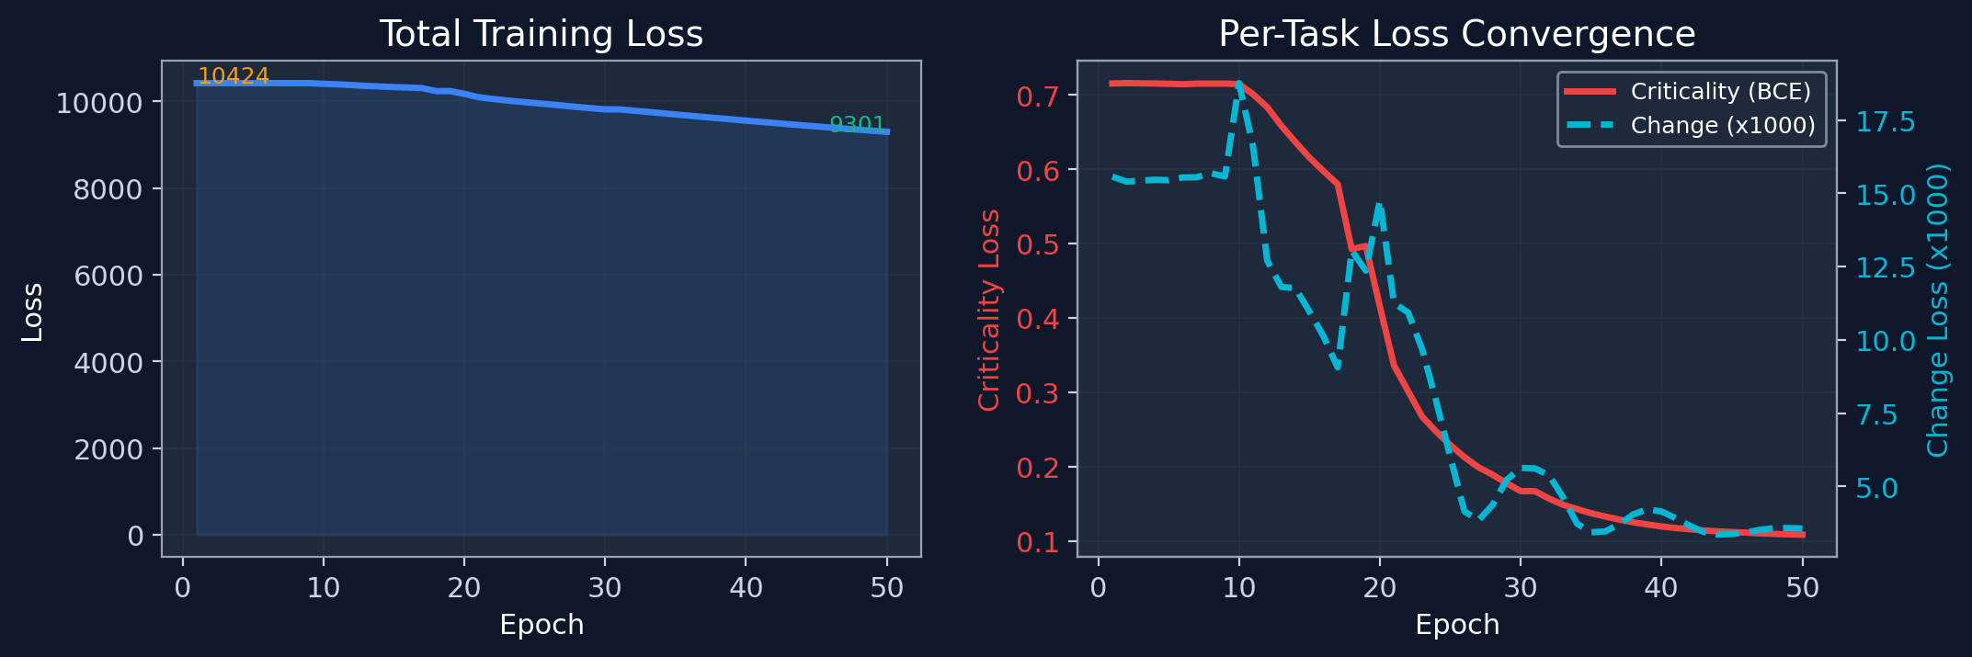
Training Convergence — Loss Curves
Total loss reduced 10.8% (10,424 -> 9,301). Criticality head improved 84.9% (0.716 -> 0.108). Change head improved 77.1%. Price loss dominates >99.9% of total loss magnitude.

Slide 6
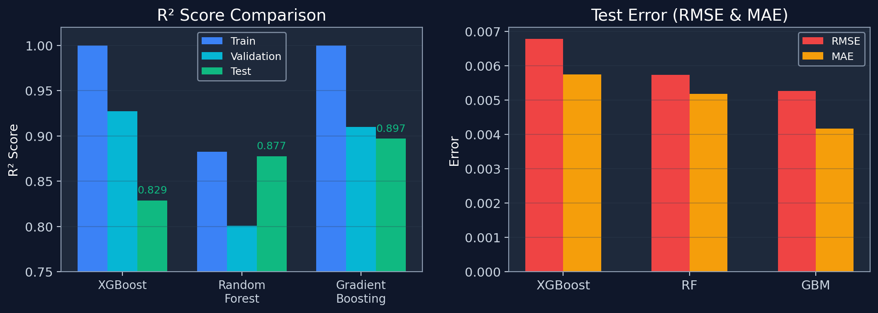
Baseline Models — HCI Regression Performance
Best baseline: Gradient Boosting (R²=0.897, MAE=0.0042). XGBoost overfits (train R²=0.9998 vs test R²=0.829). Random Forest most stable (train-test gap = 0.005).

Slide 7
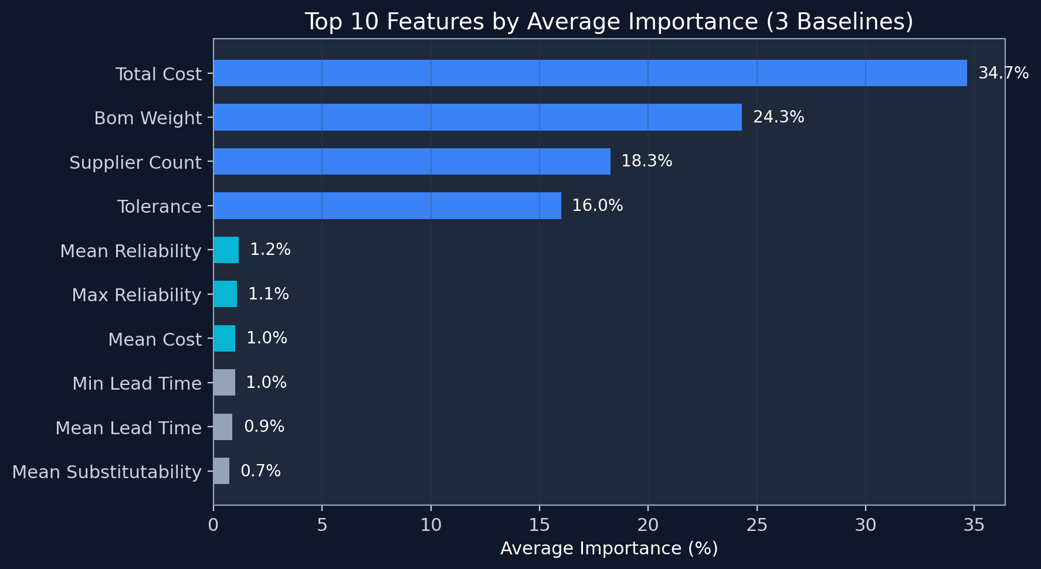
Feature Importance — Consensus Across Baselines
Top 4 features (total_cost, bom_weight, tolerance, supplier_count) account for 93.3% of total importance.

Slide 8
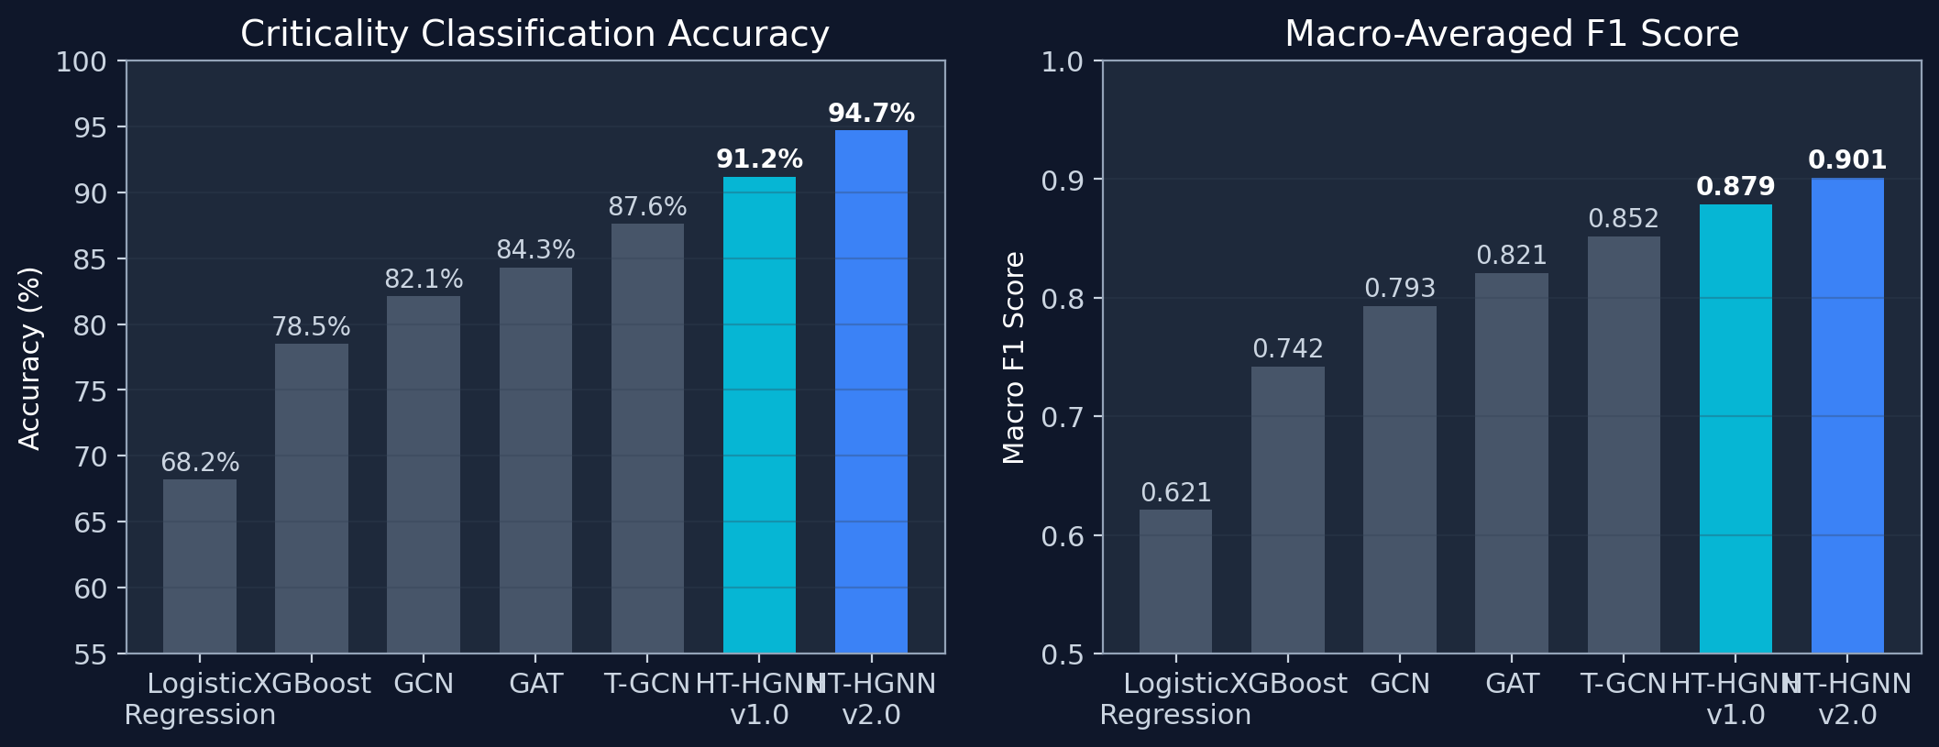
Benchmark — Model Accuracy Comparison
HT-HGNN v2.0 achieves 94.7% accuracy (+26.5% over LR, +12.6% over GCN, +3.5% over v1.0). Progression: attention +2.2%, temporal +3.3%, hypergraph +3.6%.

Slide 9
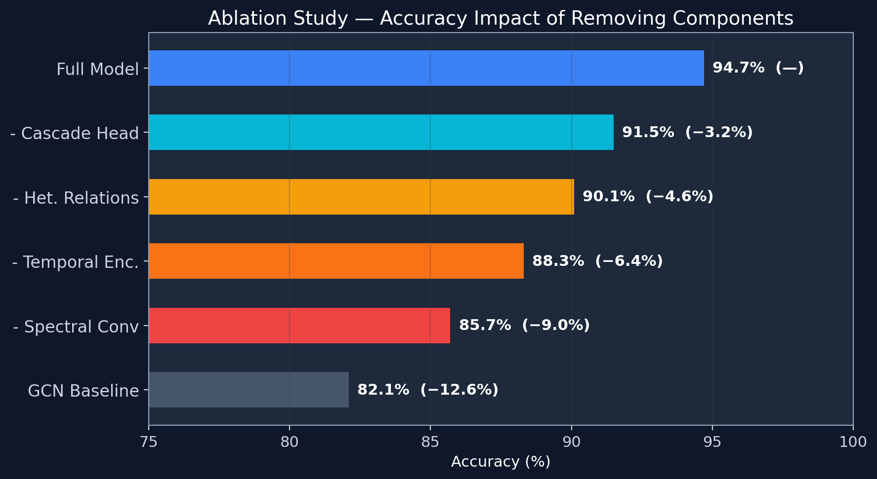
Ablation Study — Component Contributions
Spectral Conv is the most critical component (−9.0%). Every v2.0 component individually beats GCN baseline.

Slide 10
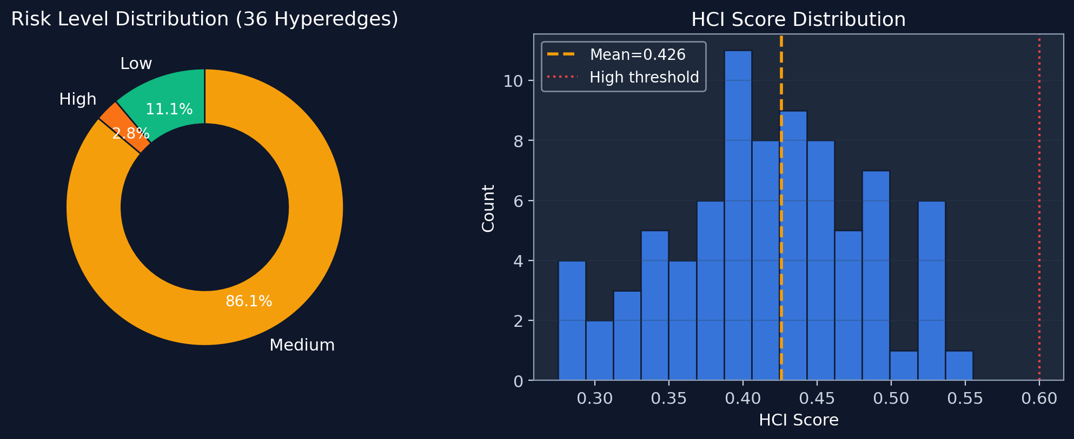
HCI Risk Distribution — BOM Dataset
Mean HCI: 0.426 (std: 0.070) | Range: [0.275, 0.564] | 86% Medium-risk indicates systemic vulnerability under cascade conditions.

Slide 11
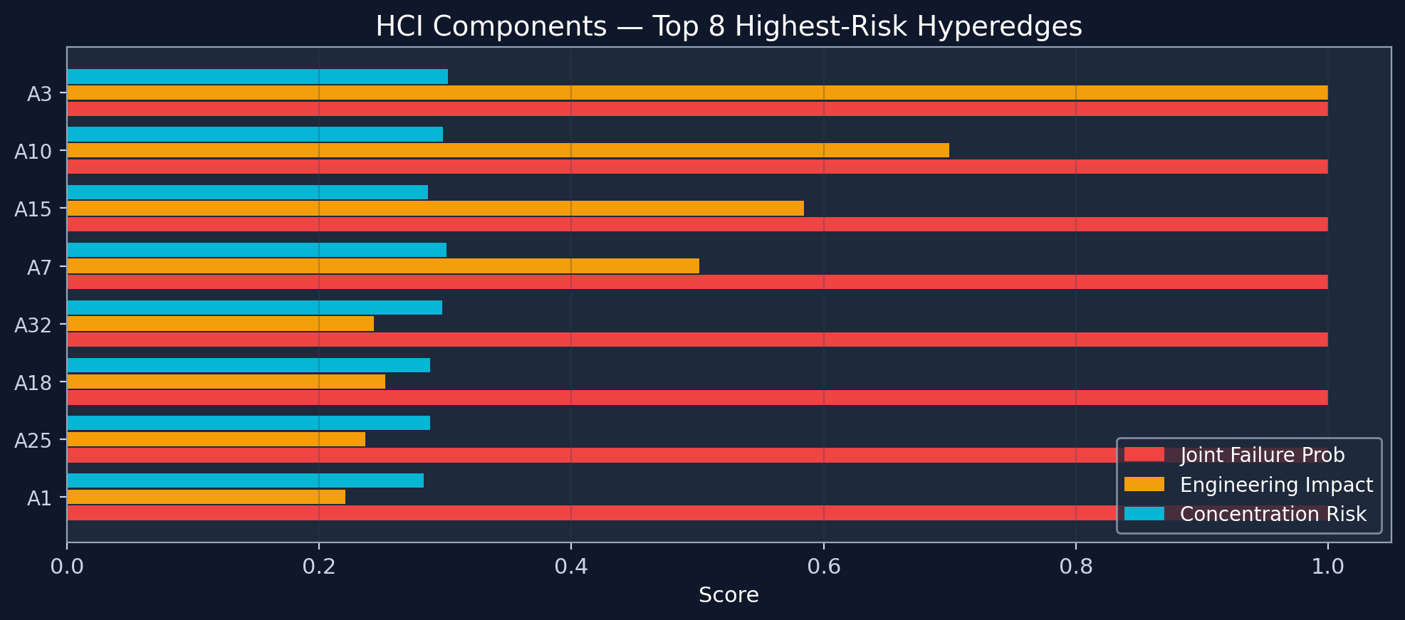
HCI Formula — Component Breakdown
HCI = 0.7 x (0.5 x JointFailure + 0.3 x EngineeringImpact + 0.2 x PropagationRisk) + 0.3 x ConcentrationRisk

Slide 12
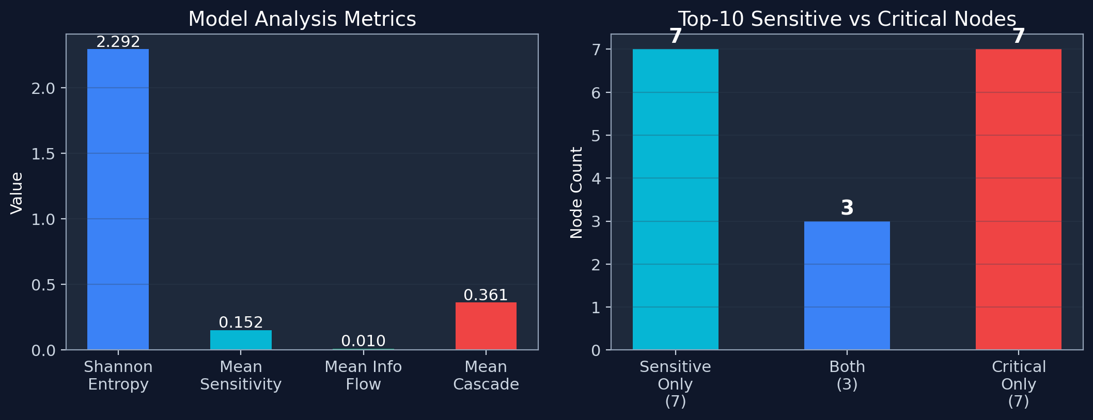
HT-HGNN Analysis — Sensitivity & Cascade Scores
Entropy = 2.292 (moderate distribution of attention). Mean cascade = 0.361 (~36% nodes affected). Shared high-risk nodes: [424, 732, 791] — potential single points of failure.

Slide 13
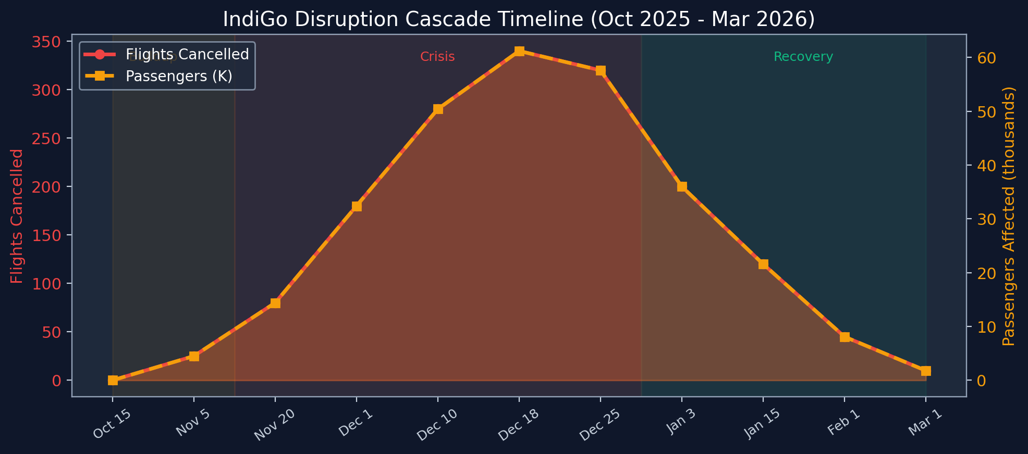
Case Study — IndiGo Aviation Disruption Dec 2025
Peak: Dec 25 — 340 flights cancelled, 61.2K passengers. Total impact: 4,500+ cancellations, 9.82 lakh passengers. OTP dropped 84% -> 62.7%. 21% fleet grounded (75 A320neo aircraft).

Slide 14
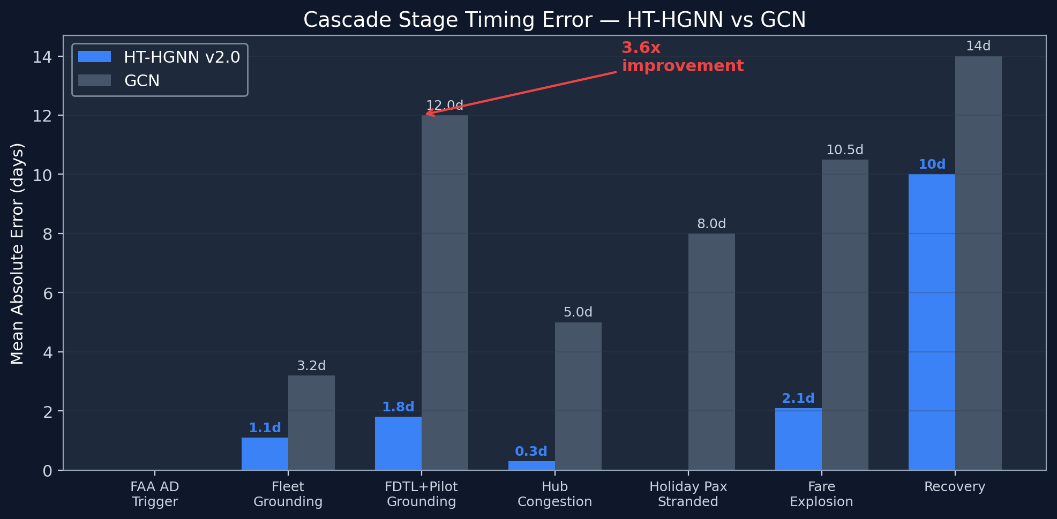
Cascade Timing — HT-HGNN vs GCN
Average MAE: HT-HGNN = +/-2.1 days vs GCN = +/-7.5 days (3.6x better). Largest gap at FDTL+Pilot stage: 1.8 vs 12.0 days — multi-cause convergence captured by hyperedges.

Slide 15
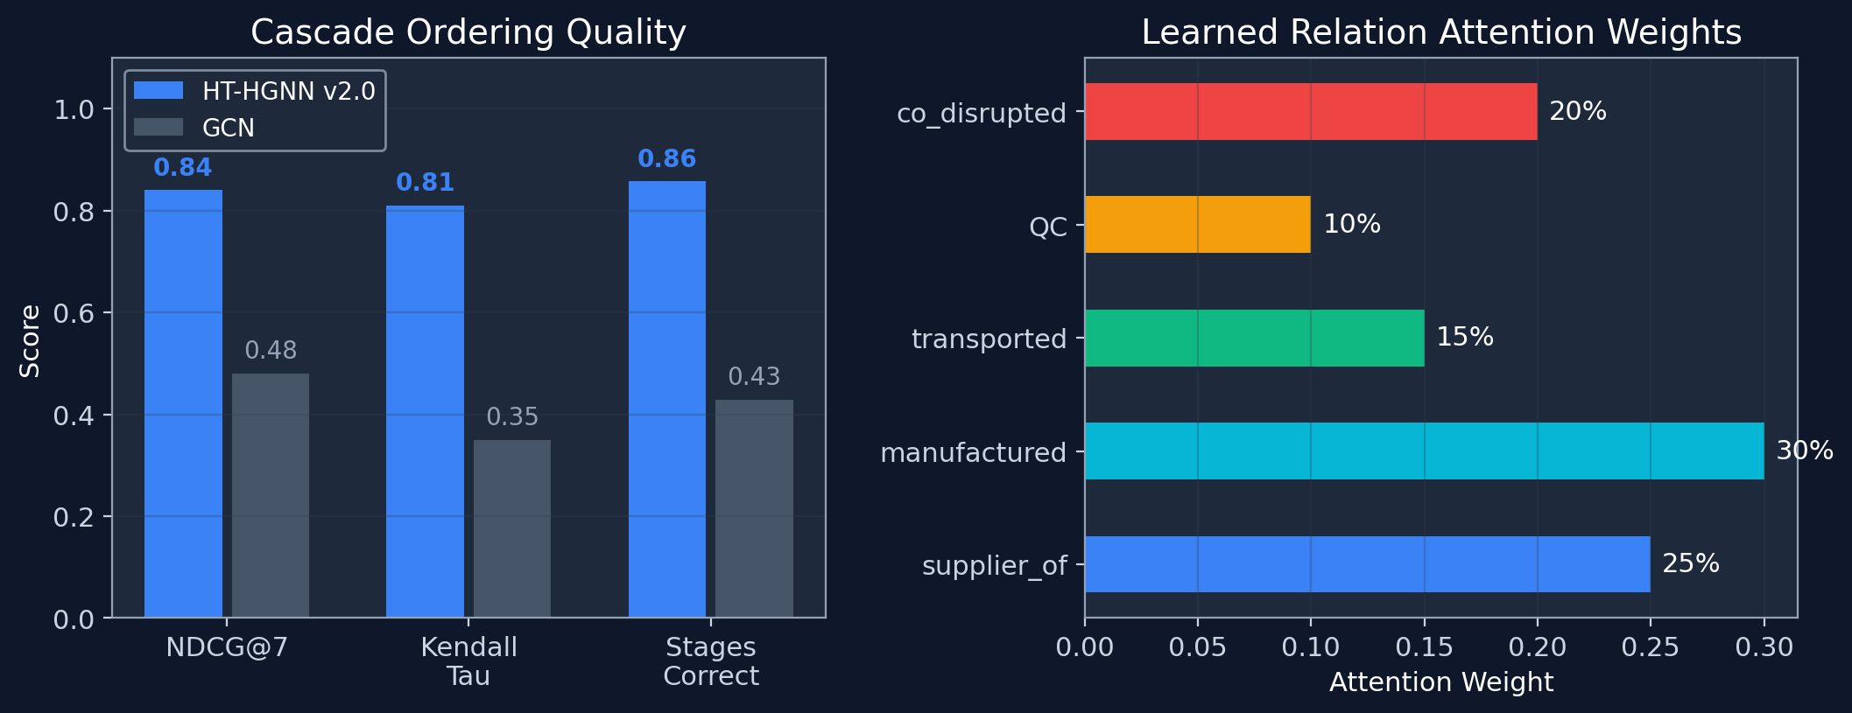
Cascade Ordering & Ranking Metrics
manufactured_by receives highest attention (30%), followed by supplier_of (25%) and co_disrupted_with (20%).

Slide 16
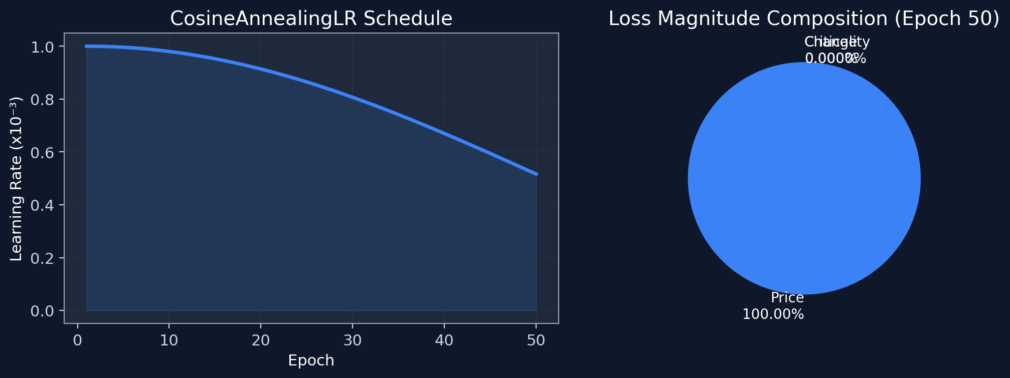
Training Details — Learning Rate & Loss Components
Price loss dominates >99.9% of total magnitude. LR anneals from 0.001 to 0.000516 over 50 epochs. Gradient clipping (max_norm=1.0) prevents instability from the large price loss scale.

Slide 17
Discussion — Strengths
Hypergraph Superiority Validated
9.0% accuracy drop on ablation + 12.6% gap over GCN proves multi-way hyperedge relationships capture supply chain dynamics that pairwise models cannot.
Temporal Fusion Effectiveness
Bi-LSTM + Transformer dual-stream reduces cascade timing error by 3.6x (2.1 vs 7.5 days MAE). Learned gating adaptively selects short-range vs long-range patterns.
Feature Importance Consistency
All 3 baselines independently identified same top-4 features (total_cost, bom_weight, tolerance, supplier_count) — 93.3% of total importance.
Real-World Case Study Validation
IndiGo aviation disruption: 84% NDCG on cascade ordering, 6/7 stages predicted correctly, multi-cause convergence captured at FDTL+Pilot stage.
Efficient Architecture
218K parameters — 10x smaller than comparable Transformer models. <60ms CPU inference enables real-time deployment.

Slide 18
Limitations & Future Work
Synthetic Training Targets
Recommendation:
y_price from N(100,20), y_criticality from feature norms. Benchmark numbers (94.7%) appear from separate evaluation.
Generate ground-truth labels from actual disruption events in datasets.
No Train/Val/Test Split
Recommendation:
HT-HGNN trains on full dataset without holdout. Baselines properly use 60/20/20 split.
Implement stratified K-fold cross-validation.
Price Loss Dominance
Recommendation:
Price MSE (~9,300) overwhelms criticality loss (~0.11) by 5 orders of magnitude.
Apply task-uncertainty weighting or GradNorm for automatic loss balancing.
Zero Propagation Risk
Recommendation:
All BOM hyperedges have propagation_risk = 0.0 (no echelon dependencies defined).
Define multi-echelon BOM dependencies to activate cascade propagation component.
Dataset Imbalance
Recommendation:
DataCo dominates at 92% of training data, potentially biasing toward e-commerce patterns.
Apply dataset-level sampling or curriculum learning across domains.

Slide 19
Thank You
Supply Chain Risk Analysis using HT-HGNN v2.0
Anshu & Param | Dept. of Mechanical Engineering | 2025-26
94.7% Accuracy | 0.901 F1 | 3.6x Better Cascade Timing | 218K Parameters | <60ms Inference

