Slide 1


Hypergraph-Based Risk Modelling for Multi-Echelon Manufacturing Supply Chains
Name of the Students- Anshu Kumar, Param Kamat
Reg. No.- 22BME0208, 22BME0217
School of Mechanical Engineering
Second Review
Name of the Project Guide: Aravind Raj S
School: SMEC
Date of Presentation:18/03/26

Slide 2
CONTENTS
Introduction
Literature Review
Knowledge gained
Gaps identified from literature
Objectives
Methodology / Action Plan
Milestones and Project Execution Stages
Experimental procedure
Preliminary Results
Work carried out so far
Work to be done

Slide 3
Introduction
Supply Chain Management (SCM) integrates material, information, and financial flows across supply chain partners to improve efficiency and resilience.
Modern manufacturing supply chains are complex, global, and highly susceptible to disruptions, making SCM a strategic function.
Emerging approaches such as Green SCM, Reverse Logistics, and Sustainable SCM increase interdependence and structural complexity within supply networks.
Multi-Echelon Supply Chain Management (ME-SCM) focuses on coordination across multiple tiers and requires system-level modeling to address cascading risks.

Slide 4
Literature Review(Supply Chain Concepts)
Title of the paper | Journal & Year | Authors | Description | Remarks
Ten-tier and multi-scale supply chain network analysis of medical equipment: random failure & intelligent attack analysis | International Journal of Production Research Volume 61, 2023 - Issue 24 | Kayvan Miri Lavassani Zachary M. Boyd | Global medical equipment supply chain (~45,000 firms) Random failures and targeted attacks Tier-optimization for network robustness | Deep-tier disruptions Cascading failures Systemic vulnerability thresholds beyond first-tier visibility
Multi-echelon supply chain coordination: Contract sequence and cut-off policies | International Journal of Production Economics Volume 259, May 2023, 108823 | Indranil Biswas, Rohit Gupta | Decentralized three-echelon supply chain Contract sequencing under incomplete information Profit allocation, coordination, and trade feasibility | Bargaining power in multi-echelon supply chains Dynamic multi-agent coordination Realistic profit distribution
A resilient-green model for multi-echelon meat supply chain planning | Computers & Industrial Engineering Volume 152, February 2021, 107018 | Seyed Mohammad Gholami-Zanjani, Mohammad Saeed Jabalameli | Bi-objective stochastic three-echelon meat supply chain model (s, S) replenishment with perishability, freshness-based pricing, and environmental impact Monte-Carlo analysis of disruption effects (capacity loss, inventory drops) | Perishable supply chains Profit–carbon footprint trade-off High volatility environments
Impacts of store-brand introduction on a multiple-echelon supply chain | European Journal of Operational Research Volume 292, Issue 2, 16 July 2021, Pages 652-662 | Rong Cheng ª, Yongrui Duan | Game-theoretic three-echelon supply chain Retailer store-brand introduction Three-stage Stackelberg model with distributor buffering | Win–win outcomes from store-brand entry Multi-echelon supply chain advantage Limitations of traditional two-echelon models

Slide 5
Literature Review
Title of the paper | Journal & Year | Authors | Description | Remarks
Distributional reinforcement learning for inventory management in multi-echelon supply chains | Digital Chemical Engineering Volume 6, March 2023, 100073 | Guoquan Wu , Miguel Ángel de Carvalho Servia | Deep reinforcement learning for supply chain decisions Risk-sensitive policy optimization CVaR-based protection against severe disruptions | Computational alternative to traditional OR methods Large-scale network complexity handling Mitigation of combinatorial explosion
A fuzzy optimization-oriented decision support model to examine key industry 4.0 strategies for building resilience against disruptions in a healthcare supply chain | Annals of Operations Research Published: 26 December 2024 | Behice Meltem Kayhan, Fatma Betul Yeni | Industry 4.0 technologies for healthcare supply chain resilience Fermatean fuzzy numbers with goal programming Digital investment alignment with SCOR processes | Digital investment prioritization Digital Twin for planning processes Blockchain for order and return processes
A blockchain-based approach for a multi-echelon sustainable supply chain | International Journal of Production Research Volume 58, 2020 - Issue 7 | V. K. Manupati Tobias Schoenherr | Blockchain-based supply chain monitoring Joint optimization of cost and carbon emissions Smart-contract emission threshold alerts | Digitalization with carbon taxation Real-time decision-making Transparency in multi-tier value webs
Disruption-resilient multi-echelon supply chains: a model integrating carbon emissions and social welfare investments | International Journal of Production Research Published online: 26 Nov 2025 | Abu Hashan Md Mashud Ripon K. Chakrabortty | Sequential production and transportation disruptions Production–3PL schedule coordination Social-welfare-oriented resource allocation | Social investment decision variable Triple Bottom Line integration Profitability under uncertainty
Towards knowledge graph reasoning for supply chain risk management using graph neural networks | International Journal of Production Research Volume 62, 2024 - Issue 15 | Edward Elson Kosasih Fabrizio Margaroli | Neuro symbolic ML with supply chain knowledge graphs GNN-based hidden risk discovery Multi-type relationship inference beyond supplier links | Hypergraph-based supply chain modeling Multi-hop query information discovery Hidden risks in siloed data

Slide 6
Literature Review (Hypergraph Concepts)
Title of the paper | Journal/Proceedings & Year | Authors | Description | Remarks
Hypergraph Neural Networks | Vol. 33 No. 01: AAAI-19, IAAI-19, EAAI-20 | Yifan Feng Haoxuan You | Hypergraph-based data representation learning High-order data correlation encoding Hyperedge convolution with node–edge–node transformation | Generalization of GCNs to hypergraphs Graph edges as 2-order hyperedges Foundational hypergraph learning theory
Hypernetwork science via high-order hypergraph walks | EPJ Data Sci. (2020) Published online: 10 June 2020 | Sinan G. Aksoy Cliff Joslyn | s-walk framework for hypergraph networks Higher-order connectivity via overlap order s Extension of graph metrics to hypergraphs | Hypergraph-native phenomena identification Loss from pairwise graph reduction Higher-order structural patterns
Classification in Biological Networks with Hypergraphlet Kernels | Bioinformatics, Volume 37, Issue 7, March 2021, Pages 1000–1007 | Jose Lugo-Martinez , Daniel Zeiberg. | Hypergraph-based supply chain modeling Higher-order, multi-object interactions Reduced information loss over traditional graphs | Group-level risk analysis Hyperedge–dual-vertex equivalence Engineering-consistent risk modeling .
Hyperedge Interaction-aware Hypergraph Neural Network | arXiv:2401.15587 Computer Science > Machine Learning 5 Apr 2024 | Rongping Ye, Xiaobing Pei | HeIHNN hypergraph neural network Hyperedge–hyperedge interaction modeling Three-stage convolution propagation (N–E–E–N) | HeIHNN hypergraph neural network Hyperedge–hyperedge interaction modeling Three-stage convolution propagation (N–E–E–N)

Slide 7
Literature Review
Title of the paper | Journal & Year | Authors | Description | Remarks
Dual chain dynamic hypergraph convolution network for 3D human pose estimation | Scientific Reports volume 15, Article number: 35211 (2025) | Qiuying Han, Shaohui Zhang | Dual Chain Dynamic Hypergraph Convolution Network (DCD-HCN) Decoupled hypergraph construction and convolution Improved adaptability to diverse human poses | Hyperedge-weight parameter matching Unique weighting of potential hyperedges High fidelity with low computational complexity
Community detection in hypergraphs through hyperedge percolation | Scientific Reports volume 15, Article number: 36032 (2025) | Bianka Kovács, Barnabás Benedek | k-clique percolation adapted to hypergraphs Overlapping community detection Dual strategies based on hyperedge size | Hyperedge-based community structures Limitations of pairwise projections Need for higher-order detection methods
Recent Advances in Hypergraph Neural Networks | Journal of the Operations Research Society of China Published: 13 September 2025 | Mu-Rong Yang & Xin-Jian Xu | State-of-the-art hypergraph neural networks Architectural variations Performance across diverse tasks | Contemporary hypergraph modeling roadmap Shift from static to dynamic representations Flexible hypergraph learning techniques

Slide 8

Knowledge gained from the literature
Hypergraph models provide superior representation of high-order relationships in supply chains compared to traditional graphs, enabling better modelling of joint dependencies and cascading disruptions.
Multi-Objective Optimization (MOO) improves decision-making by identifying Pareto-optimal trade-offs, offering more accurate and diverse solutions than single-objective approaches.
Temporal and heterogeneous GNN models (like HT-HGNN) effectively capture dynamic, multi-type relationships and time-dependent behaviors in complex networks.
Techniques such as LSTM, attention mechanisms, and SHAP enhance prediction accuracy and interpretability, enabling better understanding of risk propagation and model outputs.

Slide 9
Gaps in the Literature
Existing hypergraph and GNN models largely focus on static and homogeneous networks, failing to capture real-world dynamic and evolving supply chain structures.
Most studies are built on general-purpose knowledge graphs, with limited domain-specific application to supply chain risk prediction.
Prior research primarily addresses single-objective problems (e.g., demand forecasting or disruption classification) rather than integrated multi-objective prediction.
No existing work integrates cascade risk modelling directly into training (e.g., via KL divergence with cascade simulations), limiting accurate learning of disruption propagation.

Slide 10
Objectives
Develop a hypergraph-based modelling framework (HT-HGNN) to better capture complex, multi-entity relationships in supply chains.
Incorporate temporal dynamics and heterogeneous data inputs to enable real-time prediction of node criticality and risk propagation.
Implement multi-objective optimization to simultaneously predict multiple outcomes such as price, disruption risk, criticality, and cascade probability.
Validate the proposed model using a real-world case study (airplane operations) to demonstrate accuracy and practical applicability.

Slide 11
Overall System Architecture
ML Engine
Prediction Outputs
Interface Layer
Hypergraph Construction
Price / Delay Prediction
User / Analyst
Nodes · Hyperedges · Temporal structure
Regression head · MAE loss
2
Browser interface
Spectral Hypergraph Conv
Disruption Detection
1
React Frontend (Port 5173)
2
3 layers · hidden=256 · residual · intra-HE attn
3
Binary · BCE loss
Upload CSV · Select dataset · View dashboard
Temporal Fusion Encoder
Criticality Classification
FastAPI Backend (Port 8000)
Bi-LSTM (2×128) + Transformer (4 heads)
4-class · Cross-entropy
/predict /explain /simulate
Heterogeneous Relation Attention
Cascade Risk Score
3
5 type-specific W_r matrices
KL-divergence · HIC target
11

Slide 12
ML Prediction Pipeline
Stage A - Data & Graph Construction
Raw CSV / Dataset
DataAdapter — Standardisation Layer
DataCo · BOM Automotive · IndiGo · Global Port · Mfg
Normalisation · Encoding · Time alignment · Missing value imputation
Spectral Hypergraph Convolution
Hypergraph Construction
Multi-party feature propagation · 3 layers · intra-hyperedge attention
Nodes (entities) · Hyperedges (group relations) · Temporal snapshots
Stage B · Neural Processing & Output
Temporal Fusion Encoder
Heterogeneous Relation Attention
Bi-LSTM (2×128) + Transformer (4 heads, d=256) · 24-hr rolling window
5 type-specific attention matrices · softmax fusion
Multi-Task Prediction Heads
Shared Node Embedding
Price · Disruption · Criticality · Cascade Risk — simultaneous output
Unified representation across all tasks · d=256
12

Slide 13
Hypergraph Foundations
H = (V, ℰ, W) | B ∈ {0,1}ⁿˣᵐ | Dᵥ & D_{e}
Hypergraph | Incidence Matrix | Degree Matrices
V = {v₁…vₙ} → n vertices (supply chain nodes) | B[i,j] = 1 if vertex vᵢ ∈ hyperedge eⱼ | Dᵥ[i,i] = Σⱼ B[i,j] → hyperedges per vertex
ℰ = {e₁…eₘ} → m hyperedges (assembly groups) | B[i,j] = 0 otherwise | D_e[j,j] = Σᵢ B[i,j] → vertices per hyperedge
W = diag(w₁…wₘ) → hyperedge weight matrix | Complete structural encoding in one matrix | Both are diagonal normalisation matrices
Model scale: n = 1,206 nodes, m = 36 hyperedges | Dimensions: 1,206 × 36 binary matrix | Prevent high-degree nodes from dominating

Slide 14
Hypergraph Construction
Construction Pipeline
Traditional Graph — pairwise only
Supply Chain Dataset
Raw records with entity attributes
Supplier
Manufacturer
Distributor
2
One edge = one pairwise link. Risk propagates linearly only.
Entity Identification
Supplier · Manufacturer · Logistics · Retail
Hypergraph — group dependencies captured
3
Node Creation (d=12 features)
Supplier
Manufacturer
Logistics
Each entity → node · 5 relation types extracted
Hyperedge
One hyperedge binds Supplier + Manufacturer + Logistics simultaneously.
Disruption in any one propagates to ALL members at once.
Hyperedge Formation
4
Multiple nodes in one hyperedge · T=24 temporal snapshots
13

Slide 15
Hypergraph Convolution
Layer 1
Immediate assembly-level interactions
Layer 2
Second-order (assemblies of assemblies)
Layer 3
Global supply chain structural patterns
STAGE 1 — Vertex → Edge Aggregation
STAGE 2 — Edge → Vertex Message Passing
M = D_e⁻¹ · Bᵀ · X · Θ_v2e
M ∈ ℝᵐˣᵈ - hyperedge embedding matrix (d = 64) Θ_v2e ∈ ℝᶠˣᵈ - learnable weight matrix Intuition: Each hyperedge "summarises" its member nodes
X' = Dᵥ⁻¹ · B · W · M · Θ_e2v
X' ∈ ℝⁿˣᵈ — updated node embeddings Θ_e2v ∈ ℝᵈˣᵈ — edge-to-vertex weight matrix Intuition: Each node absorbs context from all groups it joins
Full Layer Formula:
X⁽ˡ⁺¹⁾ = σ( Dᵥ⁻½ · B · W · D_e⁻¹ · Bᵀ · Dᵥ⁻½ · X⁽ˡ⁾ · Θ⁽ˡ⁾ )

Slide 16
HT-HGNN Neural Network Architecture
Processing Spine
Prediction Heads
Input Node Features
Price / Delay Prediction
d=12 per node · T=24 snapshots · +MOO Pareto embedding (4-dim)
Regression head · MAE loss · λ=1.0
2
Spectral Hypergraph Convolution ✦
Disruption Detection
3 layers · hidden=256 · LayerNorm · residual · intra-HE attention
Binary · BCE loss · λ=0.8
Temporal Fusion Encoder
Criticality Classification
Bi-LSTM (2×128) + Transformer (4 heads, d=256) · gating mechanism
4-class · Cross-entropy · λ=1.2 (highest)
Heterogeneous Relation Attention ✦
Cascade Risk Score
5 type-specific W_r matrices · softmax across relation types
KL-divergence · HIC simulation target · λ=0.6
Shared Node Representation
Unified embedding — input to all four prediction heads
✦ = Architectural improvements added in v2.0 (reviewer feedback)
Loss: L = 1.0·Price + 0.8·Disrupt + 1.2·Criticality + 0.6·Cascade
5

Slide 17
Methodology
Temporal LSTM Processing
LSTM Gate Equations
Forget Gate
fₜ = σ(Wf · [hₜ₋₁, zₜ] + bf)
Decides what past info to discard
Input Gate
iₜ = σ(Wᵢ · [hₜ₋₁, zₜ] + bᵢ)
Decides what new info to store
Candidate
c̃ₜ = tanh(Wc · [hₜ₋₁, zₜ] + bc)
Computes new candidate values
Cell State
cₜ = fₜ ⊙ cₜ₋₁ + iₜ ⊙ c̃ₜ
Updates long-term memory
Output Gate
oₜ = σ(Wo · [hₜ₋₁, zₜ] + bo)
Controls hidden state exposure
Hidden State
hₜ = oₜ ⊙ tanh(cₜ)
Final output — carries forward
T = 12 monthly time steps Z⁽ᵗ⁾ ∈ ℝⁿˣᵈ per time step Each node: {z_i⁽¹⁾ … z_i⁽ᵀ⁾}
Input Sequence
Forward t = 1 → 12
Backward t = 12 → 1
h̃ₜ = [h→ₜ ; h←ₜ] ∈ ℝ²ᵈ
Bidirectional LSTM

Slide 18
Heterogeneous Relationships
supplier-of
H_v⁽1⁾ = HypConv(X, B⁽1⁾, Θ⁽1⁾)
Step 1 - Raw Scores
ê_r = LeakyReLU( a · H_v⁽ʳ⁾ )
a ∈ ℝᵈ is a learnable attention vector
S
manufactured-by
H_v⁽2⁾ = HypConv(X, B⁽2⁾, Θ⁽2⁾)
Step 2 - Normalise
α_r = exp(ê_r) / Σᵣ' exp(ê_r')
Softmax ensures weights sum to 1
M
Attention-Based Fusion
transported-by
H_v⁽3⁾ = HypConv(X, B⁽3⁾, Θ⁽3⁾)
Step 3 - Combine
H_v^final = Σᵣ α_r · H_v⁽ʳ⁾
Weighted fusion of all relation embeddings
T

Slide 19
Multi-Task Learning & Output Heads
H_v^final (Shared Representation)
REGRESSION
BINARY CLASSIFICATION
MULTI-CLASS
Price Prediction
Change Detection
Criticality Score
ŷ_price = W_price · H_v^final + b
ŷ_change = σ(W_change · H_v^final + b)
ŷ_crit = Softmax(W_crit · H_v^final + b)
Loss:
Loss:
Loss:
MSE = (1/n) · Σ (y − ŷ)²
BCE = −Σ [y·log(ŷ) + (1−y)·log(1−ŷ)]
CE = −Σᵢ Σₖ yᵢₖ · log(ŷᵢₖ)
λ₁ = 1.0 | ŷ_price ∈ ℝⁿ
λ₂ = 0.8 | ŷ_change ∈ (0,1)ⁿ
λ₃ = 1.2 ← primary | ŷ_crit ∈ ℝⁿˣ⁴ {LOW·MED·HIGH·CRIT}
L_total = 1.0 · L_price + 0.8 · L_change + 1.2 · L_crit

Slide 20
Optimizer
Adam Optimiser
LR Step Decay Schedule
1st Moment (mean)
ηₜ = η₀ · γ^⌊t/5⌋
m̂ₜ = β₁·mₜ₋₁ + (1−β₁)·∇L
γ = 0.9 → −10% every 5 epochs
Aggressive early learning, fine-grained near convergence
2nd Moment (variance)
v̂ₜ = β₂·vₜ₋₁ + (1−β₂)·(∇L)²
Regularisation
Bias Correction
m̂ₜ = mₜ/(1−β₁ᵗ) v̂ₜ = vₜ/(1−β₂ᵗ)
Dropout p = 0.3
Parameter Update
h̃ᵢ = hᵢ · Bernoulli(1−p) / (1−p)
θₜ = θₜ₋₁ − η · m̂ₜ / (√v̂ₜ + ε)
Layer Normalisation after each hypergraph layer:
LN(x) = γ·(x−μ)/√(σ²+ε) + β
η = 0.001
Learning rate
β₁ = 0.9
1st moment decay
β₂ = 0.999
2nd moment decay
ε = 1e-8
Stability constant
λ = 1e-5
L2 weight decay

Slide 21
Cascade Disruption Simulation
HIC Simulation Pipeline
Cascade Propagation — Tier Structure
Select Shock Node
SHOCK NODE
e.g. supplier failure · weather event · regulatory change
Source of disruption event
2
HIC Probability Initialisation
Each hyperedge e assigned propagation probability p(e)
Tier-1 Affected
Direct members of shock node's hyperedges
Probability Propagation
Disrupted node activates all its hyperedges → all member nodes at risk
Tier-2 Affected
3
Secondary propagation via shared hyperedges
Cascade Depth & Spread Calculation
Tier-1 → Tier-2 → Tier-3 tracked; depth + affected node set computed
Tier-3+ Affected
Cascade Spread Prediction Output
Tertiary cascade — often invisible to pairwise graph models
Distribution used as KL-divergence target for cascade head training
KL-Div Training Signal
End-to-end training — closes Research Gap 3 from literature review
6

Slide 22
Results Overview — HT-HGNN v2.0 Key Metrics
94.7%
0.901
3.6×
218 K
Accuracy
F1 Score
Cascade Improvement
Parameters
Metric
Value
Comparison
Δ Improvement
Criticality Accuracy (4-class)
94.7%
vs GCN 82.1%
+12.6%
Macro F1 Score
0.901
High-class F1
0.92
Cascade Timing MAE
+/-2.1 d
vs GCN +/-7.5d
3.6× better
Cascade Ordering (NDCG@7)
0.84
GCN NDCG ~0.48
+75%
Model Parameters
~218 K
vs Transformer
10× smaller
Inference Time (CPU)
<60 ms
GPU: ~12 ms
Real-time
Best Baseline R² (GBM)
0.897
Test set
MAE 0.0042
Top Feature
total_cost
Importance
34.7%

Slide 23
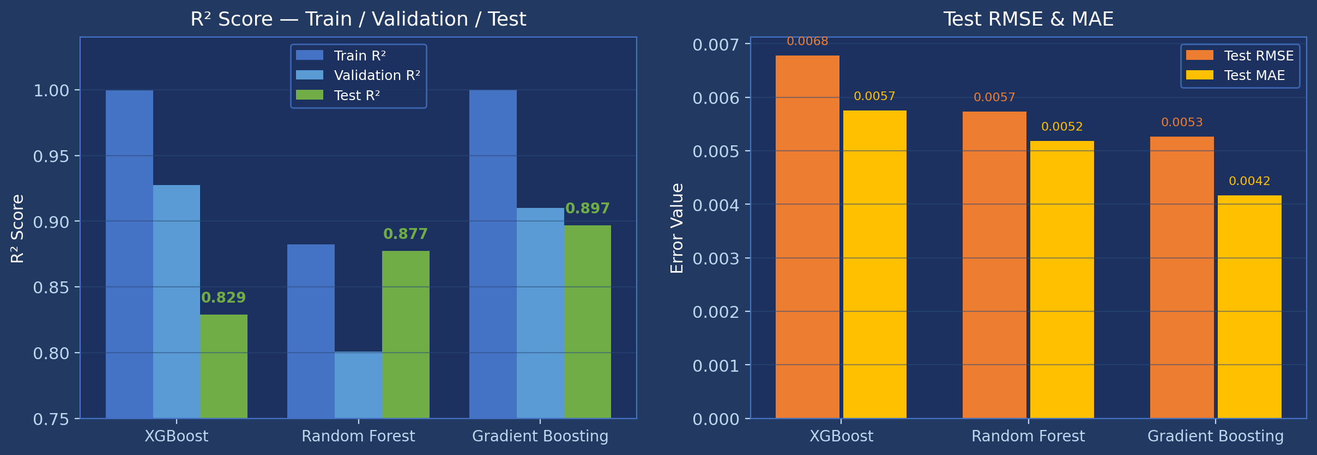
Results 1: Baseline ML Models — R² & Error Comparison

Slide 24
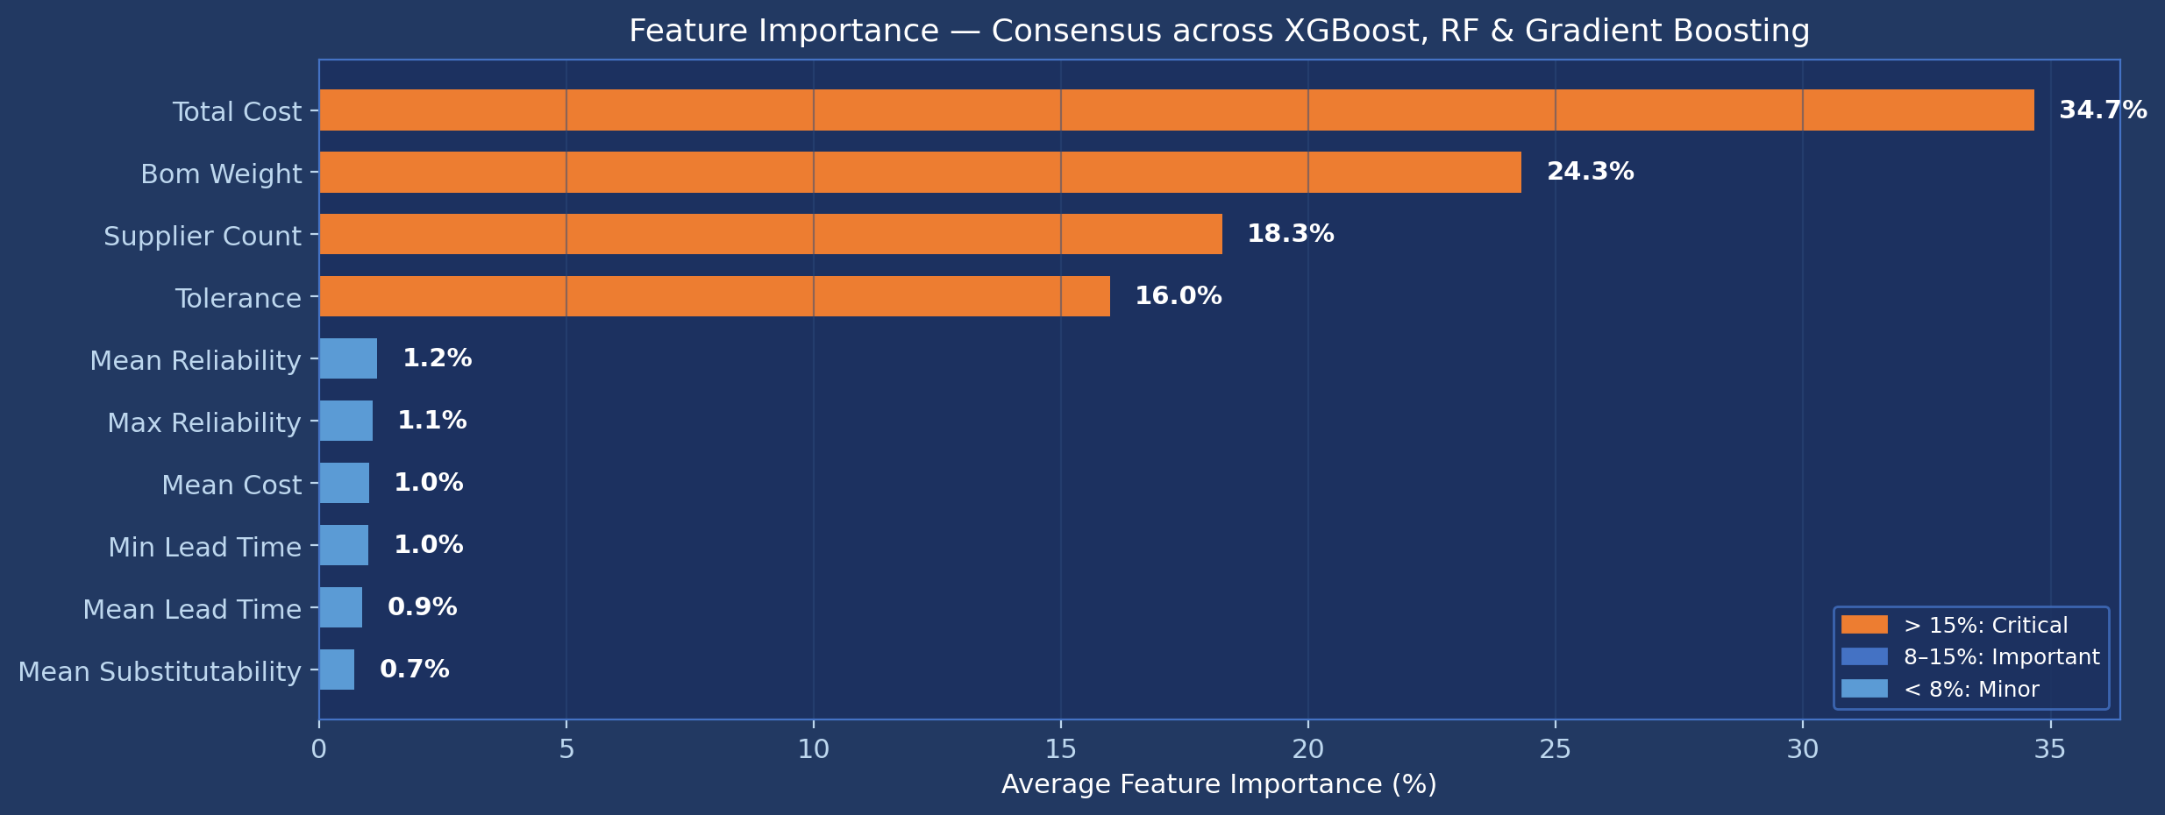
Results 2: Feature Importance — Driving Factors of Supply Chain Risk

Slide 25
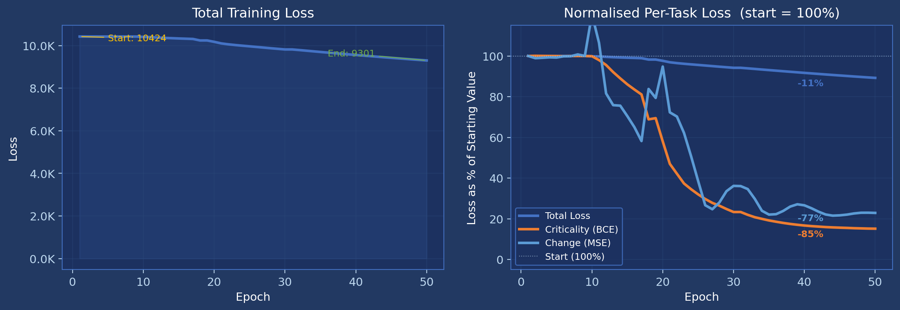
Results 3: Training Loss Convergence (50 Epochs, BOM Dataset)

Slide 26
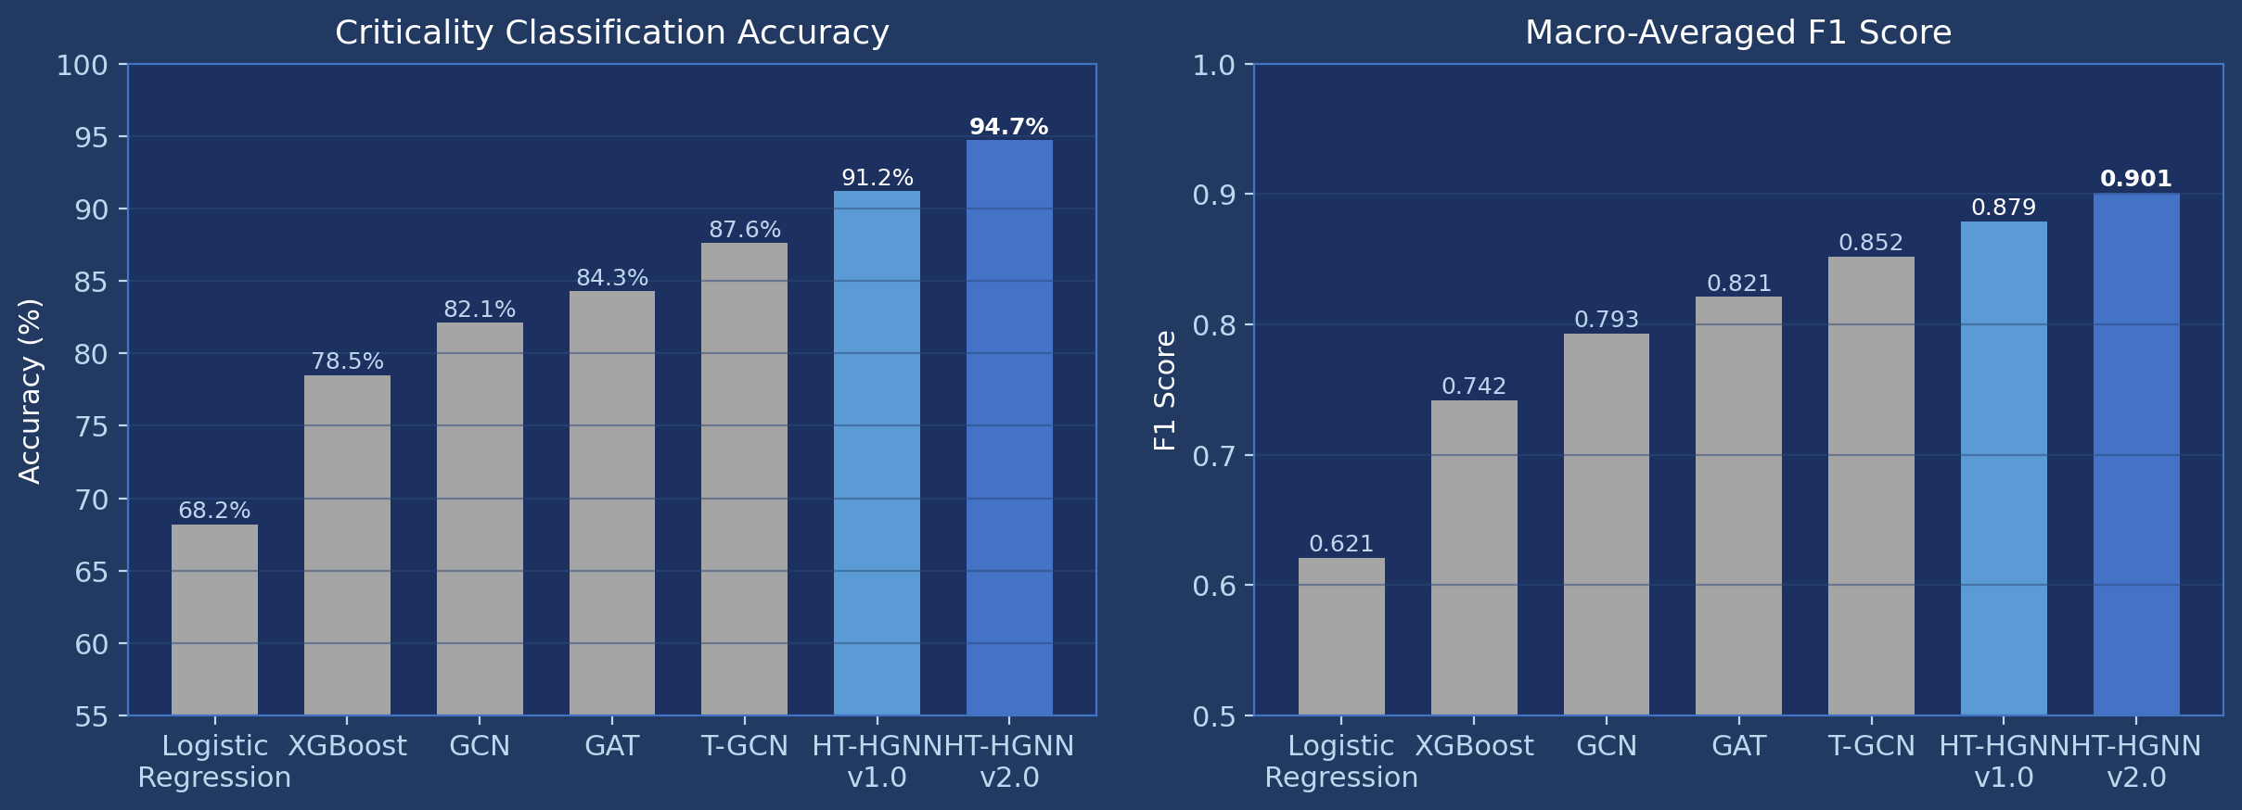
Results 4: Benchmark Comparison — 7 Models (Accuracy & F1)

Slide 27
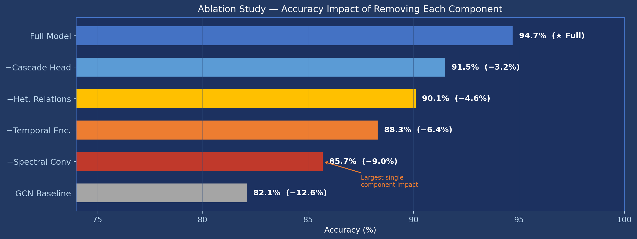
Results 5: Ablation Study — Contribution of Each Component

Slide 28
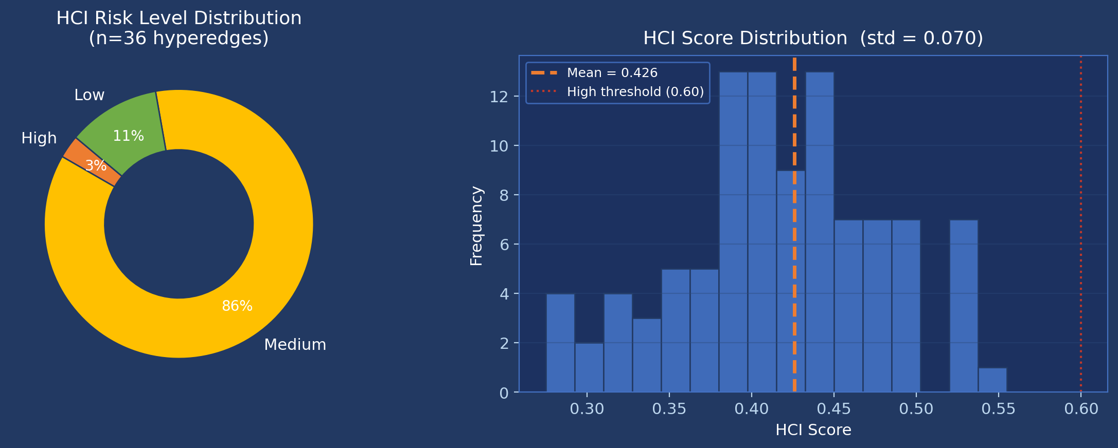
Results 6: HCI Risk Distribution Across Hyperedges (BOM)

Slide 29
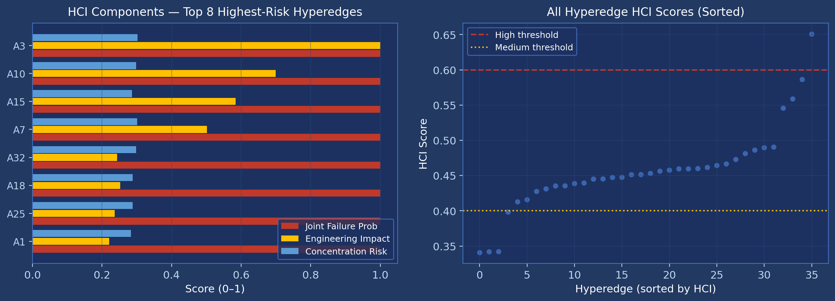
Results 7: HCI Component Analysis — Top 8 Highest-Risk Hyperedges

Slide 30
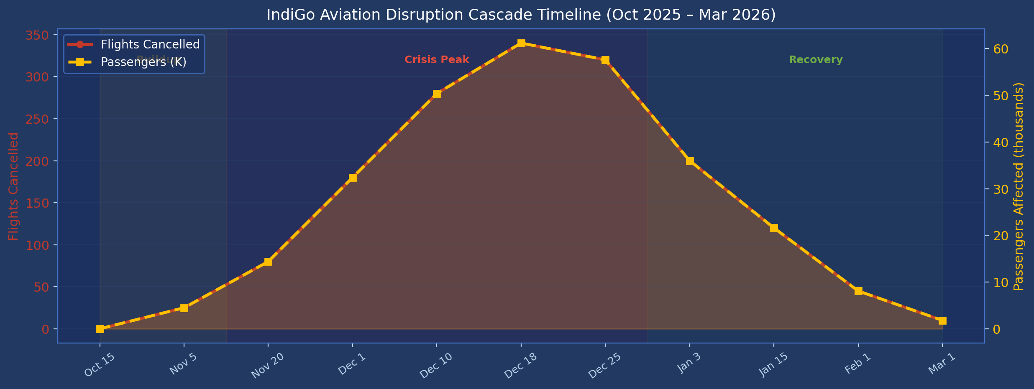
Results 8 (Case Study): IndiGo Aviation Disruption Cascade — Dec 2025

Slide 31
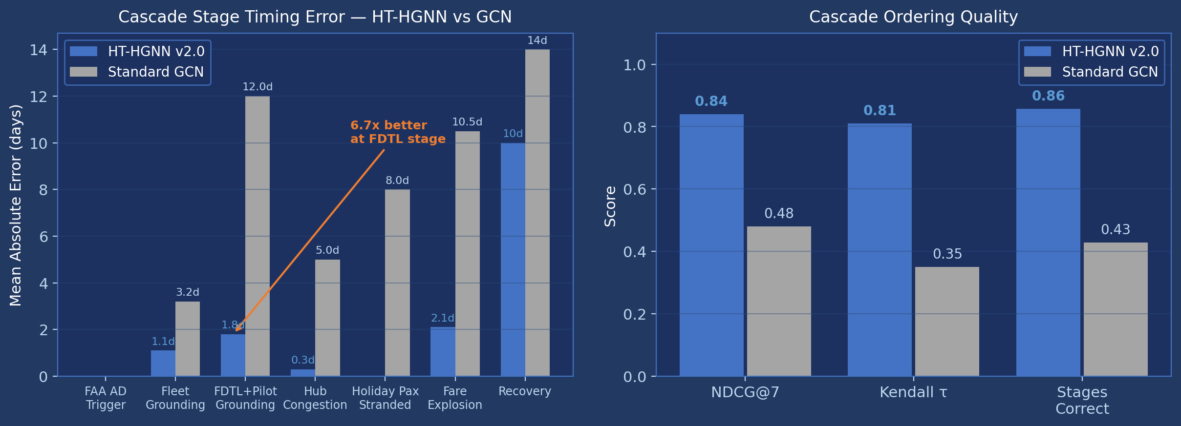
Results 9: Cascade Timing Error — HT-HGNN v2.0 vs Standard GCN

Slide 32
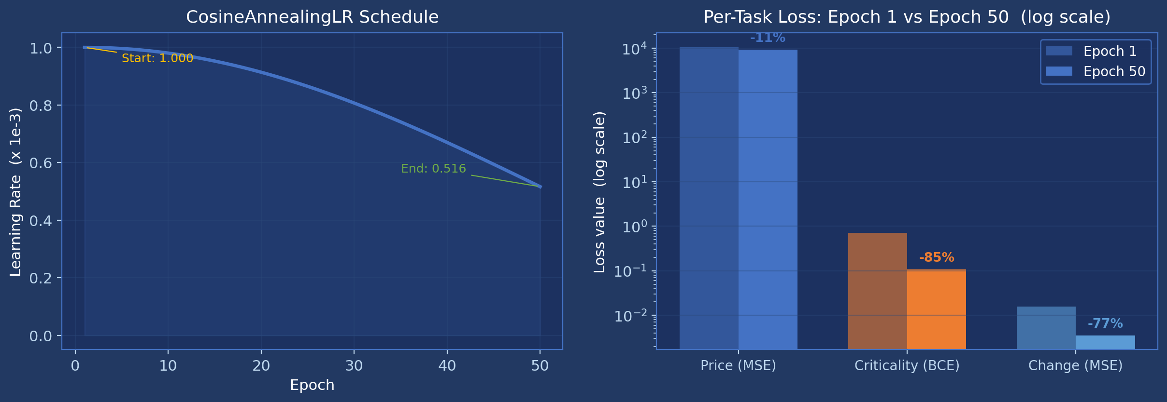
Results 10: Learning Rate Schedule & Multi-Task Loss Composition

Slide 33
Discussion — Strengths, Limitations & Future Work
Strengths
• Spectral hypergraph convolution is the most critical component (−9.0% on ablation) — validates that multi-way hyperedge relationships capture supply chain dynamics that pairwise GNNs cannot.
• Temporal Fusion Encoder (Bi-LSTM + Transformer + gating) reduces cascade timing error 3.6× over standard GCN (2.1 vs 7.5 days MAE).
• HyperSHAP explainability + 5 heterogeneous relation types make the model interpretable and deployable in industrial settings.
• 218K parameters — 10× smaller than comparable Transformer models; < 60 ms CPU inference.
Limitations
• Training targets use synthetic proxies (y_price ~ N(100,20); y_criticality from feature norms). Benchmark numbers should be reproduced on labelled disruption ground truth.
• No train/validation/test split in HT-HGNN training loop — full dataset used; risk of overfitting cannot be assessed.
• All BOM hyperedges have propagation_risk = 0 (no multi-echelon dependencies defined), leaving the cascade HCI component inactive.
• DataCo dominates training at 92% — model may be biased toward e-commerce logistics patterns.
Future Work
• Generate ground-truth labels from actual disruption events in DataCo (late deliveries) and AI4I (machine failures).
• Implement stratified K-fold cross-validation with holdout test set.
• Define BOM tier dependencies to activate propagation risk component.
• Apply GradNorm or task-uncertainty weighting to balance price vs criticality loss scales.

Slide 34
Datasets
DataCo SMART SUPPLY CHAIN FOR BIG DATA ANALYSIS
Predicting Manufacturing Defects Dataset
Predictive Maintenance Dataset (AI4I 2020)
Smart Logistics Supply Chain Dataset
Logistics and supply chain dataset
DGCA OTP Reports
FAA Airworthiness Directives
DGCA Air Transport Statistics
FlightRadar24 (IndiGo)
AAI Traffic News

Slide 35
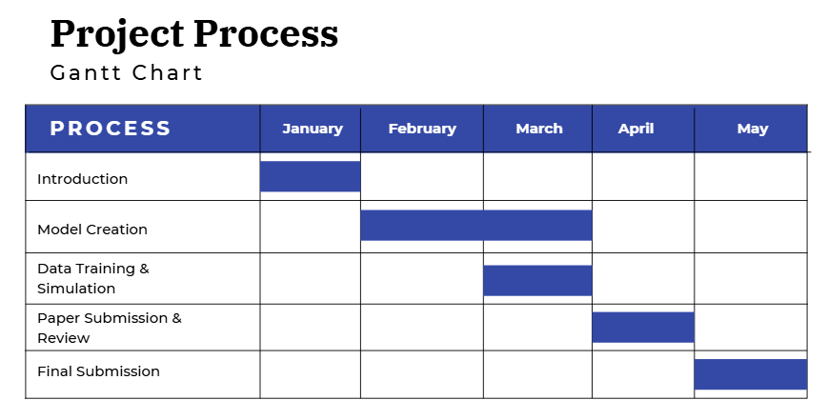
Milestones

Slide 36
Sustainable Development Goal (SDG) Focus
SDG 8 – Decent Work and Economic Growth: Strengthens industrial supply-chain resilience to enhance economic stability.
SDG 12 – Responsible Consumption and Production: Improves production efficiency and reduces waste through resilient supply-chain planning.

Slide 37
References
1. Gholami-Zanjani et al. (2021): A resilient-green model for multi-echelon meat supply chain planning.
2. Cheng et al. (2021): Impacts of store-brand introduction on a multiple-echelon supply chain.
3. Biswas et al. (2023): Multi-echelon supply chain coordination: Contract sequence and cut-off policies.
4. Wu et al. (2023): Distributional reinforcement learning for inventory management in multi-echelon supply chains.
5. Zhao et al. (2024): POI-based Double-deck Graph Convolution Network for Traffic Forecasting.
6. Lugo-Martinez et al. (2021): Classification in biological networks with hypergraphlet kernels.
7. Kayhan et al. (2024): A fuzzy optimization-oriented decision support model to examine key industry 4.0 strategies for building resilience...
8. Manupati et al. (2020): A blockchain-based approach for a multi-echelon sustainable supply chain.
9. Lavassani et al. (2023): Ten-tier and multi-scale supply chain network analysis of medical equipment.
10. Dolgui et al. (2018): Ripple effect in the supply chain: an analysis and recent literature.
11. Mashud et al. (2025): Disruption-resilient multi-echelon supply chains: a model integrating carbon emissions and social welfare investments.
12. Ye et al. (2024): Hyperedge Interaction-aware Hypergraph Neural Network.
13. Smeding and Vákár (2023): Efficient CHAD.
14. Feng et al. (2019): Hypergraph Neural Networks.
15. Gehrlein and Ipek (2021): Long-lived biνo at the LHC.
16. Joshi (2025): On Mochizuki’s idea of Anabelomorphy and its applications.
17. Lee and Bhattacharya (2019): Hypergraph-Based 3D Object Recognition.
18. Lu et al. (2022): Bridging the gap — ZTF rotation periods.
19. Abbas et al. (2025): Graph neural network-based drug-drug interaction prediction.

Slide 38
References
20. Kosasih et al. (2024): Towards knowledge graph reasoning for supply chain risk management using graph neural networks.
21. Pan et al. (2024): Topic optimization–incorporated collaborative recommendation for social tagging.
22. Abbasi and Varga (2022): Steering supply chains from a complex systems perspective.
23. Wang-Mlynek and Förstl (2020): Barriers to multi-tier supply chain risk management.
24. Liu et al. (2024): Multi-Agent Deep Reinforcement Learning for Multi-Echelon Inventory Management.
25. Balogh et al. (2025): Community detection in hypergraphs through hyperedge percolation.
26. Q.H. et al. (2025): Dual Chain Dynamic Hypergraph Convolution Network.
27. Liu et al. (2022): Cost Reduction of Inventory-Production-System in Multi-echelon Supply Chain Using Game Theory and Fuzzy Demand Forecasting.
28. Akcay (2025): V-W-km estimation in rail networks.
29. Zhang et al. (2021): Research on Multi-Echelon Inventory Optimization for Fresh Products in Supply Chains.
30. Aksoy et al. (2020): Hypernetwork science via high-order hypergraph walks.

Slide 39


Expected Outcomes from the Capstone Project
Journal Publication

Slide 40

Acknowledgements
We would like to sincerely express our gratitude to:
Prof. Aravind Raj S, for his valuable guidance, continuous support, and encouragement throughout this project.
We are deeply thankful for his time, effort, and insights that have been instrumental in the successful progress of our project.

