Slide 1

FOODIE
Online Food Ordering & Restaurant Website
PROJECT PRESENTATION
Arun Kumar • 2628MCA0295
Anshu Kumar • 2628MCA0316
Anjali Tyagi • 2628MCA0258
Under the Supervision of Mrs. Mahima Tayal (Assistant Professor)
Department of Computer Applications • KIET Deemed To Be University
01

Slide 2
Presentation Roadmap
A clear journey from the problem to the final outcome
01
Project Overview
02
Objectives & Scope
03
Features & User Flow
04
Technology & Methodology
05
Requirements & Timeline
06
Outcomes & Future Scope
02

Slide 3
Project Overview
Foodie focuses on a simple, responsive and convenient ordering experience
What is Foodie?
• Responsive frontend web application for restaurant food ordering
• Users can explore menu items and filter food by category
• Homepage supports direct ordering from the table
• Order-tracking interface uses Order ID and Table Number
4+
2
3
5
Core food categories
Tracking inputs
Frontend technologies
Week development plan
03

Slide 4
Key Features
Designed around fast discovery, easy ordering and simple tracking
H
Attractive homepage
M
Explore Menu
F
Food Categories
Branding, food introduction and clear CTAs
Browse food items in a structured layout
Pizza, Burger, Biryani, Chinese, Desserts & Drinks
O
Easy Ordering
T
Order Tracking
R
Responsive UI
Simple interface for selecting food
Order ID + Table Number input
Works across desktop, tablet and smartphone
04

Slide 5
Objectives & Success Measures
What the project aims to achieve — and how we know it works
Objectives
• Develop a modern and attractive food-ordering website
• Create a simple, user-friendly interface
• Let customers explore available food items
• Provide an Order Tracking interface
• Demonstrate practical HTML, CSS and JavaScript implementation
• Improve the overall digital food-ordering experience
Measurement of Success
• Easy navigation
• Clear menu and categories
• Accessible order-tracking page
• Order ID and Table Number inputs
• Responsive behavior on different screen sizes
05

Slide 6
Project Scope
The current version is intentionally focused on frontend development
Included
• Home Page — Foodie branding, “Good Food. Good Mood.”, introduction and CTAs
• Menu Page — Pizza, Burger, Biryani, Chinese, Desserts and Drinks
• Order Tracking Page — Order ID and Table Number
• Responsive UI for different devices
Not Included in Current Version
• Production backend
• Permanent database
• Online payment gateway
06

Slide 7
User Flow
A simple journey from discovering the menu to checking an order
1
Open Foodie
User reaches the attractive home page.
2
Explore Menu
User opens the menu and selects a category.
3
Select Food
Food items are explored through the interface.
4
Place Order
The interface supports the ordering journey.
5
Track Order
User enters Order ID and Table Number.
07

Slide 8
Technology Stack
Lightweight technologies suited to a responsive frontend project
Page structure
Visual design
Interactions
HTML
CSS
JavaScript
Semantic structure and content
Layout, styling and responsiveness
Dynamic UI behavior and interactions
Source control
Hosting
Testing
GitHub
GitHub Pages
Browser
Repository and version management
Online deployment of the frontend
Chrome, Edge and Firefox
08

Slide 9
Development Methodology
Five practical stages used to move from requirements to deployment
1
Requirement Analysis
2
UI Design
Identify menu, categories, ordering, tracking and responsive requirements.
Plan home page, menu, food cards, buttons, tracking page and footer.
3
Frontend Development
4
Testing
Implement the interface using HTML → CSS → JavaScript.
Check navigation, buttons, categories, inputs and responsive layout.
5
Deployment
Publish the frontend through GitHub Pages.
09

Slide 10
Hardware & Software Requirements
The project can run on standard student/developer hardware
Hardware
• Computer/Laptop
• Dual Core processor or above
• 4 GB RAM minimum
• Keyboard and Mouse
• Internet connection for deployment/testing
Software
• Windows / Linux / macOS
• Visual Studio Code or any HTML editor
• Google Chrome / Microsoft Edge / Firefox
• Git + GitHub account
• GitHub Pages for hosting
10

Slide 11
5-Week Development Timeline
A phased plan keeps the frontend project structured and testable
Week 1
Requirement Analysis
UI Planning
Week 2
Home Page
Menu & Categories
Week 3
Order Tracking
JavaScript Interactions
Week 4
Responsive Design
Testing & Bug Fixing
Week 5
GitHub Deployment
Documentation & Presentation
11

Slide 12
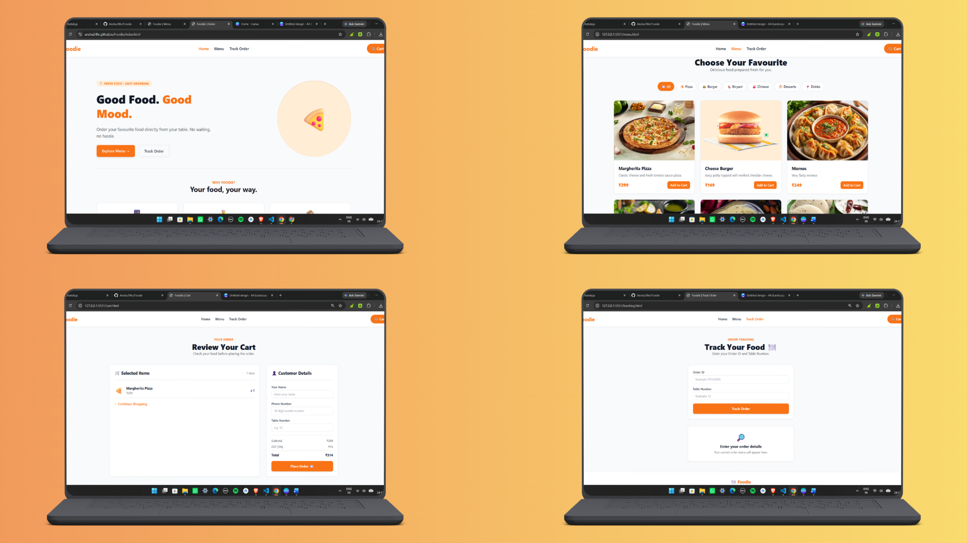

Slide 13
Outcomes & Future Scope
The frontend establishes a strong base for a complete full-stack restaurant platform
Project Outcomes
• Responsive frontend developed using HTML5, CSS3 and JavaScript
• Users can explore categories and interact with ordering features
• Order Tracking interface supports Order ID and Table Number
• UI is designed for desktop, tablet and mobile devices
• Frontend is deployed online using GitHub Pages
Future Scope
• Backend integration
• Database integration
• Online payment gateway
• User authentication
• Real-time order management
12

Slide 14
Thank You
FOODIE — Good Food. Good Mood.😊
QUESTIONS & DISCUSSION
Arun Kumar • Anshu Kumar • Anjali Tyagi
KIET Deemed To Be University | Department of Computer Applications
13

