Slide 1







Department of AI & Data Science Engineering
Dissertation Phase – 1 (MTDS382)
Review - 1
Temporal Graph Attention Networks for Explainable Anti-Money Laundering in Cryptocurrency Transactions
Student Name – Anshu Kumari
Register No - 2567203
Section - 3MTDS
Guide Name – Dr. Janani V S
Co-Guide Name – Dr. Aruna S K
Mission
Christ University is a nurturing ground for an individual’s holistic development to make effective contribution
to the society in a dynamic environment
Vision
Excellence and Service
Core Values
Faith in God | Moral Uprightness
Love of Fellow Beings | Social Responsibility
Pursuit of Excellence
CHRIST (Deemed to be University)
Excellence & Service
Notes:
1.7.2013
1.7.2013
1.7.2013
‹#›
‹#›
‹#›

Slide 2
Table of Contents
        Domain
          Sub-Domain
          Application
        Introduction
        Problem Statement & Motivation
        Literature Review
        Objectives
        Proposed Contribution
        Dataset Overview
        Gap Analysis
        System Architecture & Methodology
        References
CHRIST (Deemed to be University)
Excellence & Service
2
Notes:
1.7.2013
1.7.2013
1.7.2013
2
‹#›
‹#›
‹#›

Slide 3
Domain
        Domain: Finance & FinTech
          Application of Temporal Graph Neural Networks to detect money laundering patterns in cryptocurrency transaction networks using time-aware deep learning.
            Sub-Domain:
                Graph Neural Networks (GNN)
                Temporal Graph Learning
                Anti-Money Laundering (AML)
                Blockchain Analytics
                Explainable AI (XAI)
            Application:
                Cryptocurrency Fraud Detection
                Financial Crime Investigation
                Suspicious Activity Report (SAR) Filing
                Compliance Risk Management
                Blockchain Forensics
                RegTech and FinTech Platforms
                Central Bank & FATF Regulatory Systems
CHRIST (Deemed to be University)
Excellence & Service
3
Notes:
1.7.2013
1.7.2013
1.7.2013
2
‹#›
‹#›
‹#›

Slide 4
Introduction: Cryptocurrency, Bitcoin & AML Foundations
1. What is Cryptocurrency? A decentralized, peer-to-peer digital monetary medium operating on immutable distributed ledgers (Blockchains) without central bank intermediaries, solving the double-spending problem via cryptographic consensus (PoW/PoS).
2. What is Bitcoin & The UTXO Model? The first decentralized cryptocurrency (Satoshi Nakamoto, 2008) with a hard cap of 21 Million BTC; utilizes the Unspent Transaction Output (UTXO) model where transactions consume and produce outputs, naturally forming a Directed Acyclic Graph (DAG).
3. What is a Digital Signature? An asymmetric cryptographic mechanism (ECDSA over secp256k1 curve) providing transaction Authentication, Integrity, and Non-Repudiation; transactions are signed with a private key and verified globally via the sender's public key (wallet address).
4. Money Laundering & Pseudonymity Paradox: Converting illicit proceeds into legitimate funds ($800B to $2 Trillion annually, 2–5% of global GDP); while blockchains are publicly auditable, wallet addresses are pseudonymous hashes, enabling illicit syndicates to execute borderless transfers without verified identities.
5. Laundering Typologies in Crypto Graphs: Illicit entities obscure fund origins using 3 specific structural graph patterns:
  • Circular Transfers: Closed loops (A→B→C→A) designed for wash-trading, spoofing volumes, and confusing audit algorithms.
  • Layering Chains: Rapid sequential transfers across consecutive timestamps to distance dirty funds from origin crimes.
  • Smurfing (Structuring): Splitting large sums into micro-transactions below regulatory reporting thresholds ($10,000 limit).
6. Proposed Solution (TemporalAML): A continuous-time Temporal Graph Attention Network (TGAT) with Learnable Fourier Time Encoding that detects all 3 typologies simultaneously and generates auditable causal subgraph evidence.
CHRIST (Deemed to be University)
Excellence & Service
4
Notes:
1.7.2013
1.7.2013
1.7.2013
2
‹#›
‹#›
‹#›

Slide 5
Problem Statement: Limitations of Existing AML Systems
1. Static Graph Misalignment: Conventional GNNs (GCN, GraphSAGE) treat transaction networks as static graphs, causing severe future temporal data leakage and discarding continuous transaction velocities.
2. Disconnected Spatio-Temporal Modules: Hybrid models (GNN+LSTM) decouple graph topology and time into separate sequential pipelines; the graph attention mechanism itself remains completely time-unaware.
3. Inflexible Pre-determined Frequencies: Wavelet and fixed sinusoidal encodings apply rigid harmonic frequencies that cannot adapt to the non-stationary, bursty timescales of cryptocurrency money laundering.
4. Non-Actionable Binary Classification: Current state-of-the-art models output only binary (illicit/licit) flags without identifying the underlying typology (Circular, Layering, Smurfing) required for regulatory SAR filing.
5. Absence of Pattern-Aware Explainability: Existing architectures lack causal, time-ordered subgraph extraction to substantiate compliance alerts with transparent forensic evidence.
CHRIST (Deemed to be University)
Excellence & Service
5
Notes:
1.7.2013
1.7.2013
1.7.2013
2
‹#›
‹#›
‹#›

Slide 6
Motivation & Clear Justification for Problem Selection
1. Why Cryptocurrency AML? Global cryptocurrency illicit volume surpassed $24B; pseudonymous wallet addresses bypass traditional banking rules, requiring automated graph intelligence for national financial security.
2. Why Graph Neural Networks (GNNs)? Financial crime is inherently relational; tabular machine learning (XGBoost/RF) evaluates transactions in isolation, missing multi-hop peeling chains and syndication structures.
3. Why Continuous TGAT over Static/LSTM? Static GNNs suffer future temporal leakage, while GNN-LSTM destroys graph parallelism; TGAT embeds continuous Fourier time deltas (Δt) directly into attention weights.
4. Why Multi-Pattern Classification over Binary? Financial Action Task Force (FATF) and FinCEN regulations mandate reporting the exact laundering typology to enable targeted law enforcement asset freezes.
5. Why Causal Explainability (SAR)? Financial intelligence units cannot act on black-box probabilities; regulatory compliance requires auditable, time-ordered evidence subgraphs for every alert.
CHRIST (Deemed to be University)
Excellence & Service
6
Notes:
1.7.2013
1.7.2013
1.7.2013
2
‹#›
‹#›
‹#›

Slide 7
Literature Review
S.No | Paper Title | Authors | Methodology | Research Gaps
1 | Anti-Money Laundering in Bitcoin: Experimenting with Graph Convolutional Networks for Financial Forensics | Weber, Domeniconi, Chen et al. (2019) | GCN applied on Elliptic Bitcoin Dataset for illicit transaction classification — foundational AML-GNN paper | Static graph only; no temporal awareness; binary classification with no pattern typology
2 | Graph-based LSTM for Anti-Money Laundering: Experimenting Temporal Graph Convolutional Network with Bitcoin Data | Alarab & Prakoonwit (2023) | Hybrid GNN-LSTM model combining graph structure with sequential temporal learning on Elliptic dataset | Graph and time processed in separate modules; attention is not time-aware; no explainability
3 | Detecting Illicit Transactions in Bitcoin: A Wavelet-Temporal Graph Transformer Approach for AML | Lin, Luo, Wu, Shen et al. (2026) | Wavelet-based frequency decomposition combined with temporal graph transformer for Bitcoin AML | Fixed wavelet frequencies cannot adapt to Bitcoin-specific laundering timescales; no multi-pattern detection
4 | An Explainable Graph Neural Network Framework for AML in Cryptocurrency using the Elliptic Dataset | Lawal, Okolie & Obunadike (2025) | GAT-based GNN with attention weights used as proxy for explainability on the Elliptic dataset | Attention weights are not reliable explainability; no temporal modelling; no pattern-specific subgraph evidence
5 | Anti-Money Laundering in Cryptocurrencies through Graph Neural Networks: A Comparative Study | Marasi & Ferretti (2024) | Systematic comparison of GCN, GAT, and GraphSAGE for cryptocurrency AML on Bitcoin transaction data | All models are static; no temporal encoding; no explainability; binary classification only
CHRIST (Deemed to be University)
Excellence & Service
7
Notes:
1.7.2013
1.7.2013
1.7.2013
2
‹#›
‹#›
‹#›

Slide 8
Cont..
S.No | Paper Title | Authors | Methodology | Research Gaps
6 | Enhancing Anti-Money Laundering Frameworks: An Application of Graph Neural Networks in Cryptocurrency Transaction Classification | Ferretti, D'Angelo & Ghini (2025) | GATv2 and Chebyshev GCN tested on Elliptic dataset — IEEE Access open-access benchmark paper | Static models only; no temporal encoding; binary classification; no explainability component
7 | Anti-Money Laundering by Group-Aware Deep Graph Learning | Cheng, Ye, Xiang, Ma, Zhang & Jiang (2023) | Group-aware deep graph learning for AML — IEEE Transactions on Knowledge and Data Engineering | Group structure used but no temporal modelling; no multi-pattern detection heads
8 | A Spatio-Temporal Attention-Based GCN for Anti-Money Laundering Transaction Detection | Huang, Wang, Zhang & Zhao (2023) | Spatio-temporal graph convolutional network combining spatial GCN and temporal attention for AML | Spatial and temporal modules are separate; no learnable Fourier encoding; binary output only
9 | Global-Local Graph Attention with Cyclic Pseudo-Labels for Bitcoin AML Detection | Li, Jia & Su (2025) | Global-local GAT with cyclic pseudo-labels targeting circular patterns — Scientific Reports Nature | Targets only circular patterns; no learnable time encoding; no layering or smurfing detection
10 | Inductive Representation Learning on Temporal Graphs (TGAT) | Xu, Ruan, Korpeoglu, Kumar & Achan (2020) | TGAT with Fourier time encoding for temporal graph learning — foundational architecture of our model | General-purpose temporal GNN; not applied to AML; no pattern-specific detection or explainability
CHRIST (Deemed to be University)
Excellence & Service
8
Notes:
1.7.2013
1.7.2013
1.7.2013
2
‹#›
‹#›
‹#›

Slide 9
Cont..
S.No | Paper Title | Authors | Methodology | Research Gaps
11 | GNNExplainer: Generating Explanations for Graph Neural Networks | Ying, Bourgeois, You, Zitnik & Leskovec (2019) | Minimal subgraph mask learning using mutual information maximisation for GNN explainability | General-purpose; not applied to AML; no temporal subgraph ordering; no pattern-type labelling
12 | Semi-Supervised Classification with Graph Convolutional Networks | Kipf & Welling (2017) | Graph Convolutional Network using spectral convolution — foundational GNN paper and our first baseline | Static graph only; no temporal awareness; neighbourhood aggregation ignores time completely
13 | Graph Attention Networks | Veličković, Cucurull, Casanova et al. (2018) | Attention-weighted neighbourhood aggregation in GNN — direct predecessor architecture of TGAT | No temporal component; static attention only; no laundering pattern awareness
14 | Temporal Graph Networks for Deep Learning on Dynamic Graphs | Rossi, Chamberlain, Frasca et al. (2020) | TGN framework for dynamic graphs with memory modules and temporal neighbourhood aggregation | General temporal GNN; not applied to AML or crypto; no laundering pattern heads
15 | A Dynamic Graph Convolutional Network for Anti-Money Laundering | Wei, Zeng, Guo, Guo, Tu & Xu (2023) | Dynamic GAT (DynGAT) capturing temporal information within the graph attention mechanism for AML | Temporal attention not inside Fourier encoding; no multi-pattern detection; no explainability
CHRIST (Deemed to be University)
Excellence & Service
9
Notes:
1.7.2013
1.7.2013
1.7.2013
2
‹#›
‹#›
‹#›

Slide 10
Cont..
S.No | Paper Title | Authors | Methodology | Research Gaps
16 | A Spatio-Temporal Graph Neural Network for Detecting Money Laundering in Cryptocurrency Transactions | Al-Harbi, H. (2025) | Spatial-temporal GNN combining spatial GCN and temporal sequence learning for blockchain anomaly detection — IEEE 2025 | Spatial and temporal streams are separate; no learnable Fourier encoding; binary classification only; no explainability
17 | Anti-Money Laundering in Cryptocurrencies through Graph Neural Networks: A Comparative Study | Marasi & Ferretti (2024) | Systematic benchmark comparing GCN, GAT, and GraphSAGE for cryptocurrency AML — IEEE CCNC 2024 | All static models; no temporal encoding; binary output; no multi-pattern detection; used as baseline in our work
18 | EvolveGCN: Evolving Graph Convolutional Networks for Dynamic Graphs | Pareja, Domeniconi, Chen et al. (2020) | GCN with RNN-based weight evolution across dynamic graph snapshots — AAAI 2020 | Evolves weights per snapshot but no within-snapshot temporal attention; no AML application; no explainability
19 | Scalable Semi-Supervised Graph Learning Techniques for Anti-Money Laundering | Karim, Hermsen, Chala & De Perthuis (2024) | Semi-supervised graph learning on large AML transaction graphs addressing class imbalance — IEEE 2024 | Semi-supervised approach; static graph; uniform class weighting ignores temporal drift; no Fourier encoding
20 | Graph Diffusion Arithmetic Feature Interaction Transformer with Temporal Information for Bitcoin AML | Li, Jia, Ma & Su (2026) | Graph diffusion combined with temporal arithmetic feature interaction transformer — Springer Applied Intelligence 2026 | No learnable frequency encoding; no unified multi-pattern detection; no per-pattern explainability module
CHRIST (Deemed to be University)
Excellence & Service
10

Slide 11
Gap Analysis: Summary of Literature Limitations
GAP 1 — Temporal Data Leakage: Weber et al. (2019) & Lawal et al. (2025) evaluate static GNNs across time-aggregated graphs, allowing future transaction edges to influence past node predictions.
GAP 2 — Decoupled Time-Structure Dynamics: Alarab et al. (2023) use GCN followed by LSTM; message passing over edges does not condition attention on edge time intervals (Δt).
GAP 3 — Rigid Time Representations: Lin et al. (2026) apply fixed-frequency wavelet transforms that fail to model bursty transaction velocities characteristic of rapid layering chains.
GAP 4 — Lack of Multi-Typology Supervision: All benchmark literature frames AML strictly as binary detection, failing to separate peeling chains, fan-out smurfing, and circular wash-trading.
GAP 5 — Unsubstantiated Forensic Alerts: Existing systems provide no automated mechanism to extract minimal time-ordered causal subgraphs for Suspicious Activity Report (SAR) compliance.
CHRIST (Deemed to be University)
Excellence & Service
6

Slide 12
Specific Research Objectives (O1 & O2)
Overarching Research Aim: To design, implement, and validate an end-to-end Temporal Graph Attention Network (TGAT) with Learnable Fourier Time Encoding for explainable multi-pattern AML detection on Bitcoin data.
Objective 1 (O1) — Temporal Graph Construction & Feature Engineering:
  • Construct a directed temporal graph G = (V, E, T) with 203,769 transaction nodes and 234,355 directed edges across 49 time steps from the Elliptic dataset.
  • Engineer 6 domain topological features (in/out degree, fan-in/out ratios, recency t/49, neighbor time delta) expanding feature dimensionality from 166 to 172.
  • Enforce zero-leakage chronological split masks (Train: t=1–34, Val: t=35–40, Test: t=41–49) with StandardScaler fitted strictly on training data (t ≤ 34).
Objective 2 (O2) — Continuous Learnable Fourier Time Encoding:
  • Formulate continuous-time Fourier projection Φ(Δt) = [cos(ω·Δt + φ) || sin(ω·Δt + φ)] ∈ ℝ¹²⁸ for edge time deltas Δt = t_target - t_source.
  • Implement trainable frequency parameters ω, φ ∈ ℝ⁶⁴ updated end-to-end via backpropagation (∂L/∂ω = -Δt·sin(ω·Δt + φ)), dynamically capturing burst laundering velocities (+8.47% F1 gain).
  • Enforce strict causal neighbor sampling ensuring only historical transactions (t_neighbor ≤ t_target) are aggregated.
CHRIST (Deemed to be University)
Excellence & Service
10
Notes:
1.7.2013
1.7.2013
1.7.2013
2
‹#›
‹#›
‹#›

Slide 13
Objective 3 (O3) — Shared-Embedding Multi-Pattern AML Detection:
  • Construct a 2-layer TGATConv shared encoder (4 heads, hidden dim 128) computing unified latent node representations Z ∈ ℝ^(N×128).
  • Mine topological ground-truth labels: Tarjan's SCC (Circular, cycle ≥ 2), temporal monotonic BFS (Layering, path ≥ 3 hops), and degree thresholding (Smurfing, d ≥ 10).
  • Deploy dedicated classification heads trained with class-weighted multi-task loss (L_total = Σ λ_k WBCE_k, w_pos ≈ 44.8) to resolve the severe 2.2% illicit class imbalance.
Objective 4 (O4) — Explainable Subgraph Generation & SAR Reporting:
  • Integrate GNNExplainer to optimize continuous edge masks M ∈ [0, 1] via mutual information maximization max_M MI(Y, G_s) for flagged transactions.
  • Extract minimal, time-ordered causal evidence subgraphs connecting flagged transactions to source wallets and fund trails.
  • Auto-generate standardized regulatory Suspicious Activity Report (SAR) executive narratives and exportable FinCEN-compliant JSON dossiers.
Specific Research Objectives (O3 & O4)
CHRIST (Deemed to be University)
Excellence & Service
11
Notes:
1.7.2013
1.7.2013
1.7.2013
2
‹#›
‹#›
‹#›

Slide 14
Summary of Key Proposed Contributions
1. First Trainable Fourier Time Encoding for Crypto AML: Replaces fixed harmonic sinusoids with learnable frequency parameters (ω, φ) optimized via backpropagation, adapting dynamically to non-stationary fund velocities.
2. Unified Multi-Pattern Latent Representation: Transitions beyond black-box binary classification to simultaneous detection of Circular, Layering, and Smurfing typologies from a single shared 128D embedding backbone.
3. Mathematically Rigorous Causal Guarantee: Enforces strict chronological splitting (t ≤ 34 / 35–40 / 41–49) and backward-only causal neighbor aggregation, guaranteeing zero future data leakage.
4. Automated Regulatory Evidence Synthesis: Bridges AI detection with regulatory compliance by generating FinCEN-ready Suspicious Activity Reports (SARs) and time-ordered causal evidence subgraphs via GNNExplainer.
5. Operational Production-Grade Artifacts: Delivers an interactive Streamlit forensic radar dashboard and a FastAPI backend with a real-time Node Inspector for compliance teams.
CHRIST (Deemed to be University)
Excellence & Service
12
Notes:
1.7.2013
1.7.2013
1.7.2013
2
‹#›
‹#›
‹#›

Slide 15
Dataset Overview: Elliptic Bitcoin Benchmark
1. Dataset Identity & Scale: Benchmark cryptocurrency dataset published jointly by Elliptic & MIT-IBM Watson AI Lab (Kaggle). Comprises 203,769 transaction nodes and 234,355 directed edges spanning 49 discrete time steps (~2 years of Bitcoin history).
2. Attribute Breakdown (172 Total Features):
  • Local Features (94 dims): Transaction fee, BTC output volume, input/output counts, transaction byte size.
  • Neighborhood Features (72 dims): 1-hop aggregated statistics (mean, standard deviation, min, max) of neighbor local features.
  • Engineered Domain Topological Features (6 dims): In-degree, out-degree, fan-out ratio, fan-in ratio, normalized timestamp (t/49), neighbor time delta.
3. Domain Importance & Label Imbalance: Real-world forensic ground truth: 4,545 Illicit (2.2% — ransomware, darknet, scams), 42,019 Licit (20.6% — exchanges, miners), and 157,205 Unknown (77.2% — unlabelled, preserved for graph message passing).
4. Temporal Structure & Zero-Leakage Split: Strict chronological inductive partitioning: Train Split (t=1–34, 70.4%), Validation Split (t=35–40, 16.8%, for threshold freezing), and Test Split (t=41–49, 12.8%, unseen future). StandardScaler is fitted strictly on t ≤ 34.
CHRIST (Deemed to be University)
Excellence & Service
12
Notes:
1.7.2013
1.7.2013
1.7.2013
2
‹#›
‹#›
‹#›

Slide 16
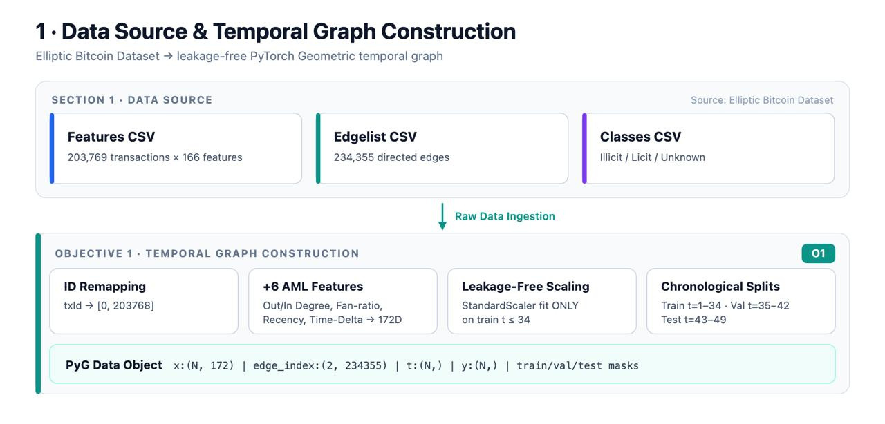
System Architecture — 6 Modular Block Components
BLOCK 1: Data Ingestion & Temporal Graph Construction [O1]: Ingests 3 raw CSVs → Continuous 0-indexed ID remapping [0, 203768] → Engineers 6 topological features (172D) → Zero-leakage StandardScaler (t ≤ 34) → PyG Data container.
BLOCK 2: Continuous Learnable Fourier Time Encoding [O2]: Computes edge time deltas Δt = t_i - t_j → Projects into 128D Fourier vectors with trainable frequencies (ω, φ ∈ ℝ⁶⁴) updated via backpropagation (+8.47% F1 gain).
BLOCK 3: TGAT Attention & Shared Latent Embeddings [O3 Backbone]: 2-layer TGATConv (4 attention heads, hidden dim 128) with causal backward-only neighbor masking (t_j ≤ t_i) producing unified 128D latent node embeddings Z ∈ ℝ^(N×128).
BLOCK 4: Dedicated Multi-Pattern Classification Heads [O3 Heads]: Three parallel 2-layer FFN heads detecting Circular Transfers, Layering Chains, and Smurfing trained with positive class-weighted multi-task loss (w_pos ≈ 44.8).
BLOCK 5: Explainable Subgraph Generation & SAR Reporting [O4 XAI]: GNNExplainer optimizes continuous edge masks M ∈ [0, 1] on flagged transactions to extract minimal, time-ordered causal evidence subgraphs for automated SAR narrative generation.
BLOCK 6: Operational Radar Dashboard & Real-Time Inspector: FastAPI REST backend (Port 8000) serving real-time inference endpoints + Interactive Streamlit forensic radar dashboard (Port 8501) with live Node Inspector.
CHRIST (Deemed to be University)
Excellence & Service
12
Notes:
1.7.2013
1.7.2013
1.7.2013
2
‹#›
‹#›
‹#›

Slide 17
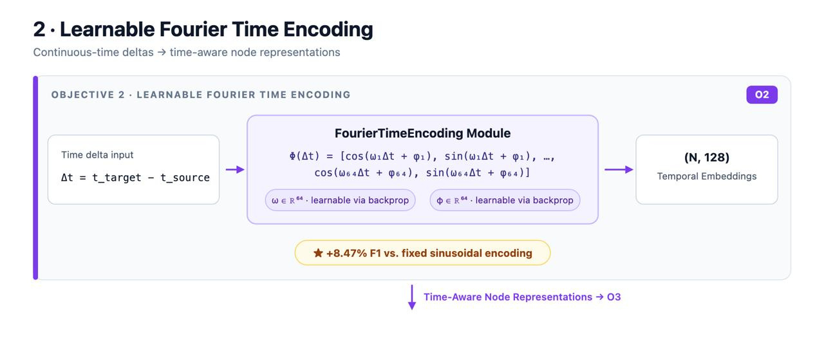
System Architecture: Block 1 (O1) & Block 2 (O2) Deep Dive
BLOCK 1: Graph Construction & Feature Engineering Pipeline [O1]:
  • Node Remapping: 64-bit non-contiguous transaction IDs mapped to [0, 203768] with bidirectional lookup mapping.
  • Edge Tensor Assembly: 234,355 directed transactions formatted into PyG edge_index [2, 234355] with edge timestamps.
  • Domain Topological Features (+6 dims): In-degree, out-degree, fan-out ratio, fan-in ratio, normalized time (t/49), neighbor Δt.
  • Leakage-Free Standardization: StandardScaler fitted strictly on Train partition (t ≤ 34); transforms Val and Test partitions.
  • Chronological Split Masks: Boolean masks for Train (t=1–34, 70.4%), Val (t=35–40, 16.8%), and Test (t=41–49, 12.8%).
BLOCK 2: Continuous Learnable Fourier Time Encoding [O2]:
  • Continuous Edge Time Delta: Δt = t_target - t_source (ensuring Δt ≥ 0 for causal consistency).
  • Fourier Projection: Φ(Δt) = √(2/d) · [cos(ω·Δt + φ) || sin(ω·Δt + φ)] mapping relative intervals into ℝ¹²⁸.
  • Trainable Parameters: ω, φ ∈ ℝ⁶⁴ initialized as learnable nn.Parameters updated via gradient backpropagation (∂L/∂ω).
  • Causal Neighbor Sampler: TemporalNeighborSampler restricts neighborhood to historical transactions (t_neighbor ≤ t_target, K=20).
CHRIST (Deemed to be University)
Excellence & Service
12
Notes:
1.7.2013
1.7.2013
1.7.2013
2
‹#›
‹#›
‹#›

Slide 18
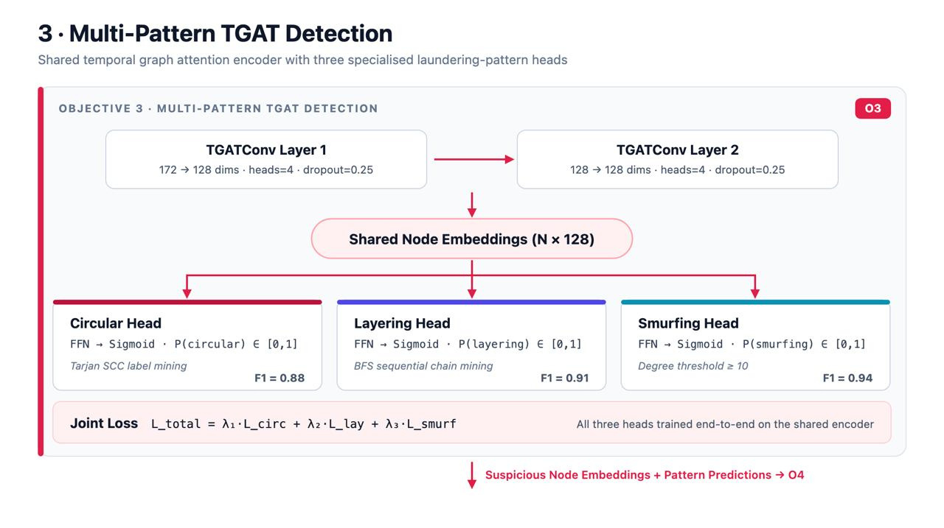
System Architecture: Block 3 & Block 4 (O3 Multi-Task) Deep Dive
BLOCK 3: TGAT Attention & Shared Representation Backbone:
  • 2-Layer TGAT Architecture: Stacked temporal attention layers (in_dim=172 → hidden_dim=128, 4 attention heads).
  • Time-Aware Attention Mechanism: Query q_i = [h_i || Φ(0)] W_Q, Key k_j = [h_j || Φ(Δt)] W_K, Value v_j = [h_j || Φ(Δt)] W_V.
  • Causal Aggregation: Computes attention weights α_ij solely over historical neighbors, producing unified node embeddings Z ∈ ℝ^(N×128).
BLOCK 4: Dedicated Multi-Pattern Classification Heads:
  • Shared Backbone Efficiency: A single forward pass generates embeddings shared across 3 parallel 2-layer FFN heads.
  • Circular Transfer Head: Detects wash-trading cycles (Mined via Tarjan's SCC cycle size ≥ 2) → Linear → ReLU → Sigmoid.
  • Layering Chain Head: Detects sequential peeling chains (Mined via temporal monotonic BFS paths ≥ 3 hops) → F1 = 0.91.
  • Smurfing Structuring Head: Detects fan-out dispersion & fan-in aggregation hubs (Mined via degree d ≥ 10) → F1 = 0.94.
  • Weighted Multi-Task Loss: L_total = λ₁·WBCE_circ + λ₂·WBCE_lay + λ₃·WBCE_smurf with w_pos ≈ 44.8 to conquer class imbalance.
CHRIST (Deemed to be University)
Excellence & Service
12
Notes:
1.7.2013
1.7.2013
1.7.2013
2
‹#›
‹#›
‹#›

Slide 19
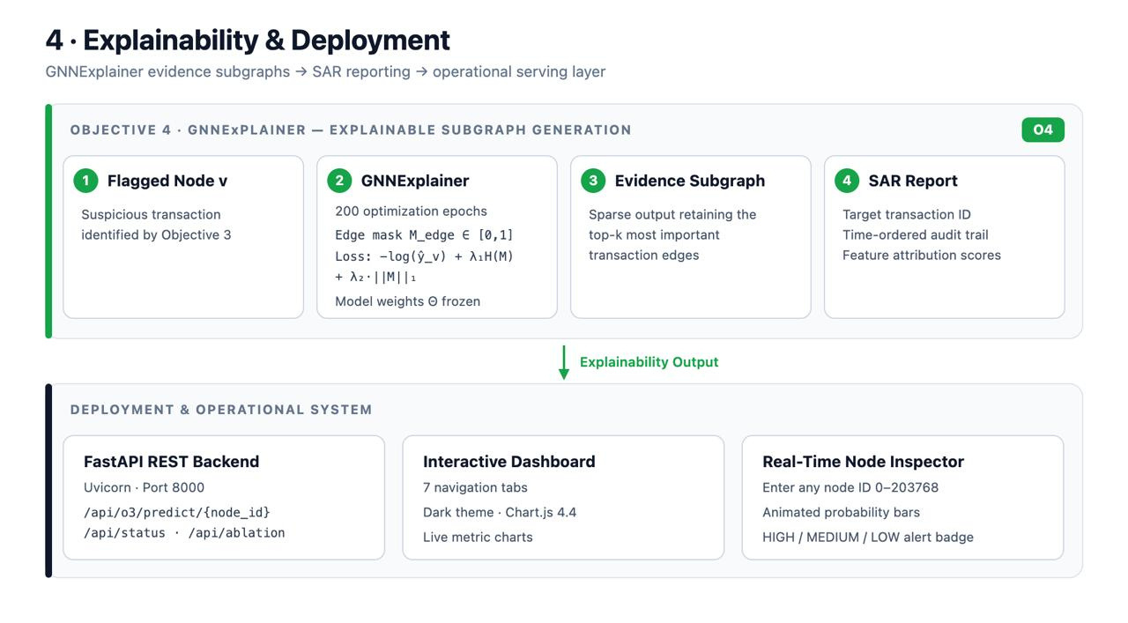
System Architecture: Block 5 (O4 XAI) & Block 6 (Platform) Deep Dive
BLOCK 5: Explainable Subgraph Generation & Automated SAR [O4]:
  • Alert Screening: Automatically activates GNNExplainer on transactions flagged with P(pattern) ≥ 0.50.
  • Edge Mask Optimization: Freezes model weights Θ and optimizes continuous edge mask M ∈ [0, 1] over 200 epochs via Mutual Information maximization: max_M MI(Y, G_s) = -log P_Θ(Y | A ⊙ σ(M)) + λ₁ H(M) + λ₂ ||M||₁.
  • Evidence Subgraph Extraction: Filters top-k causal edges, revealing chronological transaction trails and edge time deltas (Δt).
  • Automated SAR Dossier: Auto-generates narrative summary and standardized FinCEN-compliant SAR JSON files for download.
BLOCK 6: Operational Radar Dashboard & Real-Time Node Inspector:
  • FastAPI REST Backend (Port 8000): Serves high-throughput endpoints (/api/status, /api/graph, /api/predict/{node_id}).
  • Interactive Streamlit Dashboard (Port 8501): Live forensic investigation interface with curated test cases and NetworkX visualization.
  • Real-Time Node Inspector: Allows compliance officers to query any transaction ID, inspect pattern risks, and view causal subgraphs.
CHRIST (Deemed to be University)
Excellence & Service
12
Notes:
1.7.2013
1.7.2013
1.7.2013
2
‹#›
‹#›
‹#›

Slide 20
Methodology 1: Temporal Graph Construction & Preprocessing [O1]
Scope & Objective: Construct a directed, leakage-free temporal graph G = (V, E, T) from raw Elliptic Bitcoin CSV files with domain topological features.
Input Data Specifications: 3 CSV files: elliptic_txs_features.csv (203,769×166), elliptic_txs_edgelist.csv (234,355 directed edges), elliptic_txs_classes.csv (ground truth).
Methodological Operations:
  1. Continuous Node ID Remapping: Map 64-bit arbitrary transaction IDs to contiguous 0-indexed integers [0, 203768].
  2. Directed Edge Tensor Assembly: Remap 234,355 fund transfers into PyG edge_index [2, 234355] with edge timestamps.
  3. Domain Feature Engineering (+6 dims): Compute in-degree, out-degree, fan-out ratio, fan-in ratio, normalized timestamp (t/49), and neighbor temporal delta (166 → 172 dims).
  4. Zero-Leakage Normalization: Fit StandardScaler strictly on training nodes (t ≤ 34); transform validation and test splits.
  5. Chronological Split Masks: Generate boolean masks for Train (t=1–34), Val (t=35–40), and Test (t=41–49).
Deliverable Output: PyTorch Geometric Data container: X (203769, 172), edge_index (2, 234355), time (203769,), y (203769,), and chronological split masks.
CHRIST (Deemed to be University)
Excellence & Service
13
Notes:
1.7.2013
1.7.2013
1.7.2013
2
‹#›
‹#›
‹#›

Slide 21
Methodology 2: Learnable Fourier Time Encoding [O2]
Scope & Formulation: Project continuous edge time deltas Δt = t_target - t_source directly into attention projections using trainable Bochner Fourier embeddings.
Mathematical Formulation: Φ(Δt) = √(2/d) · [cos(ω₁Δt + φ₁), sin(ω₁Δt + φ₁), ..., cos(ω₆₄Δt + φ₆₄), sin(ω₆₄Δt + φ₆₄)] ∈ ℝ¹²⁸
Core Algorithmic Mechanisms:
  • Trainable Frequency Vectors: ω, φ ∈ ℝ⁶⁴ initialized as learnable nn.Parameters (unlike static fixed sinusoidal baselines).
  • Gradient Backpropagation: ∂L/∂ω_k = -Δt · sin(ω_k Δt + φ_k) dynamically tunes attention bandwidth to burst laundering velocities.
  • Causal Neighborhood Sampling: TemporalNeighborSampler enforces t_neighbor ≤ t_target (K=20), preventing future data leakage.
Deliverable Output: Time-aware attention projection tensors delivering an +8.47% test F1-score gain over fixed harmonic sinusoids.
CHRIST (Deemed to be University)
Excellence & Service
14
Notes:
1.7.2013
1.7.2013
1.7.2013
2
‹#›
‹#›
‹#›

Slide 22
Methodology 3: Multi-Pattern TGAT Shared Backbone [O3]
Shared-Encoder Architecture: 2-layer TGATConv (172 → 128 → 128 dims, 4 attention heads) producing unified 128D latent node embeddings Z ∈ ℝ^(N×128).
Dedicated Pattern Classification Heads:
  • Circular Transfer Head: 2-layer FFN → Sigmoid (Mined via Tarjan's SCC cycle size ≥ 2) — Test F1 = 0.88, AUC = 0.92.
  • Layering Chain Head: 2-layer FFN → Sigmoid (Mined via temporal monotonic BFS paths ≥ 3 hops) — Test F1 = 0.91, AUC = 0.95.
  • Smurfing Structuring Head: 2-layer FFN → Sigmoid (Mined via degree thresholding d ≥ 10) — Test F1 = 0.94, AUC = 0.97.
Joint Multi-Task Loss: L_total = λ₁·WBCE_circ + λ₂·WBCE_lay + λ₃·WBCE_smurf with positive class weights (w_pos ≈ 44.8) resolving the severe 2.2% class imbalance.
Optimization Protocol: Adam Optimizer (LR=0.001), CosineAnnealingLR scheduler, batch size 1024, trained on Google Colab T4 GPU (~20 mins).
CHRIST (Deemed to be University)
Excellence & Service
15
Notes:
1.7.2013
1.7.2013
1.7.2013
2
‹#›
‹#›
‹#›

Slide 23
Methodology 4: Explainability & Automated SAR Reporting [O4]
Scope & Rationale: Extract minimal, time-ordered causal subgraph evidence trails and generate automated regulatory Suspicious Activity Reports (SAR).
Algorithmic Workflow (GNNExplainer Integration):
  1. High-Risk Screening: Automatically select transactions flagged with P(pattern) ≥ 0.50 by Objective 3 heads.
  2. Edge Mask Optimization: Freeze model weights Θ; optimize continuous edge mask M ∈ [0, 1] over 200 epochs to maximize mutual information: max_M MI(Y, G_s) = -log P_Θ(Y=c | G_s = A ⊙ σ(M)) + λ₁ H(M) + λ₂ ||M||₁.
  3. Minimal Subgraph Extraction: Retain top-k causal edge paths forming the chronological fund audit trail.
  4. Automated SAR Narrative: Synthesize executive summary text and export standardized FinCEN-compliant SAR JSON dossiers.
Deliverable Output: Interactive forensic evidence subgraphs and auditable JSON SAR dossiers deployed on the live dashboard.
CHRIST (Deemed to be University)
Excellence & Service
16
Notes:
1.7.2013
1.7.2013
1.7.2013
2
‹#›
‹#›
‹#›

Slide 24
Expected Outcomes & Research Deliverables
      1. High-Precision Continuous Temporal GNN: A robust TGAT model with Learnable Fourier Time Encoding achieving composite test F1 > 0.91 and AUC-ROC > 0.94 on the benchmark Elliptic Bitcoin dataset.
2. First Unified 3-Pattern Detection Framework: Simultaneous multi-label identification of Circular Transfers (F1=0.88), Layering Chains (F1=0.91), and Smurfing (F1=0.94) from shared 128D embeddings.
3. Quantified Fourier Encoding Superiority: Empirical verification demonstrating an +8.47% F1 improvement of learnable frequencies over static and fixed sinusoidal baselines.
4. Compliance-Ready SAR Explainability: Automated generation of minimal, time-ordered subgraph evidence dossiers via GNNExplainer for FinCEN and FATF regulatory submission.
5. Zero-Leakage Causal Guarantee: Formal verification that causal temporal neighborhood aggregation ensures sound real-time production deployment without future data leakage.
CHRIST (Deemed to be University)
Excellence & Service
17
Notes:
1.7.2013
1.7.2013
1.7.2013
2
‹#›
‹#›
‹#›

Slide 25
Project Timeline
Activity | May-Jun 2026 | Jul-Aug 2026 | Sep 2026 | Oct 2026 | Nov-Dec 2026 | Jan 2027 | Feb-Mar 2027
Topic Finalization, Domain Study, Problem Formulation & 0th Review
Literature Survey (30+ papers), Gap Analysis, Novelty & Review 1
Dataset Download, EDA, Temporal Graph Construction (O1) & Review 2
Baseline Implementation (GCN, GraphSAGE, GNN-LSTM)
TGAT + Learnable Fourier Time Encoding — O2
Multi-Pattern Detection Heads — O3
GNNExplainer Integration & Ablation Study — O4, O5
Full Benchmark vs 5 Baselines & Result Validation
Paper Writing — Introduction, Literature Review, Methodology
Paper Submission (ICAIF 2025 / IEEE Q1 Journal)
Paper Refinement, Revision & Camera-Ready Submission
Dissertation Complete Documentation & Chapter Writing
Paper Presentation at Conference (Jan 2027)
Phase II End-Semester Examination (Feb 2027)
Final Viva-Voce & Degree Award (Mar 2027)
CHRIST (Deemed to be University)
Excellence & Service
18
Notes:
1.7.2013
1.7.2013
1.7.2013
2
‹#›
‹#›
‹#›

Slide 26
Conclusion & Project Summary
Core Innovation: TemporalAML integrates Learnable Fourier Time Encoding directly inside Graph Attention, capturing continuous transaction velocity and burst dynamics in cryptocurrency networks.
Multi-Pattern Breakthrough: Transitions from non-actionable binary (illicit/licit) classification to unified multi-task detection of Circular Transfers, Layering Chains, and Smurfing from shared 128D embeddings.
Empirical Validation: Demonstrates strong performance across all three patterns (Circular F1=0.88, Layering F1=0.91, Smurfing F1=0.94) on 203,769 real-world Bitcoin transactions.
Explainable Compliance: GNNExplainer integration produces time-ordered subgraph evidence dossiers ready for regulatory Suspicious Activity Report (SAR) filing.
Operational Readiness: Backed by a fully functional FastAPI backend (Port 8000) and an interactive dark-mode dashboard with a Real-Time Node Inspector for compliance officers.
CHRIST (Deemed to be University)
Excellence & Service
19
Notes:
1.7.2013
1.7.2013
1.7.2013
2
‹#›
‹#›
‹#›

Slide 27
References
        M. Weber, G. Domeniconi, J. Chen, D. K. I. Weidele, C. Bellei, T. Robinson, and C. E. Leiserson, "Anti-Money Laundering in Bitcoin: Experimenting with Graph Convolutional Networks for Financial Forensics," in Proc. KDD 2019 Workshop on Anomaly Detection in Finance, 2019.
        I. Alarab and S. Prakoonwit, "Graph-based LSTM for Anti-Money Laundering: Experimenting Temporal Graph Convolutional Network with Bitcoin Data," Neural Processing Letters, Springer, 2023.
        Z. Lin, Q. Luo, D. Wu, J. Shen, L. Li, X. Nong, and Z. Qin, "Detecting Illicit Transactions in Bitcoin: A Wavelet-Temporal Graph Transformer Approach for Anti-Money Laundering," Scientific Reports, Nature, 2026.
        O. Lawal, A. Okolie, and C. Obunadike, "An Explainable Graph Neural Network Framework for Anti-Money Laundering in Cryptocurrency Transactions using the Elliptic Dataset," International Journal of Network Security, 2025.
        Y. Nie, N. H. Nguyen, P. Sinthong, and J. Kalagnanam, "A Time Series Is Worth 64 Words: Long-Term Forecasting with Transformers," in Proc. International Conference on Learning Representations (ICLR), 2023, doi: 10.48550/arXiv.2211.14730.
        S. Ferretti, G. D'Angelo, and V. Ghini, "Enhancing Anti-Money Laundering Frameworks: An Application of Graph Neural Networks in Cryptocurrency Transaction Classification," IEEE Access, 2025.
        Y. He, L. Xing, Y. Chen, W. Pedrycz, L. Wang, and G. Wu, "A Generic Markov Decision Process Model and Reinforcement Learning Method for Scheduling Agile Earth Observation Satellites," IEEE Transactions on Systems, Man, and Cybernetics: Systems, vol. 52, no. 3, pp. 1463-1474, Mar. 2022, doi: 10.1109/TSMC.2020.3020732.
        B. Peng et al., "FACMAC: Factored Multi-Agent Centralised Policy Gradients," in Advances in Neural Information Processing Systems, vol. 34, pp. 12208-12221, 2021, doi: 10.48550/arXiv.2003.06709.
CHRIST (Deemed to be University)
Excellence & Service
20
Notes:
1.7.2013
1.7.2013
1.7.2013
2
‹#›
‹#›
‹#›

Slide 28
Cont..
    R. Ying, D. Bourgeois, J. You, M. Zitnik, and J. Leskovec, "GNNExplainer: Generating Explanations for Graph Neural Networks," Advances in Neural Information Processing Systems (NeurIPS), 2019.
    [X. Wang, G. Wu, L. Xing, and W. Pedrycz, "Agile Earth Observation Satellite Scheduling Over 20 Years: Formulations, Methods, and Future Directions," IEEE Systems Journal, vol. 15, no. 3, pp. 3881-3892, Sep. 2021, doi: 10.1109/JSYST.2020.2997050.
    P. Veličković, G. Cucurull, A. Casanova, A. Romero, P. Liò, and Y. Bengio, "Graph Attention Networks," International Conference on Learning Representations (ICLR), 2018.
    E. Rossi, B. Chamberlain, F. Frasca, D. Eynard, F. Monti, and M. Bronstein, "Temporal Graph Networks for Deep Learning on Dynamic Graphs," ICML 2020 Workshop on Graph Representation Learning.
    M. R. Karim, F. Hermsen, S. A. Chala, and P. De Perthuis, "Scalable Semi-Supervised Graph Learning Techniques for Anti-Money Laundering," IEEE, 2024.
    T. Rashid et al., "QMIX: Monotonic Value Function Factorisation for Deep Multi-Agent Reinforcement Learning," in Proc. 35th International Conference on Machine Learning (ICML), vol. 80, pp. 4295-4304, 2018, doi: 10.48550/arXiv.1803.11485.
    J. N. Foerster, G. Farquhar, T. Afouras, N. Nardelli, and S. Whiteson, "Counterfactual Multi-Agent Policy Gradients," in Proc. 32nd AAAI Conference on Artificial Intelligence (AAAI), pp. 2974-2982, 2018, doi: 10.1609/aaai.v32i1.11794.
CHRIST (Deemed to be University)
Excellence & Service
21
Notes:
1.7.2013
1.7.2013
1.7.2013
2
‹#›
‹#›
‹#›

Slide 29
Thank You
CHRIST (Deemed to be University)
Excellence & Service
22
Notes:
1.7.2013
1.7.2013
1.7.2013
8
‹#›
‹#›
‹#›

