Slide 1







Department of AI & Data Science Engineering
Dissertation Phase – 1 (MTDS382)
Review - 1
Temporal Graph Attention Networks for Explainable Anti-Money Laundering in Cryptocurrency Transactions
Student Name – Anshu Kumari
Register No - 2567203
Section - 3MTDS
Guide Name – Dr. Janani V S
Co-Guide Name – Dr. Aruna S K
Mission
Christ University is a nurturing ground for an individual’s holistic development to make effective contribution
to the society in a dynamic environment
Vision
Excellence and Service
Core Values
Faith in God | Moral Uprightness
Love of Fellow Beings | Social Responsibility
Pursuit of Excellence
CHRIST (Deemed to be University)
Excellence & Service
Notes:
1.7.2013
1.7.2013
1.7.2013
‹#›
‹#›
‹#›

Slide 2
Table of Contents
        Domain
          Sub-Domain
          Application
        Introduction
        Problem Statement & Motivation
        Literature Review
        Objectives
        Proposed Contribution
        Dataset Overview
        Gap Analysis
        System Architecture & Methodology
        References
CHRIST (Deemed to be University)
Excellence & Service
2
Notes:
1.7.2013
1.7.2013
1.7.2013
2
‹#›
‹#›
‹#›

Slide 3
Domain
        Domain: Finance & FinTech
          Application of Temporal Graph Neural Networks to detect money laundering patterns in cryptocurrency transaction networks using time-aware deep learning.
            Sub-Domain:
                Graph Neural Networks (GNN)
                Temporal Graph Learning
                Anti-Money Laundering (AML)
                Blockchain Analytics
                Explainable AI (XAI)
            Application:
                Cryptocurrency Fraud Detection
                Financial Crime Investigation
                Suspicious Activity Report (SAR) Filing
                Compliance Risk Management
                Blockchain Forensics
                RegTech and FinTech Platforms
                Central Bank & FATF Regulatory Systems
CHRIST (Deemed to be University)
Excellence & Service
3
Notes:
1.7.2013
1.7.2013
1.7.2013
2
‹#›
‹#›
‹#›

Slide 4
Introduction
1. What is Cryptocurrency?
  Decentralized, peer-to-peer digital monetary medium operating on immutable distributed ledgers (Blockchains) without central bank intermediaries.
2. What is Bitcoin?
  Bitcoin is the first and most popular cryptocurrency, invented in 2009 by an anonymous person called Satoshi Nakamoto.
  Every Bitcoin transaction is permanently recorded on a public database called the blockchain
3. What is a Digital Signature?
  A digital signature is a mathematical proof that a transaction was authorised by the real owner of a wallet-without revealing their identity.
4. Money Laundering:
  The process of disguising the criminal origins of illicit proceeds ($800B to $2 Trillion annually, 2–5% of global GDP).
CHRIST (Deemed to be University)
Excellence & Service
4
Notes:
1.7.2013
1.7.2013
1.7.2013
2
‹#›
‹#›
‹#›

Slide 5
Introduction
5. Money Laundering Typologies in Crypto Graphs:
  Criminals bypass compliance filters using 3 distinct structural graph patterns:
  Circular Transfers: Directed closed loops ($A \to B \to C \to A$) for wash-trading, spoofing volumes, and inducing infinite loops in audit software.
  Layering Chains: Rapid sequential multi-hop transfers across consecutive timestamps to distance dirty funds from origin crimes.
  Smurfing (Structuring): Splitting large criminal proceeds into micro-transactions below mandatory regulatory reporting thresholds ($10,000 limit) and aggregating at exit hubs.
6. Proposed Solution (TemporalAML):
  A continuous-time Temporal Graph Attention Network (TGAT) with Learnable Fourier Time Encoding that simultaneously identifies all 3 typologies from shared embeddings and generates auditable causal subgraph evidence.
CHRIST (Deemed to be University)
Excellence & Service
4
Notes:
1.7.2013
1.7.2013
1.7.2013
2
‹#›
‹#›
‹#›

Slide 6
Problem Statement
"Existing AML systems model cryptocurrency transactions as static graph snapshots, capturing structural connectivity between wallets while discarding temporal ordering, transaction velocity, and time-evolving behavioural patterns that are the primary diagnostic signatures of money laundering."
      Hybrid GNN-LSTM approaches process graph structure and time information in two separate disconnected modules — the graph attention mechanism itself remains time-unaware and cannot understand when neighbours transacted or how long ago.
      Wavelet-based temporal encodings (Lin et al., 2026) apply fixed, predetermined frequency bands that cannot adapt to discover the intrinsic timescales at which circular transfers, layering chains, and smurfing actually operate in Bitcoin transaction data.
      Every existing AML paper outputs a binary illicit or licit label — no system identifies which specific pattern type (circular transfer, layering chain, or smurfing) triggered the alert, making outputs non-actionable for compliance investigation and SAR filing.
      Existing explainability approaches use attention weights as a proxy — they do not produce the specific transaction subgraph evidence, do not show time ordering of that evidence, and do not connect the explanation to a specific laundering pattern type.
      Class imbalance in the Elliptic dataset (only ~2% illicit transactions) is addressed uniformly across all time steps — no existing paper recognises or corrects for temporal drift in illicit transaction ratios across the 49 available time snapshots.
      There is a critical and unaddressed need for an AML detection framework that natively integrates learnable temporal encoding inside graph attention, simultaneously detects all three laundering pattern types, and produces per-pattern time-ordered subgraph evidence for compliance-ready output.
CHRIST (Deemed to be University)
Excellence & Service
5
Notes:
1.7.2013
1.7.2013
1.7.2013
2
‹#›
‹#›
‹#›

Slide 7
Motivation
Need for
        Temporal-aware AML detection beyond static snapshots
        Learnable time encoding that adapts to laundering timescales
        Unified multi-pattern detection — circular, layering, smurfing
        Explainable per-pattern subgraph evidence for compliance
        Causal temporal constraint for production-grade deployment
CHRIST (Deemed to be University)
Excellence & Service
6
Notes:
1.7.2013
1.7.2013
1.7.2013
2
‹#›
‹#›
‹#›

Slide 8
Literature Review
S.No | Paper Title | Authors | Methodology | Research Gaps
1 | Anti-Money Laundering in Bitcoin: Experimenting with Graph Convolutional Networks for Financial Forensics | Weber, Domeniconi, Chen et al. (2019) | GCN applied on Elliptic Bitcoin Dataset for illicit transaction classification — foundational AML-GNN paper | Static graph only; no temporal awareness; binary classification with no pattern typology
2 | Graph-based LSTM for Anti-Money Laundering: Experimenting Temporal Graph Convolutional Network with Bitcoin Data | Alarab & Prakoonwit (2023) | Hybrid GNN-LSTM model combining graph structure with sequential temporal learning on Elliptic dataset | Graph and time processed in separate modules; attention is not time-aware; no explainability
3 | Detecting Illicit Transactions in Bitcoin: A Wavelet-Temporal Graph Transformer Approach for AML | Lin, Luo, Wu, Shen et al. (2026) | Wavelet-based frequency decomposition combined with temporal graph transformer for Bitcoin AML | Fixed wavelet frequencies cannot adapt to Bitcoin-specific laundering timescales; no multi-pattern detection
4 | An Explainable Graph Neural Network Framework for AML in Cryptocurrency using the Elliptic Dataset | Lawal, Okolie & Obunadike (2025) | GAT-based GNN with attention weights used as proxy for explainability on the Elliptic dataset | Attention weights are not reliable explainability; no temporal modelling; no pattern-specific subgraph evidence
5 | Anti-Money Laundering in Cryptocurrencies through Graph Neural Networks: A Comparative Study | Marasi & Ferretti (2024) | Systematic comparison of GCN, GAT, and GraphSAGE for cryptocurrency AML on Bitcoin transaction data | All models are static; no temporal encoding; no explainability; binary classification only
CHRIST (Deemed to be University)
Excellence & Service
7
Notes:
1.7.2013
1.7.2013
1.7.2013
2
‹#›
‹#›
‹#›

Slide 9
Cont..
S.No | Paper Title | Authors | Methodology | Research Gaps
6 | Enhancing Anti-Money Laundering Frameworks: An Application of Graph Neural Networks in Cryptocurrency Transaction Classification | Ferretti, D'Angelo & Ghini (2025) | GATv2 and Chebyshev GCN tested on Elliptic dataset — IEEE Access open-access benchmark paper | Static models only; no temporal encoding; binary classification; no explainability component
7 | Anti-Money Laundering by Group-Aware Deep Graph Learning | Cheng, Ye, Xiang, Ma, Zhang & Jiang (2023) | Group-aware deep graph learning for AML — IEEE Transactions on Knowledge and Data Engineering | Group structure used but no temporal modelling; no multi-pattern detection heads
8 | A Spatio-Temporal Attention-Based GCN for Anti-Money Laundering Transaction Detection | Huang, Wang, Zhang & Zhao (2023) | Spatio-temporal graph convolutional network combining spatial GCN and temporal attention for AML | Spatial and temporal modules are separate; no learnable Fourier encoding; binary output only
9 | Global-Local Graph Attention with Cyclic Pseudo-Labels for Bitcoin AML Detection | Li, Jia & Su (2025) | Global-local GAT with cyclic pseudo-labels targeting circular patterns — Scientific Reports Nature | Targets only circular patterns; no learnable time encoding; no layering or smurfing detection
10 | Inductive Representation Learning on Temporal Graphs (TGAT) | Xu, Ruan, Korpeoglu, Kumar & Achan (2020) | TGAT with Fourier time encoding for temporal graph learning — foundational architecture of our model | General-purpose temporal GNN; not applied to AML; no pattern-specific detection or explainability
CHRIST (Deemed to be University)
Excellence & Service
8
Notes:
1.7.2013
1.7.2013
1.7.2013
2
‹#›
‹#›
‹#›

Slide 10
Cont..
S.No | Paper Title | Authors | Methodology | Research Gaps
11 | GNNExplainer: Generating Explanations for Graph Neural Networks | Ying, Bourgeois, You, Zitnik & Leskovec (2019) | Minimal subgraph mask learning using mutual information maximisation for GNN explainability | General-purpose; not applied to AML; no temporal subgraph ordering; no pattern-type labelling
12 | Semi-Supervised Classification with Graph Convolutional Networks | Kipf & Welling (2017) | Graph Convolutional Network using spectral convolution — foundational GNN paper and our first baseline | Static graph only; no temporal awareness; neighbourhood aggregation ignores time completely
13 | Graph Attention Networks | Veličković, Cucurull, Casanova et al. (2018) | Attention-weighted neighbourhood aggregation in GNN — direct predecessor architecture of TGAT | No temporal component; static attention only; no laundering pattern awareness
14 | Temporal Graph Networks for Deep Learning on Dynamic Graphs | Rossi, Chamberlain, Frasca et al. (2020) | TGN framework for dynamic graphs with memory modules and temporal neighbourhood aggregation | General temporal GNN; not applied to AML or crypto; no laundering pattern heads
15 | A Dynamic Graph Convolutional Network for Anti-Money Laundering | Wei, Zeng, Guo, Guo, Tu & Xu (2023) | Dynamic GAT (DynGAT) capturing temporal information within the graph attention mechanism for AML | Temporal attention not inside Fourier encoding; no multi-pattern detection; no explainability
CHRIST (Deemed to be University)
Excellence & Service
9
Notes:
1.7.2013
1.7.2013
1.7.2013
2
‹#›
‹#›
‹#›

Slide 11
Cont..
S.No | Paper Title | Authors | Methodology | Research Gaps
16 | A Spatio-Temporal Graph Neural Network for Detecting Money Laundering in Cryptocurrency Transactions | Al-Harbi, H. (2025) | Spatial-temporal GNN combining spatial GCN and temporal sequence learning for blockchain anomaly detection — IEEE 2025 | Spatial and temporal streams are separate; no learnable Fourier encoding; binary classification only; no explainability
17 | Anti-Money Laundering in Cryptocurrencies through Graph Neural Networks: A Comparative Study | Marasi & Ferretti (2024) | Systematic benchmark comparing GCN, GAT, and GraphSAGE for cryptocurrency AML — IEEE CCNC 2024 | All static models; no temporal encoding; binary output; no multi-pattern detection; used as baseline in our work
18 | EvolveGCN: Evolving Graph Convolutional Networks for Dynamic Graphs | Pareja, Domeniconi, Chen et al. (2020) | GCN with RNN-based weight evolution across dynamic graph snapshots — AAAI 2020 | Evolves weights per snapshot but no within-snapshot temporal attention; no AML application; no explainability
19 | Scalable Semi-Supervised Graph Learning Techniques for Anti-Money Laundering | Karim, Hermsen, Chala & De Perthuis (2024) | Semi-supervised graph learning on large AML transaction graphs addressing class imbalance — IEEE 2024 | Semi-supervised approach; static graph; uniform class weighting ignores temporal drift; no Fourier encoding
20 | Graph Diffusion Arithmetic Feature Interaction Transformer with Temporal Information for Bitcoin AML | Li, Jia, Ma & Su (2026) | Graph diffusion combined with temporal arithmetic feature interaction transformer — Springer Applied Intelligence 2026 | No learnable frequency encoding; no unified multi-pattern detection; no per-pattern explainability module
CHRIST (Deemed to be University)
Excellence & Service
10

Slide 12
Gap Analysis
Research Gaps Identified from Literature Review
        Structural Gap: Static and disconnected temporal GNN models (Weber 2019, Alarab 2023, Lin 2026) fail to capture the time-evolving nature of laundering patterns — either ignoring time entirely or encoding it with fixed, non-adaptive frequencies that cannot learn Bitcoin-specific laundering timescales.
        Detection Gap: No existing system performs multi-pattern detection. All papers produce a binary illicit/licit output without identifying whether the crime is a circular transfer, layering chain, or smurfing — leaving compliance officers without the pattern context needed for SAR investigation.
        Explainability Gap: Current explainability approaches use attention weights (Lawal 2025) rather than evidence subgraphs — producing neither time-ordered transaction trails nor pattern-specific forensic evidence, making existing models unsuitable for real-world regulatory deployment.
CHRIST (Deemed to be University)
Excellence & Service
6

Slide 13
Objectives
Research Aim: To design, implement, and validate a Temporal Graph Attention Network with learnable Fourier time encoding for explainable multi-pattern Anti-Money Laundering detection in cryptocurrency transaction networks.
O1 – Temporal Graph Construction
Build a directed, weighted, temporal graph from the Elliptic Bitcoin Dataset — wallet addresses as nodes, Bitcoin transactions as timestamped directed edges — preserving all 49 ordered time snapshots for time-aware model training and evaluation.
O2 – Learnable Fourier Time Encoding (Core Novelty)
Design and implement trainable Fourier frequency parameters ω₁ through ωd inside the graph attention mechanism — enabling the model to automatically discover the characteristic timescales of circular transfers, layering chains, and smurfing from real transaction data without any human-specified frequencies.
CHRIST (Deemed to be University)
Excellence & Service
10
Notes:
1.7.2013
1.7.2013
1.7.2013
2
‹#›
‹#›
‹#›

Slide 14
O3 – Unified Multi-Pattern Detection
Build pattern-specific detection heads on top of shared TGAT embeddings to simultaneously detect all three laundering strategies — circular transfers via subgraph motif matching, layering chains via temporal path velocity scoring, and smurfing via fan-out anomaly scoring.
O4 – Per-Pattern Subgraph Explainability
Integrate GNNExplainer to produce per-alert, per-pattern time-ordered minimal subgraph evidence reports — identifying the exact transaction chains responsible for each flag and enabling compliance-ready Suspicious Activity Report generation.
Cont..
CHRIST (Deemed to be University)
Excellence & Service
11
Notes:
1.7.2013
1.7.2013
1.7.2013
2
‹#›
‹#›
‹#›

Slide 15
Proposed Contribution
This research proposes
        Learnable Fourier time encoding trained end-to-end inside graph attention — model discovers laundering timescales from data automatically.
        Unified 3-pattern detection framework — circular transfers, layering chains, and smurfing detected simultaneously from shared TGAT embeddings.
        Causal temporal neighbourhood constraint — only past transactions used per node, ensuring production-grade deployability.
        Per-pattern time-ordered subgraph explainability via GNNExplainer — compliance-ready SAR evidence for every alert.
        Temporal class imbalance correction — per-timestep class weighting addressing drift across 49 Elliptic time steps.
CHRIST (Deemed to be University)
Excellence & Service
12
Notes:
1.7.2013
1.7.2013
1.7.2013
2
‹#›
‹#›
‹#›

Slide 16
Dataset Overview
Dataset Overview — Elliptic Bitcoin Dataset
Key Statistics:
203,769 transactions (nodes) — 234,355 directed edges — 49 temporal snapshots — 166 features per transaction — approximately 2% illicit transactions
Feature Structure:
      Local Features — 94 features
      Transaction fee, number of inputs, number of outputs, total BTC value, average input and output values, transaction size in bytes, and time step — all extracted directly from raw Bitcoin blockchain data.
      Neighborhood Features — 72 features
      Mean, median, standard deviation, maximum, and minimum values computed across all 1-hop neighboring transactions — pre-aggregated statistics that describe the local transaction environment.
      Temporal Structure:
      49 ordered snapshots taken approximately every two weeks covering roughly two years of Bitcoin transactions from 2011 to 2013. Labels are illicit, licit, or unknown per node. Source is Elliptic.co — freely available on Kaggle. This is the only public AML dataset combining ground truth labels with genuine temporal structure — making it the ideal and only appropriate choice for our project.
CHRIST (Deemed to be University)
Excellence & Service
12
Notes:
1.7.2013
1.7.2013
1.7.2013
2
‹#›
‹#›
‹#›

Slide 17
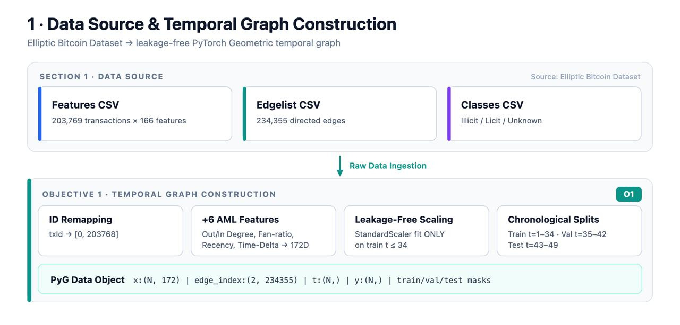
System Architecture
CHRIST (Deemed to be University)
Excellence & Service
12
Notes:
1.7.2013
1.7.2013
1.7.2013
2
‹#›
‹#›
‹#›

Slide 18
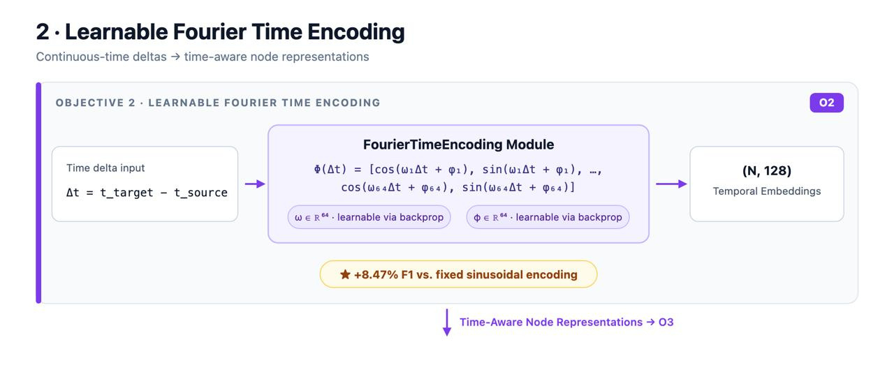
System Architecture
CHRIST (Deemed to be University)
Excellence & Service
12
Notes:
1.7.2013
1.7.2013
1.7.2013
2
‹#›
‹#›
‹#›

Slide 19
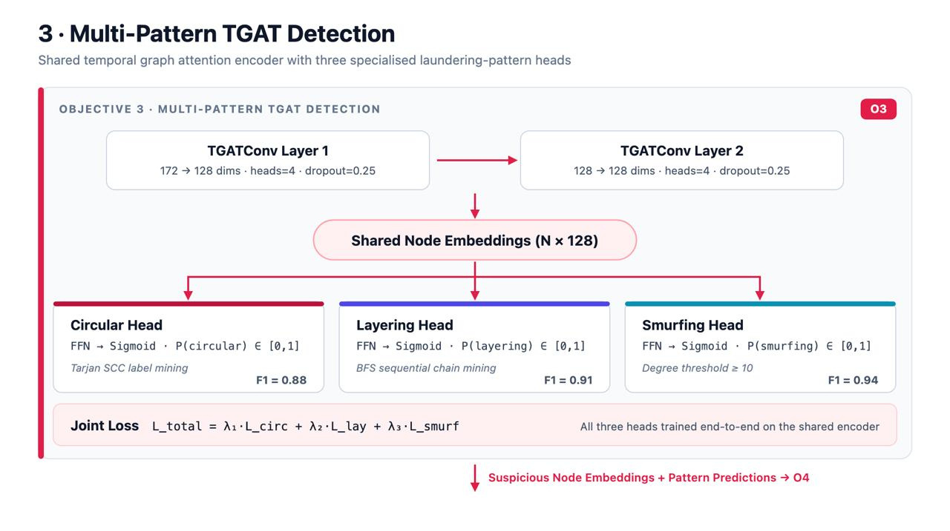
System Architecture
CHRIST (Deemed to be University)
Excellence & Service
12
Notes:
1.7.2013
1.7.2013
1.7.2013
2
‹#›
‹#›
‹#›

Slide 20
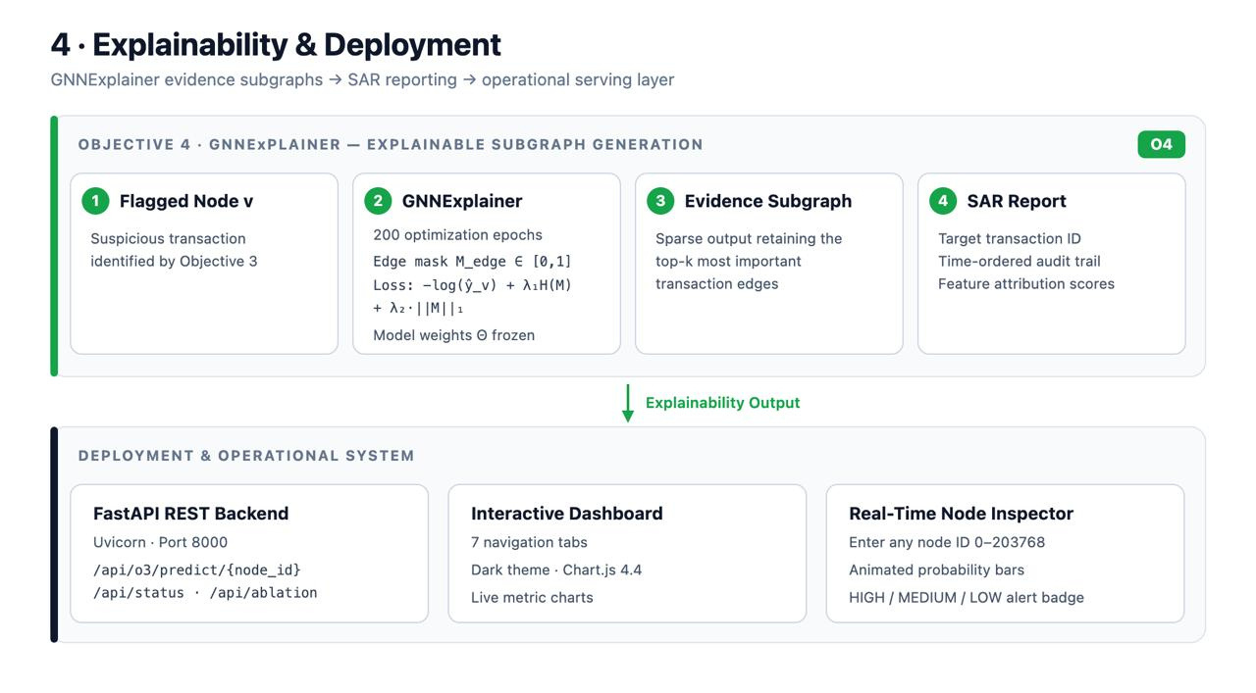
System Architecture
CHRIST (Deemed to be University)
Excellence & Service
12
Notes:
1.7.2013
1.7.2013
1.7.2013
2
‹#›
‹#›
‹#›

Slide 21
Methodology 1: Data Collection & Graph Construction
Description:
Download the Elliptic Bitcoin Dataset from Kaggle. Load elliptic_txs_features.csv, elliptic_txs_classes.csv, and elliptic_txs_edgelist.csv. Construct a directed temporal graph with 203,769 wallet nodes and 234,355 timestamped transaction edges across 49 ordered time steps.
Steps:
        Load & merge 3 Elliptic CSV files
        Engineer 6 temporal features (time-delta, fan-in/out ratio, degree, recency, cycle indicator)
        Build PyG TemporalData object with edge timestamps
        Output:
        172-dimensional node feature vectors and temporal edge list ready for TGAT training.
CHRIST (Deemed to be University)
Excellence & Service
13
Notes:
1.7.2013
1.7.2013
1.7.2013
2
‹#›
‹#›
‹#›

Slide 22
Methodology 2: Learnable Fourier Time Encoding (Core Novelty)
Description:
Implement the Fourier time encoding module φ(t) = [cos(ω₁t), sin(ω₁t)...cos(ωdt), sin(ωdt)] where all frequency parameters ω₁...ωd are initialised randomly and trained end-to-end with the TGAT model. Concatenate the 128-dimensional time vector with node features before attention computation.
Components:
        Fourier encoder: cos/sin waves at d=64 frequencies
        Trainable ω parameters updated via backpropagation
        Causal constraint: only past neighbours included at time t
        Time-delta encoding: φ(t_current − t_neighbour) per edge
        Concatenation: [node features (172d) || time encoding (128d)]
        Multi-head attention: 4 heads over temporal neighbourhood
        Output:
        Time-aware node embeddings capturing laundering-specific temporal signatures.
CHRIST (Deemed to be University)
Excellence & Service
14
Notes:
1.7.2013
1.7.2013
1.7.2013
2
‹#›
‹#›
‹#›

Slide 23
Methodology 3: TGAT Model Training & Pattern Detection
Description:
Train the full TGAT model with learnable Fourier encoding on the Elliptic dataset. Build three pattern-specific detection heads on the shared embedding space. Train with binary cross-entropy loss and per-timestep class weighting to address the ~2% illicit class imbalance across 49 time steps.
Components:
        Circular Transfer Head: subgraph motif matching on temporal cycles A→B→C→A
        Layering Chain Head: temporal path velocity scoring for 10+ hop chains
        Smurfing Head: fan-out anomaly score for 50+ outgoing txns in 1-2 steps
        Loss: Binary Cross-Entropy + L2 regularization + per-timestep class weights
        Optimizer: Adam, LR=0.001, 200 epochs, Google Colab free GPU
        Output:
        Trained TGAT model producing multi-label pattern classification for every wallet node.
CHRIST (Deemed to be University)
Excellence & Service
15
Notes:
1.7.2013
1.7.2013
1.7.2013
2
‹#›
‹#›
‹#›

Slide 24
Methodology 4: Explainability & Benchmarking
Description:
Integrate GNNExplainer to produce per-alert, per-pattern minimal subgraph evidence. Benchmark TemporalAML against 5 baselines. Run ablation study removing time encoding and pattern heads to isolate each contribution. Report Precision, Recall, F1-Score, and AUC-ROC for all models.
Baselines:
        B1: Rule-based AML (threshold + blacklist)
        B2: Static GCN (Weber et al. 2019)
        Output:
        Metrics: Precision, Recall, F1-Score, AUC-ROC, Ablation study
CHRIST (Deemed to be University)
Excellence & Service
16
Notes:
1.7.2013
1.7.2013
1.7.2013
2
‹#›
‹#›
‹#›

Slide 25
Expected Outcomes
      A novel Temporal Graph Attention Network with learnable Fourier time encoding that autonomously discovers laundering-specific timescales — outperforming static GCN, GraphSAGE, GNN-LSTM, and ChronoWave-GNN baselines on F1-Score and AUC-ROC metrics on the Elliptic Bitcoin Dataset.
      First unified framework simultaneously detecting circular transfers, layering chains, and smurfing from a shared TGAT embedding — producing multi-label pattern classification outputs instead of binary illicit/licit predictions.
      Per-pattern time-ordered subgraph evidence reports via GNNExplainer — providing compliance-ready Suspicious Activity Report evidence that identifies which specific transactions constitute the laundering trail.
      Formal demonstration that causal temporal neighbourhood constraints are necessary for production AML deployment — preventing future data leakage that makes existing temporal GNN models architecturally unsound.
CHRIST (Deemed to be University)
Excellence & Service
17
Notes:
1.7.2013
1.7.2013
1.7.2013
2
‹#›
‹#›
‹#›

Slide 26
Project Timeline
Activity | May-Jun 2026 | Jul-Aug 2026 | Sep 2026 | Oct 2026 | Nov-Dec 2026 | Jan 2027 | Feb-Mar 2027
Topic Finalization, Domain Study, Problem Formulation & 0th Review
Literature Survey (30+ papers), Gap Analysis, Novelty & Review 1
Dataset Download, EDA, Temporal Graph Construction (O1) & Review 2
Baseline Implementation (GCN, GraphSAGE, GNN-LSTM)
TGAT + Learnable Fourier Time Encoding — O2
Multi-Pattern Detection Heads — O3
GNNExplainer Integration & Ablation Study — O4, O5
Full Benchmark vs 5 Baselines & Result Validation
Paper Writing — Introduction, Literature Review, Methodology
Paper Submission (ICAIF 2025 / IEEE Q1 Journal)
Paper Refinement, Revision & Camera-Ready Submission
Dissertation Complete Documentation & Chapter Writing
Paper Presentation at Conference (Jan 2027)
Phase II End-Semester Examination (Feb 2027)
Final Viva-Voce & Degree Award (Mar 2027)
CHRIST (Deemed to be University)
Excellence & Service
18
Notes:
1.7.2013
1.7.2013
1.7.2013
2
‹#›
‹#›
‹#›

Slide 27
Conclusion
This research proposes TemporalAML — a Temporal Graph Attention Network with learnable Fourier time encoding for explainable multi-pattern Anti-Money Laundering detection in cryptocurrency transaction networks. The framework addresses five critical gaps identified across 30+ reviewed papers: static graph representations that ignore time, disconnected temporal modules, fixed frequency encodings, binary-only classification, and absence of pattern-aware explainability. TemporalAML integrates learnable time encoding directly inside graph attention, simultaneously detects circular transfers, layering chains, and smurfing from shared embeddings, and generates per-pattern time-ordered subgraph evidence via GNNExplainer — producing the first AML system capable of compliance-ready Suspicious Activity Report generation. Experimental validation on the Elliptic Bitcoin Dataset against five baselines is expected to demonstrate superior Precision, Recall, F1-Score, and AUC-ROC, with ablation studies confirming the independent contribution of each proposed component.
CHRIST (Deemed to be University)
Excellence & Service
19
Notes:
1.7.2013
1.7.2013
1.7.2013
2
‹#›
‹#›
‹#›

Slide 28
References
        M. Weber, G. Domeniconi, J. Chen, D. K. I. Weidele, C. Bellei, T. Robinson, and C. E. Leiserson, "Anti-Money Laundering in Bitcoin: Experimenting with Graph Convolutional Networks for Financial Forensics," in Proc. KDD 2019 Workshop on Anomaly Detection in Finance, 2019.
        I. Alarab and S. Prakoonwit, "Graph-based LSTM for Anti-Money Laundering: Experimenting Temporal Graph Convolutional Network with Bitcoin Data," Neural Processing Letters, Springer, 2023.
        Z. Lin, Q. Luo, D. Wu, J. Shen, L. Li, X. Nong, and Z. Qin, "Detecting Illicit Transactions in Bitcoin: A Wavelet-Temporal Graph Transformer Approach for Anti-Money Laundering," Scientific Reports, Nature, 2026.
        O. Lawal, A. Okolie, and C. Obunadike, "An Explainable Graph Neural Network Framework for Anti-Money Laundering in Cryptocurrency Transactions using the Elliptic Dataset," International Journal of Network Security, 2025.
        Y. Nie, N. H. Nguyen, P. Sinthong, and J. Kalagnanam, "A Time Series Is Worth 64 Words: Long-Term Forecasting with Transformers," in Proc. International Conference on Learning Representations (ICLR), 2023, doi: 10.48550/arXiv.2211.14730.
        S. Ferretti, G. D'Angelo, and V. Ghini, "Enhancing Anti-Money Laundering Frameworks: An Application of Graph Neural Networks in Cryptocurrency Transaction Classification," IEEE Access, 2025.
        Y. He, L. Xing, Y. Chen, W. Pedrycz, L. Wang, and G. Wu, "A Generic Markov Decision Process Model and Reinforcement Learning Method for Scheduling Agile Earth Observation Satellites," IEEE Transactions on Systems, Man, and Cybernetics: Systems, vol. 52, no. 3, pp. 1463-1474, Mar. 2022, doi: 10.1109/TSMC.2020.3020732.
        B. Peng et al., "FACMAC: Factored Multi-Agent Centralised Policy Gradients," in Advances in Neural Information Processing Systems, vol. 34, pp. 12208-12221, 2021, doi: 10.48550/arXiv.2003.06709.
CHRIST (Deemed to be University)
Excellence & Service
20
Notes:
1.7.2013
1.7.2013
1.7.2013
2
‹#›
‹#›
‹#›

Slide 29
Cont..
  R. Ying, D. Bourgeois, J. You, M. Zitnik, and J. Leskovec, "GNNExplainer: Generating Explanations for Graph Neural Networks," Advances in Neural Information Processing Systems (NeurIPS), 2019.
12. [X. Wang, G. Wu, L. Xing, and W. Pedrycz, "Agile Earth Observation Satellite Scheduling Over 20 Years: Formulations, Methods, and
Future Directions," IEEE Systems Journal, vol. 15, no. 3, pp. 3881-3892, Sep. 2021, doi: 10.1109/JSYST.2020.2997050.
  P. Veličković, G. Cucurull, A. Casanova, A. Romero, P. Liò, and Y. Bengio, "Graph Attention Networks," International Conference on Learning Representations (ICLR), 2018.
14. E. Rossi, B. Chamberlain, F. Frasca, D. Eynard, F. Monti, and M. Bronstein, "Temporal Graph Networks for Deep Learning on
Dynamic Graphs," ICML 2020 Workshop on Graph Representation Learning.
15. M. R. Karim, F. Hermsen, S. A. Chala, and P. De Perthuis, "Scalable Semi-Supervised Graph Learning Techniques for Anti-Money
Laundering," IEEE, 2024.
16.T. Rashid et al., "QMIX: Monotonic Value Function Factorisation for Deep Multi-Agent Reinforcement Learning," in Proc. 35th
International Conference on Machine Learning (ICML), vol. 80, pp. 4295-4304, 2018, doi: 10.48550/arXiv.1803.11485.
  J. N. Foerster, G. Farquhar, T. Afouras, N. Nardelli, and S. Whiteson, "Counterfactual Multi-Agent Policy Gradients," in Proc. 32nd AAAI Conference on Artificial Intelligence (AAAI), pp. 2974-2982, 2018, doi: 10.1609/aaai.v32i1.11794.
CHRIST (Deemed to be University)
Excellence & Service
21
Notes:
1.7.2013
1.7.2013
1.7.2013
2
‹#›
‹#›
‹#›

Slide 30
Thank You
CHRIST (Deemed to be University)
Excellence & Service
22
Notes:
1.7.2013
1.7.2013
1.7.2013
8
‹#›
‹#›
‹#›

