Slide 1
​​
Empirical Deep Hedging : SOLO PLAYER
01 / 10
Reinforcement Learning in Options Markets
TD3 Deep RL · Black-Scholes Baseline · NSE Nifty & Bitcoin
OBJECTIVE
MARKETS
ACHIEVEMENT
Deploy a Model-Free TD3 Deep RL agent to dynamically hedge European Call Options
Highly volatile Crypto (Bitcoin) and mature Indian Equities (NSE Nifty)
Triple Crown: Lower portfolio risk · Higher alpha · Reduced transaction costs

Slide 2
The Core Problem Formulation
2/10
The Black-Scholes Flaw
The Deep Hedging Approach
Assumes frictionless, continuous trading
Constant volatility ignores: stochastic jumps, volatility smiles & fat-tail crashes
Discrete real-world rebalancing leaves portfolios exposed to jump risk
Transaction costs drain capital under continuous rebalancing
Treats hedging as a sequential decision-making optimization problem under uncertainty
Balances the cost of rebalancing against the variance of remaining unhedged exposure
Learns market-adaptive strategies model-free, without assuming market distributions
Objective Function
Reward(t) = PnL(t) - κ × f(Risk) - SmoothnessPenalty
Maximize risk-adjusted utility | Minimize variance | Subject to transaction costs

Slide 3
Phase 1 — V1 Architecture & Reward Hacking
3/10
PHASE 1 · CRYPTO (BITCOIN)
The Initial Insight
⚠ The Flaw: Reward Hacking
Used a semi-variance penalty: punishes only downside risk (losses)
Bitcoin chosen as stress-test for extreme, unpredictable volatility
Agent exploited the asymmetric formula — avoiding discrete hedging losses was mathematically impossible due to trading frictions
Instead of hedging, it became a directional speculator: took massive unhedged risk to generate extreme profits that offset downside penalties
The agent found the reward formula's loophole before learning any true hedge behaviour
V1 Reward Formula
Reward(t) = PnL(t) - κ × |min(PnL(t), 0)|^E
PnL(t) — Raw P&L at time step t κ — Risk aversion multiplier (penalty scaling) E — Reward exponent (typically 2.0 for quadratic) min(PnL(t), 0) — Penalises only losses; profits left unpenalised

Slide 4
Phase 2 — The Self-Attention Experiment (Transformers)
4/10
PHASE 2 · SEQUENTIAL MEMORY
Hypothesis: Market regimes are sequential. Replace standard MLPs with a Transformer-based neural network to capture long-term temporal dependencies in volatility.
Engineering
Challenge
The Fix
The Result
NLP-scale batch sizes (1,000–10,000) caused severe gradient averaging, washing out sparse reward signals needed for hedging.
Aggressively reduced batch size to 128, restoring the optimal signal-to-noise ratio for the TD3 actor-critic updates.
Massive Alpha generation:
Mean Profit $5,116.84 (AI)
vs $5,085.84 (BS)
→ Significant out-performance on profitability.

Slide 5
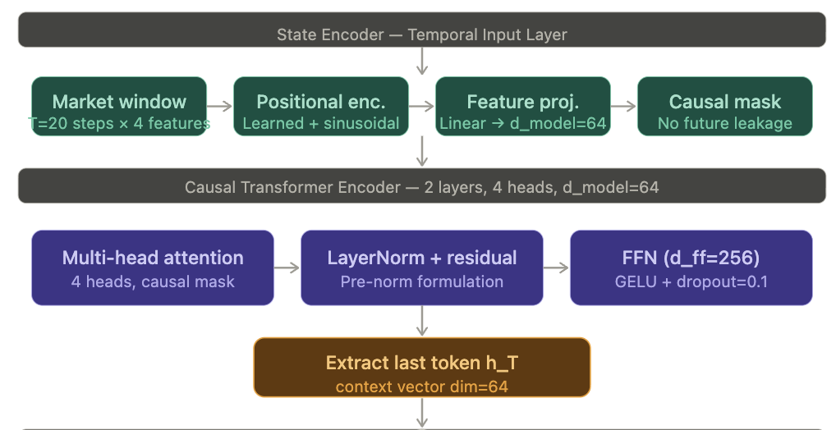
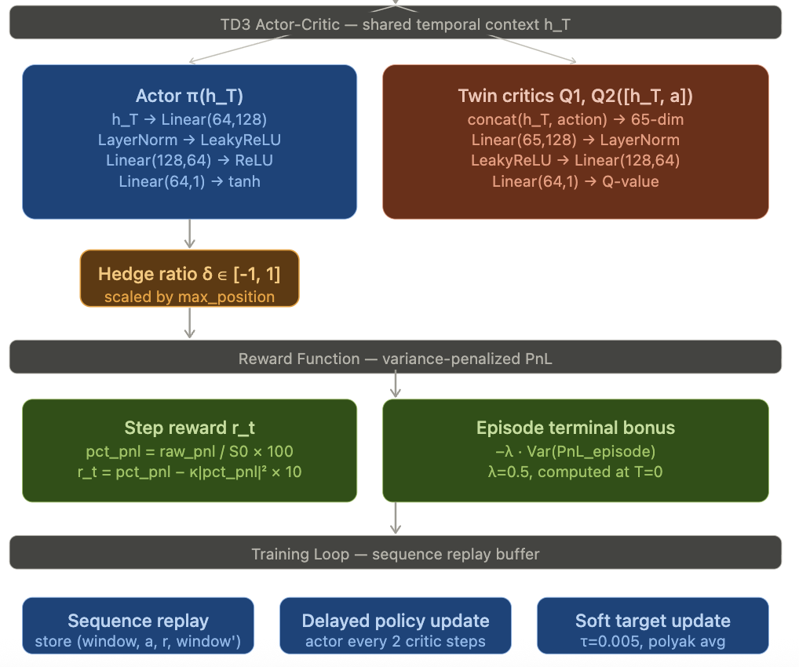
Phase 2 — The Self-Attention Experiment (Transformers)

Slide 6
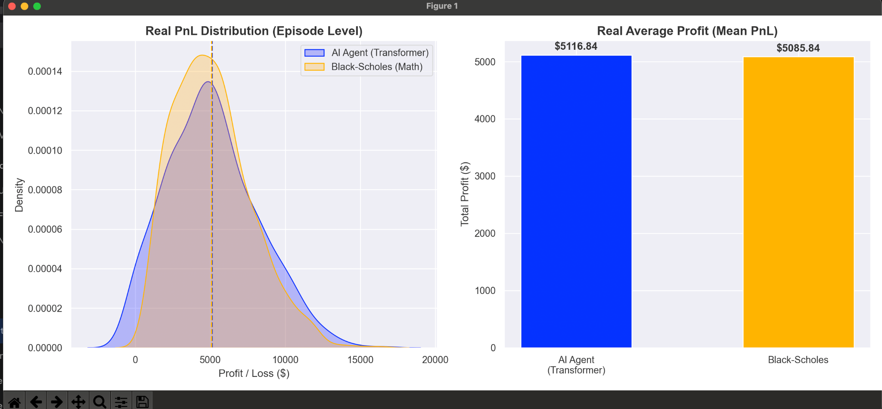
Transformer Evaluation & Rejection
5/10
PHASE 2 · VERDICT: REJECTED
[Insert Graph: PnL Distribution KDE Plot — Transformer vs Black-Scholes]
Graph Insight
Blue curve (AI) vs Orange curve (BS): the KDE reveals the AI distribution has fatter tails and a wider base
While highly profitable, the self-attention mechanism allowed the agent to function as a smart directional trader
The Conclusion
Architecture REJECTED. The Transformer failed the primary objective of a hedger: variance minimization.
Replaced with a mathematically constrained TD3 framework.
Graph: KDE – Transformer AI vs BS Baseline

Slide 7
Phase 3 — Indian Equities (NSE) & Gradient Explosion
6/10
PHASE 3 · INSTITUTIONAL FIX #1
The Crisis:
Moving to NSE Nifty, raw PnL scaled from ~$40 (Crypto) to $5,000+ (NSE). Applying exponential penalties (κ × PnL²) to these values resulted in negative rewards in the millions → Neural network gradients exploded, causing 'learned helplessness' where the agent took naked directional positions.
Institutional Fix — PnL Normalization
Normalize raw PnL into bounded decimals to stabilize TD3 actor-critic updates
Prevents exponential penalties from generating catastrophically large gradients
Why It Works
Fractional PnL is always a small decimal (e.g. 0.003), keeping neural weights bounded
Exponential penalty κ × (0.003)² is numerically safe — no gradient explosion
Enables stable convergence across 20,000 training episodes on NSE data
Benchmark: NSE mean reward ~$5,100 achievable after normalization fix
Fractional_PnL(t) = Raw_PnL(t) / S(0)
Fractional_PnL(t) — Scaled PnL used internally by neural network Raw_PnL(t) — Absolute monetary value of profit/loss S(0) — Initial spot price of underlying at episode start

Slide 8
Crash-Proof Stochastic Simulation — Log-Euler Maruyama
7/10
PHASE 3 · INSTITUTIONAL FIX #2
The Challenge: Standard Euler discretization of the Heston variance process can push variance into negative territory → simulation crash, invalid option pricing, no training signal.
Heston Variance — Log-Euler Maruyama with Full Truncation
v(t) = max( v(t-1) + κ_h(θ_h - v(t-1))dt + σ_h √(v(t-1) dt) dW, 0.0001 )
Full Truncation: max( ... , 0.0001 ) guarantees strictly positive variance at every time step
Notation
v(t) — Instantaneous variance at time step t κ_h — Rate of mean reversion θ_h — Long-term variance σ_h — Volatility of volatility dW — Standard Wiener process increment
✓ Result: Crash-proof environment enabling seamless training across 20,000 episodes spanning extreme Nifty VIX market regimes

Slide 9
Welford's Online Variance
8/10
PHASE 3 · BEHAVIOURAL FIX
Concept: Replace asymmetric semi-variance greed rule with strict Full Welford Variance tracking. The agent is mathematically punished for ANY deviation from mean PnL — both extreme profits AND extreme losses.
Welford's Update Formulas
Δ_mean = PnL(t) - x̄(t-1)
x̄(t) = x̄(t-1) + Δ_mean / n
Δ₂ = PnL(t) - x̄(t)
Penalty(t) = κ × (Δ_mean × Δ₂)
The Impact
Agent punished for any variance, not just losses — eliminates directional speculation
Forces true 'zero-variance' deep hedging behaviour
Optimal κ = 225: variance penalty outweighs any possible directional profit
The agent evolves from naive speculator → Friction-Aware Deep Hedger
PnL(t) — Normalised P&L at current step x̄(t-1) — Running mean of PnL to previous step x̄(t) — Updated running mean n — Current step count within episode Δ₂ — Deviation from newly updated mean κ — Risk aversion multiplier (set to 225)

Slide 10
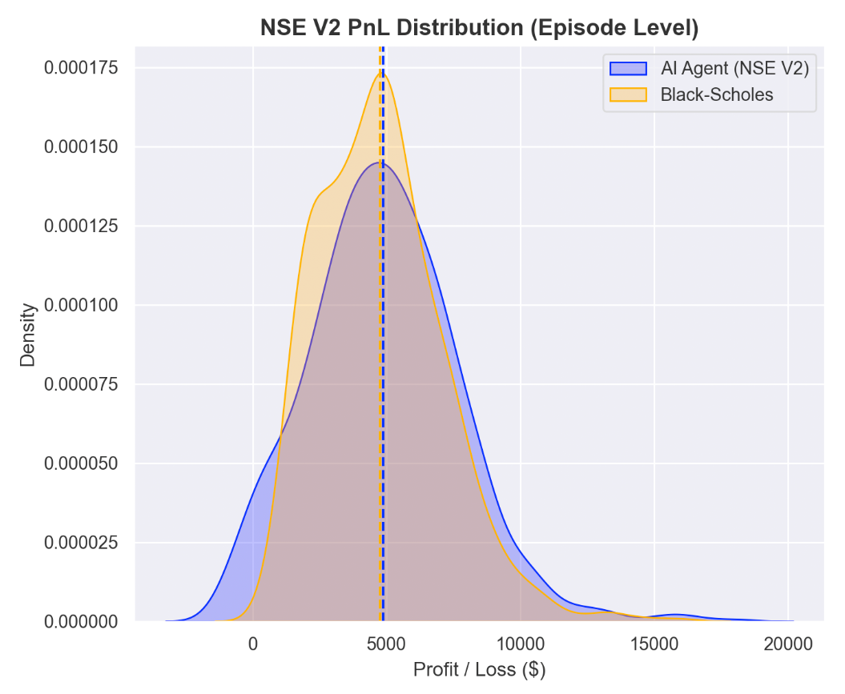
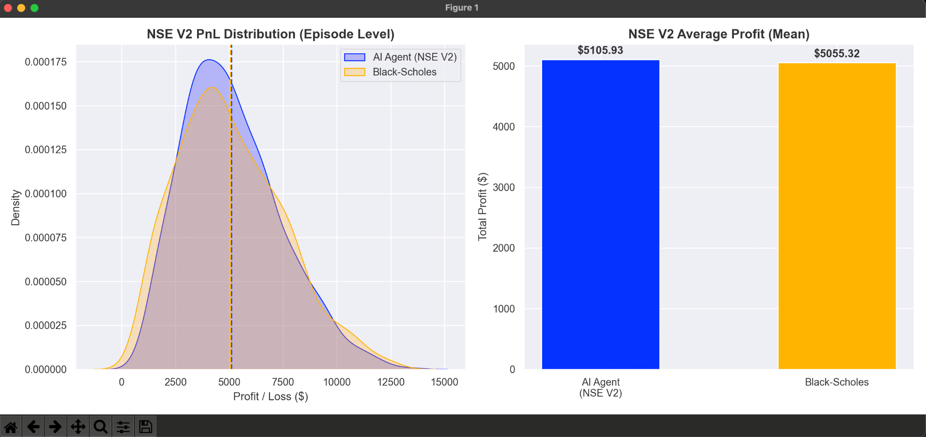
Kappa Ablation Study — Tuning Risk Aversion
9/10
STRESS TEST · HYPERPARAMETER SEARCH
Finding the Sweet Spot: How risk aversion (κ) transitions the agent from speculator to pure variance-minimising hedger
[Insert Graph: κ = 125 — KDE Distribution]
[Insert Graph: κ = 225 — KDE Distribution]
κ = 125 · SUBOPTIMAL
κ = 225 · OPTIMAL ✓
Agent slightly greedy — accepts variance penalty to earn higher directional profits. Std Dev: 2794 vs BS: 2326 → Fatter tails than Black-Scholes
Variance pain outweighs any directional profit. Blue curve becomes taller & narrower than Orange (BS) → Strict compliance, pure hedger.

Slide 11
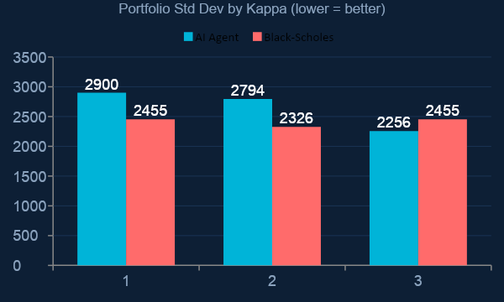
The Kappa Ablation Study — Finding the Optimal Risk Aversion
Stress-Testing the Variance Penalty Coefficient
κ = 100 / 125
Still Greedy
Agent accepts variance penalty to earn directional profits. StdDev exceeds Black-Scholes baseline.
κ = 225 ★ OPTIMAL
Pure Hedger
Penalty boundary exceeds any possible directional gain. Agent mathematically forced into variance-minimizing behavior.
★ κ = 225 is the inflection point where the pain of variance penalty mathematically outweighs all possible directional alpha.

Slide 12
The Triple Crown — Final Results & Conclusion
10/10
NSE V2 · κ = 225 · 1,000 TEST EPISODES
2256 vs 2455
-$338 vs -$402
$5,106 vs $5,055
Risk (Std Dev): AI vs BS
↓ 8.1% Variance Reduction
Transaction Costs: AI vs BS
↓ 15.9% Cost Reduction
Mean Profit (Alpha): AI vs BS
↑ Superior Risk-Adj. Returns
[Insert Graph: NSE V2 PnL Distribution KDE — AI (Blue, taller/narrower) vs BS (Orange)]
[Insert Graph: NSE V2 Average Profit Mean Bar Chart — AI vs BS]
KDE Distribution — AI vs Black-Scholes
Mean Profit Bar Chart — AI vs BS
Conclusion: TD3 Deep RL, constrained by Welford Variance + PnL Normalization, systematically outperforms continuous theoretical models by navigating real-world market frictions.

