Slide 1
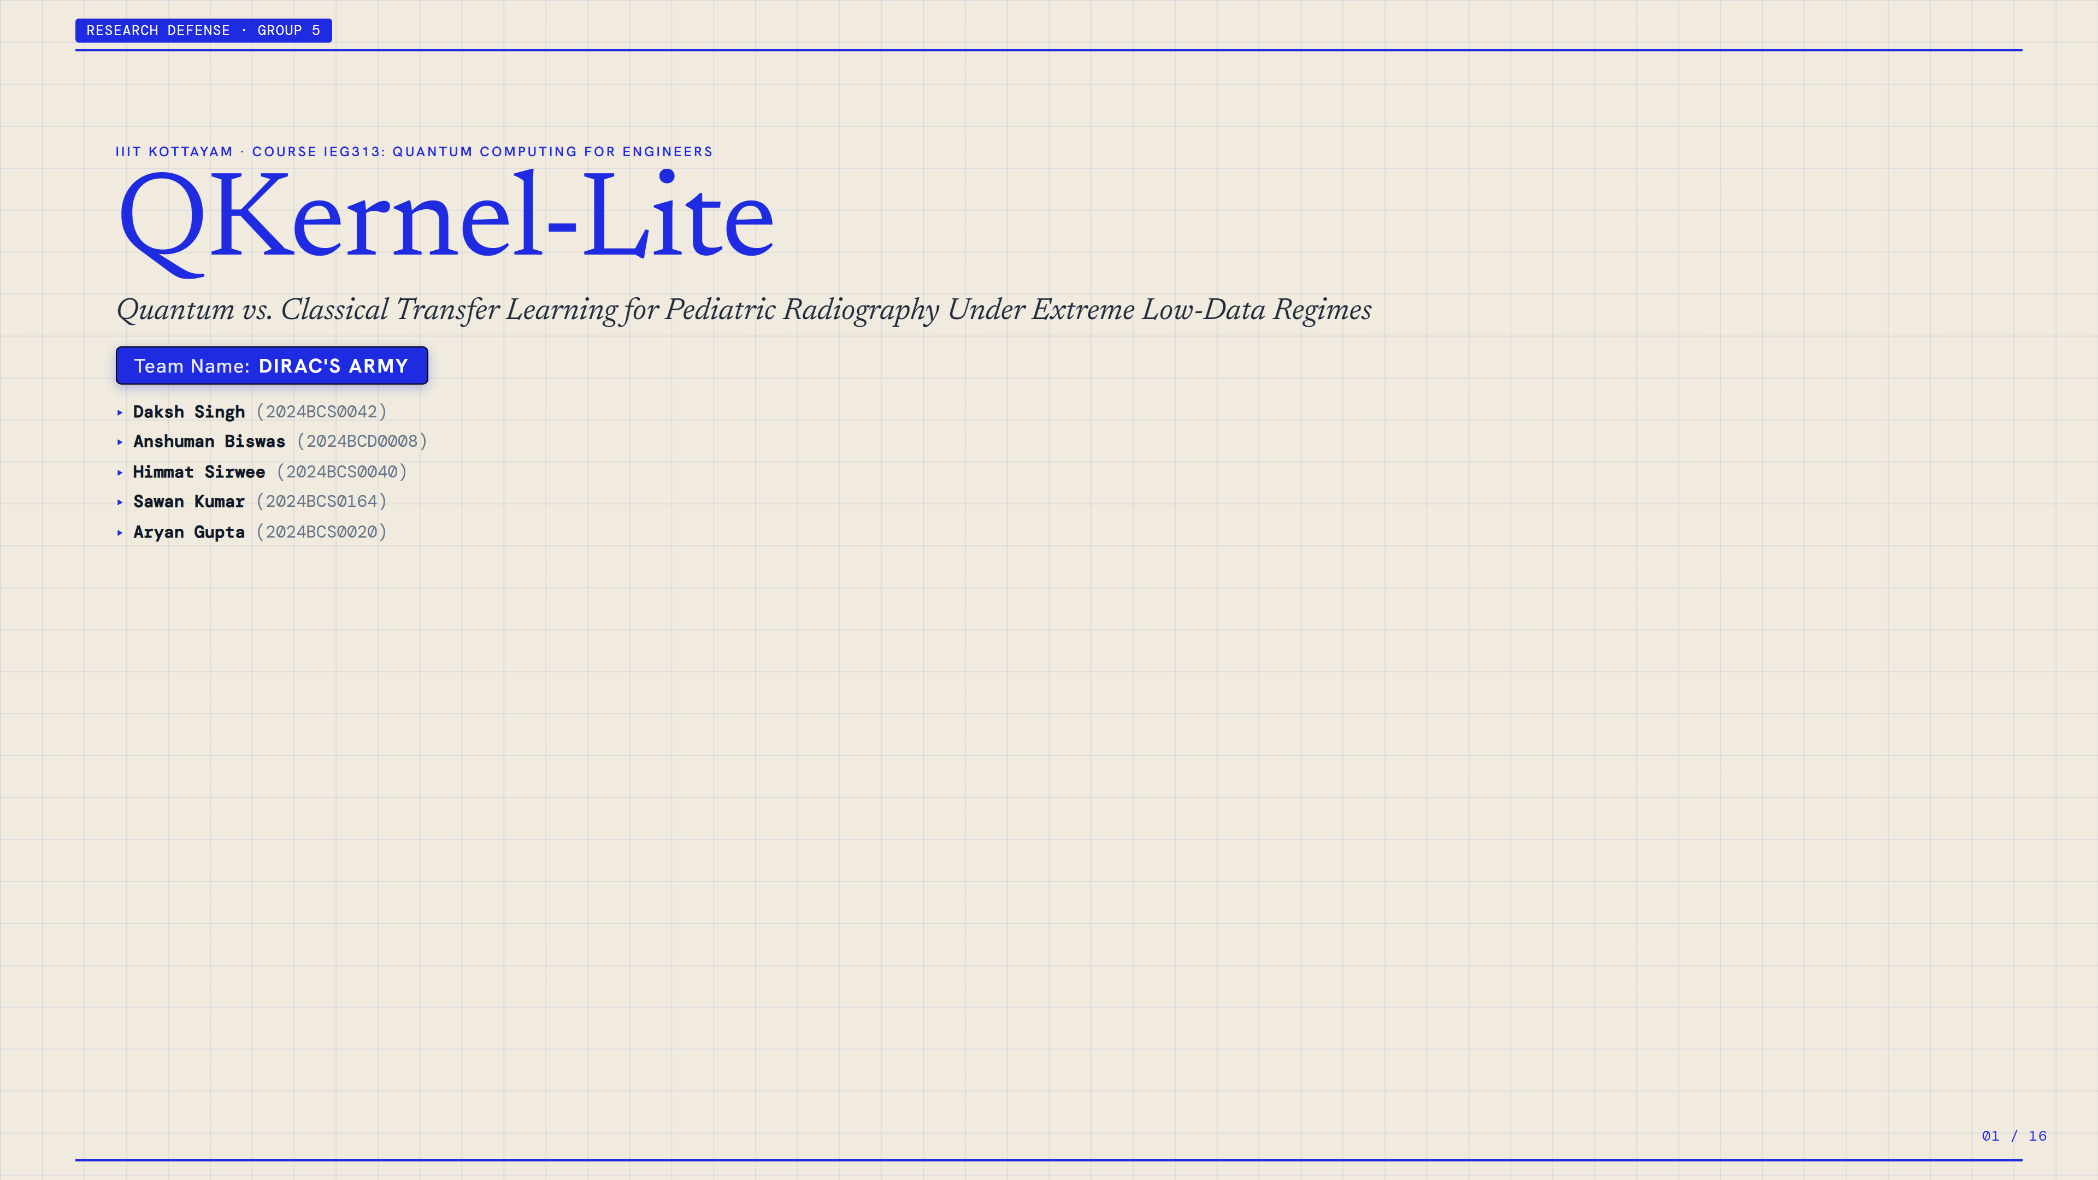
Notes:
SLIDE 1: QKernel-Lite
Presenter / Section: RESEARCH DEFENSE · GROUP 5
Topic: IIIT KOTTAYAM · COURSE IEG313: QUANTUM COMPUTING FOR ENGINEERS
--- SLIDE TRANSCRIPT & NOTES ---
RESEARCH DEFENSE · GROUP 5
IIIT KOTTAYAM · COURSE IEG313: QUANTUM COMPUTING FOR ENGINEERS
QKernel-Lite
Quantum vs. Classical Transfer Learning for Pediatric Radiography Under Extreme Low-Data Regimes
Team Name:
DIRAC'S ARMY
▸Daksh Singh (2024BCS0042)
▸Anshuman Biswas (2024BCD0008)
▸Himmat Sirwee (2024BCS0040)
▸Sawan Kumar (2024BCS0164)
▸Aryan Gupta (2024BCS0020)
01 / 16

Slide 2
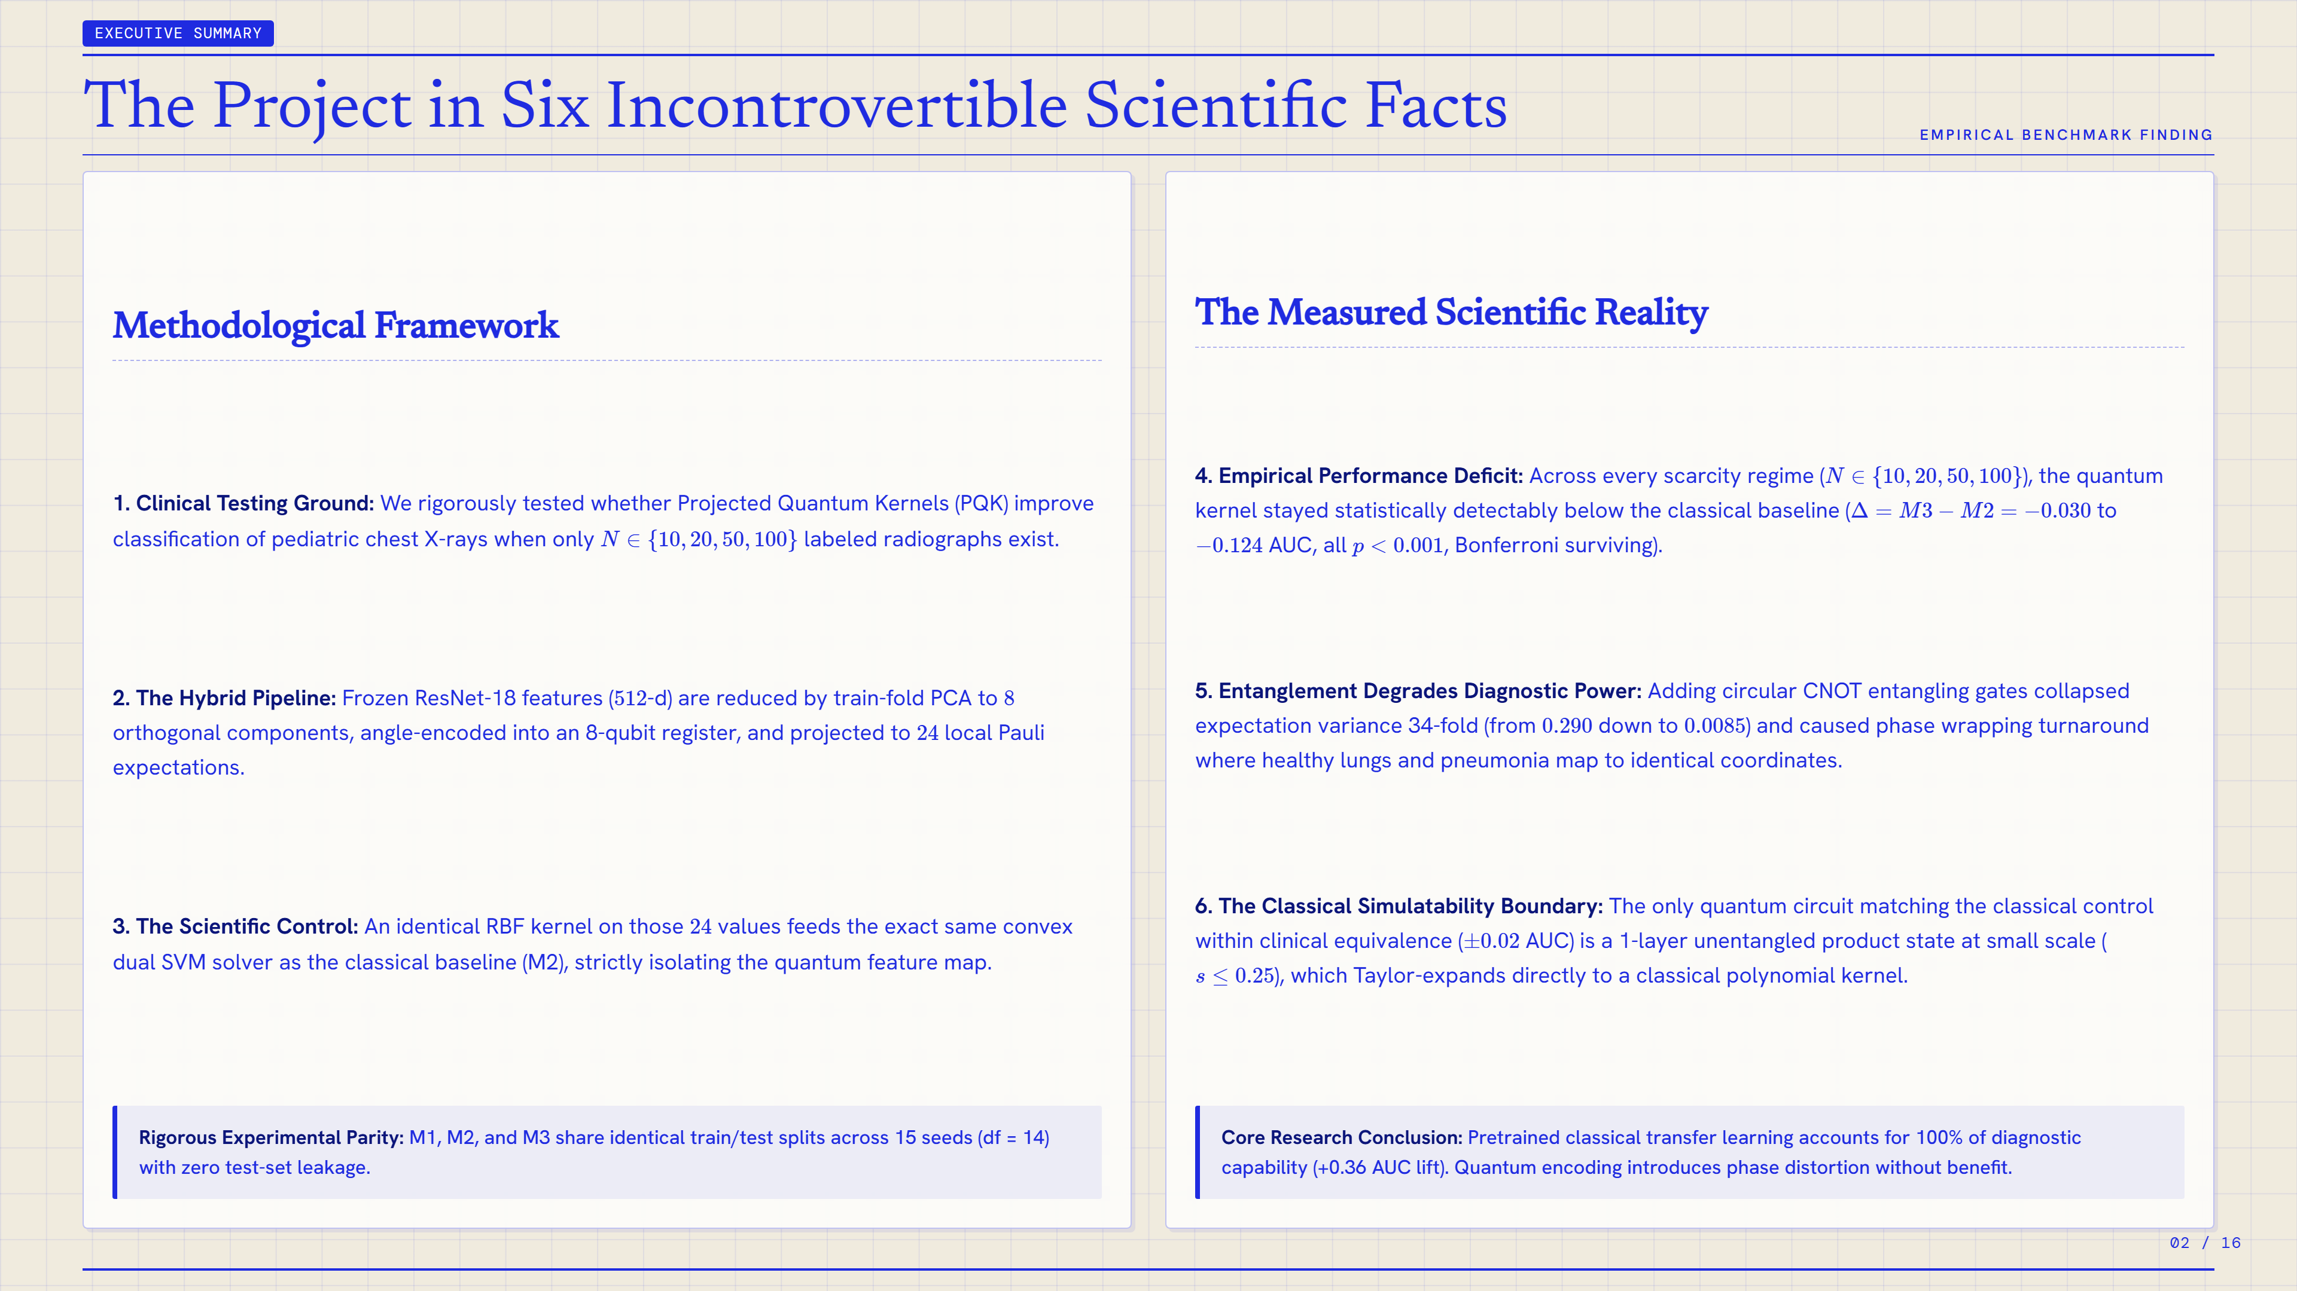
Notes:
SLIDE 2: The Project in Six Incontrovertible Scientific Facts
Presenter / Section: EXECUTIVE SUMMARY
Topic: EMPIRICAL BENCHMARK FINDING
KEY TAKEAWAY:
Rigorous Experimental Parity: M1, M2, and M3 share identical train/test splits across 15 seeds (df = 14) with zero test-set leakage.
Core Research Conclusion: Pretrained classical transfer learning accounts for 100% of diagnostic capability (+0.36 AUC lift). Quantum encoding introduces phase distortion without benefit.
--- SLIDE TRANSCRIPT & NOTES ---
EXECUTIVE SUMMARY
The Project in Six Incontrovertible Scientific Facts
EMPIRICAL BENCHMARK FINDING
Methodological Framework
1. Clinical Testing Ground: We rigorously tested whether Projected Quantum Kernels (PQK) improve classification of pediatric chest X-rays when only
𝑁
∈
{
10
,
20
,
50
,
100
}
labeled radiographs exist.
2. The Hybrid Pipeline: Frozen ResNet-18 features (
512
-d) are reduced by train-fold PCA to
8
orthogonal components, angle-encoded into an 8-qubit register, and projected to
24
local Pauli expectations.
3. The Scientific Control: An identical RBF kernel on those
24
values feeds the exact same convex dual SVM solver as the classical baseline (M2), strictly isolating the quantum feature map.
Rigorous Experimental Parity: M1, M2, and M3 share identical train/test splits across 15 seeds (df = 14) with zero test-set leakage.
The Measured Scientific Reality
4. Empirical Performance Deficit: Across every scarcity regime (
𝑁
∈
{
10
,
20
,
50
,
100
}
), the quantum kernel stayed statistically detectably below the classical baseline (
Δ
=
𝑀
3
−
𝑀
2
=
−
0.030
to
−
0.124
AUC, all
𝑝
<
0.001
, Bonferroni surviving).
5. Entanglement Degrades Diagnostic Power: Adding circular CNOT entangling gates collapsed expectation variance 34-fold (from
0.290
down to
0.0085
) and caused phase wrapping turnaround where healthy lungs and pneumonia map to identical coordinates.
6. The Classical Simulatability Boundary: The only quantum circuit matching the classical control within clinical equivalence (
±
0.02
AUC) is a 1-layer unentangled product state at small scale (
𝑠
≤
0.25
), which Taylor-expands directly to a classical polynomial kernel.
Core Research Conclusion: Pretrained classical transfer learning accounts for 100% of diagnostic capability (+0.36 AUC lift). Quantum encoding introduces phase distortion without benefit.
02 / 16

Slide 3
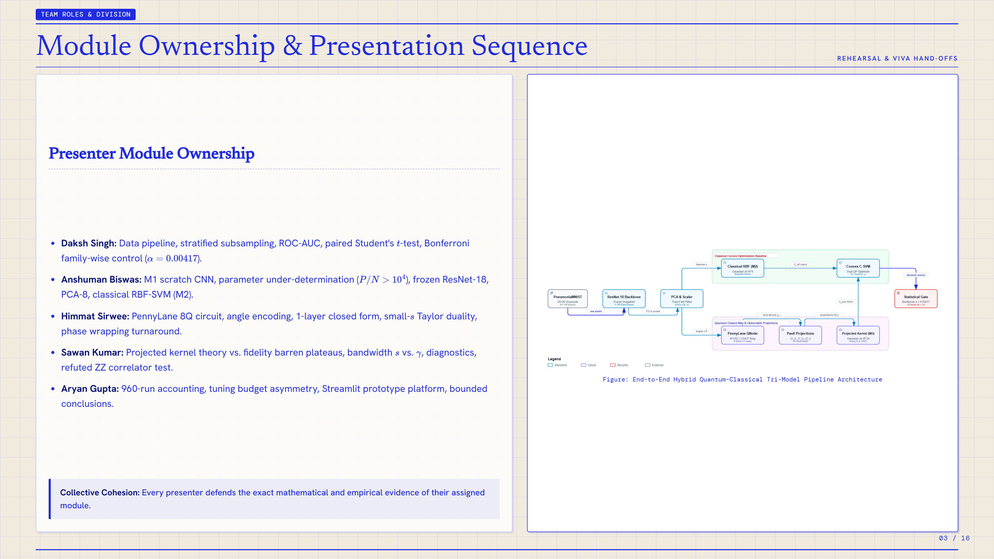
Notes:
SLIDE 3: Module Ownership & Presentation Sequence
Presenter / Section: TEAM ROLES & DIVISION
Topic: REHEARSAL & VIVA HAND-OFFS
KEY TAKEAWAY:
Collective Cohesion: Every presenter defends the exact mathematical and empirical evidence of their assigned module.
--- SLIDE TRANSCRIPT & NOTES ---
TEAM ROLES & DIVISION
Module Ownership & Presentation Sequence
REHEARSAL & VIVA HAND-OFFS
Presenter Module Ownership
Daksh Singh: Data pipeline, stratified subsampling, ROC-AUC, paired Student's
𝑡
-test, Bonferroni family-wise control (
𝛼
=
0.00417
).
Anshuman Biswas: M1 scratch CNN, parameter under-determination (
𝑃
/
𝑁
>
10
4
), frozen ResNet-18, PCA-8, classical RBF-SVM (M2).
Himmat Sirwee: PennyLane 8Q circuit, angle encoding, 1-layer closed form, small-
𝑠
Taylor duality, phase wrapping turnaround.
Sawan Kumar: Projected kernel theory vs. fidelity barren plateaus, bandwidth
𝑠
vs.
𝛾
, diagnostics, refuted ZZ correlator test.
Aryan Gupta: 960-run accounting, tuning budget asymmetry, Streamlit prototype platform, bounded conclusions.
Collective Cohesion: Every presenter defends the exact mathematical and empirical evidence of their assigned module.
Figure: End-to-End Hybrid Quantum-Classical Tri-Model Pipeline Architecture
03 / 16

Slide 4
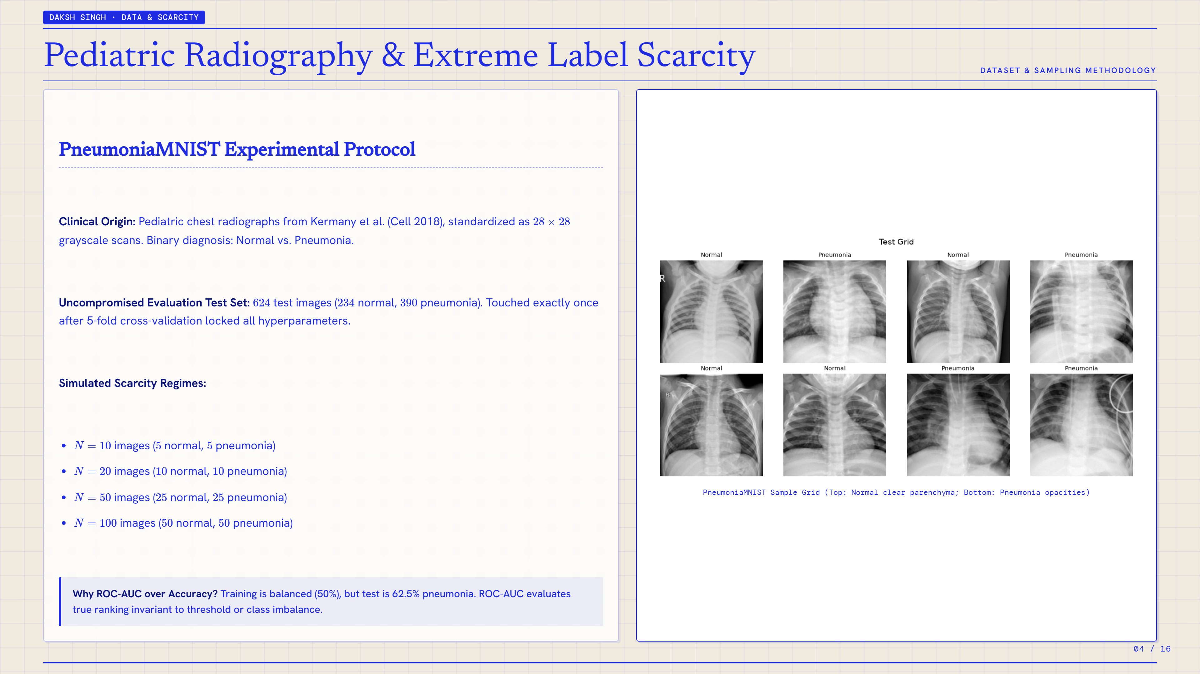
Notes:
SLIDE 4: Pediatric Radiography & Extreme Label Scarcity
Presenter / Section: DAKSH SINGH · DATA & SCARCITY
Topic: DATASET & SAMPLING METHODOLOGY
KEY TAKEAWAY:
Why ROC-AUC over Accuracy? Training is balanced (50%), but test is 62.5% pneumonia. ROC-AUC evaluates true ranking invariant to threshold or class imbalance.
--- SLIDE TRANSCRIPT & NOTES ---
DAKSH SINGH · DATA & SCARCITY
Pediatric Radiography & Extreme Label Scarcity
DATASET & SAMPLING METHODOLOGY
PneumoniaMNIST Experimental Protocol
Clinical Origin: Pediatric chest radiographs from Kermany et al. (Cell 2018), standardized as
28
×
28
grayscale scans. Binary diagnosis: Normal vs. Pneumonia.
Uncompromised Evaluation Test Set:
624
test images (
234
normal,
390
pneumonia). Touched exactly once after 5-fold cross-validation locked all hyperparameters.
Simulated Scarcity Regimes:
𝑁
=
10
images (
5
normal,
5
pneumonia)
𝑁
=
20
images (
10
normal,
10
pneumonia)
𝑁
=
50
images (
25
normal,
25
pneumonia)
𝑁
=
100
images (
50
normal,
50
pneumonia)
Why ROC-AUC over Accuracy? Training is balanced (50%), but test is 62.5% pneumonia. ROC-AUC evaluates true ranking invariant to threshold or class imbalance.
PneumoniaMNIST Sample Grid (Top: Normal clear parenchyma; Bottom: Pneumonia opacities)
04 / 16

Slide 5
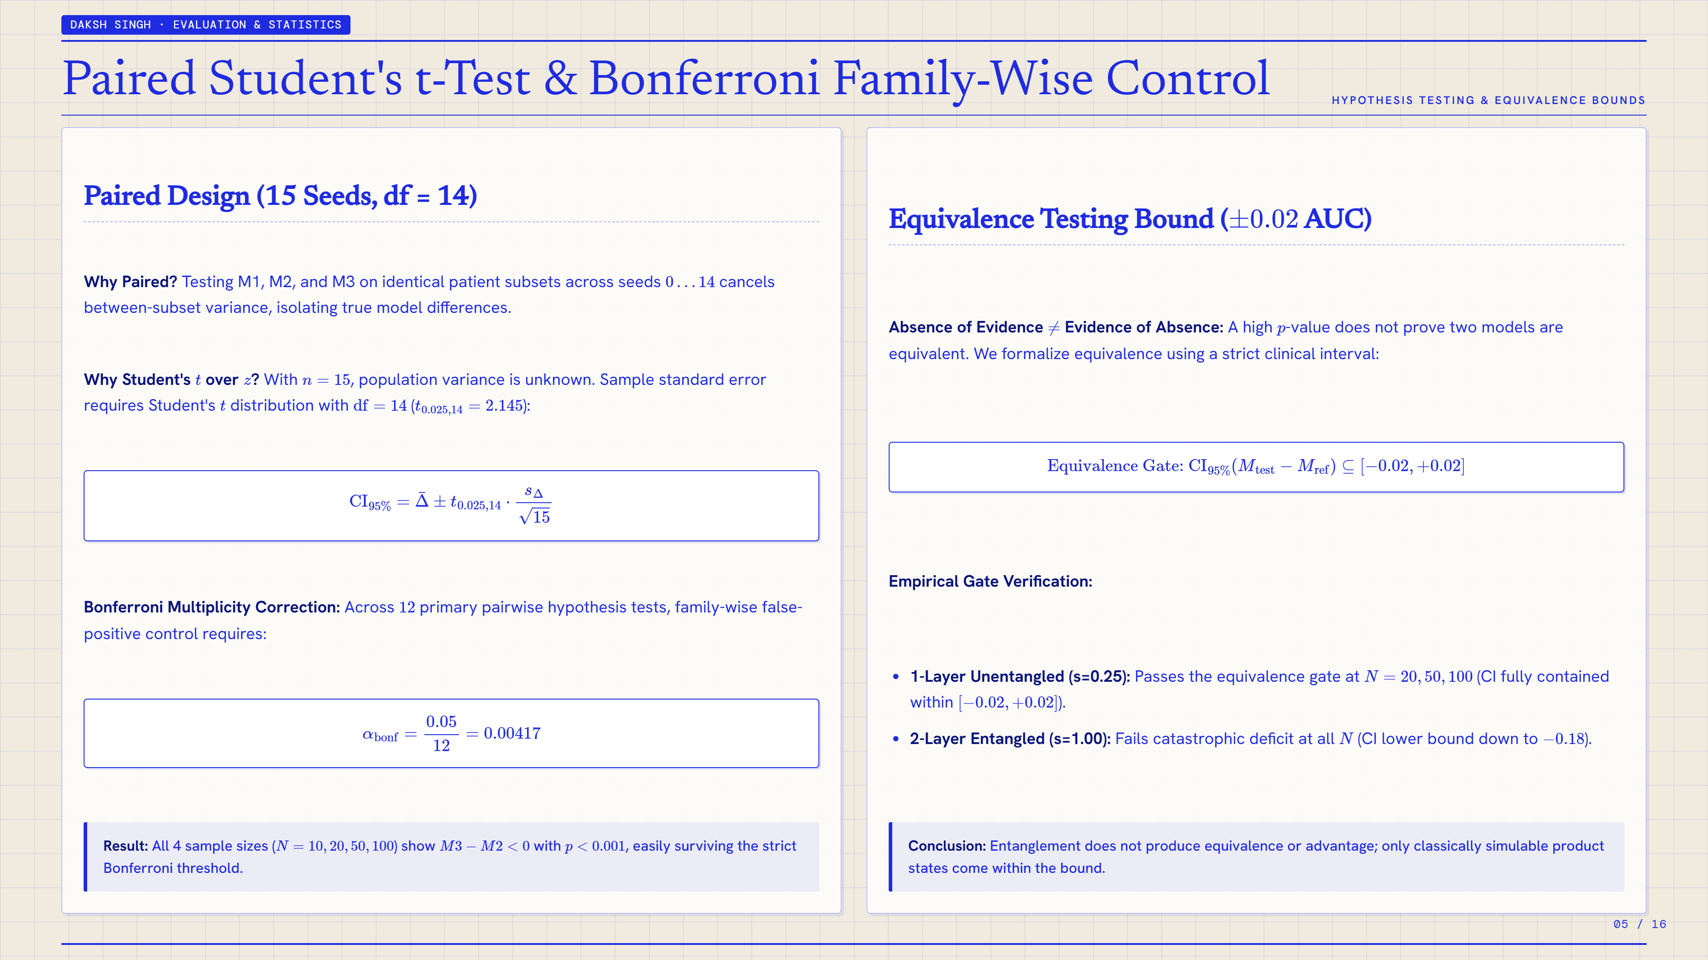
Notes:
SLIDE 5: Paired Student's t-Test & Bonferroni Family-Wise Control
Presenter / Section: DAKSH SINGH · EVALUATION & STATISTICS
Topic: HYPOTHESIS TESTING & EQUIVALENCE BOUNDS
KEY TAKEAWAY:
Result: All 4 sample sizes (
𝑁
=
10
,
20
,
50
,
100
) show
𝑀
3
−
𝑀
2
<
0
with
𝑝
<
0.001
, easily surviving the strict Bonferroni threshold.
Conclusion: Entanglement does not produce equivalence or advantage; only classically simulable product states come within the bound.
--- SLIDE TRANSCRIPT & NOTES ---
DAKSH SINGH · EVALUATION & STATISTICS
Paired Student's t-Test & Bonferroni Family-Wise Control
HYPOTHESIS TESTING & EQUIVALENCE BOUNDS
Paired Design (15 Seeds, df = 14)
Why Paired? Testing M1, M2, and M3 on identical patient subsets across seeds
0
…
14
cancels between-subset variance, isolating true model differences.
Why Student's
𝑡
over
𝑧
? With
𝑛
=
15
, population variance is unknown. Sample standard error requires Student's
𝑡
distribution with
df
=
14
(
𝑡
0.025
,
14
=
2.145
):
CI
95
%
=
Δ
¯
±
𝑡
0.025
,
14
⋅
𝑠
Δ
15
Bonferroni Multiplicity Correction: Across
12
primary pairwise hypothesis tests, family-wise false-positive control requires:
𝛼
bonf
=
0.05
12
=
0.00417
Result: All 4 sample sizes (
𝑁
=
10
,
20
,
50
,
100
) show
𝑀
3
−
𝑀
2
<
0
with
𝑝
<
0.001
, easily surviving the strict Bonferroni threshold.
Equivalence Testing Bound (
±
0.02
AUC)
Absence of Evidence
≠
Evidence of Absence: A high
𝑝
-value does not prove two models are equivalent. We formalize equivalence using a strict clinical interval:
Equivalence Gate:
CI
95
%
(
𝑀
test
−
𝑀
ref
)
⊆
[
−
0.02
,
+
0.02
]
Empirical Gate Verification:
1-Layer Unentangled (s=0.25): Passes the equivalence gate at
𝑁
=
20
,
50
,
100
(CI fully contained within
[
−
0.02
,
+
0.02
]
).
2-Layer Entangled (s=1.00): Fails catastrophic deficit at all
𝑁
(CI lower bound down to
−
0.18
).
Conclusion: Entanglement does not produce equivalence or advantage; only classically simulable product states come within the bound.
05 / 16

Slide 6
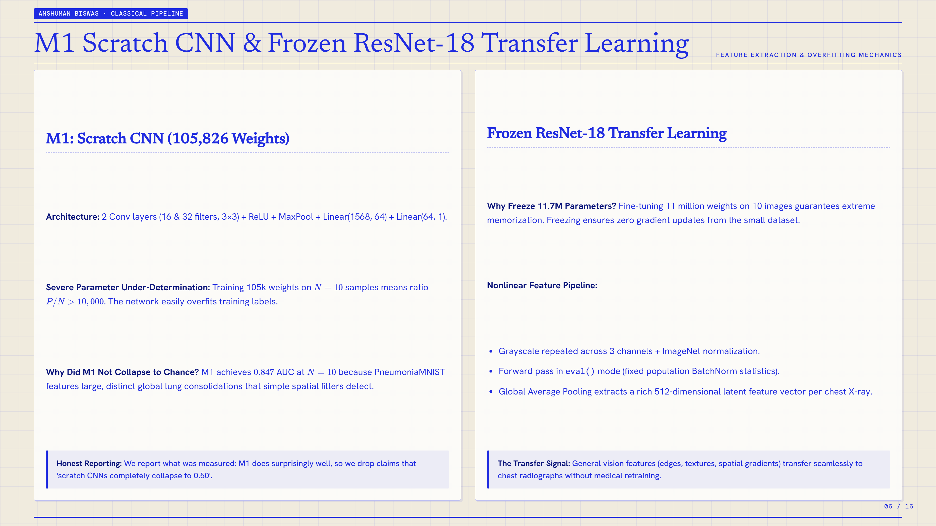
Notes:
SLIDE 6: M1 Scratch CNN & Frozen ResNet-18 Transfer Learning
Presenter / Section: ANSHUMAN BISWAS · CLASSICAL PIPELINE
Topic: FEATURE EXTRACTION & OVERFITTING MECHANICS
KEY TAKEAWAY:
Honest Reporting: We report what was measured: M1 does surprisingly well, so we drop claims that 'scratch CNNs completely collapse to 0.50'.
The Transfer Signal: General vision features (edges, textures, spatial gradients) transfer seamlessly to chest radiographs without medical retraining.
--- SLIDE TRANSCRIPT & NOTES ---
ANSHUMAN BISWAS · CLASSICAL PIPELINE
M1 Scratch CNN & Frozen ResNet-18 Transfer Learning
FEATURE EXTRACTION & OVERFITTING MECHANICS
M1: Scratch CNN (105,826 Weights)
Architecture: 2 Conv layers (16 & 32 filters, 3×3) + ReLU + MaxPool + Linear(1568, 64) + Linear(64, 1).
Severe Parameter Under-Determination: Training 105k weights on
𝑁
=
10
samples means ratio
𝑃
/
𝑁
>
10
,
000
. The network easily overfits training labels.
Why Did M1 Not Collapse to Chance? M1 achieves
0.847
AUC at
𝑁
=
10
because PneumoniaMNIST features large, distinct global lung consolidations that simple spatial filters detect.
Honest Reporting: We report what was measured: M1 does surprisingly well, so we drop claims that 'scratch CNNs completely collapse to 0.50'.
Frozen ResNet-18 Transfer Learning
Why Freeze 11.7M Parameters? Fine-tuning 11 million weights on 10 images guarantees extreme memorization. Freezing ensures zero gradient updates from the small dataset.
Nonlinear Feature Pipeline:
Grayscale repeated across 3 channels + ImageNet normalization.
Forward pass in eval() mode (fixed population BatchNorm statistics).
Global Average Pooling extracts a rich 512-dimensional latent feature vector per chest X-ray.
The Transfer Signal: General vision features (edges, textures, spatial gradients) transfer seamlessly to chest radiographs without medical retraining.
06 / 16

Slide 7
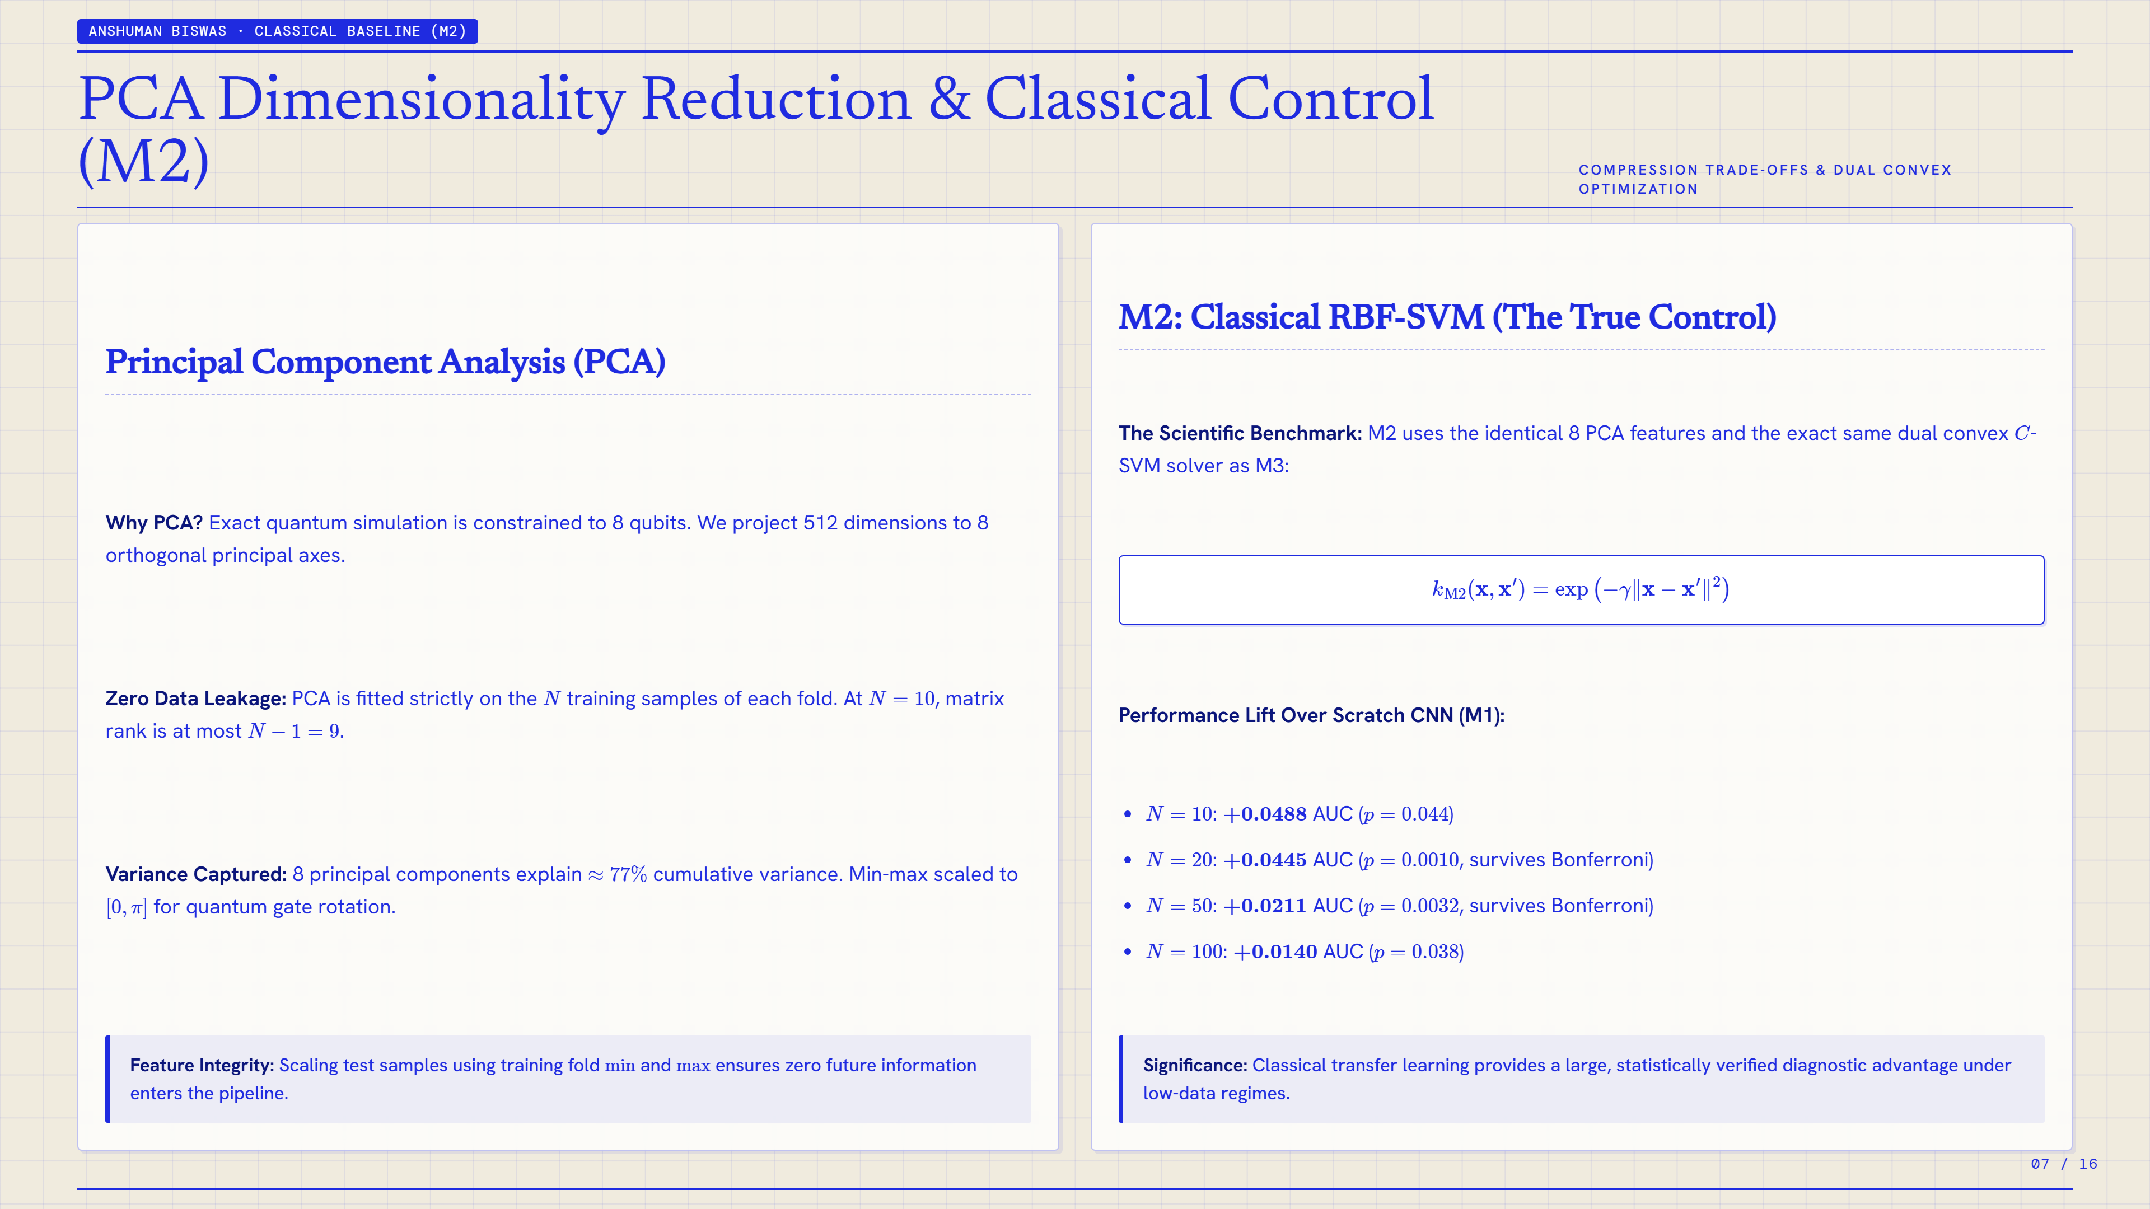
Notes:
SLIDE 7: PCA Dimensionality Reduction & Classical Control (M2)
Presenter / Section: ANSHUMAN BISWAS · CLASSICAL BASELINE (M2)
Topic: COMPRESSION TRADE-OFFS & DUAL CONVEX OPTIMIZATION
KEY TAKEAWAY:
Feature Integrity: Scaling test samples using training fold
min
and
max
ensures zero future information enters the pipeline.
Significance: Classical transfer learning provides a large, statistically verified diagnostic advantage under low-data regimes.
--- SLIDE TRANSCRIPT & NOTES ---
ANSHUMAN BISWAS · CLASSICAL BASELINE (M2)
PCA Dimensionality Reduction & Classical Control (M2)
COMPRESSION TRADE-OFFS & DUAL CONVEX OPTIMIZATION
Principal Component Analysis (PCA)
Why PCA? Exact quantum simulation is constrained to 8 qubits. We project 512 dimensions to 8 orthogonal principal axes.
Zero Data Leakage: PCA is fitted strictly on the
𝑁
training samples of each fold. At
𝑁
=
10
, matrix rank is at most
𝑁
−
1
=
9
.
Variance Captured: 8 principal components explain
≈
77
%
cumulative variance. Min-max scaled to
[
0
,
𝜋
]
for quantum gate rotation.
Feature Integrity: Scaling test samples using training fold
min
and
max
ensures zero future information enters the pipeline.
M2: Classical RBF-SVM (The True Control)
The Scientific Benchmark: M2 uses the identical 8 PCA features and the exact same dual convex
𝐶
-SVM solver as M3:
𝑘
M2
(
𝑥
,
𝑥
′
)
=
exp
⁡
(
−
𝛾
‖
𝑥
−
𝑥
′
‖
2
)
Performance Lift Over Scratch CNN (M1):
𝑁
=
10
:
+
0.0488
AUC (
𝑝
=
0.044
)
𝑁
=
20
:
+
0.0445
AUC (
𝑝
=
0.0010
, survives Bonferroni)
𝑁
=
50
:
+
0.0211
AUC (
𝑝
=
0.0032
, survives Bonferroni)
𝑁
=
100
:
+
0.0140
AUC (
𝑝
=
0.038
)
Significance: Classical transfer learning provides a large, statistically verified diagnostic advantage under low-data regimes.
07 / 16

Slide 8
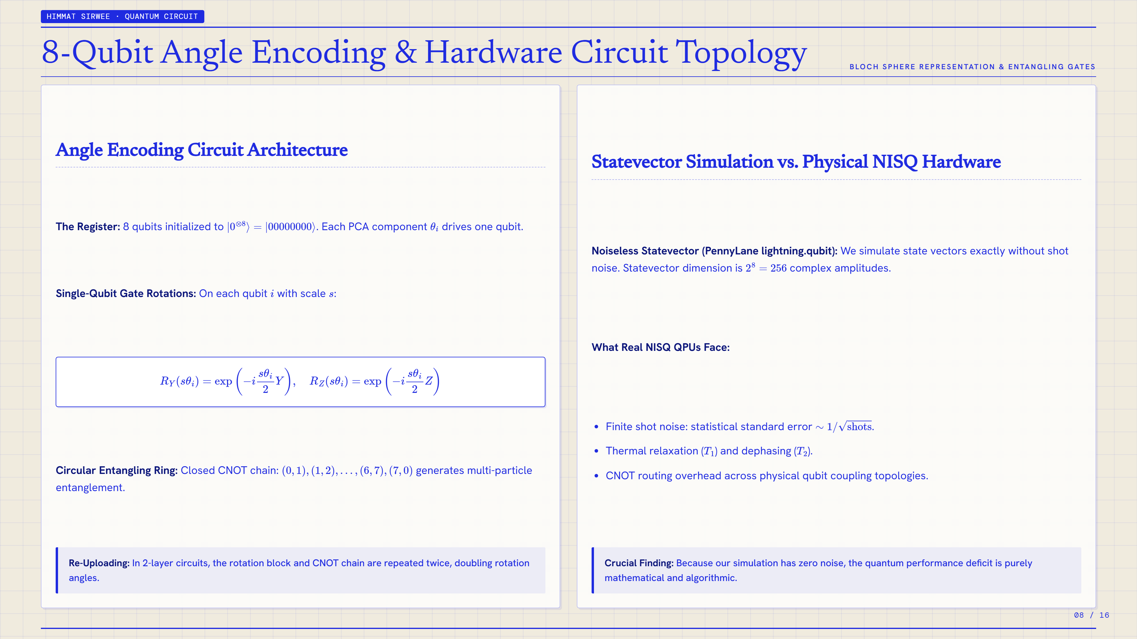
Notes:
SLIDE 8: 8-Qubit Angle Encoding & Hardware Circuit Topology
Presenter / Section: HIMMAT SIRWEE · QUANTUM CIRCUIT
Topic: BLOCH SPHERE REPRESENTATION & ENTANGLING GATES
KEY TAKEAWAY:
Re-Uploading: In 2-layer circuits, the rotation block and CNOT chain are repeated twice, doubling rotation angles.
Crucial Finding: Because our simulation has zero noise, the quantum performance deficit is purely mathematical and algorithmic.
--- SLIDE TRANSCRIPT & NOTES ---
HIMMAT SIRWEE · QUANTUM CIRCUIT
8-Qubit Angle Encoding & Hardware Circuit Topology
BLOCH SPHERE REPRESENTATION & ENTANGLING GATES
Angle Encoding Circuit Architecture
The Register: 8 qubits initialized to
|
0
⊗
8
⟩
=
|
00000000
⟩
. Each PCA component
𝜃
𝑖
drives one qubit.
Single-Qubit Gate Rotations: On each qubit
𝑖
with scale
𝑠
:
𝑅
𝑌
(
𝑠
𝜃
𝑖
)
=
exp
⁡
(
−
𝑖
𝑠
𝜃
𝑖
2
𝑌
)
,
𝑅
𝑍
(
𝑠
𝜃
𝑖
)
=
exp
⁡
(
−
𝑖
𝑠
𝜃
𝑖
2
𝑍
)
Circular Entangling Ring: Closed CNOT chain:
(
0
,
1
)
,
(
1
,
2
)
,
…
,
(
6
,
7
)
,
(
7
,
0
)
generates multi-particle entanglement.
Re-Uploading: In 2-layer circuits, the rotation block and CNOT chain are repeated twice, doubling rotation angles.
Statevector Simulation vs. Physical NISQ Hardware
Noiseless Statevector (PennyLane lightning.qubit): We simulate state vectors exactly without shot noise. Statevector dimension is
2
8
=
256
complex amplitudes.
What Real NISQ QPUs Face:
Finite shot noise: statistical standard error
∼
1
/
shots
.
Thermal relaxation (
𝑇
1
) and dephasing (
𝑇
2
).
CNOT routing overhead across physical qubit coupling topologies.
Crucial Finding: Because our simulation has zero noise, the quantum performance deficit is purely mathematical and algorithmic.
08 / 16

Slide 9
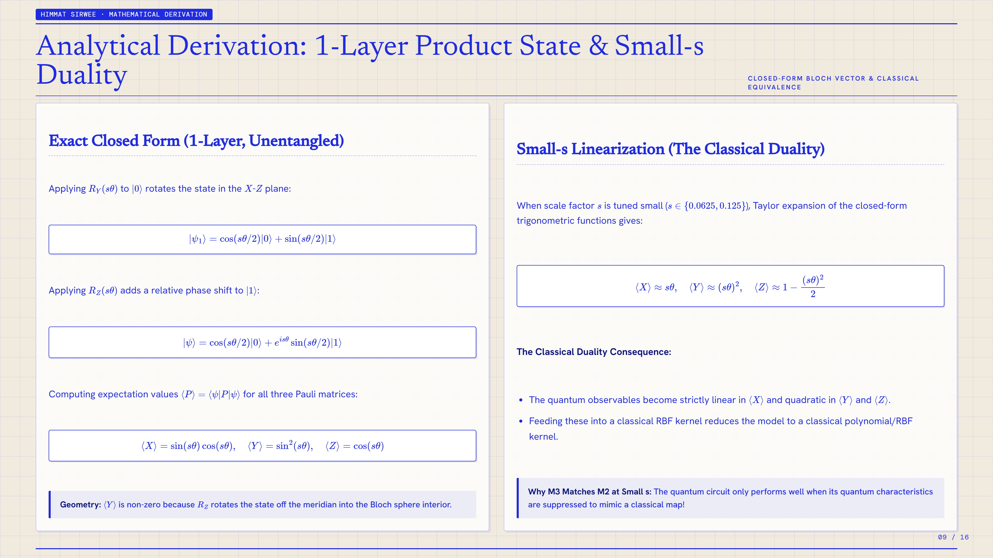
Notes:
SLIDE 9: Analytical Derivation: 1-Layer Product State & Small-s Duality
Presenter / Section: HIMMAT SIRWEE · MATHEMATICAL DERIVATION
Topic: CLOSED-FORM BLOCH VECTOR & CLASSICAL EQUIVALENCE
KEY TAKEAWAY:
Geometry:
⟨
𝑌
⟩
is non-zero because
𝑅
𝑍
rotates the state off the meridian into the Bloch sphere interior.
Why M3 Matches M2 at Small s: The quantum circuit only performs well when its quantum characteristics are suppressed to mimic a classical map!
--- SLIDE TRANSCRIPT & NOTES ---
HIMMAT SIRWEE · MATHEMATICAL DERIVATION
Analytical Derivation: 1-Layer Product State & Small-s Duality
CLOSED-FORM BLOCH VECTOR & CLASSICAL EQUIVALENCE
Exact Closed Form (1-Layer, Unentangled)
Applying
𝑅
𝑌
(
𝑠
𝜃
)
to
|
0
⟩
rotates the state in the
𝑋
-
𝑍
plane:
|
𝜓
1
⟩
=
cos
⁡
(
𝑠
𝜃
/
2
)
|
0
⟩
+
sin
⁡
(
𝑠
𝜃
/
2
)
|
1
⟩
Applying
𝑅
𝑍
(
𝑠
𝜃
)
adds a relative phase shift to
|
1
⟩
:
|
𝜓
⟩
=
cos
⁡
(
𝑠
𝜃
/
2
)
|
0
⟩
+
𝑒
𝑖
𝑠
𝜃
sin
⁡
(
𝑠
𝜃
/
2
)
|
1
⟩
Computing expectation values
⟨
𝑃
⟩
=
⟨
𝜓
|
𝑃
|
𝜓
⟩
for all three Pauli matrices:
⟨
𝑋
⟩
=
sin
⁡
(
𝑠
𝜃
)
cos
⁡
(
𝑠
𝜃
)
,
⟨
𝑌
⟩
=
sin
2
⁡
(
𝑠
𝜃
)
,
⟨
𝑍
⟩
=
cos
⁡
(
𝑠
𝜃
)
Geometry:
⟨
𝑌
⟩
is non-zero because
𝑅
𝑍
rotates the state off the meridian into the Bloch sphere interior.
Small-s Linearization (The Classical Duality)
When scale factor
𝑠
is tuned small (
𝑠
∈
{
0.0625
,
0.125
}
), Taylor expansion of the closed-form trigonometric functions gives:
⟨
𝑋
⟩
≈
𝑠
𝜃
,
⟨
𝑌
⟩
≈
(
𝑠
𝜃
)
2
,
⟨
𝑍
⟩
≈
1
−
(
𝑠
𝜃
)
2
2
The Classical Duality Consequence:
The quantum observables become strictly linear in
⟨
𝑋
⟩
and quadratic in
⟨
𝑌
⟩
and
⟨
𝑍
⟩
.
Feeding these into a classical RBF kernel reduces the model to a classical polynomial/RBF kernel.
Why M3 Matches M2 at Small s: The quantum circuit only performs well when its quantum characteristics are suppressed to mimic a classical map!
09 / 16

Slide 10
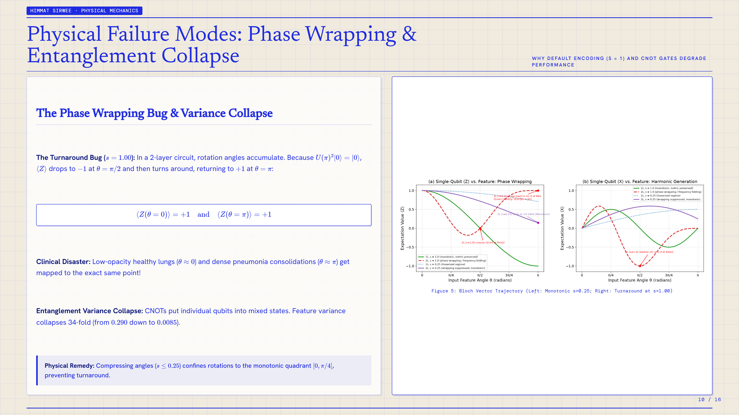
Notes:
SLIDE 10: Physical Failure Modes: Phase Wrapping & Entanglement Collapse
Presenter / Section: HIMMAT SIRWEE · PHYSICAL MECHANICS
Topic: WHY DEFAULT ENCODING (S = 1) AND CNOT GATES DEGRADE PERFORMANCE
KEY TAKEAWAY:
Physical Remedy: Compressing angles (
𝑠
≤
0.25
) confines rotations to the monotonic quadrant
[
0
,
𝜋
/
4
]
, preventing turnaround.
--- SLIDE TRANSCRIPT & NOTES ---
HIMMAT SIRWEE · PHYSICAL MECHANICS
Physical Failure Modes: Phase Wrapping & Entanglement Collapse
WHY DEFAULT ENCODING (S = 1) AND CNOT GATES DEGRADE PERFORMANCE
The Phase Wrapping Bug & Variance Collapse
The Turnaround Bug (
𝑠
=
1.00
): In a 2-layer circuit, rotation angles accumulate. Because
𝑈
(
𝜋
)
2
|
0
⟩
=
|
0
⟩
,
⟨
𝑍
⟩
drops to
−
1
at
𝜃
=
𝜋
/
2
and then turns around, returning to
+
1
at
𝜃
=
𝜋
:
⟨
𝑍
(
𝜃
=
0
)
⟩
=
+
1
and
⟨
𝑍
(
𝜃
=
𝜋
)
⟩
=
+
1
Clinical Disaster: Low-opacity healthy lungs (
𝜃
≈
0
) and dense pneumonia consolidations (
𝜃
≈
𝜋
) get mapped to the exact same point!
Entanglement Variance Collapse: CNOTs put individual qubits into mixed states. Feature variance collapses 34-fold (from
0.290
down to
0.0085
).
Physical Remedy: Compressing angles (
𝑠
≤
0.25
) confines rotations to the monotonic quadrant
[
0
,
𝜋
/
4
]
, preventing turnaround.
Figure 5: Bloch Vector Trajectory (Left: Monotonic s=0.25; Right: Turnaround at s=1.00)
10 / 16

Slide 11
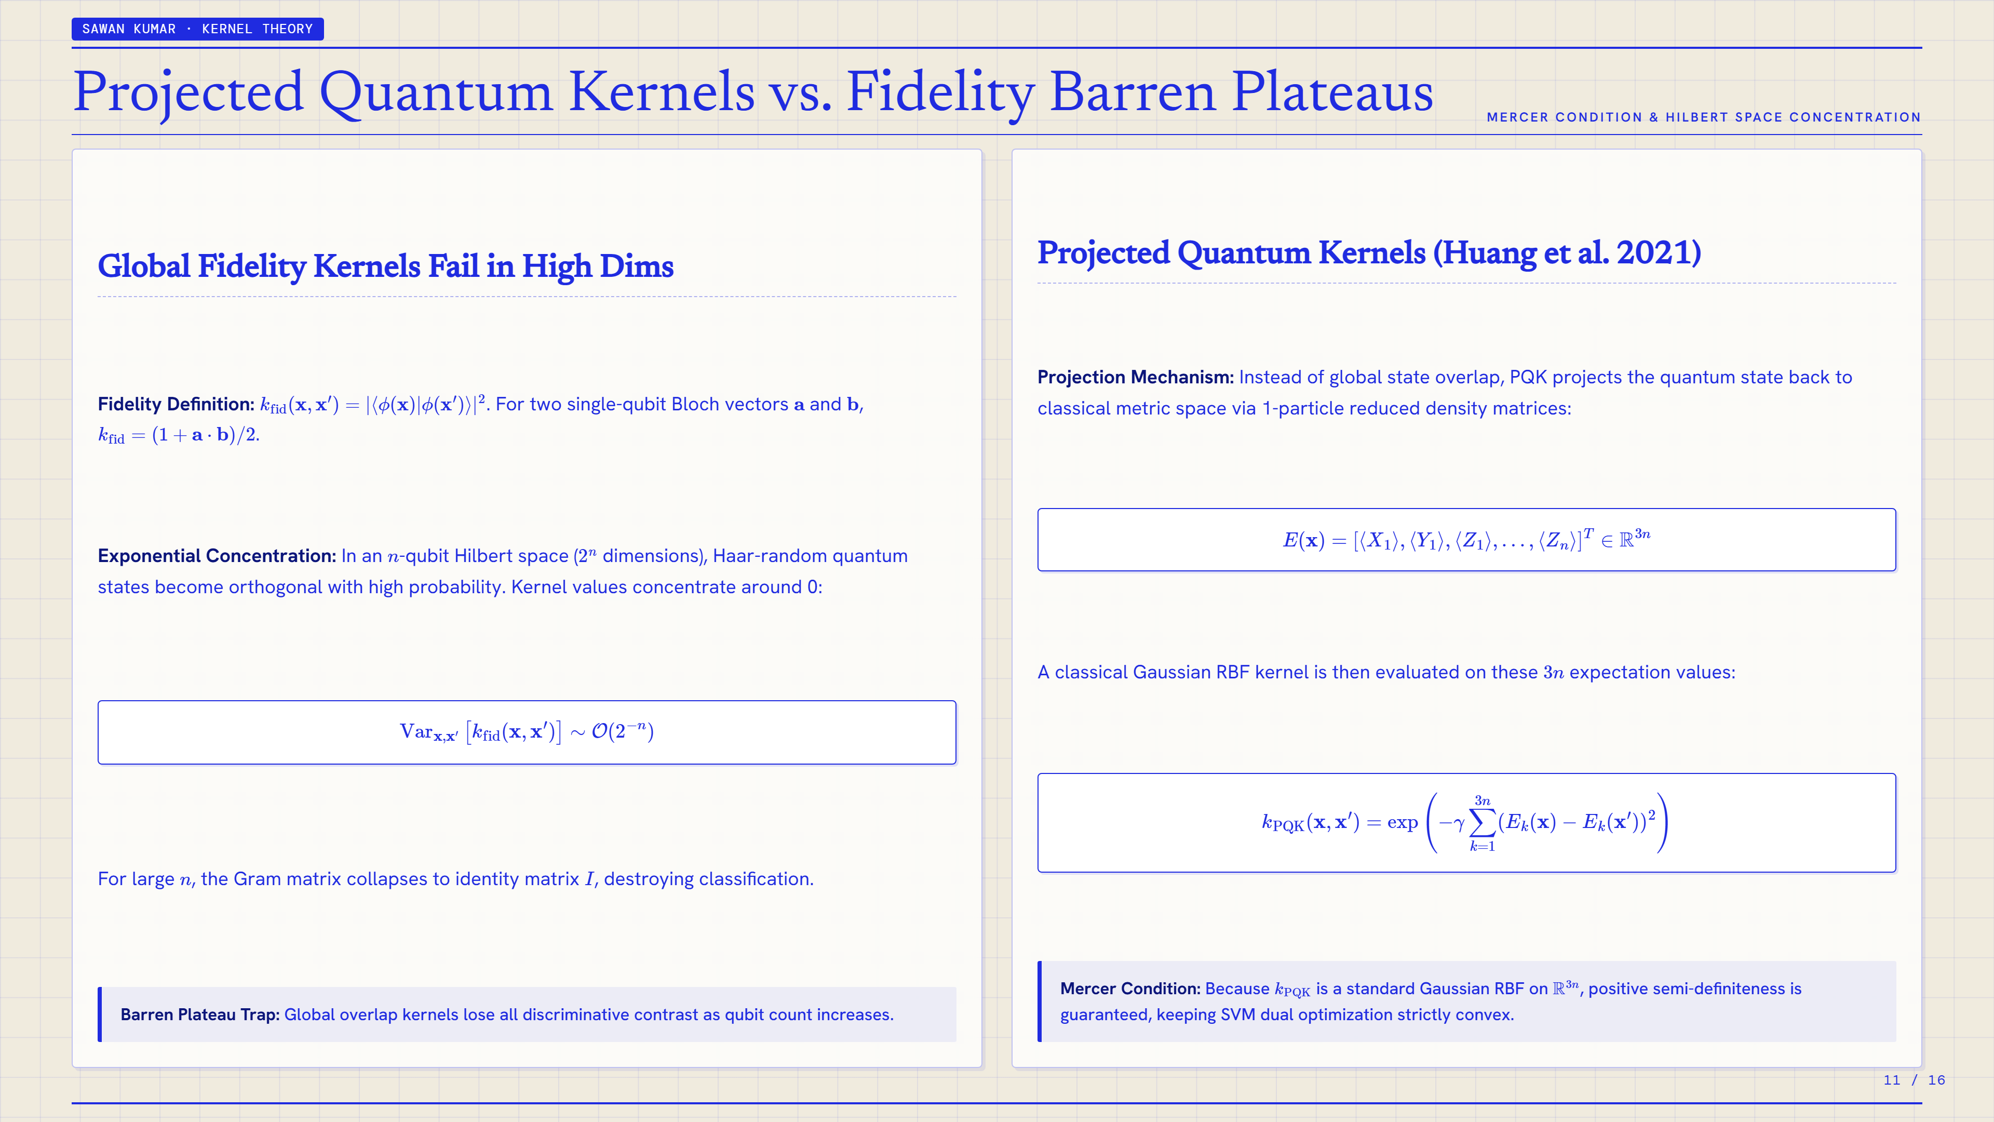
Notes:
SLIDE 11: Projected Quantum Kernels vs. Fidelity Barren Plateaus
Presenter / Section: SAWAN KUMAR · KERNEL THEORY
Topic: MERCER CONDITION & HILBERT SPACE CONCENTRATION
KEY TAKEAWAY:
Barren Plateau Trap: Global overlap kernels lose all discriminative contrast as qubit count increases.
Mercer Condition: Because
𝑘
PQK
is a standard Gaussian RBF on
𝑅
3
𝑛
, positive semi-definiteness is guaranteed, keeping SVM dual optimization strictly convex.
--- SLIDE TRANSCRIPT & NOTES ---
SAWAN KUMAR · KERNEL THEORY
Projected Quantum Kernels vs. Fidelity Barren Plateaus
MERCER CONDITION & HILBERT SPACE CONCENTRATION
Global Fidelity Kernels Fail in High Dims
Fidelity Definition:
𝑘
fid
(
𝑥
,
𝑥
′
)
=
|
⟨
𝜙
(
𝑥
)
|
𝜙
(
𝑥
′
)
⟩
|
2
. For two single-qubit Bloch vectors
𝑎
and
𝑏
,
𝑘
fid
=
(
1
+
𝑎
⋅
𝑏
)
/
2
.
Exponential Concentration: In an
𝑛
-qubit Hilbert space (
2
𝑛
dimensions), Haar-random quantum states become orthogonal with high probability. Kernel values concentrate around 0:
Var
𝑥
,
𝑥
′
[
𝑘
fid
(
𝑥
,
𝑥
′
)
]
∼
𝑂
(
2
−
𝑛
)
For large
𝑛
, the Gram matrix collapses to identity matrix
𝐼
, destroying classification.
Barren Plateau Trap: Global overlap kernels lose all discriminative contrast as qubit count increases.
Projected Quantum Kernels (Huang et al. 2021)
Projection Mechanism: Instead of global state overlap, PQK projects the quantum state back to classical metric space via 1-particle reduced density matrices:
𝐸
(
𝑥
)
=
[
⟨
𝑋
1
⟩
,
⟨
𝑌
1
⟩
,
⟨
𝑍
1
⟩
,
…
,
⟨
𝑍
𝑛
⟩
]
𝑇
∈
𝑅
3
𝑛
A classical Gaussian RBF kernel is then evaluated on these
3
𝑛
expectation values:
𝑘
PQK
(
𝑥
,
𝑥
′
)
=
exp
⁡
(
−
𝛾
∑
𝑘
=
1
3
𝑛
(
𝐸
𝑘
(
𝑥
)
−
𝐸
𝑘
(
𝑥
′
)
)
2
)
Mercer Condition: Because
𝑘
PQK
is a standard Gaussian RBF on
𝑅
3
𝑛
, positive semi-definiteness is guaranteed, keeping SVM dual optimization strictly convex.
11 / 16

Slide 12
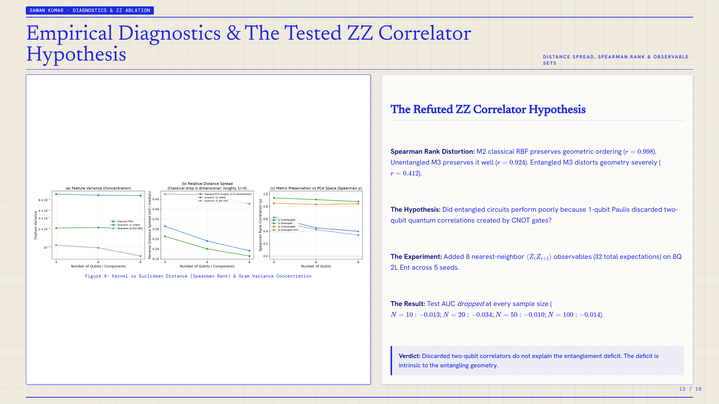
Notes:
SLIDE 12: Empirical Diagnostics & The Tested ZZ Correlator Hypothesis
Presenter / Section: SAWAN KUMAR · DIAGNOSTICS & ZZ ABLATION
Topic: DISTANCE SPREAD, SPEARMAN RANK & OBSERVABLE SETS
KEY TAKEAWAY:
Verdict: Discarded two-qubit correlators do not explain the entanglement deficit. The deficit is intrinsic to the entangling geometry.
--- SLIDE TRANSCRIPT & NOTES ---
SAWAN KUMAR · DIAGNOSTICS & ZZ ABLATION
Empirical Diagnostics & The Tested ZZ Correlator Hypothesis
DISTANCE SPREAD, SPEARMAN RANK & OBSERVABLE SETS
Figure 4: Kernel vs Euclidean Distance (Spearman Rank) & Gram Variance Concentration
The Refuted ZZ Correlator Hypothesis
Spearman Rank Distortion: M2 classical RBF preserves geometric ordering (
𝑟
=
0.998
). Unentangled M3 preserves it well (
𝑟
=
0.924
). Entangled M3 distorts geometry severely (
𝑟
=
0.412
).
The Hypothesis: Did entangled circuits perform poorly because 1-qubit Paulis discarded two-qubit quantum correlations created by CNOT gates?
The Experiment: Added 8 nearest-neighbor
⟨
𝑍
𝑖
𝑍
𝑖
+
1
⟩
observables (
32
total expectations) on 8Q 2L Ent across 5 seeds.
The Result: Test AUC dropped at every sample size (
𝑁
=
10
:
−
0.013
;
𝑁
=
20
:
−
0.034
;
𝑁
=
50
:
−
0.010
;
𝑁
=
100
:
−
0.014
).
Verdict: Discarded two-qubit correlators do not explain the entanglement deficit. The deficit is intrinsic to the entangling geometry.
12 / 16

Slide 13
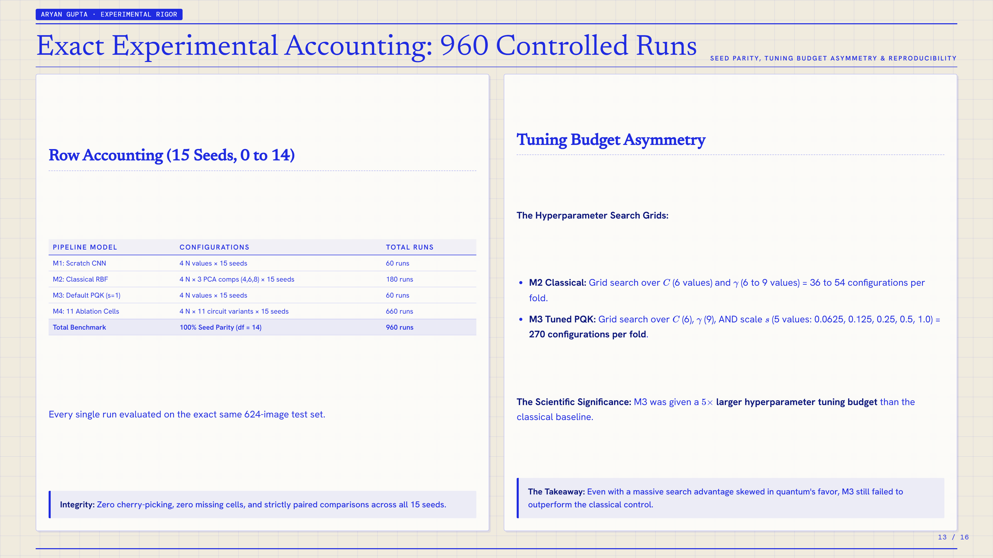
Notes:
SLIDE 13: Exact Experimental Accounting: 960 Controlled Runs
Presenter / Section: ARYAN GUPTA · EXPERIMENTAL RIGOR
Topic: SEED PARITY, TUNING BUDGET ASYMMETRY & REPRODUCIBILITY
KEY TAKEAWAY:
Integrity: Zero cherry-picking, zero missing cells, and strictly paired comparisons across all 15 seeds.
The Takeaway: Even with a massive search advantage skewed in quantum's favor, M3 still failed to outperform the classical control.
--- SLIDE TRANSCRIPT & NOTES ---
ARYAN GUPTA · EXPERIMENTAL RIGOR
Exact Experimental Accounting: 960 Controlled Runs
SEED PARITY, TUNING BUDGET ASYMMETRY & REPRODUCIBILITY
Row Accounting (15 Seeds, 0 to 14)
PIPELINE MODEL CONFIGURATIONS TOTAL RUNS
M1: Scratch CNN 4 N values × 15 seeds 60 runs
M2: Classical RBF 4 N × 3 PCA comps (4,6,8) × 15 seeds 180 runs
M3: Default PQK (s=1) 4 N values × 15 seeds 60 runs
M4: 11 Ablation Cells 4 N × 11 circuit variants × 15 seeds 660 runs
Total Benchmark 100% Seed Parity (df = 14) 960 runs
Every single run evaluated on the exact same 624-image test set.
Integrity: Zero cherry-picking, zero missing cells, and strictly paired comparisons across all 15 seeds.
Tuning Budget Asymmetry
The Hyperparameter Search Grids:
M2 Classical: Grid search over
𝐶
(6 values) and
𝛾
(6 to 9 values) = 36 to 54 configurations per fold.
M3 Tuned PQK: Grid search over
𝐶
(6),
𝛾
(9), AND scale
𝑠
(5 values: 0.0625, 0.125, 0.25, 0.5, 1.0) = 270 configurations per fold.
The Scientific Significance: M3 was given a
5
×
larger hyperparameter tuning budget than the classical baseline.
The Takeaway: Even with a massive search advantage skewed in quantum's favor, M3 still failed to outperform the classical control.
13 / 16

Slide 14
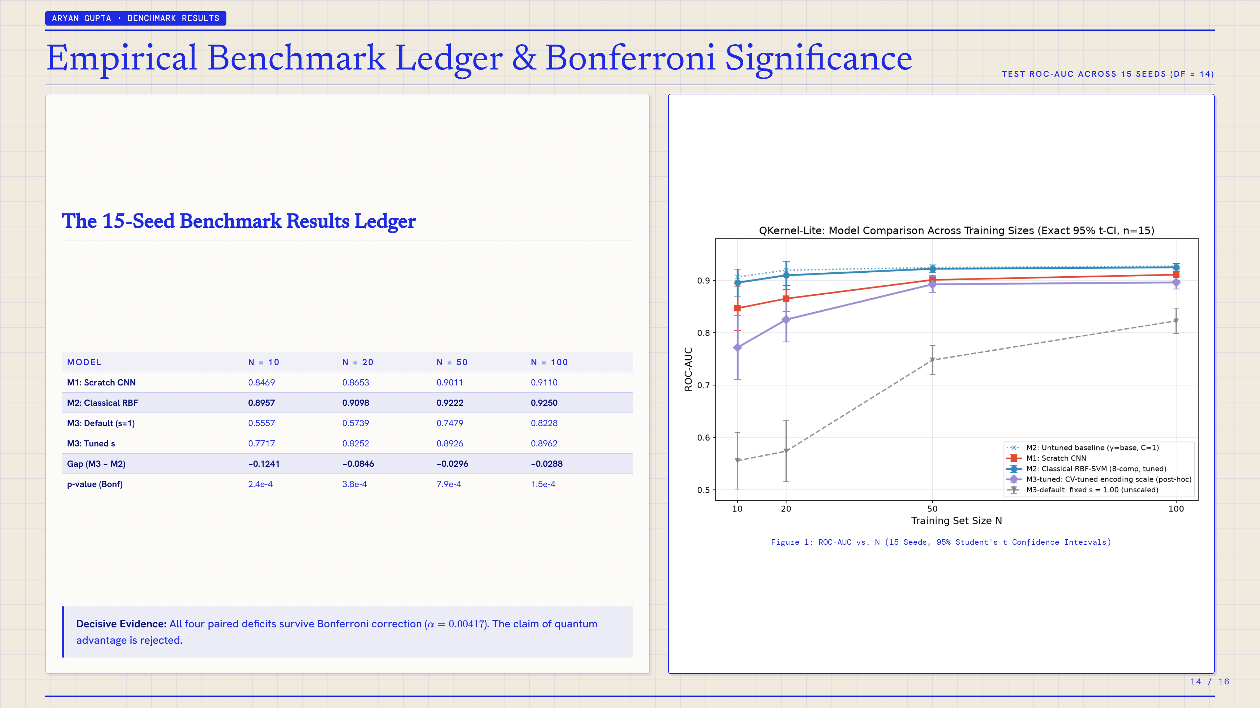
Notes:
SLIDE 14: Empirical Benchmark Ledger & Bonferroni Significance
Presenter / Section: ARYAN GUPTA · BENCHMARK RESULTS
Topic: TEST ROC-AUC ACROSS 15 SEEDS (DF = 14)
KEY TAKEAWAY:
Decisive Evidence: All four paired deficits survive Bonferroni correction (
𝛼
=
0.00417
). The claim of quantum advantage is rejected.
--- SLIDE TRANSCRIPT & NOTES ---
ARYAN GUPTA · BENCHMARK RESULTS
Empirical Benchmark Ledger & Bonferroni Significance
TEST ROC-AUC ACROSS 15 SEEDS (DF = 14)
The 15-Seed Benchmark Results Ledger
MODEL N = 10 N = 20 N = 50 N = 100
M1: Scratch CNN 0.8469 0.8653 0.9011 0.9110
M2: Classical RBF 0.8957 0.9098 0.9222 0.9250
M3: Default (s=1) 0.5557 0.5739 0.7479 0.8228
M3: Tuned s 0.7717 0.8252 0.8926 0.8962
Gap (M3 − M2) −0.1241 −0.0846 −0.0296 −0.0288
p-value (Bonf) 2.4e-4 3.8e-4 7.9e-4 1.5e-4
Decisive Evidence: All four paired deficits survive Bonferroni correction (
𝛼
=
0.00417
). The claim of quantum advantage is rejected.
Figure 1: ROC-AUC vs. N (15 Seeds, 95% Student's t Confidence Intervals)
14 / 16

Slide 15
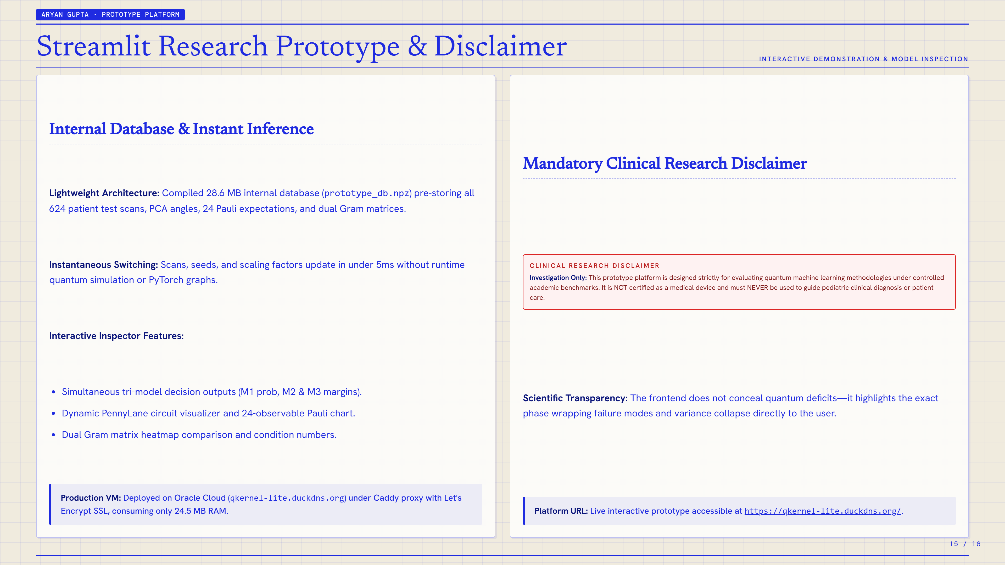
Notes:
SLIDE 15: Streamlit Research Prototype & Disclaimer
Presenter / Section: ARYAN GUPTA · PROTOTYPE PLATFORM
Topic: INTERACTIVE DEMONSTRATION & MODEL INSPECTION
KEY TAKEAWAY:
Production VM: Deployed on Oracle Cloud (qkernel-lite.duckdns.org) under Caddy proxy with Let's Encrypt SSL, consuming only 24.5 MB RAM.
Platform URL: Live interactive prototype accessible at https://qkernel-lite.duckdns.org/.
--- SLIDE TRANSCRIPT & NOTES ---
ARYAN GUPTA · PROTOTYPE PLATFORM
Streamlit Research Prototype & Disclaimer
INTERACTIVE DEMONSTRATION & MODEL INSPECTION
Internal Database & Instant Inference
Lightweight Architecture: Compiled 28.6 MB internal database (prototype_db.npz) pre-storing all 624 patient test scans, PCA angles, 24 Pauli expectations, and dual Gram matrices.
Instantaneous Switching: Scans, seeds, and scaling factors update in under 5ms without runtime quantum simulation or PyTorch graphs.
Interactive Inspector Features:
Simultaneous tri-model decision outputs (M1 prob, M2 & M3 margins).
Dynamic PennyLane circuit visualizer and 24-observable Pauli chart.
Dual Gram matrix heatmap comparison and condition numbers.
Production VM: Deployed on Oracle Cloud (qkernel-lite.duckdns.org) under Caddy proxy with Let's Encrypt SSL, consuming only 24.5 MB RAM.
Mandatory Clinical Research Disclaimer
CLINICAL RESEARCH DISCLAIMER
Investigation Only: This prototype platform is designed strictly for evaluating quantum machine learning methodologies under controlled academic benchmarks. It is NOT certified as a medical device and must NEVER be used to guide pediatric clinical diagnosis or patient care.
Scientific Transparency: The frontend does not conceal quantum deficits—it highlights the exact phase wrapping failure modes and variance collapse directly to the user.
Platform URL: Live interactive prototype accessible at https://qkernel-lite.duckdns.org/.
15 / 16

Slide 16
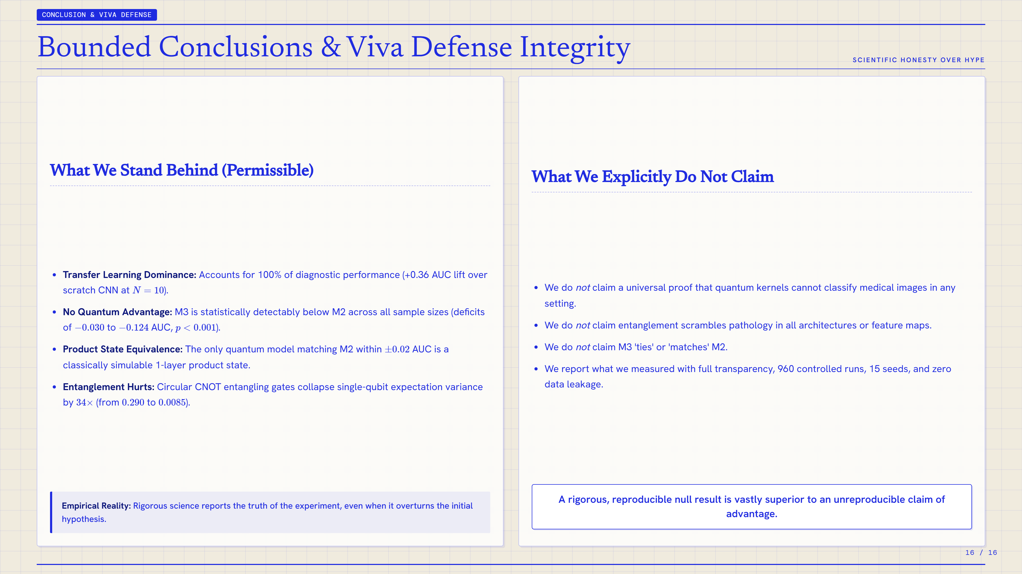
Notes:
SLIDE 16: Bounded Conclusions & Viva Defense Integrity
Presenter / Section: CONCLUSION & VIVA DEFENSE
Topic: SCIENTIFIC HONESTY OVER HYPE
KEY TAKEAWAY:
Empirical Reality: Rigorous science reports the truth of the experiment, even when it overturns the initial hypothesis.
--- SLIDE TRANSCRIPT & NOTES ---
CONCLUSION & VIVA DEFENSE
Bounded Conclusions & Viva Defense Integrity
SCIENTIFIC HONESTY OVER HYPE
What We Stand Behind (Permissible)
Transfer Learning Dominance: Accounts for 100% of diagnostic performance (+0.36 AUC lift over scratch CNN at
𝑁
=
10
).
No Quantum Advantage: M3 is statistically detectably below M2 across all sample sizes (deficits of
−
0.030
to
−
0.124
AUC,
𝑝
<
0.001
).
Product State Equivalence: The only quantum model matching M2 within
±
0.02
AUC is a classically simulable 1-layer product state.
Entanglement Hurts: Circular CNOT entangling gates collapse single-qubit expectation variance by
34
×
(from
0.290
to
0.0085
).
Empirical Reality: Rigorous science reports the truth of the experiment, even when it overturns the initial hypothesis.
What We Explicitly Do Not Claim
We do not claim a universal proof that quantum kernels cannot classify medical images in any setting.
We do not claim entanglement scrambles pathology in all architectures or feature maps.
We do not claim M3 'ties' or 'matches' M2.
We report what we measured with full transparency, 960 controlled runs, 15 seeds, and zero data leakage.
A rigorous, reproducible null result is vastly superior to an unreproducible claim of advantage.
16 / 16

