Slide 1

Exploratory Data Analysis and Logistic Regression Model
Anshu Anamika

Slide 2

Data set :Ongoing cardiovascular study on residents of the town of Framingham, Massachusetts.
Information : Patients demographic, behavioural and medical information
Goal : To predict whether the patient has 10-year risk of future coronary heart disease (CHD)
Importance : Predicting heart disease is crucial for early prevention and personalised treatment plan

Slide 3

Exploratory Data Analysis
>4000 rows and 16 colums
Missing values : Six features (glucose ,education, BPMeds , totChol, cigsPerDay, BMI, heartrate)
Data type
Statistical Description and correlation

Slide 4
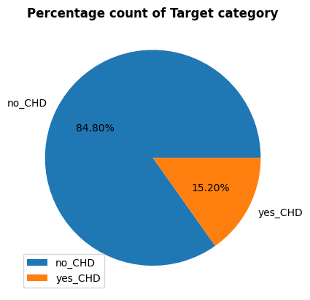
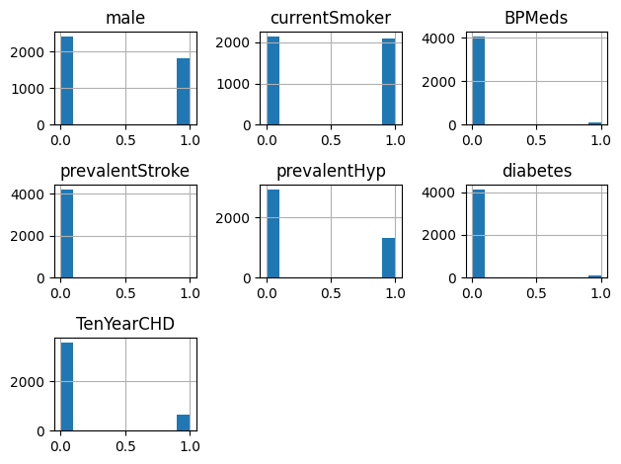
Is dataset balanced?

Slide 5
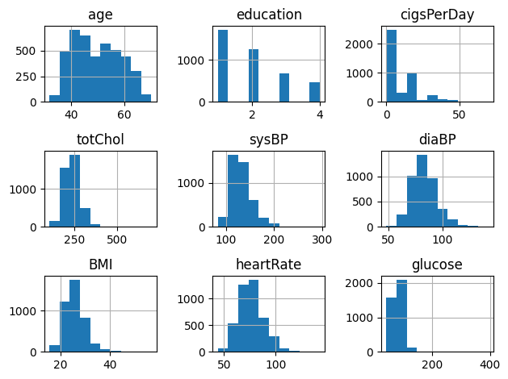

Slide 6
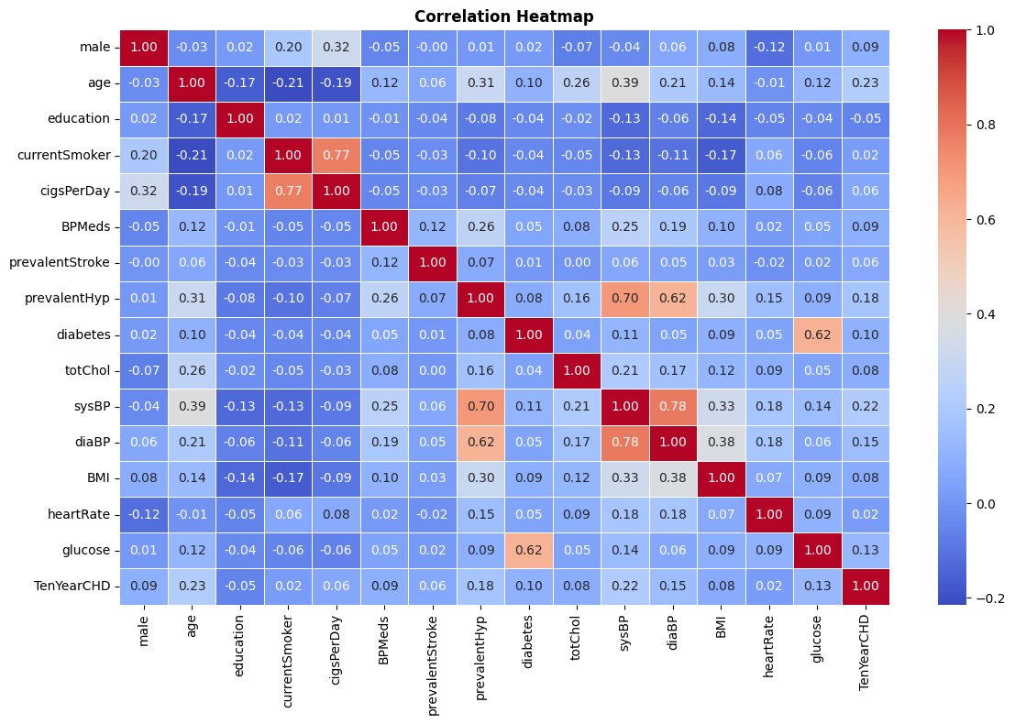
Is there any correlation?

Slide 7
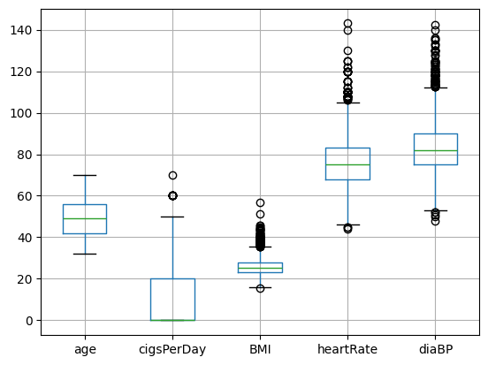
Boxplots to see outliers

Slide 8
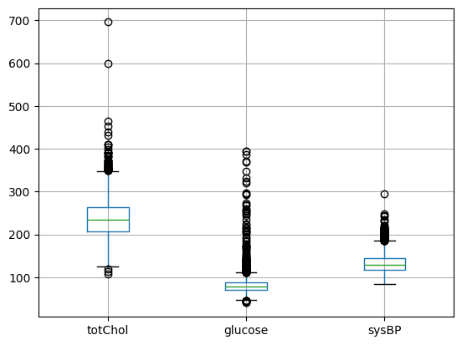
Box plot to see outliers

Slide 9

Conclusion from EDA
Target data not balanced can affect accuracy
1
Replace missing values with median
2
Use Standarscaler as there are outliers
3

Slide 10
Logistic regression model
Logistic regression
Accuracy score: 0.862
Confusion matrix :
[717, 4],
[113, 14]

Slide 11
Logistic regression model with oversampling
Logistic regression
Accuracy score: 0.862
Confusion matrix :
[717, 4],
[113, 14]
Logistic regression with over sampling
Accuracy score: 0.676 Confusion matrix :
[476, 233]
[233, 496]

Slide 12
Logistic regression model with undersampling
Logistic regression
Accuracy score: 0.862
Confusion matrix :
[717, 4],
[113, 14]
Logistic regression with under sampling
Accuracy score:0.705 Confusion matrix :
[92, 32],
[44, 90]

Slide 13
Logistic regression model with Kfold validation
Logistic regression
Accuracy score: 0.862
Confusion matrix :
[717, 4],
[113, 14]
Logistic regression with K-Fold validation
Mean accuracy: 0.853

Slide 14
K-Nearest Neighbour(KNN) model
Accuracy score: 0.851
Confusion matrix :
[714, 7],
[119, 8]
Logistic regression
Accuracy score: 0.862
Confusion matrix :
[717, 4],
[113, 14]

Slide 15
Conclusion
We can calculate precision, Recall, F-score etc. to know more about how our model perform
We can add more real data to make it more balanced
We can try other classification models

