Slide 1
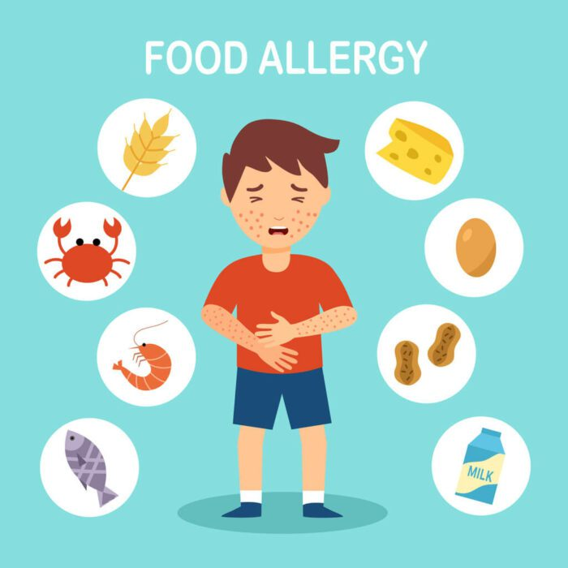
Instant Food Allergens Detection Device (FOLDEV)
BY
Anshu Anamika

Slide 2

Food allergy and common allergens
A food allergy is when the body's immune system reacts unusually to specific foods. Although allergic reactions are often mild, they can be very serious. In the most serious cases, a person has a severe allergic reaction (anaphylaxis), which can be life-threatening.
The Top 9 Food Allergens

Slide 3
Serious public health concern
Globally, an estimated 220 million people suffer from food allergies.
The U.S. Centers for Disease Control and Prevention (CDC) reports that the prevalence of food allergies has increased by 50 percent since the 1990s, making it a serious public health concern.
The prevalence of food allergies is higher in children than in adults.
Despite labeling laws and awareness, accidental exposure is still common in, Restaurants, School cafeterias, Packaged or bulk foods and Home-cooked meals (e.g., at social events)

Slide 4
We need a real-time food allergens detection device which every household can use it when they are travelling or they are in need to use it.
Limitation:
Allergy test kits exist but are:
Slow (10–30 mins)
Not portable/easy to use
Not affordable
Not practical in social or urgent contexts

Slide 5
Instant Food Allergen Detection Device (FOLDEV)
Detect presence of specific allergens in under 1 min.
Alert user with a vibration/sound/colour indication or app notification
Small, portable and affordable
Simple to use ( like fork sensor/ pen sensor)

Slide 6
Success criteria
Real-time allergy detection device
Small & portable
Accurate for detecting many allergens (peanuts, gluten, milk, soy, tree nut etc.)
Affordable
Reliable

Slide 7
Value it can bring!
We will save millions of live and give them freedom to enjoy their food anywhere without any stress
core market = Parents of allergic children, Schools, Airlines, Hospitals, Restaurants
Large & Growing Market- 250M+ global users and growing
Scalable: Expand to restaurants, schools, airlines, hospitals.
Recurring Revenue Model
Initial device sale + subscription model (test strips, app features) offers sustainable income.
strong market demand Allergy diagnosis rising globally (5–10% of population)

