Slide 1
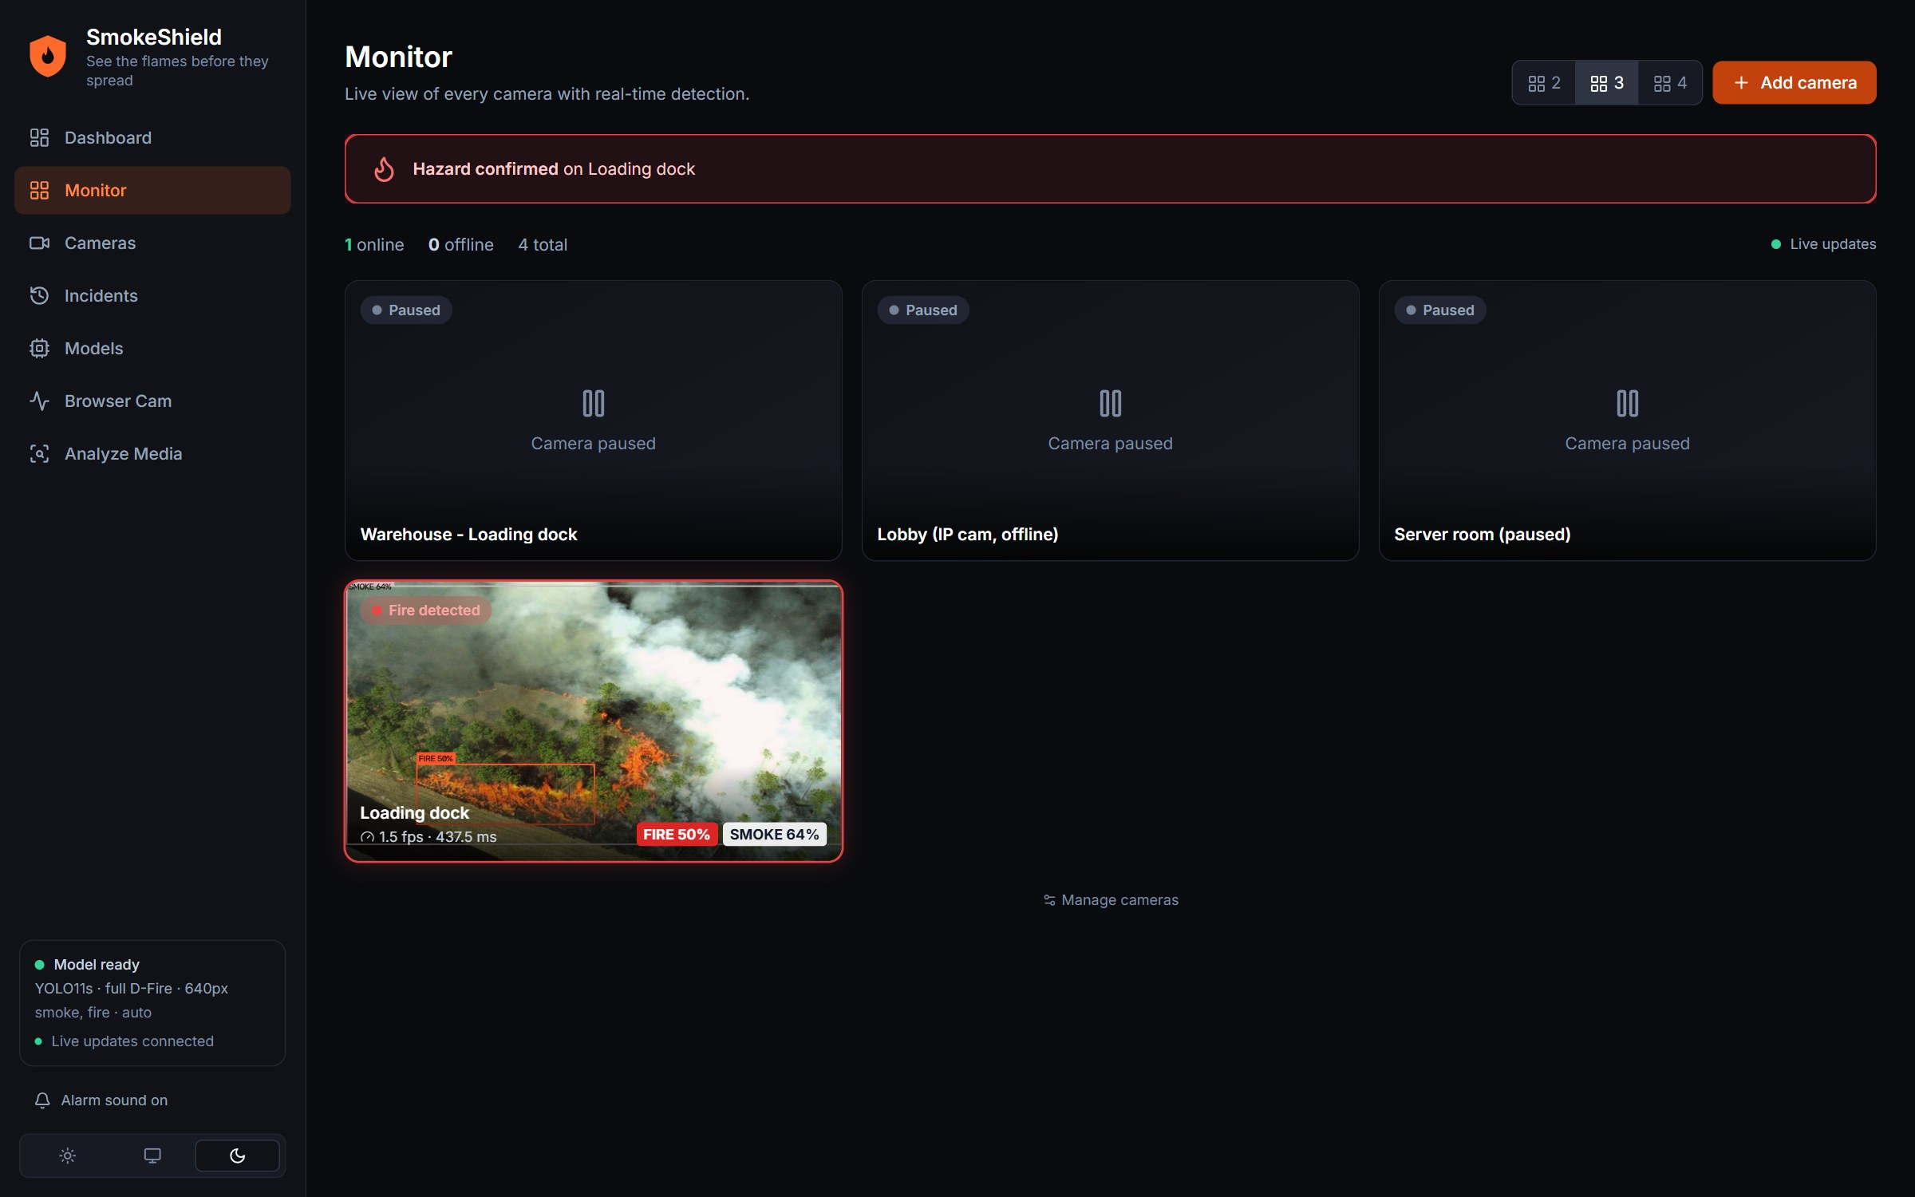
COMPUTER VISION PROJECT
SmokeShield
Real-time fire and smoke detection with YOLO
See the flames before they spread
Hemal Katariya
Enrollment no. 23002171210049
LJ University · AML · 1 Nov 2026
Notes:
Welcome. SmokeShield is my computer-vision project: a system that watches ordinary cameras and warns when it sees fire or smoke. In the next seven slides I will cover why it matters, how it works, the product itself, the model results, what small flames taught us about reliability, and what comes next.

Slide 2
THE PROBLEM
A fire is cheapest to stop in its first minutes
01
Cameras are already everywhere
Shops, warehouses, campuses and homes have CCTV. Almost none of it understands what it records.
02
People cannot watch every feed
Attention drifts within minutes. A small flame in the corner of one screen is easy to miss.
03
Smoke alarms wait for the smoke
A conventional alarm reacts once particles reach the sensor, which can be late in large or open spaces.
The goal: turn ordinary cameras into detectors that alert quickly, rarely cry wolf, and learn from every mistake.
SmokeShield · Computer Vision project
2 / 7
Notes:
Start with the motivation. Cameras are cheap and already installed, but nobody can watch dozens of feeds all day, and ordinary smoke alarms only react once smoke reaches them. The idea is to let software watch the cameras. The goal on this slide is the thread of the whole project: alert quickly, avoid false alarms, and keep improving from feedback.

Slide 3
EXHIBIT 1 · ARCHITECTURE
Every camera runs in its own worker and shares one model
01
Sources
RTSP cameras, video files, USB and browser webcams
02
Workers
One thread per camera, auto-reconnect, up to 4 frames a second
03
YOLO11s model
One shared model, swapped live with no restart
04
Alarm tracker
N of M frames, an instant path and a short hold
05
Incidents
One per episode, with snapshot, duration and review
The dashboard receives camera states and alerts over a live WebSocket, and data over REST.
FastAPI
Ultralytics YOLO11
OpenCV
SQLite
React
TypeScript
Tailwind CSS
SmokeShield · Computer Vision project
3 / 7
Notes:
Walk left to right. Sources can be network cameras, video files, USB webcams or the browser camera. Each enabled camera gets its own worker thread that reads frames, reconnects if the stream drops, and runs at most four detections a second. All workers share one YOLO model, and a new model version can be switched in live. The alarm tracker turns noisy per-frame detections into a stable alarm, and each alarm becomes an incident with a snapshot, a duration and a review status. The dashboard is a React app talking to a FastAPI backend.

Slide 4
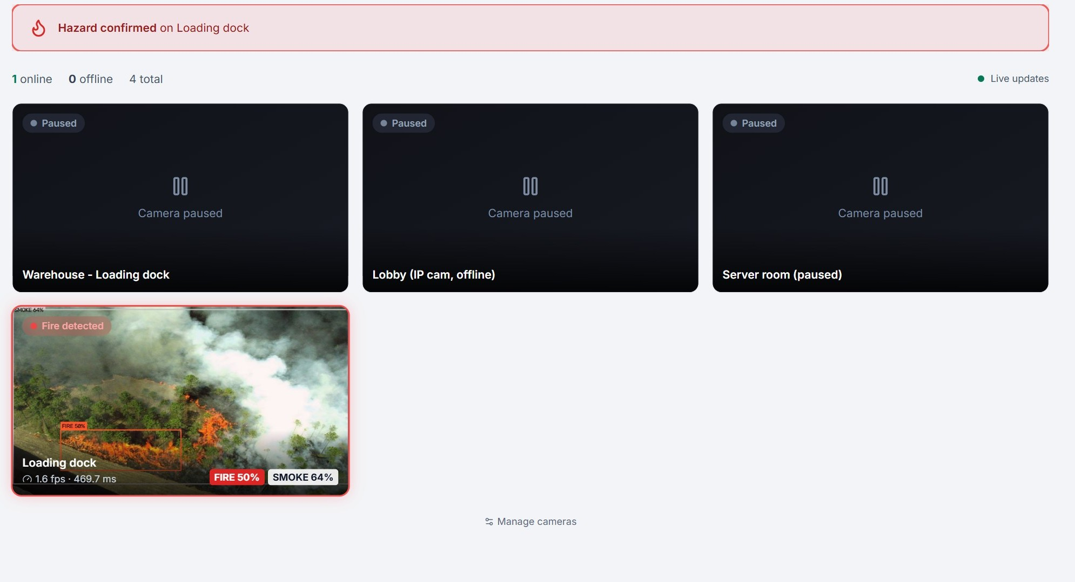
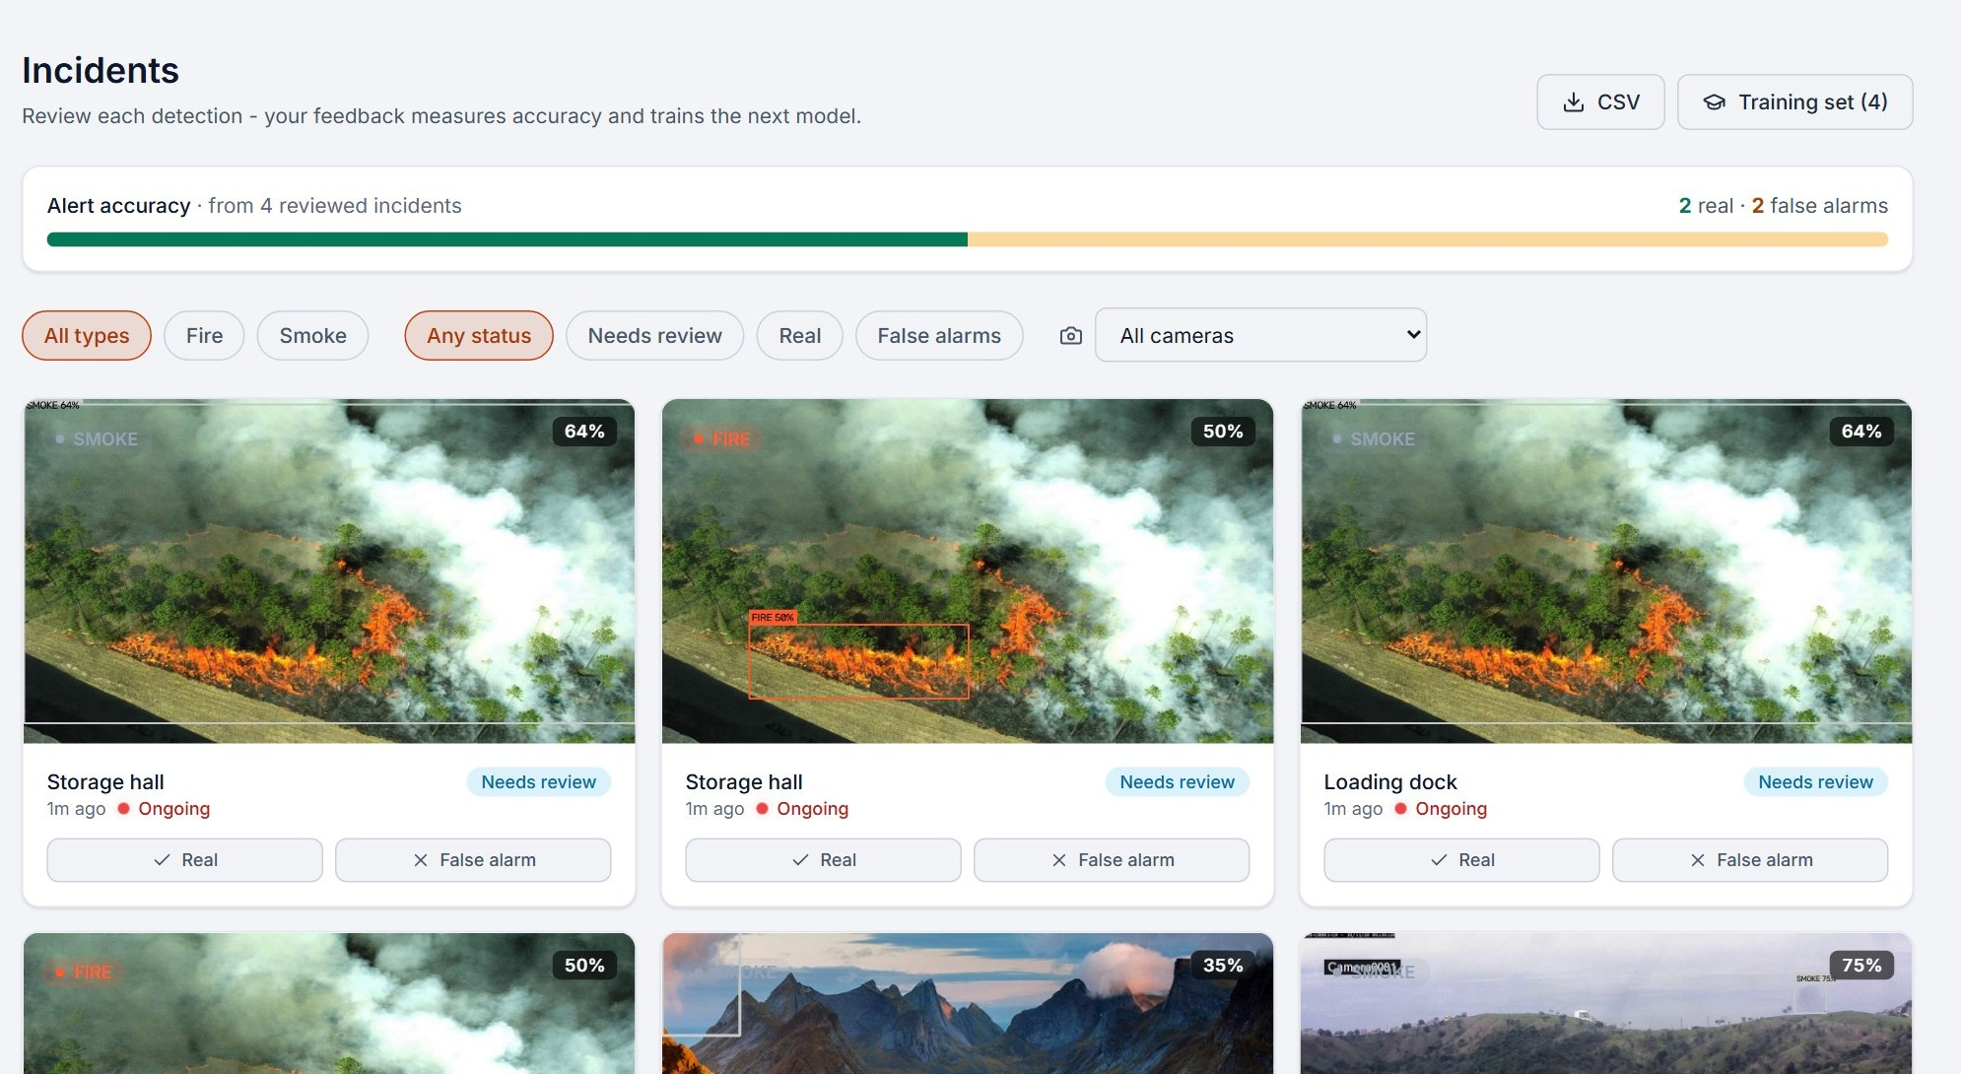
EXHIBIT 2 · THE PRODUCT
From live camera to reviewed incident in one dashboard
Monitor
Incidents
Live boxes, a verifying state and an instant alarm.
Duration, Real or False alarm review, and a training export.
Screenshots from the running system on a CPU-only laptop (Intel i5-9500)
4 / 7
Notes:
This is the product. On the left, the Monitor page shows every camera live with the detection boxes drawn on the video, and a red banner when a hazard is confirmed. The frame rate shown is honest: this laptop has no GPU. On the right, the Incidents page lists every detection with its snapshot, how long it lasted, and buttons to mark it Real or False alarm. Those reviews feed an accuracy score and can be exported as a training set. Besides these two pages there are also pages for cameras, models, a browser-webcam test and uploading images or videos.

Slide 5
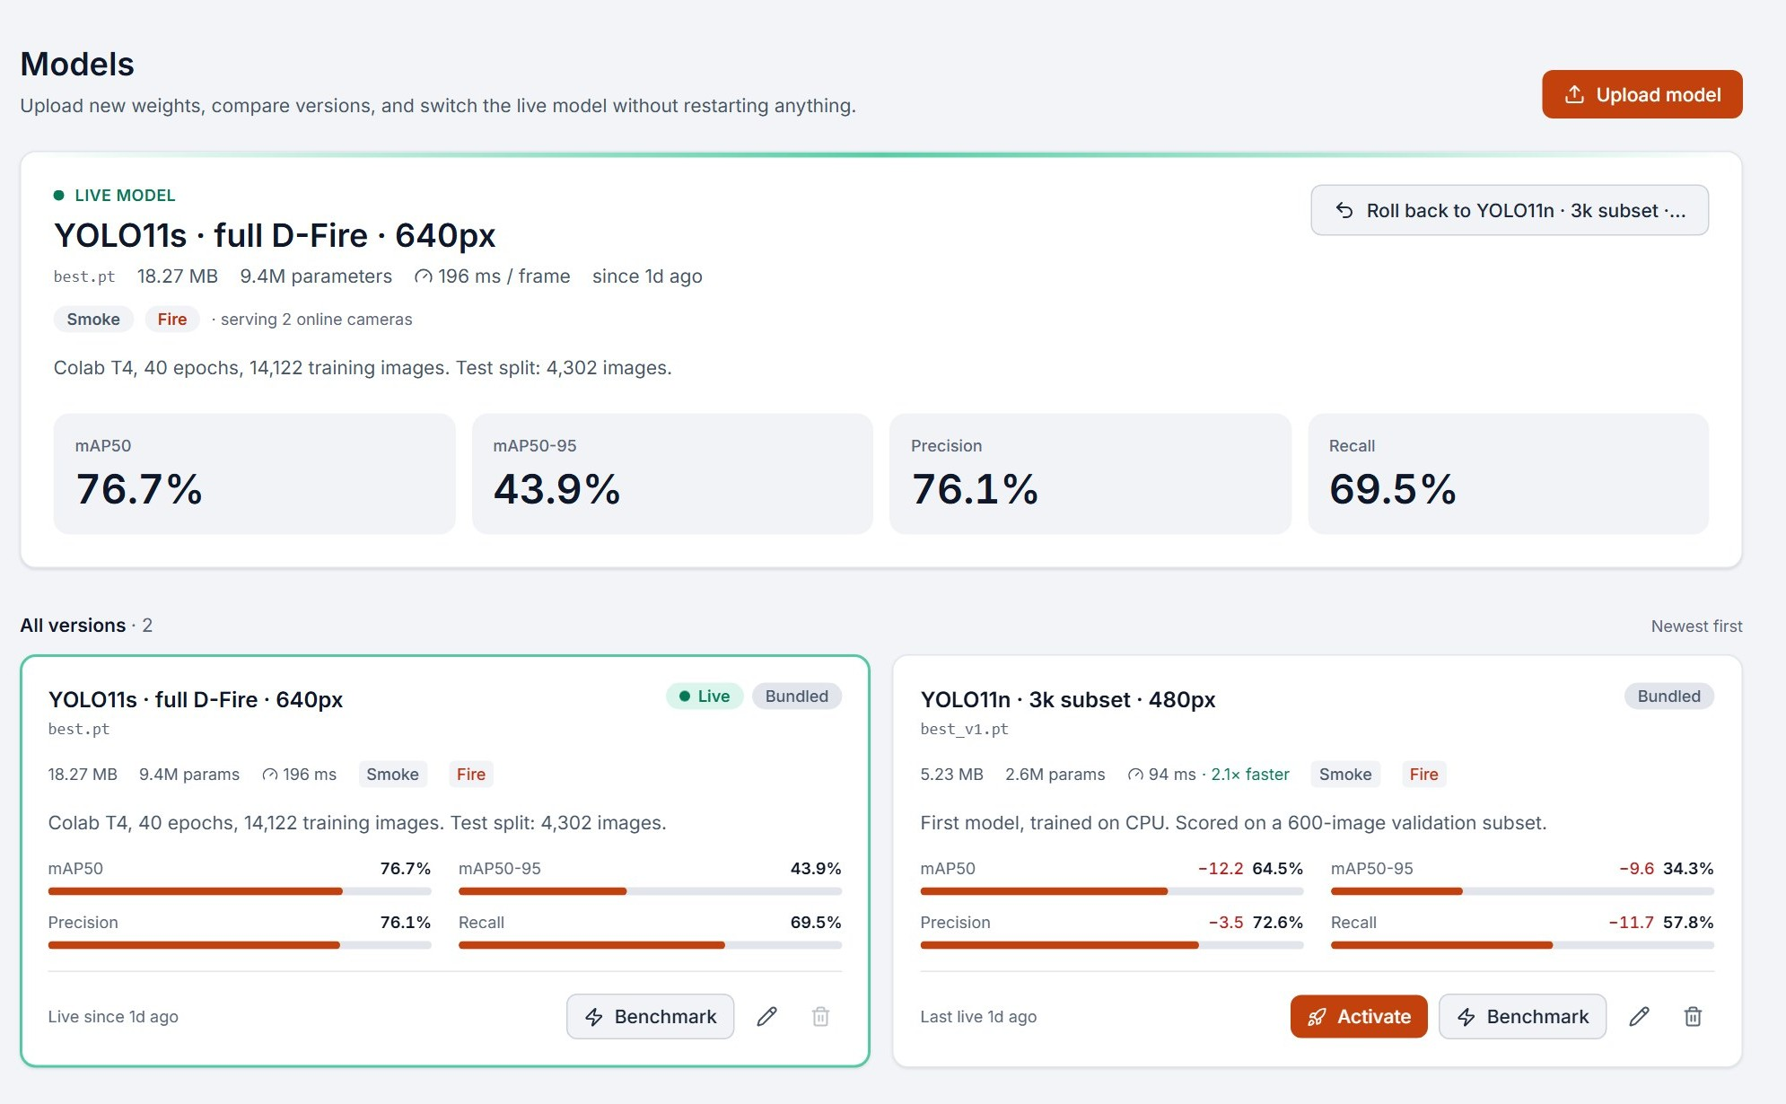
EXHIBIT 3 · MODEL RESULTS
Training on all 14,122 images lifted every metric
0.767
mAP50 on 4,302 unseen test images
up from 0.645 with the first model
Measure | First model | Current model
Overall mAP50 | 0.645 | 0.767
Fire recall | 0.482 | 0.627
Smoke recall | 0.673 | 0.764
Fire found (30 photos) | 24 / 30 | 29 / 30
Smoke found (30 photos) | 22 / 30 | 29 / 30
False alarms (30 empty) | 3 / 30 | 1 / 30
Model versions page: compare, switch live, roll back.
First model: YOLO11n, 3,000 images, 600-image validation. Current: YOLO11s, 14,122 images, 40 epochs.
5 / 7
Notes:
The first model was a small YOLO11n trained on a 3,000-image subset on the laptop CPU and scored on a 600-image validation subset. The current one is YOLO11s trained on all 14,122 training images on a free Colab GPU for 40 epochs, then scored on the 4,302-image test split it never saw. Overall mAP50 went from 0.645 to 0.767, and fire recall from 0.48 to 0.63. The photo counts come from running the same 90 unseen images through the live system: fire found in 29 of 30, smoke in 29 of 30, and one false alarm on 30 empty scenes. Note that the two evaluation sets differ, so the test-set figures are the more reliable ones. Fire is still the weaker class.

Slide 6
EXHIBIT 4 · RELIABILITY
Small flames exposed the limits, so we measured them
How often a 0.5% flame is found, per frame
01
Alarm tracker
One confident hit confirms at once. The alarm holds a few seconds, so a flickering flame does not blink.
Browser Cam, 640 px frames
12%
Webcam, model at 640 px
19%
Webcam, model at 960 px
31%
02
Incident episodes
A flame that returns extends the same incident, so nothing is dropped.
Webcam, model at 1280 px
49% best
Confidence 0.40. Real flame crops pasted onto empty scenes: a proxy, not a lighter test. The cost: 198, 394 and 704 ms per frame on a CPU.
03
Detail level and presets
More pixels for small flames at about twice the cost per frame, plus a Close-range preset.
Honest limit: the model has never seen a lighter or match flame. Retraining on our own footage is the lasting fix.
Source: held-out D-Fire test images, live model, Intel i5-9500 CPU
6 / 7
Notes:
When we held a lighter in front of the camera it was missed, flickered, or was slow to confirm. Instead of guessing, we measured. Half of the flames the model was trained on fill under half a percent of the frame, and a lighter is in that range. The chart shows a 0.5 percent flame is found in only 12 percent of frames through the old browser camera path, and 49 percent at 1280 pixels, at a cost of roughly 3.5 times the compute. That shows why the alarm logic has to tolerate misses: it now confirms on one confident detection, holds the alarm for a few seconds, and merges returning detections into one incident. The honest limit is that the model never saw a lighter or match, so the lasting fix is retraining on our own footage. The chart is a proxy using pasted real flame crops, not a lighter test.

Slide 7
WHAT COMES NEXT
Next: alerts, login and our own training footage
01
Alerts people receive
Telegram and email with the snapshot, and a second person alerted when nobody responds.
02
Login and roles
Admin and viewer accounts and an audit log, before anyone else reaches the dashboard.
03
Train on our own scenes
Collect lighter, match and candle clips, label them, and retrain on Colab.
79
automated backend tests
7
dashboard pages
4,302
unseen test images
198 ms
per frame on a CPU
Thank you. Questions?
SmokeShield · See the flames before they spread
7 / 7
Notes:
Close with what is next. The most valuable next step is alerts, because a detector nobody is told about is not a safety tool yet. Then login and roles, because the dashboard has no accounts today. And the lasting fix for small flames is data: record clips of our own scenes, label them and retrain. The four figures summarise the project: 79 automated backend tests, seven dashboard pages, a 4,302-image unseen test set, and 198 milliseconds per frame on an ordinary laptop CPU at standard detail. Then invite questions.

