Slide 1
Welcome
An Easy Online food ordering website

Slide 2
Technology Used:
HTML
CSS
JavaScript
MongoDb Compass
React
ExpressJs

Slide 3
Objectives :
➤ To develop a system to properly manage the restaurant
➤ To increase the online customers
➤ To eliminate the sort of problem that have been occurs during biling, ordering and payments time
➤ To gain profit by gaining review in social media also

Slide 4
Methodology :
► A methodology is the elaboration of a clear strategy for gathering evidence, including the specific data collection methods to be used, the kinds of evidence to be collected, and the approach for analyzing the evidence.

Slide 5
Requirement Analysis:
Functional requirement is used to help the reader understanding why the requirements is needed, and to track the requirement through the development of the system.

Slide 6
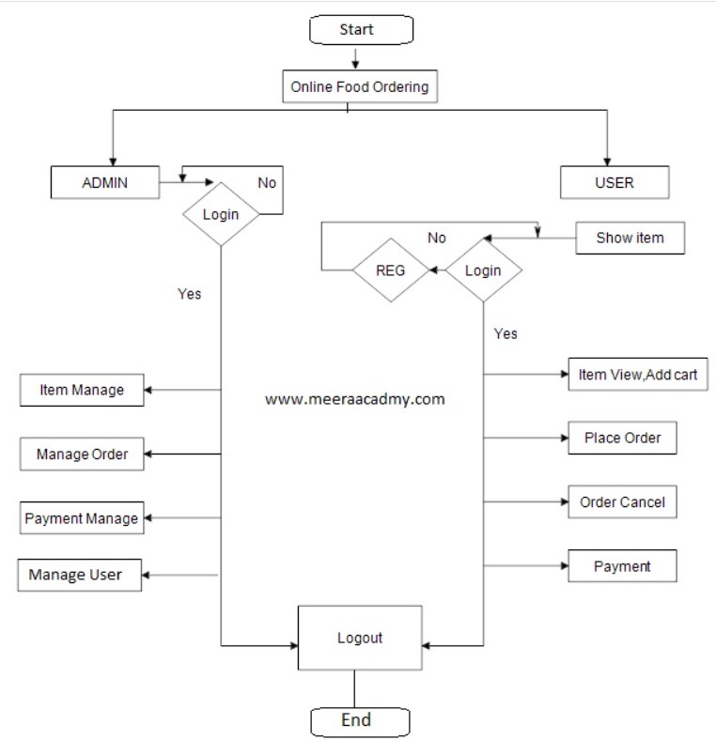
Flowchart :

Slide 7
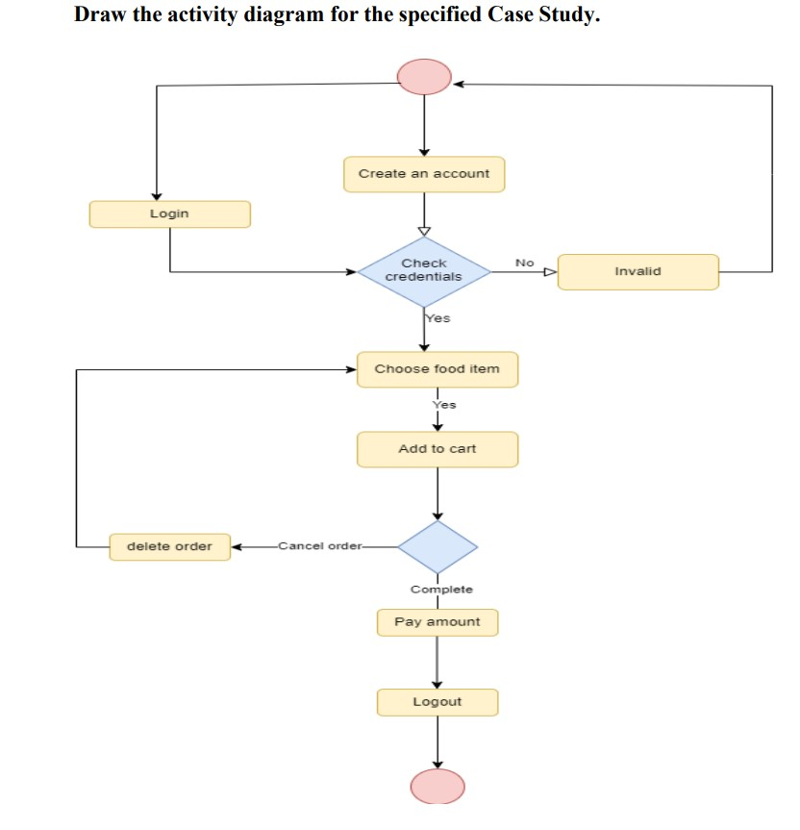
Activity Diagram:

Slide 8
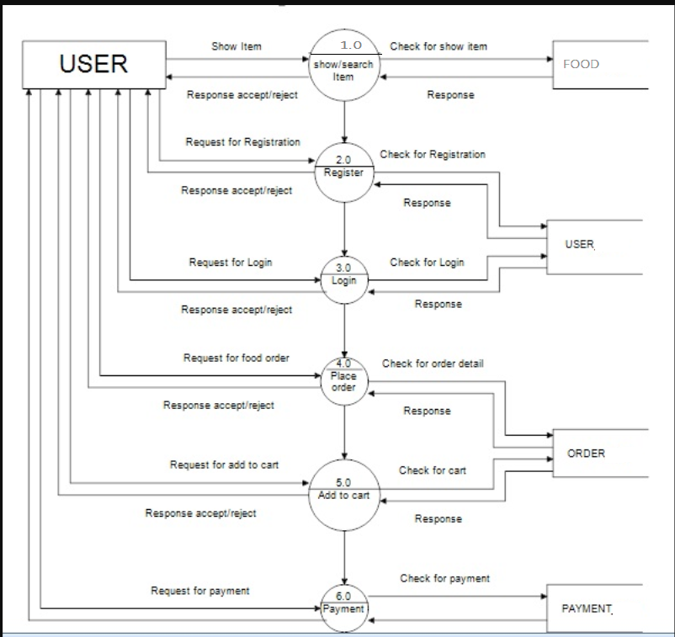
Data Flow Diagram

Slide 9
THANKYOU

