Slide 1
Unveiling Stock Market Trends Through Predictive Analytics and Sentiment Analysis: InsightfulEquity
STOCK WALLET
Special Track: An Empirical System of Data Analytics, AI, IOT, and Its Applications
Harsh Kumar Singh, Ankur Sharma, Harshit Singhal KIET Group of Institutions, Delhi-NCR

Slide 2
Outline
Introduction
Existing Approaches/Related Works
Problems in Existing Approaches
Proposed Methodology
Results and Discussion
Conclusions and Future Work
References

Slide 3

Introduction
In today's dynamic financial landscape, predicting stock market movements and analyzing market sentiment in real-time have become crucial for investors and financial institutions. Accurate forecasts can significantly impact investment strategies, risk management, and decision-making processes.
Accurate prediction models offer valuable insights for investors, aiding in informed decision-making and risk management. They help identify optimal entry and exit points, maximizing returns and minimizing losses. Successful prediction models are essential for gaining a competitive edge in the market.
Market sentiment, especially on platforms like Twitter, influences stock prices. Sentiment analysis, assessing emotional tones in textual data, is a powerful tool for gauging market sentiment and capturing opinions that impact stock prices.
Key technologies employed in this endeavor encompass a robust toolkit, including Alpha Vantage for financial data, Tweepy for Twitter data extraction, and a suite of Python libraries such as Pandas, NumPy, Statsmodels, Keras, Scikit-Learn, TextBlob, and Flask for data processing, modeling, and analysis. The study's significance is underscored by its commitment to advancing the understanding of how Twitter sentiment influences stock prices, thereby contributing to the broader discourse on the integration of technology and finance.
The subsequent sections of this research expound upon the meticulous methodologies employed, the intricacies of experimentation, and the valuable insights gained through rigorous model evaluation and sentiment analysis.

Slide 4

Existing Approaches/Related Works
Stock market prediction involves various approaches, including technical analysis methods like moving averages and relative strength index, fundamental analysis utilizing metrics such as earnings per share and price-to-earnings ratio, machine learning models such as regression, decision trees, and neural networks, sentiment analysis based on news and social media, quantitative analysis using statistical methods, time series analysis with techniques like ARIMA and GARCH, and ensemble methods for combining predictions.
Despite efforts to model complex relationships and utilize vast datasets, accurately predicting stock prices remains challenging due to the unpredictable nature of financial markets and the impact of external factors like geopolitical events and economic changes.
Researchers often employ a combination of these approaches and continuously refine models to enhance predictive accuracy in the dynamic stock market environment.

Slide 5

Problems in Existing Approaches
Inherent Complexity: Accurately predicting stock market movements is hindered by the inherent complexity of financial markets, characterized by dynamic and unpredictable behaviors.
Diverse Approaches: Existing methods, including technical analyses, fundamental evaluations, machine learning models, sentiment analyses, and quantitative methods, each face limitations in capturing the intricacies of stock price dynamics.
External Factors: The impact of external factors, such as geopolitical events and economic changes, introduces additional challenges, contributing to the difficulty in developing robust predictive models.
Persistent Challenges: Despite efforts to refine and diversify prediction models, challenges persist, underscoring the need for ongoing research to address limitations and enhance the efficacy of existing approaches.
Complex Landscape: Recognizing the intricate nature of stock market dynamics is essential for researchers to navigate and improve strategies in the face of evolving challenges.

Slide 6
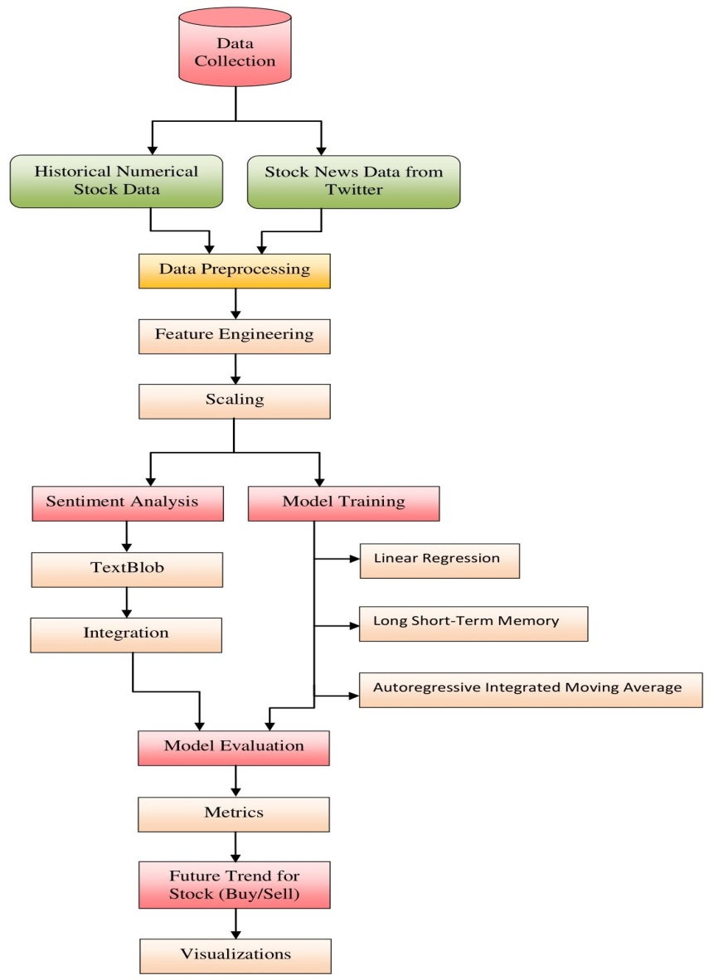
Proposed Methodology
The methodology section stands as the foundational pillar of our research, intricately detailing the systematic exploration of the complex interplay between stock market prediction and sentiment analysis. Embodied in the comprehensive architectural framework illustrated in Figure 1, our system unfolds a meticulously planned and sequential methodology, encompassing pivotal stages critical to the research's success. These stages include the strategic orchestration of data collection, the intricate process of preprocessing, the strategic deployment of advanced predictive models, and the seamless integration of sentiment analysis into our analytical framework.
The bedrock of our dataset is established through the acquisition of historical stock data meticulously sourced from Alpha Vantage and real-time sentiment data extracted from Twitter, all facilitated seamlessly through the Tweepy API. To address inherent challenges within the dataset, we employ sophisticated techniques, including forward-filling, back-filling, and normalization. These techniques are applied with precision to ensure the dataset's integrity and uniformity, thereby laying the foundation for robust and reliable analyses.

Slide 7
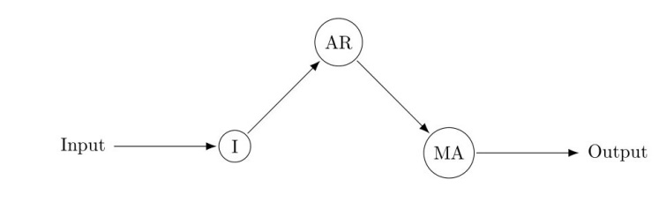
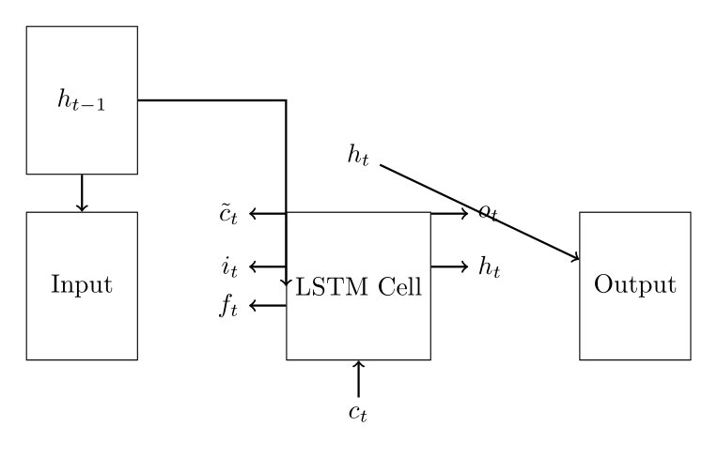
The predictive modeling phase unfolds with the application of two key models: the versatile Autoregressive Integrated Moving Average (ARIMA) model, illustrated in Figure 2, and the Long Short-Term Memory (LSTM) model, depicted in Figure 3.
These models collectively contribute to our ability to capture diverse aspects of stock price movements. Additionally, the Linear Regression model, recognized as a cornerstone in predictive analytics, establishes linear relationships between financial indicators and historical stock prices, offering valuable insights into underlying trends. Sentiment analysis, a crucial component, utilizes the TextBlob library to quantify emotional tones in tweets, thereby enriching our predictive models with nuanced insights.
The holistic approach of our methodology combines these multifaceted elements, fostering a comprehensive analysis of stock market dynamics and contributing to a deeper understanding of the interplay between financial indicators, sentiment, and market trends.

Slide 8
Results and Discussion
Tomorrow's Closing Price Predictions
Models | AMZN | TCS | TSLA
ARIMA Model | 136.33 | 3.87 | 256.49
LSTM Model | 97.5 | 3.43 | 180.09
Linear Regression Model | 137.01 | 2.37 | 248.69
The Experimental Results section is a comprehensive examination of our methodology's empirical validation, centering on the analysis of three prominent stocks: Amazon (AMZN), Tata Consultancy Services (TCS), and Tesla (TSLA). Our experimental setup encompasses a meticulous process, involving dataset selection, evaluation metrics, and the application of ARIMA, LSTM, and Linear Regression models to predict stock prices. This section not only delves into the technical aspects but also includes sentiment analysis results, shedding light on overall sentiment polarity and providing a detailed analysis of individual tweets.
To gauge the accuracy of our predictive models, we employ the Root Mean Square Error (RMSE), a reliable metric, complemented by visual representations showcasing recent stock trends. Furthermore, our section offers precise forecasts for the next day's closing prices, providing a practical perspective for investors and traders. The integration of sentiment analysis enriches our findings, with sentiment scores reflecting the overall sentiment landscape.
Models Root Mean Square Error (RMSE)
Models | AMZN | TCS | TSLA
ARIMA Model | 2.44 | 1.26 | 7.68
LSTM Model | 2.26 | 0.19 | 7.11
Linear Regression Model | 4.79 | 0.42 | 20.49
Stocks | AMZN | TCS | TSLA
Overall Sentiment | 0.65 | 0.38 | 0.72
Stock | Recommendation
Amazon (AMZN) | SELL
Tata Consultancy Services (TCS) | BUY
Tesla (TSLA) | BUY

Slide 9
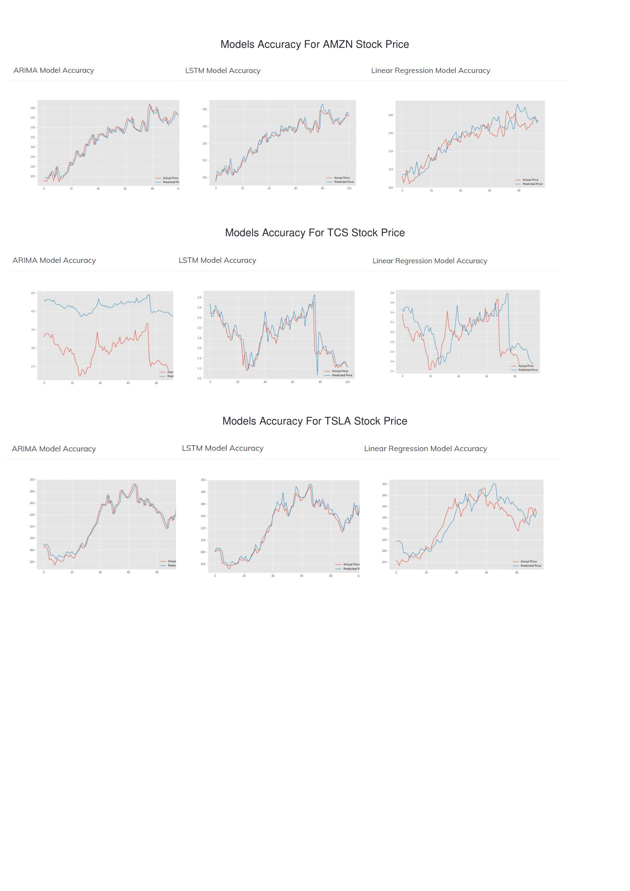

Slide 10

Conclusions and Future Work
In the Future Work section, we explore avenues to enhance predictive accuracy and sentiment analysis robustness, suggesting research directions like advanced sentiment analysis tailored to financial language, ensemble methods such as hybrid ARIMA-LSTM, and a deeper understanding of sentiment-stock price interplay through advanced statistical analyses. Recommendations include hybridizing sentiment analysis with predictive models, incorporating external data, and leveraging machine learning interpretability. Ethical considerations stress transparent model development and regulatory guidelines for fairness.
In the Conclusion section, we highlight key findings, emphasizing the synthesis of ARIMA, LSTM, and Linear Regression models with sentiment analysis as a multifaceted decision-making tool. This dynamic interplay informs strategic portfolio optimization, advancing financial analytics and addressing predictive paradigm gaps. The conclusion marks a stepping stone to untapped possibilities, suggesting future directions like integrating external data, exploring hybrid models, and advancing sentiment analysis techniques. Ethical considerations and model transparency are pivotal for shaping the future landscape of predictive analytics in finance.

Slide 11
References
[1] S. Trivedi, Review of “Machine learning models in stock market prediction,” 2022. doi:10.14293/s2199-1006.1.sor-uncat.admnax.v1.rxbnkr
[2] “Sentiment analysis,” Sentiment Analysis, 2020. doi:10.4135/9781526421036754533
[3] L. D. Broemeling, “Time series and stationarity,” Bayesian Analysis of Time Series, pp. 113–148, 2019. doi:10.1201/9780429488443-6
[4] S. Kuang, “A comparison of linear regression, LSTM model and ARIMA model in predicting stock price a case study: HSBC’s stock price,” BCP Business Management, vol. 44, pp. 478–488, 2023. doi:10.54691/bcpbm.v44i.4858
[5] M. García and R. Herrera, “An analysis of AI models for making predictions: Groundwater case study,” Proceedings of the 20th International Conference on Smart Business Technologies, 2023. doi:10.5220/0012120400003552
[6] Table 3: Contradiction in TextBlob and original dataset labels. doi:10.7717/peerj-cs.914/table-3
[7] Pak, A., & Paroubek, P. (2010). Twitter as a Corpus for Sentiment Analysis and Opinion Mining. Proceedings of LREC.
[8] LeCun, Y., Bengio, Y., & Hinton, G. (2015). Deep learning. Nature, 521(7553), 436-444.
[9] Gilbert, E., & Karahalios, K. (2010). Widespread Worry and the Stock Market. In ICWSM.

Slide 12


