Slide 1
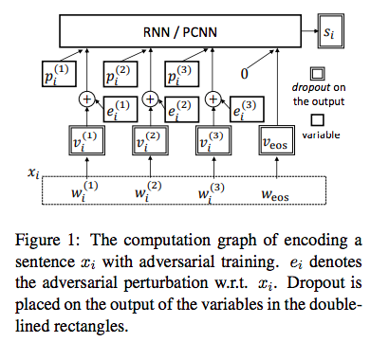
Yi Wu, David Bamman, Stuart Russell, ”Adversarial Training for Relation Extraction,"
Conference on Empirical Methods in Natural Language Processing (EMNLP) 2017, Copenhagen, Denmark.
https://people.eecs.berkeley.edu/~russell/papers/emnlp17-relation.pdf
Relation Extraction using Adversarial Training
Input:
Sentence, Entity Pairs, Entity Position, Relation
Output:
Relation with Highest Probability
Approach:
Input dataset [MIML framework], pretrained embeddings
MIML – distant supervision
Construct P-CNN and RNN [Dropout is applied]
Piecewise – CNN [Piecewise Pooling] , RNN
P-CNN / RNN tradeoffs
Perform Adversarial Training
Introduce Noise
https://github.com/jxwuyi/AtNRE
Aravind Jyothi

Slide 2
Evaluation Datasets
Evaluation Results
For this paper:
NYT Dataset
UW Dataset [NAACL]
Benchmark Datasets:
NYT Dataset
DDI 2013
SemEval 2010
Table 1: Precision for AtNRE, DITK/AtNRE for NYT dataset
Neural Network | AtNRE | DITK/AtNRE
PCNN | 0.67 | 0.65
RNN | 0.73 | 0.71
Table 2: Precision for AtNRE, DITK/AtNRE for UW dataset
Neural Network | AtNRE | DITK/AtNRE
PCNN | 0.76 | 0. 73
RNN | 0.82 | 0. 79
Evaluation Metric
For this paper:
Precision
Benchmark:
Precision
Recall
F1
Table 3: Precision for AtNRE, DITK/AtNRE for SemEval 2010
Neural Network | AtNRE | DITK/AtNRE
PCNN | 0.69 | 0.64
RNN | 0.72 | 0.72
Aravind Jyothi

