Slide 1
IBM University Engagement Project Submission
“Exploring the Power of Agentic AI with IBM Granite and LangFlow”

Slide 2

Project Tile – [Fitness Buddy]
Domain of Project – [ Healthcare /Fitness ]
Student Name | Recent Passport Photo | Email ID | Mobile number [WhatsApp]
Anshu Raj |  | anshuraj12012007@gmail.com | 8789407443

Slide 3
PROBLEM STATEMENT
The Challenge & Objective
⚠️ The Challenge
🎯 The Objective
Lack of personalized fitness guidance
Time constraints and rigid schedules
Inconsistent motivation & no accountability
Expensive subscriptions & consultations
Recommends home workouts based on user goals
Provides beginner-friendly nutrition guidance
Delivers daily motivation & habit encouragement
Adapts to age, activity level & diet preferences
3B+
$100B+
70%
1 Agent
People lack fitness guidance
Global fitness market
Quit plans in 3 weeks
Solves it all with AI

Slide 4





TECHNOLOGY USED
Technology Stack
IBM watsonx Orchestrate
GPT-OSS-120B (OpenAI)
IBM Cloud Lite
Primary Platform
Foundation Model
Infrastructure
Single AI agent deployment with behavior instructions, conversation management & web chat embed.
Powers natural language understanding, personalized fitness plan generation & motivational responses.
Free-tier cloud hosting with IAM security, API management in au-syd (Sydney) region.
HTML + JavaScript
AI Ethics & Guardrails
Python HTTP Server
Frontend Interface
Governance
Local Dev Server
Custom web page embedding the watsonx web chat widget via wxoLoader.js & wxOConfiguration.
HAM principles: Helpful, Accurate, Mindful. No medical diagnosis. Safe fitness guidance only.
Serves the HTML file over localhost to satisfy IBM CORS & origin requirements for embed widget.

Slide 5




PROPOSED SOLUTION
Proposed Solution — AI-Powered Fitness Buddy
Fitness Buddy is a single-agent, conversational AI health coach on IBM watsonx Orchestrate. A carefully crafted behavior instruction set guides the IBM LLM to act as a personalized fitness advisor. Users interact via a custom HTML web page embedding the watsonx web chat widget.
01
02
03
04
05
Safe Fitness Guidance
Home Workout Plans
Beginner Nutrition
Habit Building
Positive Motivation
Provides evidence-based home workout recommendations. Collects age, fitness goal, and activity level before any plan.
Recommends structured routines based on fitness level, available equipment & time — no gym needed.
Suggests balanced meal ideas based on veg/non-veg preference and medical history like diabetes or blood pressure.
Encourages consistency, tracks user goals across conversation turns, and provides positive reinforcement messages.
Delivers energetic, personalized motivational messages. Uses HAM (Helpful, Accurate, Mindful) communication tone.
🚫 Never provides medical diagnosis · Always asks for Age, Goal & Activity Level first · Follows ethical AI principles

Slide 6
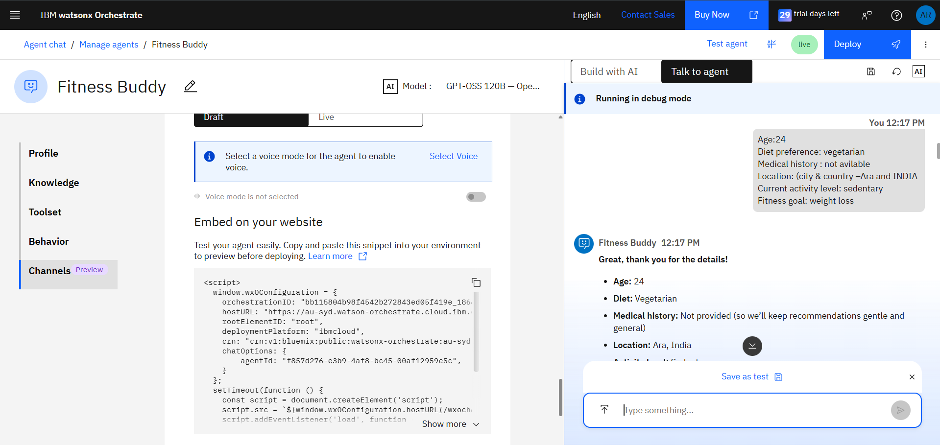
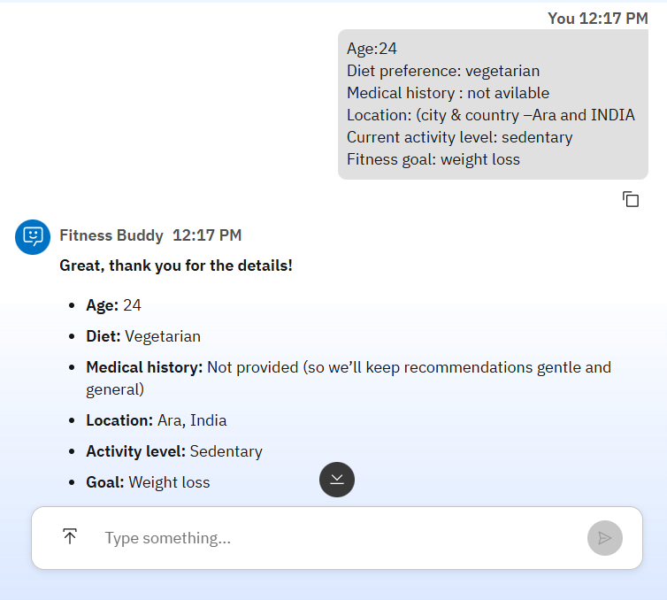
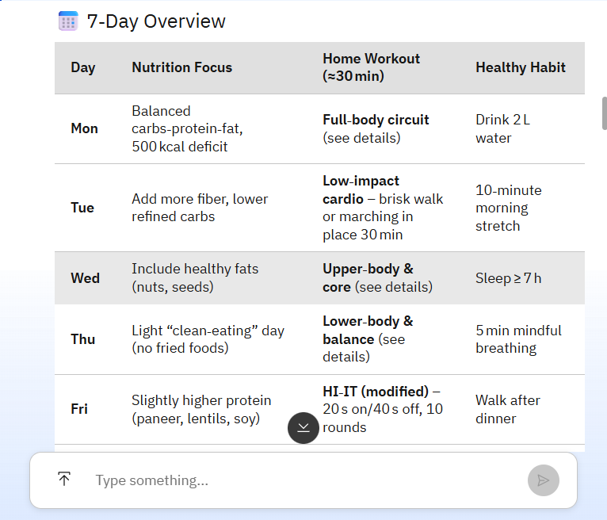
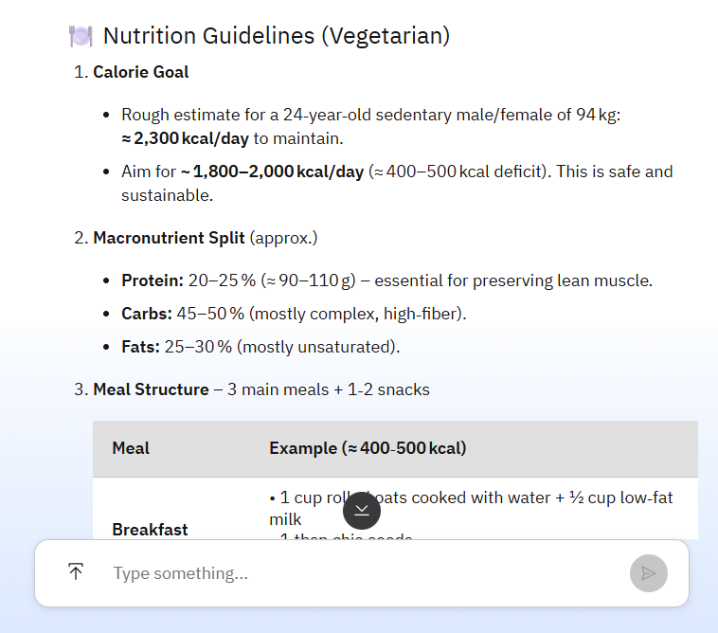
SCREENSHOT
Screenshots & Live Demo
[ Insert Screenshot ]
[ Insert Screenshot ]
[ Insert Screenshot ]
[ Insert Screenshot ]

Slide 7
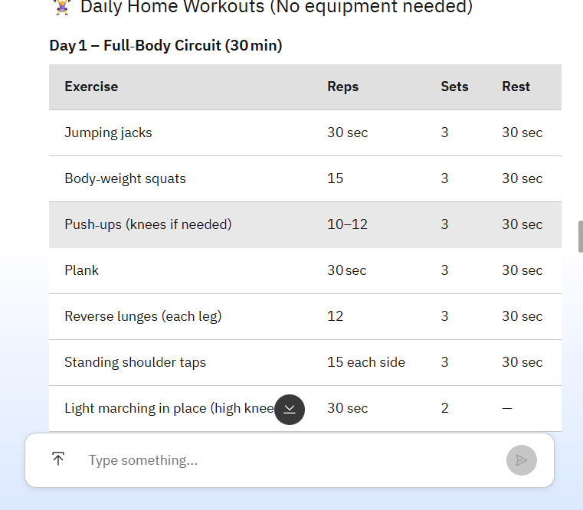
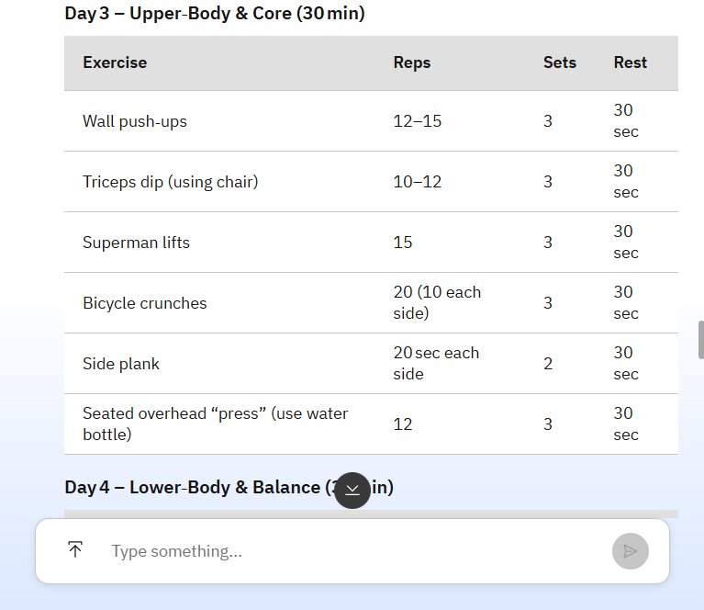
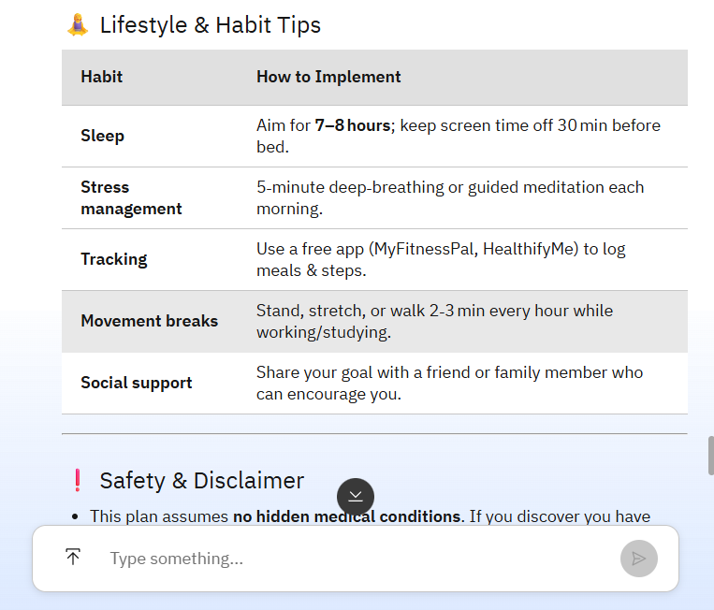
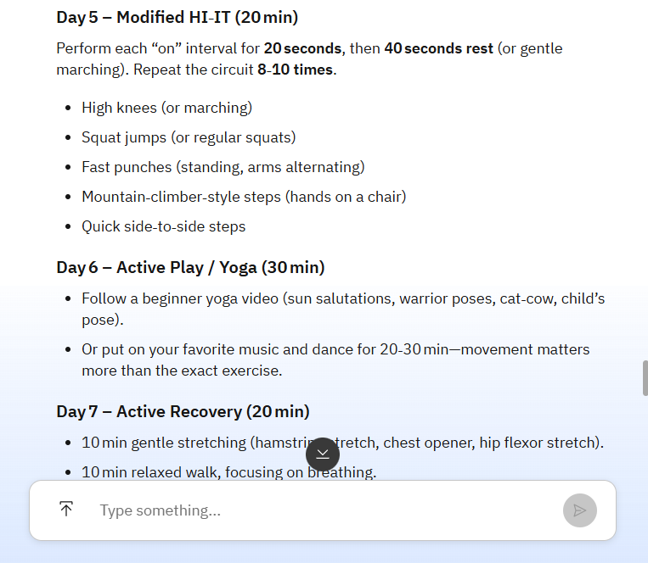
SCREENSHOT
Screenshots & Live Demo
[ Insert Screenshot ]
[ Insert Screenshot ]
[ Insert Screenshot ]
[ Insert Screenshot ]

Slide 8
ARCHITECTURE BLUEPRINT
System Architecture — Single-Agent on IBM Cloud Lite
LAYER 1 — USER INTERFACE
Web Browser
(HTML Page)
wxoLoader.js
(IBM Script)
Chat Widget
(Embedded)
HTTPS API Calls ↓
LAYER 2 — IBM watsonx ORCHESTRATE
Fitness Buddy
Agent
Behavior
Instructions
Intent
Routing
Conversation
Memory
LLM API Calls ↓
LAYER 3 — IBM GRANITE / GPT-OSS-120B LLM
NL Understanding
& Reasoning
Plan Generation
& Personalization
Motivation
& Tone Control
Cloud Services ↓
LAYER 4 — IBM CLOUD LITE
IAM & API Keys
au-syd Region
Instance
Cloud Object
Storage (Free)

Slide 9


ROLE OF AGENTIC AI
Role of Agentic AI in Fitness Buddy
Autonomous
Decision-Making
Context
Awareness
Independently decides what info to collect, which plan to generate, and when to apply guardrails.
Agentic
AI
Core
Retains user profile (age, diet, medical history) throughout conversation for consistent responses.
Goal-Driven
Behavior
Real-Time
Adaptation
Proactively guides users toward fitness goals by collecting required data before generating any plan.
Continuously adapts tone, recommendations & motivation based on user feedback during the session.
Agentic AI makes Fitness Buddy proactive, personalized & goal-driven — a smart digital fitness coach, not just a static chatbot.

Slide 10
TECH DETAILS
Technology Details & Configuration
IBM watsonx Orchestrate
GPT-OSS-120B (Default LLM)
IBM Cloud Lite (Free Tier)
HTML + JS Frontend
Platform for building & deploying AI agents
Single agent with behavior instructions
Web chat widget with wxoLoader.js embed
Hosted on IBM Cloud (au-syd region)
AgentID: 9a497dbc-e774-4f20-a072-4c826379a0c0
Foundation model powering the agent
Natural language understanding & reasoning
Personalized plan generation
Motivation & tone-aware responses
Deployed via watsonx.ai model serving
Free-tier IBM Cloud account
watsonx Orchestrate Lite instance
IAM API Key for authentication
CORS-compliant localhost deployment
au-syd.watson-orchestrate.cloud.ibm.com
Single HTML file frontend
wxOConfiguration object setup
wxoLoader.js injected dynamically
Python HTTP server for localhost
rootElementID: 'root' div mount

Slide 11

NOVELTY
Novelty & Uniqueness
Holistic Single-Agent Design
Built-in Ethical AI Guardrails
Achieves all 5 roles (workout, nutrition, motivation, habit-building, ethics) through one expertly-crafted behavior instruction — simpler, faster, more cost-effective on IBM Cloud Lite.
HAM principles (Helpful, Accurate, Mindful) are embedded directly in the agent behavior. The agent proactively refuses medical diagnosis and ensures safe guidance by design.
Personalization Before Planning
100% IBM Cloud Lite (Free)
Mandatory collection of age, fitness goal, activity level, diet type & medical history before any plan generation ensures truly personalized — not generic — recommendations.
Entire solution runs on IBM Cloud Lite free tier — zero infrastructure cost. Makes it accessible for students & resource-constrained users while leveraging enterprise-grade AI.
Zero-Install Web Deployment
Responsible AI for Health Domain
No app to install, no account required. A simple HTML web page with the watsonx embed script gives instant access to the AI coach from any browser on any device.
Applies IBM's AI ethics framework to a sensitive health domain. Clear boundaries between fitness coaching and medical advice protect users while building trust in AI tools.

Slide 12
GITHUB
GitHub Repository & Project Files
Repository Name
🔗 GitHub URL:
fitness-buddy-ibm-watsonx
https://github.com/AnshuRaj1201/FItness_Buddy.git
📁 Required Files Checklist
✅
Fitness buddy.html
Frontend web page with watsonx Orchestrate web chat embed
✅
fitness-buddy-Submission.pptx
This project submission presentation
✅
README.md
Project description, setup instructions & demo screenshots
✅
Fitness Buddy SS.pdf
Demo screenshots of the working agent

Slide 13




FUTURE SCOPE
Roadmap for Enhancing Fitness Buddy
Phase 2
Phase 2
Phase 3
Wearable Integration
Voice & Multilingual
Progress Dashboard
Connect with Apple Watch, Fitbit & Samsung Health for real-time biometric data — steps, heart rate, calories — enabling dynamic workout adjustments.
Add voice-enabled interaction via IBM Watson Speech-to-Text. Support 10+ languages for global accessibility.
Visual dashboard (IBM Cognos / React) showing weekly workout completion, calorie trends, habit streaks & goal progress.
Phase 3
Phase 4
Phase 4
RAG Nutrition Knowledge Base
Healthcare Integration
Multi-Agent Specialization
Retrieval-Augmented Generation pipeline with USDA/WHO databases stored in IBM Cloud Object Storage for evidence-based dietary advice.
Partner with healthcare APIs so doctors can set fitness boundaries for patients with chronic conditions.
Evolve to multi-agent architecture with dedicated agents for workout planning, nutrition, mental wellness & progress tracking.

Slide 14


