Slide 1
AI-Powered Collections Strategy
Leveraging Agentic AI for Scalable, Fair, and Effective Debt Management at Geldium

Slide 2
How the System Works
Data Inputs
Collects customer data such as payment history, credit utilization, income, and recent account activity.
Decision Logic
AI model assigns a delinquency risk score and applies predefined business rules by risk level.
Automated Actions
Triggers personalized reminders, payment plan offers, or escalation based on risk severity.
Learning Loop
Monitors outcomes and continuously improves decisions using new customer behavior data.
Notes:
Prompts to try:
Generate a simple outline for an AI collections system workflow, including inputs, decision logic, action triggers, and learning loop.
List 3–5 key customer attributes that would be most predictive for collections decision-making, and explain why each one matters.
Suggest examples of business rules and AI-driven actions the system could use at different risk levels (e.g., low, medium, high risk).
Create a rough sketch or step-by-step description of how customer data flows through the system from intake to action.

Slide 3
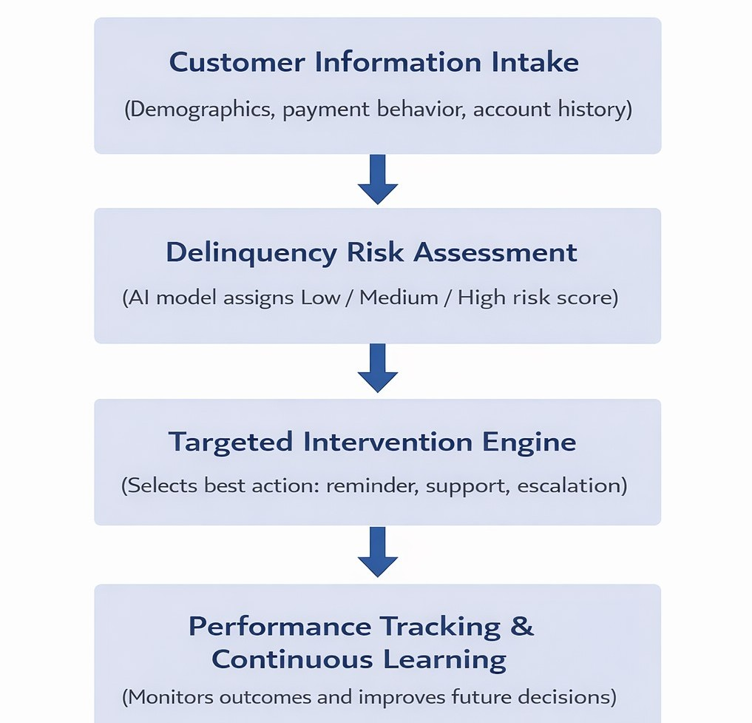
System Workflow Diagram

Slide 4
Role of Agentic AI
Autonomous (AI-Driven) | Human Oversight
Predict delinquency risk | Approve hardship or settlement plans
Trigger reminders & nudges | Handle disputes and customer appeals
Adjust outreach timing | Review edge or sensitive cases
Learn from outcomes | Audit fairness and compliance
Key Principle: AI handles scale and speed, humans handle judgment and accountability
Notes:
Prompts to try:
Explain how agentic AI could automate financial collections while keeping humans in critical decision points.
List 3–5 examples of collection actions, and classify each as best suited for full automation or requiring human oversight, with a brief reason why.

Slide 5
Responsible AI Guardrails
Reduction in overall delinquency rates through timely, targeted outreach
Lower collection costs by automating low-risk and routine actions
Improved recovery rates by focusing human agents on high-risk cases
Scalable collections strategy that adapts to changing customer behavior
Notes:
Prompts to try:
List key fairness, transparency, and compliance practices to build into an AI-powered credit collections system.
Suggest specific ways to monitor and audit the system over time to ensure it stays fair, compliant, and effective.

Slide 6
Expected Business Impact
Fair and consistent treatment of customers across all segments
More relevant and personalized communication
Early support for customers facing financial stress
Increased trust through transparent and explainable AI decisions
Notes:
Prompts to try:
Suggest KPIs for an AI-powered collections strategy that balances business outcomes with customer fairness.
Describe 2–3 ways an AI collections system could improve both operational efficiency and customer experience.

Slide 7
Thank You

