Slide 1

Anshu Reddy Ashanna
Naiyani Paladugu
Krithika Reddy Sangireddy
Kush Palkesh Dudhia

Slide 2
INTRODUCTION
Scala is a versatile, high-level programming language that combines object-oriented and functional programming paradigms.
It runs on the Java Virtual Machine (JVM) and is designed to be concise, expressive, and scalable.
Scala addresses some limitations of Java while maintaining standards with Java libraries.
Scala is widely used for building high-performance systems in big data processing, web services, and machine learning, with companies like Twitter, Netflix, and LinkedIn leveraging it for their backend infrastructure.

Slide 3
NAMES, BINDING, SCOPES
In Scala, like many other programming languages, names refer to identifiers which are used to specify various program elements such as variables, classes, objects, methods, and functions.
Operator Identifiers: Scala allows the use of symbols as valid identifiers, which is not common in many languages. For example, +, ++,=, and :: are valid names for methods or functions in Scala.
Example : class Vector(val x: Int, val y: Int) {
def +(other: Vector) = new Vector(x + other.x, y + other.y)
}
val v1 = new Vector(1, 2)
val v2 = new Vector(3, 4)
val result = v1 + v2 // Uses the + operator defined in the Vector class

Slide 4
NAMES, BINDING, SCOPES
Scala allows you to use reserved keywords as variable names by enclosing them in backticks.
Example : val `class` = "this is valid"
println(`class`)
In Scala, singleton objects are used to define a single instance of a class. Unlike Java’s static members, Scala does not allow static methods or variables inside a class. Instead, Scala uses singleton objects to hold static-like members and methods.
Example : object MathHelper {
def square(x: Double): Double = x * x
}

Slide 5
NAMES, BINDING, SCOPES
A companion object is a singleton object that has the same name as a class and is defined in the same file. A class and its companion object can access each other’s private members.
Example: class Person(val name: String, val age: Int)
object Person {
def apply(name: String): Person = new Person(name, 0) }
Lazy binding: Scala supports lazy evaluation of values using the lazy keyword. A lazy val is not evaluated until it is first accessed, providing a form of deferred or lazy initialization.
Example: lazy val expensiveComputation = {
println("Computing...") 42 }

Slide 6
NAMES, BINDING, SCOPES
In Scala, scope defines the visibility and lifetime of variables, methods, and objects. Scala has similar scoping rules as other languages (local, class-level, and global scope).
Nested Functions: Scala allows to define functions within functions, giving inner functions access to variables from the outer function’s scope.
Example: def outer(x: Int): Int = {
def inner(y: Int): Int = x + y
inner(10)
}

Slide 7
DATA TYPES
In Scala, the data types are similar to Java in terms of length and storage.
All data types are objects, even what are considered primitive types in other languages (like Int, Boolean, and Double).
Unit is similar to void in other languages. It's used when a function doesn't return a meaningful value.
Example: def printHello(): Unit = println("Hello")
Option type is used to represent optional values. It can either be Some(value) or None to handle absence of values safely.
Example : val someVal: Option[Int] = Some(5)
val noneVal: Option[Int] = None

Slide 8
DATA TYPES
Nothing is a subtype of all types and represents an absence of value, often used for methods that never return (e.g., throw).
Example: def infiniteLoop(): Nothing = throw new Exception("Never returns")
Any is the supertype of all types, while AnyRef is the supertype of all reference types.
Example : val anyValue: Any = 42
val anyRefValue: AnyRef = "Hello"
Case classes in Scala are special types of classes that come with built-in features like immutability, pattern matching, and auto-generated methods (toString, equals, hashCode).
Example: case class Person(name: String, age: Int)
val person = Person("Alice", 30)
println(person.name) // Outputs: Alice

Slide 9
EXPRESSIONS
Expressions are the main components of a Scala program that evaluate to a value.
Expressions exist at compile-time for type checking, but they evaluate to values at run-time.
Example:
val x = 2 // x is an expression that evaluates to the value 2
A value is information stored in the computer’s memory. It exists at run-time.
Types Of Expression:
a)Literal Expression
b)Compound Expression

Slide 10
LITERAL EXPRESSION
A literal expression represents a fixed value that stands “for itself”.
SYNTAX:
42 // A literal expression
EXAMPLE:
val num = 42 // res0: Int = 42
The literal 42 is the textual representation, while the value is what exists in memory after evaluation

Slide 11
COMPOUND EXPRESSIONS
CONDITIONAL
It allows us to choose which expression to evaluate based on a condition
SYNTAX:
if (condition) trueExpression else falseExpression
EXAMPLE:
val result = if (1 < 2) "Yes" else "No"
// result: String = "Yes"

Slide 12
COMPOUND EXPRESSIONS
b) BLOCKS
Blocks are expressions that allow us to sequence computations together.
SYNTAX: {
declarationOrExpression …
Expression
}
EXAMPLE: val blockResult = {
val a = 10
val b = 20
a + b // This is the final expression in the block
} // blockResult: Int = 30

Slide 13
Support to Object Oriented
Programming
Scala is a hybrid between functional and object-oriented programming, and it smoothly integrates the features of object-oriented and functional languages.
Object-oriented programming concepts in Scala:
Classes and Objects
Encapsulation
Inheritance
Polymorphism
Traits

Slide 14
CLASSES AND OBJECTS
Defining Classes:
Example: class Bread
Creating Objects:
Example: val whiteBread= new Bread
Defining Fields:
class Bread {
val name: String = "white“
var weight: Int = 1
}

Slide 15
ENCAPSULATION
It describes the idea of bundling data and methods that work on that data within a class.
Example:
class Sandwich(bread: Bread, filling: ArrayBuffer[String]) {
private def getFillingsName: String = {
filling.mkString(", ")
}
}

Slide 16
INHERITANCE
Inheritance is a mechanism where one class can inherit the properties and behaviors of another class.
This allows for code reuse and the creation of more specialized classes based on more general ones.
Drawback:
Does not support Multiple Inheritance
Example:
class Animal {
def speak(): Unit = {
println("Animal makes a sound")
}
}
class Dog extends Animal {
override def speak(): Unit = {
println("Dog barks")
}
}

Slide 17
POLYMORPHISM
The ability of different types (classes) to be treated as if they were the same type, typically through inheritance or interfaces (traits in Scala).
There are two main types of polymorphism in Scala:
a) Method Overloading: Overloading a method means using a method name but
applying different logic, depending on the parameters defined in the methods.
b) Method Overriding: Overriding is used in a subclass to redefine the
implementation of a method provided by its superclass.

Slide 18
TRAITS
A trait is used to define an object is created as a mixture of methods that can be used by different classes without requiring multiple inheritances.
Traits can have both abstract and non-abstract methods, fields as its members. When you do not initialize a method in a trait, then they are abstract, while the ones that are initialized are called non-abstract.
SYNTAX:
trait Trait_Name{
// Variables
// Method
}

Slide 19
CONCURRENCY
When developing parallel and concurrent applications in Scala, you can utilize the native Java Thread. However, the Scala Future provides a more high-level and idiomatic solution, making it the preferred choice
“A Future represents a value which may or may not currently be available, but will be available at some point, or an exception if that value could not be made available.”
For example, we call a method wrapped in a Future, the main thread proceeds to execute the following code while the Future processes the task in the background. This non-blocking behavior is essential for creating responsive applications, particularly in situations like web services or user interfaces, where delays can negatively impact the user experience.

Slide 20
SOME FEATURES OF CONCURRENCY
Promising Non-Blocking: Using Futures enables non-blocking behavior, allowing the main thread to continue executing while waiting for tasks to complete.
Composability: Futures can be easily composed using methods like map, flatMap making it simple to chain asynchronous operations.
Error Handling: Futures provide mechanisms for handling exceptions, enabling developers to specify fallback behavior using methods like recover.
Parallel Collections: Scala offers parallel collections that allow developers to easily parallelize operations on collections, making it easier to take advantage of multi-core processors.
Simplicity and Readability: The concurrency model in Scala is designed to be more intuitive and easier to read than traditional thread management in Java.
Thread Safety: Scala encourages immutability and functional programming principles, which help in writing thread-safe code by minimizing shared mutable state.
Integration with Java: Scala concurrency features integrate well with Java concurrency utilities, allowing developers to leverage existing Java frameworks and libraries.

Slide 21
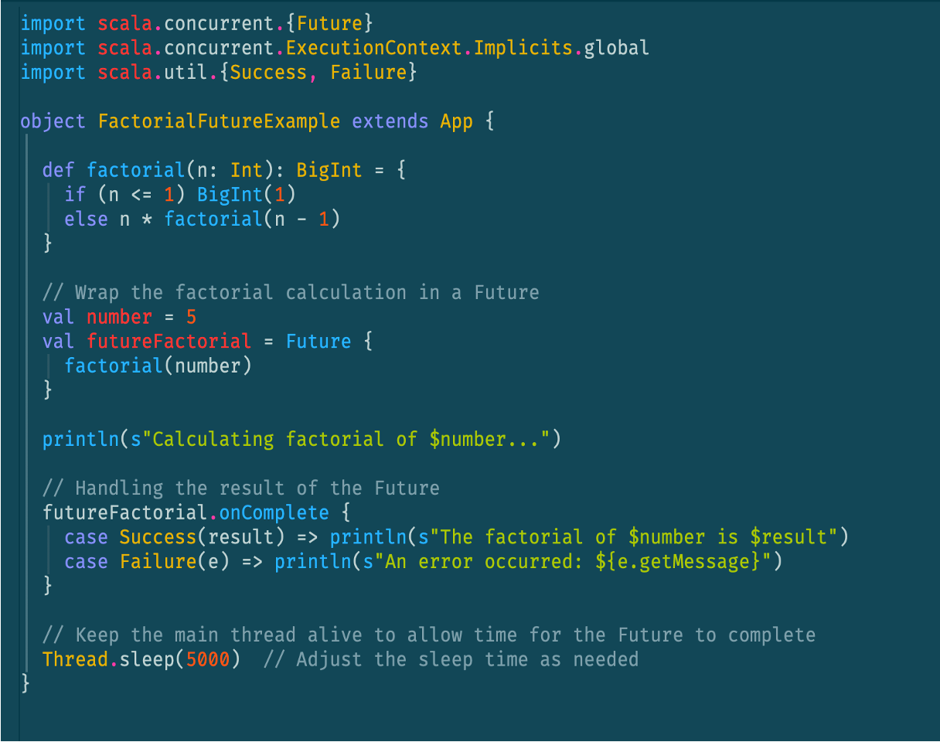
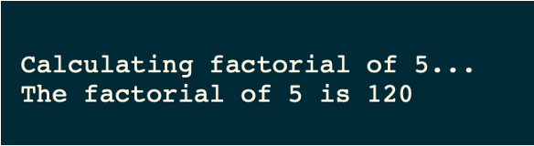
INPUT
OUTPUT

Slide 22
CODE EXPLAINED
This program showcases the use of Future for asynchronous computation by calculating the factorial of a specified number, in this case, 5. It defines a recursive factorial function that returns the factorial value. By wrapping this computation in a Future, the program allows the calculation to run in the background without blocking the main thread, enabling the application to remain responsive. While the factorial is being computed, a message is displayed to indicate that the calculation is in progress.
The program employs the onComplete , method to manage the result of the Future, either printing the calculated factorial or an error message if an exception occurs. To ensure the main thread stays alive long enough for the computation to finish, a Thread.sleep(5000) call is included.
This example effectively illustrates the advantages of using Future in Scala for concurrent tasks, allowing for efficient and responsive applications

Slide 23
Exception and Event Handling
All exceptions are unchecked (no concept of checked exceptions).
Use try { ... } catch { ... } block similar to Java.
Catch block uses pattern matching to identify and handle exceptions.
Catching Exceptions
Scala allows you to try/catch any exception in a single block and then perform pattern matching against it using case blocks.
Throwing Exceptions
Throwing an exception looks the same as in Java. You create an exception
object and then you throw it with the throw keyword as follows.
Example: throw new IllegalArgumentException

Slide 24
Functional Programming
Higher-order Functions:
Definition: Functions that either accept functions as arguments or return functions as results.
Key Features:
Can accept one or more parameters that are functions.
Offer flexibility in programming.
Use Case: Higher-order functions allow modular, reusable code by leveraging function arguments or results.
Currying in Scala:
Definition: The process of transforming a function with multiple arguments into a series of one-argument functions.
Application: Commonly used in various functional programming languages.
Benefit: Makes functions more flexible and easier to reuse in different contexts.

Slide 25
Functional Programming
Pure Functions:
Definition: Always return the same result for the same inputs.
Key Characteristics:
No side effects (do not modify external state).
Depend only on input parameters.
Example: A function that computes and returns a result based solely on the input.
Non-pure Functions:
Definition: May change internal or external state (allow context changes).
Characteristics:
Can have side effects (e.g., modifying global variables, updating files, or databases).
Results may vary depending on external factors.
Use Case: Necessary when actions need to affect state (e.g., file writing, database updates).

Slide 26
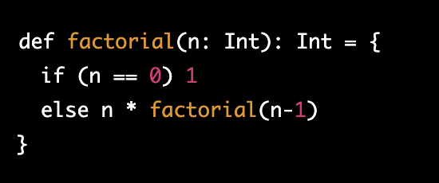
Functional Programming
Defines a function factorial(n) to compute
the factorial of an integer n.
If n == 0, the function returns 1.
This is because 0! = 1
If n != 0, the function calls itself recursively
with (n-1).
Multiplies the result by n
(i.e., n * factorial(n-1)).
The recursion continues until n reaches 0.
At that point, the recursion stops, and the final factorial result is returned.
Note that in Scala, the return keyword is optional if the last expression in the function body is the return value.

Slide 27
PROJECT DESCRIPTION
TASKMATE
OBJECTIVE:
To create a web application for tracking daily tasks and activities, allowing users to view their lists and stay organized.
The Scala TASKMATE web application is a project that aims to create a simple and intuitive task management tool for users.
The application is built using the Scala programming language and utilizes the Play Framework to provide a robust and scalable web application architecture.

Slide 28
PROJECT DESCRIPTION
LIMITATIONS:
Calendar integration is not allowed.
Time logging is prohibited.
No external File Uploads
TECHNOLOGIES USED:
Scala3
SQL
Play Framework

Slide 29
PROJECT DESCRIPTION
FEATURES:
Login & Register User
Add, modify, or delete a task.
Each task will include a checklist for marking completion.
Adding Comments section to help remind any special thing for a particular event.

