Slide 1

CHOOSING DATASET & MODELS FOR
ECG ARRHYTHMIA CLASSIFICATION
Dataset • Model Selection • Comparative Study

Slide 2

STEP 1 — THE DATA
The Dataset We're Using
We use the MIT-BIH Arrhythmia Dataset, published on Kaggle as the “ECG Heartbeat Categorization Dataset.” Every heartbeat has already been segmented from raw patient ECG recordings, so the signal shape is ready to feed directly into a model.
Source: Kaggle — ECG Heartbeat Categorization Dataset (MIT-BIH)
Normal (N)
Size: 109,446 individually segmented heartbeats
Supraventricular (S)
Sequence length: 187 time-steps per heartbeat, sampled at 125 Hz
Ventricular (V)
Classes: 5 types — Normal, Supraventricular, Ventricular, Fusion, Unknown
Fusion (F)
Unknown (Q)
02

Slide 3




STEP 2 — THE MODELS
Overview of the 4 Algorithms
1D-CNN
4
MODELS
LSTM
Shape detection
Sequential memory
GRU
Transformer
Lightweight memory
Self-attention
03

Slide 4
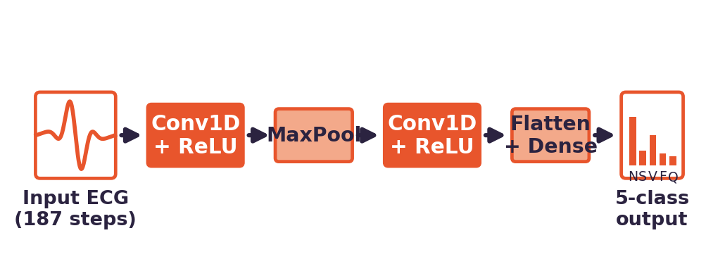
ALGORITHM 1 OF 4 — CONCEPT
1D Convolutional Neural Network (1D-CNN)
BASIC IDEA
Slides a small filter across the ECG signal to pick up local wave shapes — the same idea an image CNN uses to detect edges, just in one dimension across time instead of two across pixels.
WHY IT FITS THIS DATASET
Each heartbeat class differs mainly in the shape of its P-QRS-T wave, so a filter that scans for shape irregularities is looking directly at the feature that separates a Normal beat from a Ventricular or Fusion beat.
CORE LOGIC
Convolution → ReLU → Pooling layers stack to build increasingly abstract shape detectors; the final dense layer maps the learned shape pattern to one of the 5 heartbeat classes.
04

Slide 5
ALGORITHM 1 OF 4 — THE MATH
1D Convolutional Neural Network (1D-CNN)
The equations actually implemented for this model
y_{i} = Σ_{k} ( x_{i+k} · w_{k} ) + b
Convolution: the filter slides over the signal, multiplying and summing a small window at each position.
a_{i} = max(0, y_{i})
ReLU activation: negative responses are zeroed out, keeping only the shape features that fired positively.
p_{j} = max(a_{2j}, a_{2j+1})
Max-pooling: only the strongest response from each neighboring pair survives, shrinking the sequence.
ŷ = softmax(W · flatten(p) + b)
The pooled features are flattened and passed through a dense layer to produce 5 class probabilities.
05

Slide 6
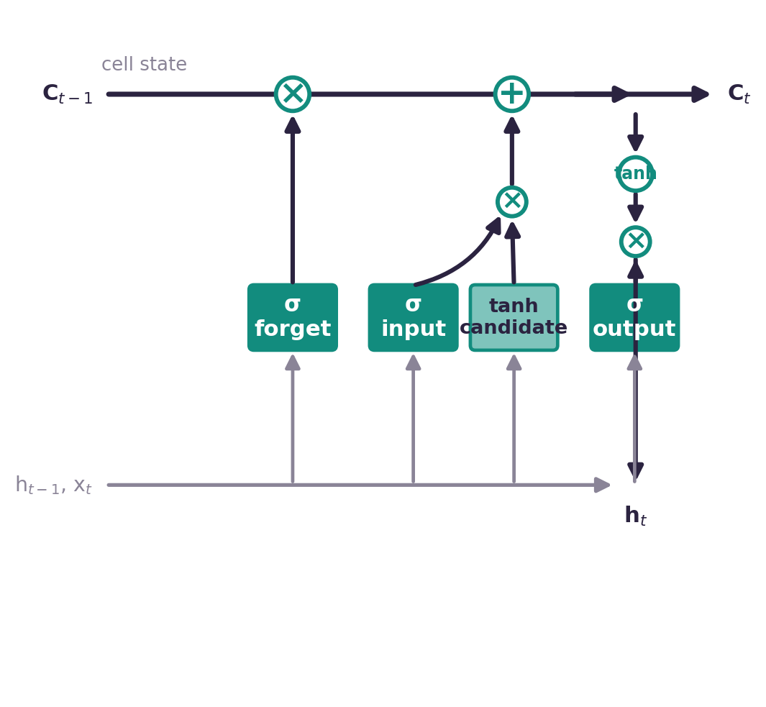
ALGORITHM 2 OF 4 — CONCEPT
Long Short-Term Memory (LSTM)
BASIC IDEA
Reads the ECG signal one time-step at a time while carrying forward a “memory” of everything seen so far, using gates that decide what to keep, forget, and pass on.
WHY IT FITS THIS DATASET
An arrhythmia isn't only about a single beat's shape — the rhythm and timing building up to it matters too. LSTM's memory is built exactly to capture that kind of build-up across a sequence.
CORE LOGIC
At each step, forget/input/output gates update a running cell state; the final cell state — having “remembered” the relevant rhythm history — is passed to a dense layer for classification.
06

Slide 7
ALGORITHM 2 OF 4 — THE MATH
Long Short-Term Memory (LSTM)
The equations actually implemented for this model
f_{t} = σ(W_{f} [h_{t-1}, x_{t}] + b_{f})
Forget gate: decides how much of the old cell memory to keep versus throw away.
i_{t} = σ(W_{i} [h_{t-1}, x_{t}] + b_{i})
Input gate: decides how much of the newly seen information to add into memory.
c˜_{t} = tanh(W_{c} [h_{t-1}, x_{t}] + b_{c})
Candidate values: a proposal for what could be added to the cell state.
c_{t} = f_{t} ⊙ c_{t-1} + i_{t} ⊙ c˜_{t}
The cell state is updated — this is the running “memory” carried across the whole ECG sequence.
h_{t} = o_{t} ⊙ tanh(c_{t})
Output gate shapes the memory into the hidden state passed to the next time-step and the classifier.
07

Slide 8
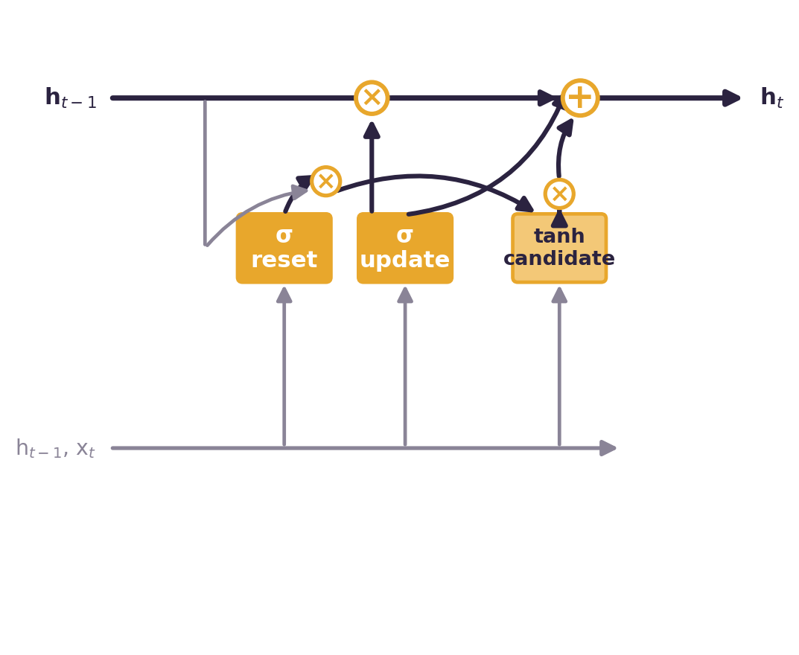
ALGORITHM 3 OF 4 — CONCEPT
Gated Recurrent Unit (GRU)
BASIC IDEA
A streamlined version of LSTM: it merges the forget and input gates into one “update gate” and drops the separate cell state — same memory idea, fewer moving parts.
WHY IT FITS THIS DATASET
With 100k+ heartbeats to train on, a lighter recurrent model that trains faster while still tracking rhythm gives a practical speed-vs-accuracy comparison to test directly against LSTM.
CORE LOGIC
An update gate decides how much of the past to carry forward, and a reset gate decides how much past information to ignore — together producing the next hidden state in a single step.
08

Slide 9
ALGORITHM 3 OF 4 — THE MATH
Gated Recurrent Unit (GRU)
The equations actually implemented for this model
z_{t} = σ(W_{z} [h_{t-1}, x_{t}])
Update gate: decides how much of the previous hidden state to keep for this step.
r_{t} = σ(W_{r} [h_{t-1}, x_{t}])
Reset gate: decides how much past information to ignore when forming the new candidate.
h˜_{t} = tanh(W [r_{t} ⊙ h_{t-1}, x_{t}])
Candidate hidden state, computed using only the part of the past the reset gate lets through.
h_{t} = (1 - z_{t}) ⊙ h_{t-1} + z_{t} ⊙ h˜_{t}
The new hidden state blends the old state and the candidate, weighted by the update gate.
09

Slide 10
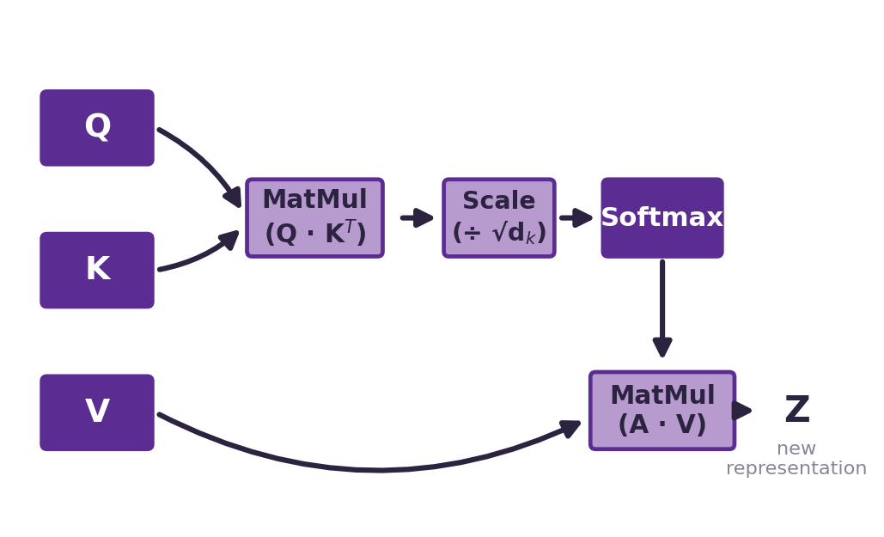
ALGORITHM 4 OF 4 — CONCEPT
Transformer (Self-Attention Network)
BASIC IDEA
Instead of reading the signal step-by-step, self-attention lets every point in the sequence directly compare itself with every other point at once — no matter how far apart they are.
WHY IT FITS THIS DATASET
An abnormal beat is often defined by a relationship between two distant parts of the waveform. Attention captures this long-range relationship directly, without it fading the way it can in a recurrent model.
CORE LOGIC
Each time-step becomes a Query, Key, and Value vector; attention scores (Query · Key) decide how much every other time-step contributes to the current one, producing a weighted mix of Values as the new representation.
10

Slide 11
ALGORITHM 4 OF 4 — THE MATH
Transformer (Self-Attention Network)
The equations actually implemented for this model
Q = XW^{Q}, K = XW^{K}, V = XW^{V}
Every time-step of the signal is projected into a Query, Key, and Value vector.
A = softmax(QK^{T}/sqrt(d_{k}))
Attention weights: how strongly each time-step should attend to every other time-step.
Z = A · V
The new representation for each time-step is a weighted mix of Values, guided by attention.
11

Slide 12
STEP 3 — PUTTING IT TOGETHER
Comparing the Four Approaches
Algorithm | Core Mechanism | Best At | Relative Training Speed
1D-CNN | Local shape detection via convolution | Spotting abnormal beat shapes | Fast
LSTM | Sequential memory (gates + cell state) | Capturing rhythm over time | Slow
GRU | Simplified sequential memory | Rhythm patterns, lower compute cost | Medium–Fast
Transformer | Self-attention across all time-steps | Long-range relationships in signal | Medium (parallelizable)
Final comparison will add measured Accuracy, Precision, Recall, and F1-score once all four models are trained on the same train/test split.
12

Slide 13
“Four different ways of thinking, one goal: catching an irregular heartbeat before it becomes a problem.”
CNN · LSTM · GRU · TRANSFORMER

