Slide 1
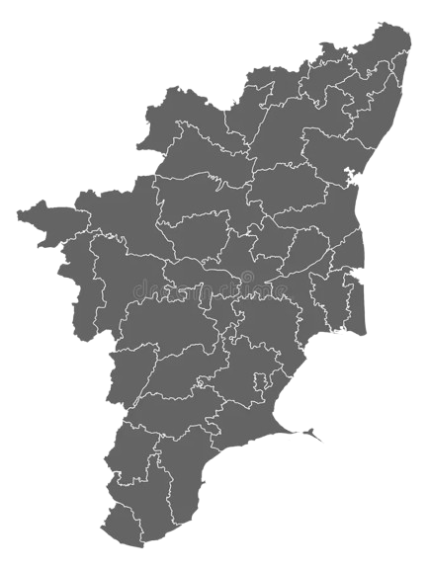

Decoding Tamil Nadu 2026
A Data-Driven Story Pitch for AtliQ Media
Powered by ECI Data Only · Non-Partisan Analysis
Anshu Kunwar · May 2026 · Python · Power BI · Canva

Slide 2
THE STORY IN ONE SENTENCE
A landslide in seats.
A fragmented mandate in votes.
And it happened equally across every seat category.
Q2: The Flip Story
Q4: Reserved Seats
Q6: The Mandate Paradox
Three stories. One show. 234 constituencies. All ECI data.

Slide 3
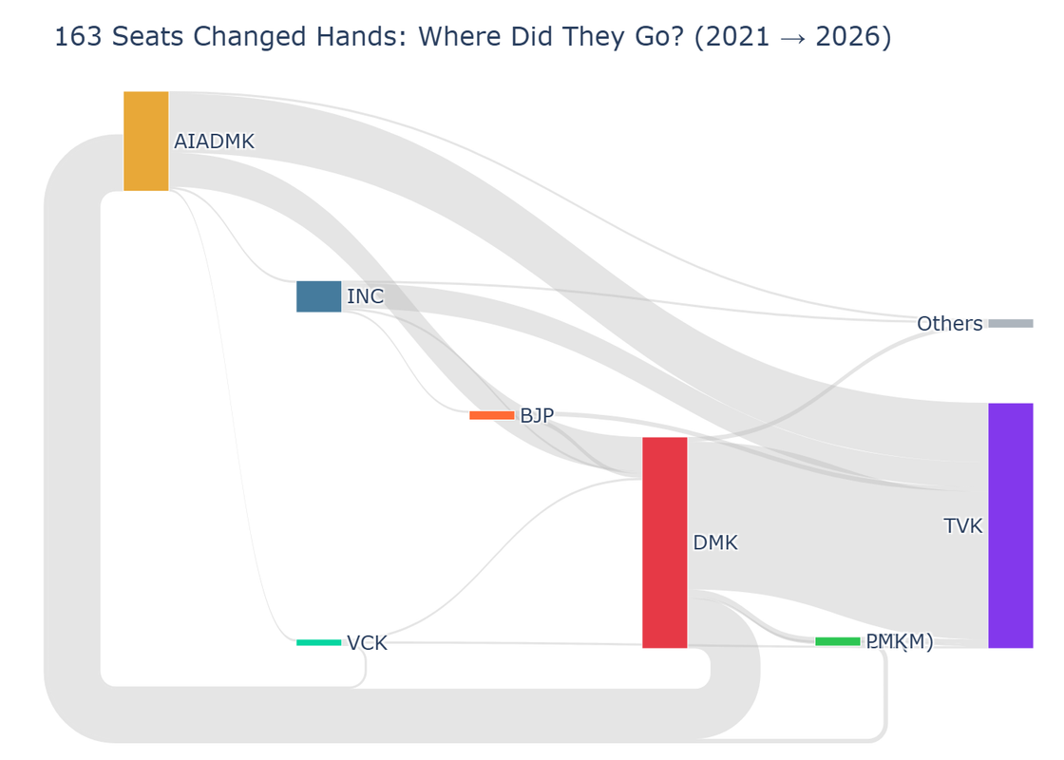
Story 1: 70% of Tamil Nadu Changed Hands
Q2 · The Flip Story · 163 of 234 constituencies recorded a change in winner
163 / 234
Seats changed hands
69.7% of the state
65 seats
DMK held in 2021
went to TVK in 2026
26 seats
AIADMK held in 2021
went to TVK in 2026
TVK pulled from both sides equally —
not from one party alone
Data insight: TVK entered the 2026 election with zero seats.
It absorbed from both the largest party (DMK) and the
second largest party (AIADMK) simultaneously. In seat count
terms this is the fastest rise from zero in the state's data record.
DMK: 133 seats in 2021 → 59 seats in 2026 · AIADMK: 88 seats → 47 seats · TVK: 0 seats → 108 seats

Slide 4
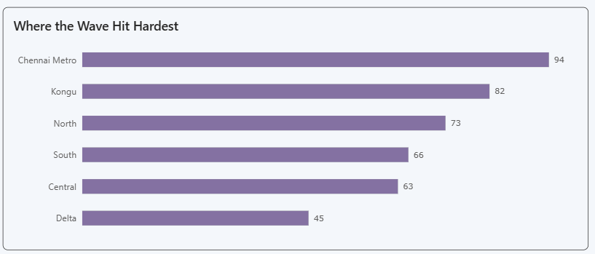
The Wave Was Statewide. But Not Uniform.
Q2 · Regional flip rates across Tamil Nadu's 6 regions
Chennai Metro
94%
Kongu
82%
North
73%
South
66%
Central
63%
page1_regional.png
Insert regional flip rate chart here
Delta
45%
State average: 69.7%
Strongest wave
Chennai Metro: 94% of seats changed hands
29 of 32 constituencies
Most resistant region
Delta: only 45% of seats changed hands
5 of 11 constituencies
Data note: Chennai Metro recorded the highest flip rate (94%) of any
region. Delta recorded the lowest (45%). The 49-point gap between
them is the widest regional divergence in this dataset.

Slide 5
Story 2: Reserved Seats Told the Exact Same Story
Q4 · The Reserved Seat Verdict · 44 SC seats + 2 ST seats + 188 GEN seats
Did the 44 reserved constituencies
flip differently from general seats?
No. The difference was 0.8 percentage points.
70.5%
69.7%
SC Seats Flipped
GEN Seats Flipped
31 of 44 reserved seats
131 of 188 general seats
Why this matters: Most analyses focus on overall seat counts. This finding shows the reshaping of Tamil Nadu was structurally uniform — not concentrated in any one category of constituency. That uniformity is the data story.

Slide 6
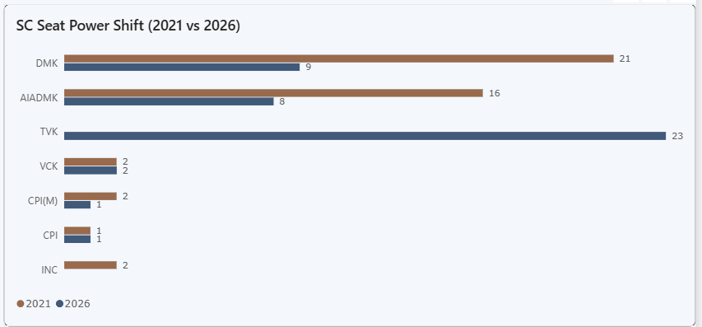
TVK's Performance Was Stronger in Reserved Seats Than General Seats
Q4 · SC seat winners: 2021 vs 2026 · A finding most analysts will miss
DMK
SC seats 2021: 21 → SC seats 2026: 9
Lost 57% of reserved hold
AIADMK
SC seats 2021: 16 → SC seats 2026: 8
Lost 50% of reserved hold
TVK
SC seats 2021: 0 → SC seats 2026: 23
Single largest SC seat holder
TVK SC win rate: 52.3%
TVK GEN win rate: 44.7%
TVK performed 7.6 percentage points stronger in reserved constituencies than in general constituencies.

Slide 7
The Map Says Landslide. The Votes Say Something Else.
Q6 · Margin of Victory · Average win share across 234 constituencies
48.4%
▼
38.8%
−9.6 pp
Average winner's vote share
dropped in one election
Average winner's vote share
2021
2026
Seats won >50% in 2021: 70
Seats won >50% in 2026: 13
Seats won <35% in 2021: 2
Seats won <35% in 2026: 64
In 2021, the average winner got nearly half of all votes cast. In 2026, they got barely a third. The seat tally looks decisive. The vote concentration tells a more complex story.
This tension — landslide in seats, fragmentation in votes — is what makes the 2026 result analytically unusual.

Slide 8
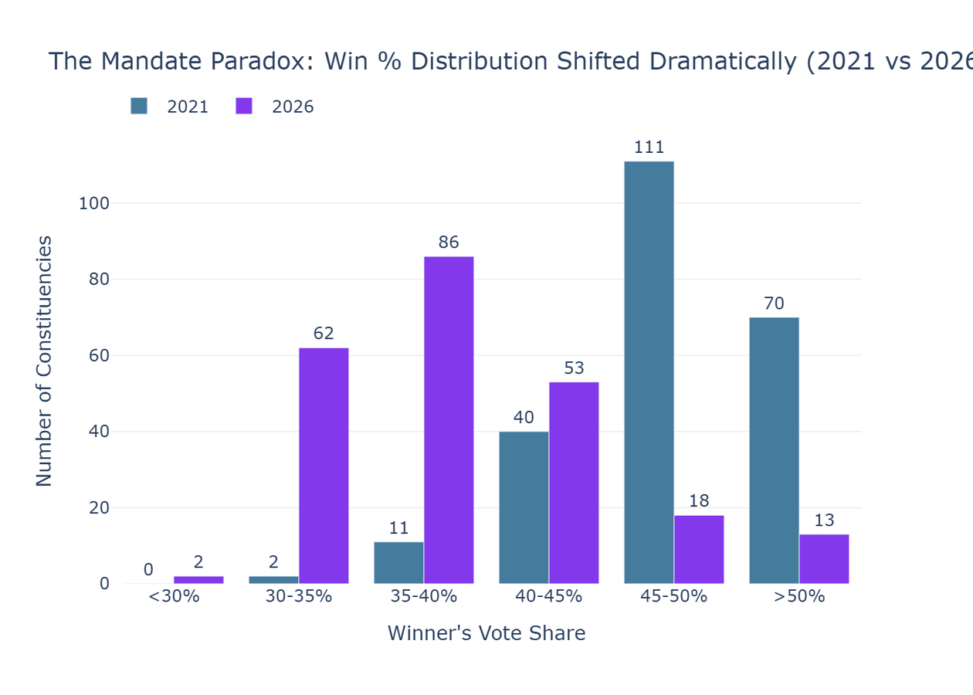
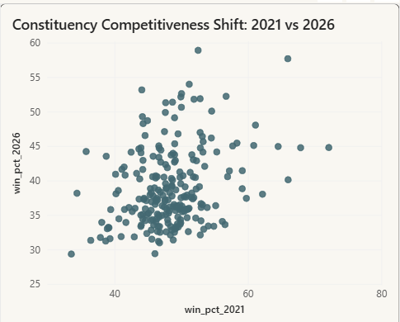
In 1 of Every 4 Constituencies, Most Voters Chose Someone Else
Q6 · Win percentage distribution shift · 2021 vs 2026
64 seats
Won with under 35% of valid votes polled
13 seats
Won with over 50% — Was 70 in 2021
1 vote
Tiruppattur — tightest margin in the state
South TN: 36.95% — Most fragmented region
Chennai Metro: 46.63% — Most decisive region
Each dot = one constituency
Dots below diagonal = more fragmented in 2026 than 2021

Slide 9
How AtliQ Should Structure the Show
A 35-minute data segment built entirely from ECI numbers
SEGMENT 1
SEGMENT 2
SEGMENT 3
10 minutes
10 minutes
15 minutes
The Great Reshuffle
The Reserved Seat Verdict
The Mandate Paradox
Opening line for anchor:
"163 of 234 seats changed hands. That is 70% of Tamil Nadu redrawn in a single day."
Lead visual: Sankey diagram
Drill-down: Regional flip rate bar
Key number: 69.7%
Opening line for anchor:
"Did reserved seats tell a different story? The data says no — by 0.8 points."
Lead visual: SC seat shift bar
Drill-down: TVK win rate comparison
Key number: 52.3% vs 44.7%
Opening line for anchor:
"The winner won big in seats. But in 64 constituencies, most voters chose someone else."
Lead visual: Distribution chart
Drill-down: Tightest seats table
Key number: 1 vote margin
EDITORIAL RECOMMENDATION FOR ATLIQ MEDIA
AtliQ's competitive advantage is what this show does NOT do.
No commentary. No predictions. No debates. Only ECI numbers.
Three data facts no other channel will present this way:
· 70% of Tamil Nadu changed hands — but Chennai Metro and Delta
tell completely opposite stories within the same election.
· Reserved seats flipped at the same rate as general seats — a
finding most analysts skip because they assume it is niche.
· 64 seats were won by a minority of voters — the mandate is more
complex than the seat count suggests.
Every number on screen is verifiable from the public record.
Every chart can be filtered live during the broadcast using the
Power BI dashboard built for this analysis.
Recommended show opener: Tiruppattur — won by exactly 1 vote.
It is factual, specific, and immediately tells the audience this will not be a typical election show.

Slide 10
What the Data Can and Cannot Tell Us
Full transparency on sources, scope, and analytical boundaries
WHAT WE USED
WHAT WE COULD NOT USE
DATA SOURCES
KNOWN LIMITATIONS
REPRODUCIBILITY
Election Commission of India
Candidate-level assembly results
tn_2021_results.csv (4,232 rows)
tn_2026_results.csv (4,257 rows)
constituency_master.csv (234 rows)
Full Jupyter notebook on GitHub
All processed CSV files included in repo
Every number in this deck is traceable to a specific notebook cell output
2026 turnout data
Not available from ECI at time of analysis. All margin figures use vote counts only.
No demographic data
No caste, religion, gender, or socioeconomic data was used at any point.
No causal claims
This analysis describes observable patterns in ECI data only. It makes no claim about why any result occurred.
No third-party sources
No exit polls, news articles, opinion surveys, or social media data was used or referenced.
SCOPE
234 constituencies
6 regions across Tamil Nadu
3 seat categories: GEN · SC · ST
Candidate votes and winner margins only
TOOLS
Python pandas · plotly
Data cleaning, Sankey, margin calc
Power BI 3-page interactive dashboard
DAX measures, scatter, matrix
Canva This pitch deck
Non-partisan analysis · Codebasics RPC May 2026 · Anshu Kunwar · anshukun777@gmail.com

