Slide 1
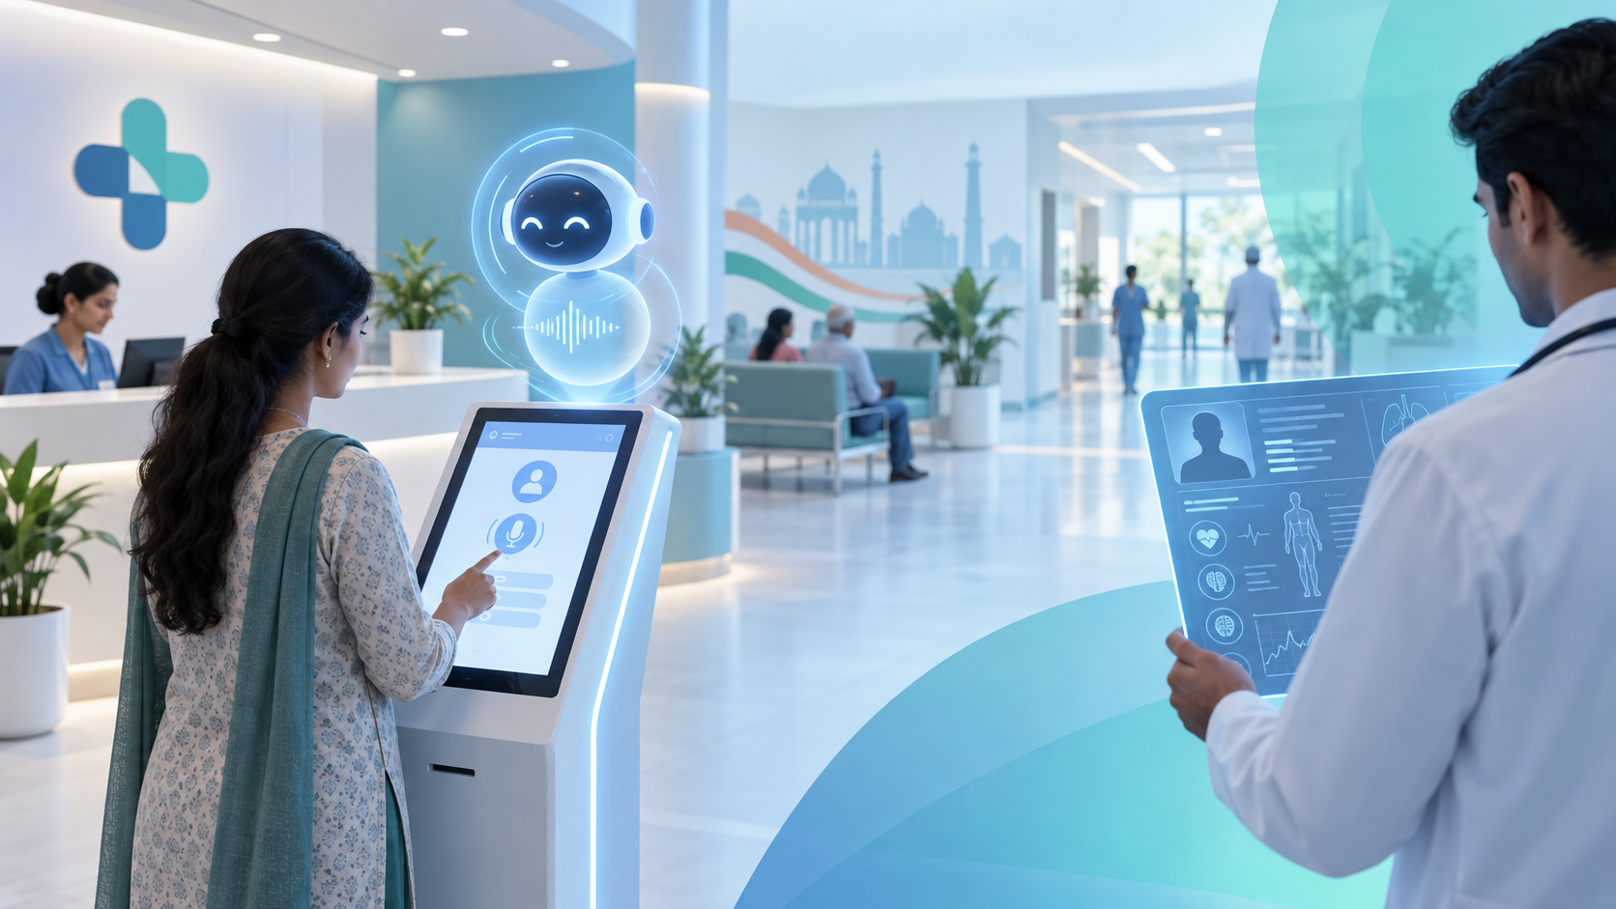
SMART INDIA HACKATHON
Patient Case-Taking
Software
Visual Architecture & Workflow Deck
Problem Statement ID 26047 | Ministry of Ayush | MedTech / HealthTech
Core principle
AI collects and structures clinical history; the doctor stays in control of diagnosis and treatment.
VOICE
OCR
REPORT
From patient narration to physician-ready case history.
01

Slide 2
Project overview: why this matters
Context
Problem
Busy OPDs lose time in repetitive history-taking before the doctor sees the patient.
Solution
A voice-led clinical intake layer that structures history and supporting documents.
Outcome
A concise physician-readable report before consultation begins.
Core goals
Reduce manual history bottleneck
before physician consultation
Capture complaints by voice
with adaptive follow-up questions
Digitize previous documents
prescriptions, lab reports, summaries
Generate report history
view, download, print, share
Support Hindi and English
accessible for first-time users
Separate admin operations
secure hospital CRUD portal
02

Slide 3
Approved 9-module architecture
Module map
Patient Registration
Profile intake
AI Consultation
Voice-led case taking
My Report History
Stored reports
1
2
3
Notification Center
Care updates
Profile & Settings
Preferences
Multi-Language
Hindi / English
4
5
6
Help & Support
Guidance
Hospital Services
Patient services
Admin Portal
Hospital CRUD
7
8
9
Architecture rule
Patient-facing modules connect through backend services; Hospital Admin Portal remains separate and role-protected.
03

Slide 4

End-to-end patient journey
Workflow
Account Access
Patient enters platform
Registration
Basic profile captured
AI Consultation
Voice-led history
Report Upload
Optional OCR
AI Report
Review / edit
Confirm
Final PDF
History
Stored reports
Services
Hospital access
Patient-friendly path
A patient can still access hospital services directly; emergency access is never blocked by AI consultation.
AI does
Collects
Structures
Summarizes
Doctor does
Examines
Diagnoses
Treats
04

Slide 5
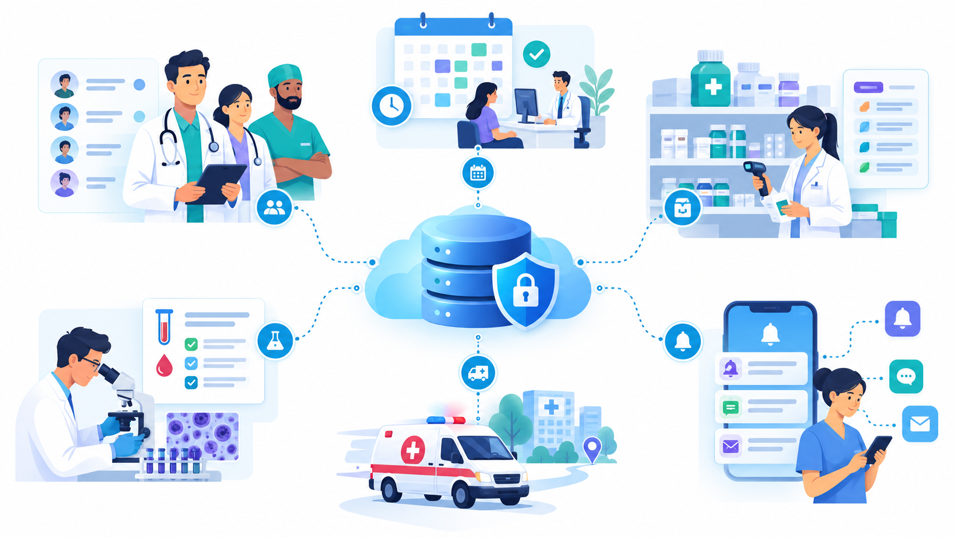
High-level system architecture
Architecture
User layer
Patient + authorized staff
Frontend layer
React website + admin portal
Auth layer
Supabase Auth + RBAC
Backend API
FastAPI services
AI & OCR
STT, LLM, OCR, PDF
Data layer
PostgreSQL + secure storage
Shared integration pattern
Every feature talks through protected backend services, not direct uncontrolled client-side access.
Patient app
Modules 1-8
Admin portal
Module 9
05

Slide 6
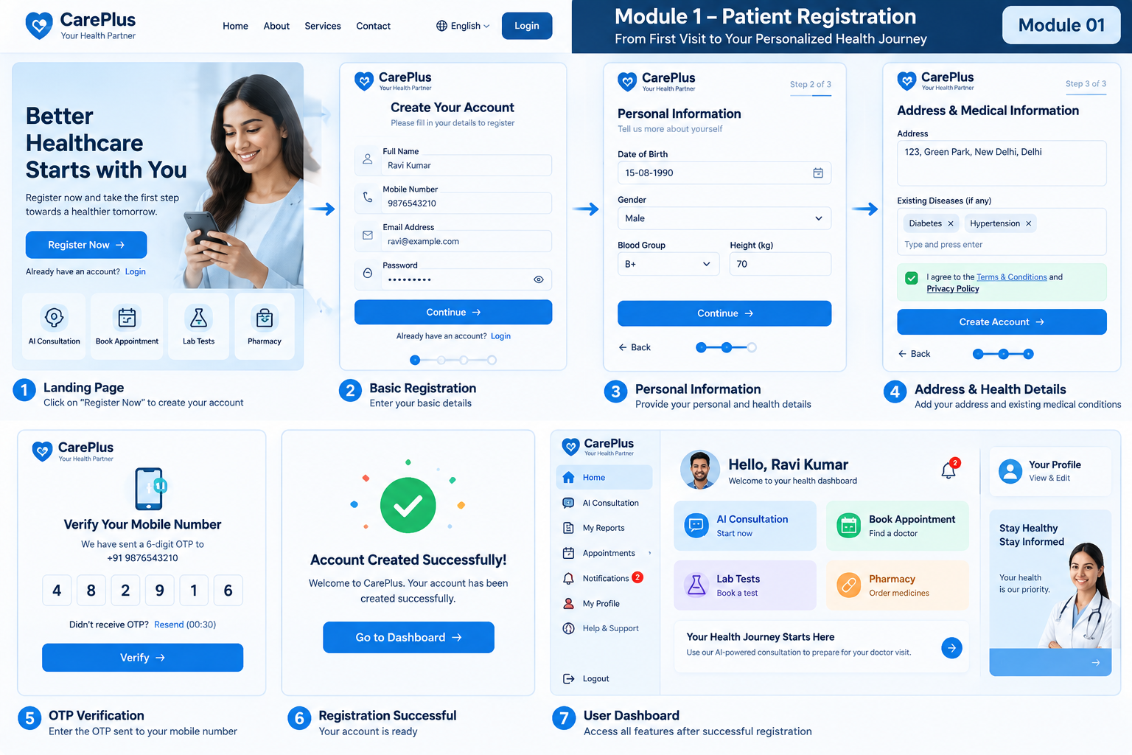
Module 1: Patient Registration
Foundation
Goal
Capture only essential demographic and baseline information so onboarding stays simple.
Approved fields
Full Name
DOB
Gender
Mobile
Email
Address
Blood Group
Height
Weight
Existing Diseases
None option
Submit
Validation
Required fields, email/mobile format, duplicate profile prevention.
Output
Stored patient profile available to AI, Services and Profile modules.
06

Slide 7
Module 2: AI Consultation deep dive
Core AI
1
Welcome + language
2
Open chief complaint
3
Dynamic follow-up
4
Optional report upload
Voice assistant
STT captures Hindi/English narration and builds context.
Document intelligence
OCR reads previous prescriptions, lab reports and summaries.
5
AI report review
6
Confirm + PDF
Safety boundary
The AI prepares a clinical-history draft. Final diagnosis and prescription stay with the physician.
07

Slide 8
From documents to physician-ready report
Data flow
Report sections
Patient voice
Narration + answers
Previous reports
Prescription / lab / discharge
Processing
STT + OCR + extraction
Structured report
Sections + summary
Patient confirm
Review / edit / lock
Doctor use
Physician reads report
Patient details
Chief complaint
History of present illness
Past history
Medicines taken
Uploaded document info
Patient summary
Report date
Clinical note
The report is a structured patient-history document, not a final medical diagnosis.
08

Slide 9
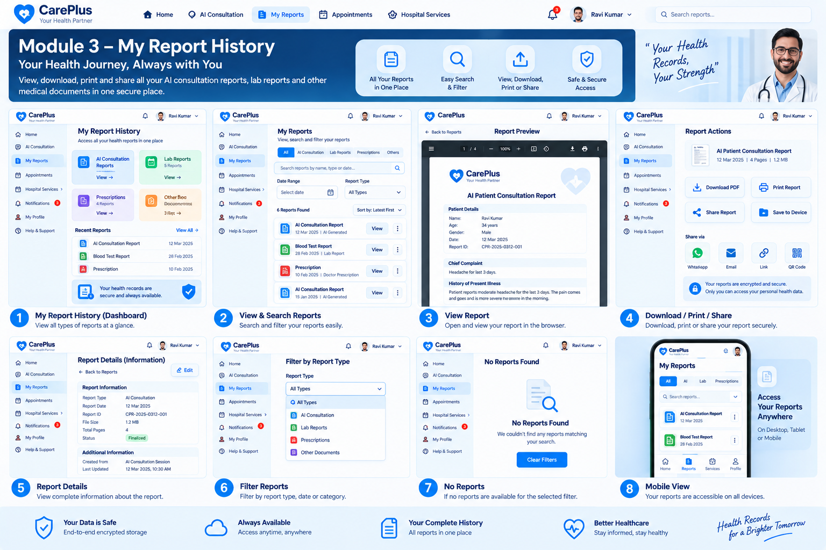
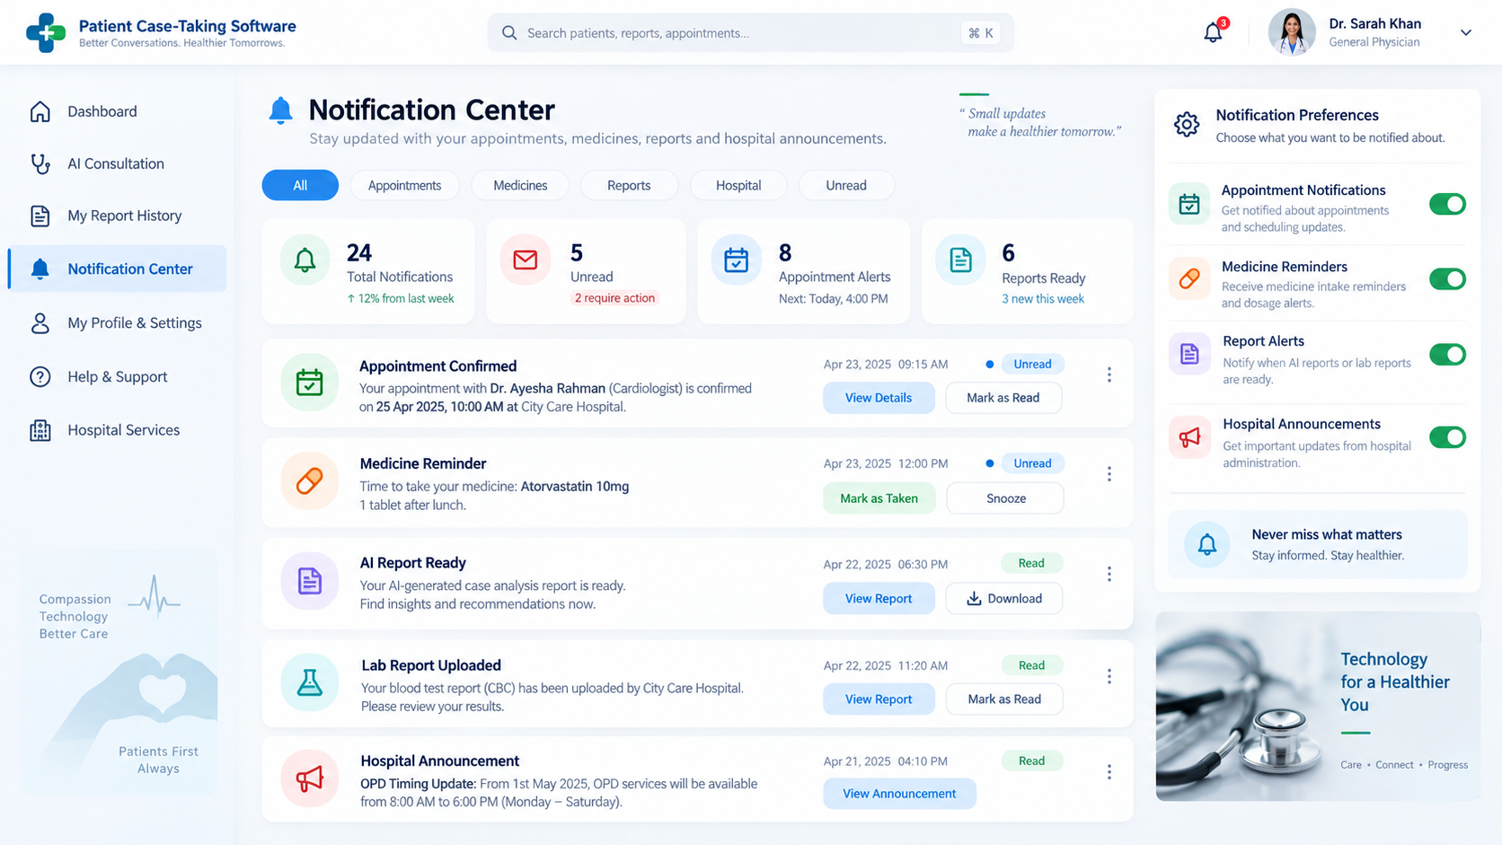
Modules 3 & 4: reports and timely updates
Patient continuity
Module 3 - My Report History
View, review, download, print, share, search and filter finalized reports. Patient-side delete is not provided for formal records.
Module 4 - Notification Center
Appointment updates, medicine reminders, report alerts and hospital announcements are delivered as patient-specific notifications.
Connected workflow: Report generated -> Stored in history -> Patient notified -> Patient opens the report securely
F0EDFF
09

Slide 10
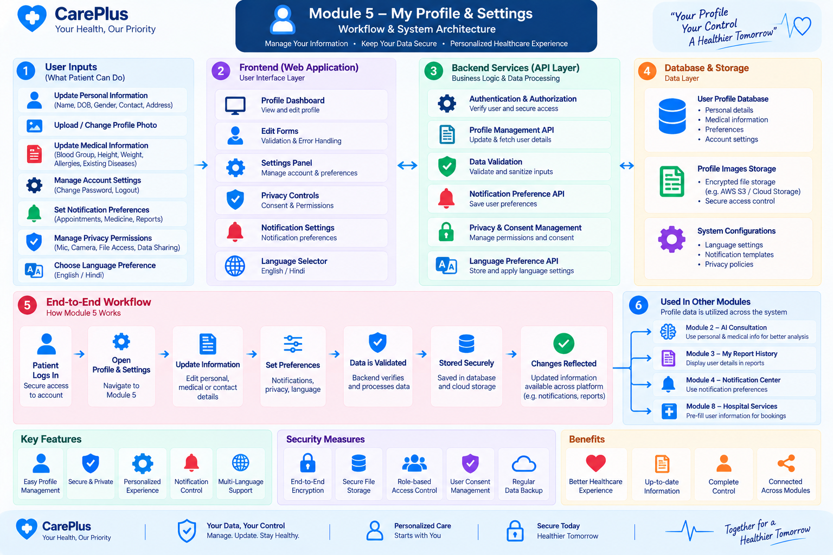
Modules 5, 6 & 7: personalization and support
Experience layer
Module 5
Profile & Settings
Profile data, photo, privacy, permissions and notification preferences.
Module 6
Multi-Language
Hindi/English UI, voice language, speech-to-text and saved preference.
Module 7
Help & Support
User guide, FAQ, contact support, feedback, issue reports and tutorials.
Accessibility objective: large readable labels, simple navigation, voice guidance and clear support for elderly and first-time users.
E8F7EF
10

Slide 11
Module 8: Hospital Services
Patient services
Doctor Appointment
Profiles, timings, slots
Hospital Pharmacy
Availability, pickup/delivery
Lab Test Booking
Test details, reports
Departments & Services
OPD, ICU, blood bank
Doctor Directory
Searchable doctor list
Ambulance Request
Fast emergency pathway
Contact & Location
Maps and hospital details
Service rule
Hospital services are accessible directly. A patient in emergency should not be forced through AI consultation first.
Admin connection
Doctor schedules, pharmacy stock, lab tests, departments and ambulance workflow are managed from Module 9.
11

Slide 12
Module 9: Hospital Admin Portal
Operations
Admin Auth
Patients
Doctors
Appointments
Pharmacy
Lab Tests
Departments
Ambulance
Notifications
Analytics
Separate portal
Patients must never receive admin CRUD privileges.
Role-based access
Each staff role gets only required permissions.
Auditability
High-impact actions are logged and confirmed.
Admin data powers patient services: Doctor Management -> Directory + Appointments | Lab Management -> Lab booking + reports | Notifications -> patient alerts
E8F5FF
12

Slide 13
Security, privacy and consent architecture
Trust
1
2
3
4
5
Authenticate
Patient or admin login
Authorize
Role / ownership check
Validate
Input and file rules
Store securely
DB + protected files
Audit
Admin operations
Patient data isolation
Patient A must never access Patient B reports, notifications or appointments.
Consent-first design
Privacy and permission handling prepares the system for ABDM/HIS/EMR integration.
Clinical safety
AI output is never positioned as autonomous diagnosis or prescription.
13

Slide 14
SIH requirement alignment
Coverage
Requirement
Project coverage
Independent history capture
AI Consultation + Voice Assistant
Natural voice + guided interaction
Voice-led UI and accessibility
Adaptive clinical questioning
Dynamic follow-up conversation
Medical document digitization
Optional upload + OCR
Physician-ready summary
AI Patient Report
Editable/verifiable report
Review, Edit and Confirm
Hindi/English support
Multi-Language Support
No autonomous diagnosis
Core safety principle
Scope note
Hospital Services and Admin Portal are useful extensions, separated from the core AI case-taking workflow for clear SIH demonstration.
14

Slide 15
Suggested build order for demo-ready implementation
Roadmap
1
Account + Registration
Dashboard, profile creation
2
AI Consultation
Voice flow, dynamic Q&A
3
Document + OCR
Previous report processing
4
Report Engine
Review, edit, confirm, PDF
5
Reports + Notifications
History, alerts, preferences
6
Language + Support
Hindi/English, FAQ, guide
7
Hospital Services
Appointments, lab, pharmacy, ambulance
8
Admin Portal
CRUD, RBAC, analytics
9
Hardening
Security, testing, deployment
Demo story: Patient registers -> speaks to AI -> uploads report -> reviews PDF -> doctor receives structured history -> admin manages hospital services.
E8F5FF
15

Slide 16
Final project definition
Faster, cleaner
clinical history before
doctor consultation
The project value is not autonomous diagnosis. Its value is structured clinical intake, document digitization, patient report generation and connected hospital services.
VOICE
OCR
REPORT
SIH Patient Case-Taking Software

