Slide 1
APPLE SALES DASHBOARD
MSME Internship Project
Presented By : Prashansa Sahu
Domain : Junior Web Designing
Submission Date : 9th May 2026

Slide 2
About the Project
• Apple Sales Dashboard is a frontend-based dashboard project.
• The project is designed using HTML, CSS, and JavaScript.
• Dashboard helps analyze sales performance and inventory tracking.
• Includes analytics section, product management, and responsive UI.
• Inspired by modern Apple product ecosystems.
• Designed for both desktop and mobile devices.

Slide 3
Project Features & Technologies
Project Features:
• Sales Analytics Dashboard
• Inventory Tracking System
• Product Search Functionality
• Responsive Dark Theme UI
• Product Category Visualization
Technologies Used:
• HTML5 – Structure of dashboard
• CSS3 – Styling and responsive layouts
• JavaScript – Dynamic functionality and interactivity

Slide 4
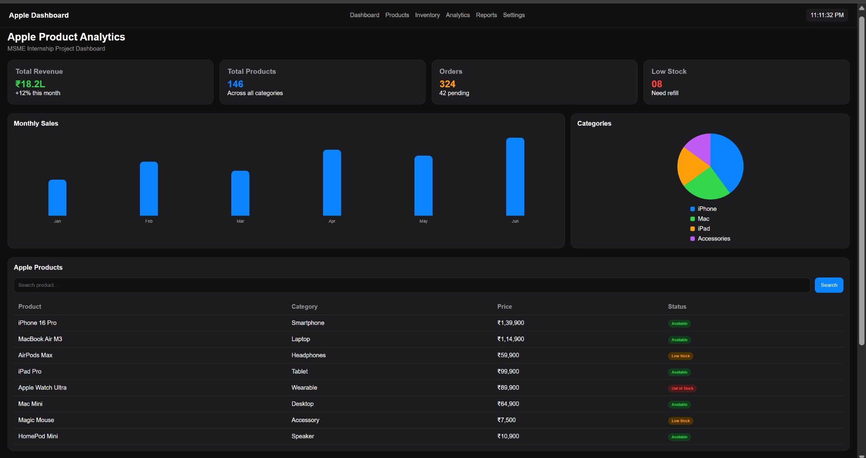
Dashboard Snapshot

Slide 5
GitHub Repository
Project Source Code Available on GitHub
GitHub Link:
https://github.com/Anshul-295/Apple_Sales_Dashboard_-MSME-/tree/main
The repository contains complete source code of the Apple Sales Dashboard project.

Slide 6
THANK YOU
MSME Internship Project Presentation

