Slide 1
AWS Certified Machine Learning – Speciality Examination (MLS-C01)

Slide 2
Curriculam
Data Engineering (20%)
Exploratory Data Analysis (24%)
Modeling (36%)
Implementation and Operations (20%)

Slide 3
Data Engineering
Storage Solutions
  S3 Data Lakes
  DynamoDB
Transformation
  Glue
  Glue ETL

Slide 4
Data Engineering
Streaming
  Kinesis
  Kinesis Video Streams
Workflow Management Tools
  Data Piplelines
  AWS Batch
  Step Functions

Slide 5
Exploratory Data Analysis
Data Science
  scikit-learn
  Data Distributions
  Trends and Seasonality
Analysis Tools
  Athena
  Quicksight
  Elastic Map Reduce (EMR)
  Apache Spark
Notes:
Apache Spark – Not a part of default AWS suit, but used heavily in data analysis

Slide 6
Exploratory Data Analysis
Feature Engineering
  Imputation methods
  Outliers
  Binning/Categorizing Data
  Log transforms
  One-hot encoding
  Scaling and Normalization

Slide 7
Modeling
Deep Learning
  Multi-layer Perceptrons (MLPs)
  Convolutional Neural Networks (CNNs)
  Recurrent Neural Networks (RNNs)
  ANN – Tuning and Regularization Techniques
SageMaker
  Architecture
  Built-in Algorithms
  Automatic Model Tuning
  SageMaker Integration with other services - Spark

Slide 8
Modeling
High-level AI Services
  Comprehend
  Translate
  Polly
  Transcribe
  Lex
  Rekognition
  Additional Services – Personalize, Forecast, Textract etc
  DeepLens
Evaluating and Tuning
  Confusion Matrix
  RMSE
  Precision and Recall
  F1 Score
  ROC / AUC

Slide 9
Implementation and Operations
Sagemaker Operations
  Using containers
  Security with SageMaker
  Choosing instance types
  A/B testing
  Tensorflow integration
  SageMaker Neo and GreenGrass
  SageMaker Pipes
  Elastic Inference
  Inference Pipelines

Slide 10
Data Engineering

Slide 11
AWS S3 Overview
S3 allows for storing objects (files) in buckets (directories)
Buckets must have a globally unique name
The full path of the objects is called ‘Key’. Example:
  <bucketname>/<filename>.txt
  <bucketname>/<foldername>/<filename>.txt
The maximum object size that can be stored: 5TB

Slide 12
AWS S3 for Machine Learning
Backbone for many AWS ML services (Ex: SageMaker)
Core service for Data Lake
  Infinite size, no provisioning
  99.999999999% durability
  S3 allows for decoupling (segregating) storage for all the compute based services. Examples:
    EC2, Athena, Redshift, Rekognition, Glue
Centralized Architecture – all the data at the same place
Object Storage – supports any file format
Common formats for ML – CSV, JSON, Parquet, ORC, Avro, Protobuf

Slide 13
AWS S3 Data Partitioning
Pattern for speeding up range queries (Eg: AWS Athena)
Partitioning Examples:
  By Date: s3://<bucketname>/<dataset>/year/month/day/hour/<datafile>.csv
  By Product: s3://<bucketname>/<dataset>/product-id/<datafile>.csv
We should choose the partitioning type based on use case
Some tools like Kinesis and Glue can help with partitioning

Slide 14
AWS S3 Storage Tiers
Amazon S3 Standard – General Purpose (GP)
Amazon S3 Standard – Infrequent Access (IA)
Amazon S3 One Zone-Infrequent Access
  Cheaper IA with diluted availability
Amazon S3 Intelligent Tiering
  New – Amazon determines where to put data to save cost
Amazon Glacier
  Archival

Slide 15
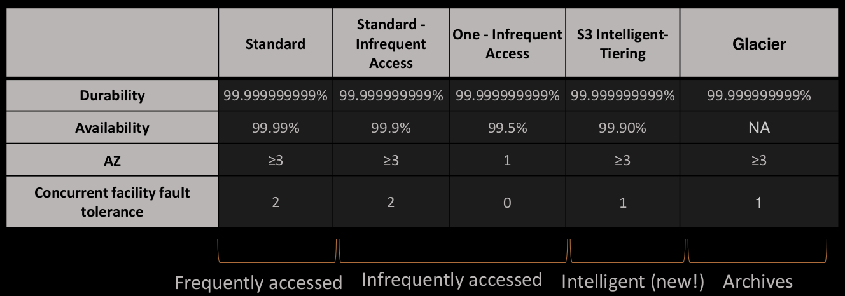
AWS S3 Storage Tiers

Slide 16
S3 Lifecycle Rules
In order to save on cost, the lifecycle rules help in moving data between different tiers
Example:
  General Purpose (GP) -> Infrequent Access (IA) -> Glacier
Transition actions – Objects are transitioned to another storage class
  Move objects from:
    GP to IA, 60 days post creation
    IA to Glacier 6 months post creation
Expiration actions – S3 deletes expired objects on our behalf
  Log files can be set to delete after a specific period of time

Slide 17
S3 Security - Encryption for Objects
There are four methods of encrypting objects in S3:
SSE-S3: Encrypts S3 objects using keys handled and managed by AWS
SSE-KMS: Use AWS key Management Service to manage encryption keys
  Additional Security
  Audit trail for KMS key usage

Slide 18
S3 Security - Encryption for Objects
SSE-C: We need to use our own encryption keys
Client Side Encryption
From an ML perspective, SSE-S3 and SSE-KMS will be the most likely used scenarios

Slide 19
SSE-S3
AWS S3
Object
Object
HTTP/S + Header
Object
Encryption
Bucket
S3 Managed Data Key

Slide 20
SSE-KMS
AWS S3
Object
Object
HTTP/S + Header
Object
Encryption
Bucket
KMS Customer Master Key

Slide 21
S3 Security
User Based
  IAM Policies – which API calls the user should be allowed
Resource Based
  Bucket Policy – allowing cross account access
  Object Access Control List (ACL) – more precise control
  Bucket Access Control List (ACL) – less commonly used

Slide 22
S3 Bucket Policies
JSON based policies
  Resources: buckets and objects
  Actions: Set of API to Allow or Deny
  Effect: Allow / Deny
  Principal: The account or user to apply the policy to

Slide 23
S3 Bucket Policies
Use S3 bucket policies for:
  Granting public access to the bucket
  For objects to be encrypted at upload
  Grant access to another account (Cross Account)

Slide 24
S3 Security – Points to Remember
Networking – VPC Endpoint Gateway
  Allow traffic to stay within your VPC
  Make sure the private services (Eg: SageMaker) can access S3
Logging and Audit:
  S3 access logs can be stored in other S3 bucket
  API calls can be logged in AWS CloudTrail
Tagged Based (combined with IAM and bucket policies)

