Slide 1
Machine Learning - Introduction

Slide 2

Artificial Intelligence
Notes:
Systems that appear to be intelligent
They can observe their surroundings and respond in a logical and appropriate way
Examples:
Voice Recognition
Playing Chess
Predicting disease based on symptoms

Slide 3
Artificial Intelligence
Artificial Intelligence is a broader term that includes Machine Learning
Machine Learning inturn has a specialized concept called Deep Learning
Artificial Intelligence >> Machine Learning >> Deep Learning
Notes:
Systems that appear to be intelligent
They can observe their surroundings and respond in a logical and appropriate way
Examples:
Voice Recognition
Playing Chess
Predicting disease based on symptoms

Slide 4
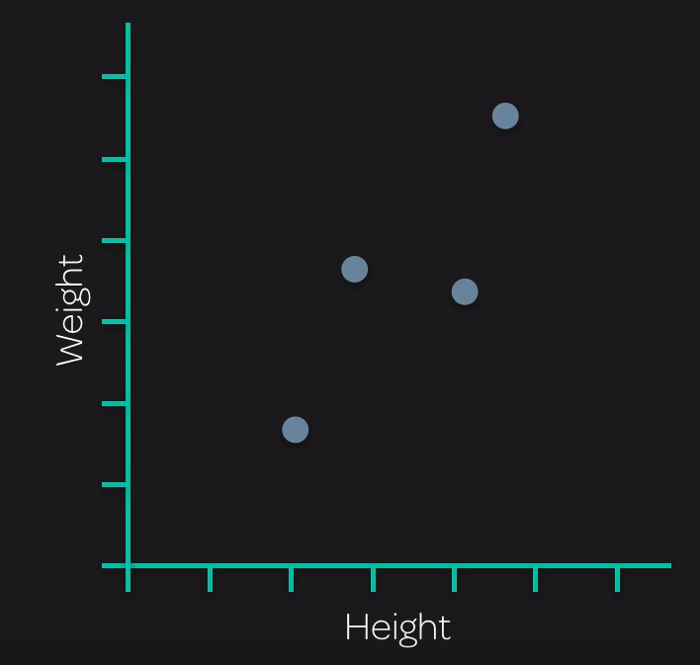
Machine Learning
Notes:
Consider a scenario where we have exploratory data related to Penguins
Scientists have captured data like Height and Weight of the Penguins and plotted a correlation as shown

Slide 5
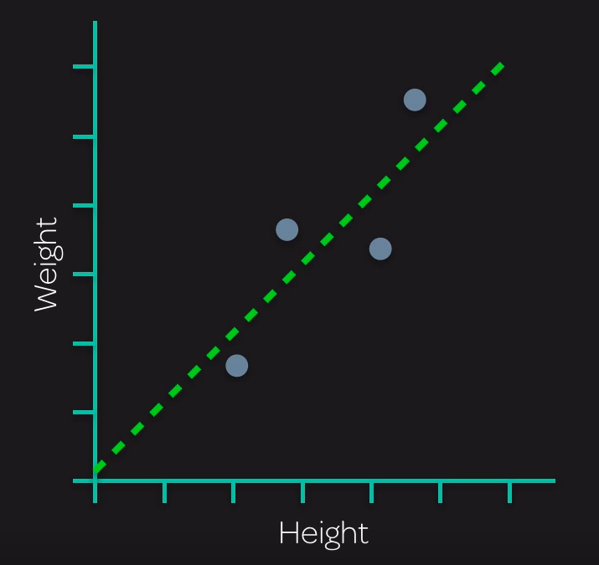
Machine Learning
Notes:
We can draw a trend line that passes through these data points and indicates a general trend – weights increase as the height increases and vice veras

Slide 6
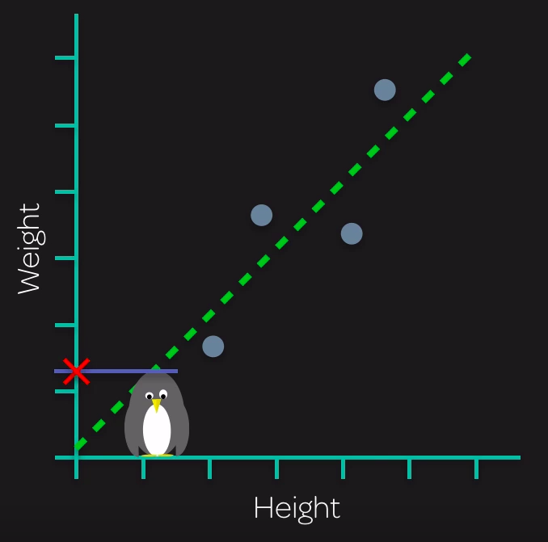
Machine Learning
Notes:
With the given trend line we can predict the weight of some other penguins for which, lets say only height is known

Slide 7
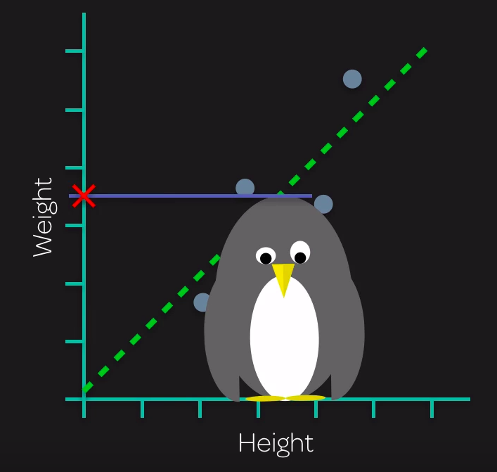
Machine Learning

Slide 8
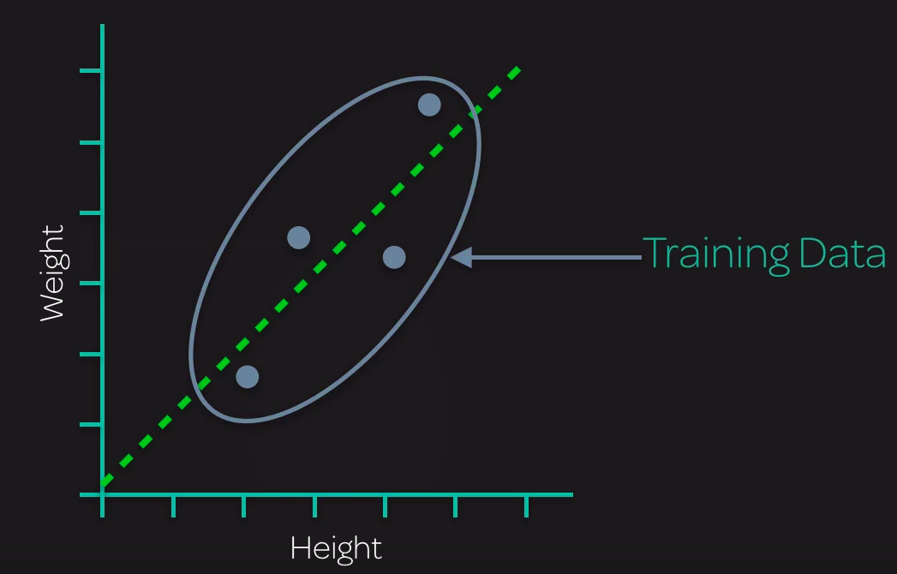
Machine Learning
Notes:
These set of points that help us identify the trend line are called the training dataset
Help the machine learning model to train

Slide 9
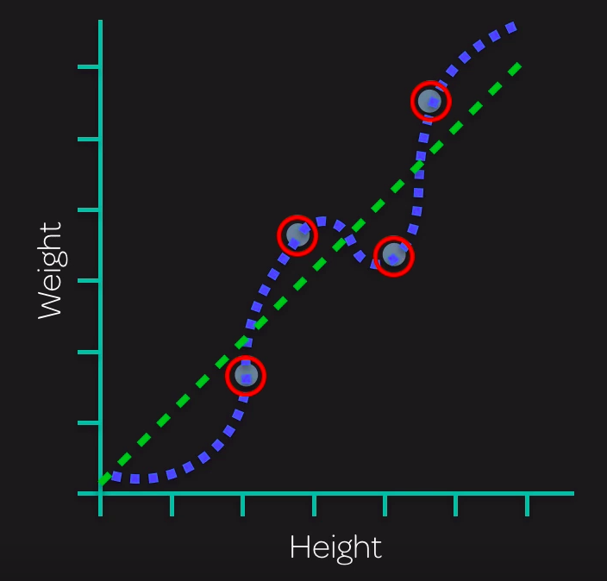
Machine Learning
Notes:
Out of curosity and also logically you may have a question if the trend line best represents the actual trend. A better option would have been the curve passing through all the points.

Slide 10
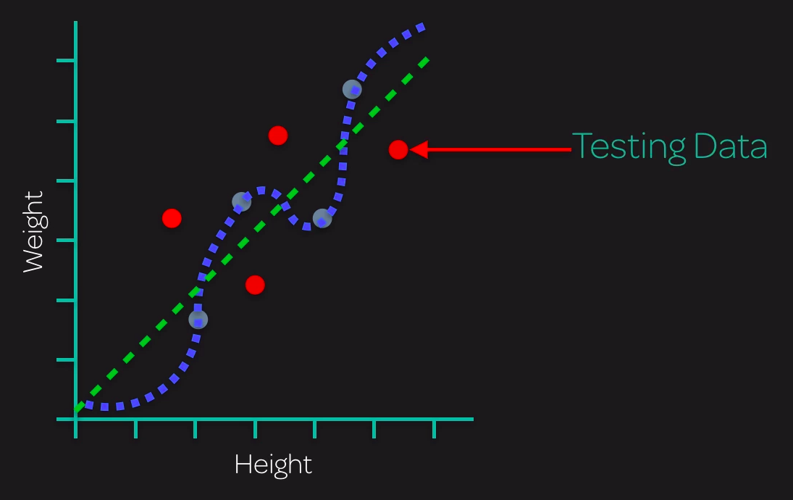
Machine Learning
Notes:
To verify we use testing data

Slide 11
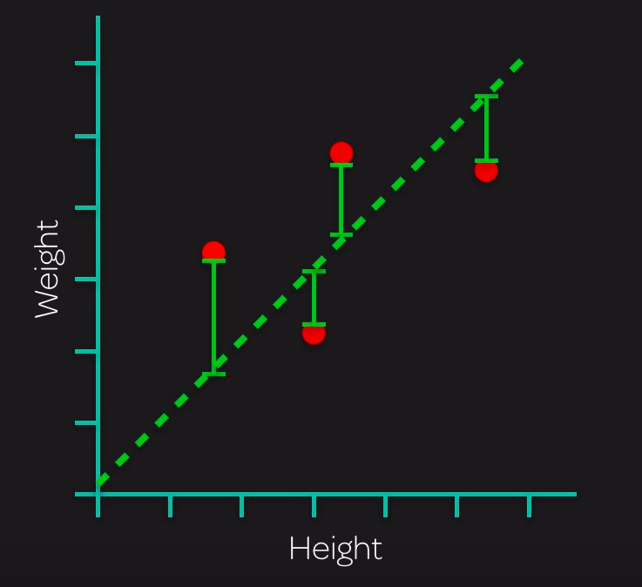
Machine Learning

Slide 12
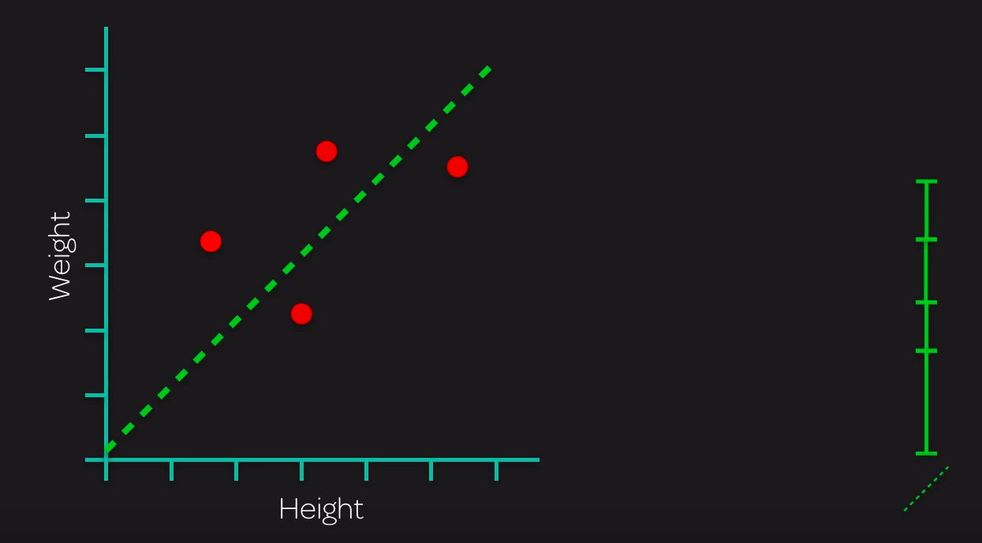
Machine Learning

Slide 13
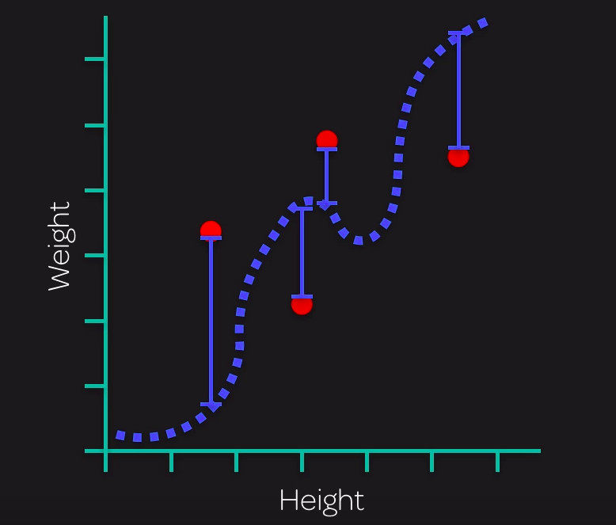
Machine Learning

Slide 14
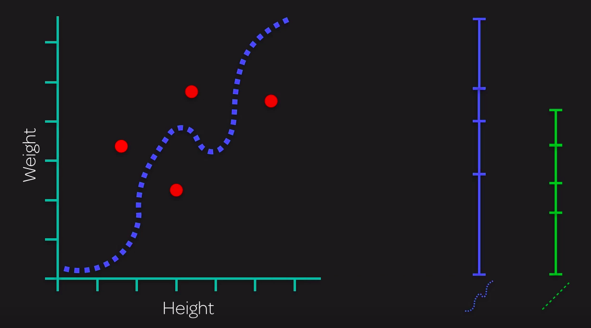
Machine Learning

Slide 15
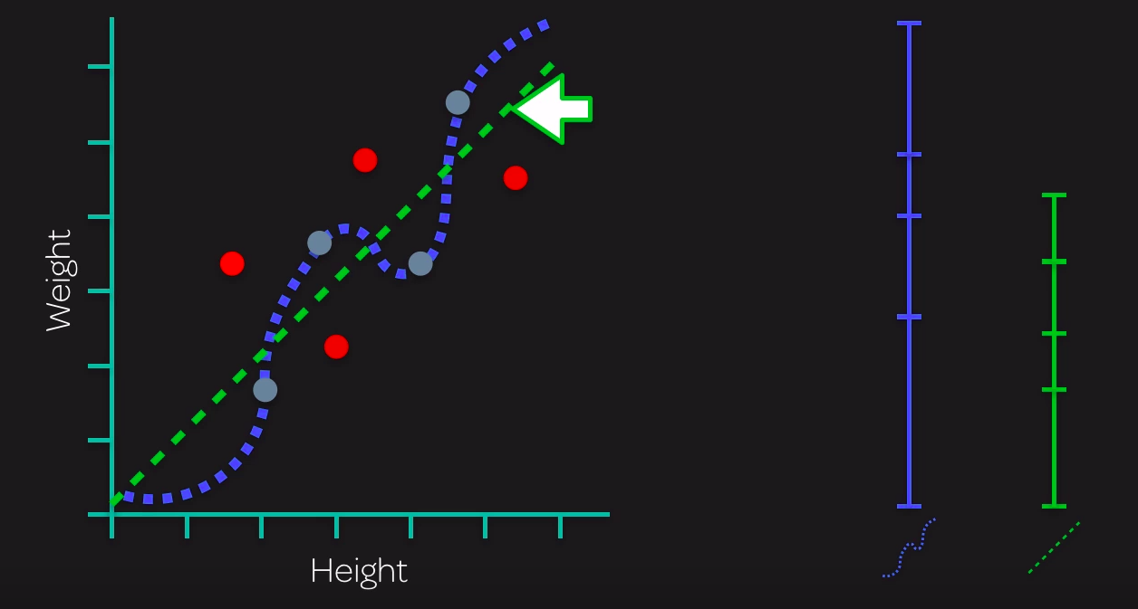
Machine Learning – Linear Regression
Notes:
Blue curve overfits the training data and fails to generalize
The green trend line is better in generalizing and its predictions are closer to actual weights
This model is called Linear Regression

Slide 16
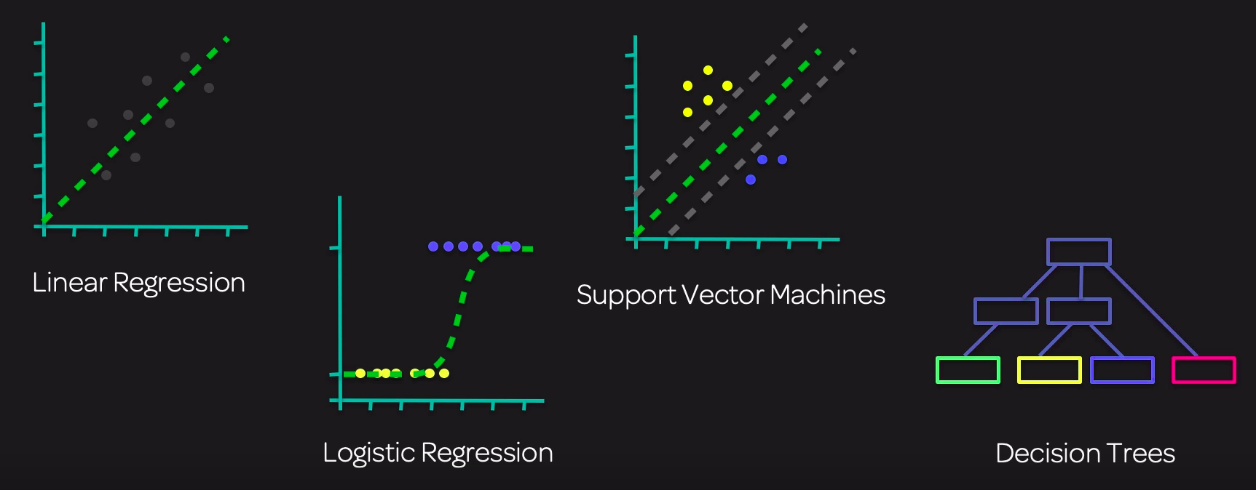
Machine Learning
Notes:
Out of curosity and also logically you may have a question if the trend line best represents the actual trend. A better option would have been the curve passing through all the points.

Slide 17
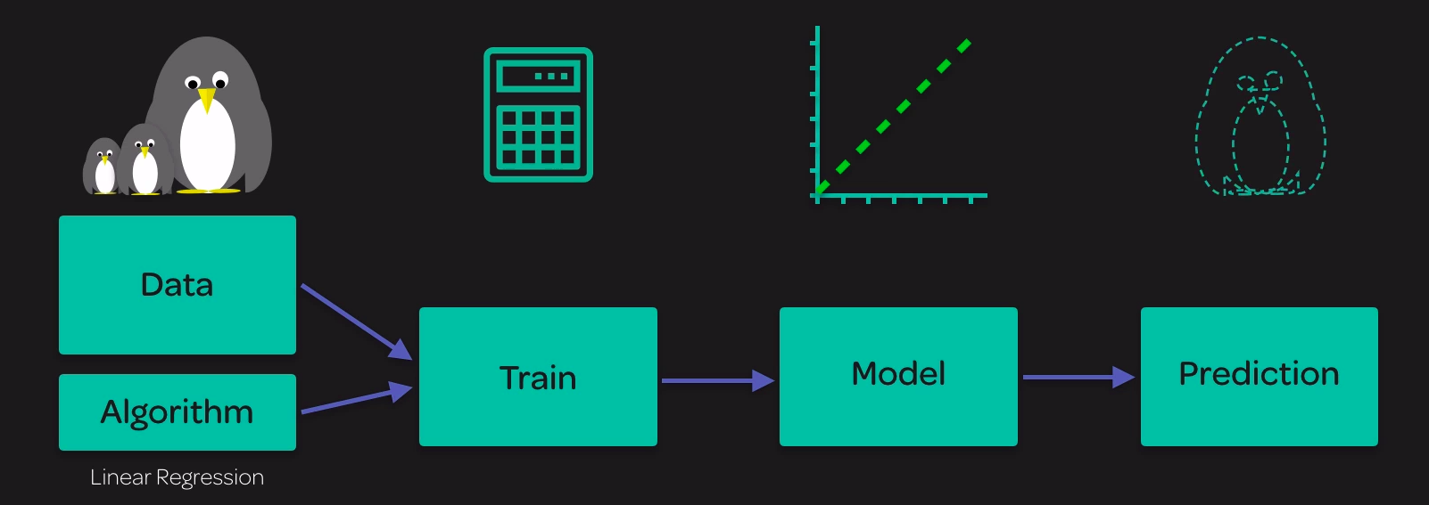
Machine Learning
Notes:
Out of curosity and also logically you may have a question if the trend line best represents the actual trend. A better option would have been the curve passing through all the points.

