Slide 1
MIE 1624
ASSIGNMENT 1
SALARY CLASSIFICATION
Anshul Verma
1004730703
Date: 28th. February. 2020

Slide 2
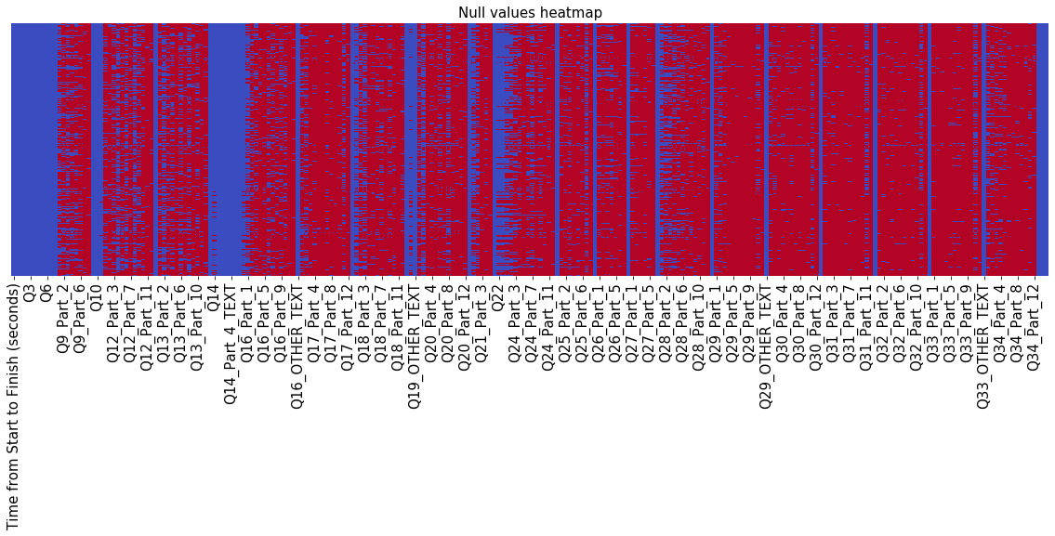
Q1. Data Cleaning
Most of the features in the data-set where binary either they had an entry or were null. So I encoded all these columns in 0-1 form.
Then columns like sex, country, job-positions were treated as nominal categories and one-hot encoding was used for these types of columns.
Other columns like education level, age, experience, Use of ML etc. were treated as ordinal categorical data and were encoded in a way that preserves the order.
After encoding all the major columns there were some Nan values still present in the data-frame so the rows with Nan were removed from the dataset (I did this because the number of Nans were very small)
Heat map of data-frame without cleaning

Slide 3
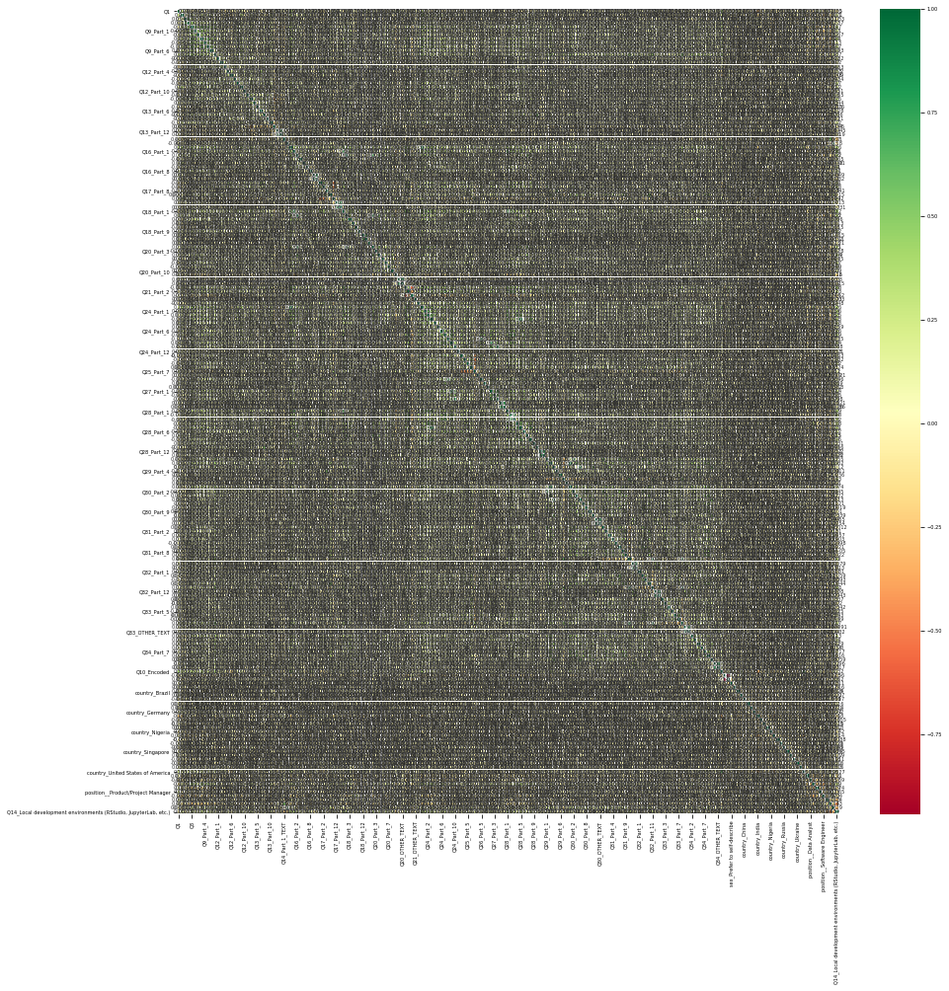
Q2 & 3. Exploratory Analysis & Feature Selection
For Exploratory data analysis the final salary bucket vs features which seem more influential is plotted and presented in the jupyter notebook.
Correlation between features was used for feature selection
Based on Correlation top 200 features were selected and used for the purpose of logistic regression.
Finally the features and targets were seperated and features were further used to build an ordinal logistic regression model.
Feature Correlation

Slide 4
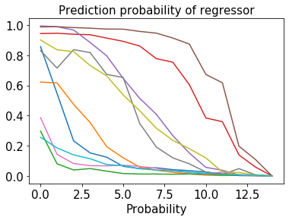
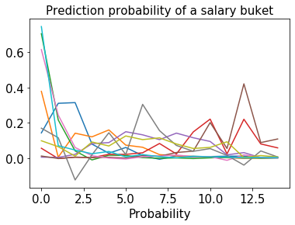
Q4. Model Implementation
14 different binary linear regressor were used to classify all the classes.
The classification for every class was of the form 0(<=salary_bucket) and 1(>salary_bucket).
Using probabilities for this mixed classification probabilities of each class was identified.
Then Based on the each classes probability predictions were made.
The models were then used for 10-fold cross validation to make sure that the model doesn’t overfit. (Making sure standard deviations of accuracy is low )

Slide 5
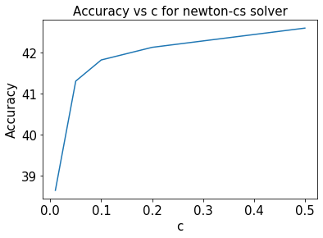
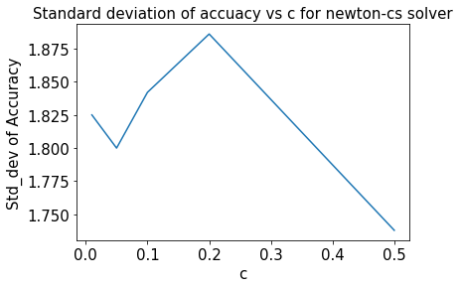
Q5. Model Tuning
Grid search on some possible hyper-parameter list was performed.
There can be more hyper-parameter like regularize type, number of iterations. But for the purpose of assignment only L2 regularizer was used and max_iter was set to 100.
The final selected model had a 10-fold average accuracy of 42.6% with standard deviation 1.73%.
This model was finally used to make predictions on the test set.

Slide 6
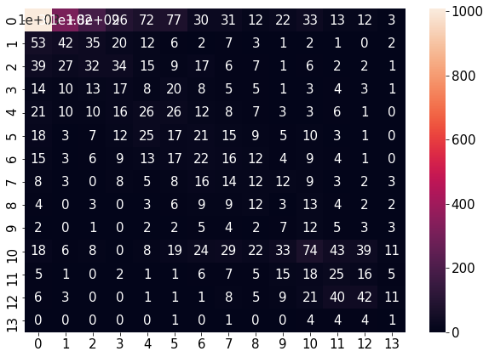
Q4. Testing
The final selected model was then used to test the points in the test-set.
The model was found to be 35.9% accurate which is pretty close to training error(42.6%). This shows that generalization was decent as test data was not seen while training
The accuracy is not very high because of a lot of classes and simplicity of the ordinal logistic regression model.
Using some other classification approach can increase the accuracy.
Confusion Matrix of Test Prediction

