Slide 1
DECISION TREE & RANDOM FOREST
Anshul Verma
Hiba Doudar
Nada El Moghany
Obaid Muhammad
Zoha Sherkat-Masoumi

Slide 2



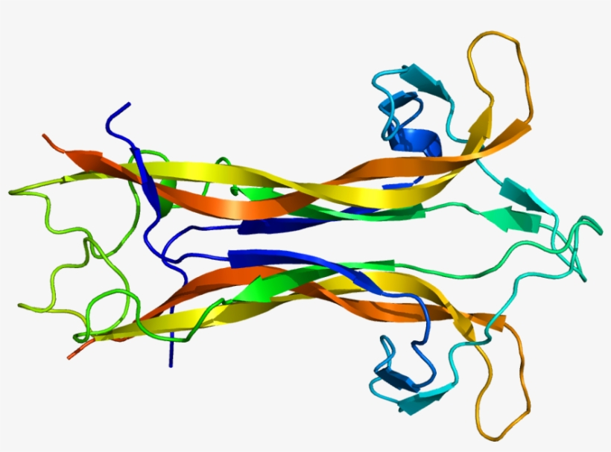


Outline
Introduction
Example #2
Decision Trees
Random Forest
Temperature Dataset
Algorithm
Example #3
Intuition
Pseudo Code
Diabetes Dataset
Example #1
Conclusion
Dummy Dataset
Bagging
K-Fold

Slide 3
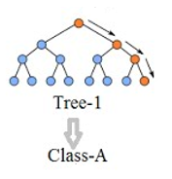
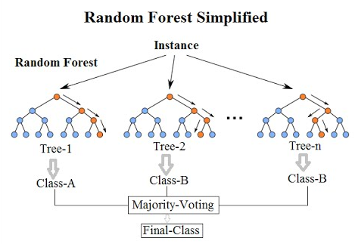
Introduction
Decision Trees
Require continuous split of data according to a certain parameter.
Classification trees (Categorical)
Regression trees (Continuous)
Used to visually represent decision making.
Random Forests
Type of ensemble learning method.
Ensemble learning methods combine several machine learning techniques.
Individual decision trees where each tree in the random forest makes a prediction
Relatively uncorrelated models (trees) operating together are likely to outperform a constituent tree.
Low correlation is key!

Slide 4


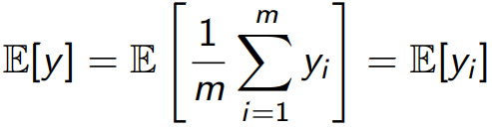
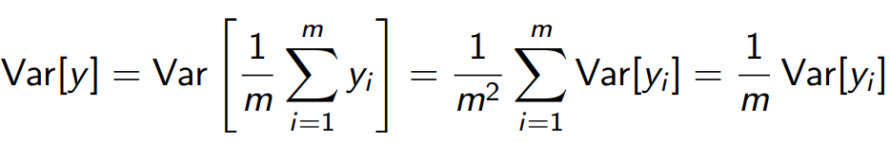
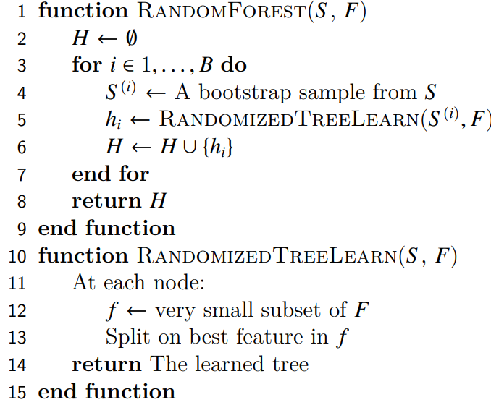
Algorithm
Idea
Sample m independent training sets from Dataset (S)
Compute the prediction yi, and take the average
Problem: Sets aren’t independent, so 1/m reduction in variance is unlikely.
Algorithm
Inputs:
Dataset (S), Features (F)
Number of Trees (B)
Algorithm:
Sub sample from the Dataset
Build Decision Tree
choose random set (f) at each node of the decision tree
Repeat until all trees are created
Notes:
Suppose we could somehow sample m independent training sets from D

Slide 5
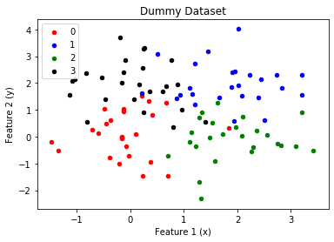
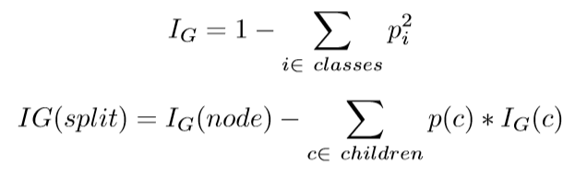
Example #1: Decision Tree Model
DataSet
Dummy dataset using make_blobs function in python.
The dataset has two features ‘x’ and ‘y’ so that it’s visualizable and there are four different classes in the dataset.
Decision Tree Mechanisms
Split the nodes recursively by using features and value which maximize the information gain.
Then splitting mechanism is continued till a maximum-height condition is reached or there is no information gain from any of the possible splits. The terminating nodes are labelled as leafs in the end.

Slide 6
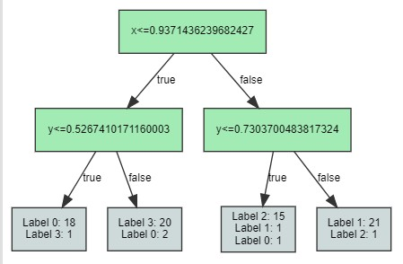
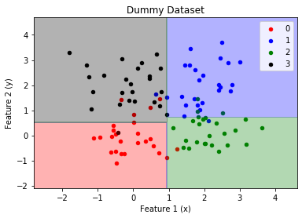
Example #1: Decision Tree Model
Decision Tree & Boundary
Decision-tree was obtained without using any built-in functions.
Fig: Decision Tree
Fig: Decision Boundary of Decision Tree
Hyperparameters of a decision tree model are selection criterion and max-depth which can be tuned using cross validation.
The dummy dataset is small and easily separable thus tuning is not needed.

Slide 7
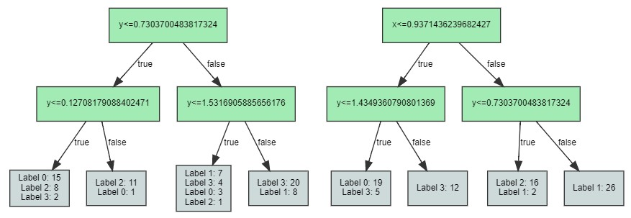
Example #1: Random Forest Model
Random Forest
Using the algorithm defined above an ensemble of decision trees was made.
The decision trees in the forest (ensemble) were different as different subsets of data was used to train each tree and used a different random subset of features to split a node.
Fig: Two trees of the random forest model

Slide 8
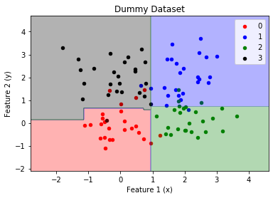
Example #1: Random Forest Model
Random Forest Hyperparameters
The hyperparameters for the random forest model is number of trees, maximum depth of trees and selection criterion for the split.
All these hyperparameter can be tuned but since the data-set was small and easily separable it was not needed.
Predictions
Fig: Decision Boundary of Random Forest
Final random forest model uses for final prediction had 10 trees, each with a maximum height of 2.
The prediction from forest model was by using a voting scheme where maximum votes of all the trees in the forest was decided to be the predicted class of a test point.

Slide 9
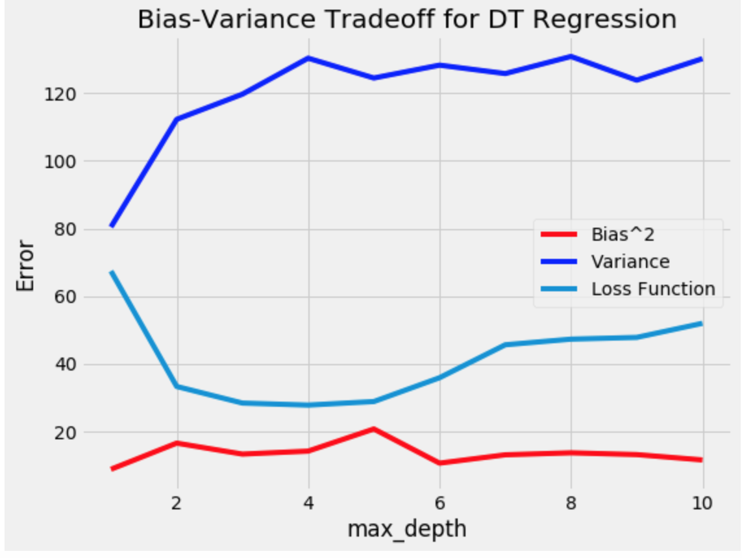
Example #2: Decision Trees (Regression)
Dataset:
8 features
Target: Maximum temperature in Seattle
Function:
DecisionTreeRegressor() from sklearn
Parameter:
max_depth
Results:
Bias remains low, variance increases -> Overfitting
Loss Function decreases initially; increases when max_depth > 5
After Tuning:
Training Accuracy = 87 %
Testing Accuracy = 82 %
Fig: Bias-Variance tradeoff for DT regressor (temperature dataset)

Slide 10
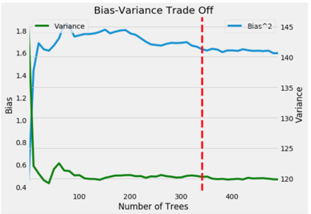
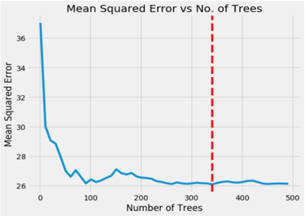
Example #2: Random Forest (Regression)
Function:
Using the RandomForestRegressor from sklearn()
Parameters:
Criterion – the error the model uses to evaluate each split (MSE)
n_estimator – No. of Trees
Results:
Decrease in variance (from 145 to 122)
Minimal increase in bias (from 0.47 to 1.59)
Training Accuracy = 97%, Testing Accuracy = 83%

Slide 11
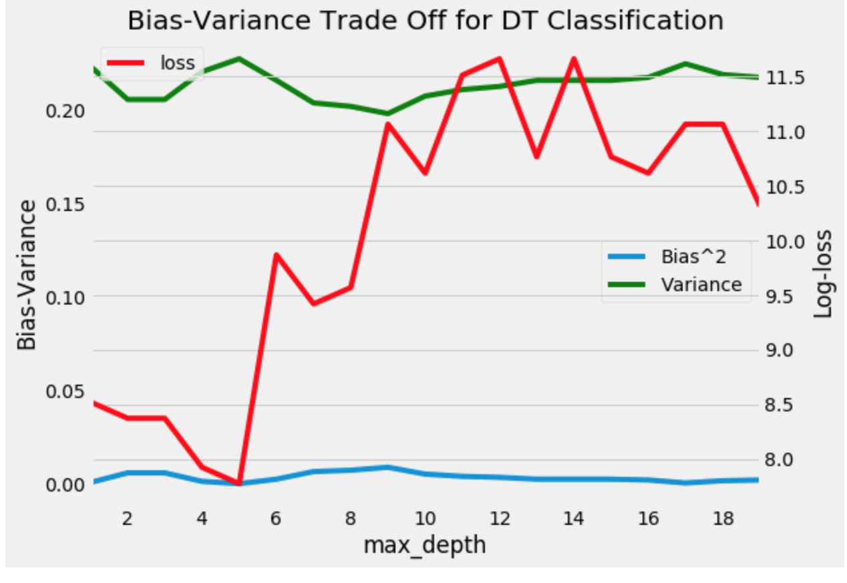
Example #3: Decision Trees (Classification)
Dataset:
8 features
Binary Target: 1 (Patient has diabetes), 0 (Patient does not have diabetes)
Function:
DecisionTreeClassifier() from sklearn
Parameter:
max_depth
Results:
Bias remains low, variance increases -> Overfitting
Loss Function increases
After Tuning:
Training Accuracy = 80%
Testing Accuracy = 77%
Fig: Bias-Variance tradeoff for DT regressor (diabetes dataset)

Slide 12
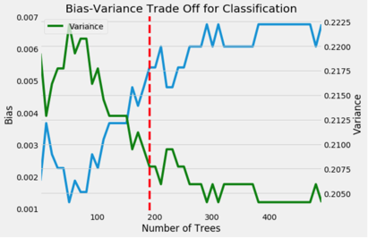
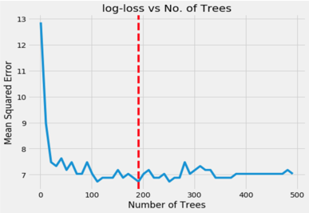
Example #3: Random Forest (Classification)
Function:
Using the RandomForestClassifier from sklearn()
Parameters:
Criterion – the error the model uses to evaluate each split (gini)
n_estimator – No. of Trees
Results:
Decrease in variance, minimal increase in bias
Decrease in loss error
Training Accuracy = 100%, Testing Accuracy = 80%

Slide 13

Conclusion
Random Forest vs Bagging
Both use bootstrapping method by taking independent samples from existing data with replacement and use each sample to train learners.
Random Forest makes a small tweak to Bagging which results in a great improvement and creates a strong classifier.
Random forest randomly selects a set of features which are used to decide the best split at each node of the decision tree.
Bagging uses all the features
Cross validation for Random Forest
Cross validation is computationally intensive for random forest
Out of Bag Error is computed as alternative.
The bootstrap sample does not contain all the data points in the original data.
These out of bag points can be used as test case to get an unbiased estimate of the error.

Slide 14
thanks!

