Slide 1

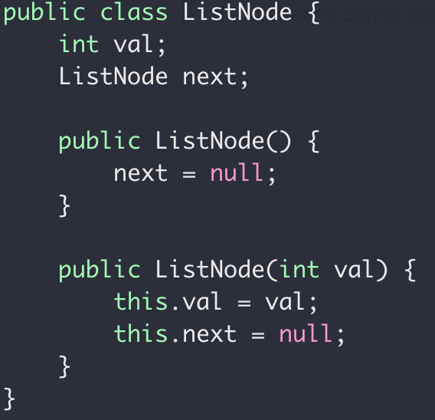
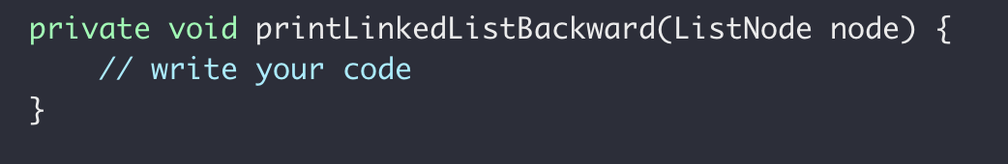
Quiz 2
Problem 1: (5pt) When could recursion cause stack overflow error like this?
Problem 2: (5pt) If one claims “recursion is always better than iterative method”,
Do you agree? Why or Why not?
Problem 3: (10pt) Finish the following code to print a single linked list values backward
Example: Input 1→2→3→4 output: 4 3 2 1
Single Linked List has no dummy node.
System.out.println(String str)

Slide 2
Answer 1
Recursion is never stopped when, for example the stopping condition is missed.

Slide 3
Answer 2
Depending on what “better” means. If it means performance, then disagree because recursion could suffer from duplicated subproblems issue and has worse performance than iterative method.
Also recursion code is limited by stack memory size while iterative method uses memory in heap which is larger in size than stack
If “better” means less code to write then agree

Slide 4
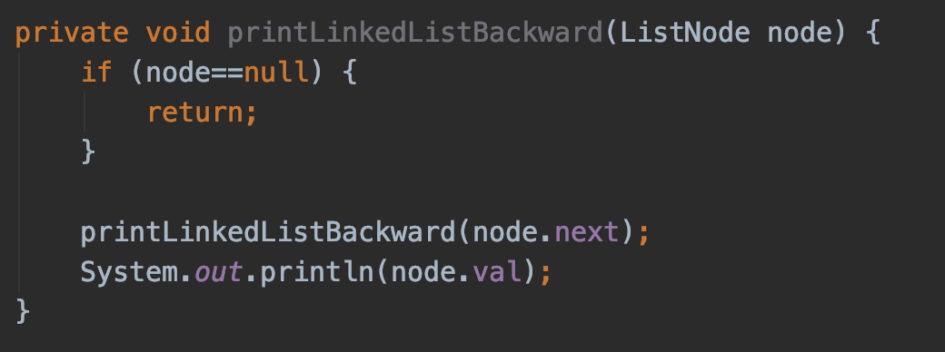
Answer 3

