Slide 1
CS
What it is, what it isn’t, and why you should care
Tushar Rakheja and Shibjash Dutt

Slide 2
A little about us
Hey, I’m Tushar. I’m an alumnus of BVN (Class of 2014), and, am now an undergrad majoring in Computer Science and Physics at The University of Texas at Dallas (UT Dallas).
And I’m Shibjash. People call me SJD. I’m an alumnus of BVN, too. I’m studying Computer Science at the Northern India Engineering College.
We’re here to tell you a few things, we wish “we” would have known, when we were your age, about what exactly you’re getting yourself into, and how to make the most out of your amazing decision to study Computer Science.
Let’s start.

Slide 3
Our job today:
It is to get you excited about CS!
CS is very different from everything else you study in school. If we may be a little poetic, it is power and vision itself. It is like mathematics of a new kind, in which you’re not alone. You have your trusty sidekick computer with you.
This will be more like a workshop/bootcamp than a talk, and may get a little technical. We hope you think that’s a good thing – you’re students of CS now. You’re not allowed to be intimidated by technicality any more. It should be your poison.

Slide 4
What is Computer Science?
As much as we love talking about it, it’s not the topic of today’s discussion. Briefly, I’ll tell you this – it is, more than a science. It is an entirely new way of thinking about things. Once you get used to it, you’ll love it, and there’s not going back.
Definition (simple) – It is a way of thinking about things algorithmically, to find the most efficient solution.
Programming: This is like Power Cosmic to CS’s Galactus. This how algorithms are implemented, that is, prepared and executed, to solve an important, real life problem, encoded in a specific way. This is how you talk to your sidekick, the computer, and tell it what to do.

Slide 5
Instructions, algorithms, and programs:
Imagine you’re up against the Tic-Tac Man. Your job is to assemble a team of instructions - Earth’s Mightiest Zeros, that can run on your computer and beat anyone in a game of Tic-Tac-Toe. Write a program to do so.
The instructions, here, are individual units (like equations, sentences, or phrases) that your computer will understand and perform an accorded action. Something like – “If he puts an X there, put a 0 there.”, or, “Is that square under an X?” They are mostly dependent on the programming language you use.
A team, or a set of these instructions together, make a program. The essence of your program, or, the general ideology behind your procedure, is called an algorithm. Think of it this way, what YOU are thinking – your strategy to beat the Tic-Tac man, is the algorithm, while what you’re telling the computer (which is basically your strategy encoded in a specific way), makes the program.

Slide 6
Strategy:
Let’s say you take up a defensive strategy (algorithm):
“1. we shall not let him complete a line. 2. we shall play randomly when there’s no threat.”
Let’s say your computer understands only six basic instructions: -- It can tell you if a square is occupied or not (True/False) True and False are called Boolean values. -- It can understand integers, and the relationships >, <, or = between any two integers. -- It can put a ‘0’ on an unoccupied square. -- It understands that each square of the tic-tac-toe board has a pair of coordinates (see image to the left). -- It can perform a conditional expression – that is, perform a series of steps if a condition is true, and not otherwise. -- It can perform a loop – That is, a sequence of steps repeatedly, until some condition is satisfied.
You have to code up your strategy to play tic-tac-toe using these five basic ingredients.
(0, 0)
(0, 1)
(0, 2)
(1, 0)
(1, 1)
(1, 2)
(2, 0)
(2, 1)
(2, 2)

Slide 7
Tic-Tac-Man
Earth’s Mightiest Zeros

Slide 8
Syntax:
Syntax is a way of encoding the steps of an algorithm into instructions for your computer to understand.
Modern computers only understand binary language (1s and 0s in a string). Therefore, we generally care about syntax for programming languages, which can take in somewhat human-readable instructions (but still in a specific, well-defined way), and convert (compile) them into binary language for the computer to understand.
Let’s say our computer supports only one language, the Tic-Tac-Tongue, which has the syntax on the left:
Then, our tic-tac-toe playing program, which implements our algorithm, will look like this
Syntax What it does
put(x, y) Puts a O at (x, y) in the grid. if (condition) Performs the steps inside
{ } the curly braces once if the condition is true.
isCross(x, y) Returns true if there’s an X at the mentioned point. Else, false.
while (condition) Performs the steps inside { } the curly braces till the condition is true.

Slide 9
Some of you may remember that there was an actual program here. Now, that program had serious flaws, intentionally. We had actually planned to go over the program in detail, in order to point out the flaws and remove them together, but we didn’t have time.
So, we encourage you to use the syntax we mentioned earlier to try to come up with your own program, that implements your OWN algorithm/strategy to play Tic-Tac-Toe.
Remember, as an algorithmic programmer, your first and foremost role when you try to solve a problem will be to come up with a good strategy. Tic-Tac-Toe isn’t hard, so this step is easier one.
The next step is to convert that algorithm into code, using a language’s instruction set and specifics (called syntax).
Use the Tic-Tac-Tongue as your language to come up with a strategy. Maybe then have a review amongst yourselves.
We’ll try to send you some working code sometime. Cheers.

Slide 10
Exercise for the reader:
Prove that there exists a strategy (algorithm) which can ensure that the Earth’s Mightiest Zeros are never defeated. Code this strategy up, in Tic-Tac-Tongue.
How can we make our computer “improvise”? That is, actually, make changes to its strategy based on the situation of the game?
Model “Chess” the same way.
Kidding! Do think about it though. Instead of six basic instructions, how many instructions would you need to model a game of chess? If you really want to, we’ll seriously recommend trying to model chess, yes. It’s great fun.
So this. This, is a small part of Computer Science. All we looked at, was, a VERY simple programming language, and how we implement an algorithm in a programming language according to its syntax, to solve a problem. Thanks to you, Earth is now safe.

Slide 11
Data and data structures:
Programming can essentially be seen as the digesting and processing of “data”.
In a nutshell, a data structure is the layout of how a program stores data in memory.
How programs “visualize” or represent data internally strongly affects how well they work, and how easy they are to maintain.
The choice of data structure can often reduce a difficult problem to an easy one.
Now, onto an example!

Slide 12
Friends and friends thereof:
You’ve been hired as a programmer for the upcoming social networking website, FakeBook.
Your boss wants you to write an algorithm which recommends potential “friends” to people on the network.
The potential friends for a person are the people who are the friends of his friends.
You have been given the following data

Slide 13
Person’s Name | No. of Friends | List of Friends
Alice | 3 | Bob, Charlie, Javier
Bob | 5 | Alice, Jane, Douglas, Charlie, Zoe
Charlie | 5 | Alice, Pepe, Zoe, Javier, Bob
Douglas | 3 | Jane, Ryu, Bob
Javier | 6 | Alice, Charlie, Danny, Leo
How many potential friends (friends of friends) does Alice have? What about Bob and Charlie?

Slide 14
Nodes and Edges:
KEY IDEA : Think in terms of connections between people, instead of a flat “table” structure.
TRANSFORM : Our “tabular” data-structure into a “mesh”-like data-structure!

Slide 15
Alice
Bob
Javier
An undirected graph showing who is friends with who.
Charlie
Leo
Jane
Zoe
Danny
Douglas
Pepe
Ryu
Our imaginary social network.

Slide 16
Devising an “algo”
In order to count or determine how many potential friends Alice has, we...
Set the list of people containing our final answer to NULL, or empty.
Find all the people Alice is friends with.
“Foreach” of these people, find all their friends.
Add each of these people to the list.
And finally : Remove, or prune, any duplicates that may have arisen.
And there you have it : a watered down version of how Facebook recommends friends for your profile!
Did you spot the error in the algorithm yet?
How can we mitigate this?

Slide 17
The cutting edge
Your ignorance in matters pertaining to Computer Science has condemned you to life as a pizza delivery guy!
On a particularly busy day, you receive 6 orders for pizza at various locations in the city.
You happen to possess a remarkable mental map of the city, and know the distances between these places.
Given that there is little to no traffic, what is the fastest way to make the deliveries?
And most importantly, why would we be interested in such a problem?

Slide 18
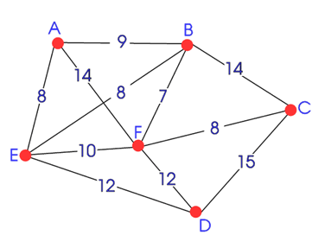
Fame and prosperity await you, but only if you figure out the optimal route fast enough.

Slide 19
Like the problems?
You can try some yourself!
There’s an entire world out there, known as “Competitive Programming”.
You’ll be required to solve such problems, and much, much harder ones, in a limited time, facing-off against some of the most brilliant and egotistical kids of your age.
We want you to crush them. And their inflated egos.
For fame, for glory, and for excellence – not the added benefit of $$$, really..

Slide 20
Programming Contests:
Programming contests happen at all imaginable levels – from inter-school events to global events.
The most popular ones, however, happen at the school level – your level. If you’ve ever enjoyed a game of chess, or a math puzzle, we bet you’ll like competitive programming too.
Some of the biggest one right now, are these 1. Facebook Hacker Cup 2. Google Code Jam 3. IOI (this. This) 4. Google Code-in
And many, many more.

Slide 21
Tools of the trade.
Programming languages are a dime a dozen.
Most competitions do not enforce a particular language, except the ZIO.
There are many languages, each with their own strengths and weaknesses and each suited to particular tasks.
Want speed? Go C!
Ease of use? Python!
Large libraries? Java!
There’s a way you can possibly have all three, or possibly, none of them – C++!
While you should make an effort to learn and use as many languages as you can, we’ll only look at some of the most popular ones.
The subsequent slides list some programming languages, with pros and cons of each.
They also contain sample code for each language. Note that you’re NOT expected to understand that code.
But, we just put it there so that you can decide which language to use for your programming career, maybe based on aesthetics. We recommend C++. But, you can go with any.
Do keep in mind that many inter-school contests ‘may’ impose C++ on you.

Slide 22
C++
Pros:
Rigorous syntax means you can master other languages once familiar with C++.
THE industry standard.
Very fast.
Has tons of libraries.
Useful for school.
Modern C++ 11 has features suited for Competitive Programming.
Compilers : GCC 5.x, clang 3.6, MSVC 2015
Cons:
Steep learning curve.
Very powerful.
Code looks ugly.
India still uses 25+ years old software
Sample C++ program on next slide.

Slide 23
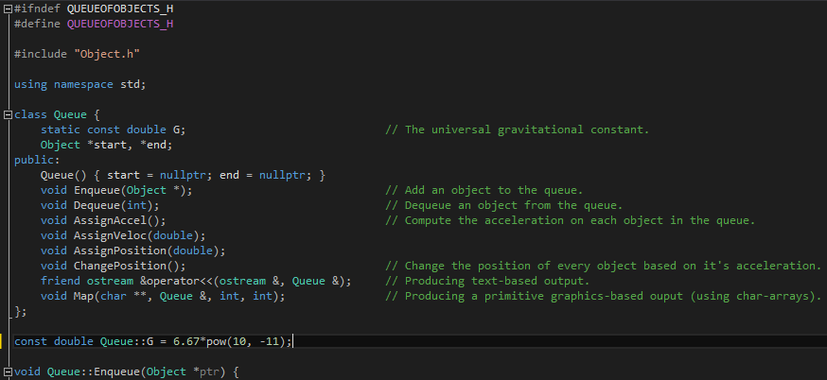

Slide 24
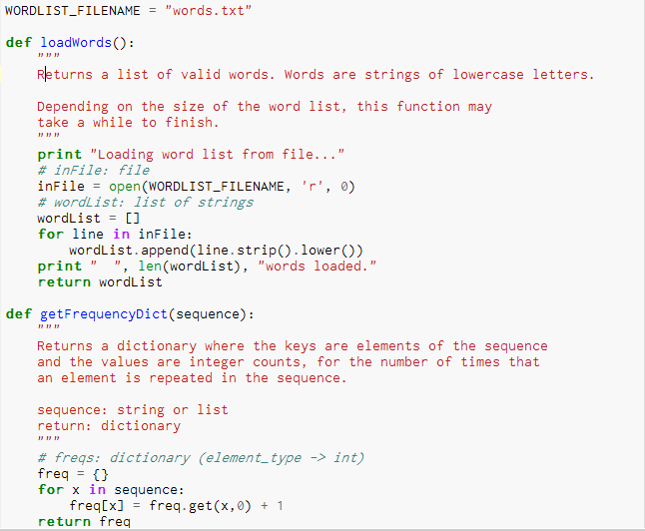
Python
Pros:
Easy to learn
Large standard libraries (that is, functions other people have made and you can readily use, without having to write them from scratch again. Google for more info, and other terms you don’t understand. That’s how you learn!)
Great community support.
Makes it easier to work with various diff data structures.
Very widely used.
Less verbose than C++
Cons:
Slower than C++, which means a disadvantage in time based contests.

Slide 25
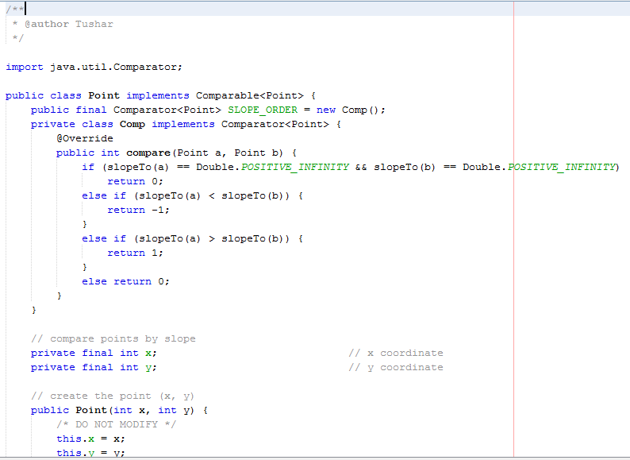
Java
Pros:
Large standard library
Easier learning curve
Less scary than C++
Easy to get good at, and quite powerful
Lots of built in data structures (Collections Framework)
Widely used in coding industry
Native Big Integer support.
Cons:
Struggles to compete with C++
JVM is slow for some types of computations.

Slide 26
Language agnostic resources
BOOKS:
Hardware Software Interface - Hennessey & Patterson
CODE - Charles Petzold
Elements of Computing Systems - Nisan & Schocken
Intro to Algorithms – DPV (Lightweight)
Intro to Algorithms – CLRS (Heavy)
TAO CP Vol. 1 – Donald E. Knuth
Concrete Mathematics – Don. Knuth
Maths For CS – Lehman, Leighton, Meyer
Competitive Programming 2 - Steven Halim
Also try sample papers of ZIO!
Look out for more books, these ones can get pretty thick
(some of them are hard, even for college students. But of course, you have to better than the average college student to master CS)
Khan Academy and Codecademy have some good stuff.

Slide 27
Language agnostic resources (contd.)
WEBSITES (Learning)
StackExchange Network
StackOverflow
Programmers
Codegolf
Compsci
Reddit [programming, codegolf, cpp, python, compsci, algo..]
Coursera
Khan Academy
MIT OCW
Quora (beware of Indians!)
Wikipedia!

Slide 28
Language agnostic resources (contd.)
WEBSITES / COMPETITVE PROGRAMMING
HackerRank
HackerEarth
SPoJ
Google Code Jam Archives
UVa Online Judge (Browse problems)
Project Euler
CodeChef
IARCS (Important!)
Rosetta Code
Excercism.io

Slide 29
Competitions
ZIO -> INOI -> IOI Training Camp -> IOI
Get a medal in IOI, and statistically, you can get into a top 10 university.
Facebook’s Hacker Cup ($$$)
Google’s Code Jam
Google’s Code-In
CodeChef Monthly Contests
HackerRank Contests
IIIT-Delhi’s Esya
DPS RKP’s Exun
Other DPS competition
BVN’s The Grid (Right..? Guys?)

Slide 30
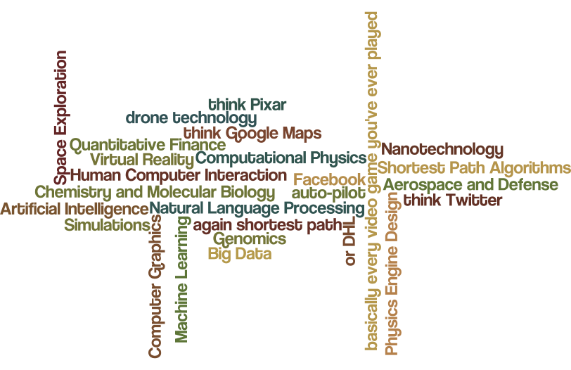

Slide 31
On a more philosophical note:
People are trying, trying really hard to solve problems that we see, that exist everywhere in this world.
Some techniques do well, some don’t, and some are just stupid.
Then, there comes a point when mankind hits the goldmine, which makes things, godlike things possible.
In Newton’s time, it was advanced mathematics, which gave birth to far-reaching advancements in physics.
A couple of genius crackpots in the late 19th brought the party with quantum mechanics.
In our time, it is, undeniably, computer science. Gonna miss out on this? You’ll get really old, really soon.

