Slide 1
Walmart data set Pre Placement Project
Presented by –
Anshul Chauhan

Slide 2


Business Objective
The Management team at Walmart Inc. wants to analyze the customer purchase behavior and the various other factors to help the business make better decisions.
Dataset Location :https://drive.google.com/file/d/1P71LFagdnedMbBzH8VHWo45jbQpfoGUH/view?usp=drive_link

Slide 3
Data driven questions
Customer with which age group are most frequent buyers.
Which product categories have the highest purchasing frequency.
How many occupations are there and which occupation buys the most.
Outlier analysis on purchase column.
Which city has high purchase amount so company can add more products in these cities.
Is there any effect on purchase rate of the buyer moving to a new city.
Purchases based on Marital Status & Gender.
Purchases based on Age & Gender.
Total purchase based on City Category and gender.
What is the relationship between purchase and product category.
Show city wise Distribution of Purchases.
Show gender wise purchases using pie chart.
How does person time of staying in city impact on purchase rate .
Show Total purchase based on City Category and gender.
Evaluate Gender wise age distribution on purchases.
Show Top 10 product most purchased my the customer by product ID.
Perform Tree map analysis on City Category wise age column with respect to Sales.
What’s the effect on Purchase with respect to marital status and gender.
How purchase varies with respect to gender and city category .
Which age group of male customers are actively purchasing.

Slide 4

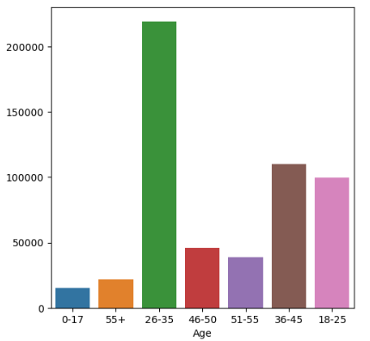
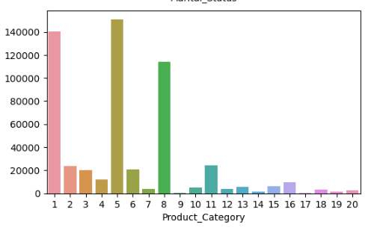
Customer with which age group are most frequent buyers.
Which product categories have the highest purchasing frequency.
Product Category - 1, 5, 8 have highest purchasing frequency. it means these are the products in these categories are liked more by customers. Company can focus on selling more of these products.
Customers in the age 18-45 spend more money than the others, So company should focus on retaining these customers.

Slide 5
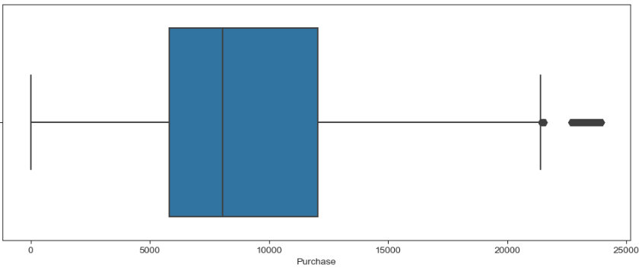

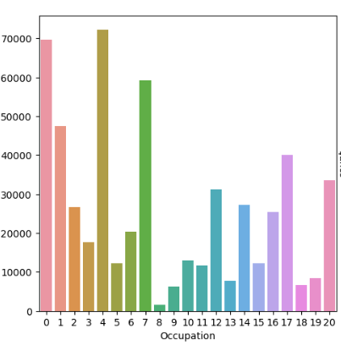
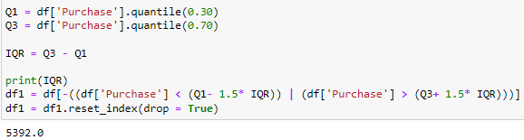
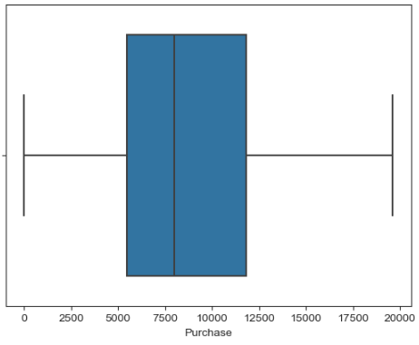
How many occupations are there and which occupation buys the most.
Outlier analysis on purchase column.
There are many outliers in the purchase column which will effect our interpretations, therefore I had performed the analysis for more accurate data set
There are 20 occupations out of which 0,4 and 7 are the most frequent buyers.

Slide 6

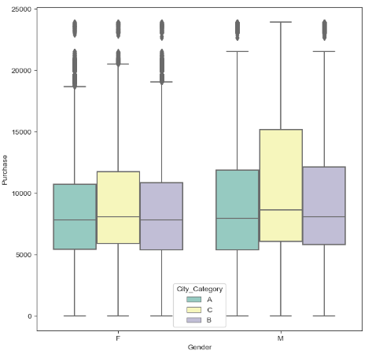
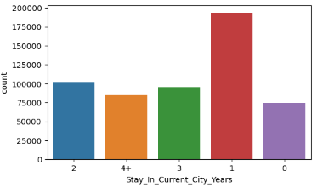
​
​
Which city has high purchase amount so company can add more products in these cities.
Is there any effect on purchase rate of the buyer moving to a new city.
People Living in C category cities have high purchase amount so company can add more products in these cities.
People that are kind of new like living in a city for past 1 year only are most frequent buyers then others .

Slide 7

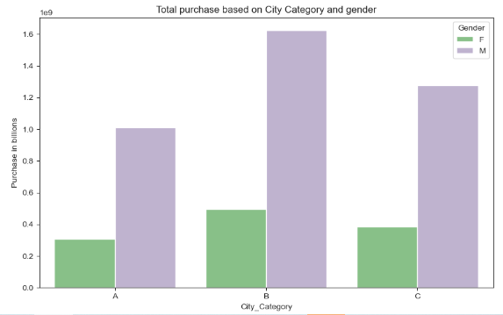
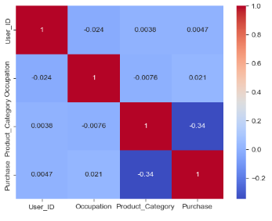
​
​
Total purchase based on City Category and gender
What is the relationship between purchase and product category.
Males belonging to any category of city have high Average purchase amount than females.
Purchase and product category are very less correlated.

Slide 8
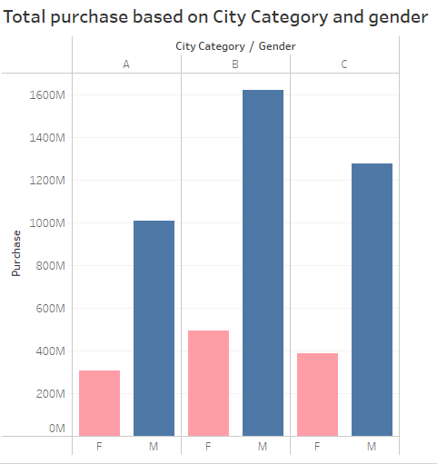
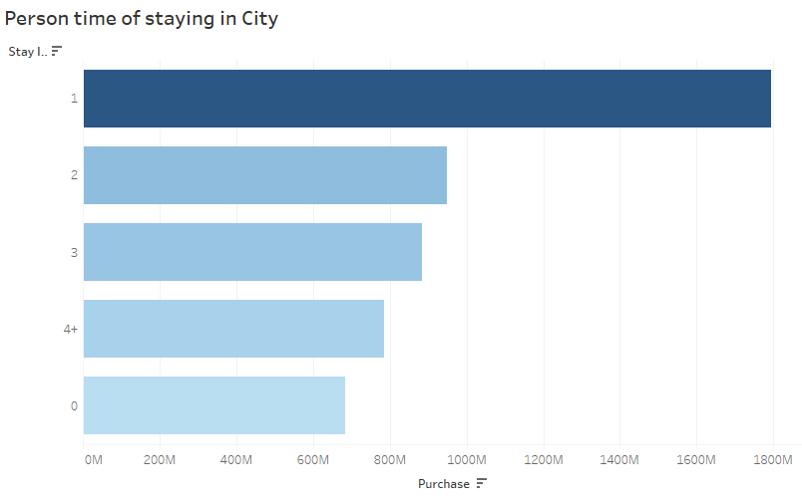
​
​
How does person time of staying in city impact on purchase rate .
Total purchase based on City Category and gender
Person new to the city or staying less then a year have high purchase rate as compared to other .
Males belonging to any category of city have high total purchase amount than females.

Slide 9
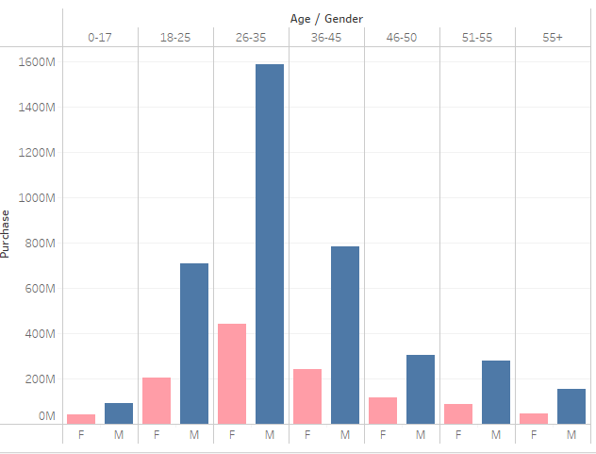
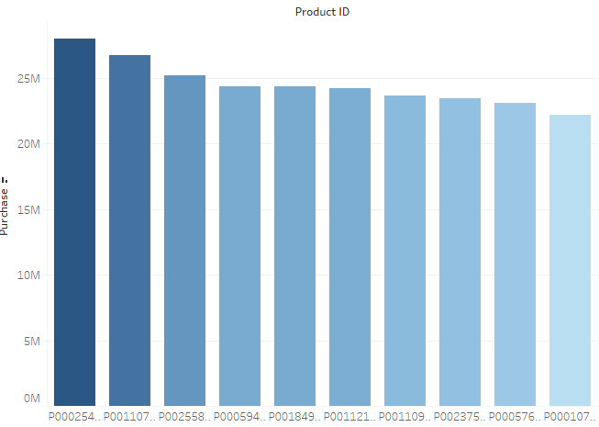
​
​
Gender wise age distribution on purchases.
Top 10 product most purchased my the customer by product ID
.Male purchases more then females in every age group, also age group b/w 18 – 45 purchases more . So company should focus on these customers.
the list of top 10 products with respected products ID.

Slide 10
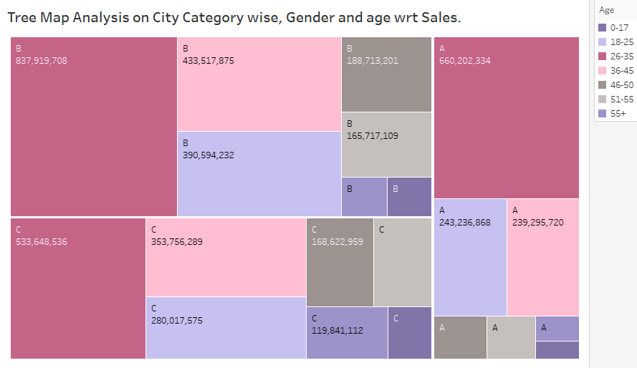
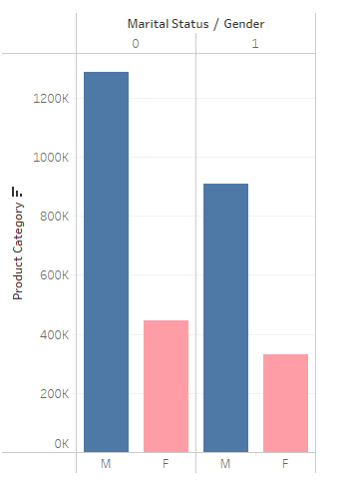
​
​
Perform Tree map analysis on City Category wise age column with respect to Sales.
What’s the effect on Purchase with respect to marital status and gender.
Age group 26-35 purchase more then any other age group in every City, therefore company should focus more on these customers
Males customer either married or unmarried purchases more .

Slide 11
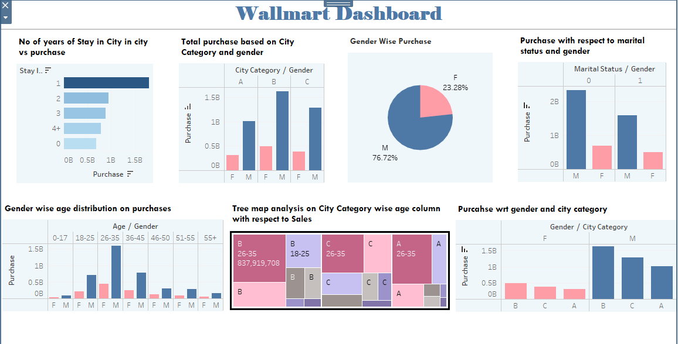
Tableau Dashboard
Dashboard Link : https://public.tableau.com/views/WallmartProject_17005682696920/Dashboard1?:language=en-US&publish=yes&:display_count=n&:origin=viz_share_link
Python Project : ..\Downloads\Walmart (1).html

Slide 12
Conclusions
There are more male customers then female.
Men spend more money than women in every age group and Female spent less compare to male.
Product Category - 1, 5, 8 have highest purchasing frequency.
Customers in the age 18-45 spend more money than the others.
People Living in C category cities have high purchase amount .

