Slide 1
Automatic Fence Lighting with Alarm

Slide 2
Instructions To Project
Fence lighting is used for security purpose and can be used at various place like door alarm, pathway alarm etc. where monitoring is required.
Various types of fence lighting circuit are already available over internet but the problem with those circuit is they required high precision alignment. In order to overcome this problem, we can be designed a very sensitive automatic fence lighting circuit. We can place this circuit within the line-of-sight to any light source like sunlight, electric light etc.

Slide 3
Construction
RESISTORS:
R₁, R₂, R₆ = 10 kΩ
R₃, R₄ = 1 kΩ
R₅ = 470 Ω
RV₁ = 50 kΩ (POT.)
CAPACITORS:
C₁ = 0.01 µF
C₂ = 10 µF

Slide 4
SEMI-COUNTERS:
U₁ = LM741 (Op-amp IC)
U₂ = NE555 (Timer IC): The 555 timer IC is an integrated chip (chip) used in a variety of timer, pulse generation, and oscillator applications. The 555 can be used to provide time delays, as an oscillator, and as a flip-flop element.
T1= BC557(General Purpose PNP transistor)
MISCELLANEOUS:
B₁ = 9V Battery
PZ₁ = Piezo Buzzer
D₁ = 5mm YELLOW Color LED
LDR₁ = Light Dependent Resistor

Slide 5
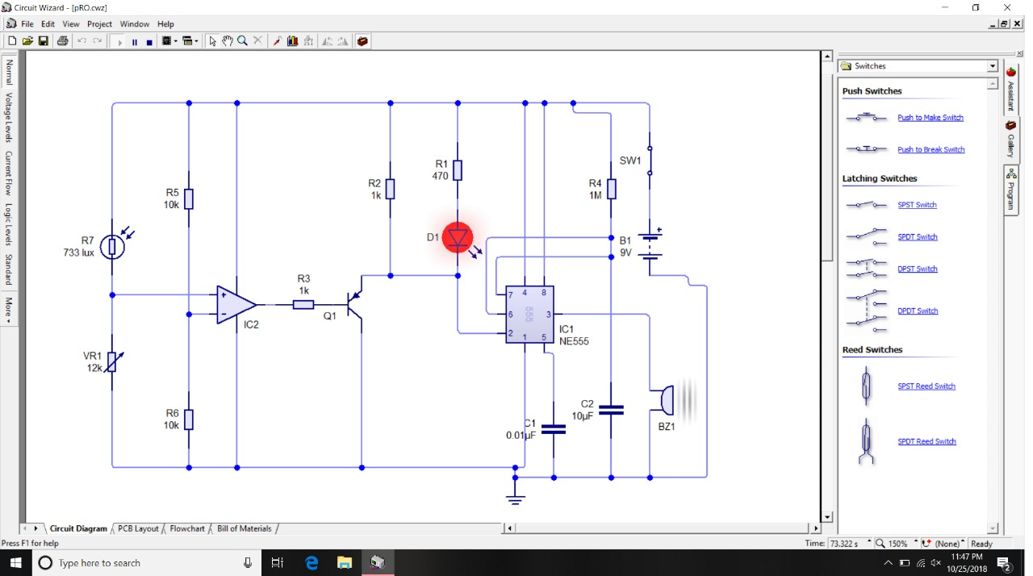
Software Implementation

Slide 6
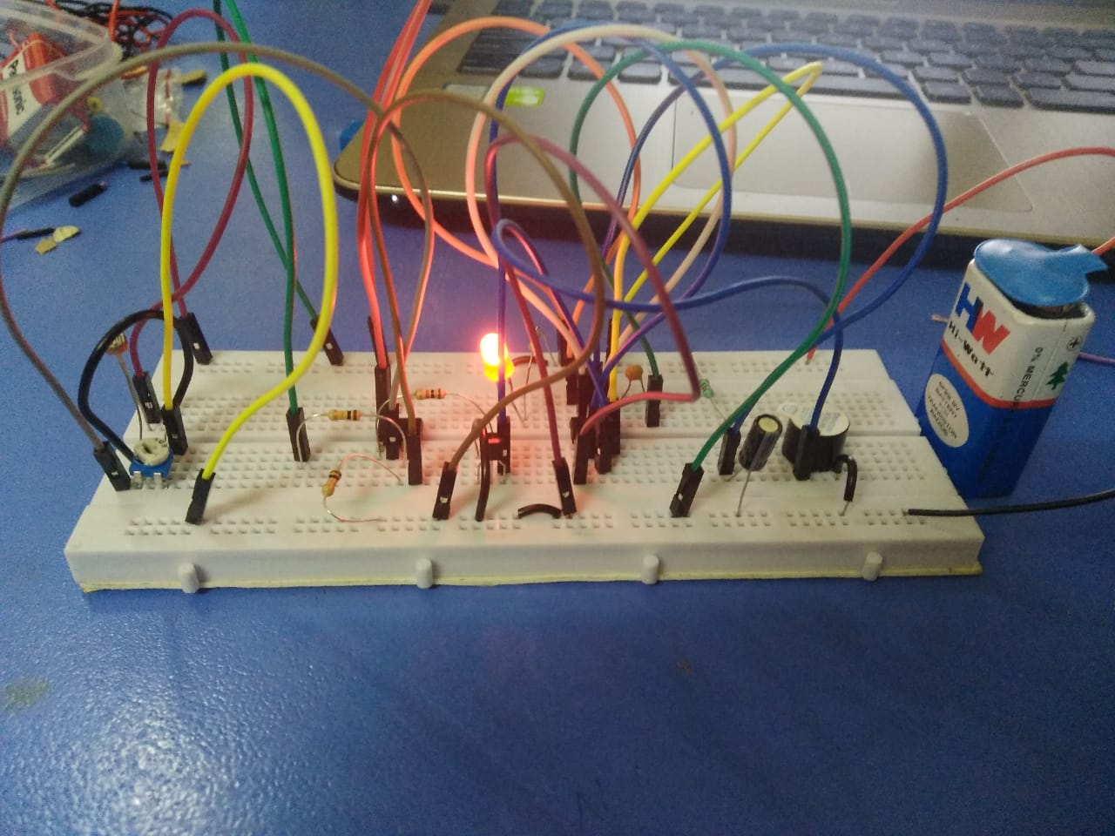
Hardware Implementation

