Slide 1

TEAM: Team Halo · Thapar Institute of Engineering & Technology
AIRTEL SYNC 2026 · YTL HACKATHON · ENTERPRISE TRACK A
Project Udyam Digital
Making Small Businesses Go Digital in One Sitting
Transforming Airtel Business MSME acquisition through intelligent, conversational digital onboarding for Bharat’s growing commercial backbone.
Focus
Core Breakthrough
Kirana & MSME Onboarding
Multi-Vendor Friction to One Flow
Notes:
Good morning evaluators. Today we present Project Udyam Digital for Airtel SYNC 2026 Enterprise Track A. We are addressing the single biggest growth engine in India: the millions of micro and small business owners who want to digitize, but drop out because enterprise procurement was never designed for them.

Slide 2



THE CUSTOMER REALITY
Meet Rajesh. He Runs a Business, Not an IT Department.
Rajesh is an illustrative kirana owner, not a real testimonial. He needs connectivity, billing, payments, inventory, customer communication and security.
A BROKEN SIX-STEP ORDEAL
Contacts multiple vendors
Repeats his requirements
Waits 3–5 days for confusing PDF quotes
Repeats documentation and KYC
Calls for installation updates
Abandons or buys only part of the solution
He needs one simple way to digitize his entire business.
2
Notes:
Rajesh is an illustrative kirana owner who represents 63 million Indian MSMEs. He wants to digitize his storefront, but when he tries to buy from enterprise telcos, he is treated like a corporate procurement team. He faces multiple sales desks, slow PDF quotes, and repeated paperwork—leading to massive abandonment before activation.

Slide 3
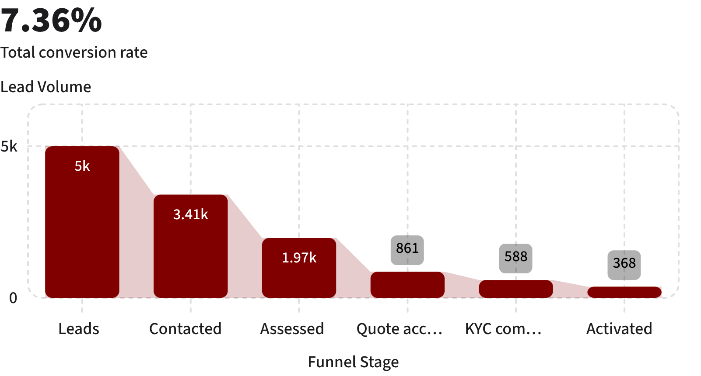
BASELINE FUNNEL AUDIT
The Problem Is Not Demand. It Is Conversion.
5,000-lead conversion funnel
56.4% drop-off
From needs assessed to quote accepted. Pricing uncertainty, delayed PDF quotes and fragmented offerings create friction.
7.36% lead-to-activation
GSTIN leads convert at 9.6% versus 2.0% for non-GSTIN leads.
Historical Baseline: 17.6 days onboarding · 3+ follow-up calls · ₹15,000 CAC · 15.2% six-month churn (smb_leads.csv).
5,000 leads → 3,406 contacted (68.1%) → 1,974 assessed (39.5%) → 861 quotes accepted → 588 KYC completed → 368 activated.
3
Notes:
Look at the audited data: of 5,000 inbound leads, 3,406 are reached, and nearly 2,000 have their needs assessed. But between needs assessment and quote acceptance, we lose over 1,100 qualified prospects. Customers get tired of waiting 3 to 5 days for a manual PDF quote. Overall lead-to-activation is just 7.36% with a CAC of ₹15,000.

Slide 4

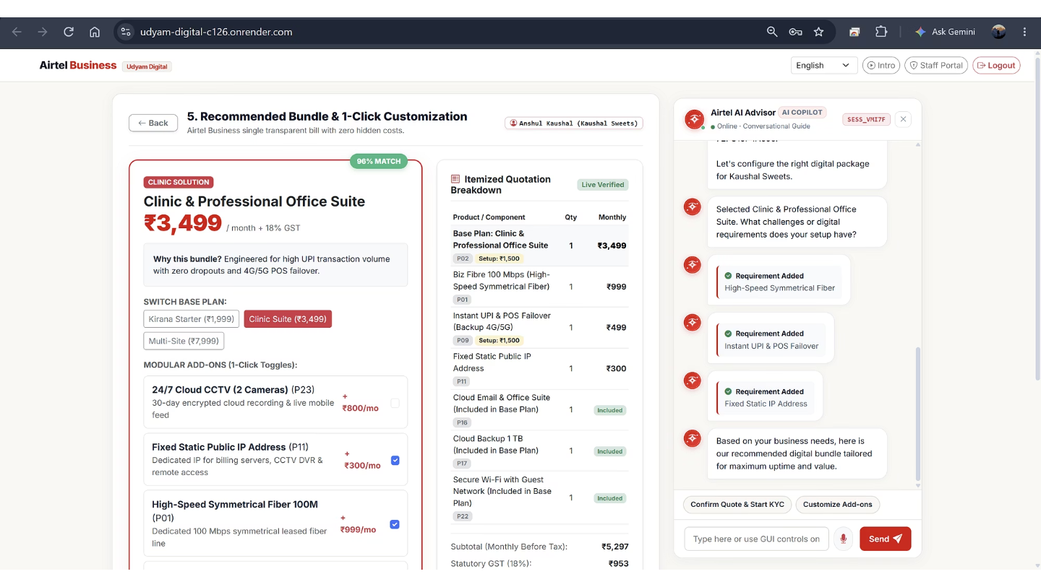


UNIFIED ARCHITECTURE
Introducing Project Udyam Digital
Consumer Portal ➔ Udyam Intelligence Engine ➔ Airtel Control & Partner Desk
Live Consumer App · Live Control Portal · GitHub Repository
Mobile-First Consumer Portal [Implemented in Prototype]
Hindi, Hinglish and English advisor; discovery, bundle recommendations, itemized quote, digital KYC (automated & manual choices) and order tracking.
Prototype interface evidence
Udyam Intelligence Engine [Implemented in Prototype]
Rule-based requirements mapping, 25-product catalogue, recommendations and real-time quotation (18% GST); mock GSTIN & Udyam verification and order lifecycle.
Airtel Control & Partner Desk [Implemented in Prototype]
Funnel analytics, rules-based quote recovery, officer KYC review desk, partner QR attribution, quotes and ₹1,500 activation commission ledger.
Implemented in prototype (simulated registry & verification lookups).
4
Notes:
On the left is the supplied prototype interface. The architecture on the right is proposed: the kirana owner experiences a conversational, mobile-first interface in their preferred language, while Airtel sales, verification officers, and channel partners run on a unified Control Desk powered by the central intelligence engine.

Slide 5
END-TO-END CUSTOMER EXPERIENCE
From Namaste to Digital Activation — In One Guided Journey
THE GUIDED JOURNEY
CURATED SECTOR SOLUTIONS
Discover · Hindi, Hinglish and English; three questions map needs to a 25-product catalogue.
1
Kirana Digital Starter
₹1,999/month · Contract: 12 Months
5G AirFiber 100 Mbps, POS 4G Backup SIM, WhatsApp Business API, Secure Wi-Fi.
Clinic & CA Professional Suite
₹3,499/month · Contract: 12 Months
Symmetrical Fiber 300 Mbps, 1TB Cloud Backup, Google Workspace, Cyber Protect.
Recommend · Business-specific recommendations and four bundles.
2
Quote · Modular add-ons, real-time itemized pricing and 18% GST where applicable.
3
Retail Pro Multi-Site
₹7,999/month · Contract: 24 Months
Fiber 1 Gbps, SD-WAN Failover, 4x Cloud CCTV, Managed Firewall.
Manufacturing Edge
₹14,999/month · Contract: 24 Months
Leased Line/MPLS, Industrial IoT, Remote ERP Connectivity.
Verify · Mock GSTIN and Udyam lookups; document extraction and validation; utility bill under 90 days; instant or officer review; bilingual DPDP consent.
4
Activate · Order Created → KYC Approved → Equipment Dispatched → Fiber Splicing → Live Activation.
5
5
Notes:
The five-stage customer journey connects discovery, recommendations, itemized quoting, verification and activation. The four curated commercial bundles range from Kirana Digital Starter to Manufacturing Edge.

Slide 6



OPERATIONAL FLYWHEEL
Build a Scalable Acquisition Engine
Quote Recovery
Assisted Partners
Smart KYC & Ops
Explainable 8-class objection taxonomy and rules-based recovery scoring for 1,113 historical quote-stage losses, with rescue scripts and one-click quote-resume links.
QR referral attribution, assisted lead rescue, and a ₹1,500 commission after activation. The ledger tracks Pending → Eligible → Approved → Paid. 10,000+ is the addressable local network, not onboarded partners.
Prototype document extraction & validation (<90d utility recency), dual verification choices (automated vs officer review), affirmative DPDP consent, and Operations Intelligence explainable installation delay risk scoring.
THE CONTINUOUS OPERATING CYCLE
Discover →
Recommend →
Quote →
Verify →
Activate →
Learn & Recover
6
Notes:
Behind the customer portal is an operating engine. Recovery analyzes 1,113 abandoned leads with guided rescue scripts. Local retail and DTH partners can assist discovery using attributed QR codes, with upfront and recurring commission sharing. KYC includes document extraction, utility bill validity verification, officer approval and audit logs; order visibility covers dispatch and fiber splicing.
The cycle spans 3-question conversational intake, tailored bundles, itemized pricing, KYC and consent, five-stage fulfillment, and closed-loop analytics and partner telemetry. ML propensity scoring applies only where implemented and validated.

Slide 7
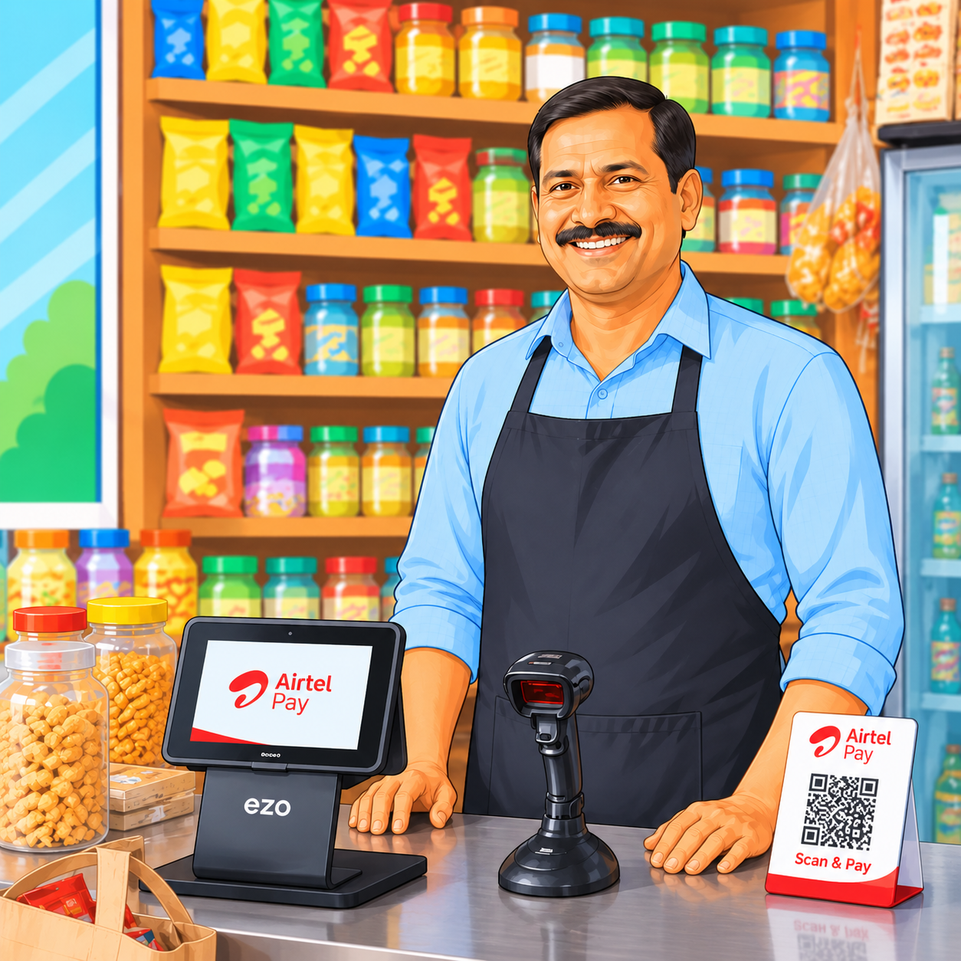
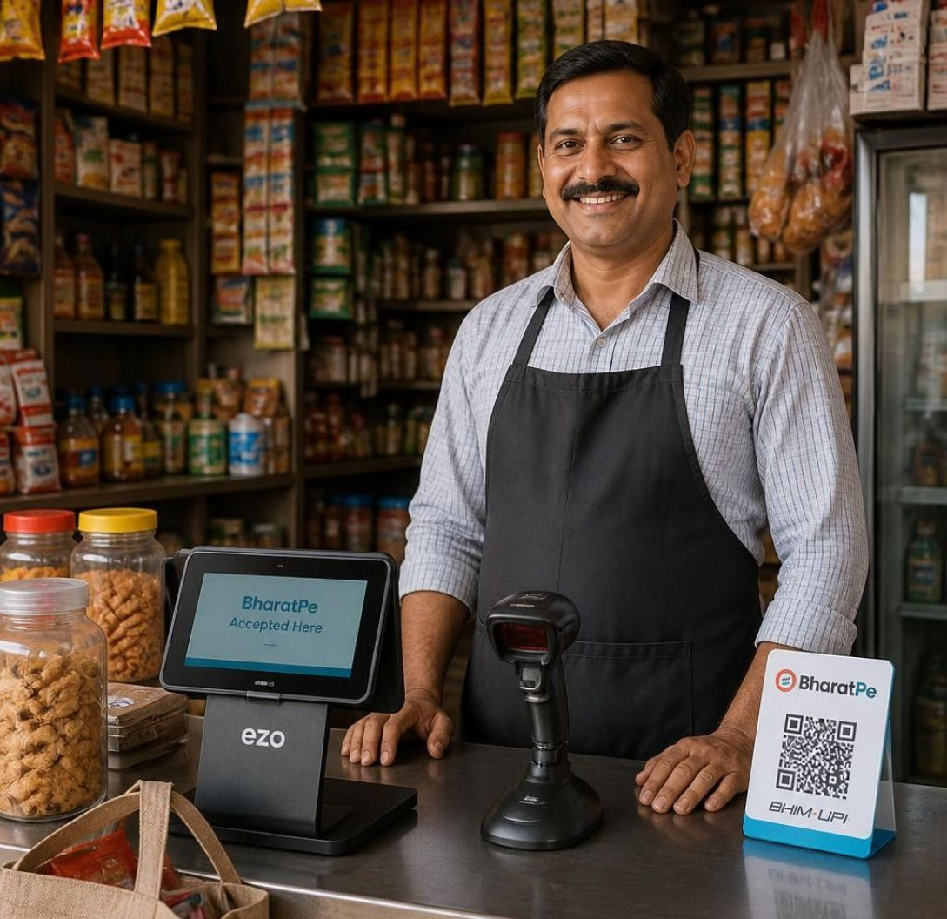
PROJECTED BUSINESS IMPACT
From 7.36% Conversion to a 22% Target
Targets for a simpler, faster MSME acquisition journey.
Operating metric | Historical baseline | Project target | Projected impact
Funnel conversion | 7.36% (368 / 5,000) | 22.0% | ~3× expansion
Activation TAT | 17.6 days avg | 3.5 days | 80% reduction
Acquisition cost (CAC) | ₹15,000 / activation | ₹3,800 | ~75% reduction
Six-month churn | 15.2% (smb_leads.csv) | 4.8% (team model) | ~68% reduction
Customer follow-up calls | 3+ calls / lead | < 0.2 calls | Near-zero touch
THE VISION
Project Udyam Digital
Making Bharat’s MSMEs Go Digital in One Sitting.
Historical baseline: smb_leads.csv. Targets/projections only; no production results. Churn target is a team-model assumption.
7
Notes:
To conclude, Project Udyam Digital aims to improve conversion, reduce acquisition cost, accelerate activation, enable efficient KYC and partner distribution, and improve retention. All figures are targets, not verified production results.

Slide 8
PHASED ROLLOUT & RISK MITIGATION
Proposed Rollout & Key Risks
Illustrative rollout assumptions; prototype features and launch controls are labeled separately.
3-PHASE EXECUTION ROADMAP
Pilot Gating, Partner Rollout & Scale
Phase 1: Controlled Pilot (Months 1–3)
• Scope: 500 Kirana & Clinic MSMEs across Top 5 Metro circles.
• Focus: Validate digital KYC pass rates, mobile self-serve UX, & advisor.
• Gate: Conversion >15%, KYC first-pass rate >70%, TAT <5 days.
Phase 2: Regional Cluster Expansion (Months 4–6)
• Scope: Expansion into Tier-2 clusters with partner-assisted QR acquisition.
• Focus: Partner Desk, ₹1,500 activation commission ledger, & Quote Recovery.
• Gate: 1,000 active partner agents, quote recovery lift >15%.
Phase 3: National Scale-Up (Months 7–12)
• Scope: Commercial launch across all Airtel Business circles.
• Focus: Self-serve onboarding, automated dispatch, & OSS/BSS billing sync.
• Gate: Blended CAC <₹4,500, activation TAT <3.5 days, follow-up calls <0.2.
Note: Planning assumptions and illustrative scenarios; gated on pilot performance.
KEY RISKS & RESPONSE
Prototype controls and launch assumptions
1. Partner Channel Conflict
Risk: Resellers may fear disintermediation.
Prototype: QR attribution + ₹1,500 only on activation; pilot terms need validation.
2. Digital & Language Barriers
Risk: Owners may find technical forms difficult.
Prototype: Guided text advisor in English, Hindi and Hinglish plus GUI choices. No voice/WhatsApp claim.
3. KYC Quality & Fraud
Risk: Documents may be expired, mismatched or unreadable.
Prototype: Mock registry checks and officer review route exceptions; they do not eliminate fraud.
4. Privacy & Security
Risk: Sensitive documents need safe handling.
Prototype: Consent, masking and role checks. Retention/purge need production validation.
5. Installation Delays
Risk: Site constraints can delay activation.
Prototype: Explainable risk flags support follow-up; they do not guarantee an SLA.
8

Slide 9

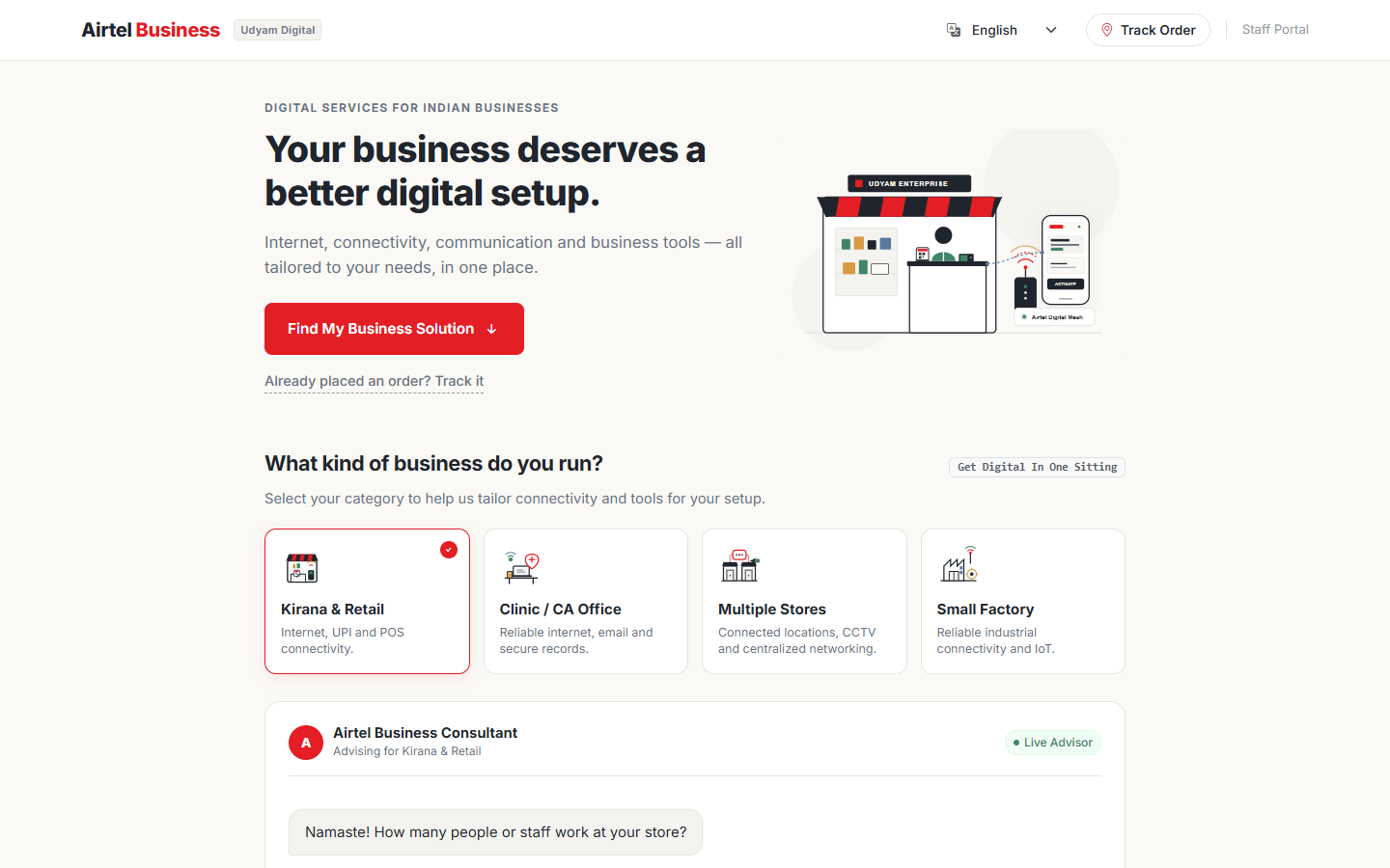
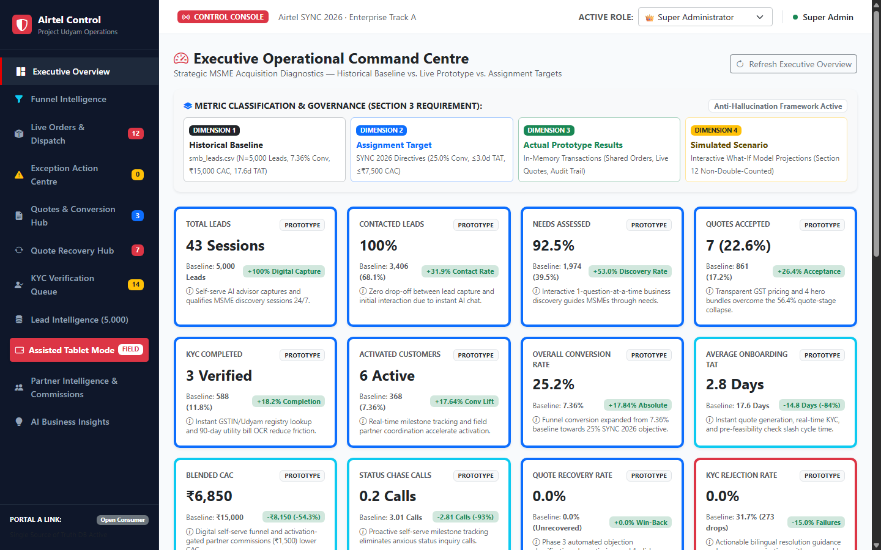
WATCH THE 3-MINUTE DEMO
Simple for customers. Clearer for Airtel teams.
Guided customer choices connect to clear operational queues for Airtel teams.
SCAN TO WATCH
CUSTOMER SIDE
AIRTEL TEAM SIDE
A guided start, in plain language
Work from clear operational queues
Orders & dispatch
KYC verification queue
Quote recovery
Exceptions & installation risk
Partner intelligence
Staff can move from status visibility to review and follow-up in the same control workspace. The portal screenshot’s badges represent demo records.
Choose a business type, describe a need, review a tailored bundle and quote, then continue to KYC and tracking.
What this demo shows: ease of guided onboarding and Airtel-side workflow visibility—not measured superiority over competitors.
Notes:
Evidence screenshots: E:/Airtel/qa_screenshots/consumer_desktop_proactive.png and control_desktop.png. The Control Portal capture is cropped to its navigation; badge counts in the source are seeded demo data. This slide describes workflow usability, not comparative performance. Source materials: assignment brief and current prototype UI.

