Slide 1

INFO6105, Data Science Engineering Methods & Tools Fall 2023
Risk Analysis in Bank and Financial Services
Submitted by Team 08 -
Anshul Singh (singh.anshul@northeastern.edu)
Manish Rao (rao.mani@northeastern.edu)

Slide 2
Contents
Introduction
Methodology
Description of Dataset
Data Cleaning & Processing
Exploratory Data Analysis
Models Employed
Result and Analysis
Conclusion
References

Slide 3
Introduction
Loans play a crucial role in meeting the financial needs of the modern world.
Banks derive a significant portion of their profits from providing loans.
Loans serve diverse purposes, such as supporting students in managing education and living expenses and enabling individuals to purchase luxuries like houses and cars.
The decision to grant a loan is a complex process, involving careful consideration of various factors.
Machine Learning with Python can streamline this decision-making process by predicting the relevance of an applicant's profile for loan approval.
Key features considered in this prediction include Marital Status, Education, Applicant Income, Credit History, and more.
By leveraging machine learning algorithms, banks can enhance efficiency and accuracy in evaluating loan applications.

Slide 4
Methodology
1. Data Preprocessing: The data is preprocessed to make it suitable for machine learning models. This includes handling missing values, encoding categorical variables, and scaling numerical variables. 2. Exploratory Data Analysis (EDA): This involves analyzing the data to understand the patterns, trends, and relationships between different variables. This is done using various statistical and visualization techniques. 3. Model Training: Several machine learning models are trained on the preprocessed data. These models include Logistic Regression, Decision Tree, K-Nearest Neighbors (KNN), and XGBoost. The models are trained using the training data and their performance is evaluated using the test data.
4. Part of Feature Engineering :
Data Scaling: standardization or normalization was applied to the data. This is a common preprocessing step, especially for algorithms that are sensitive to the scale of the input features.

Slide 5
Handling Categorical Variables: The dataset contained categorical variables, it needed to be encoded into a numerical format that can be used by machine learning algorithms.
5. Hyperparameter Tuning: The hyperparameters of the models are tuned to improve their performance. This is done using techniques like GridSearchCV and RandomizedSearchCV, which search through a predefined space of hyperparameters to find the best ones.
6. Model Evaluation: The performance of the models is evaluated using various metrics like accuracy, precision, recall, and F1 score. The models are also evaluated using confusion matrices.
7. Resampling: As the dataset is highly imbalanced, SMOTE (Synthetic Minority Over-sampling Technique) is used to oversample the minority class. This helps to improve the performance of the models on the minority class.

Slide 6
Description of the Dataset
Dataset Link: Risk analysis in banking and financial services
https://www.kaggle.com/code/gauravduttakiit/risk-analytics-in-banking-financial-services-1
Dimensions of the application data frame: (307511, 122), Dimensions of the column description data frame: (122, 1) 'application_data.csv’ - It contains all the information of the client at the time of application. The data is about whether a client has payment difficulties.
'previous_application.csv’ - It contains information about the client’s previous loan data. It contains the data whether the previous application had been Approved, Cancelled, Refused or Unused offer.
'columns_description.csv’ - It is data dictionary which describes the meaning of the variables.

Slide 7
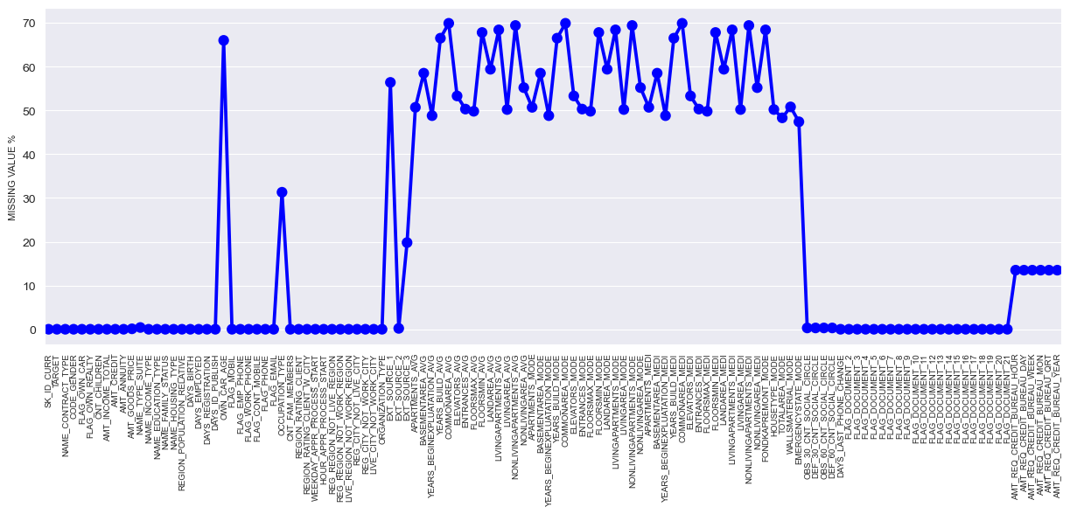
Data Cleaning and Processing
Missing values percentage in columns
Columns with more than 40% missing values, we will have to remove them as filling 40~50% missing values would be too much

Slide 8
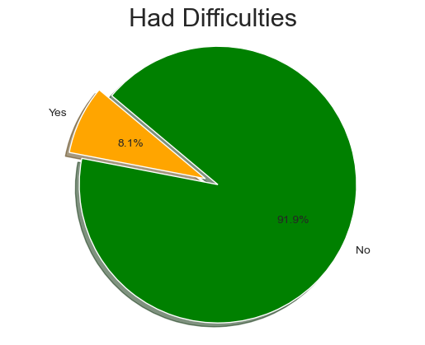
Exploratory Data Analysis
Distribution of Target

Slide 9
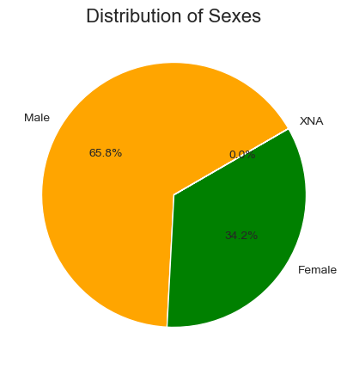
Exploratory Data Analysis
Distribution of Gender

Slide 10
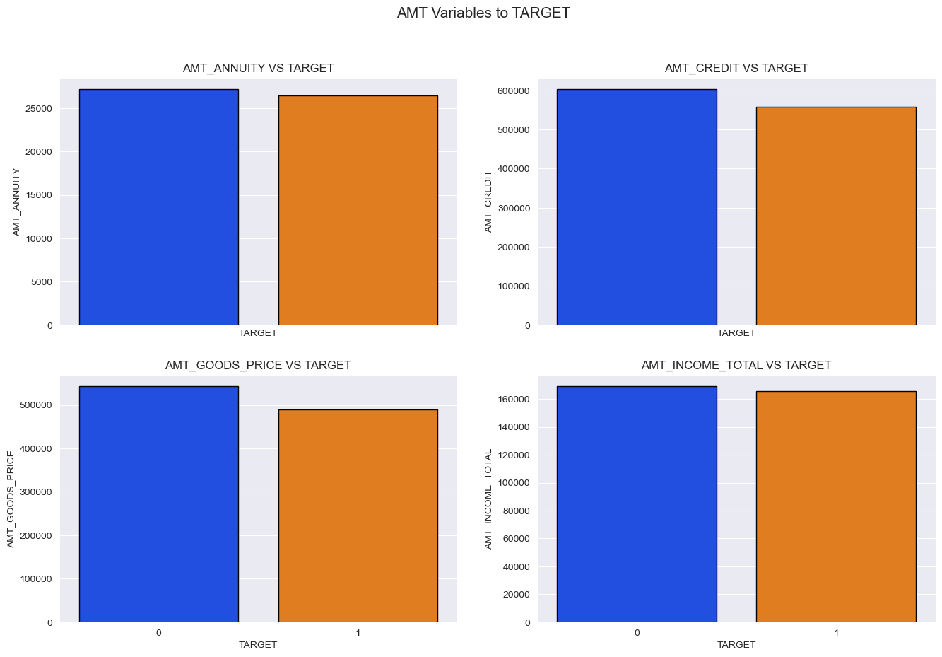
Exploratory Data Analysis
AMT_ANNUITY: Loan annuity
AMT_CREDIT: Credit amount of the loan
AMT_GOODS_PRICE: For consumer loans it is the price of the goods for which the loan is given
AMT_INCOME_TOTAL: Income of the client

Slide 11
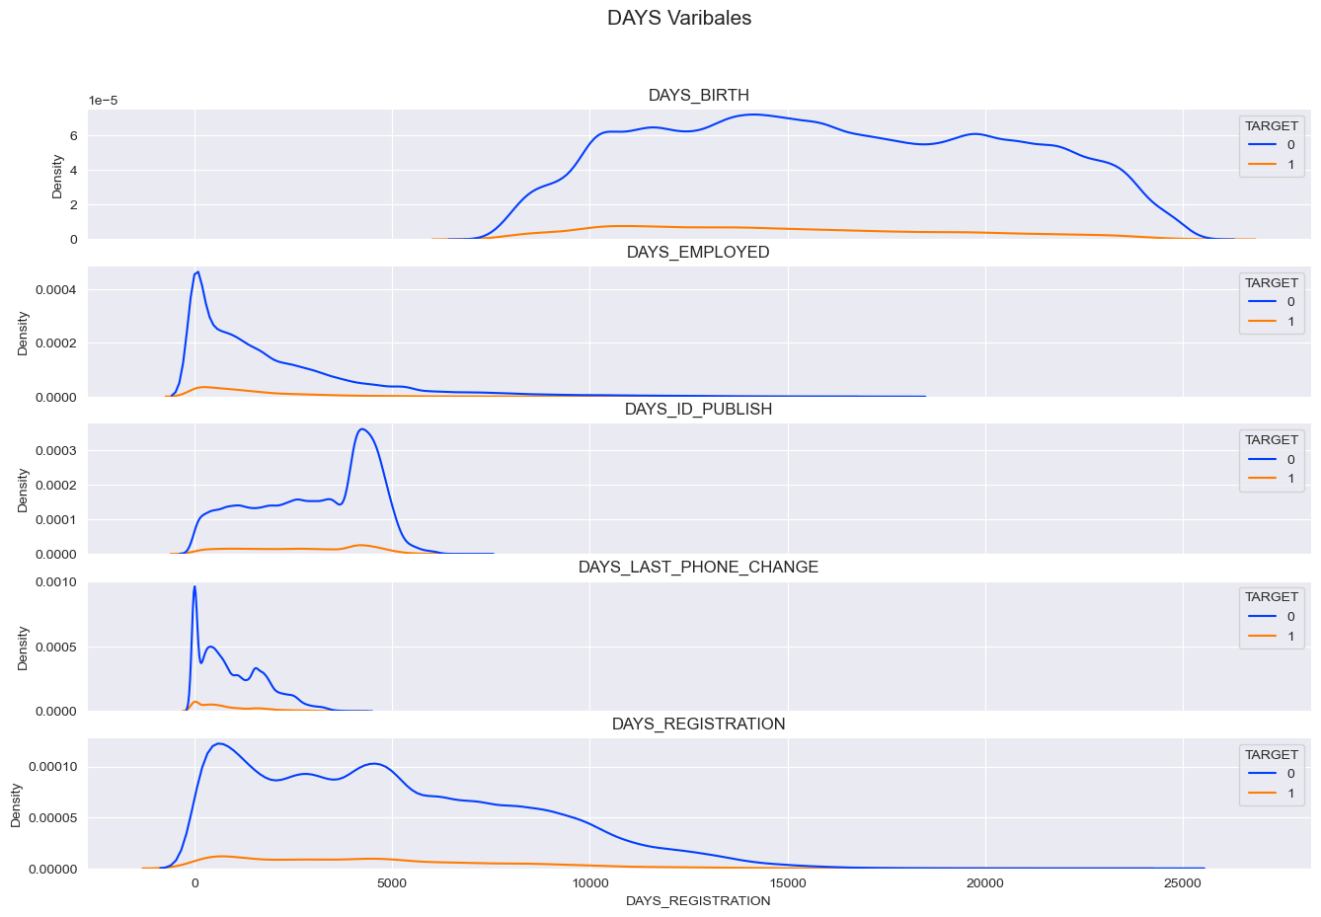
Exploratory Data Analysis
DAYS_BIRTH: Client's age in days at the time of application
DAYS_EMPLOYED: How many days before the application the person started current employment
DAYS_ID_PUBLISH: How many days before the application did client change the identity document with which he applied for the loan
DAYS_LAST_PHONE_CHANGE: How many days before application did client change phone
DAYS_REGISTRATION: How many days before the application did client change his registration

Slide 12
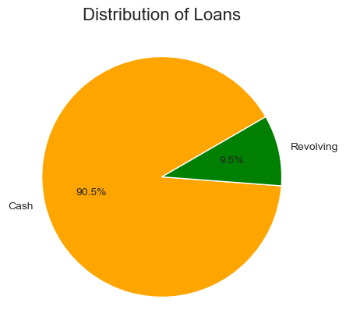
Exploratory Data Analysis
90.5 % of the total loans distributed according to the data we have is in cash.
Rest 9.5% of the loans distributed is revolving loan (A revolving loan occurs when a lender grants a borrower money up to an approved limit)

Slide 13
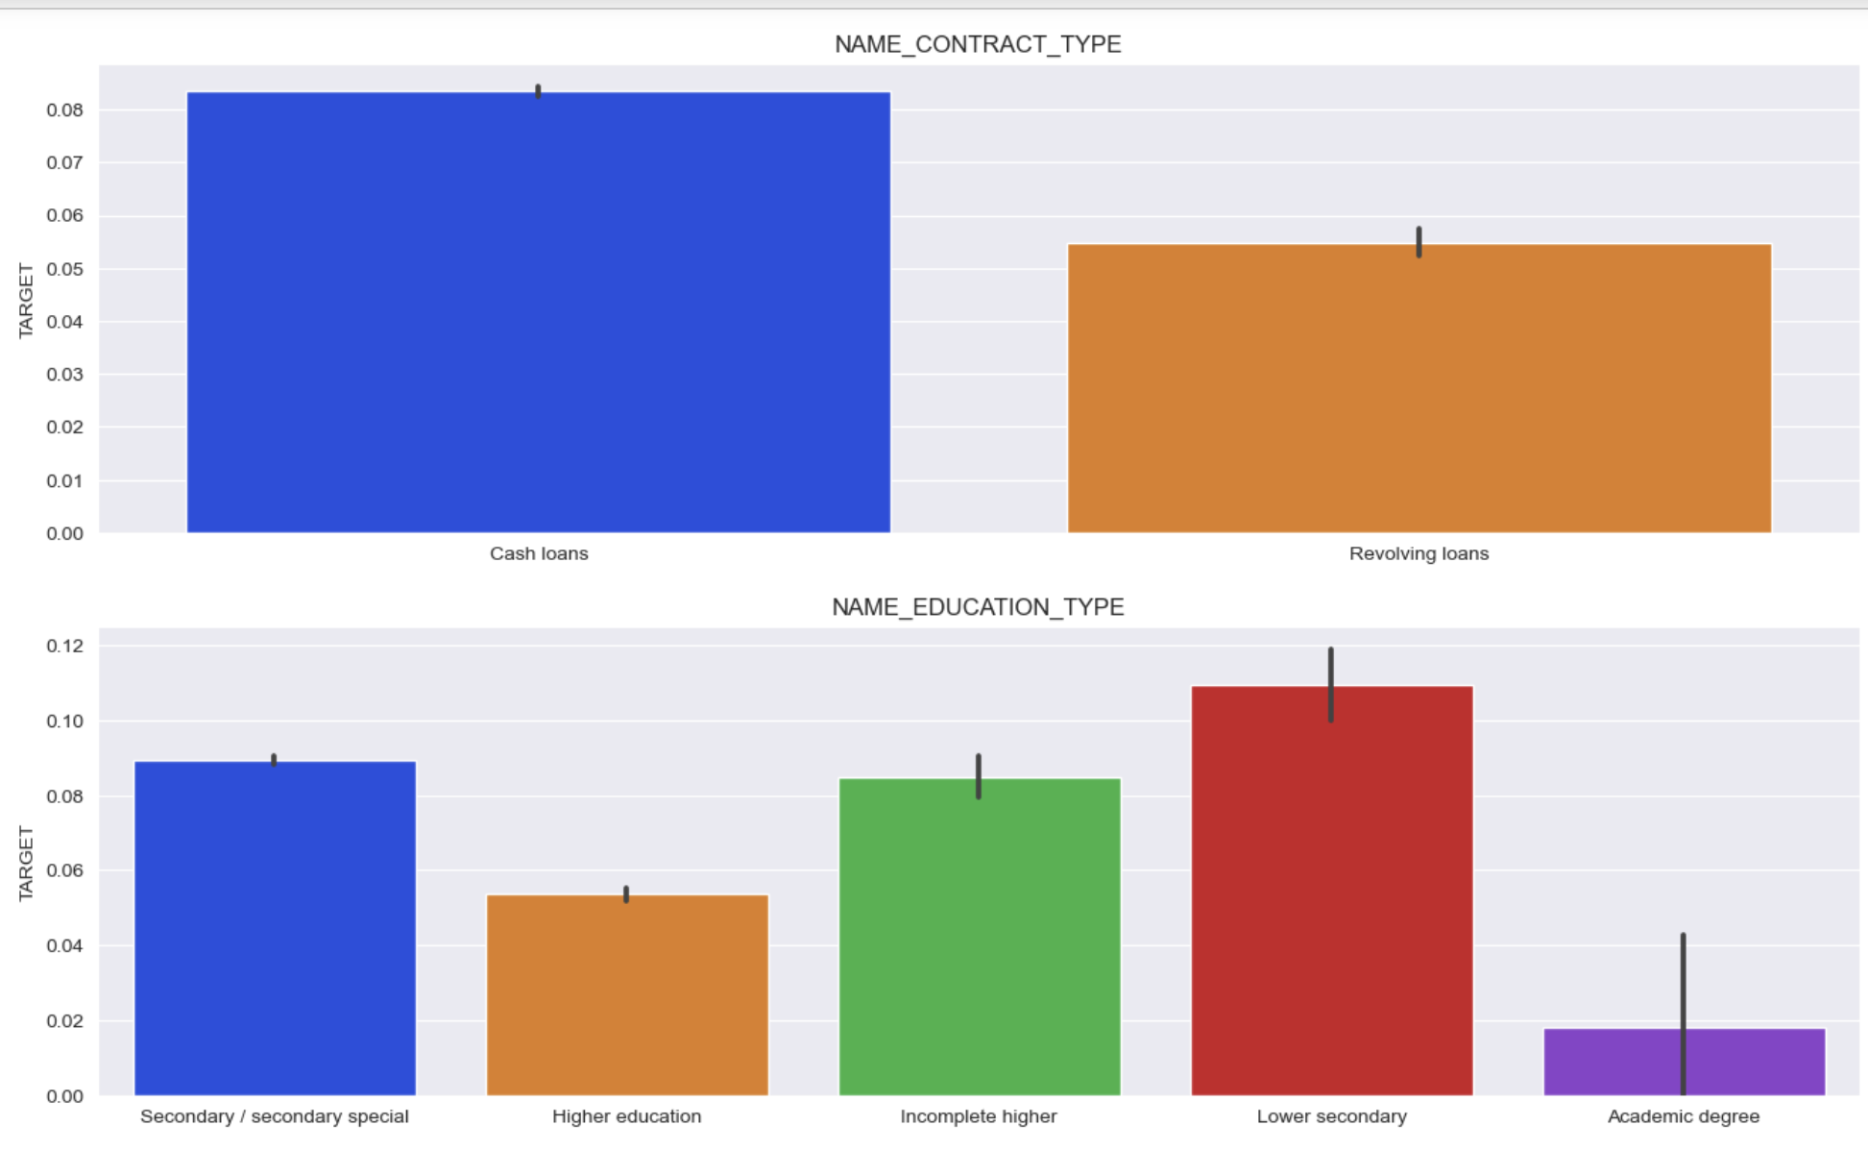
Exploratory Data Analysis
There are more payment problems with cash loans rather than revolving loans
People with higher education are less likely to have problems with payment

Slide 14
Models Employed
1. Logistic Regression: This is a statistical model used for binary classification problems. It models the probability that each input belongs to a particular category. It is a simple yet efficient algorithm, especially when the dataset is linearly separable. 2. Decision Tree: This is a type of supervised learning algorithm that is mostly used for classification problems. It works for both categorical and continuous input and output variables. In this technique, we split the population into two or more homogeneous sets based on the most significant attributes/ independent variables. 3. XGBoost: XGBoost stands for eXtreme Gradient Boosting. It is an implementation of gradient boosting machines which are machine learning models that are used for classification and regression problems. XGBoost is known for its speed and performance. 4. K-Nearest Neighbors (KNN): KNN is a simple, easy-to-implement supervised machine learning algorithm that can be used to solve both classification and regression problems. It classifies new cases based on a similarity measure (e.g., distance functions).

Slide 15
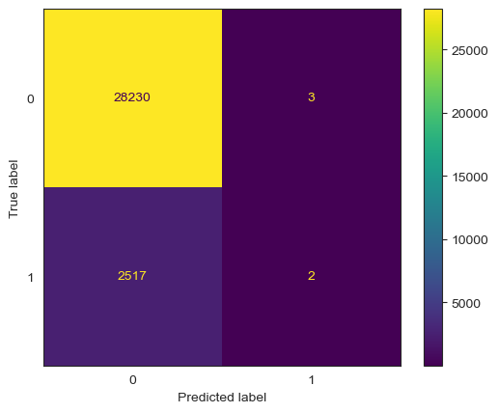
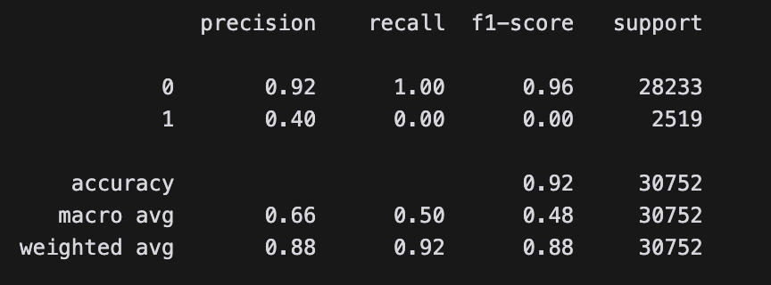
Logistic Regression

Slide 16
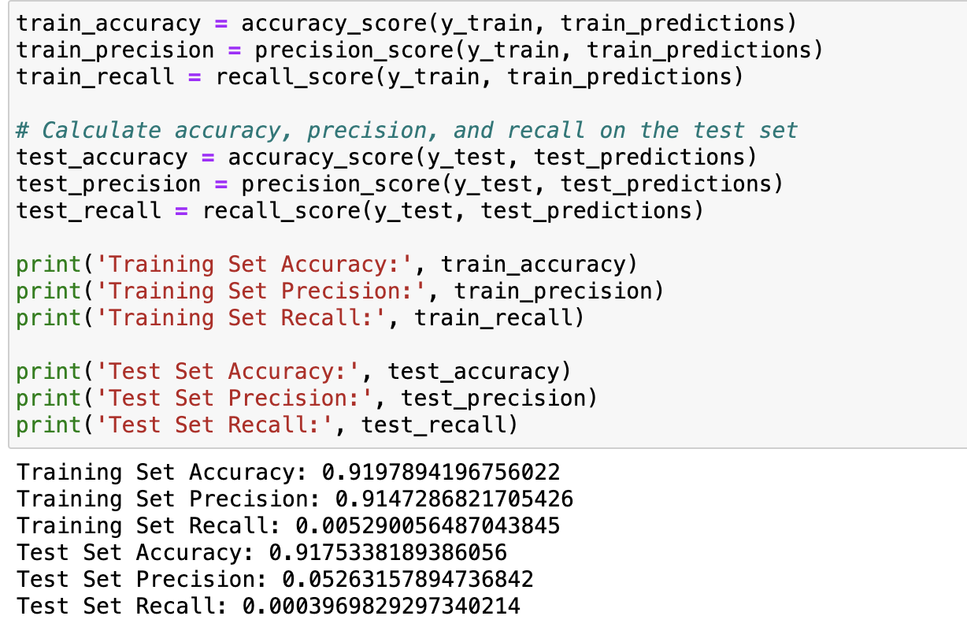
Decision Trees

Slide 17
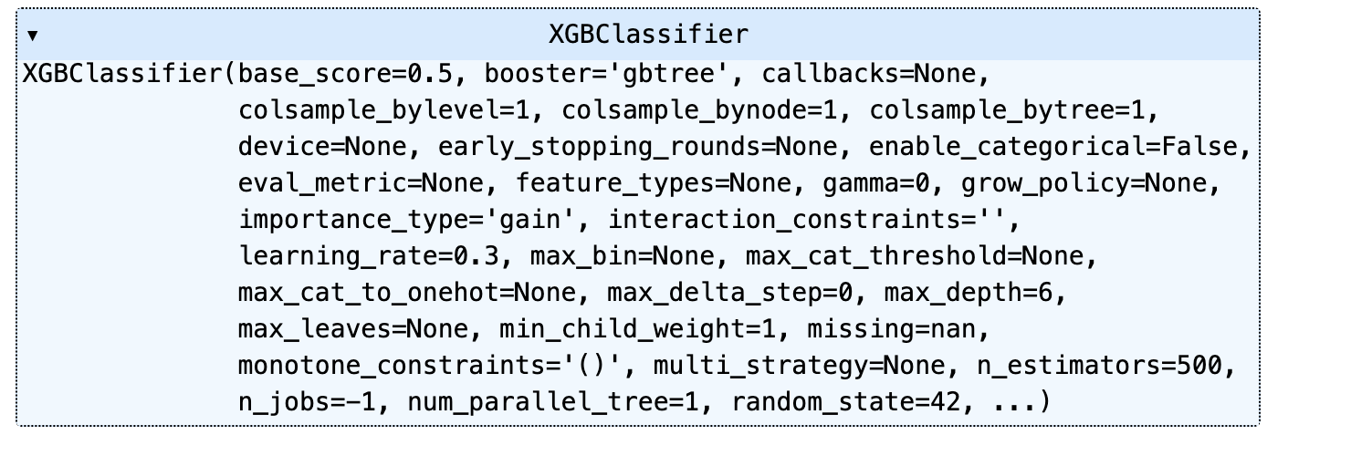
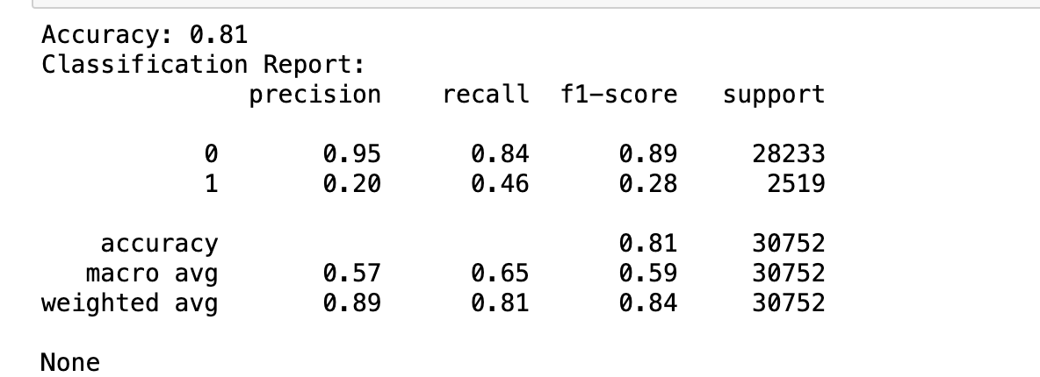
XGB Classifier

Slide 18
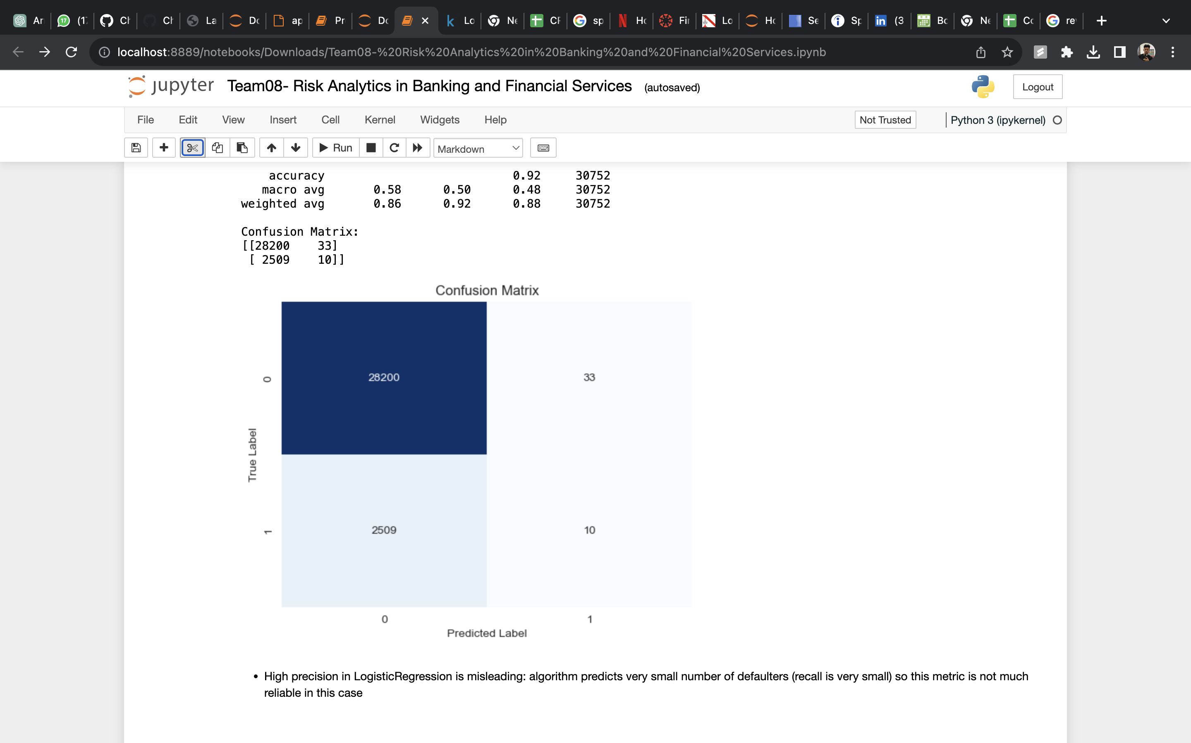
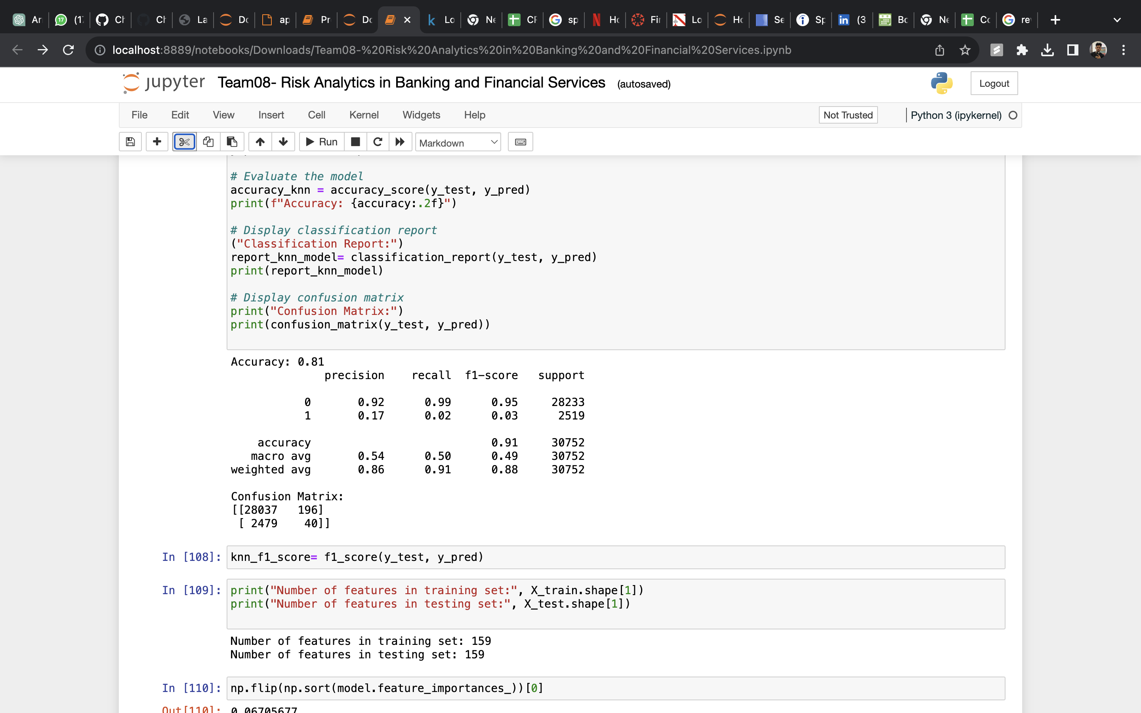
K-Nearest Neighbors

Slide 19
Result and Analysis
We can choose KNN Model after comparison with all other models which becomes our best choice:
Accuracy: 92% (Model predicts costumers status with 92% accuracy)
F-1 Score: 96% (Model can classify Positive or Negative )
We also performed Hyperparameter tuning on all three of our major models we did not produce much change in classification reports of the models.
Moreover, we performed re-sampling on logistic regression which made decreased the accuracy of the model by 20% which was one of the reason not to choose Logistic Regression as our best model.

Slide 20
Conclusion
We have finalized best model as KNN model as per the classification report. The model has an overall accuracy of 92%, which means it correctly predicted the class for 92% of all instances in the test set. Looking at the precision, recall, and F1-score for each class, we can see that the model's performance is significantly better for class 0 than for class 1.
The model has a high precision of 92%, indicating that when it predicts an instance , it is correct 92% of the time. The recall is 99%, meaning the model correctly identified all actual instances. The F1-score, which is the harmonic mean of precision and recall, is also high at 96%.

Slide 21
References
https://www.kaggle.com/code/gauravduttakiit/risk-analytics-in-banking-financial-services-1
https://www.kaggle.com/code/lukabarbakadze/loan-defaulter-prediction#Model-Building
https://www.kaggle.com/code/gauri1996/loandefaulter-eda-modelling
https://www.geeksforgeeks.org/

