Slide 1




Philips: Innovation And You
A global leader in health technology, transforming lives through meaningful innovation and cutting-edge solutions
Notes:
1

Slide 2
From Light Bulbs to Life-Saving Technology
1891
The Beginning 💡
“Founded in Netherlands by Gerard Philips and his father Frederik Philips.The goal was simple but powerful — make reliable products using innovation.”
Power of Research 🔬
“Very early on, Philips invested in research by creating the NatLab. This decision shaped its future and led to breakthroughs like X-ray technology.”
1914
1930s–
1970s
Everywhere in Homes 📻📺
“Philips entered everyday life through radios, electric shavers, televisions, and even invented the compact cassette, changing how the world consumed music.”
Strategic Turning Point 🔄
“As technology evolved, Philips made a bold move — it slowly exited many consumer electronics and focused more on healthcare and medicalsolutions.”
1980s–
2000s
2010s
Focused Identity 🏥
“Philips sold off lighting and other divisions and fully committed to health technology, including imaging systems and patient monitoring.”
Global Health Tech Leader 🌍
“Today, Philips improves billions of lives through medical technology, diagnostics, and connected healthcare systems.”
Today –
Notes:
3

Slide 3
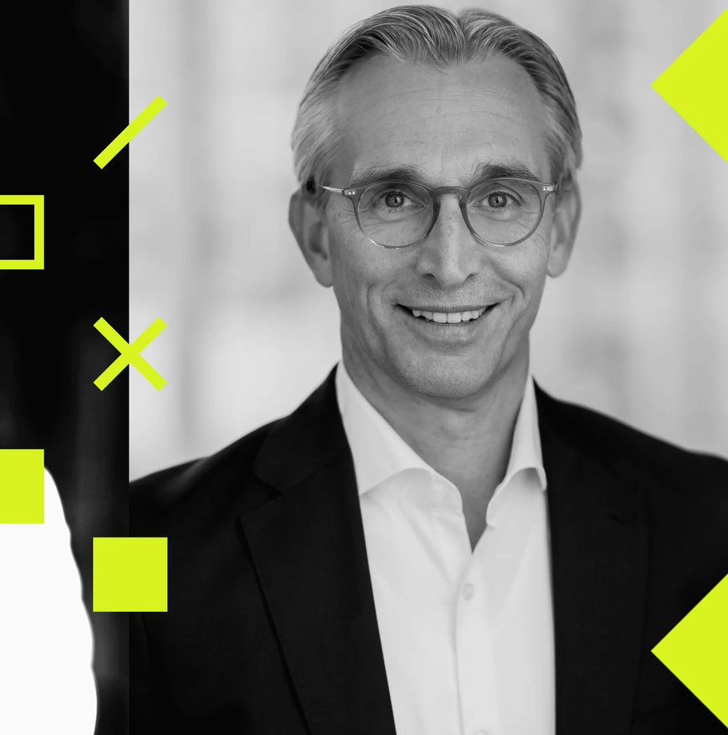
Organizational Structure
Headed by - Roy Jakobs (CEO)
Supported by - Executive Management Committee
Operations are divided into three Core Business:
Diagnostic and Treatment - MRI,CT,X-ray Systems
Connected Care - Patient Monitoring and digital health
Personal Health - Consumer health and wellness products
Common Supportive Functions:
Marketing & Sales
Finance
Human Resource
IT & Digital
Legal & Compliance
Operated Globally across North America , Europe and Asia - Pacific
Notes:
2

Slide 4
Products and Services
PROFESSIONAL HEALTH (B2B)
PERSONAL HEALTH & SERVICES (B2C)
Diagnostic Imaging
Image-Guided Therapy
Enterprise Informatics
Connected Care
Managed Services
Oral Healthcare
Personal Care & Grooming
Mother & Child Care
Household Appliances
Consumer Lighting
Managed Services
Notes:
4

Slide 5







Technology Powering Healthcare Innovation
Current Technologies
Future Expansion Areas
AI & Machine Learning
Precision Medicine
Automated diagnostics, predictive analytics, clinical decision support
Philips invests in personalized diagnostics and tailored clinical pathways
Robotics
IoT & Cloud
Surgical assistance and automated healthcare workflows
Connected medical devices, remote monitoring, data management platforms
AR/VR Healthcare
Surgical planning and medical training simulations
Advanced Imaging
Philips has strong offerings in ultrasound and advanced imaging integrating AI
R&D Investment: Philips invests approximately €2 billion annually in research and development
Embedded Systems
Real-time processing, sensor integration, device optimization
Notes:
5

Slide 6

Company’s Financials
€21.92B
€16.86B
€2B
€220M
Market Valuation
Annual Revenue
R&D Investment
Annual Profitability
Enterprise value
2025 sales performance
Innovation commitment
Worldwide
Diagnosis & Treatment (Healthcare, mostly B2B/B2G)
Cooking Appliances (Kitchen devices & solutions, B2C)
Grooming Products (Consumer products, B2C)
Philips earns most of its revenue from B2B and B2G customers hospitals, health systems, and government healthcare making up around ~77% globally and ~86% in India. The consumer (B2C) division contributes a smaller but significant share (~19% globally, ~13% in India) through products like oral care and grooming devices.
Notes:
6

Slide 7
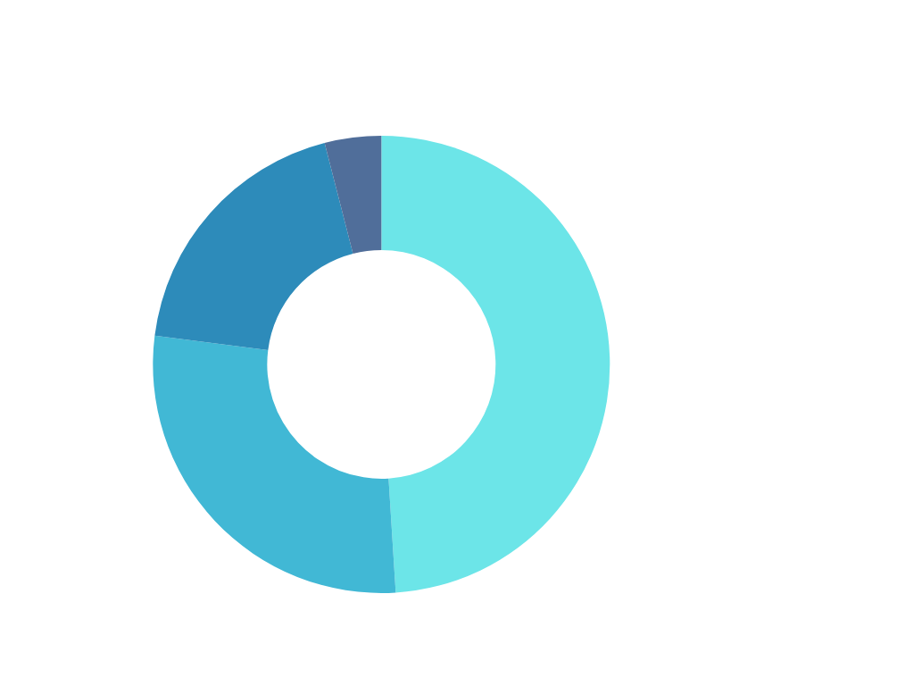




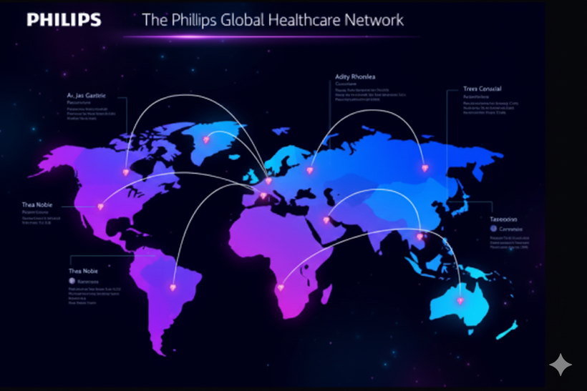
Clients & Consumer Base
Hospitals & Health Systems
Healthcare Providers
Over 10,000 hospitals globally use Philips medical equipment and solutions
Clinics, diagnostic centers, and specialized care facilities worldwide
Direct Consumers
Global Reach
2.5 billion people reached annually through personal health products
Operations in 100+ countries across North America, Europe, Asia-Pacific, and emerging markets
Key Markets
Target Segments
North America (35%)
Acute care facilities
Europe (40%)
Home healthcare
Asia-Pacific (20%)
Consumer wellness
Other regions (5%)
Preventive care
Notes:
7

Slide 8


Career Opportunities & Compensation
1
Software Engineer
Skills: C++, Python, Java, embedded systems, cloud platforms, medical device standards (IEC 62304)
Salary: $75K-$145K (entry to senior level)
2
Data Scientist
Skills: Machine learning, Python, R, TensorFlow, healthcare analytics, statistical modeling
Salary: $85K-$155K
3
Biomedical Engineer
Skills: Medical device design, regulatory knowledge (FDA, CE), systems engineering, testing protocols
Salary: $70K-$135K
4
Product Manager
Skills: Healthcare domain knowledge, agile methodologies, stakeholder management, strategic planning
Salary: $90K-$165K
Additional roles include AI/ML Engineers, Clinical Specialists, Regulatory Affairs, Quality Assurance, Hardware Engineers, and UX Designers with competitive compensation packages including benefits, equity, and growth opportunities.
Notes:
8

Slide 9




Career Roadmap: Securing a Role at Philips
Essential Skills and Strategies for Aspiring Engineers
Technical & Core Fundamentals
Professional Profile
Core CSE Subjects: Master Data Structures & Algorithms (DSA), Object-Oriented Programming (OOP), and Database Management Systems (DBMS).
Programming Proficiency: Achieve fluency in Java (widely used in Philips' enterprise systems) or Python (ideal for AI/Data research).
GitHub: A clean repository showcasing your best code and documentation.
LinkedIn: Optimized profile highlighting skills, certifications, and networking with Philips recruiters.
Resume: Quantifiable achievements rather than just a list of duties.
Industry-Relevant Specializations
Applied Learning
Cloud Computing: AWS/Azure for scalable health solutions.
AI & Data Analytics: Improving patient outcomes through predictive modeling.
IoT & Embedded Systems: Critical for medical device integration.
Hands-on Projects: Build end-to-end applications that solve real-world problems.
Internships & Hackathons: Gain exposure to agile environments and collaborative coding.

Slide 10
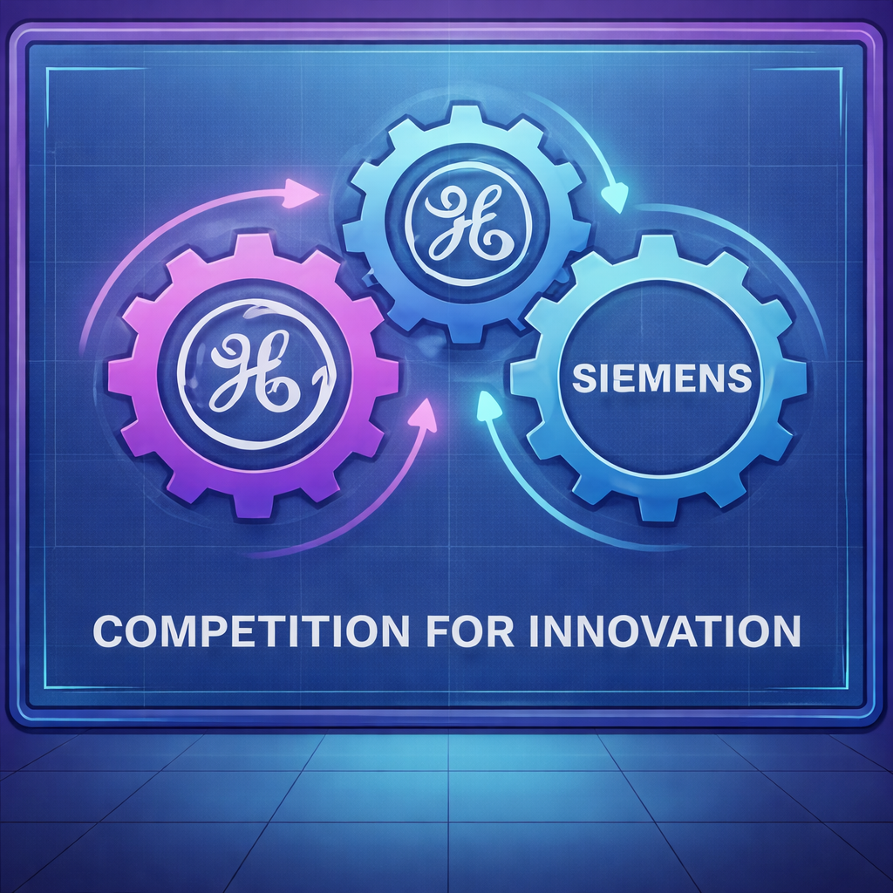
Competitive Landscape & Threats
Major Competitors
New Rivals
GE Healthcare
Apple & Samsung :
Leveraging consumer wearables for biometric analytics, directly challenging traditional medical monitoring markets.
Global leader in integrated digital health ecosystems and enterprise software solutions.
Small AI Companies :
Utilizing specialized machine learning to accelerate diagnostics, offering agile alternatives to established hardware systems.
Siemens Healthineers
Industry benchmark for high-precision diagnostic modalities and superior hardware engineering.
Threats & Challenges
Supply Chain
Constraints :
Semiconductor shortages limiting production capacity for medical systems.
Cybersecurity
Risks :
Connected medical infrastructure expands vulnerability to data breaches and cyber threats.
Notes:
9

Slide 11
Conclusion
1
Philips has evolved from a lighting company into a global healthcare technology leader focused on meaningful innovation.
2
The company leverages advanced technologies, like Ai and Data Science to improve healthcare worldwide .
3
Philips also emphasizes employee well-being, supportive work culture, and a healthy work-life balance, making it an attractive organization for professionals.
With continuous innovation and a people-centric approach, Philips is well-positioned for sustainable growth and future success
4
Phillips make healthcare afforable to all people at low cost.
Notes:
8

Slide 12
Thank You
Notes:
10

