Slide 1


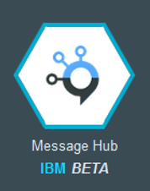







Consumer Spark Streaming App
Control Center 1
KAFKA
Web App
Control Center 2
STORE IN HDFS
Topic 1
Topic 2
Control Center 3
ETL
Topic N

