Slide 1
Rigorous, leak-free portfolio research: what works, what doesn't, and how we know
Context Team Quantify · CitadelxFinesse Portfolio Challenge · NSE universe of 300 stocks (Nifty 100 + Midcap 100 + Smallcap 100)
Question Can a transparent rules-based 10-stock book beat the equal-weight universe, and would the result survive new periods?
Answer Strong on the design window (Sharpe 1.88), but on a locked holdout it returned 0.6% (CAGR 0.2%, Sharpe 0.13) vs benchmark CAGR 3.3%. We found no reliable edge, and report that honestly.
What we built A purged walk-forward framework with a locked holdout, placebo, bootstrap, deflated Sharpe and a test of the selection procedure itself.
Why that is the contribution Anyone can pick the best backtest. This deck shows how every decision was made, tested and, where it failed, rejected.
Notes:
Open with the honest headline: the framework is the contribution, the alpha is not proven.

Slide 2
1. Data integrity came first
Decision: can we trust the data enough to backtest? Result: yes after audit, with known defects documented.
Coverage 300 of 300 stocks have files for 2020-01-01 to 2026-10-30; 382 empty partitions are pre-listing periods.
Gaps about 311 missing stock-days across 225 stocks (224 stocks lack 2024-07-19; FORCEMOT has 77). Missing bars are never traded or imputed as prices.
Defect found on 2021-09-15/16 eight stocks (AFFLE, CESC, IRCTC, JUBLFOOD, SRF, BEL, GAIL, TORNTPHARM) are unadjusted for splits/bonus (1.5x to 10x). It inflates the original static book's NAV by +29.5% then -22.7%; the 2022+ walk-forward is unaffected.
Universe today's constituents applied to history, so survivorship bias exists in both strategy and benchmark. This is disclosed, not hidden.
Liquidity a Rs 2 crore minimum 20-day average traded value is required at every rebalance.
Costs 0.1% per side on actual traded value; signal at close t executes at open t+1 (no same-bar trading).
Notes:
Source: results/data_audit_report.csv and results/data_extreme_moves.csv.

Slide 3
2. Strategy space: 13 signals, chosen before testing
Decision: which ideas to test? We pre-specified them so we could not cherry-pick afterwards.
Family | Signals | Inputs / construction
Hand-set (8) | Momentum 12-1, 6M, relative strength, risk-adjusted momentum, trend quality, technical composite, momentum+low-vol, composite quantitative | Return/volatility ratios, moving-average structure, ATR, drawdown, RSI/MACD-type features
ML / DL (4) | Ridge, LightGBM, 3-seed MLP neural net, equal-rank ensemble | 37 non-redundant features + 2 derived, converted to cross-sectional percentiles; expanding window, retrained every 63 days, purge gap of horizon+2
Combinations (2) | core3 and hybrid (rank-averaged) | No weights fitted; average of ranks
Why ML/DL were included they were allowed wherever they could plausibly add value. LSTM/transformer were excluded because ~1,700 days x 300 stocks is too little data for them.
Why features were reduced 98 columns collapse to 37 after removing highly correlated pairs, which stabilises the linear model and cuts overfitting.
Why percentiles cross-sectional ranks remove market-wide level shifts so the model learns relative strength, not market direction.
Notes:
Source: src/battle/models.py, context.py. ML hyper-parameters were fixed, not tuned.

Slide 4
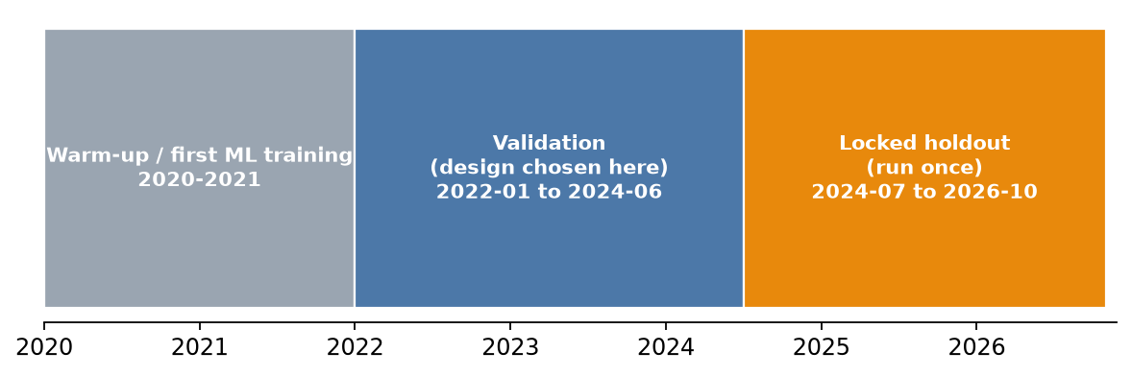
3. Protocol: how we prevented leakage
Decision: how to judge a strategy? A fixed validation window plus a locked holdout, with rules frozen before the holdout was opened.
Walk-forward ML expanding training window, retrain every 63 days, purged by horizon+2 days so no label overlaps the test period.
Selection rule (frozen first) top 3 signals by mean validation Sharpe, rank-averaged -> core3 = momentum 6M + MLP + risk-adjusted momentum.
Frequency rule (frozen first) highest mean validation Sharpe across signals -> Quarterly. Extras (buffer, inverse-vol, trend overlay) adopted only if validation Sharpe AND drawdown both improved. None did.
Honest caveat holdout figures for all variants were eventually viewed, so anything chosen after that is a lead, not a finding.
Notes:
This slide is the foundation for trusting every later number.

Slide 5
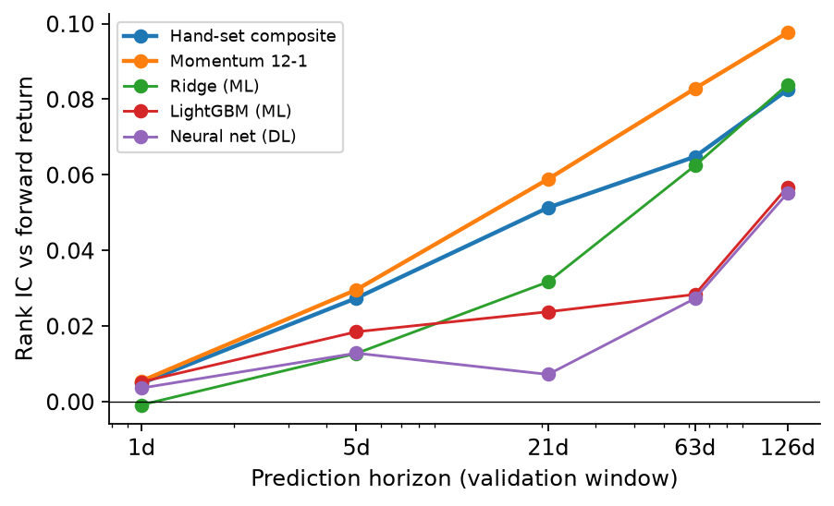
4. Why simple factors beat ML here: signal-strength evidence
Decision: trade fast or slow signals? The information builds over weeks and months, not days.
Signal | IC 1d | IC 21d | IC 126d
Composite | 0.005 | 0.051 | 0.082
Mom 12-1 | 0.005 | 0.059 | 0.098
ridge | -0.001 | 0.032 | 0.084
lgbm | 0.005 | 0.024 | 0.057
mlp | 0.004 | 0.007 | 0.055
1-day IC is about 0.005 no edge at daily horizons; about 0.05 at 21 days.
• ML/DL IC at 21 days is lower than hand-set composites (0.01 to 0.03 vs 0.05).
• Ridge coefficients flip sign across retrains (Momentum12_1 negative in 90%), a sign of instability.
Conclusion complexity did not add predictive power on this sample size.
Notes:
Source: results/battle/signal_ic_decay.csv and ridge/lgbm feature-weight CSVs.

Slide 6
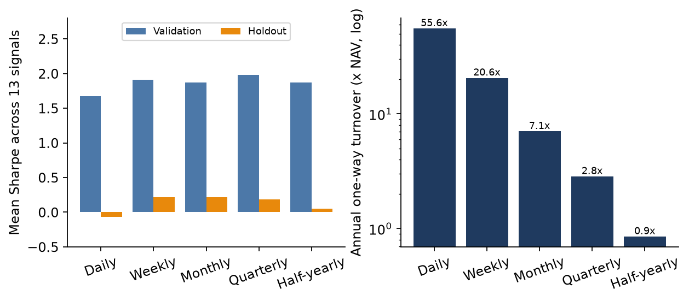
5. Rebalance frequency: why quarterly
Decision: daily, weekly, monthly, quarterly or half-yearly? Costs and signal speed decide; evidence is mixed beyond 'not daily'.
Daily is clearly worst about 20x the turnover of quarterly, and lowest Sharpe on both windows.
Quarterly won validation mean Sharpe 1.98, which is why it was frozen as the rule.
Industry logic quarterly matches factor decay (rank autocorrelation 0.64 at 63 days), earnings cycle, tax/brokerage drag, and liquidity in mid/small caps.
Honest finding on the holdout, weekly, monthly, quarterly and half-yearly are not cleanly separated; half-yearly looked better post hoc and is only a forward-test lead.
Sensitivity trading on a one-month-stale signal changed Sharpe materially, so we recommend three tranches rebalanced one month apart.
Notes:
Source: grid_signal_frequency.csv (130 cells) and the sensitivity file.

Slide 7
6. Weights: why equal weight, not Markowitz or CAPM
Decision: adopt only if validation Sharpe AND drawdown beat equal weight. No scheme qualified at the quarterly rebalance.
Scheme | Val Sharpe | Val max DD | Holdout Sharpe | Holdout max DD | Holdout return
Equal weight | 1.88 | -24.8% | 0.11 | -31.7% | -0.6%
Inverse-vol | 1.83 | -25.1% | 0.13 | -30.4% | 0.6%
Min-variance (Ledoit-Wolf) | 1.73 | -26.7% | 0.30 | -27.8% | 10.1%
Risk parity | 1.88 | -24.8% | 0.12 | -31.2% | -0.2%
Mean-variance | 1.86 | -25.9% | 0.18 | -36.2% | 2.6%
CAPM mean-variance | 1.55 | -27.3% | 0.05 | -41.4% | -5.3%
Estimation error 10 stocks and 252 days give noisy covariances and near-useless return forecasts (rank IC about 0.05).
CAPM was worst mid/small-cap returns are not explained by beta; drawdown reached -41%.
• Covariance-only schemes lower volatility in 80-95% of quarters but do not reliably raise return (beat equal weight in 45-60% of quarters).
• Min-variance is the one challenger worth forward-testing (holdout +10.1% total return), but it lost on validation.
Inputs trailing 252-day Ledoit-Wolf covariance, 20% cap, 0.1% cost per side. Rule: adopt only if validation Sharpe and max drawdown both beat equal weight.
Notes:
Source: portfolio_opt_summary.csv, portfolio_opt_winrates.csv.

Slide 8
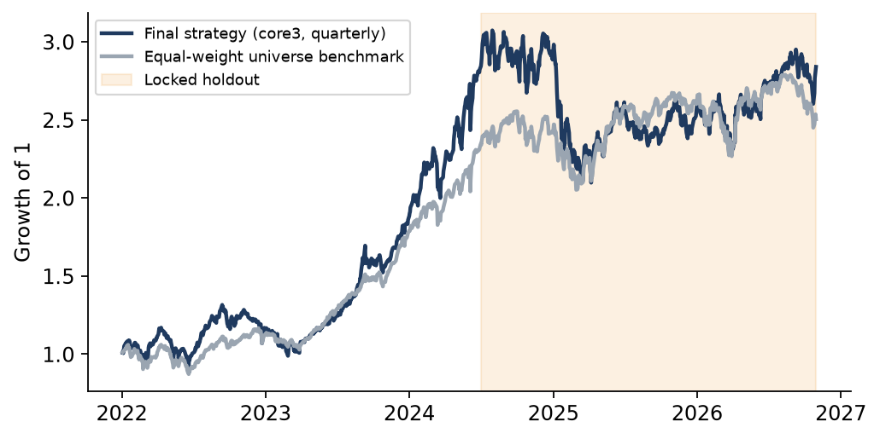
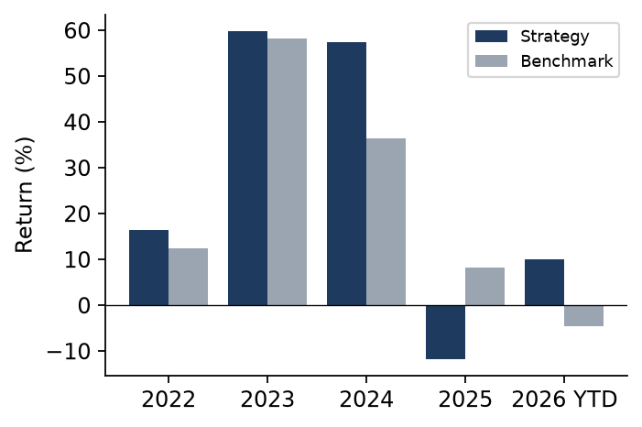
7. Results on validation and the locked holdout
The design looked strong where it was chosen; it did not carry to the holdout. That gap is the key research finding.
Window | CAGR | Sharpe | Max DD | Bench CAGR | Bench Sharpe
Validation | 51.9% | 1.88 | -24.8% | 40.4% | 2.10
Holdout | 0.2% | 0.13 | -31.7% | 3.3% | 0.28
Full | 24.2% | 1.02 | -31.7% | 21.0% | 1.21
• Validation 2022-01 to 2024-06; holdout 2024-07 to 2026-10; full = both.
• Most of the return is the 2023-24 mid/small-cap boom; 2025 was a momentum-reversal year (-11.8% vs +8.3%).
• The full-window number includes validation data, so it is the flattering view; the holdout is the honest one.
Notes:
Source: strategy_summary.csv, calendar_years.csv. Full window includes validation data, so it is flattering.

Slide 9
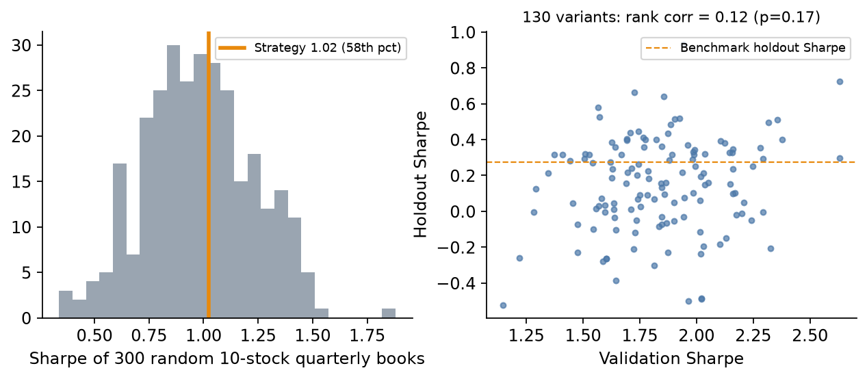
8. Is any of it statistically real?
Decision: claim alpha or not? Not: no test cleared its bar.
Test | Result
Bootstrap mean excess / yr | 4.1% (90% CI -6.0% to 14.1%)
Placebo percentile (Sharpe) | 58th of 300 random books
Deflated Sharpe (138 trials) | 0.74 (bar 0.95)
Procedure walk-forward | beat benchmark in 38% of 8 blocks; Sharpe 0.77
12-month rolling windows | beat benchmark 38%, median excess -4.8%
Variants beating bench on holdout | 36%
Winner's curse the best validation signals were among the worst on the holdout.
RL overlay cut Sharpe from 1.15 to 0.46; rejected.
Verdict no test cleared its bar, so we do not claim a reliable edge.
Notes:
Source: placebo_random.csv, bootstrap.csv, statistical_tests.csv, procedure_walkforward_summary.csv, rolling_summary.csv, replicability.csv, rl_overlay.csv.

Slide 10
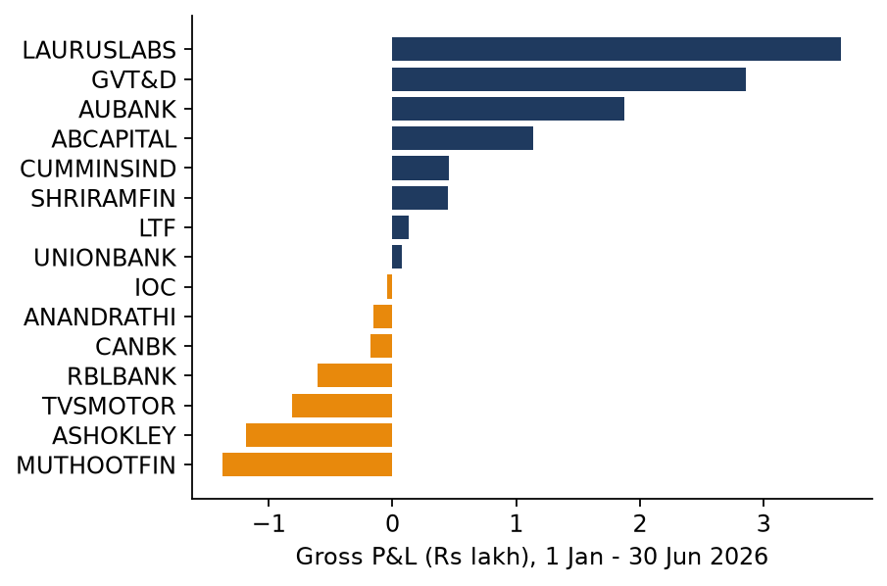
9. Decision log, limitations and what we would do next
Every decision is traceable to a table or chart above.
Decision | How decided | Outcome
Allow rebalancing? | Static was our own choice, not a verified brief rule | Allowed; tested all frequencies
Which signals | 13 pre-specified incl. ML/DL | core3 (top-3 on validation)
Frequency | IC decay, turnover x cost, validation Sharpe | Quarterly; daily rejected
Weights | Adopt only if val Sharpe and DD improve | Equal weight kept
RL / overlay | Walk-forward Q-learning on regimes | Rejected (Sharpe 1.15 to 0.46)
Claim alpha? | Holdout, placebo, DSR, procedure walk-forward | No reliable edge shown
Limitations survivorship bias, flat 0.1% costs, a synthetic benchmark, known data gaps, 4 years of regimes, 138 variants examined.
Next (1) forward-test from 2 Nov 2026 with tranched rebalancing; (2) test 15-20 holdings (Sharpe 1.09-1.12 vs 1.02); (3) forward-test min-variance and half-yearly leads; (4) fix 2021 unadjusted bars and use real Nifty indices.
H1 2026 (1 Jan-30 Jun) check the strategy returned +6.05% net (benchmark +2.1%); LAURUSLABS, GVT&D and AUBANK drove it. No pre-2026 rule we tested reached 22%.
Notes:
Close on process: transparent, reproducible (python -m src.battle.*), and honest about the edge.

