Slide 1

Predicting Movie Success Using TMDB Dataset
Data Science Capstone Project - July 2025
Thanks to springboard mentor
Gaurav Laddha (CFA®, FRM®)
By - Anshul Dang

Slide 2
Problem Statement
Business Challenge: Studios need early indicators of whether a movie will be successful.
Objective: Predict the vote average of a movie based on metadata available.
Value: Helps stakeholders optimize investment decisions and marketing strategies.

Slide 3
Movie Ratings Dataset Kaggle
Source: TMDB (The Movie Database) from Kaggle
~10,000 movies with columns: genres, actors, keywords, popularity, vote_count, runtime, release_date, etc.
Target: vote_average
(https://www.kaggle.com/datasets/kunalduttads/tmdb-top-10000-10k-movies-data set)

Slide 4
Data Wrangling
Initially dropped irrelevant columns like, 'Unnamed: 0', 'poster_path', 'backdrop_path', 'imdb_id', 'tagline','overview'.
Checked Dtypes and converted release_date into datetime and extracted release_year.
Parsed Stringified lists, like actors, genres, directors, keywords by using literal_eval by importing ast.
Reorganized dataset by setting index to ‘id’ column and moved ‘Title’ column next to ‘id’ column so that the table is easier to read.
Dropped Nulls in relevant columns.

Slide 5
Exploratory Data Analysis(EDA)
Visualized distributions of vote_average, popularity, runtime, etc. (Highly Skewed)
Found weak correlation with vote_average from numeric features.
Top 3 genres: Drama, Action, Comedy.
Top 3 actors: Nicolas Cage, Jackie Chan, Tom Hanks.
Top 3 Directors: Steven Spielberg, Clint Eastwood, Ridley Scott
Top 3 Languages: English, Japanese, French.

Slide 6
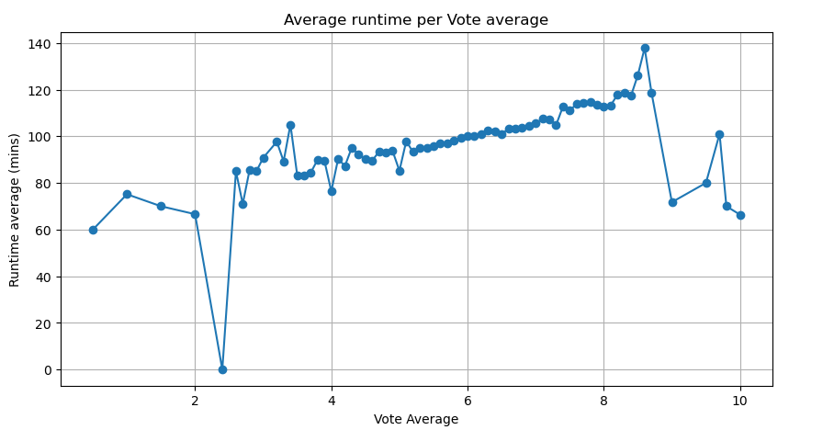
EDA Graphs

Slide 7
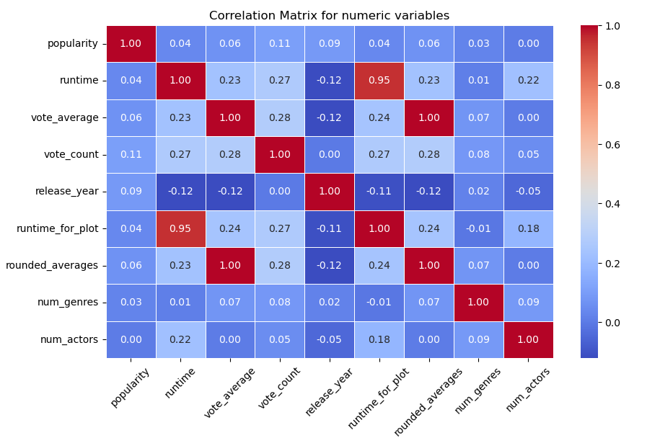

Slide 8
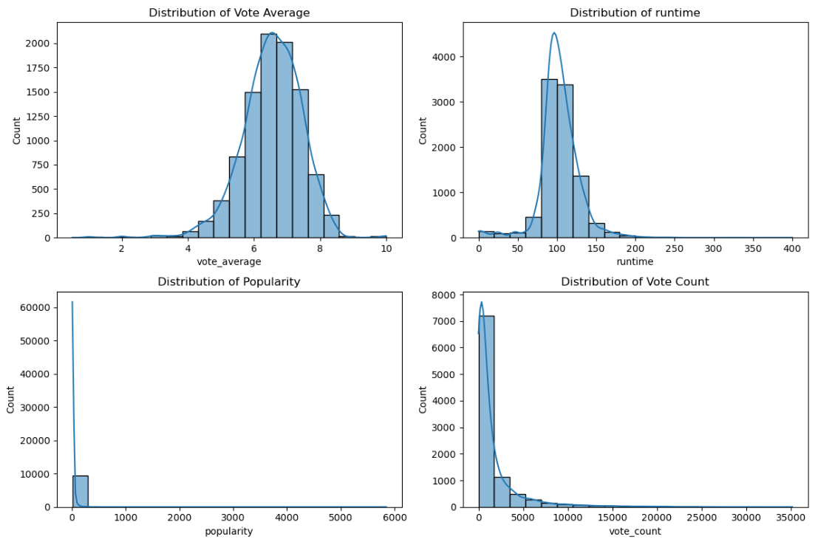

Slide 9
Preprocessing
Log-transformed skewed columns (vote_count, popularity, runtime).
One-hot encoded categorical variables.
Trimmed outliers using standard deviation method.
Engineered features: num_genres, main_genre, num_actors, main_actor.
Aligned feature/target data post-cleaning.
Made sure the order of these steps was performed correctly to avoid data leakage.

Slide 10
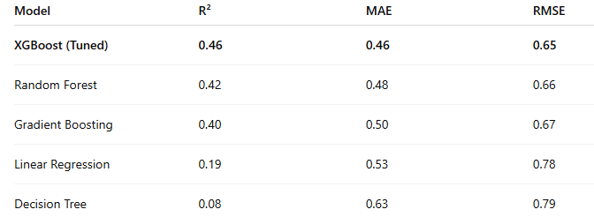
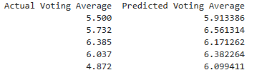
Modeling
Tried: Linear Regression, Decision Tree, Random Forest, GBM, XGBoost.
Evaluation Metrics: R² Score, MAE, RMSE.
Linear models underperformed due to weak linearity.
Tree-based models performed better.
XGBoost gave best results post tuning.

Slide 11
Conclusion
XGBoost delivered the best performance
Feature engineering and cleaning significantly boosted accuracy
Limitations:
No access to actual review text, budget, or revenue
Future Improvements:
Merge with review or box office data for richer features
Add sentiment analysis or NLP features

